Slide 1
Customer Segmentation & Purchase Behavior Analysis
Client Project | Customer Data Analysis Dashboard
Prepared using MySQL/phpMyAdmin and Microsoft Power BI

Slide 2
Project Objectives
Understand customer segments, revenue drivers and purchase behavior.
Analyze total revenue, customer count, average purchase value and customer ratings.
Compare revenue across product categories, gender, seasons, age groups, payment methods and locations.
Classify customers into Low Value, Medium Value and High Value segments.
Convert dashboard findings into practical marketing, inventory and retention recommendations.

Slide 3
Methodology
From raw shopping data to business insights.
Validated the shopping dataset in MySQL/phpMyAdmin and reviewed fields, records and data structure.
Exported the validated dataset as CSV and loaded it into Power BI.
Created analytical fields including Age Group and Customer Segment.
Built a three-page interactive dashboard with filters for Gender, Product Category and Season.
Interpreted results using both purchase volume and revenue contribution.

Slide 4
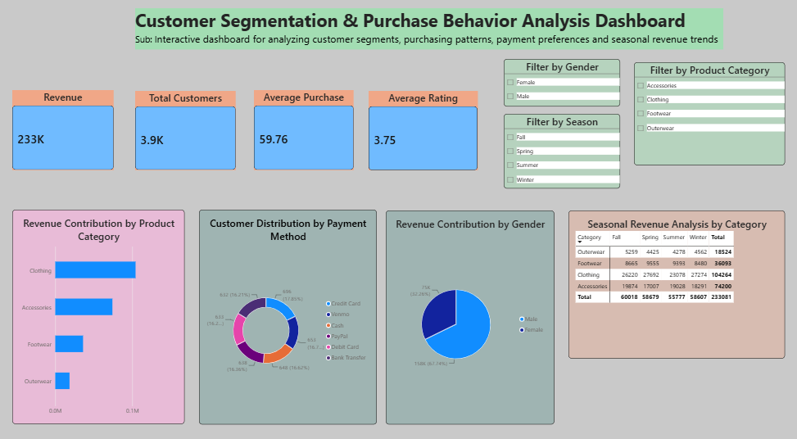
Dashboard Page 1 — Executive Business Overview

Slide 5
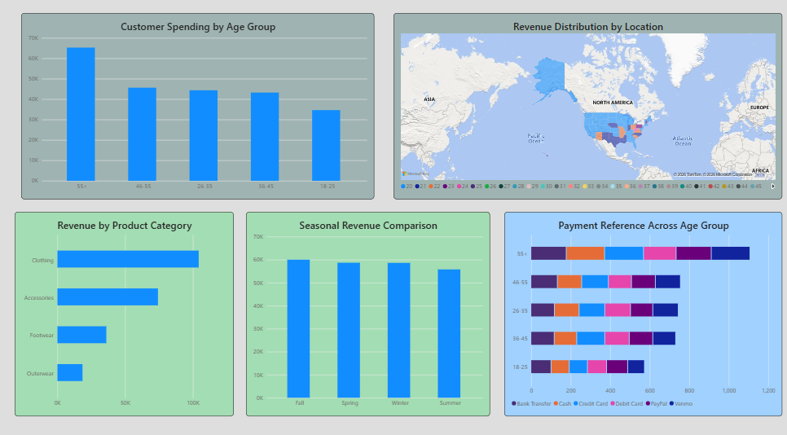
Dashboard Page 2 — Customer Behavior Analysis

Slide 6
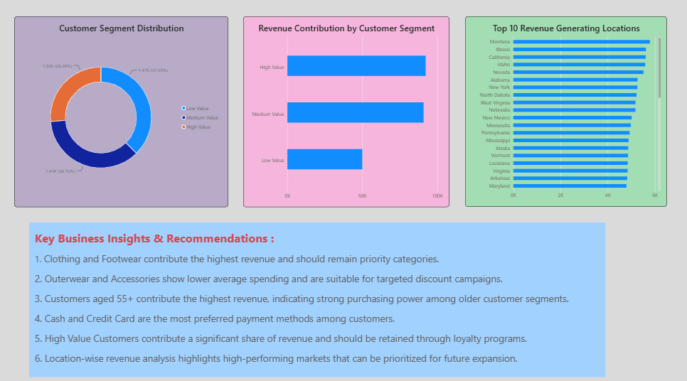
Dashboard Page 3 — Customer Segmentation & Recommendations

Slide 7
Key Findings
Insights derived from the dashboard.
Total revenue is approximately USD 233K across approximately 3.9K customers.
Clothing is the leading revenue-generating product category; Accessories and Footwear also contribute meaningfully.
Customers aged 55+ contribute the highest revenue, indicating strong purchasing power in this segment.
High Value and Medium Value customer groups contribute the largest revenue share.
Revenue is relatively consistent across seasons, while payment preferences vary across age groups.
Location-level analysis identifies priority markets for sales focus and inventory planning.

Slide 8
Business Recommendations
Actions supported by the analysis.
Retain High Value customers through loyalty rewards, early-access offers and personalized communication.
Move Medium Value customers upward through bundles, cross-selling and targeted recommendations.
Use focused coupons for Low Value customers instead of broad discounting.
Prioritize Clothing and other high-performing categories for inventory availability and promotions.
Plan age-specific campaigns, especially for the 55+ segment, and tailor payment offers by customer preference.
Use high-revenue locations for regional marketing and expansion decisions.

