Slide 1
DATA PROFESSIONAL HIRING TRENDS
Job Market Analysis Dashboard
742 job openings across 19 states, analyzed by role, salary, industry, skills and education
Prepared using Microsoft Power BI

Slide 2







Dashboard Overview
Understanding where the data-professional job market stands today.
742
$101.5K
19
313
Total Job Openings
Average Salary
States Covered
Data Scientist Roles
Geographic Spread
Industry Mix
Skills in Demand
Education & Pay
Job openings and salary ranges compared across 19 U.S. states.
Biotech & Pharmaceuticals, Insurance, IT Services and more are hiring data talent.
Python, SQL, Excel, AWS, Spark and Tableau usage compared across job roles.
Average salary compared across education levels and job titles.

Slide 3
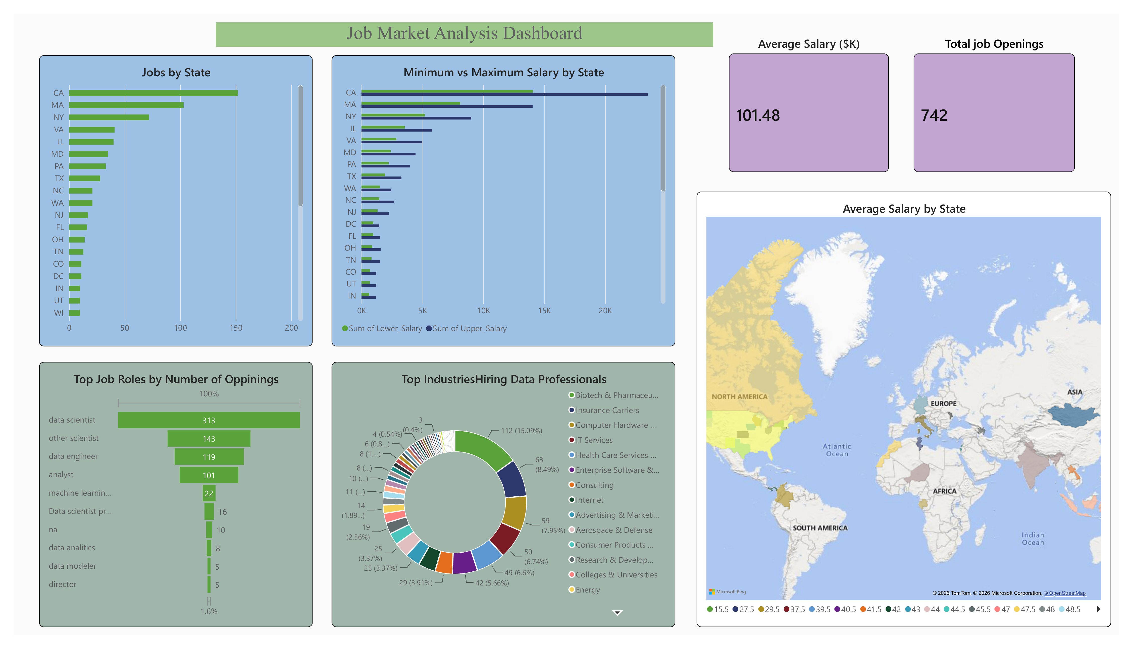
Roles, States & Industries
Jobs by state, salary ranges, top job roles and industries hiring data professionals
Highlights
California leads job volume by a wide margin, followed by Massachusetts and New York.
Salary ranges widen in higher-cost states like CA, MA and NY.
Data Scientist is the most in-demand role with 313 openings, well ahead of Other Scientist (143) and Data Engineer (119).
Biotech & Pharmaceuticals is the top hiring industry at roughly 15% of openings, followed by Insurance Carriers and Computer Hardware.
Source: Power BI dashboard, exported visuals.

Slide 4
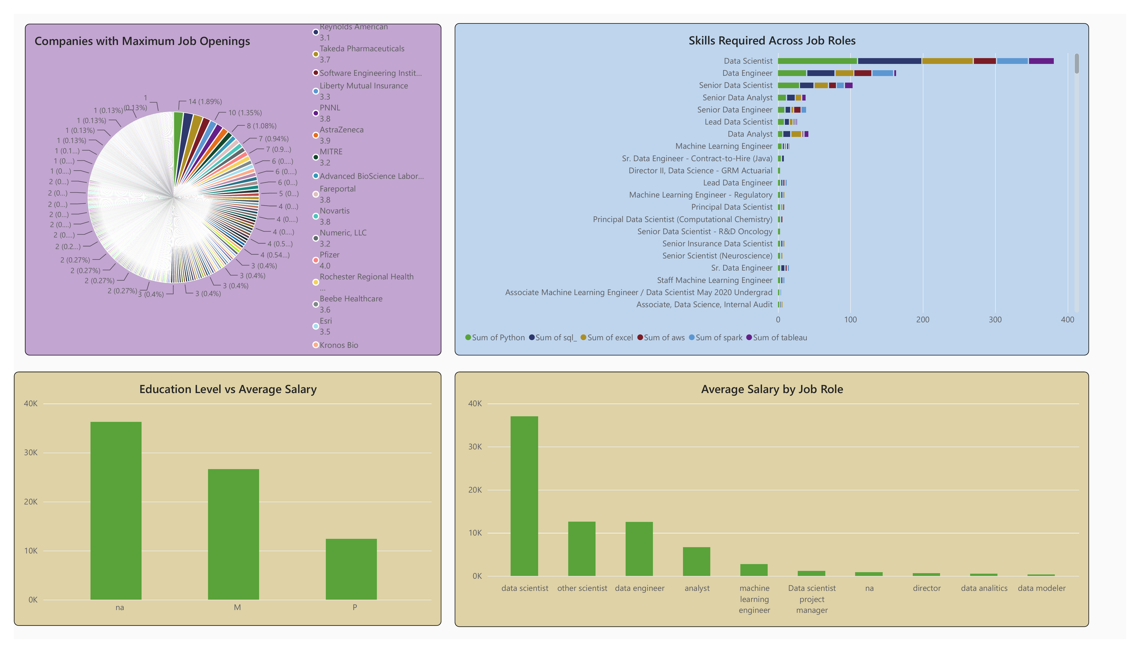
Companies, Skills & Education
Top hiring companies, in-demand skills, and how education level relates to salary
Highlights
Hiring is spread across many companies rather than concentrated in a few — Reynolds American, Takeda and Liberty Mutual post the most openings.
Python and SQL are the most frequently requested skills, especially for Data Scientist and Data Engineer roles.
Average salary rises with seniority — Data Scientist roles command the highest average pay.
Education level correlates with pay, though many postings do not specify a required degree (na).
Source: Power BI dashboard, exported visuals.

Slide 5
Key Findings
What the data says about hiring demand for data professionals.
Strong Overall Demand
Coastal Hubs Dominate
Data Scientist Leads
742 total job openings tracked, with an average salary of $101.5K across roles.
California, Massachusetts and New York account for the largest share of openings.
313 openings for Data Scientist alone — more than double the next closest role.
Biotech & Pharma on Top
Python & SQL Essential
Pay Scales with Education
Biotech & Pharmaceuticals is the single largest industry hiring data talent.
These two skills appear most frequently across job postings, especially for technical roles.
Average salary trends upward from no degree listed, to Master's, to PhD-level postings.

Slide 6






What This Means
Practical takeaways for job seekers, recruiters and hiring teams.
Build Python & SQL Fluency
Target High-Demand States
These remain the baseline skills employers screen for across almost every data role.
California, Massachusetts and New York offer the most openings and the widest salary bands.
Advanced Degrees Pay Off
Look Beyond Big Names
Candidates with a Master's or PhD trend toward meaningfully higher average salaries.
Openings are spread across many mid-size companies, not just a handful of giants.
Specialize Strategically
Watch Biotech & Insurance
Data Scientist roles pay the most on average — specialization can outearn broader analyst titles.
These industries are hiring data professionals at the highest volume right now.

Slide 7
Thank You
Job Market Analysis Dashboard · Built with Microsoft Power BI

