Slide 1

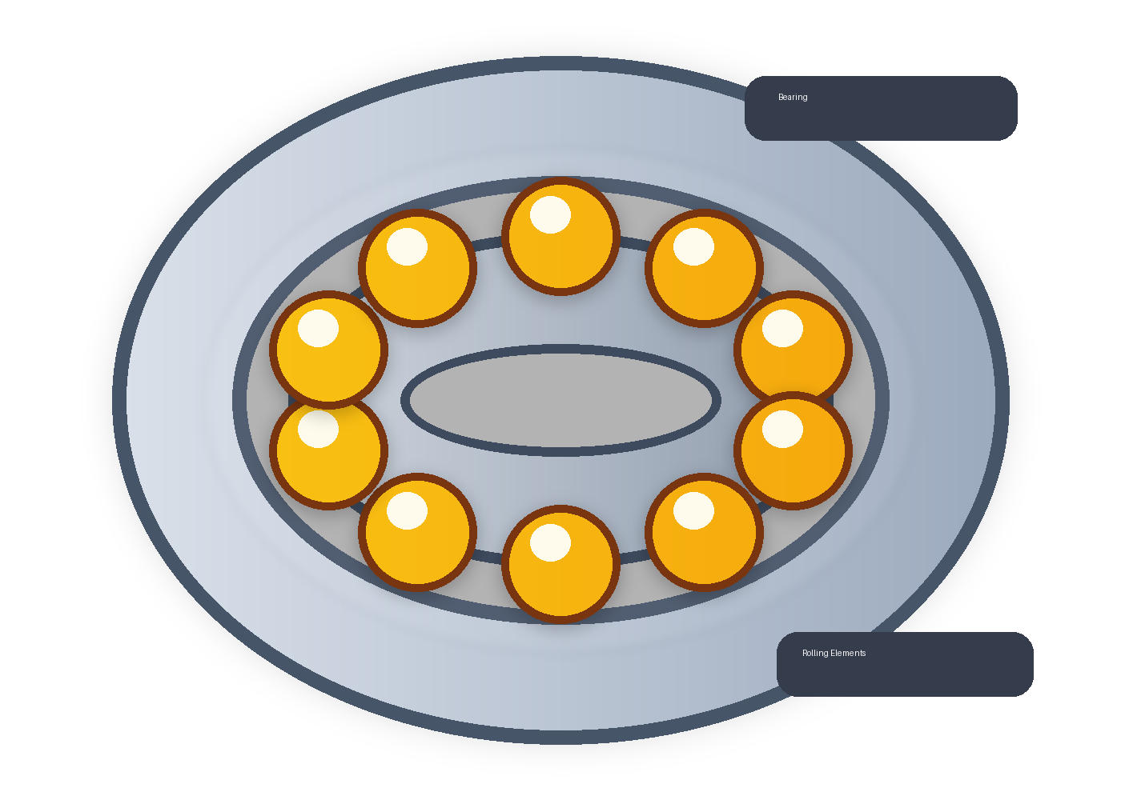
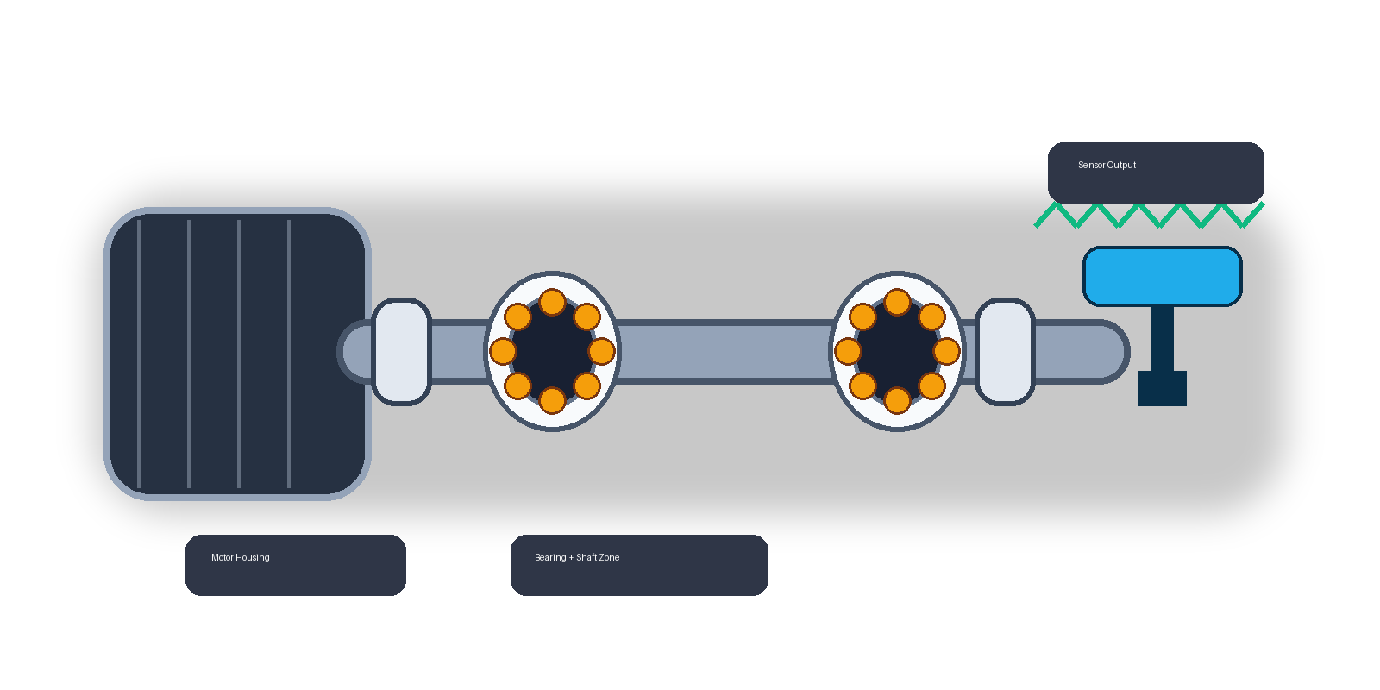
NIT
JSR
NATIONAL INSTITUTE OF TECHNOLOGY JAMSHEDPUR
Department of Mechanical Engineering
Intelligent Bearing
SUBMITTED BY
Pradeep Modak
2023UGCM026
Fault Diagnosis
Ashwini Kumar
2023UGCM004
for Predictive Maintenance
SUPERVISED BY
Rotating Machinery Context
Dr. Saroj Sarangi
Dr. Abhijit Dey
Project-II | CM1611
Spring Semester 2025-26 • April 2026
Notes:
Slide 1: Title Slide
Start with a short self-introduction and name your teammate clearly. Mention that this is a Project-II presentation from the Department of Mechanical Engineering at NIT Jamshedpur.
State the project title slowly: Intelligent Bearing Fault Diagnosis for Predictive Maintenance Using Vibration Signal Analysis and Machine Learning.
Add one purpose sentence: the project aims to detect bearing faults early from vibration signals and present the result through a working machine-learning based dashboard.
Tell the professors how the talk will flow: background, literature, gaps, methodology, results, conclusion, and future scope.
If asked why this topic was chosen, answer: because it connects mechanical condition monitoring with a practical AI workflow and has strong relevance to predictive maintenance.

Slide 2
OUTLINE
01
Introduction
05
Methodology & Workflow
02
Applications
06
Results & Discussion
03
07Summary & Conclusion
Literature Survey
04
08References
Research Gaps & Objectives
Notes:
Slide 2: Outline
Do not spend much time here. Use this slide only to orient the audience.
Say that the presentation moves from the problem context toward the developed system, and then to the achieved results and final takeaways.
Mention that a live demonstration is possible because the project includes a Streamlit GUI backed by the trained model.

Slide 3
INTRODUCTION
TIME
Time-Domain Analysis
Background
Here we study how vibration amplitude changes with time and extract statistical indicators like RMS, standard deviation, skewness, kurtosis, and crest factor. These features help us capture signal energy, impulsiveness, and abnormal peaks caused by bearing defects.
The Critical Role of Bearings
Rotating machinery depends heavily on rolling element bearing health. Defects cause:
FFT
Frequency Analysis
Excess heat & noise
We apply FFT to convert the signal from time to frequency space. This reveals dominant frequency components and spectral patterns that are strongly linked to fault types such as inner race, outer race, and ball defects. Frequency features improve separability between classes.
Efficiency loss
Catastrophic shutdowns
🧠
ML Classification
Vibration analysis is the most widely used non-invasive technique for early fault diagnosis.
We combine time- and frequency-domain features into a feature vector and train models like SVM and Random Forest. The classifier learns fault-specific patterns and predicts the bearing condition automatically. This gives us a fast, interpretable, and practical diagnosis pipeline
Bearing Element Model
Notes:
Slide 3: Introduction and Technical Background
Explain the background in mechanical terms first. Bearings support rotating shafts, so any defect in the rolling elements or races changes the vibration response of the machine.
When you mention time-domain analysis, explain it as observing how vibration amplitude changes with time. These values help capture signal spread, impulsive behavior, and abnormal peaks.
When you mention frequency analysis, explain that FFT is used to see which frequencies dominate the signal. Fault conditions produce characteristic frequency signatures, so the frequency view helps separate classes [1].
For machine learning classification, say that both time-domain and frequency-domain descriptors are combined into one feature vector and then used to train classifiers such as SVM and Random Forest.
If a professor asks why both domains are used, answer: time-domain features capture amplitude variation directly, while frequency-domain features capture spectral structure; using both improves discrimination.

Slide 4
INTRODUCTION: Problem Statement
THE DIAGNOSTIC CHALLENGE
Manual interpretation of vibration signals is time-consuming and requires strong domain expertise. When machines generate continuous sensor streams, manual screening becomes difficult to maintain consistently across large industrial systems.
🎯 PROJECT FOCUS
Build a reliable, interpretable, and automated end-to-end ML pipeline that classifies bearing vibration signals into:
Normal
Ball Fault
Inner Race Fault
Outer Race Fault
Dataset: CWRU Benchmark • 9,736 labeled windows • 48 kHz sampling • 4 bearing conditions
Notes:
Slide 4: Problem Statement
Frame the problem as a scalability issue. Manual interpretation of vibration signals is possible for a few samples but not for large continuous industrial data streams.
State the specific project objective: to create a reliable and interpretable end-to-end workflow that classifies bearing condition into Normal, Ball Fault, Inner Race Fault, or Outer Race Fault.
Mention the dataset-specific numbers from the project: 9,736 labeled windows, 48 kHz sampling, and four bearing conditions.
If asked what exactly is difficult in raw data, answer: a long vibration signal is only a sequence of amplitude values; the challenge is converting that sequence into meaningful features that a classifier can use.

Slide 5
FUTURISTIC APPLICATIONS
Where this technology transforms industries
01
02
03
SMART MANUFACTURING
GREEN ENERGY
SAFETY CRITICAL
Industry 4.0
Energy Sector
Aerospace
Integration with smart factories can support real-time health monitoring across production lines and help maintenance teams plan action before failure.
The same workflow can be adapted for wind turbines, hydroelectric generators, and other rotating energy assets where early fault detection lowers maintenance burden.
Similar vibration-based fault monitoring ideas are relevant for safety-critical aerospace components, where early warning is more valuable than post-failure diagnosis.
"Shifting from Reactive to Proactive Maintenance Paradigms"
Notes:
Slide 5: Applications
Present this slide as the relevance slide. Tie the project to real mechanical systems instead of speaking in abstract AI terms.
For smart manufacturing, explain that the same idea can be extended to plant-wide monitoring where multiple machines are tracked continuously.
For the energy sector, mention turbines, generators, and rotating auxiliaries where unscheduled bearing failure is expensive.
For aerospace or safety-critical systems, explain that early indication is valuable because bearing damage can propagate into larger mechanical problems.
If asked whether this project is directly deployable to those sectors, answer honestly: this project is a benchmark-driven academic implementation, but the workflow is relevant and can be adapted to real sensor setups with further validation.

Slide 6
LITERATURE SURVEY
01
Classical Signal Processing
02
Feature-Based ML
03
Deep Learning
Waveform analysis, FFT peak identification, wavelet decomposition and fault frequency interpretation.
Statistical features extracted + SVM, Random Forest, and gradient boosting classifiers applied.
CNNs and autoencoders learning directly from raw signals or time-frequency images.
KEY RESEARCHERS & BENCHMARK
Kankar et al. (2011)
Rajeswari et al. (2014)
CWRU Benchmark Dataset
Demonstrated effectiveness of SVM & Random Forest for bearing classification.
Explored Wavelet Packet Transforms combined with hybrid PSO + SVM.
The gold standard for evaluating all bearing fault diagnosis methods.
Notes:
Slide 6: Literature Survey
Explain the literature in comparison style. Do not read the slide word by word.
Say that earlier work can be grouped into three approaches: classical signal analysis, feature-based machine learning, and deep learning-based diagnosis [2]-[4].
Mention that classical methods depend more on domain interpretation of frequency behavior, while feature-based ML uses engineered descriptors with classifiers such as SVM and Random Forest.
Mention that deep learning reduces manual feature design but may require more computation and may be less interpretable for a classroom-style demonstration [4], [5].
If asked why CWRU is used so often, answer: because it is a controlled public benchmark with known fault classes, which makes method comparison easier [1].

Slide 7
LITERATURE SURVEY: Limitations
01
Hidden Preprocessing
Many studies emphasize model accuracy while keeping all preprocessing and feature engineering assumptions completely opaque making reproduction impossible.
02
Lack of Accessibility
Complete absence of user-facing interfaces for real-time demonstration or educational purposes. Results exist only in research papers.
03
Research-Practice Gap
Prototypes rarely integrate raw signal handling, feature extraction, and GUI deployment in a single cohesive, reproducible workflow.
This project addresses ALL three limitations with a complete, open, end-to-end system.
Notes:
Slide 7: Literature Limitations
Use this slide to justify your project contribution. Say that many works emphasize model performance but do not show a complete reproducible engineering pipeline.
Explain hidden preprocessing as one important issue. If the paper does not make the segmentation rule or feature design clear, reproduction becomes difficult.
Explain lack of accessibility as another issue. Many works stay at paper level and do not provide an interface that can be demonstrated by students or non-specialists.
For the research-practice gap, say that raw signal handling, feature extraction, model training, and application deployment are often separated rather than integrated.
Then clearly say what your project contributes: one repository containing preprocessing, training, evaluation, saved artifacts, and a GUI.

Slide 8
RESEARCH GAPS & OBJECTIVES
RESEARCH GAP
PROJECT OBJECTIVES
Standard literature focuses on model accuracy metrics alone, completely lacking a comprehensive mechanical engineering demonstrative tool that bridges signal processing with web-based inference and interactive visualization.
01
Preprocess CWRU signals using 2048-sample windows with 50% overlap
02
Extract 25 engineered time-domain & frequency-domain features
03
Train and compare SVM (RBF) vs. Random Forest classifiers
Missing in existing work:
Full reproducible pipeline
04
Evaluate with accuracy, precision, recall, and weighted F1-score
GUI for real-time demos
Explainable feature importance
05
Deploy an interactive Streamlit Dashboard for live inference
Notes:
Slide 8: Research Gaps and Objectives
This slide should sound like a transition from literature to your implementation.
State the gap precisely: the need is not only for classification accuracy but for a demonstrable, explainable, and reproducible mechanical engineering tool.
Go through the objectives naturally: preprocess the signals, extract 25 features, compare SVM and Random Forest, evaluate systematically, and deploy the Streamlit dashboard.
If asked why 2048 samples and 50 percent overlap were chosen, answer: that window keeps localized fault information while generating enough training examples; with 48 kHz sampling it corresponds to about 42.67 milliseconds per window.

Slide 9
METHODOLOGY: System Design
1
2
3
4
5
→
→
→
→
Data Source
Preprocessing
Feature Extraction
Modeling
Deployment
CWRU Bearing
MAT Files
(4 conditions)
2048-sample windows
50% overlap
9,736 samples
25 engineered
time + frequency
domain features
SVM (RBF) &
Random Forest
80:20 split
Streamlit Dashboard
Interactive GUI
Live inference
TECHNOLOGIES USED
Python
NumPy / Pandas
SciPy (FFT)
scikit-learn
Matplotlib
Joblib
Streamlit
Machine-Sensor Pipeline
Notes:
Slide 9: Methodology and System Design
Walk through the pipeline from left to right as if you are tracing the data flow.
Start from the data source: raw CWRU MAT files representing four bearing conditions.
Then explain preprocessing: each long signal is segmented into 2048-sample windows with 50 percent overlap, producing 9,736 usable training samples.
Next explain feature extraction: the segmented windows are converted into engineered time-domain and frequency-domain descriptors.
Then explain modeling: SVM and Random Forest are trained on the processed feature table using an 80:20 split.
Finally explain deployment: the best saved model is loaded inside the Streamlit dashboard for live inference.
If asked what scripts actually run this pipeline, answer: scripts/build_dataset.py prepares the dataset, scripts/train_model.py trains the models, and the app is in app/streamlit_app.py.

Slide 10
METHODOLOGY
〰 FREQUENCY DOMAIN — Spectral Features
Feature
Extraction
Module
FFT Peak Amplitude
Spectral Mean
Spectral Standard Deviation
⏱ TIME DOMAIN — Statistical Features
Dominant Frequency
Spectral Centroid Proxy
Mean & Standard Deviation
Frequency Variance
Mean Absolute Deviation
Frequency Variation Factor
RMS (Root Mean Square)
Maximum Absolute Amplitude
DATASET SUMMARY
Skewness & Kurtosis
9,736
25
Crest Factor, Form Factor
Shape Factor, Impulse Factor
labeled windows
engineered features
Window: 2048 samples @ 48 kHz = 42.67 ms
4
48 kHz
bearing conditions
sampling rate
Notes:
Slide 10: Feature Extraction Module
Explain that feature extraction is the bridge between raw signal and classification.
For time-domain features, give intuitive meanings: mean and standard deviation show central level and spread, RMS reflects energy, kurtosis and crest factor respond to impulsive defects, and impulse/shape/form factors capture waveform characteristics.
For frequency-domain features, explain that FFT transforms the signal into spectral form, then features such as spectral mean, dominant frequency, spectral standard deviation, and frequency variation describe how the energy is distributed.
Point out the dataset summary again: 9,736 windows, 25 features, 4 classes, 48 kHz sampling.
If asked whether the model uses raw amplitude directly, answer: no, the classifier uses the extracted feature vector, not the raw sequence itself.

Slide 11
RESULTS: Model Performance
97.59%
97.48%
Random Forest Accuracy
SVM (RBF) Accuracy
Best Model
Strong Baseline
Model
Accuracy (%)
Precision (%)
Recall (%)
Weighted F1 (%)
🏆 Random Forest
97.59
97.62
97.59
97.59
SVM (RBF)
97.48
97.50
97.48
97.49
Metric: Accuracy & Weighted F1-Score on held-out 20% test set • Stratified split • Random Forest selected as final deployment model
Notes:
Slide 11: Model Performance
Present this as measured evidence rather than a claim.
State that both models performed strongly, but Random Forest achieved the best result with 97.59 percent accuracy and 97.59 percent weighted F1-score on the held-out test set.
Mention that SVM with RBF kernel also performed well, which shows that the feature design itself is meaningful.
Explain why Random Forest was finally selected: it slightly outperformed SVM and also provides feature importance, which helps explain the model during demonstration.
If asked what weighted F1-score means, answer: it balances precision and recall across all classes while accounting for class support, making it useful for multiclass evaluation.

Slide 12
RESULTS: Confusion Matrix & Feature Importance
CONFUSION MATRIX — Random Forest
TOP FEATURE IMPORTANCES — Random Forest
Ball Fault
Inner Race
Normal
Outer Race
Spectral Mean
0.158
Ball Fault
558
6
0
5
Impulse Factor
0.098
Inner Race
14
606
0
2
Std Deviation
0.092
True Label
Freq. Variation
0.088
Normal
1
0
187
0
Max Absolute
0.082
RMS
0.075
Outer Race
15
4
0
550
Mean Abs Dev
0.065
Predicted Label
Spectral Std
0.055
Notes:
Slide 12: Confusion Matrix and Feature Importance
First explain the confusion matrix. Rows are true classes, columns are predicted classes.
Read the key diagonal numbers: Ball Fault 558, Inner Race Fault 606, Normal 187, Outer Race Fault 550. Emphasize that strong diagonal entries mean strong correct classification.
Mention that the off-diagonal values are comparatively low, so class confusion is limited.
Then move to feature importance. Say that the Random Forest model ranks which features contribute more strongly to its decisions.
Call out the most important features shown: Spectral Mean, Impulse Factor, Standard Deviation, Frequency Variation, Maximum Absolute value, and RMS.
If asked why these matter physically, answer: they reflect how rough, impulsive, and spectrally concentrated the vibration becomes under defective bearing conditions.

Slide 13
SUMMARY &
CONCLUSION
KEY ACHIEVEMENTS
FUTURE SCOPE
Integrated mechanical vibration analysis with explainable ML pipeline
Validate on additional industrial real-world datasets
Developed practical tool bridging academia and industry deployment
Extend to XGBoost, 1D-CNN for higher accuracy
97.59% accuracy with Random Forest on CWRU benchmark dataset
Fault severity estimation and remaining useful life (RUL)
Interactive Streamlit dashboard for live inference & demo
Deployment on edge computing IoT devices
Thank You for Your Attention!
Pradeep Modak & Ashwini Kumar | Dept. of Mechanical Engineering, NIT Jamshedpur | April 2026
Notes:
Slide 13: Summary and Conclusion
Use this as your closing technical slide.
Summarize the major achievement: the project integrates mechanical vibration analysis, feature engineering, machine learning classification, and GUI deployment in one system.
Restate the most important performance number only once: Random Forest reached 97.59 percent accuracy on the CWRU benchmark dataset.
For future scope, mention validation on real industrial signals, comparison with advanced methods like XGBoost or 1D-CNN, fault severity estimation, and deployment to edge or IoT settings.
If asked what next semester work could be, answer: expanding to real sensor data, testing robustness under noise, and moving from fault type classification toward severity or remaining useful life estimation.

Slide 14
REFERENCES
[1] Case Western Reserve University Bearing Data Center, "Bearing Data Center," [Online]. Available:https://engineering.case.edu/bearingdatacenter
[2] P. K. Kankar, S. C. Sharma, and S. P. Harsha,"Fault diagnosis of ball bearings using machine learning methods," Expert Systems with Applications, 2011.
[3] C. S. Rajeswari, S. Sathiyabama, and S. Devendiran, "Bearing fault diagnosis using wavelet packet transform, hybrid PSO and support vector machine," Procedia Engineering, 2014.
[4]Streamlit Documentation,[Online]. Available: https://docs.streamlit.io/

Slide 15
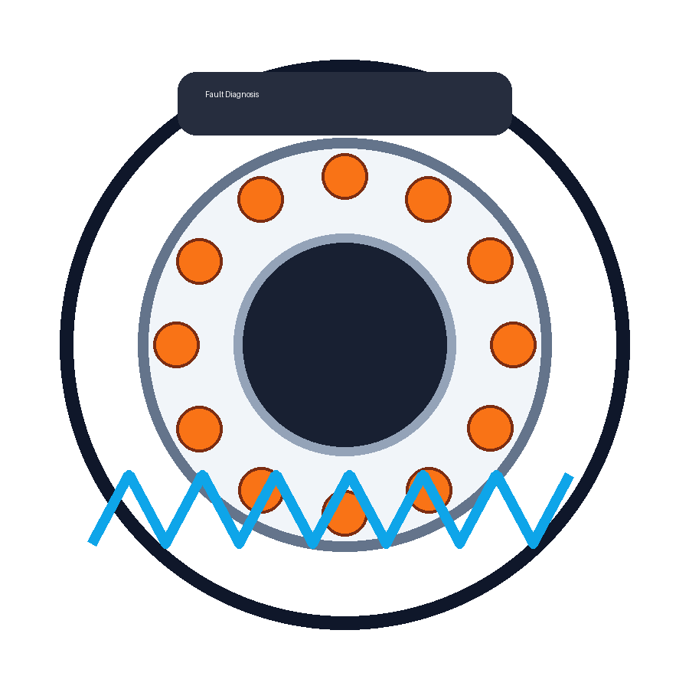
Thank You
Questions & Discussion
Ashwini Kumar (2023UGCM004) | Pradeep Modak (2023UGCM026)
Supervisors: Dr. Saroj Sarangi | Dr. Abhijit Dey
NIT Jamshedpur · Dept. of Mechanical Engineering · April 2026

