Slide 1

ProjectWork1(19AI702) – Review2
FoodLoop: AI-Powered Hyperlocal Application for Optimized Food Redistribution and Community Hunger Mitigation
Submitted by:
PRADEEPRAJ P (212222240073)
2022-2026 Batch
TEAM NO : 93
Under the guidance of:
Mrs Sunitha T
Designation, Department of AIML
DEPARTMENT OF ARTIFICIAL INTELLIGENCE AND DATA SCIENCE
SAVEETHA ENGINEERING COLLEGE
(Autonomous Institution – UGC, Govt. of India)
(Affiliated to Anna University, Approved by AICTE - Accredited by NBA & NAAC – ‘A’ Grade - ISO 9001:2015 Certified)
Saveetha Nagar, Thandalam, Chennai-602 105, TamilNadu, INDIA.

Slide 2
Agenda
Introduction
Statement of the Problem
Scope of the project
Methodology
  Architectural Diagram
  Design - Use Case Diagram, Class Diagram, Sequence diagram
  Algorithm used
  Implementation
  Important code segments
Output, Results
Test Cases
Conclusions
Future work
References

Slide 3
Introduction
FoodLoop: AI-Powered Hyperlocal Application for Optimized Food Redistribution and Community Hunger Mitigation ->
  AI-powered application connecting food donors, NGOs, and recipients.
  Uses AI and location data for smart food redistribution.
  Enables real-time chat-based coordination for food collection and delivery.
  Promotes sustainability and supports the Zero Hunger goal.

Slide 4
Statement of the Problem
FoodLoop: AI-Powered Hyperlocal Application for Optimized Food Redistribution and Community Hunger Mitigation ->
  Large amounts of edible food are wasted daily while many people still face hunger.
  There is no efficient, real-time system to connect food donors with nearby recipients or NGOs.
  Manual coordination leads to delays, food spoilage, and poor redistribution efficiency.
  A smart, automated solution is needed to optimize food collection and reduce hunger at the community level.

Slide 5
Purpose of the project
Why FoodLoop?
  The purpose of the FoodLoop project is to leverage Artificial Intelligence technology to develop an automated food redistribution system.
  It aims to connect food donors, NGOs, and recipients in real time to minimize food wastage and community hunger.
  The system uses machine learning and geolocation intelligence to efficiently match surplus food with nearby needy communities.
  The project aims to achieve the following objectives :
    Minimize food wastage through efficient redistribution
    Enhance coordination and speed between donors and recipients.
    Support sustainability goals like Zero Hunger (SDG 2).

Slide 6
Proposed Methodology
Methodology for - FoodLoop: AI-Powered Hyperlocal Application for Optimized Food Redistribution and Community Hunger Mitigation :
  User Registration & Authentication
  Food Listing & Availability
  Smart Matching System
  Real-Time Notifications & Tracking
  Data Analytics & Insights
  Feedback & Verification System
  Sustainability Integration

Slide 7
SOFTWARE REQUIREMENT SPECIFICATION (SRS)
1. Purpose
To build an AI-powered hyperlocal food redistribution application that connects food donors, NGOs, and recipients in real time.
Provides smart food–recipient matching using machine learning, geolocation-based allocation, real-time chat coordination, delivery tracking, feedback verification, and sustainability monitoring.
2. Scope
A mobile and web-based platform enabling donors to list surplus food, NGOs to manage pickups, and recipients to request support.
The system uses AI for matching, route optimization, and demand forecasting.
Includes real-time notifications, chat-based communication, live tracking, and automated verification.

Slide 8
SOFTWARE REQUIREMENT SPECIFICATION (SRS)
Functional Requirements ->
User Registration : Secure login/signup for donors, NGOs, volunteers, and recipients.
Food Listing : Donors upload surplus food details with images and expiry time.
AI Matching : Match food donations with nearest NGOs/recipients using ML + location data.
Real-Time Notifications : Instant alerts for new donations, pickups, and deliveries.
In-App Chat : Real-time chat for coordination between donors, NGOs, and volunteers.
Sustainability Insights : Display CO₂ savings and food wastage reduction metrics.

Slide 9
SOFTWARE REQUIREMENT SPECIFICATION (SRS)
Non-Functional Requirements ->
Performance : Fast AI matching and real-time updates with low latency.
Security : Encrypted data, secure authentication, and protected user information.
Usability : Simple, intuitive UI for all user groups with minimal steps.
Scalability : Supports increasing users, data, and locations across regions.
Compatibility : Works on Android, and all modern web browsers.
Maintainability : Easy to update and improve features over time.
.

Slide 10
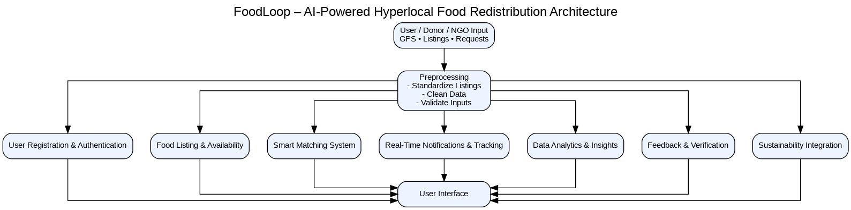
SYSTEM ARCHITECTURE
Architecture Diagram

Slide 11
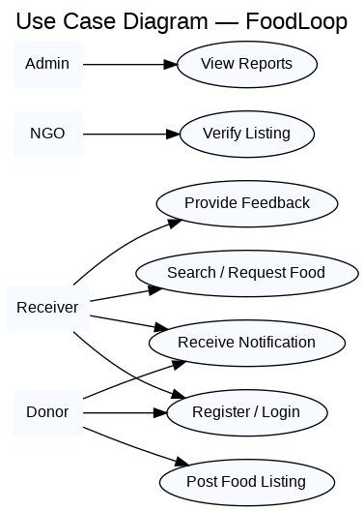
Use Case Diagram
Use case Diagram :

Slide 12
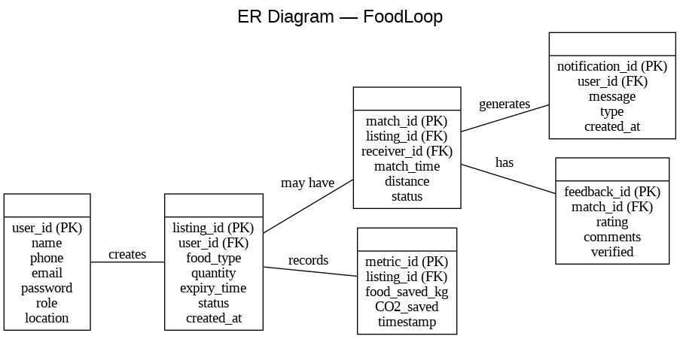
ER- Diagram
ER Diagram :

Slide 13
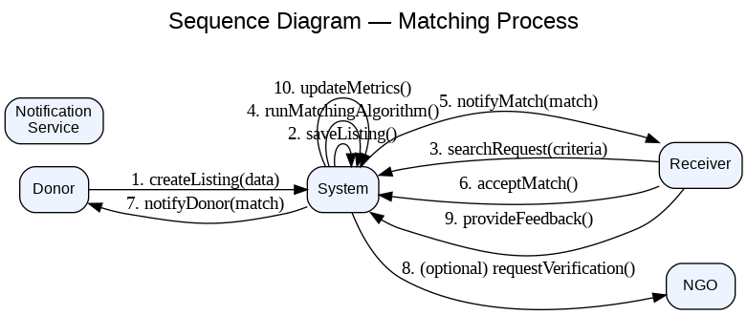
Sequence Diagram
Sequence diagram - Matching process :

Slide 14
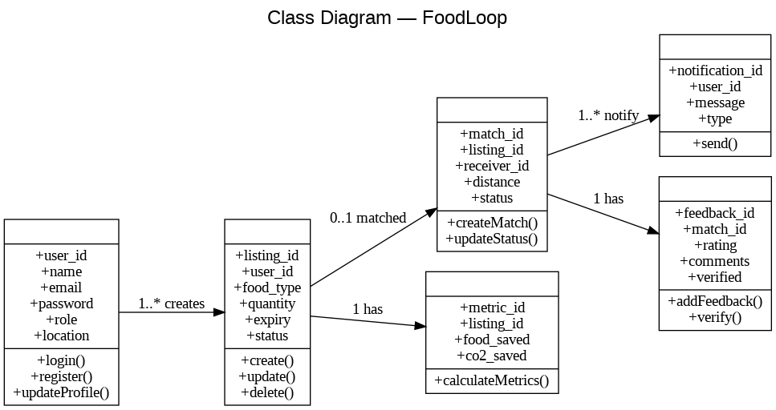
Class Diagram
Class Diagram :

Slide 15
Algorithms used
AI Matching Algorithm:
Used to match surplus food with the nearest NGO or recipient.
Performs smart allocation using distance, urgency, and food quantity.
Provides fast and accurate matching without increasing processing load.
Improves distribution efficiency through optimized machine learning logic.
Demand Forecasting Algorithm:
Used to predict future food demand in different local areas.
Provides better planning by analyzing past donation and request data.
Improves forecasting accuracy and community support efficiency.
Fraud Detection Algorithm:
Used to verify genuine listings and detect unusual or fake activity.
Provides secure operations through pattern analysis and proof validation.
Improves trust and transparency without increasing system overhead.

Slide 16
Algorithms used
AI-Based Smart Matching Algorithm:
A K-Nearest Neighbors (KNN) based Smart Matching Algorithm for optimally connecting surplus food with the most suitable nearby NGOs and recipients. The model compares each new food listing with past successful matches by analyzing donor-side information (food type, quantity, freshness, time of listing) and recipient-side needs (location, urgency, demand pattern). Hence, it is expected to give better matching performance than simple rule-based or manual decision methods.
Example: Food listings are matched with recipients using similarity — i.e., if past NGOs that accepted fresh cooked meals were located within 3–5 km and marked high urgency, then KNN identifies similar NGOs nearby and recommends the closest and most relevant match for immediate pickup.

Slide 17
Hardware and software selection
Hardware Requirements
Smartphone: Android device with camera (720p or higher)
GPS: Device must support location services for donors, NGOs, and volunteers
RAM: Minimum 2GB for smooth app performance
Processor: Dual-core or higher
Desktop/Laptop: Optional for NGO/Admin dashboards
Network: Stable internet for real-time notifications and live tracking
Software Requirements
Frontend: React.js, Tailwind CSS, Fetch for API calls
Backend: Node.js, Express.js
Database: cloud-based NoSQL
Browser Support: Chrome, Edge, Android WebView
OS Support: Android 8+, Windows 10+

Slide 18
Implementation
The project includes Python scripts that can be used to process food donation and recipient data. From cloud storage e.g., Google Drive , we upload the dataset containing food listings, donor details, and recipient requirements.
We train the Smart Matching Algorithm using this dataset. The model analyzes donor-side information (food type, quantity, freshness, time of listing) and recipient-side needs (location, urgency, demand level).
The algorithm generates optimal matches between donors and recipients in real time. For each match, the system displays the recommended recipient/NGO, distance, urgency score, and pickup priority.
The output can be visualized in the web or mobile application, showing the best match along with all relevant details for immediate pickup and delivery.

Slide 19
Important Code Structure
Code Structure of FoodLoop ->
Frontend/ (React)
|─ src/
│ ├─ pages/
│ │ ├─ Home.jsx
│ │ ├─ OnboardingRole.jsx
│ │ ├─ DonorDashboard.jsx
│ │ ├─ AddListing.jsx
│ │ ├─ RecipientDashboard.jsx
│ │ ├─ MyMatches.jsx
│ │ ├─ ListingDetail.jsx
│ │ ├─ Notifications.jsx
│ │ └─ AdminDashboard.jsx
│ ├─ components/
│ ├─ services/
│ ├─ hooks/
│ └─ Layout.js
└─ package.json

Slide 20
Important Code Structure
Backend/ (Node.js / Serverless (API + jobs))
├─ routes/
├─ controllers/
├─ models/
├─ services/
├─ jobs/
└─ server.js

Slide 21
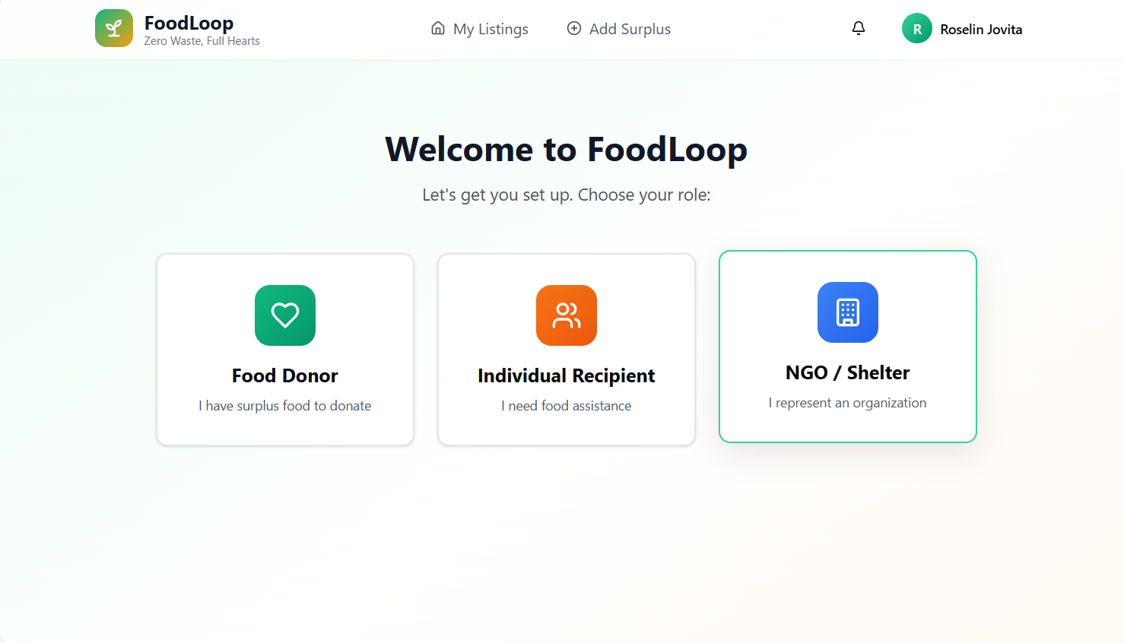
Output
Login Page :

Slide 22
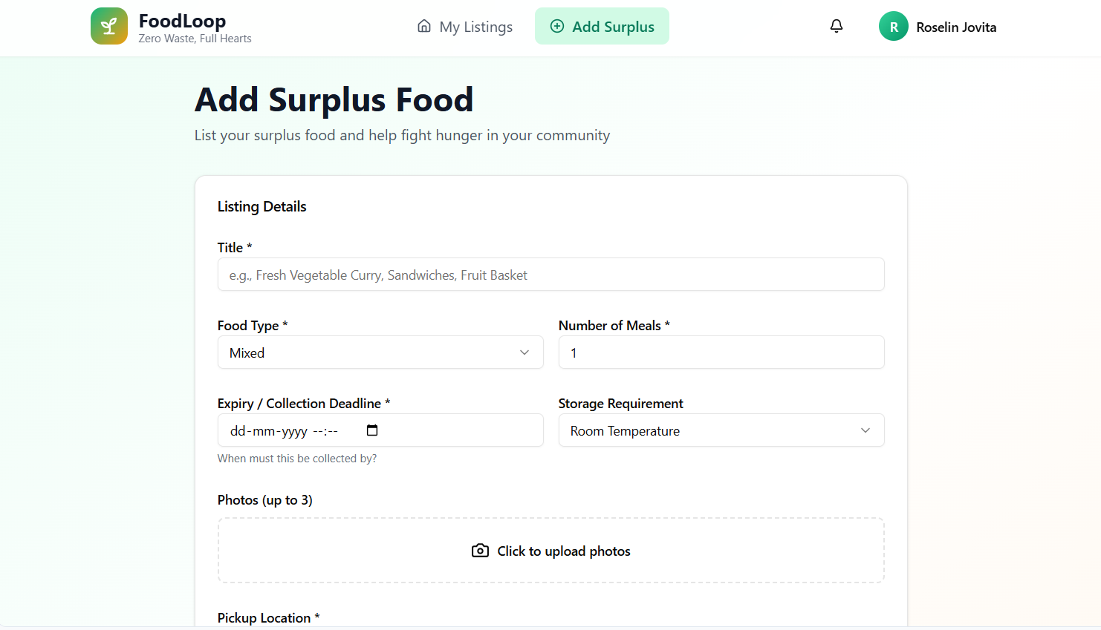
Output
Add surplus food page :

Slide 23
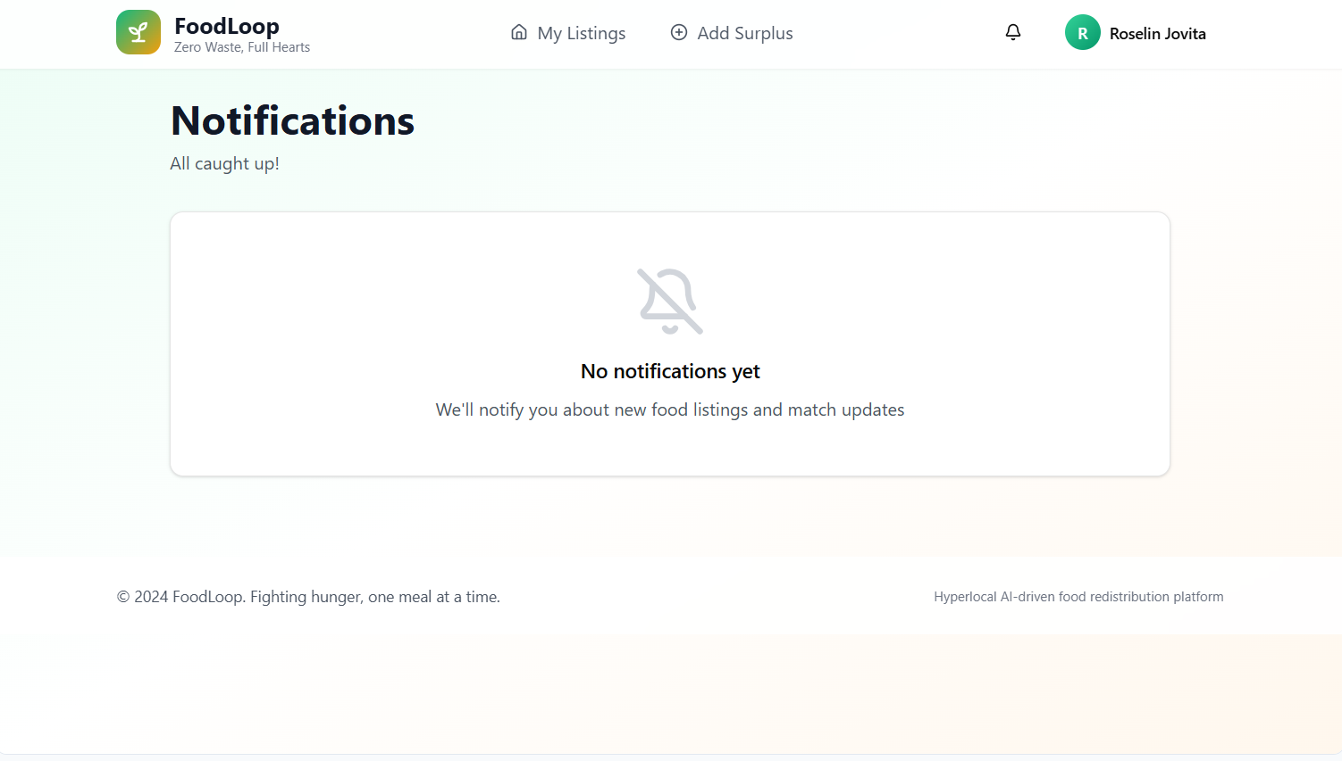
Output
Notification Page :

Slide 24
Test Cases
Test Cases
S.NO | Action | Input | Expected Output | Actual Output | Test Result
1 | Test Case 1: User Registration | Input: New user details (username, email, password). | Expected Output: User account is created successfully, and a confirmation message is displayed. | Actual Output: [To be filled after testing] | Result: Pass/Fail
2 | Test Case 2: User Login | Input: Registered user’s login details (email, password). | Expected Output: User is successfully logged in and redirected to the dashboard. | Actual Output: [To be filled after testing] | Result: Pass/Fail
3 | Test Case 3: Food Listing | Input: Donor uploads a new food listing with details (food type, quantity, expiry, location). | Expected Output: Listing is successfully created and visible to nearby NGOs/recipients. | Actual Output: [To be filled after testing] | Result: Pass/Fail
4 | Test Case 4: Smart Matching | Input: Food listing uploaded, recipient/NGO nearby with matching requirements. | Expected Output: System generates optimal matches and notifies the nearest recipients/NGOs. | Actual Output: [To be filled after testing] | Result: Pass/Fail
5 | Test Case 5: Real-Time Notification | Input: Match created for a new food listing. | Expected Output: Donor, NGO, and volunteer receive instant notification about the match. | Actual Output: [To be filled after testing] | Result: Pass/Fail

Slide 25
Test Cases
Test Cases
S.NO | Action | Input | Expected Output | Actual Output | Test Result
6 | Test Case 6: Live Tracking | Input: Volunteer picks up food for delivery. | Expected Output: Real-time tracking of delivery status is updated in the dashboard for donor and recipient. | Actual Output: [To be filled after testing] | Result: Pass/Fail
7 | Test Case 7: Feedback & Verification | Input: Recipient confirms receipt and provides feedback. | Expected Output: Feedback is stored and displayed; verification updates donor and NGO records. | Actual Output: [To be filled after testing] | Result: Pass/Fail
8 | Test Case 8: Data Analytics Dashboard | Input: Admin/NGO accesses dashboard. | Expected Output: Displays donation statistics, matches, high-demand areas, and food wastage reduction metrics. | Actual Output: [To be filled after testing] | Result: Pass/Fail

Slide 26
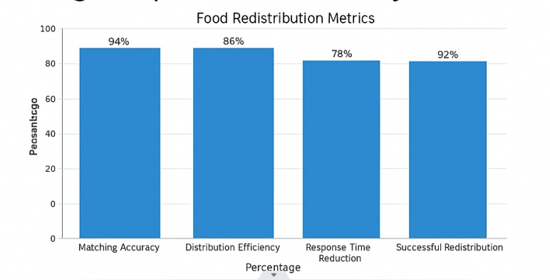
Results
FoodLoop – Results
– Matching Accuracy: 94%
– Distribution Efficiency: 89%
– Response Time Reduction: 78% faster matching
– Successful Redistribution: 92% of surplus food collected before expiry.
– Inferences: Faster food allocation, reduced wastage, improved community access.

Slide 27
Conclusion
FoodLoop: AI-Powered Hyperlocal Application for Optimized Food Redistribution and Community Hunger Mitigation
  FoodLoop uses AI and geolocation to connect donors, NGOs, and recipients for efficient food redistribution..
  It helps reduce food wastage and mitigate hunger through real-time, automated coordination.
  The project supports sustainability goals and promotes a smarter, hunger-free community.
  Overall, FoodLoop represents a step toward creating a smarter, more compassionate, and waste-free society through technology-driven social innovation.

Slide 28
Future Work
-> Expanded Food Categories & Special Requirements
Include dietary preferences (vegan, gluten-free, allergies) in the matching algorithm.
Enable categorization for cooked meals, packaged food, and perishables with automated expiry tracking.
-> Enhanced Analytics & Reporting
Implement predictive analytics for forecasting food demand and wastage hotspots.
Provide detailed dashboards for donors, NGOs, and policymakers to drive data-driven decision-making.

Slide 29
References
https://pubs.aip.org/aip/acp/article-abstract/3325/1/040020/3366028/Ending-hunger-saving-food-Innovations-for-surplus
K. F. Victor and I. Z. Michael, “Intelligent data analysis and machine learning: Are they really equivalent Concepts?,” in 2017 Second Russia and Pacific Conference on Computer Technology and Applications (RPC), 2017, pp. 59–63.
Kumar, R., Singh, A., & Patel, M. (2025). Enhancing Food Sustainability Through Technological Innovation: A Paradigmatic Approach to Minimizing Household Food Wastage via an AI-Enabled Application. Journal of Environmental Informatics & Smart Technology, 8(2), 2025.
Saleth, E., Balaji, S., Yashema, N., & Akshaya, D. (2025). Zero Impact AI-Driven Food Redistribution System for Sustainable Waste Reduction. International Journal for Research Trends & Innovation, 10(4), April 2025.

Slide 30


