Slide 1
Employee Performance Analysis – INX Future Inc.
Presented by: Pradeep Rajan
Data Scientist | IABAC Certified | NASSCOM Certified

Slide 2
Project Objectives
🎯 Analyze employee performance data
🔍 Identify top 3 performance factors
🧠 Build a predictive model
✅ Recommend actionable improvements

Slide 3
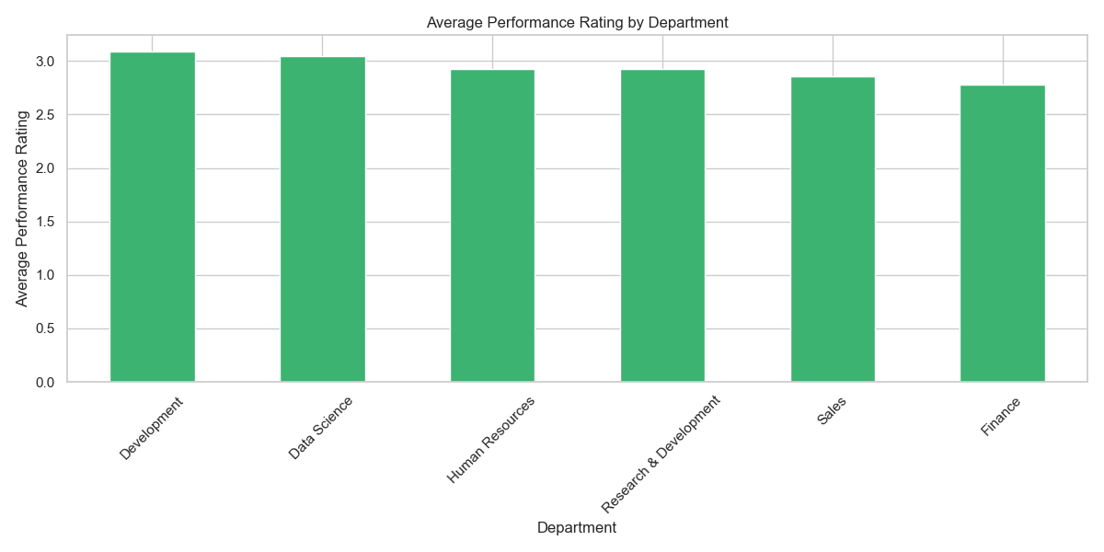
Exploratory Data Analysis
Performance trends across departments
Performance trends across departments
Impact of Environment Satisfaction, Job Involvement, and Work-Life Balance
Addressed missing values and imbalanced classes

Slide 4
Feature engineering
Created new features:
Experience Gap
Avg. Experience Per Company
Age Group, Tenure Category, Performance Category

Slide 5
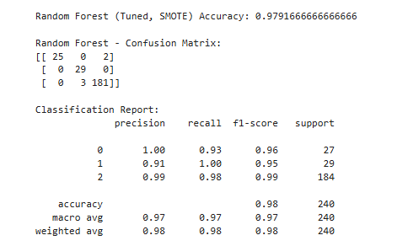
Modeling & Evaluation
Models used:
Random Forest Classifier
Logistic Regression
Best model: Random Forest (Accuracy: 97.9%)
Balanced performance across classes

Slide 6
Key Insights & Recommendations
Top Predictors:
Environment Satisfaction
Emp Last Salary Hike Percent
Years Since Last Promotion
Recommendations:
Improve work-life balance policies
Use model to guide hiring and internal training
Promote feedback mechanisms

Slide 7
Conclusion & Future scope
Project provided a scalable HR analytics solution
Future scope:
Integrate with HR dashboards
Add real-time employee feedback
Continuous model tuning

Slide 8
Thank You / Connect with Me
“Thank you for watching!”
“Let’s connect on LinkedIn!”
Connect with me:
Pradeep rajan S | LinkedIn
GitHub repository:
Pradeeprajans (Pradeep rajan S)
Portfolio:
Pradeep rajan S | Portfolio

