Slide 1
Waterfall SDLC vs Agile SDLC

Slide 2
What is SDLC?
SDLC (Software Development Life Cycle) refers to the structured process of creating software.
It defines the stages involved from planning to deployment and maintenance.
SDLC methodologies guide the process of software development.

Slide 3
Waterfall SDLC Overview
Definition: Waterfall is a linear and sequential software development model.
Stages:
Requirement Gathering: Understand the software requirements.
System Design: Plan and design the architecture.
Implementation: Code the solution.
Integration & Testing: Test the system for bugs.
Deployment: Launch the software.
Maintenance: Post-launch support and updates.

Slide 4
Characteristics:
Each phase must be completed before the next one begins.
Clear documentation and defined requirements upfront.
Suitable for projects with well-defined, unchanging requirements.

Slide 5
Waterfall SDLC – Advantages
Simple to understand and use.
Clearly defined stages and milestones.
Well-suited for smaller projects with fixed requirements.
Easy to manage due to its structured approach.
Ideal for projects with limited customer interaction

Slide 6
Waterfall SDLC – Disadvantages
Inflexible to changes after the project has started.
Late discovery of issues, making changes expensive.
Limited customer feedback during development.
Suitable for only projects with stable requirements.

Slide 7
Agile SDLC Overview
Definition: Agile is an iterative and incremental software development model.
Core Principle: Delivering small, working pieces of software in short cycles (sprints).
Phases:
Planning: Define the scope and goals for the sprint.
Design and Development: Build and design the software.
Testing: Perform continuous testing.
Review and Retrospective: Review work, collect feedback, and plan for the next iteration.

Slide 8
Characteristics:
Focus on collaboration, flexibility, and customer feedback.
Software is developed in small, manageable increments.
Changes can be incorporated easily based on feedback.

Slide 9
Agile SDLC – Advantages
Flexible and adaptable to changes.
Encourages customer collaboration throughout the process.
Faster release of working software.
Continuous testing and improvements.
Better at managing complex projects with evolving requirements.

Slide 10
Agile SDLC – Disadvantages
Can be difficult to manage with large teams or complex projects.
Requires constant collaboration, which can be time-consuming.
Less predictability in terms of timelines and costs.
Can be challenging for teams without experience in Agile practices.

Slide 11
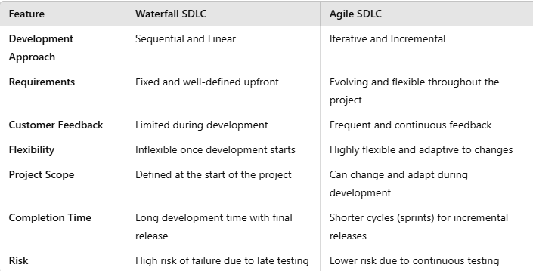
Key Differences: Waterfall vs. Agile

Slide 12
Waterfall vs. Agile – Which to Choose?
When to Use Waterfall:
Projects with clearly defined requirements and no changes expected.
Smaller teams or less complex projects.
Regulatory compliance or structured environments.
When to Use Agile:
Projects with evolving requirements or uncertain outcomes.
Teams needing rapid prototyping or feedback.
Projects requiring ongoing customer collaboration and flexibility.

Slide 13
Conclusion
Waterfall and Agile are both effective SDLC models, but they are suitable for different types of projects.
Waterfall works best for projects with fixed requirements, whereas Agile is more suited to projects with frequent changes and customer involvement.
Understanding the strengths and limitations of each methodology is key to choosing the right one for your project.

