Slide 1
Patient Survival Prediction
DATS 6101 - Team 8
SIDDHARTH NADADHUR
AROUB HALAWANI
PRADEEP SOMASUNDARAM
SURYA VAMSI PATIBALLA

Slide 2
Abstract
From our dataset, we’re going to determine whether a patient lives or dies based on numerous parameters, like heart rate, creatinine, bilirubin levels,BMI,Glucose levels etc.From this data, we can also infer the significance/ impact of Intensive Care Units and check whether they really improve a patient’s health or not. The dataset we have is in its raw form. We will preprocess (EDA)/ clean the dataset first which involves taking care of missing values and then go for feature importance, splitting the data for training and testing and move towards model building.

Slide 3
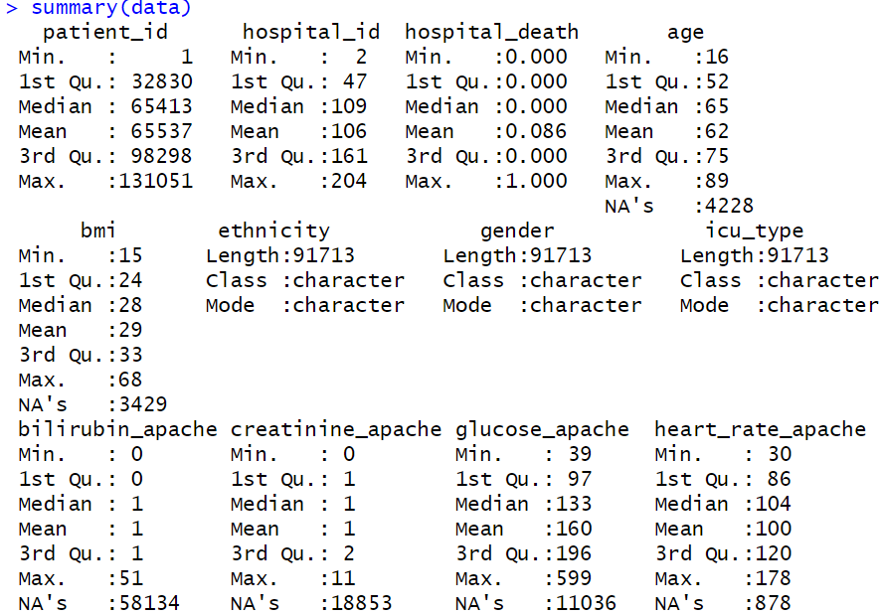
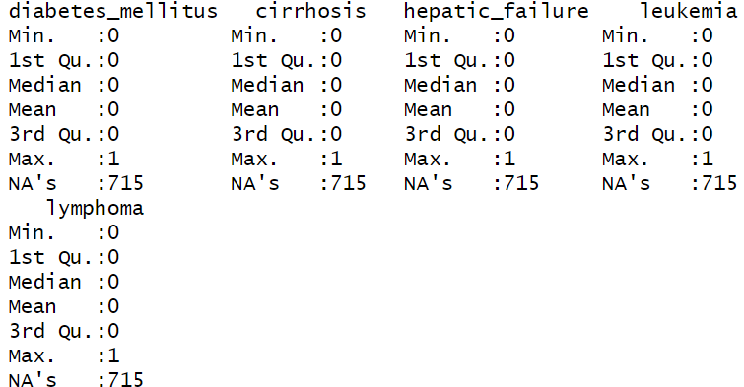
Summary
Inferences:
Age: The mean and median do not have a huge difference, so less likely to have outliers.
Glucose_apache: The mean and median have a big difference and, hence likely to have outliers.
Creatinine_apache: The mean and median do not have a considerable difference, therefore less likely to have outliers.

Slide 4
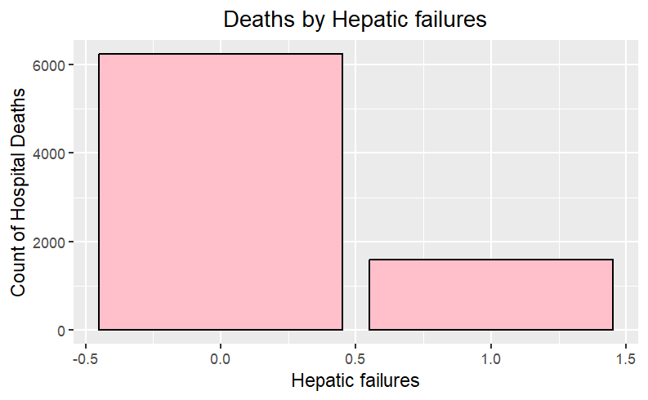
Bar graph of Hepatic failures and Hospital deaths

Slide 5
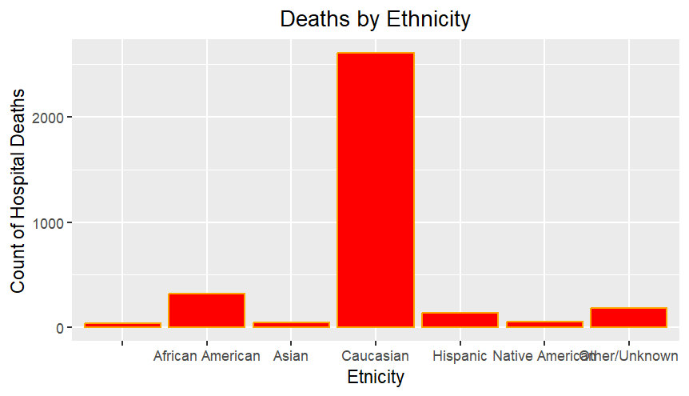
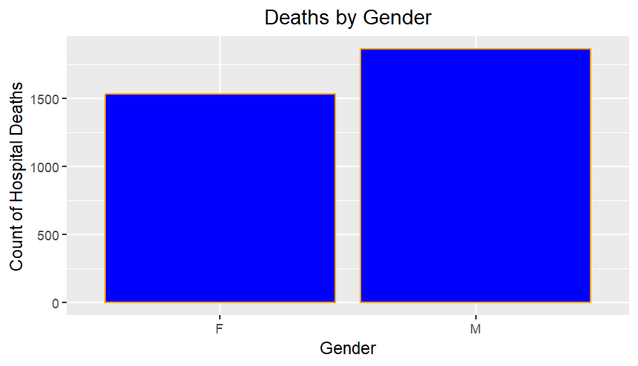
Bar graphs for Count of Hospital deaths,Ethnicity and Gender

Slide 6
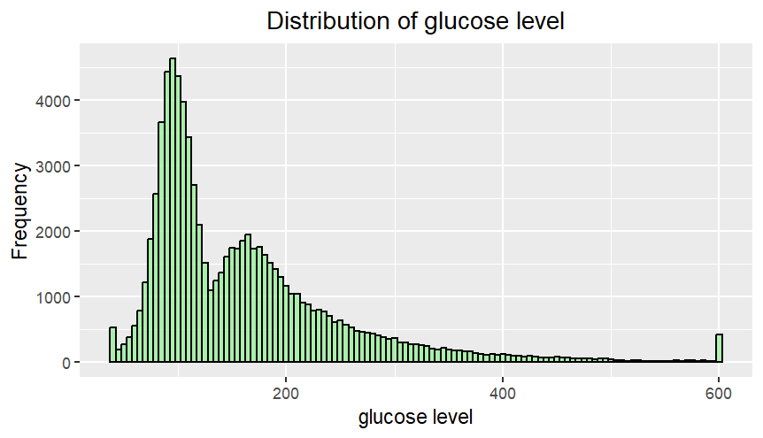
Histogram of Distribution of Glucose level

Slide 7
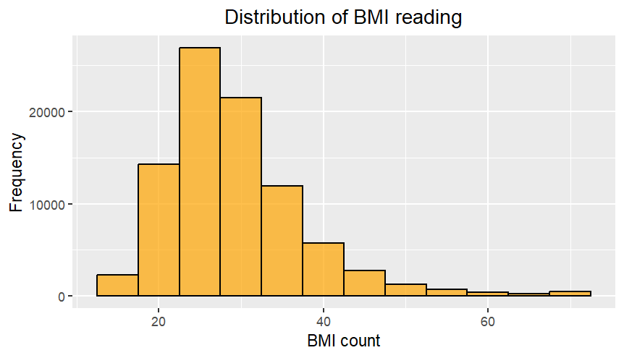
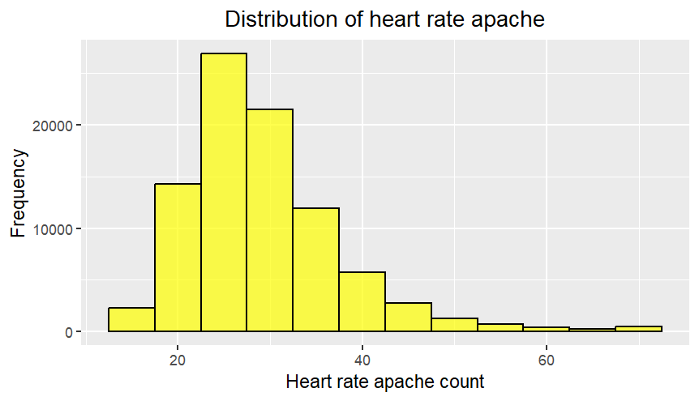
Histograms for BMI reading and Heart rate apache

Slide 8
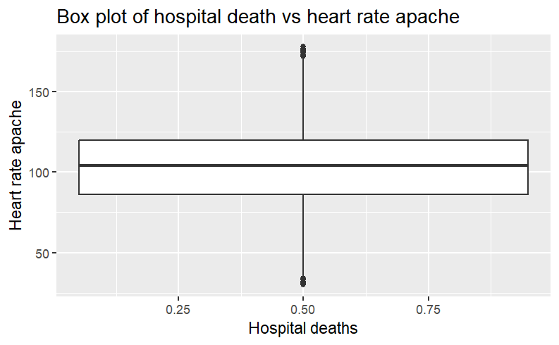
Box plot of Heart rate apache and Hospital deaths

Slide 9
1. Among different age groups (children, adults, and senior citizens), which demographic exhibits the highest mortality rate?

Slide 10
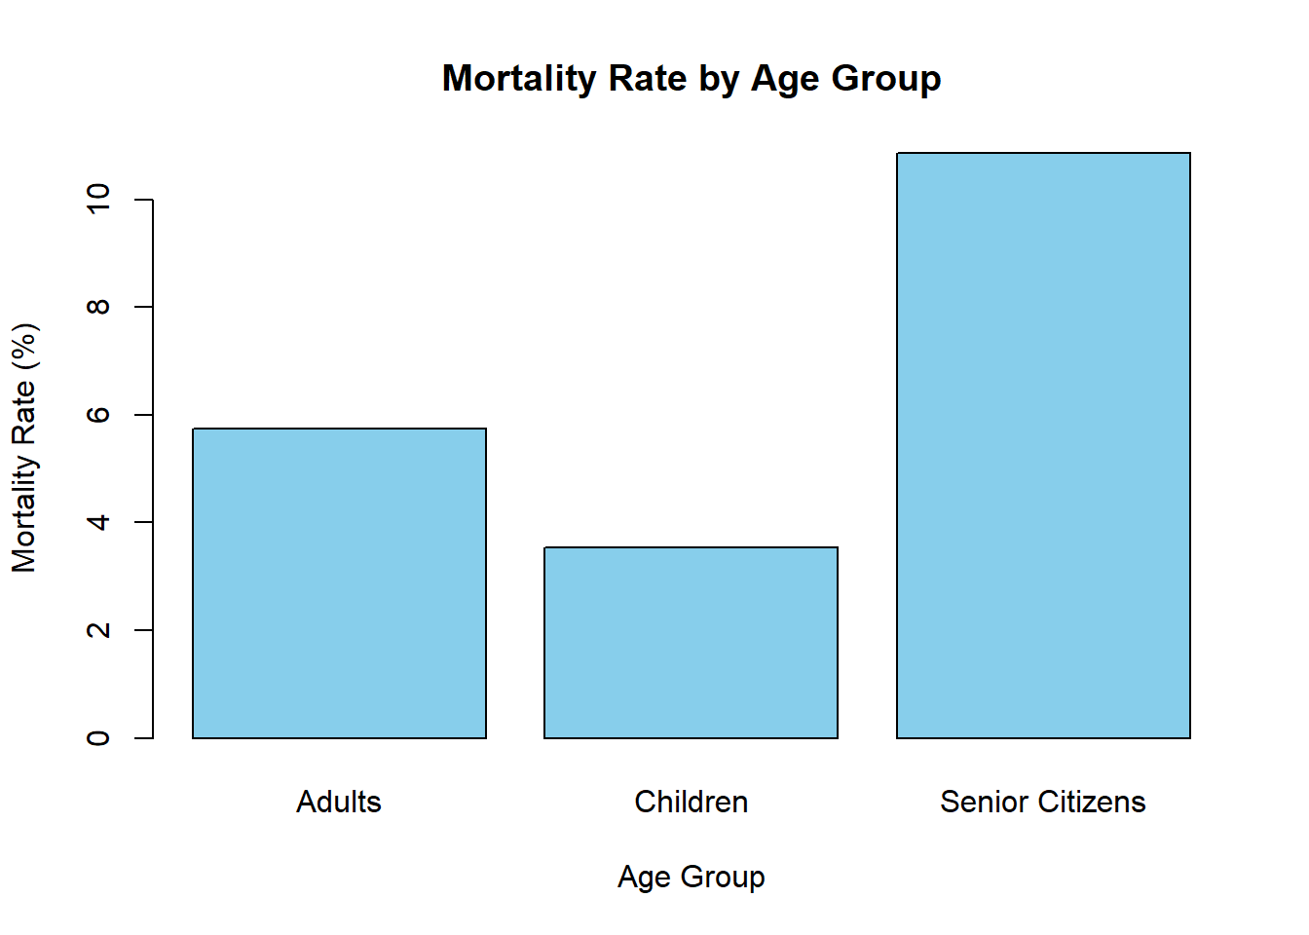
This Bar graph proves that the senior citizens group exhibits highest mortality rate.

Slide 11
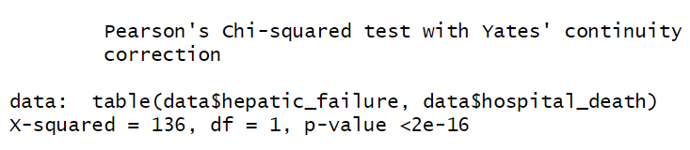
2. Can the presence of medical conditions like diabetes, hepatic failure, or other medical conditions impact an individual's likelihood of mortality?
Null Hypothesis(H0): Hospital deaths and Hepatic failures are independent.
Alternate Hypothesis(H1): Hospital deaths and Hepatic failures are dependent.

Slide 12
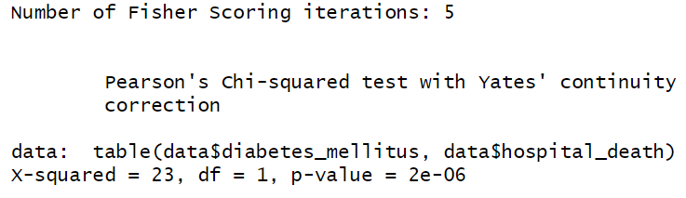
Null Hypothesis(H0): Hospital deaths and Diabetes mellitus are independent.
Alternate Hypothesis(H1): Hospital deaths and Diabetes mellitus are dependent.

Slide 13
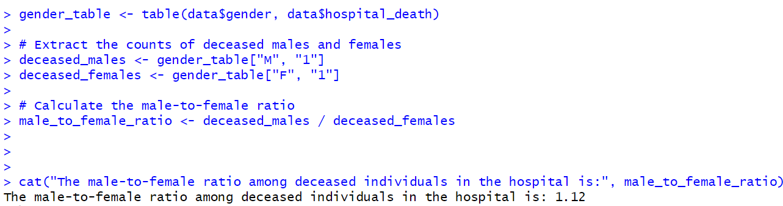
3. What is the gender distribution of deaths in the hospital, with regard to male and female ratios?

Slide 14
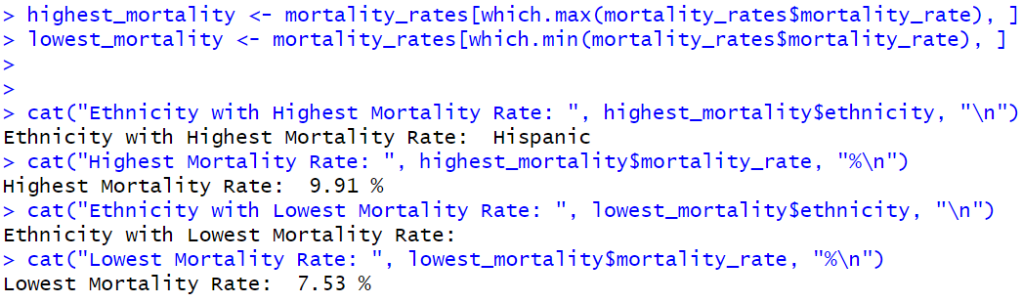
4: Among ethnicities, which one exhibits the highest and lowest mortality rate?

Slide 15
Q & A please…

