Slide 1

ODISHA UNIVERSITY OF TECHNOLOGY AND RESEARCH, BHUBANESWAR
Modified Deep Reinforcement Learning Based Offloading Decision Algorithm In MEC Network
GUIDED BY:
Dr. Sanjit Kumar Dash
Faculty , Dept of IT,
SCS, OUTR
PRESENTED BY:
Pradeepta Kumar Sahoo (2112100037)
Shubhra Jyoti Sahoo (2001106517)
Rajanikant Pattnaik (2001106533)

Slide 2
CONTENT
Introduction
MEC
Task Offloading
Literature Review
Objective
System Model
MDRO
Framework
Algorithm
Implementation
MDRO Different Quantization technique
Dataset Overview
Simulation Environment
Code
Results
Why RF is better than KNN
Conclusion
References

Slide 3
INTRODUCTION
MEC, as an effective supplement to cloud computing, gathers various resources, such as computing, storage, and application, at the edge of the network (near the user end).
Part of the user's service requests can be offloaded to a near-end MEC server for processing through the wireless channel so that delay-sensitive tasks can respond quickly, reduce task response time, and improve the user's Quality of Service (QoS) and Quality of Experience (QoE).
CONTI…

Slide 4
INTRODUCTION
Data offloading facing a great challenge because of real-time dynamics and edge environment complexity, edge environment security.
The reliability and security of edge data are becoming increasingly prominent. Therefore, to ensure the reliability and security of edge data, new methods of data offloading for edge computing are needed.

Slide 5
MOBILE EDGE COMPUTING
Multi-access Edge Computing (MEC), is a type of edge computing that extends cloud computing by bringing it to the network edge.
Mobile Edge Computing platform reduces network latency by enabling computation and storage capacity at the edge network.
It also enables application developers and content providers to serve context-aware services (such as collaborative computing) by using real time radio access network information.
CONTI…

Slide 6
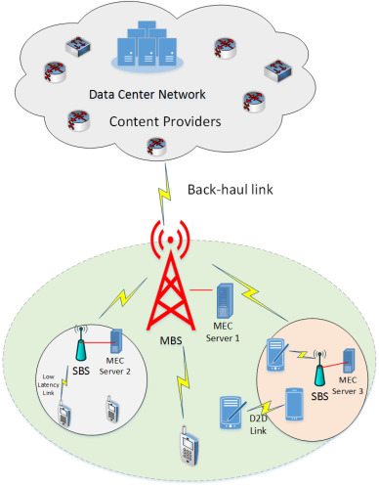
MEC ARCHITECTURE

Slide 7
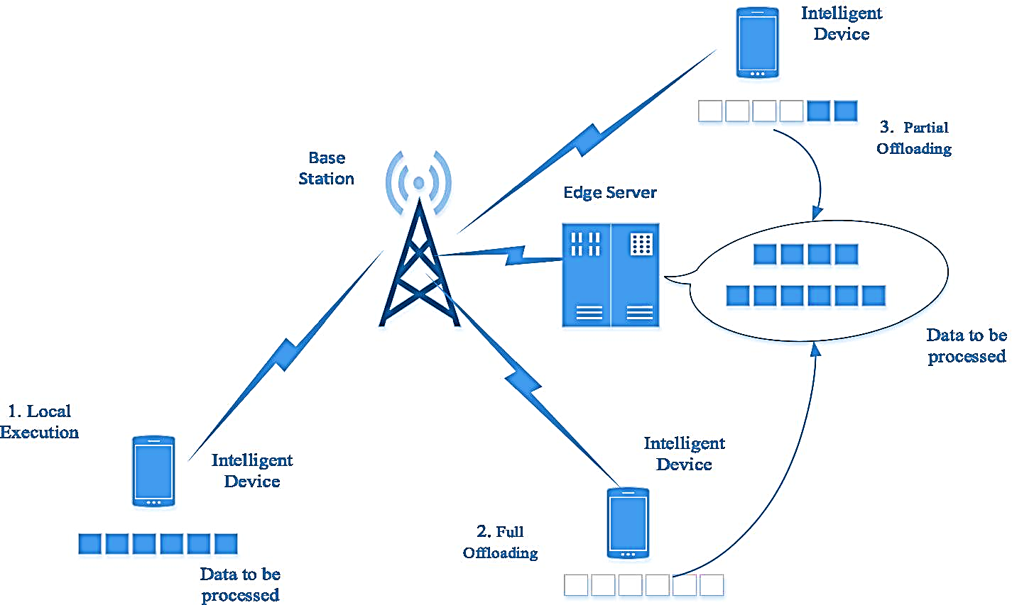
TASK OFFLOADING
Task offloading optimizes the transfer of demanding computational tasks from local devices to powerful external platforms, enhancing performance and efficiency.
Task offloading scenarios are:-
Local Execution
Full offloading
Partial offloading
CONTI…

Slide 8
LITERATURE REVIEW
Title | Journal Details | Findings
Deep Reinforcement Learning for Online Computation Offloading in Wireless Powered Mobile-Edge Computing Networks | L. Huang, S. Bi and Y. -J. A. Zhang, "Deep Reinforcement Learning for Online Computation Offloading in Wireless Powered Mobile-Edge Computing Networks," in IEEE Transactions on Mobile Computing, vol. 19, no. 11, pp. 2581-2593, 1 Nov. 2020, doi: 10.1109/TMC.2019.2928811. | The paper proposes DROO, a framework that uses a DNN and reinforcement learning to learn the best offloading decisions for WDs in wireless powered MEC networks. DROO achieves near-optimal performance with low complexity and fast convergence. The methods used are Order-preserving Quantization.
DRL based offloading of industrial IoT applications in wireless powered mobile edge computing | Chen, Wenchao & Zhu, Bincheng & Chi, Kaikai & Zhang, Shubin. (2022). DRL based offloading of industrial IoT applications in wireless powered mobile edge computing. IET Communications. 16. 10.1049/cmu2.12397. | The paper proposes a DRL-based offloading algorithm for WP-MEC networks, which decomposes the WSCR maximization problem into two subproblems and uses a gold-section search method and a DNN to solve them. The paper shows that the algorithm can achieve near-optimal WSCR with low complexity and fast convergence.

Slide 9
Title | Journal Details | Findings
Reinforcement learning for intelligent online computation offloading in wireless powered edge networks | Mustafa, Ehzaz & Shuja, Junaid & Bilal, Kashif & Mustafa, Saad & Maqsood, Tahir & Rehman, Faisal & Khan, Atta ur Rehman. (2022). Reinforcement learning for intelligent online computation offloading in wireless powered edge networks. Cluster Computing. 26. 10.1007/s10586-022-03700-5. | RLIO algorithm improves local or remote computation choices in dynamic wireless channels . It achieves speedy offloading decisions (<0.4 ms per channel) vital for dynamic networks. It only consider computation rate and other parameter are not such important.
Task Offloading and Resource Allocation for Mobile Edge Computing by Deep Reinforcement Learning Based on SARSA | T. Alfakih, M. M. Hassan, A. Gumaei, C. Savaglio and G. Fortino, "Task Offloading and Resource Allocation for Mobile Edge Computing by Deep Reinforcement Learning Based on SARSA," in IEEE Access, vol. 8, pp. 54074-54084, 2020, doi: 10.1109/ACCESS.2020.2981434 | SARSA method can optimize the offloading decision among three options: nearest edge server, adjacent edge server, and remote cloud. It can reduce the system cost, including energy consumption and computing time delay, and outperform the Q-learning method.

Slide 10
Title | Journal Details | Findings
Joint Offloading and Resource Allocation with Diverse Battery Level Consideration in MEC System | Y. Zhao, F. Hou, B. Lin and Y. Sun, "Joint Offloading and Resource Allocation With Diverse Battery Level Consideration in MEC System," in IEEE Transactions on Green Communications and Networking, vol. 7, no. 2, pp. 609-625, June 2023, doi: 10.1109/TGCN.2022.3232700. | In this paper, it use bisection searching for optimal solution. For optimal allocation there are 2 condition. First is completion of local time is equal to completion time of MEC. Second is task completion of each device is equal. SMVCR gives feasible solution with low complexity.
Distributed Deep Learning-based Offloading for Mobile Edge Computing Networks | Huang, Liang & Feng, Xu & Feng, Anqi & Huang, Yupin & Qian, Li Ping. (2022). Distributed Deep Learning-based Offloading for Mobile Edge Computing Networks. Mobile Networks and Applications. 27. 10.1007/s11036-018-1177-x. | DDLO is a distributed deep learning algorithm that learns the optimal offloading decisions for wireless devices in MEC networks using multiple DNNs. It minimizes the energy and delay. It achieves near-optimal solutions faster and more accurately than the deep Q-network algorithm.

Slide 11
Title | Journal Details | Findings
Partial offloading in device-to-device-assisted MEC network: A utility optimization approach | Zhang, Ruidong & Zhang, Jiadong & Shi, Wenxiao. (2023). Partial offloading in device-to-device-assisted MEC network: A utility optimization approach. Computer Communications. 209. 10.1016/j.comcom.2023.06.022 | The proposed Partial Offloading-based Utility Optimization (POUO) algorithm efficiently optimizes resource allocation policies and offloading. Offloading pairing decisions in D2E and D2D modes are solved using knapsack and assignment problems, respectively, improving decision-making efficiency.
A Trade-Off Task-Offloading Scheme in Multi-User Multi-Task Mobile Edge Computing | R. Li, C. S. Lim, M. E. Rana and X. Zhou, "A Trade-Off Task-Offloading Scheme in Multi-User Multi-Task Mobile Edge Computing," in IEEE Access, vol. 10, pp. 129884-129898, 2022, doi:10.1109/ACCESS.2022.3228403. | The paper proposes a dynamic reinforcement learning algorithm Improved Dynamic Niche-based Self-organizing Learning Algorithm offloading (IDO) that adapts to the changing wireless conditions and makes optimal offloading decisions based on the queue length, the number of users, and the number of tasks. The paper applies Lyapunov theory to ensure the queue stability. It compared with LFO and RFO
Notes:
bisection searching sub-channel (SC) matching based on virtual computation resource (SMVCR)

Slide 12
OBJECTIVE
To Develop a Modified deep reinforcement learning based offloading decision algorithm in MEC Network (MDRO) that contain multilayer DNN structure and different algorithm to get optimize task offloading decisions.
Implement an approach with multilayer DNN structure which is based on Deep Reinforcement Learning , quantization , reward generation algorithm to generate task offloading and resource allocation strategies
Compared two quantization algorithm which is KNN and RF and provide a best algorithm for the offloading decision.

Slide 13
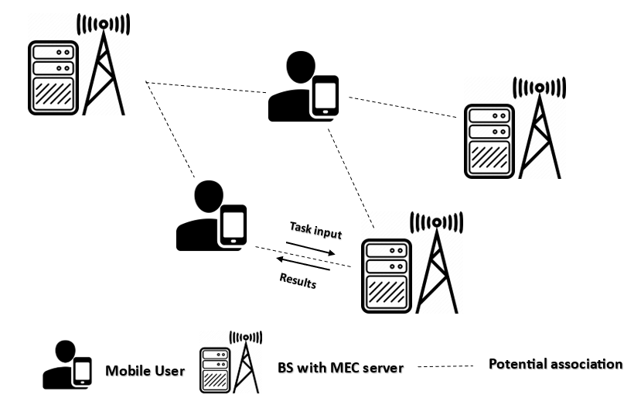
SYSTEM MODEL

Slide 14
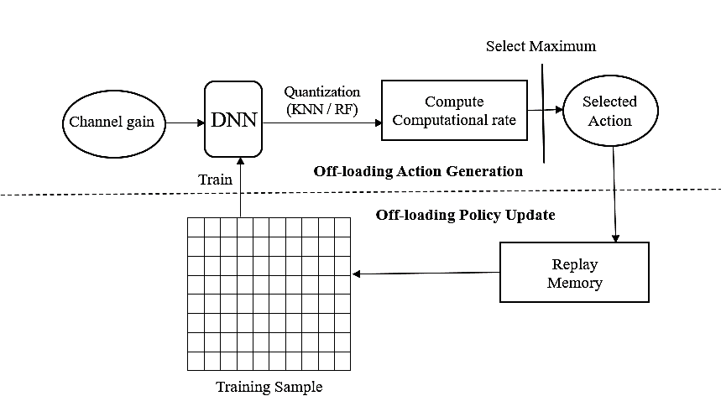
MDRO - MODEL FRAMEWORK:
The Framework of MDRO with KNN / Random Forest

Slide 15
MDRO Algorithm
Input: Wireless channel gain at each time frame t, the number of quantized actions K.
Initialize the Deep Neural Network (DNN) with random parameters and empty memory.
Set iteration number i and the training interval d.
Starts a loop that iterates over each time frame during the training process.
Generate a relaxed offloading action for the current time frame.
Quantize relaxed offloading action into K binary actions using either KNN or RF algorithm.
Compute Q-value for all possible action given the current channel gain.
Select the best action with the highest Q-value as the best action for the current channel gain.
Update the memory by adding the channel gain and the chosen action (state-action pairs).
It checks if the current time frame is a multiple of the training interval, indicating that it's time to update the neural network.
Then it randomly samples a batch of state-action pairs from the reply memory.
Train the DNN and update parameters using the Adam optimization algorithm.
End of the conditional block for updating the neural network.
End of the loop over each time frame
Output: Offloading action, and the corresponding optimal resource allocation for each time frame t;
Notes:
6.Check quality of each action and select best action(future reward)7.best action highest q function

Slide 16
IMPLEMENTATION OF MDRO:
The MDRO algorithm consists of two main stages: offloading action generation and offloading policy update.
Offloading Action Generation:
The phase is about how the MDRO algorithm generates offloading actions, which are the decisions of which tasks to send to the server and which tasks to do by themselves.
In this stage, a multilayer Deep Neural Network (DNN) is used, and it learn from data.
At each time frame , the DNN takes the channel gain as input and produces a relaxed offloading action which is a continuous value between 0 and 1.
This continuous action is then quantized into 'K' binary offloading actions. And it use quantization method.
CONTD….

Slide 17
The selected action, along with associated parameters , is considered as the solution for the given channel gain, ensuring that all physical constraints are met.
Offloading Policy Update:
This is phase describes a method for offloading (DNNs) to improve their performance and efficiency.
In this stage, during the ‘t’ time frame, a batch of training samples is randomly drawn from the replay memory.
These samples are used to train the DNN, updating its parameters from ‘ut' to 'ut+1', effectively changing the offloading policy from 'p' to 'p+1'.
The new offloading policy 'p+1' is then used in the next time frame ('t+1') to generate offloading decisions based on the observed channel 'ht+1'.
These stages repeat as new channel conditions are encountered, gradually improving the DNN's policy 'p' over time.

Slide 18
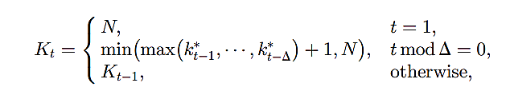
Adaptive setting of K
The proposed adaptive procedure dynamically adjusts the number of quantized actions (Kt) based on the observed performance.
By analyzing the index (kt) of the best action over time, the algorithm gradually reduces K during the learning process, effectively speeding up computation without significant performance compromise.
The update interval Δ determines how frequently Kt is adjusted, striking a balance between computational efficiency and performance in the wireless powered MEC network.

Slide 19
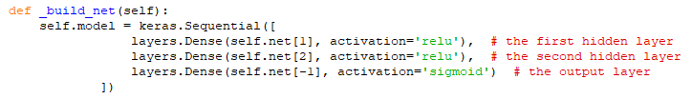
Structure of multilayer DNN
def __init__(self, net, learning_rate=0.01, training_interval=10, batch_size=50, memory_size=1024, output_graph=False):
Initialize the DNN with various parameters:
net: List representing the DNN architecture.
learning_rate: Learning rate for the DNN.
training_interval: Frequency of training the DNN.
batch_size: Size of batches used in training.
memory_size: Size of the memory to store historical data.
output_graph: Whether to output the graph (not used in the provided code).
def _build_net(self):
Define the architecture of the DNN with three layers (input, hidden, output).

Slide 20
MDRO Algorithm using different Quantization technique
In MDRO algorithm, the quantization technique is used for generating binary offloading decision
This is help us to improve the performance of the MDRO method in terms of training loss and normalized computation rate across time frame.
Here we are using two quantization techniques. Such as :-
KNN
RF

Slide 21
MDRO with KNN algorithm
Input: m, k, num_actions
1. Initialize enumerate_actions to an empty list
2. If enumerate_actions is empty:
2.1. Generate all possible binary offloading actions (2^num_actions possibilities)
2.2. Store these actions in enumerate_actions
3.Calculate the squared Euclidean distance between m and each action in enumerate_actions
4. Sort the distances in ascending order and get the indices of the sorted distances
5. Select the first k indices from the sorted indices list
6. Retrieve the corresponding actions for these indices
7. Return the k-nearest actions
Output: k-nearest actions to m

Slide 22
MDRO with KNN
MDRO with KNN starts with continuous values, such as channel gain data, which are important for making offloading decisions in MEC environments.
KNN identifies the K closest neighbors in the dataset to the given continuous value. These neighbors serve as reference points for quantization.
These close matches create groups or levels, simplifying our data.
Each data point joins the group it's closest to, like a voting system.
This categorized data helps us decide the best actions in real-time, improving efficiency.
We keep refining our decisions over time using this categorized data, getting better and better.

Slide 23
MDRO with RF Algorithm
Input: m (input vector), k (number of top actions to return)
1. Initialize RandomForest Classifier with 100 trees and a fixed random state.
2. Check if enumerate_actions is empty.
2.a. If true, generate all 2^N binary offloading actions using itertools.product.
2.b. Store these actions in enumerate_actions.
3. Train the random forest model using enumerate_actions as input and a range of integers as targets.
4. Reshape the input vector m to a 2D array with one row.
5. Use the trained model to predict the class for the reshaped input vector m.
6. Use the predictions to index into enumerate_actions and retrieve the binary actions.
7. Return the top k binary actions based on the predictions.
Output: top_k_actions (top k binary offloading actions)

Slide 24
MDRO with RF
MDRO with RF quantizes offloading actions by creating multiple decision trees.
Decision trees are built with random subsets of the dataset and features.
Each tree provides insights into optimal computational rates based on channel conditions and resource availability.
The maximum rate computed by Random Forest is selected for each potential offloading action.
This optimizes decision-making in MEC environments by dynamically adjusting computational rates.

Slide 25
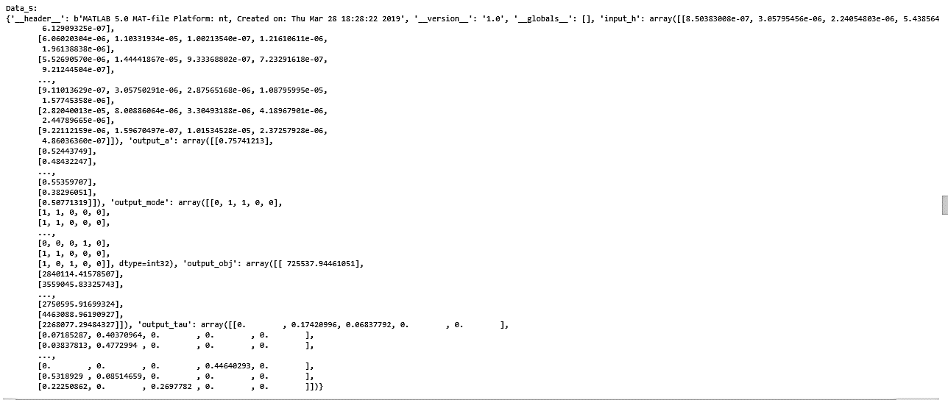
DataSet Overview
The dataset is collected from GitHub (https://github.com/revenol/DROO/tree/master/data).

Slide 26
Dataset Analysis
There are 30,000 samples saved in each ./data/data_#.mat, where # is the no. of user. Each data file including following parameters:
Input_h - Refers to wireless channel gain between WDs and the AP
Output_mode - Refers to optimal binary offloading action.
Output_a - Refers to optimal fraction of time that the AP broadcasts RF energy for the WDs to harvest
Output_tau - Refers to optimal fraction of time allocated to WDs for task offloading
Output_obj - Refers to weighted sum computation rate.

Slide 27
Simulation Environment
We are using a free online cloud-based platform, i.e. Google Colab to implement our code.
Colab is a hosted Jupyter Notebook service that requires no setup to use and provides free access to computing resources, including GPUs and TPUs.
Colab is especially well suited to machine learning, data science.
Packages Required:
TensorFlow 2.0 for creating a TensorFlow environment.
NumPy and SciPy for computational tasks.
Pandas for data manipulation.
Matplotlib and Seaborn for result visualization.
In the colab platform, we are upload the dataset and source code / program file for our execution of the project and “ %run ‘file_name.py’ ” command is used for execute the file.

Slide 28
Code
Here we are initialize some parameters such as:
number of users (N) as 10
number of time frames (n) as 5000
No of quantization (k) as N
Choose quantization mode either KNN or RF
Memory size as 1024
adaptive k interval delta = 32
Then loads data samples as:
channel = sio.loadmat('data_%d' %N)['input_h']
rate = sio.loadmat('data_%d' %N)['output_obj’]
Adjusts channel gain for training, and splits the data into training and test sets. The split is done with an 80:20 ratio
Notes:
https://github.com/Shubhra03/MDRO

Slide 29
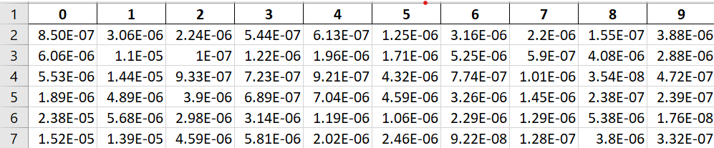
Code
The input_h dataset looks like this stored in channel.
Here 30000 samples are collected for 10 users
Firstly we normalize the sample by multiplying it with 1000000 .so that it will provide a value closer to 1
In the 1st iteration i.e when i_idx = 0 then the first row of normalized input_h is collected from the first row. It will look like this

Slide 30
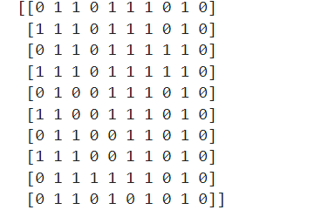
Code
Then m_list is generated by quantizing the h value.
m_list = mem.decode(h, K, decoder_mode)
here decoder mode is chosen to either KNN or RF.
The m_list looks like this. Here we set K = 10 so the K number of best action chosen.

Slide 31
Code
r_list is generated for every m in the m_list. Here r_list contains the reward given to the m using bisection algorithm.
It is used to find the optimal power allocation for maximizing the sum rate in a communication system. It iteratively adjusts a variable within a set range until the sum rate function’s root is found, indicating the best power distribution across channels.
The maximum Possible sum rate is returned for all m in the m_list.
Among this the last value has the maximum sum rate.so the possible best action among m in the m_list is
Then replace the old memory with new memory.
Here we set the training interval = 10 so after every 10 step train the DNN

Slide 32
Some Key points
On-Off conditions in MEC refer to the intermittent activation and deactivation of devices within the network, affecting resource allocation and computational demands. here also add training loss.
Alternating weights refers to changing the importance or priority assigned to different wireless devices within the network, which can affect how resources are allocated and tasks are processed.
Computation Rate refers to how fast a model learns, with higher rates speeding up learning but risking accuracy, and lower rates ensuring stable, precise learning, as seen with RF over KNN. Normalized computation rate is the moving average of computation rate over time frame.
Training loss in deep neural networks (DNNs) measures how well the model fits the training data, reflecting the error between the predicted outputs and the actual targets during training
NCR = resource utilize by the device at each time frame
resource allocated to the device at each time frame
Notes:
The computation rate in machine learning refers to the amount that the model’s weights are updated during training, which is influenced by the learning rate1. It’s a measure of how quickly a learning algorithm updates the parameters or learns from the data. A higher computation rate means the model can learn faster, but it also risks overshooting the optimal solution if the rate is too high. Conversely, a lower computation rate can lead to more stable and accurate learning over time, even with fewer computational resources, as is the case with the Random Forest (RF) algorithm compared to K-Nearest Neighbors (KNN). short it

Slide 33
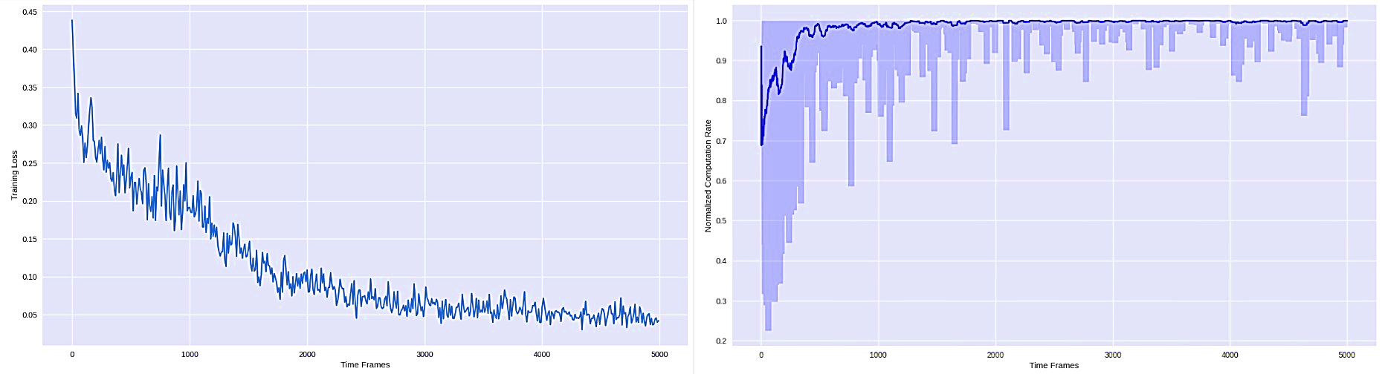
MDRO with KNN
RESULTS
The MDRO algorithm with KNN shows improved performance with training, as evidenced by a steady decrease in training loss from 0.44 to 0.04 and the normalized computational rate start at 0.92 but after a certain time it increase to 1 around 1500 time frame utilizing maximum resources.
Normalized computation rates and Training losses for MDRO with KNN under fading channels
CONTI…

Slide 34
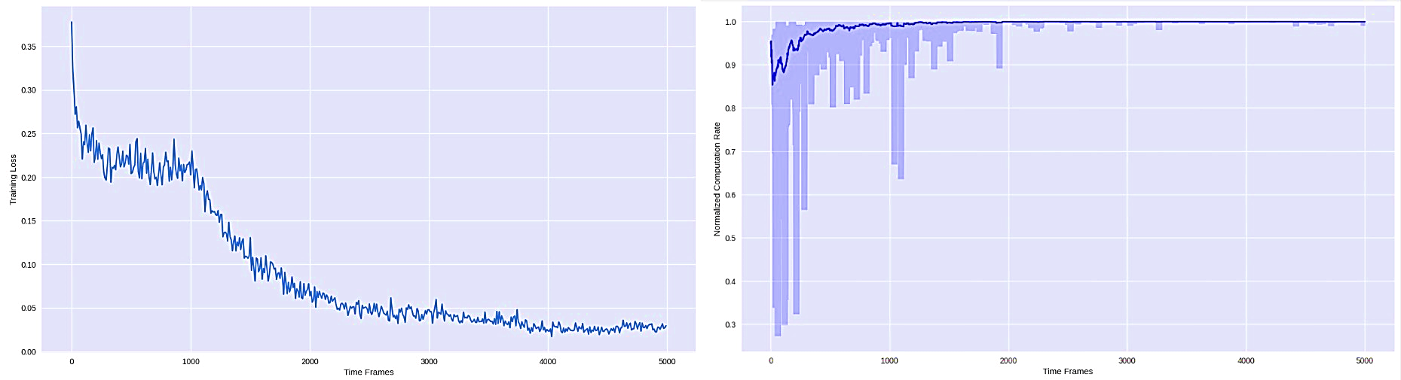
MDRO with KNN
RESULTS
On-Off conditions in MEC networks, showing consistent training loss reduction, such as it start at 0.37 and gradually decrease around 3000 time frame but around 4000 time frame it constant at 0.02 and computation rates start at 0.87 around 1000 time frame it increase and constant at 1.
Normalized computation rates and Training losses for MDRO with KNN under ON-OFF WDs
CONTI…

Slide 35
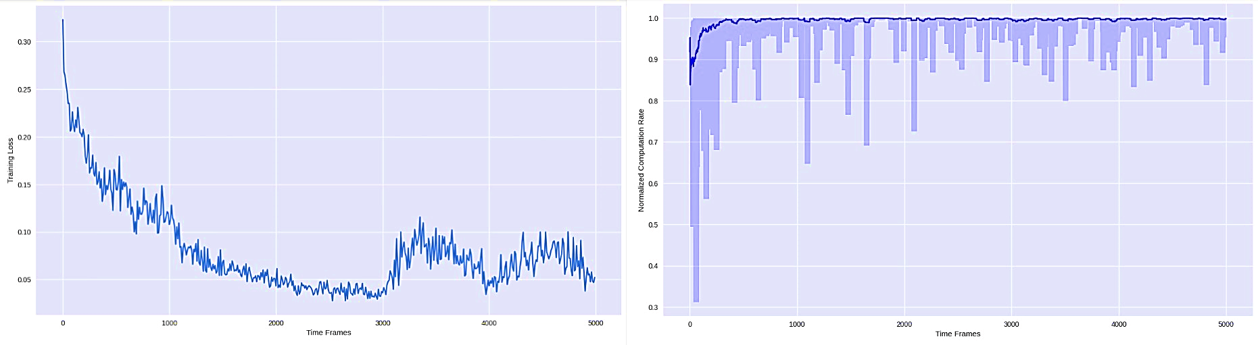
MDRO with KNN
RESULTS
Altering device weights from 1 to 1.5 causes a brief spike in training loss at t = 3000 and 4000, which then stabilizes; computation rates stay robust, consistently above 0.95, and average rates exceed 0.99 post 500 time frames.
Normalized computation rates and Training losses for MDRO with KNN
under alternating-weight WDs
CONTI…

Slide 36
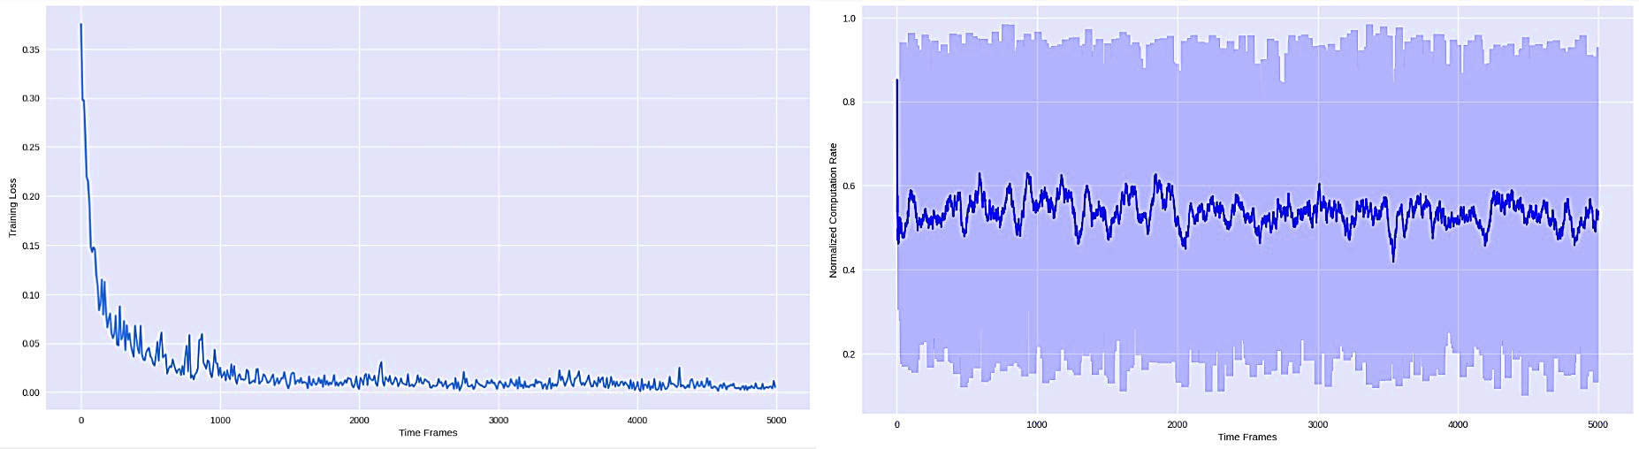
MDRO with RF
RESULTS
The MDRO algorithm with Random Forest under fading channel conditions demonstrates rapid convergence and low training loss, improving from 0.37 to 0.01, outperforming the KNN model with a lower computational rate
Normalized computation rates and Training losses for MDRO with RF under fading channels
CONTI…

Slide 37
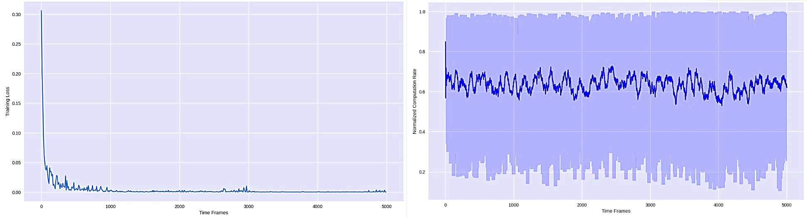
MDRO with RF
RESULTS
MDRO algorithm with Random Forest remains stable under On-Off wireless device conditions, showing optimal training loss unaffected by the dynamic network changes.
Normalized computation rates and Training losses for MDRO with RF under ON-OFF WDs
CONTI…

Slide 38
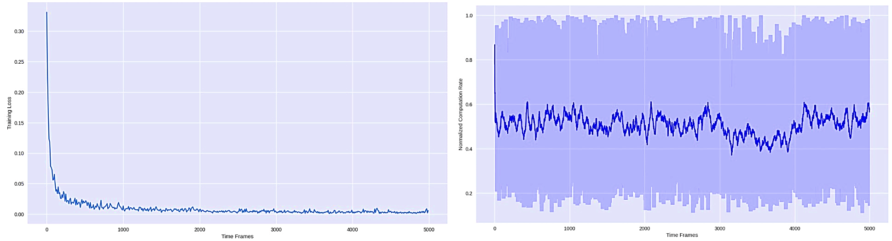
MDRO with RF
RESULTS
The MDRO algorithm with RF maintains steady training loss, even when weights of wireless devices fluctuate between 1 and 1.5, ensuring consistent performance.
Normalized computation rates and Training losses for MDRO with RF under alternating weight WDs

Slide 39
Why RF is better than KNN?
Convergence and Stability: RF achieves better convergence with a lower training loss that decreases more smoothly over time. For instance, under fading channel conditions, RF starts with a training loss of 0.37 and reaches as low as 0.01, indicating a stable and consistent improvement.
Efficiency with Lower Computational Rates: RF requires lower normalized computational rates to achieve better performance. This means that even with less computational resources, RF can provide a more efficient solution compared to KNN.
Resilience to Dynamic Conditions: Under On-Off wireless device conditions, RF maintains optimal training loss levels and shows a steady decrease over time frames, which suggests it is less affected by the intermittent activation and deactivation of devices within the network.

Slide 40
CONCLUSION
Both the algorithms were tested on the key performance metrices , notably training loss and normalized computation rate as training loss shows the ability to minimize errors and normalized computation rate provides the efficiency of the computation performed over time.
In summary, RF’s ability to maintain low training losses and achieve better stability and convergence with lower computational resources makes it a more robust choice for the MDRO algorithm in dynamic network environments compared to KNN.

Slide 41
REFERENCES:
L. Huang, S. Bi and Y. -J. A. Zhang, "Deep Reinforcement Learning for Online Computation Offloading in Wireless Powered Mobile-Edge Computing Networks," in IEEE Transactions on Mobile Computing, vol. 19, no. 11, pp. 2581-2593, 1 Nov. 2020, doi: 10.1109/TMC.2019.2928811.
Chen, Wenchao & Zhu, Bincheng & Chi, Kaikai & Zhang, Shubin. (2022). DRL based offloading of industrial IoT applications in wireless powered mobile edge computing. IET Communications. 16. 10.1049/cmu2.12397.
Mustafa, Ehzaz & Shuja, Junaid & Bilal, Kashif & Mustafa, Saad & Maqsood, Tahir & Rehman, Faisal & Khan, Atta ur Rehman. (2022). Reinforcement learning for intelligent online computation offloading in wireless powered edge networks. Cluster Computing. 26. 10.1007/s10586-022-03700-5.
T. Alfakih, M. M. Hassan, A. Gumaei, C. Savaglio and G. Fortino, "Task Offloading and Resource Allocation for Mobile Edge Computing by Deep Reinforcement Learning Based on SARSA," in IEEE Access, vol. 8, pp. 54074-54084, 2020, doi: 10.1109/ACCESS.2020.2981434
Y. Zhao, F. Hou, B. Lin and Y. Sun, "Joint Offloading and Resource Allocation With Diverse Battery Level Consideration in MEC System," in IEEE Transactions on Green Communications and Networking, vol. 7, no. 2, pp. 609-625, June 2023, doi: 10.1109/TGCN.2022.3232700..
Huang, Liang & Feng, Xu & Feng, Anqi & Huang, Yupin & Qian, Li Ping. (2022). Distributed Deep Learning-based Offloading for Mobile Edge Computing Networks. Mobile Networks and Applications. 27. 10.1007/s11036-018-1177-x.
Zhang, Ruidong & Zhang, Jiadong & Shi, Wenxiao. (2023). Partial offloading in device-to-device-assisted MEC network: A utility optimization approach. Computer Communications. 209. 10.1016/j.comcom.2023.06.022
R. Li, C. S. Lim, M. E. Rana and X. Zhou, "A Trade-Off Task-Offloading Scheme in Multi-User Multi-Task Mobile Edge Computing," in IEEE Access, vol. 10, pp. 129884-129898, 2022, doi:10.1109/ACCESS.2022.3228403.

Slide 42
Thank you

