Slide 1
Power BI Training Assignment
Sales Business Intelligence & Analytics Dashboard
Power BI Sales Intelligence Project
NAME – Pathuri Lakshmi Pradeepthi
ID - 2300031006
Notes:
Introduce yourself and the project: an end-to-end Power BI solution covering data preparation, modelling, DAX, dashboard design, insights and recommendations. Replace the Name | Roll No | Team line with your details.

Slide 2
Business Problem
1
2
3
What data was analyzed
Why sales analysis matters
What the dashboard answers
Sales transactions for 2021–2023 with product, customer, salesperson, location and date details, plus budget data.
It shows what drives revenue and profit, where performance is slipping, and where to focus effort and budget.
How are we performing against last year and budget? Which products, customers, people and regions matter most?
Notes:
Set the context: what was analyzed, why it matters to management, and what questions the dashboard helps answer.

Slide 3
Data Preparation in Power Query
Imported the different datasets
Created Fact_Sales
1
5
Inspected columns and data types
Handled data-quality issues
2
6
Removed unnecessary data
Prepared the data for analysis
3
7
Appended 2021, 2022 and 2023 sales
Result: a clean, analysis-ready model
4
Notes:
Walk through the Power Query steps in order. Mention specific data-quality issues you fixed (nulls, duplicates, data types, inconsistent names).

Slide 4
Data Model: Star Schema
Dim_Product
Dim_Date
Fact_Sales
Transaction data: sales, quantity, cost and keys.
Fact_Sales
Dimension tables
Dim_Customer
Dim_Location
Descriptive information: products, customers, locations, salespeople, dates.
Relationships
Dim_Salesperson
One-to-many links let filters flow from dimensions to facts for analysis.
Notes:
Show your Model view screenshot alongside or in place of this diagram. Explain why a star schema: simple, fast, and easy to filter.

Slide 5
DAX Measures
Total Sales
Total Orders
Exact measures used in the report
Total Sales = SUMX(Fact_Sales, Fact_Sales[Price] * Fact_Sales[Quantity])
Gross Profit = [Total Sales] - [Total Cost]
Gross Margin % = DIVIDE([Gross Profit], [Total Sales])
YTD Sales = TOTALYTD([Total Sales], Dim_Date[Date])
Budget = SUM(Budgeting[Monthly Allocation2])
Total Quantity Sold
Total Cost
Gross Profit
Gross Margin %
Average Order Value
YoY Growth %
YTD Sales
Budget Achievement %
DAX was used to build business KPIs and time-intelligence calculations such as YoY and YTD.
Notes:
Do not read every formula. Pick two or three and explain the logic. Replace the sample formulas with your exact measures and column names from the model.

Slide 6
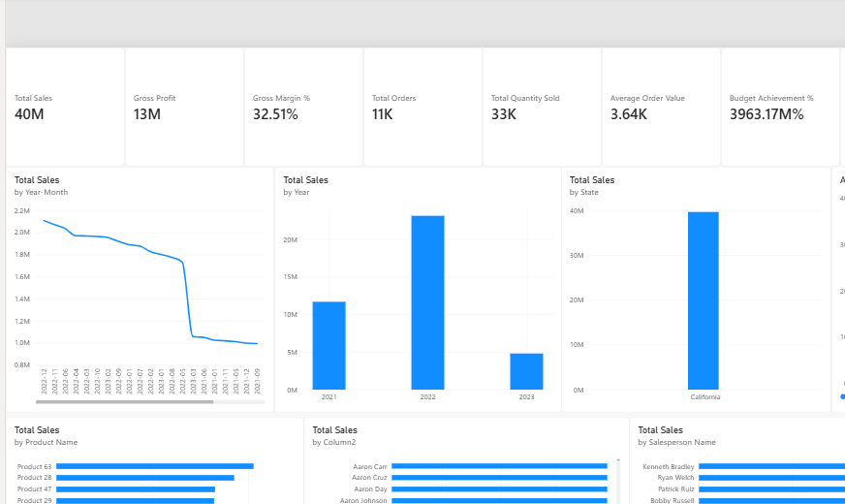
Dashboard Design
KPI cards at the top
Sales trend visualization
Year and state comparisons
Top products and customers
Top salespeople
Budget vs Actual
Seven report pages
Executive Overview
Sales Trend Analysis
Product Performance
Customer Analysis
Salesperson Performance
Geographic Analysis
Budget vs Actual
Notes:
Show the Executive Overview page and explain each component. Then briefly name the other six pages.

Slide 7
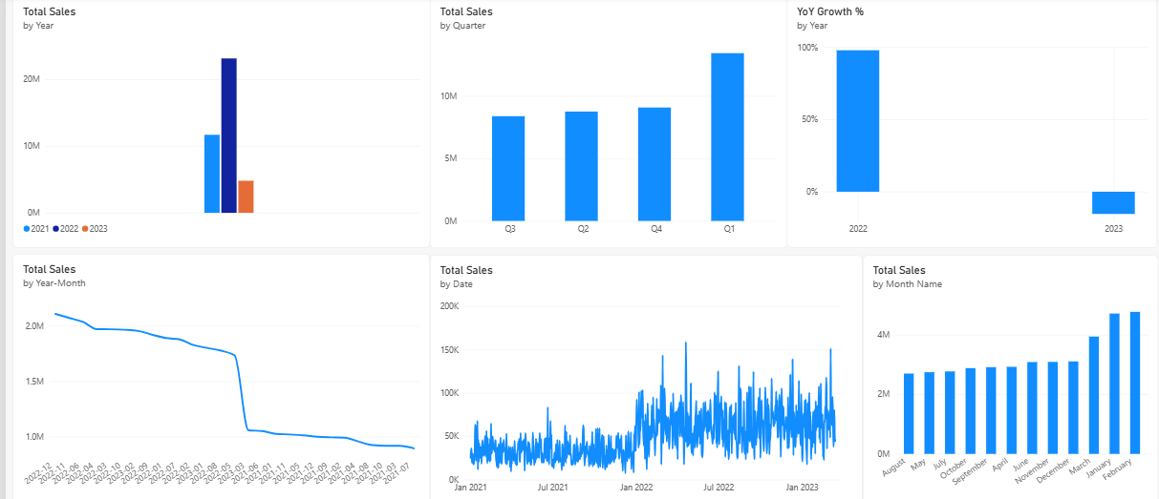
Sales & Trend Analysis
Yearly 2022 was the peak sales year
Quarterly Compare quarters to spot weak periods
Monthly Noticeable ups and downs through the period
Daily Drill down to find unusual days
YoY growth About -72.32%, a sharp decline
Seasonal patterns Plan promotions and stock around them
Notes:
Walk from yearly down to daily. Highlight that 2022 was the highest year and that YoY growth is sharply negative. Numbers to be confirmed after validation.

Slide 8
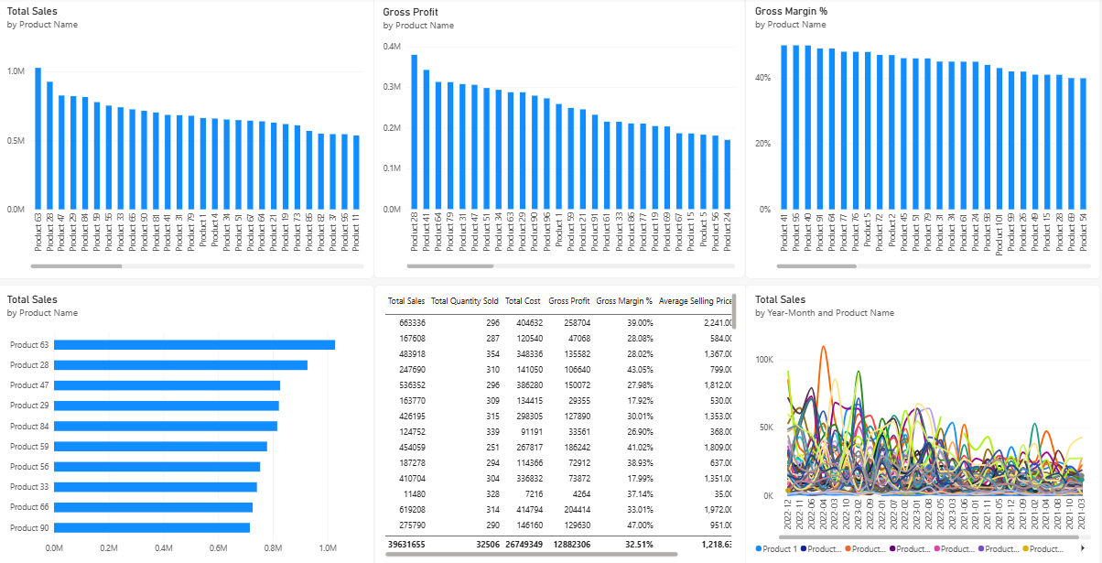
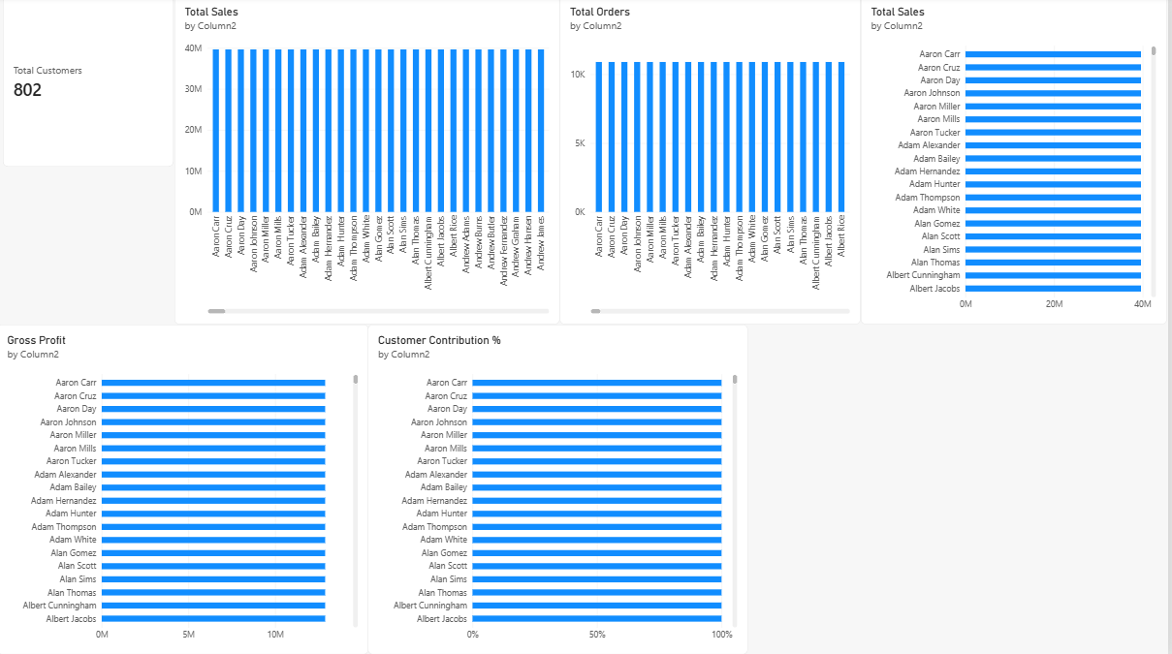
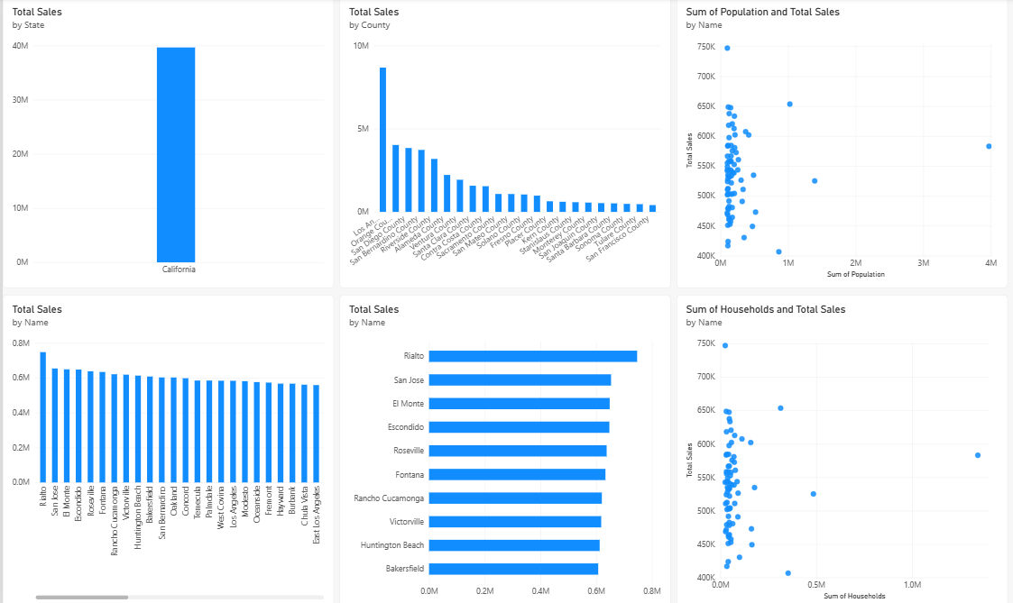
Product, Customer & Geographic Insights
Product Performance
Customer Analysis
Geographic Analysis
Top products by sales and profit
Reliance on a few key products
Weak products to review
Top customers by sales
Concentration risk
Who to prioritize for retention
Sales by state and location
Strong and weak regions
Where to target growth
Notes:
Choose one or two visuals per page and explain what management can investigate with slicers and drill-downs.

Slide 9
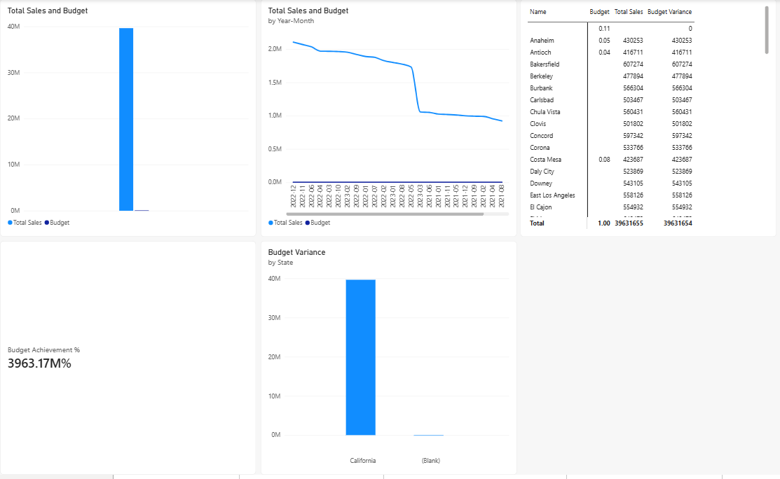
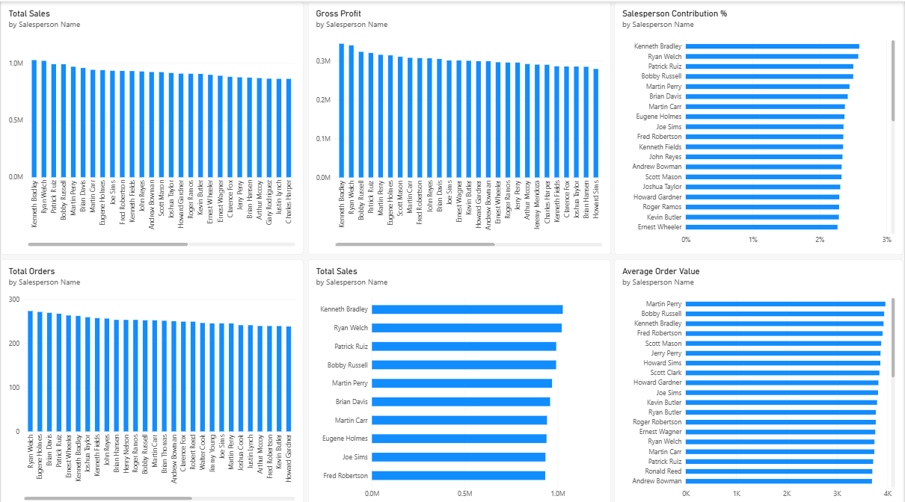
Salesperson & Budget Analysis
Salesperson Performance
Budget vs Actual
Validation note: the current report displays Budget Achievement at 3963.17%; validate the budget data/relationships before final submission.

Slide 10
Key Findings
~40M
32.51%
2022
-72.32%
11K | 33K
Total sales
Gross margin
Strongest year
YoY growth
Orders | Units
~13M gross profit
Gross margin
Sales fell after
Significant decline
Avg order ~3.64K
Small groups of products and customers drive a large share of sales.
Current figures; validate budget metrics before submission.
Notes:
Update every figure once the report is validated. The -72.32% YoY and the Budget Achievement value should be checked before presenting.

Slide 11
Business Problems & Recommendations
Top 5 Problems
Top 5 Recommendations
1
Sales decline
1
Investigate the sales decline
2
Budget calculation / data validation issue
2
Validate budget calculations
3
Product concentration
3
Focus on high-performing products
4
Customer concentration
4
Improve customer retention
5
Uneven sales performance
5
Improve monthly sales planning
Notes:
Pair each problem with its matching recommendation. Close by inviting questions.

