Slide 1
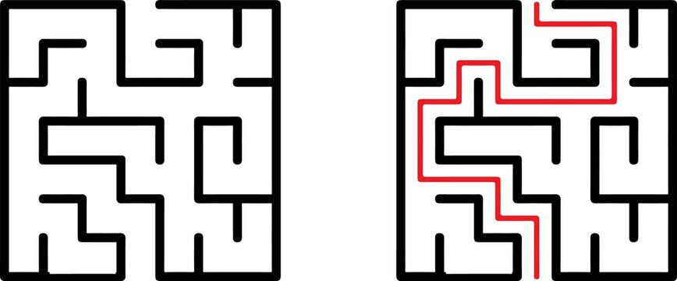
[ ]
Gray scale
array
……..
React JS
……..
Django
A*algorithm
Back Tracking
Decision Tree
……..
Input
(or)
Generated maze
paths
Output

