Slide 1

Microwave Oven Simulator using PIC16F877A
Embedded Systems Internship Project
Emertxe Information Technologies
Pradeep S
College of Engineering Guindy –AU

Slide 2
Overview
Project Title: Microwave Oven Simulator
Core Concept:
  Simulation of a fully functional microwave oven control system using PIC16F877A.
  Focuses on replicating user interface workflows, timing, and load control.
Key Features:
  Modes: Micro, Grill, Convection, Start.
  Interface: 4x4 Matrix Keypad, 16x4 CLCD.
  Timing: Interrupt-based accurate countdown timer.
  Safety: Door status simulation and safe mode transitions.

Slide 3
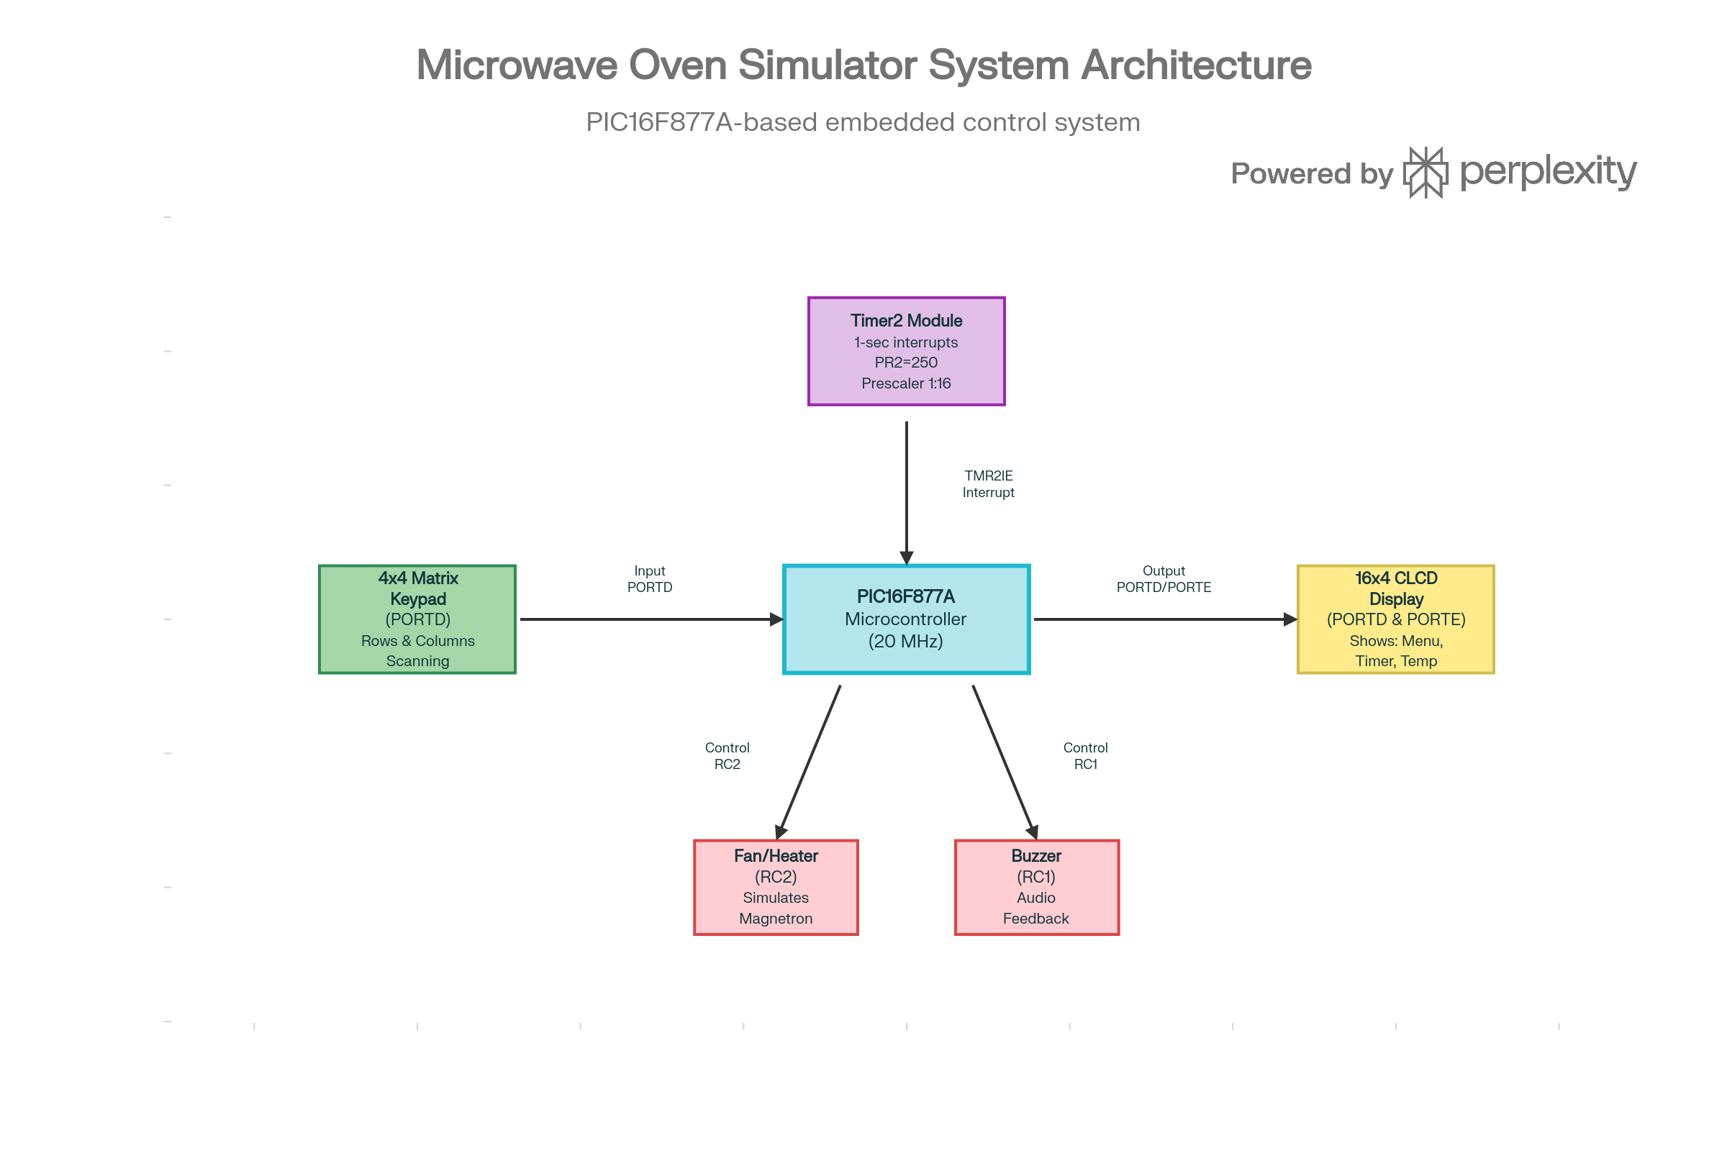

Slide 4
Goals of Internship
Primary Objective:
  Bridge gap between academic theory and industry-standard embedded development.
Learning Outcomes:
  Microcontroller Architecture: In-depth understanding of PIC16F877A.
  Embedded C Programming: Mastery of bitwise operations and register manipulation.
  Peripheral Interfacing: GPIO, Timers, Interrupts, LCDs, Keypads.
  State Machine Design: Implementing FSM for complex control logic.
  Debugging: Using MPLAB X IDE and simulators.

Slide 5
Brief about Embedded Systems
Definition:
  Computing system dedicated to a specific function within a larger system.
Characteristics:
  Specific Purpose: Designed for a singular task.
  Resource Constrained: Limited RAM/Flash/Processing power.
  Reliability: Expected to run continuously.
  Real-Time: Strict timing deadlines (hard or soft real-time).
Relevance:
  Automotive, Consumer Electronics, Medical Devices, Industrial Automation.

Slide 6
Project Brief & Requirements
Functional Requirements:
  1. Power On: Welcome screen and initialization.
  2. Menu System: Select between Micro, Grill, Convection, Start.
  3. Input Handling: Matrix Keypad (0-9, *, #).
  4. Display: Show mode, time, temperature on CLCD.
  5. Load Control: Relay/Fan status (simulate heating).
  6. Alerts: Buzzer notification on completion.
Non-Functional Requirements:
  Responsiveness, Accuracy (Timer), Usability.

Slide 7
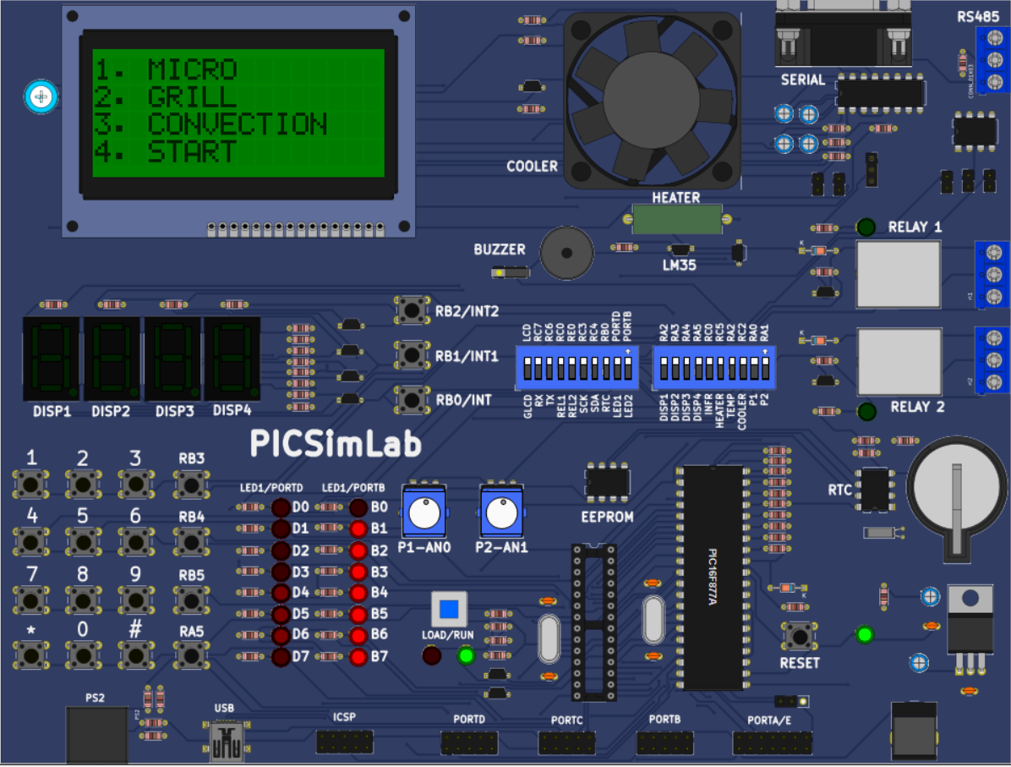

Slide 8
System Design
Controller: PIC16F877A (20 MHz)
Input: 4x4 Matrix Keypad (PORTD)
  Rows and Columns scanning.
Output: 16x4 CLCD (PORTD & PORTE)
  Displays Menus, Timer, Temperature.
Actuators:
  Fan/Heater (RC2): Simulates Magnetron.
  Buzzer (RC1): Audio feedback.
Timer Module:
  Timer2 used for 1-second interrupts.

Slide 9
Hardware & Simulation Environment
Board/Simulator:
  PICGenios Development Board / Proteus / PiximLab.
  MCU: PIC16F877A (40-pin DIP).
Key Hardware Specs:
  GPIO: Digital I/O for Keypad and LCD.
  Timers: Timer2 (8-bit) with Prescaler/Postscaler.
  Interrupts: TMR2IE for non-blocking timing.

Slide 10
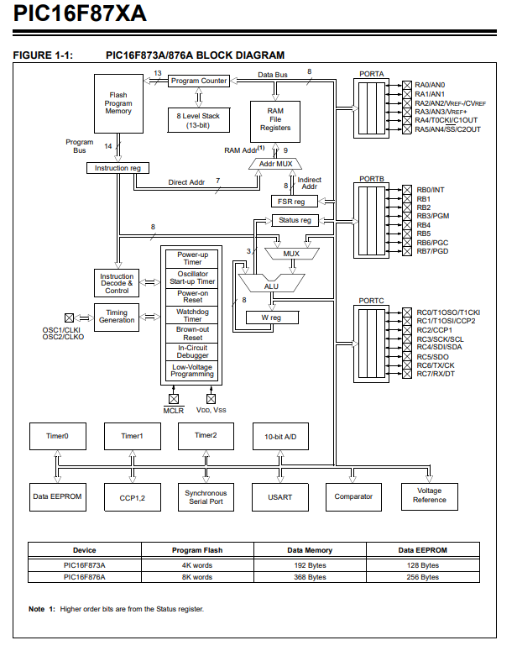

Slide 11

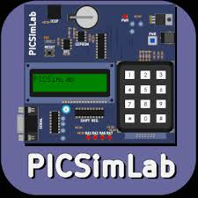

Development Process & Tools
Software Tools:
  MPLAB X IDE: Development Environment.
  XC8 Compiler: C Compiler for PIC.
  Simulators: For logic testing.
Development Workflow:
  1. Requirement Analysis.
  2. Driver Development (LCD, Keypad).
  3. Logic Implementation (FSM).
  4. Integration.
  5. Testing & Tuning (Timer calibration).

Slide 12
Implementation Details - State Machine
Finite State Machine (FSM):
  Manages system complexity and mode sets.
States:
  MAIN_MENU: Waiting for selection.
  MICRO/GRILL/CONVECTION: Configuration.
  TIME_DISPLAY: Active cooking state.
  PAUSE/STOP: Control states.
Logic:
  Switch-case structure processing 'state' variable.
  Transitions triggered by keypad input.

Slide 13
Implementation Details - Timer Logic
Challenge: keeping accurate time + responsive UI.
Solution: Interrupt Service Routine (ISR).
Mechanism:
  Timer2 overflows every few ms.
  ISR increments a counter.
  At calibrated count, 'seconds' variable decrements.
Calibration:
  PR2=250, Prescaler=1:16.
  Counter calibrated to 450 (empirically derived) for 1s accuracy.
Fosc = 20 MHz
Instruction Clock: Finst = Fosc / 4 -> 5 MHz
Instruction Cycle Time: Tinst = 1 / Finst -> 0.2 µs
Prescaler Selected: Prescaler = 1 : 16
Ttick = Tinst × Prescaler -> 3.2 µs
Toverflow = (PR2 + 1) × Ttick -> 800 µs

Slide 14
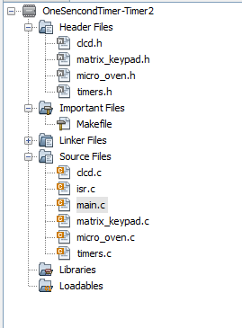
Modular Project Structure
main.c: Entry point, Super Loop, FSM.
micro_oven.c: App specific screens/logic.
isr.c: Interrupt handling (Timer).
timers.c: Timer hardware config.
clcd.c: LCD Driver.
matrix_keypad.c: Keypad Driver.

Slide 15
Conclusion & Future Scope
Conclusion:
  Successfully designed/simulated Microwave system.
  Achieved accurate timing and responsive UI.
  Demonstrated proficiency in Embedded C.
Future Scope:
  PWM Control for variable power.
  EEPROM for saving custom programs.
  Sensor integration (LM35) for temp control.
  Hardware implementation on PCB.

