Slide 1
Version Control

Slide 2
What is Version Control?
Manages file sharing for
Concurrent Development
Keeps track of changes with
Version Control
SubVersion (SVN) http://subversion.tigris.org/
is a version control system

Slide 3
Concurrent Development
Server holds all original files of a project
Gives out copies to participants (clients)
Participants modify their copies
Submit their changes to server
Automatically merges changes into original files. Huge!
Conflicts only occur when modifications are done
  by more then one participant
  at the same location in their respective copies.
  Then participants have to manually resolve such conflicts. Rare!
Powerful edit and merge tools help make this task easy

Slide 4
Version Control
SVN keeps log of any changes made to any file. Ever!
Also keeps copies of those changes. For ever!
Participants can go back and receive older versions of a file
or even an older version of an entire project state
Example:
The current version number of our project in SVN is #5
In the future you can always load the project exactly as it is today by requesting project version #5; et voila you can run an age old demo!

Slide 5
How to use SVN (in a nutshell)
Checkout:
receives a copy of an entire project from the SVN server
(source files, project & make files, resource files, etc.)
Update:
receives copies of individual files or folders on the server
and merges them with your current copy (locally)
Commit:
sends an updated file (your local copy) to the SVN server where it is incorporated into the original project database;
a new version number is assigned not the entire project
Add:
notifies SVN of a new file or folder that needs to be added to the existing project (only if SVN is aware of a file, can you commit the file)

Slide 6
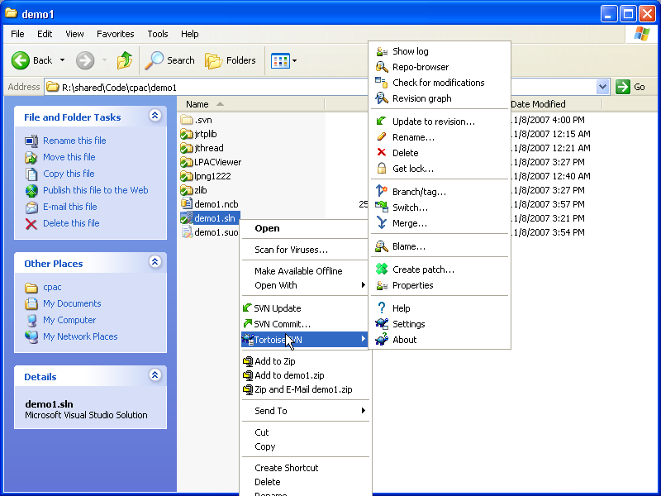

Slide 7
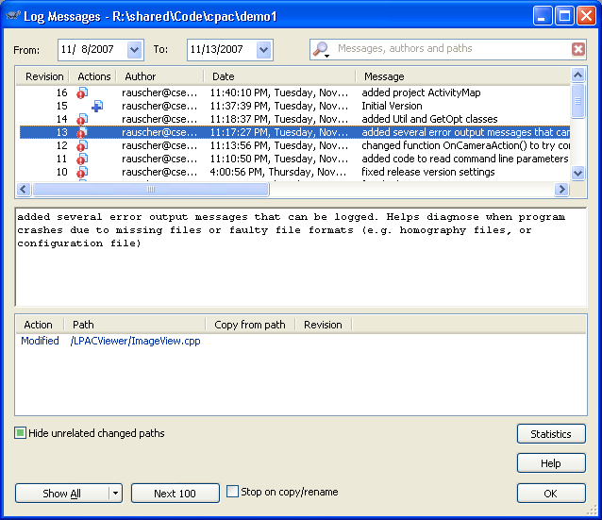

Slide 8
Further Considerations
before doing a commit
you MUST do an UPDATE (and resolve any possible conflicts) BEFORE you COMMIT your copy
to add a new file or folder
you need to use ADD and then COMMIT
if you want to get rid of a file,
you need to delete it in your local folder
and then COMMIT the folder

Slide 9
Further Considerations (cont.)
Make sure to UPDATE REGULARLY
otherwise you will have lots of conflicts
SVN will not help you
if you do not COMMIT REGULARLY
If you add lots of new stuff,
make sure to COMMIT EVERYTING

Slide 10
SVN vs. CVS
Functional replacement for CVS
Directory versioning (renames and moves)
Atomic commits (all or nothing)
Faster network access (binary diffs)
Requires less network access

