Slide 1
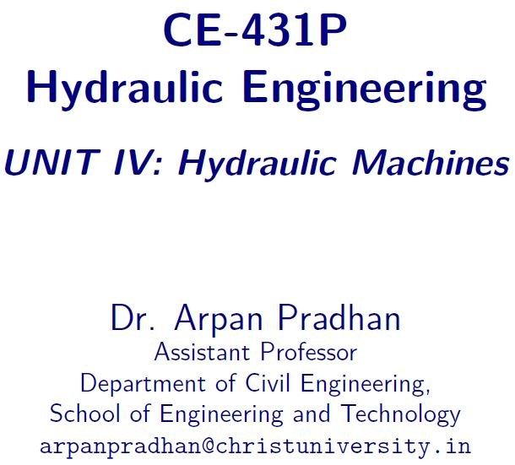

Slide 2
Contents
Hydraulic Machines
Turbines
Classification of Turbines

Slide 3
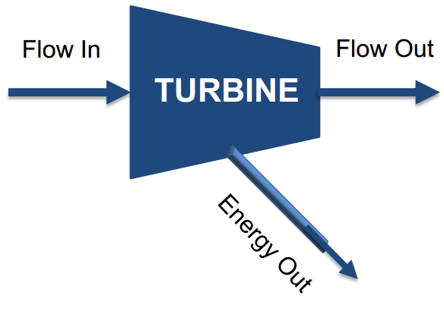
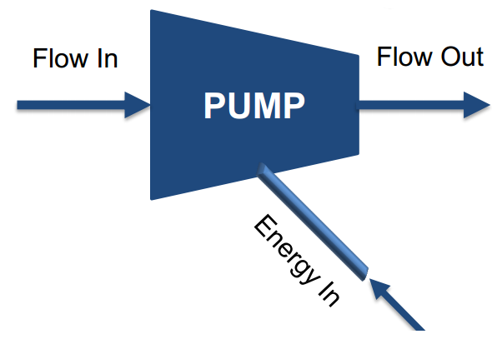
Hydraulic machines
Hydraulic machines, are defined as those machines which convert either;
Hydraulic Energy (energy possessed by water) into Mechanical Energy – further converted into Electrical Energy
- TURBINES
Mechanical Energy into Hydraulic Energy
- PUMPS

Slide 4
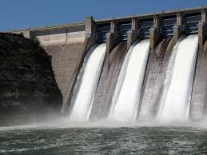
Hydraulic energy
Hydraulic Energy is what is produced by the water which is stored in Reservoirs and Lakes at a High Altitude (so that it has Gravitational Potential Energy)

Slide 5
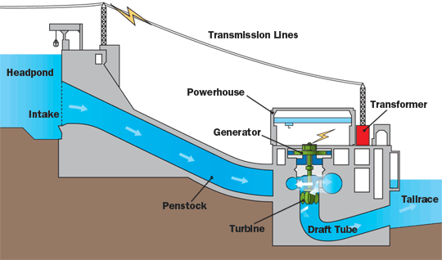
turbines
Hydroelectric Power Plant

Slide 6
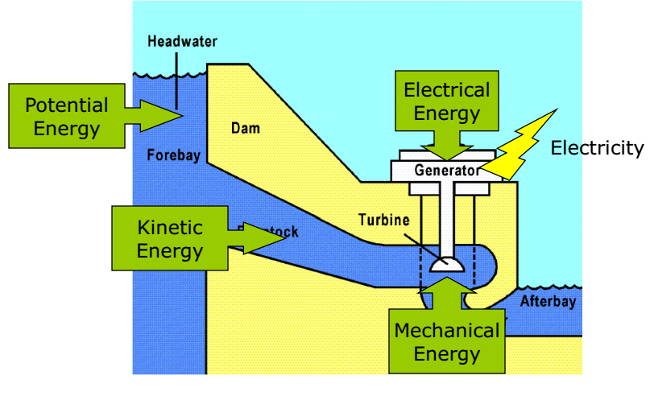
turbines
Hydroelectric Power Plant

Slide 7
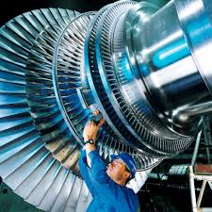
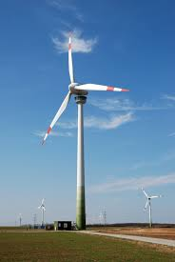
turbines
A Turbine is a Rotary Mechanical Device that extracts Energy from a Fluid Flow and Converts it into useful work.
Has at least one set of Moving Blades attached to a Shaft called the Rotor assembly.

Slide 8
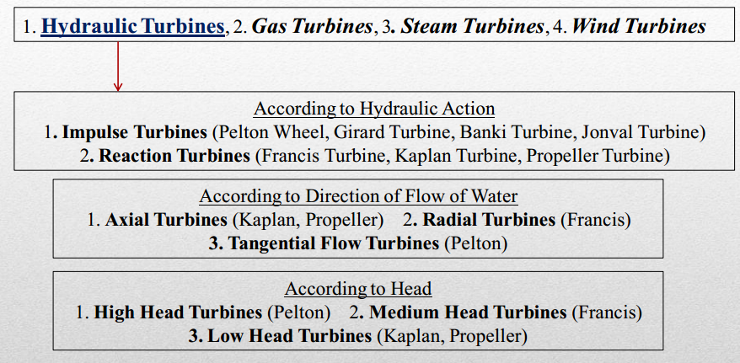
Turbine - classification

Slide 9
Impulse turbine
Impulse Turbine is a turbine which is driven by the Impulse of Water.
  In case of an impulse turbine water from the dam flows through a pipeline.
  After passing a guide mechanism it comes out through a nozzle.
  All the Energy of water is converted into Kinetic Energy.
  Water in the form of a jet from nozzle impinges on the buckets fixed to the outer periphery of a running wheel.
  After coming out of buckets water flows with a low velocity.
  The Pressure of water both at Entering and Leaving the buckets is Atmospheric.

Slide 10
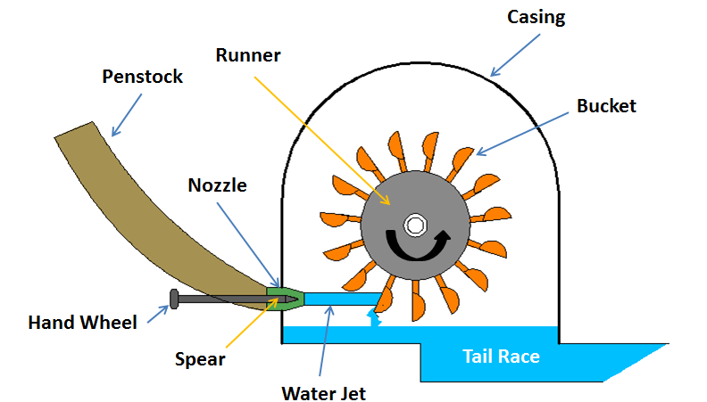

Slide 11
reaction turbine
A Reaction Turbine is a turbine into which water enters with High Pressure and flows over Curved Blades.
  A part of Pressure Head is converted into Kinetic Energy and the remaining part remains as Pressure Head.
  The Reaction Pressure is responsible for the motion of the Runner.
  The Difference of Pressure between Inlet and Outlet point is known as Reaction Pressure.
  The entire Water Passage remains totally Enclosed.

Slide 12
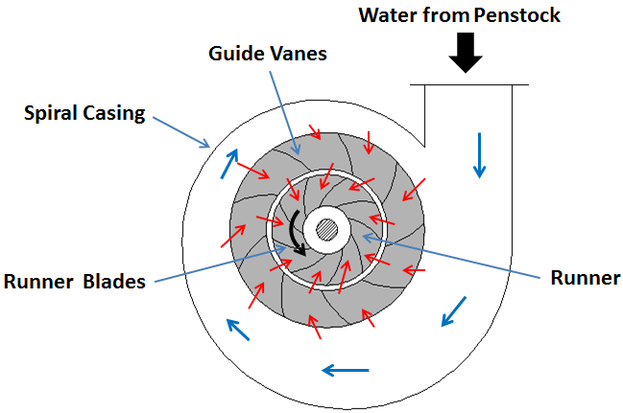
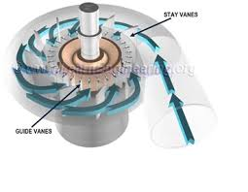
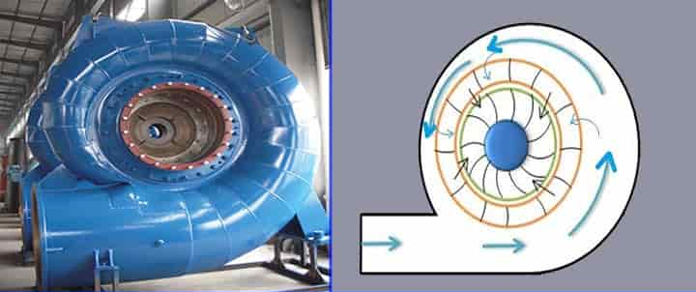

Slide 13
Impulse and reaction turbine

Slide 14
Impulse and reaction turbine
1. Conversion of Fluid Energy
Impulse turbine: Fluid energy is converted into KE by a Nozzle
Reaction Turbine: Fluid energy is partly transformed into KE, before it enters the runner of the turbine.
2. Changes in Pressure and Velocity
Impulse Turbine: Pressure remains same
Reaction Turbine: Pressure and Velocity changes while passing through runner
3. Admittance of Water over the Wheel
Impulse Turbine: Enters a part or whole of the wheel circumference
Reaction Turbine: Water enters over the wheel circumference

Slide 15
Impulse and reaction turbine
4. Installation
Impulse Turbine: Above the Tail Race, No Draft Tubes
Reaction Turbine: Above or below Tail Race, Draft tubes required.
5. Flow Regulation
Impulse Turbine: By a Needle valve
Reaction Turbine: Guide vane assembly

Slide 16
Turbine - classification

Slide 17
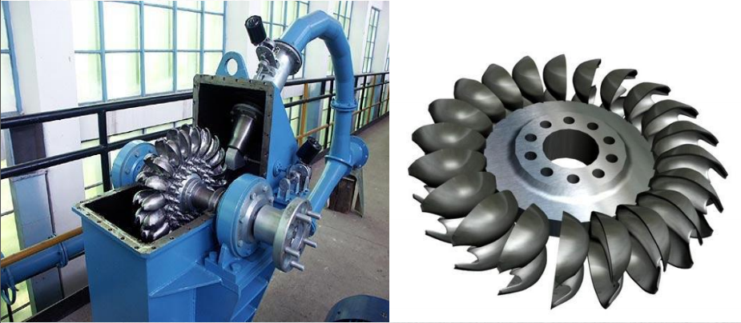
Turbine – impulse – Pelton wheel

Slide 18
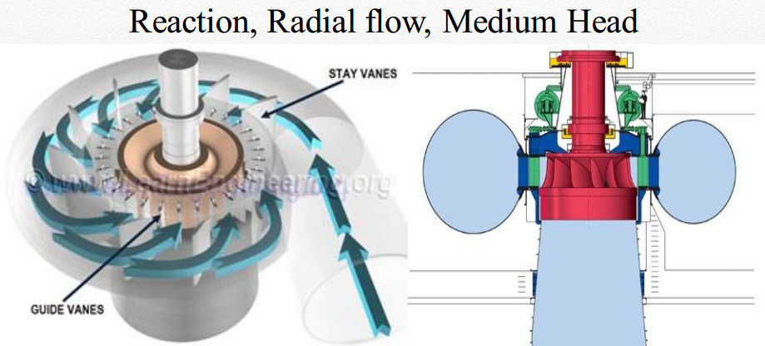
Turbine – reaction – francis turbine

Slide 19
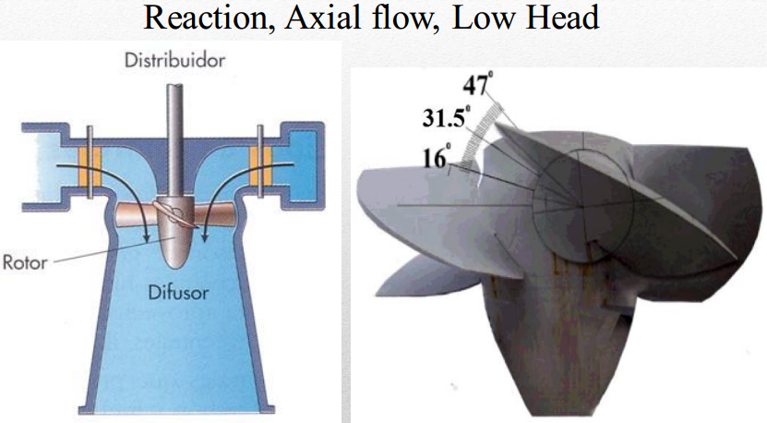
Turbine – reaction – kaplan turbine

Slide 20
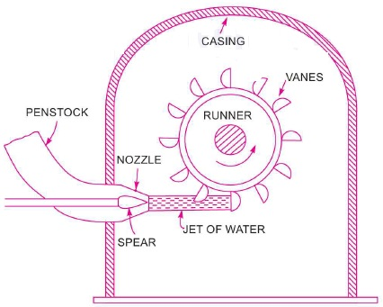
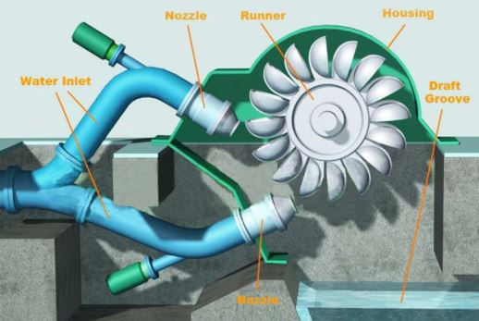
Turbine – impulse – Pelton wheel
Nozzles direct Forceful, High-Speed streams of water against a Rotary Series of spoon-shaped buckets mounted on the rim of a wheel.
The water jet’s Momentum is transferred to the wheel and then to a turbine. Thus, impulse energy does work on the turbine.
Used for High Head, Low Flow-Rate.

Slide 21
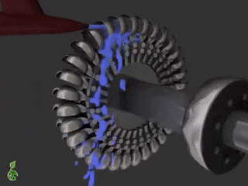
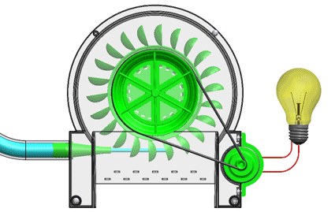

Slide 22
Pelton wheel
Nozzle and Flow Regulating Arrangement
Runner with Buckets
Casing
Breaking Jet

Slide 23
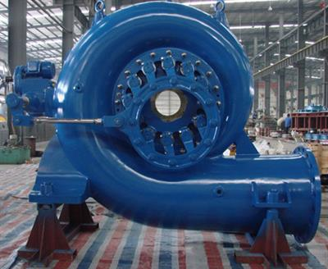
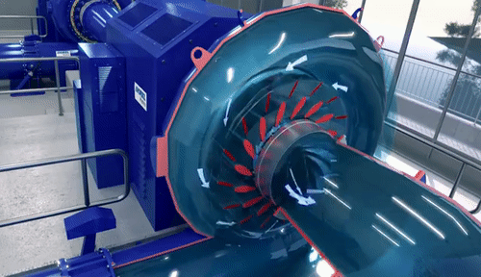
Turbine – reaction – francis turbine
Francis Turbine is an Inward Flow Reaction Turbine where the water under the pressure enters the runner from the guide vanes towards the Centre in Radial Direction and Discharges out of the runner Axially.
Used for Medium Head and Medium Flow Rates.

Slide 24
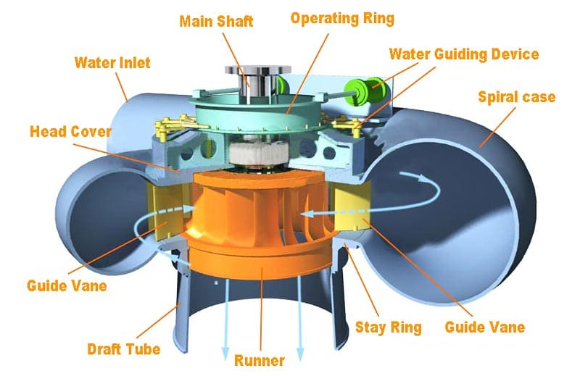

Slide 25
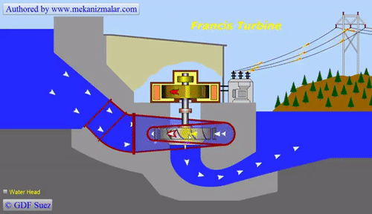

Slide 26
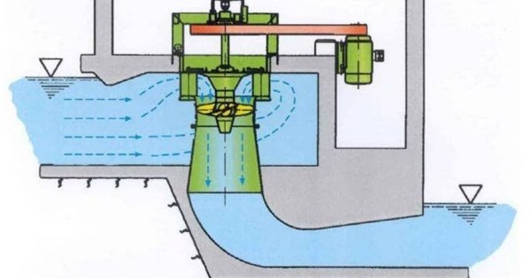
Turbine – reaction – kaplan turbine
Kaplan turbine is an evolution of the Francis turbine. It is a Propeller-Type Water Turbine which has adjustable blades.
Since the Radial distance from the Axis at the Inlet and Outlet is same, the Peripheral Velocity is Constant.
Used for Low Heads and High Flow-Rates.

Slide 27
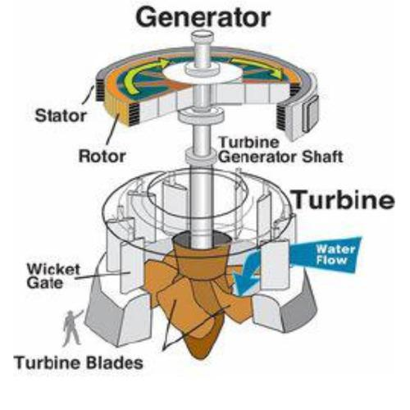

Slide 28
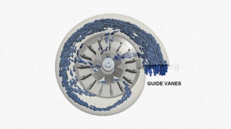

Slide 29
Turbine - classification

Slide 30
Turbine - classification
According to the Energy used
  Impulse turbine
  Reaction turbine
Direction of water flow
  Axial flow - Radial in axial out
  Inward flow - Outward flow
According to the Head available to the inlet of turbine
  High Head Turbine (250-1800m), Pelton Wheel
  Medium Head Turbine (50-250m), Francis Turbine
  Low Head Turbine ( <50m), Kaplan Turbine

Slide 31
Turbine - classification
According to the Specific Speed
  Low specific speed ( <50) Pelton wheel
  Medium specific speed (50 < Ns < 250) Francis
  High Specific speed ( >250) Kaplan
According to the Fluid used
  Water Turbine (Pelton Wheel, Francis Turbine, Kaplan Turbine)
  Gas Turbine
  Steam Turbine

Slide 32
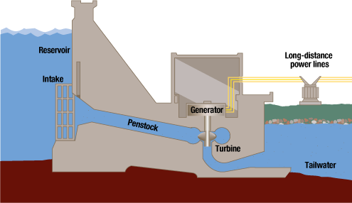

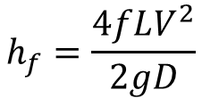
head
GROSS HEAD, H_{g}
  The difference between the Head Race Level and Tail Race Level, when no water is flowing.
NET HEAD, h_{f}
  Net Head is also called Effective Head and is defined as the Head available at the Inlet of the Turbine.
  When Water flows from Head Race to the Turbine, a Loss of Head due to Friction between Water and Penstock occurs, h_{f}
$$H=H_{g}−h_{f}$$
$$h_{f}=\frac{4fLV^{2}}{2gD}$$

Slide 33


Efficiencies of a Turbine
Hydraulic Efficiency, η_{h}
  It is defined as the Ratio of Power given by water to the Runner of the Turbine; to the Power supplied by the water at the Inlet of the Turbine.
  Power at the Inlet of the Turbine is more and this Power goes on Decreasing as the Water flows over the Vanes of the Turbine due to Hydraulic Losses as the Vanes are not smooth.
$$η_{h}=\frac{Power delivered by the Water to the Runner}{Power Supplied at the Inlet of Turbine}=\frac{R.P}{W.P}$$
$$W.P.=Water Power, Power supplied at the Inlet of the Turbine$$
$W.P.=\frac{WH}{1000}$kW
$W.P.=\frac{ρgQH}{1000}$kW
  W = Weight of Water Striking the Vanes of the Turbine per second

Slide 34
Efficiencies of a Turbine
Mechanical Efficiency, η_{m}
  It is defined as the Ratio of Power available at the Shaft of the Turbine; to the Power delivered to the Runner of the Turbine.
$$η_{m}=\frac{Power at the Shaft of the Turbine}{Power delivered by the Water to the Runner}=\frac{S.P}{R.P}$$

Slide 35
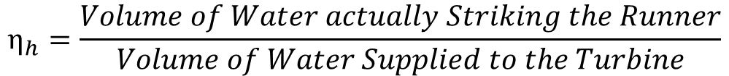
Efficiencies of a Turbine
Volumetric Efficiency, η_{V}
  It is defined as the Ratio of Volume of water striking the Runner of the Turbine; to the Volume of water supplied to the Turbine.
$$η_{h}=\frac{Volume of Water actually Striking the Runner}{Volume of Water Supplied to the Turbine}$$

Slide 36
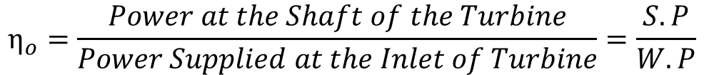
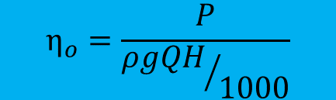



Efficiencies of a Turbine
Overall Efficiency, η_{o}
  It is defined as the Ratio of Power available at the Shaft of the Turbine; to the Power supplied by the water at the Inlet of the Turbine.
$$η_{o}=\frac{Power at the Shaft of the Turbine}{Power Supplied at the Inlet of Turbine}=\frac{S.P}{W.P}$$
$$η_{o}=\frac{S.P}{W.P}=\frac{S.P}{W.P} \frac{R.P}{R.P}=\frac{S.P}{R.P} \frac{R.P}{W.P}$$
$$η_{o}=η_{m}η_{h}$$
$W.P.=\frac{ρgQH}{1000}$kW
$$η_{o}=\frac{P}{{ρgQH}/{1000}}$$

Slide 37
Pelton wheel
Nozzles direct Forceful, High-Speed streams of water against a Rotary Series of spoon-shaped buckets mounted on the rim of a wheel.
The water jet’s Momentum is transferred to the wheel and then to a turbine. Thus, impulse energy does work on the turbine.
Used for High Head, Low Flow-Rate.

Slide 38
Pelton wheel
Nozzle and Flow Regulating Arrangement
Runner with Buckets
Casing
Breaking Jet

Slide 39
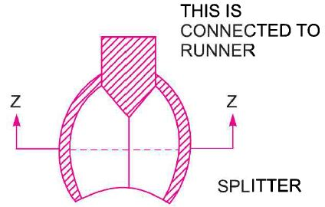
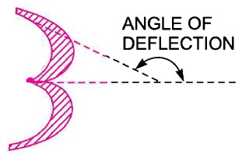
Pelton wheel – velocity triangles and work done

Slide 40
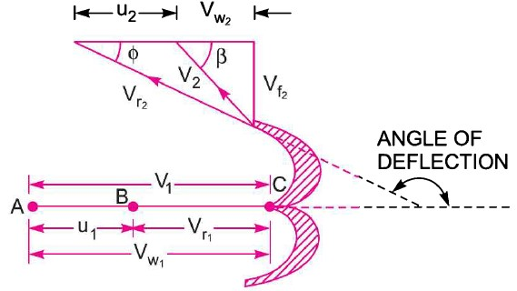
velocity triangles and work done
V → Absolute Velocity of Jet
u → Absolute Velocity of Bucket
V_{r} → Relative Velocity of Jet
V_{w} → Velocity of Whirl
V_{f} → Velocity of Flow

Slide 41
velocity triangles and work done - Pelton wheel
V₁ → Absolute Velocity of Jet before striking the bucket
V₂ → Absolute Velocity of Jet leaving the bucket
u₁ → Absolute Velocity of Bucket at Inlet
u₂ → Absolute Velocity of Bucket at Outlet
V_{r1} → Relative Velocity of Incoming Jet
V_{r2} → Relative Velocity of Jet Leaving the Bucket
V_{w 1,2} → Velocity of Whirl at Inlet and Outlet
V_{f 1,2} → Velocity of Flow at Inlet and Outlet

Slide 42
velocity triangles and work done - Pelton wheel

Slide 43


