Slide 1
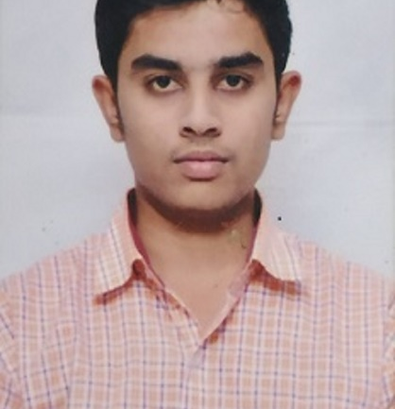

Pradhnyesh Deshpande
Bachelor of Engineering, Civil Engineering: 2018-2022
Analyst/Software Engineer
I Transform L&D Left shift batch
Skills
C# | Basics, OOPS, Exception Handling ,Arrays ,Collection and Generics, Events and File Io.
.NET Framework | ASP.NET with MVC5 and WEB API,Entity Framework
Database | SQL
Tools | GIT
UI Technology | HTML5 ,CSS, Typescript, Angular
Add On Skills | Communication Skills, Team Management.
Bangalore
pradhnyesh.deshpande@capgemini.com
+91 8007826061, 8975475530
A4
Full Stack Developer
Understanding of RDMS concepts using SQL Server.
Practical understanding of C# and SQL concepts using Visual Studio and SQL Server
Hands on experience in developing applications using .NET Framework, Entity Framework.
Understanding of HTML5 , CSS and Angular Cli.
Full Stack developer with Angular and .NET.
Completed case study on Online Shopping Cart which is a Web based application where user can login search product and add the product to the cart and order the product. And the admin is able to sell the product to customers online.
Technologies used:
ANGULAR
ASP.NET CORE Web API
Microsoft SQL Server
Video Link : Click

