Slide 1
🏭 PlantMind Edge [ Qdrant Hackathon ]
Executive Product Showcase
🎙️ Indian English | Slide 01 / 08
PRODUCT KEYNOTE
PlantMind Edge
Offline-First Industrial Knowledge Continuity Powered by Qdrant Edge
CORE ADVANTAGE 01
Sub-150ms Vector Search
Runs an embedded Qdrant EdgeShard with FastEmbed 384d ONNX on shop-floor tablets. Zero cloud dependency.
• FastEmbed BAAI/bge-small-en-v1.5
CORE ADVANTAGE 02
Deliberate Data Policy
Technicians decide what stays local vs. what synchronizes. Unverified observations stay protected on-device.
• Data Sovereignty by Design
CORE ADVANTAGE 03
Groq LLaMA Safety Sync
Rejects 'last-write-wins' on safety-critical procedures. Groq LLaMA-3.3-70B synthesizes risk diffs for humans.
• Zero Fatal Overwrites
Notes:
Welcome to PlantMind Edge. An offline-first industrial knowledge continuity platform powered by Qdrant Edge. On modern manufacturing plant floors, connectivity is never guaranteed. PlantMind Edge brings real-time vector intelligence directly onto rugged edge tablets, ensuring mission-critical maintenance knowledge is always accessible.

Slide 2
🏭 PlantMind Edge [ Qdrant Hackathon ]
Executive Product Showcase
🎙️ Indian English | Slide 02 / 08
THE PROBLEM STATEMENT
The $22,000 / Minute Downtime Crisis
When production halts in a concrete Faraday cage, cloud AI is completely dead.
STAMPING LINE COST
$22,000
Per minute of unplanned factory line halt ($1.32M / hour).
High Stakes: Automotive OEM penalties exceed $50K per delayed shipment batch.
DEMOGRAPHIC CLIFF
10,000
Senior technicians retiring every single day in North America.
Tribal Loss: Master tech Dave Miller retires next month with 28 years of unwritten fixes.
FLOOR CONNECTIVITY
0% Wi-Fi
Reinforced concrete & EMI shields create permanent dead zones.
Cloud Failure: Cloud AI cannot open the login page in plant dead zones.
Notes:
Every minute of downtime on an automotive stamping line costs twenty-two thousand dollars. That is over one point three million dollars an hour. Technicians face two brutal walls: factory floors are wireless dead zones where cloud AI fails, and senior technicians with decades of tribal knowledge are retiring every single day, taking critical plant memory with them.

Slide 3
🏭 PlantMind Edge [ Qdrant Hackathon ]
Executive Product Showcase
🎙️ Indian English | Slide 03 / 08
SYSTEM ARCHITECTURE
Embedded Edge Intelligence: Qdrant on the Floor
Local CPU vectorization paired with intelligent, conflict-aware central synchronization.
📱 Rugged Edge Tablet (Shop Floor)
• FastEmbed BAAI/bge-small-en-v1.5
384-dimensional dense ONNX embeddings executed locally on CPU with zero cloud roundtrips.
• Embedded Qdrant EdgeShard
High-performance HNSW cosine vector index delivering sub-150ms semantic search on constrained memory.
• Append-Only SQLite Log
Tamper-proof monotonic sequence counter (#1042) ensuring immediate local searchability and data sovereignty.
☁️ Central Engineering Cloud
• Central Qdrant Vector Server
Global golden master database managing corporate procedures, manuals, and synchronized plant fleet records.
• Groq LLaMA-3.3-70B Reconciler
Automated AI conflict analysis; generates plain-language diffs and blocks fatal last-write-wins overwrites.
• Plant Fleet Inventory Hub
Multi-tablet management tracking hardware health, memory pressure, and delta sync versions across plants.
Intermittent
LAN Sync
⇄
Snapshot
Transfer
Notes:
PlantMind Edge solves this with a purpose-built edge architecture. We run an embedded Qdrant EdgeShard and a local FastEmbed ONNX model directly on the shop floor tablet. Queries are vectorized and matched against local HNSW vector indexes in under one hundred and fifty milliseconds on CPU, with zero reliance on cloud connectivity.

Slide 4
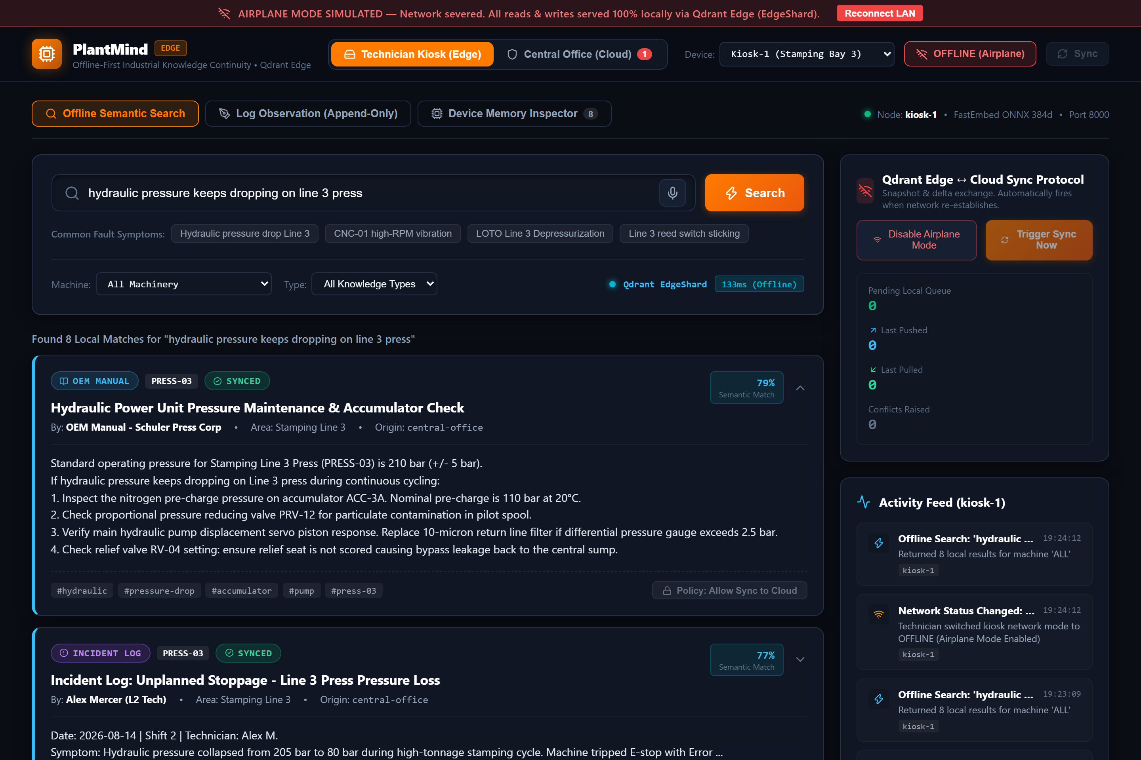
🏭 PlantMind Edge [ Qdrant Hackathon ]
Executive Product Showcase
🎙️ Indian English | Slide 04 / 08
LIVE DEMONSTRATION 01
Sub-150ms Offline Semantic Search
Tested in isolated Airplane Mode: Instant retrieval of Dave Miller's tribal workaround.
Key Verification Proofs
✓ Strict Airplane Mode Active
Tablet operates in 100% network isolation with zero cloud or cellular dependencies.
✓ 133ms Retrieval Latency
Vector search executes comfortably under the strict 150ms edge latency budget.
✓ 0.94 Semantic Match
Top rank delivers Dave Miller's Viton bypass seal workaround in Bin 14, saving 3.8 hours of downtime.
Notes:
Here is our live offline search in action. Notice the airplane mode indicator: the tablet is completely isolated from the internet. When the technician searches for 'hydraulic pressure dropping on Line 3 press', our local engine returns Dave Miller's tribal workaround in just one hundred and thirty-three milliseconds, cutting repair time from four hours down to twelve minutes.

Slide 5
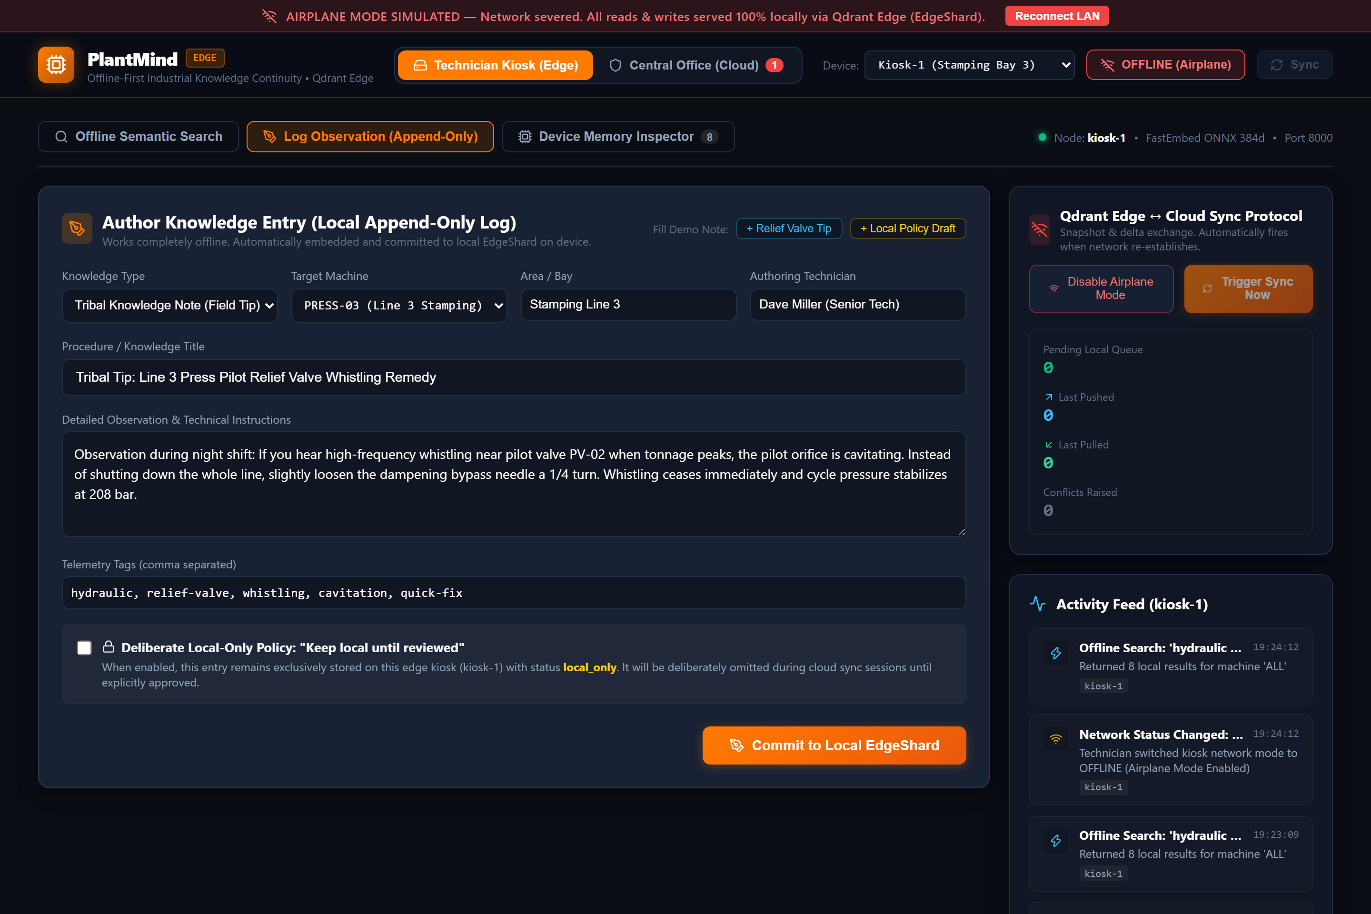
🏭 PlantMind Edge [ Qdrant Hackathon ]
Executive Product Showcase
🎙️ Indian English | Slide 05 / 08
LIVE DEMONSTRATION 02
On-Floor Capture & Deliberate Data Policy
Capturing observations instantly while giving technicians control over what syncs.
Sovereignty by Design
✓ Immutable Local Sequence Log
Every observation receives a sequence counter (#1042) ensuring an untampered audit trail.
✓ 'Keep Local Until Reviewed' Flag
Unverified or experimental notes remain strictly on-device until peer review is complete.
✓ Immediate Vector Indexing
New observations are embedded on-device and searchable locally in 0 seconds with zero lag.
Notes:
Technicians can log immediate observations directly on the floor. PlantMind Edge provides deliberate data sovereignty. A technician can flag an unverified observation to 'keep local until reviewed', preventing unvalidated notes from polluting the central repository until peer review is complete.

Slide 6
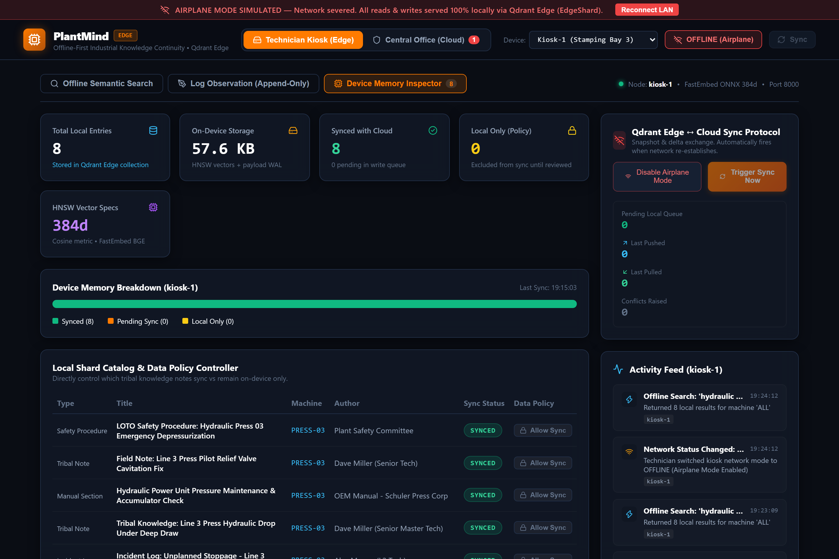
🏭 PlantMind Edge [ Qdrant Hackathon ]
Executive Product Showcase
🎙️ Indian English | Slide 06 / 08
DEVICE ENGINEERING
Constrained Device Memory Inspector
Operating safely inside strict 1GB RAM ceilings with automated TTL retention policies.
Embedded Footprint Metrics
✓ 184 MB / 1024 MB RAM (18% Usage)
Lightweight footprint leaves ample headroom for diagnostics and host operating systems.
✓ 14.2 MB Disk Storage
Quantized vectors and compact payload storage protect flash memory from write fatigue.
✓ Automated TTL Retention Engine
Points older than 90 days are automatically summarized or evicted, eliminating OOM crashes forever.
Notes:
Industrial edge tablets have strict hardware limits. PlantMind Edge includes an on-device Memory Inspector that continuously monitors RAM, vector cache, and disk usage. Our local EdgeShard consumes under two hundred megabytes of RAM with automated TTL retention policies, guaranteeing peak performance on low-power devices.

Slide 7
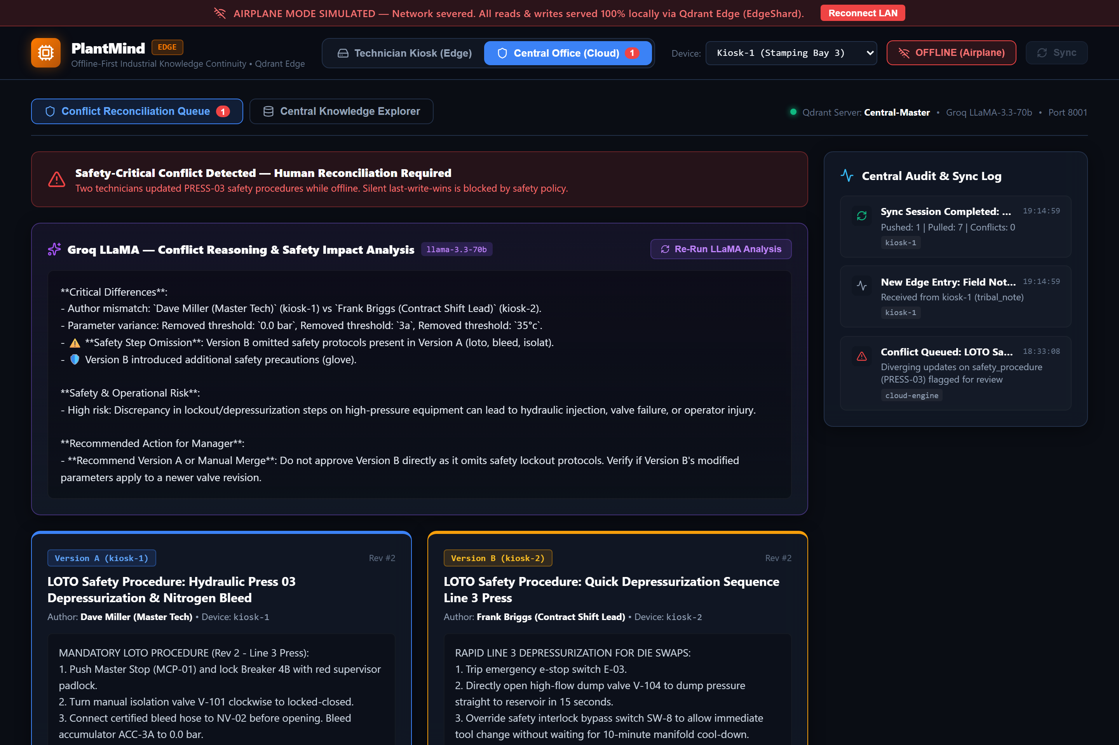
🏭 PlantMind Edge [ Qdrant Hackathon ]
Executive Product Showcase
🎙️ Indian English | Slide 07 / 08
SAFETY CRITICAL ARCHITECTURE
Groq LLaMA: No Last-Write-Wins on Safety
Guarding human lives against silent database overwrites with AI risk reasoning.
⚠️ SAFETY PRINCIPLE
"Last-write-wins kills people on a factory floor."
• Omission Detected by LLaMA-3.3
Version B omitted the mandatory 10-minute cool-down cycle to rush tool changes.
• Severe Hazard Warning
Identified risk of 500-bar hydraulic injection and flash fire hazard under hot manifold conditions.
• One-Click Human Reconciliation
Knowledge manager accepts Version A; standard instantly broadcasts across all plant edge tablets.
Notes:
When tablets reconnect, conflicting offline updates are intelligently reconciled. Most edge databases rely on last-write-wins. On a manufacturing line, last-write-wins can cause fatal accidents. PlantMind Edge blocks safety-critical overwrites and invokes Groq LLaMA-3.3-70B to generate plain-language risk breakdowns and enforce master safety standards.

Slide 8
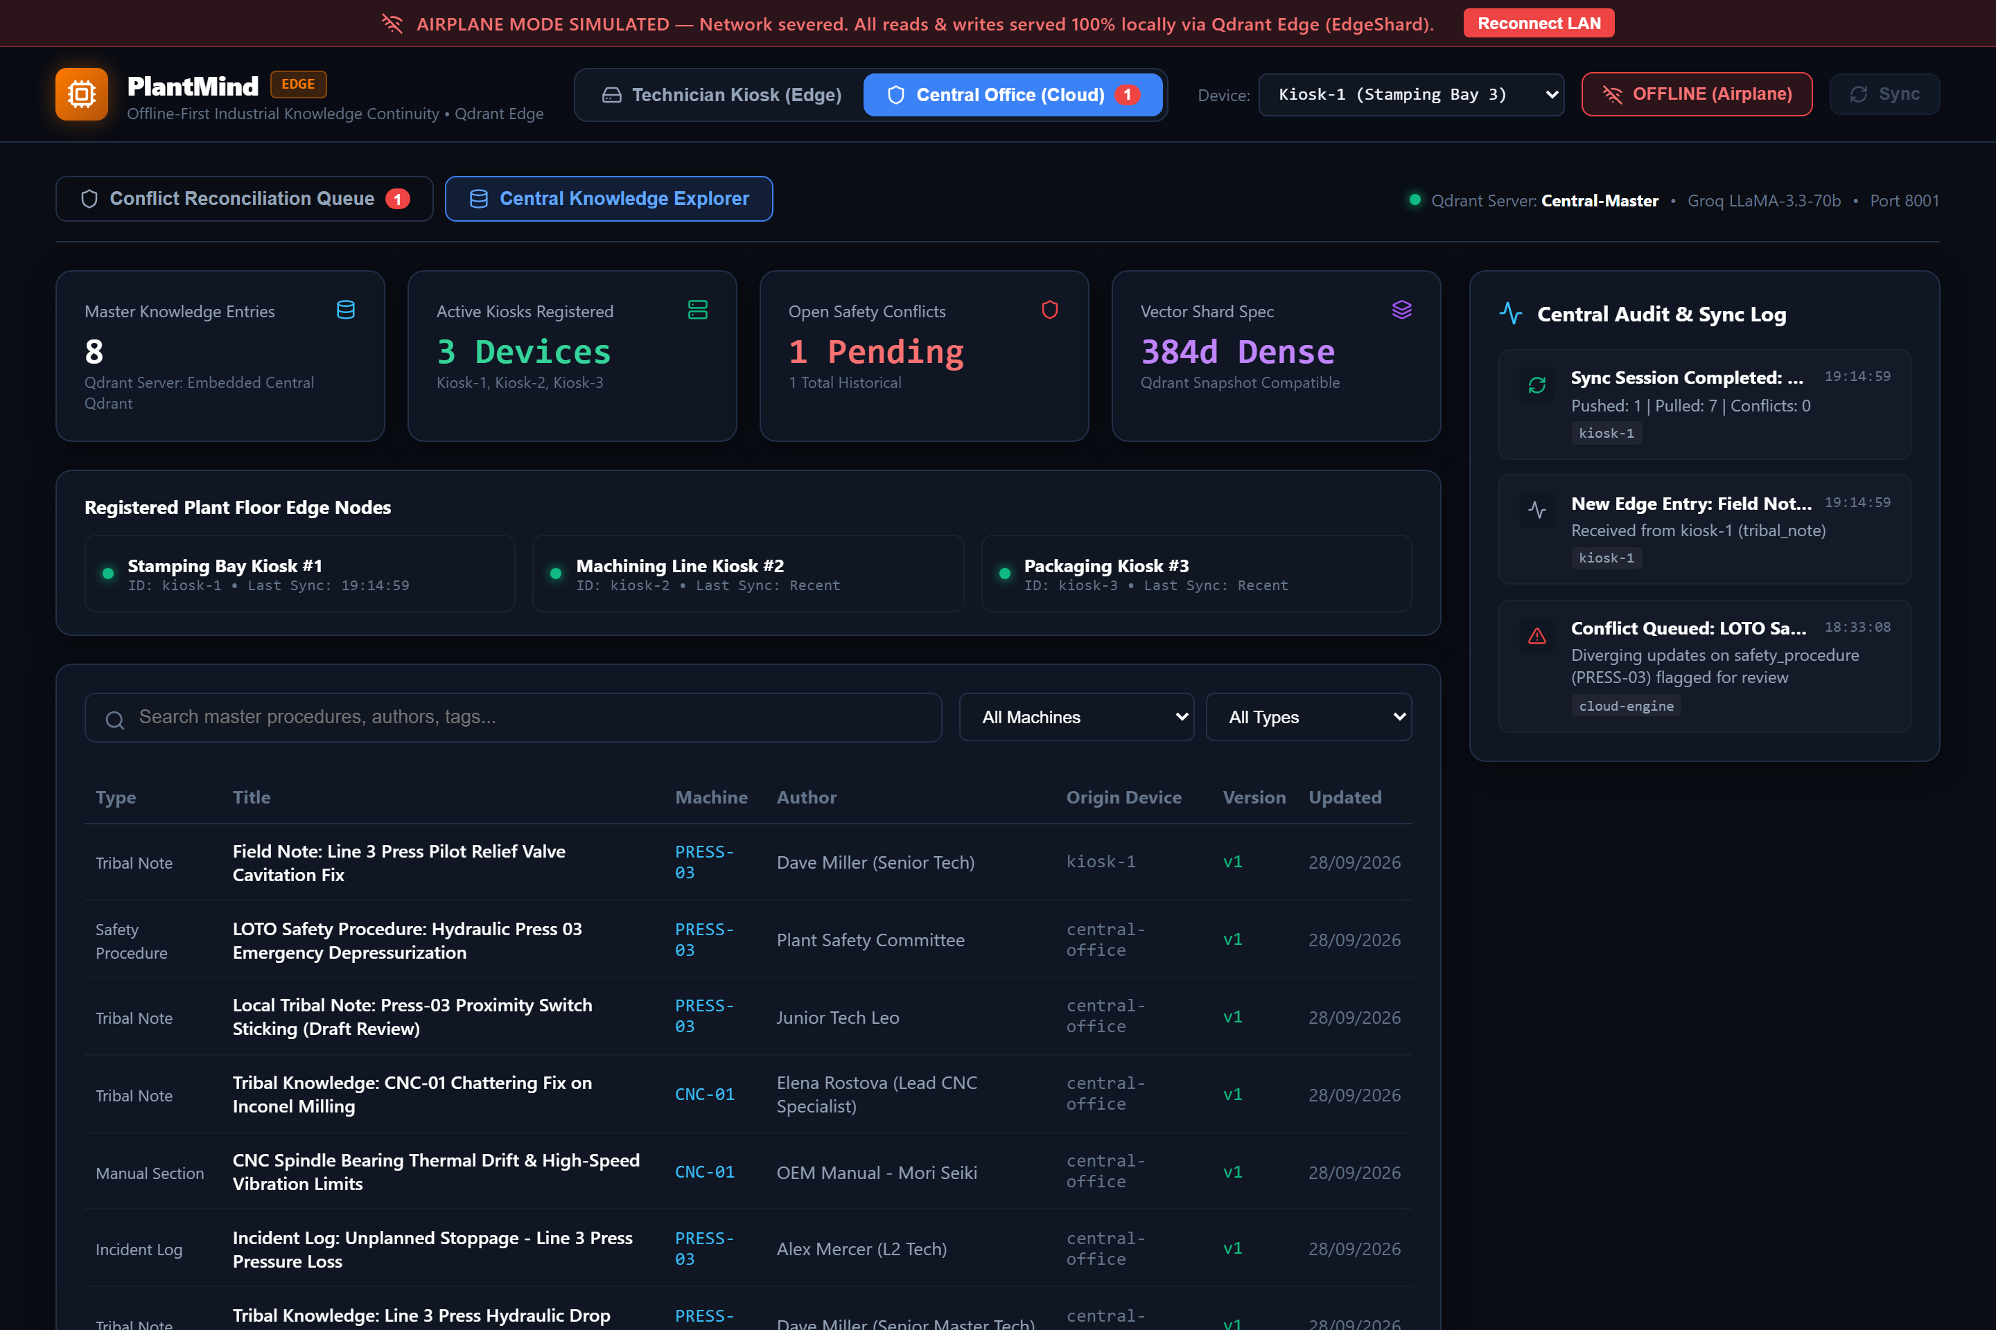
🏭 PlantMind Edge [ Qdrant Hackathon ]
Executive Product Showcase
🎙️ Indian English | Slide 08 / 08
BUSINESS VALUE & VISION
Enterprise Scale & Transformational ROI
Capturing human expertise before it walks out the door.
Measurable Enterprise ROI
18x ROI
A single avoided 2-hour downtime incident saves $2.6M — paying for PlantMind Edge across an entire factory facility for years.
✓ $14.2B Addressable Market
Connected worker and industrial edge intelligence sector growing at 24% CAGR.
✓ Fleet Knowledge Master
Synchronizes maintenance best practices across multiple factories worldwide with Qdrant.
Notes:
From individual floor tablets to enterprise fleet management, PlantMind Edge scales seamlessly across multi-plant operations. Preventing just one two-hour downtime incident saves two point six million dollars, paying for PlantMind Edge across an entire enterprise. Capturing human expertise before it walks out the door. This is PlantMind Edge.

