Slide 1
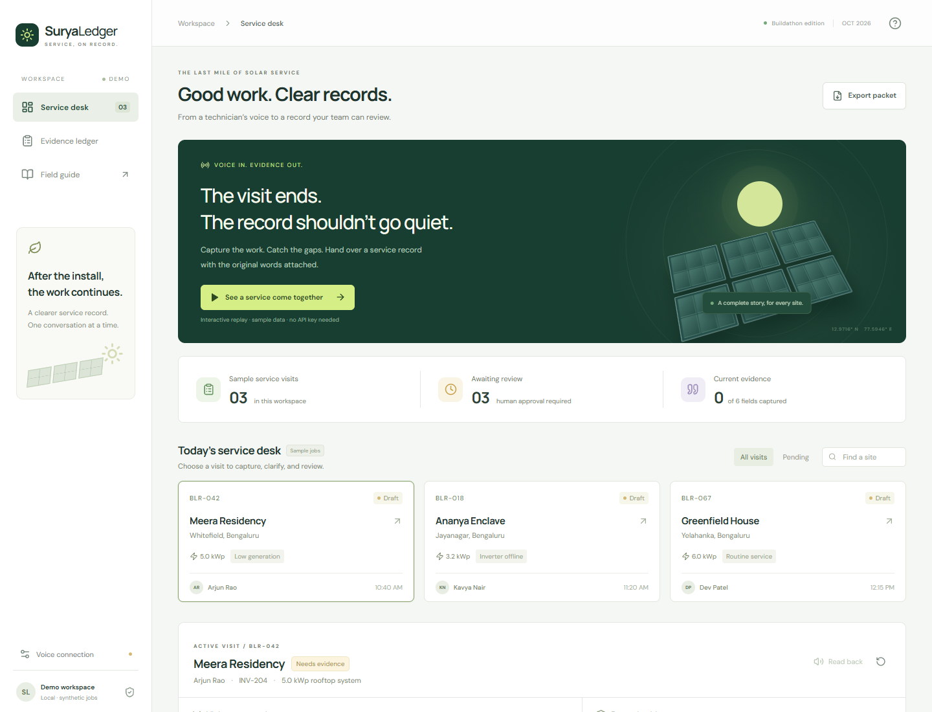
SuryaLedger
Service, on record.
Voice-first solar-service handovers
with source evidence and human review.
Working replay prototype
Synthetic demo data
Bolna connection verified
K M PRADHYUT
Solo founder
github.com/Pradhyut21/suryaledger
01
Notes:
K M PRADHYUT is the solo founder of SuryaLedger. SuryaLedger helps rooftop-solar service teams turn a technician's handover into an inspectable service record. The demo is a working local prototype with synthetic data. Account-backed Bolna WebRTC connections and report-tool callbacks have been observed. A complete spoken six-field handover remains unverified. The two synthetic Windows-TTS caller runs ended with 1/6 and 3/6 fields captured. The second report remained held after ASR errors and omitted utterances. Neither run used a customer or a physical microphone. Source code and screenshot: https://github.com/Pradhyut21/suryaledger. Screenshot contains synthetic visit data. We claim no customer adoption, savings, field accuracy, electrical safety verification or guaranteed competition placement.

Slide 2
The service handover
Small rooftop-solar
installers and their
service supervisors
01
Equipment identity
02
Work actually reported
03
Observed post-repair output
Buyer hypothesis
Missing details may trigger follow-up calls.
Customer interviews still need to test this.
04
Customer acknowledgement
Delhi's solar portal describes five years of vendor O&M under PM Surya Ghar.
Source: Delhi Solar Portal, O&M procedure. Accessed 21 Oct 2026. Context does not establish demand.
02
Notes:
Our initial buyer hypothesis is a small installer maintaining distributed residential systems. Delhi's official solar portal describes five years of vendor operations and maintenance under PM Surya Ghar. This creates workflow context, but it does not measure reporting failures or validate demand. Interviews must establish whether incomplete handovers create meaningful extra work. Source: https://solar.delhi.gov.in/page/operation-and-maintenance-procedure (accessed 21 Oct 2026). Evidence requirements reflect the implemented prototype, not a universal legal or electrical-safety standard.

Slide 3
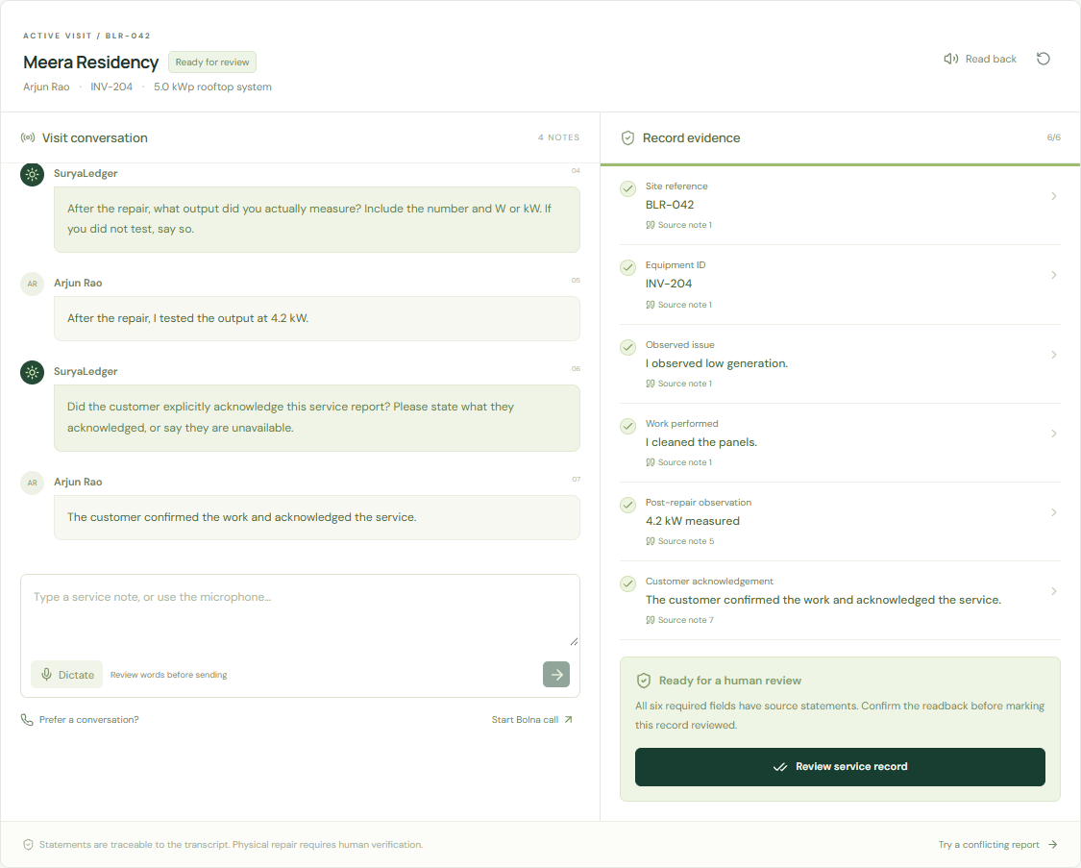
The evidence and the next question
A missing test
keeps the record pending
“I have not tested it yet”
leaves the observation missing.
A reported 4.2 kW
links to its source note
Conflicting repairs require an explicit correction. A human reviews the record.
Actual local prototype, synthetic visit. Source quotes establish submitted statements, not physical work.
03
Notes:
The replay starts with a missing post-repair test. The statement "I have not tested it yet" leaves the observation incomplete. A later measured output of 4.2 kW supplies the required value and unit. Each supported field opens the exact submitted source quote. A claimed inverter replacement followed by a denial holds the action until an explicit supported correction resolves it. Human review remains a separate local confirmation, not authenticated proof of a supervisor's identity. Source and demo: https://github.com/Pradhyut21/suryaledger#the-demo-in-one-minute . Actual screenshot: docs/assets/report-ready.png, synthetic visit. The missing-test example is a textual explanation, not a reconstructed screenshot.

Slide 4
The rule engine and the voice layer
Optional live path
Connection and report callbacks verified.
Complete spoken handover remains unverified.
Bolna browser call
Backend session
and report tool
Same evidence engine
Working local path
Typed, replay
or dictation
Node rules
Evidence and
clarification
Human review
JSON or print
Defined English and limited Romanized Hindi patterns. No general speech-accuracy claim.
Sources: repository architecture, Bolna Web Call SDK and custom-function schema. Account key stays on the backend.
04
Notes:
The domain engine is a deterministic baseline. Typed input, replay and optional browser dictation feed it. Supported fields carry exact source spans, missing/conflicting state and a next question. A human reviews the result before JSON or print export. Bolna supplies the optional conversational speech layer through an official browser SDK session and a report tool. The account API key stays server-side. Account-backed WebRTC connections and report-tool callbacks have been observed using synthetic TTS callers through a test MediaStream. A complete six-field voice handover remains unverified. The second run captured 3/6 fields and held an assigned-site mismatch after ASR dropped a letter. Do not infer speech accuracy or reliable completion from the connection check. In live mode, provenance is to tool-submitted text, not independently verified recording content. The tested callback uses a temporary protected tunnel and needs a stable deployment for production. Sources: https://github.com/Pradhyut21/suryaledger#architecture ; https://github.com/Pradhyut21/suryaledger/blob/main/docs/LIVE-VALIDATION.md ; https://github.com/bolna-ai/web-call ; https://www.bolna.ai/docs/tool-calling/custom-function-schema . Checked 22 Oct 2026.

Slide 5
Existing products overlap with this idea
Product | Advertised overlap
Settle | Voice reports, discrepancy flags, missing-field gates
MaintainX | Voice work-order summaries and maintenance records
SenseHawk | Solar work orders, field evidence and handovers
Our evaluation focus
Solar closeout with exact quotes, visible corrections,
targeted questions and a separate review step.
Sources: Settle Service Report Writer, MaintainX Assist, SenseHawk Solar. Advertised features, 21 Oct 2026.
05
Notes:
Voice service reporting already exists. Settle advertises discrepancy flags and missing-field blocking. We have not tested these competitors and do not claim they lack our behavior. Our proposed entry point is an inspectable rooftop-solar closeout workflow. It must improve the buyer's current process or fit into it. No zero-competition or feature-exclusivity claim. Primary sources: https://settlewithai.com/agents/service-report-writer ; https://help.getmaintainx.com/complete-a-work-order-with-maintainx-assist ; https://www.sensehawk.com/solar . All accessed 21 Oct 2026. Detailed landscape: https://github.com/Pradhyut21/suryaledger/blob/main/docs/RESEARCH.md .

Slide 6
Software checks and current limits
58/58
25/25
12/12
Automated tests
Authored synthetic cases
Browser workflow checks
Checks cover negation, corrections, wrong-site reports,
conflicting repairs, source quotes and review/export.
Finite, known fixtures. No field accuracy or speech benchmark.
No customer pilot. Full voice handover remains unverified.
Sources: repository docs/VERIFICATION.md, evals/results.json and docs/browser-qa.json. Verified 22 Oct 2026.
06
Notes:
The Node suite passes 58 of 58 tests. The public synthetic evaluation passes 25 of 25 authored cases. Twelve browser workflow checks pass in Chrome on tested desktop and mobile-sized layouts, not twelve different browser products. These counts have separate denominators and should never be pooled into an accuracy claim. Fixtures are finite and known to the implementation. They do not establish held-out speech accuracy, customer savings, real Bolna integration quality or arbitrary-language reliability. Real Bolna connections and report callbacks have been observed, while complete spoken six-field handover reliability remains unverified. No customer pilot has occurred. Sources: https://github.com/Pradhyut21/suryaledger/blob/main/docs/VERIFICATION.md ; https://github.com/Pradhyut21/suryaledger/blob/main/evals/results.json ; https://github.com/Pradhyut21/suryaledger/blob/main/docs/browser-qa.json ; https://github.com/Pradhyut21/suryaledger/blob/main/docs/LIVE-VALIDATION.md . Verified 22 Oct 2026.

Slide 7
A ten-visit pilot
10
Measure
Completion time
Supervisor corrections
False-ready records
Consented service handovers
with one installer and supervisor
Pricing hypothesis
Compare with today’s process
and a plain transcript summary.
₹3,000 / team / month
plus usage
github.com/Pradhyut21/suryaledger Pilot and pricing are hypotheses. No adoption or measured savings claimed.
07
Notes:
The ask is one installer and one supervisor evaluating ten consented handovers against their current process and a plain transcript summary. Measure time to complete a usable record, supervisor corrections, missing-field recall and false-ready records. The proposed ₹3,000 team subscription plus usage is an interview hypothesis, not validated willingness to pay or a provider tariff. If voice adds effort or an existing tool already solves the problem, revise the workflow. Source: https://github.com/Pradhyut21/suryaledger/blob/main/docs/RESEARCH.md . Code and replay: https://github.com/Pradhyut21/suryaledger .

