Slide 1
Natural Language Processing

Slide 2
Language meant for communicating about the world.
Aim is to build a computational model of the language for achieving this.
For this knowledge about the world in combination with linguistic facts is used.
Difficult to analyze languages.
These difficulties, on the other hand make languages so powerful.

Slide 3
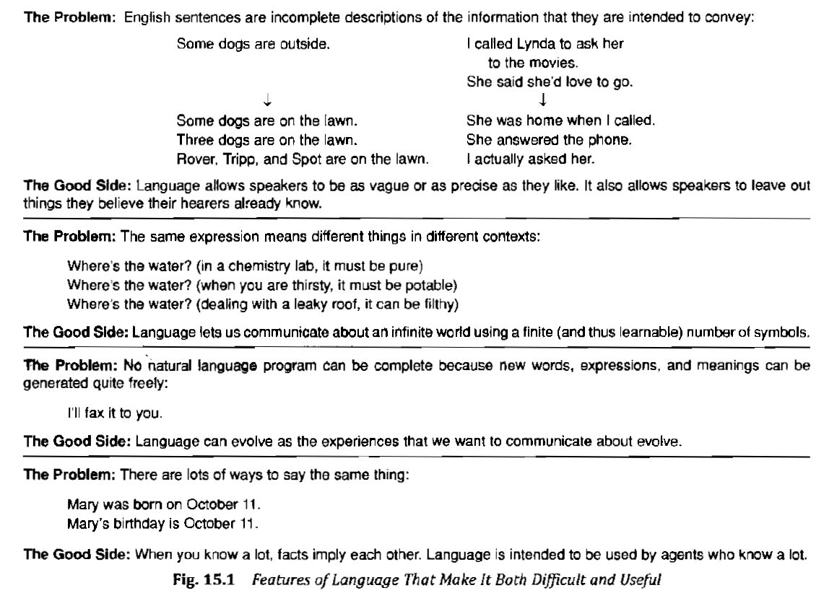

Slide 4
Largest part of human linguistic communication occurs as speech.
Processing written language is easier than processing speech.
To build a program that that understands spoken language, we need all the facilities of written language understanding as well as enough additional knowledge to handle noise and ambiguities of the audio signal.

Slide 5
Understanding is the process of mapping from an input form into a more immediately useful form.
We think of language as a pair (source language, target representation), together with a mapping between elements of each to the other.
Thus understanding a piece of language involves mapping it into some representation appropriate to a particular situation.

Slide 6
Steps in the process
Morphological Analysis
Individual words are analyzed into their components and non token words like punctuations, are separated from the words.

Slide 7
Syntactic analysis
Linear sequences of words are transformed into structures that show how the words relate to each other.
Some sentences may be rejected if they violate language rules for how words may be combined.
English syntax analyzer would reject “Boy the go the to store”.

Slide 8
Semantic Analysis
The structures created by syntactic analyzer are assigned meanings.
Thus a mapping is created between syntactic structures and objects in the task domain.
Structures for which no mapping is possible is rejected.
Example: “Colourless green ideas sleep furiously” is syntactically anomalous.

Slide 9
Discourse Integration
The meaning of individual sentences may depend on sentences that precede it and may influence the meaning of sentences that follow it.
For example the word “it” in the sentence “John wanted it” depends on the prior discourse content.

Slide 10
Pragmatic Analysis
The structure representing what was said is reinterpreted to determine what was actually meant.
The sentence “ Do you know what time it is?” may be interpreted as a request to know time.

Slide 11
The boundaries between these 5 phases is often very fuzzy.
They may be performed in a sequence or they are performed all in once.
Two ways of decomposing a program: The process and the knowledge required to perform the task and the global control structure that is imposed on those process.
Here we focus on the first of these issues.
Example: I want to print Bill’s .init file.

Slide 12
Morphological Analysis
Pull apart the word “Bill’s” into the proper noun “Bill” and the possessive suffix “s”.
Recognize the sequence “.init” as a file extension that is functioning as an adjective in the sentence.
This process will usually assign syntactic categories to all the words in the sentence.

Slide 13
Syntactic Analysis
Syntactic analysis must exploit the results of morphological analysis to build a structural description of the sentence.
Parsing: sentences are mapped into structures that defines the units that defines the units.
A set of entities are created called Reference Markers(RM) are defined to provide a place in which information about entities are to be inserted later.

Slide 14
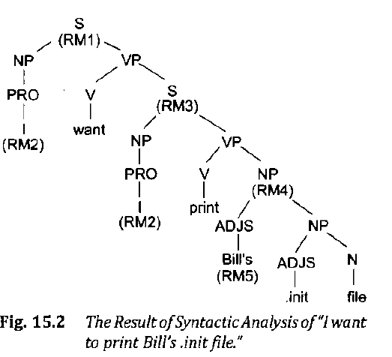

Slide 15
Semantic Analysis
It must map individual words into appropriate objects in the knowledge base or database.
It must create the correct structures to correspond to the way the meanings of the individual words combine with each other.

Slide 16
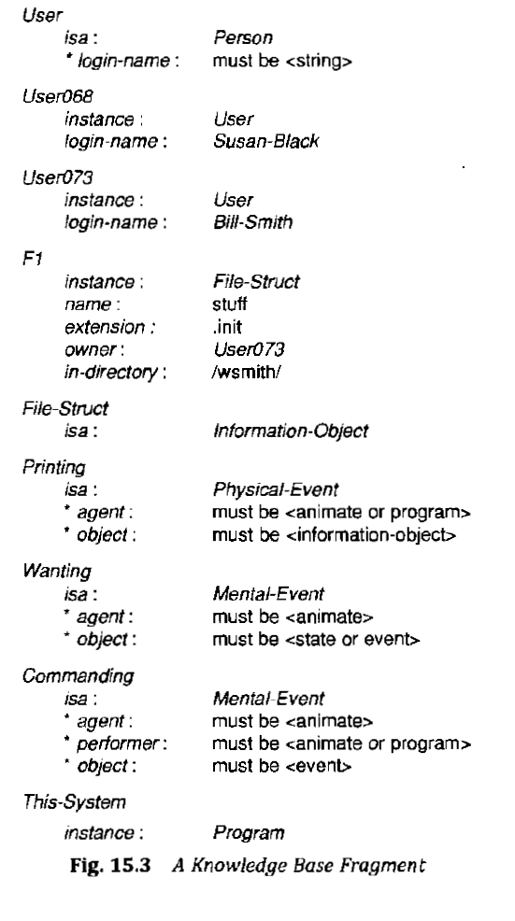

Slide 17
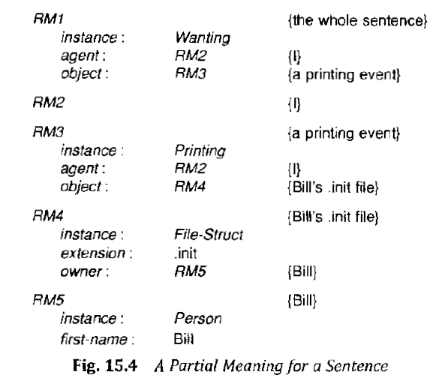

Slide 18
Discourse Integration
Aim is to pin down the specific individuals being referred to like “I” or “Bill”.

Slide 19
Pragmatic Analysis
To decide what to do with the result.
Some sentences are declarative whereas some are commanding.
For second type of sentences (Including this example) it is necessary to translate from knowledge base representation to a command to be executed by the system.

Slide 20
