Slide 1

Review Report on
A Unified SO(3) Approach to the Attitude Control Design for Quadrotors

Slide 2
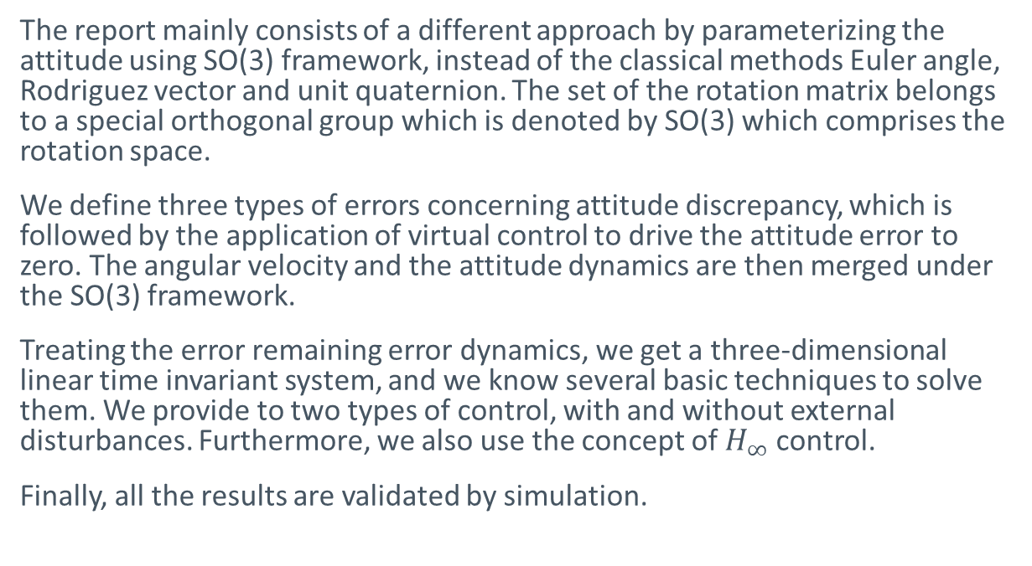
Unified SO(3) Approach to the Quadrotor Attitude Control Problem
The report mainly consists of a different approach by parameterizing the attitude using SO(3) framework, instead of the classical methods Euler angle, Rodriguez vector and unit quaternion. The set of the rotation matrix belongs to a special orthogonal group which is denoted by SO(3) which comprises the rotation space.
We define three types of errors concerning attitude discrepancy, which is followed by the application of virtual control to drive the attitude error to zero. The angular velocity and the attitude dynamics are then merged under the SO(3) framework.
Treating the error remaining error dynamics, we get a three-dimensional linear time invariant system, and we know several basic techniques to solve them. We provide to two types of control, with and without external disturbances. Furthermore, we also use the concept of $H_{∞}$ control.
Finally, all the results are validated by simulation.

Slide 3
Advantages of this Approach
The problem becomes more transparent
The design process becomes simpler
Reduces the dimension of the problem to great extent
Allows classical control schemes to applicable

Slide 4
Content Layout
A
System Model and Control Objectives
Three types of Error and virtual control
B
Gain Design
Robust Control Design
C
Stability
Validation and Performance Assessment ( Simulation )

Slide 5
Procedure

Slide 6
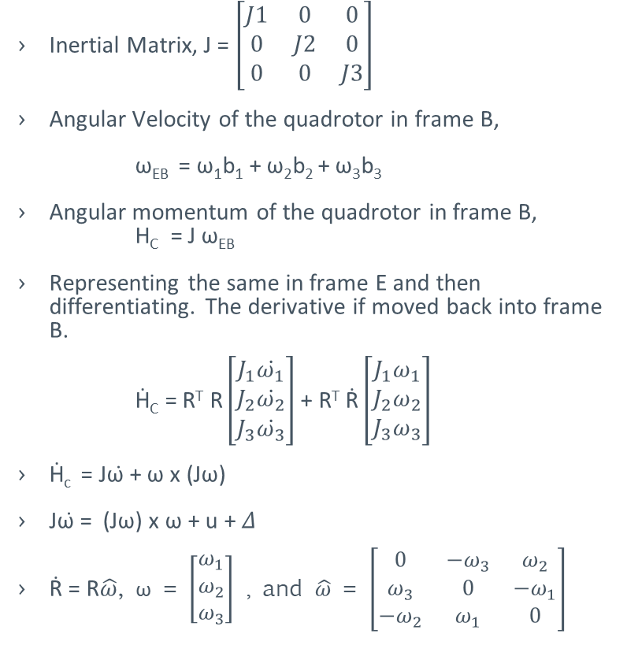
System Model and Control Objectives
Inertial Matrix, J = $\left[\begin{matrix}J1 & 0 & 0 \\ 0 & J2 & 0 \\ 0 & 0 & J3\end{matrix}\right]$
Angular Velocity of the quadrotor in frame B,
ω_{EB} = ω₁b₁ + ω₂b₂ + ω₃b₃
Angular momentum of the quadrotor in frame B, H_{C} = J ω_{EB}
Representing the same in frame E and then differentiating. The derivative if moved back into frame B.
Ḣ_{C} = R^{T} R $\left[\begin{matrix}J_{1}{ω̇}_{1} \\ J_{2}{ω̇}_{2} \\ J_{3}{ω̇}_{3}\end{matrix}\right]$ + R^{T} Ṙ $\left[\begin{matrix}J_{1}ω_{1} \\ J_{2}ω_{2} \\ J_{3}ω_{3}\end{matrix}\right]$
Ḣ_{c} = Jω̇ + ω x (Jω)
Jω̇ = (Jω) x ω + u + 𝛥
Ṙ = R$\hat{ω}$, ω = $\left[\begin{matrix}ω_{1} \\ ω_{2} \\ ω_{3}\end{matrix}\right]$ , and $\hat{ω}$ = $\left[\begin{matrix}0 & {−ω}_{3} & ω_{2} \\ ω_{3} & 0 & {−ω}_{1} \\ {−ω}_{2} & ω_{1} & 0\end{matrix}\right]$
Hence H_{C} is the input to the system and can be represented as u + 𝛥 where u is the designed input and 𝛥 is the lumped uncertainty and disturbance.

Slide 7
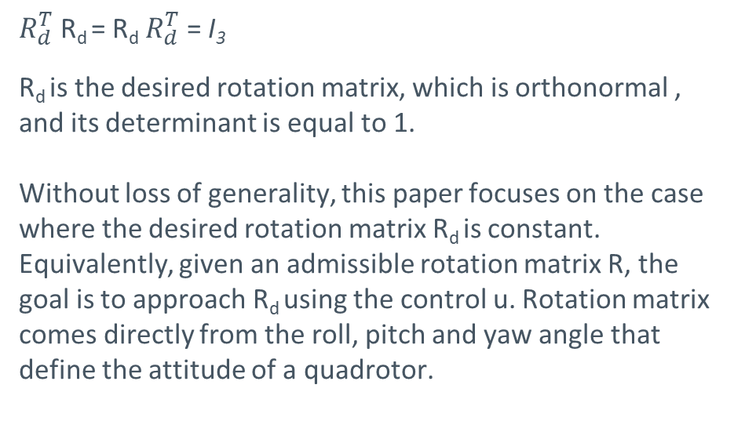
System Model and Control Objectives
$R_{d}^{T}$ R_{d} = R_{d} $R_{d}^{T}$ = I₃
R_{d} is the desired rotation matrix, which is orthonormal , and its determinant is equal to 1.
Without loss of generality, this paper focuses on the case where the desired rotation matrix R_{d} is constant. Equivalently, given an admissible rotation matrix R, the goal is to approach R_{d} using the control u. Rotation matrix comes directly from the roll, pitch and yaw angle that define the attitude of a quadrotor.

Slide 8
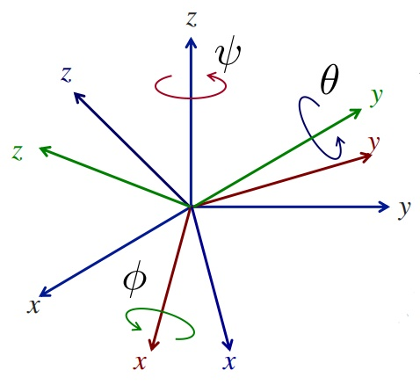
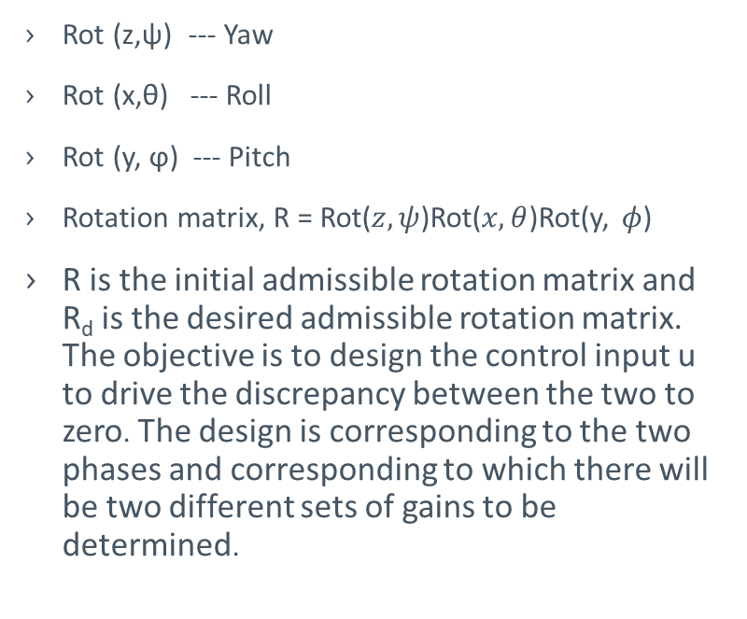
Three Types of Errors and Virtual Control
Rot (z,ψ) --- Yaw
Rot (x,θ) --- Roll
Rot (y, ϕ) --- Pitch
Rotation matrix, R = Rot($z, ψ$)Rot($x, θ$)Rot(y, $φ$)
R is the initial admissible rotation matrix and R_{d} is the desired admissible rotation matrix. The objective is to design the control input u to drive the discrepancy between the two to zero. The design is corresponding to the two phases and corresponding to which there will be two different sets of gains to be determined.

Slide 9
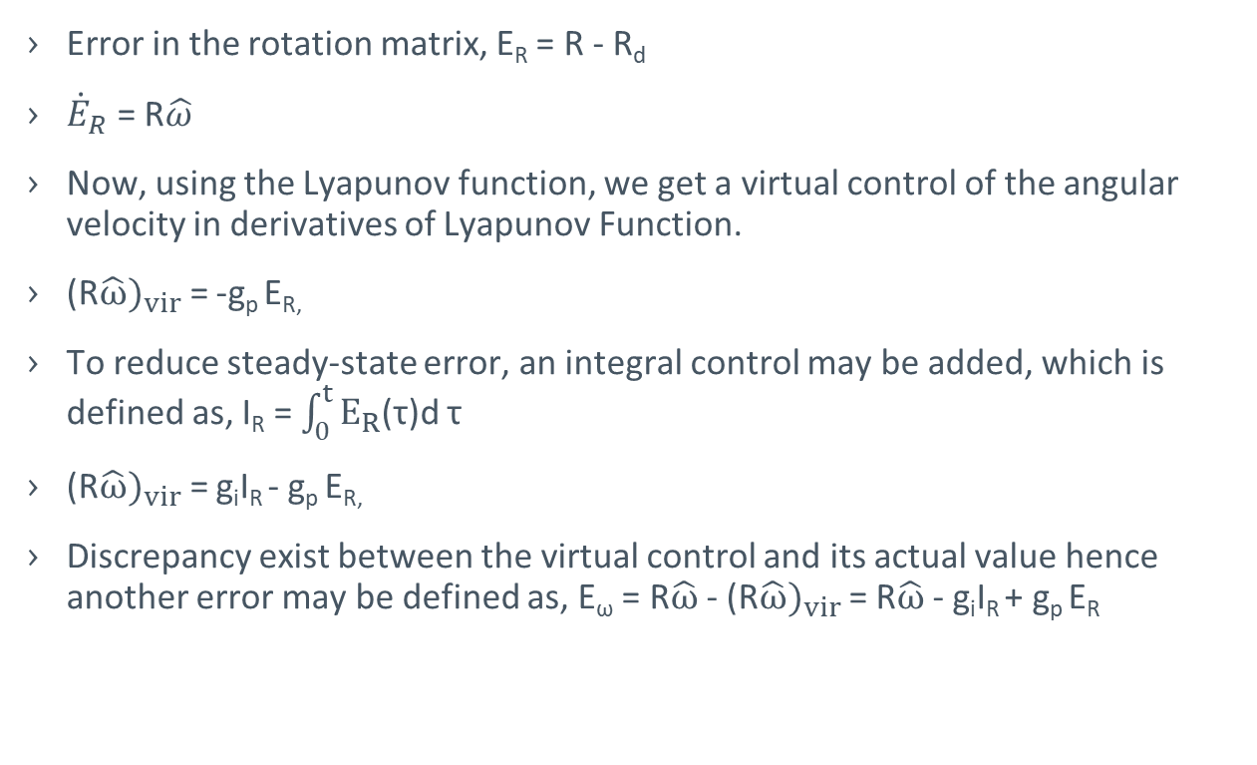
Three Types of Errors and Virtual Control
Error in the rotation matrix, E_{R} = R - R_{d}
${\dot{E}}_{R}$ = R$\hat{ω}$
Now, using the Lyapunov function, we get a virtual control of the angular velocity in derivatives of Lyapunov Function.
(R$\hat{ω})_{vir}$= -g_{p} E_{R,}
To reduce steady-state error, an integral control may be added, which is defined as, I_{R} = $\int_{0}^{t}{E_{R}}$(τ)d τ
(R$\hat{ω})_{vir}$= g_{i}I_{R} - g_{p} E_{R,}
Discrepancy exist between the virtual control and its actual value hence another error may be defined as, E_{ω} = R$\hat{ω}$ - (R$\hat{ω})_{vir}$ = R$\hat{ω}$ - g_{i}I_{R} + g_{p} E_{R}

Slide 10
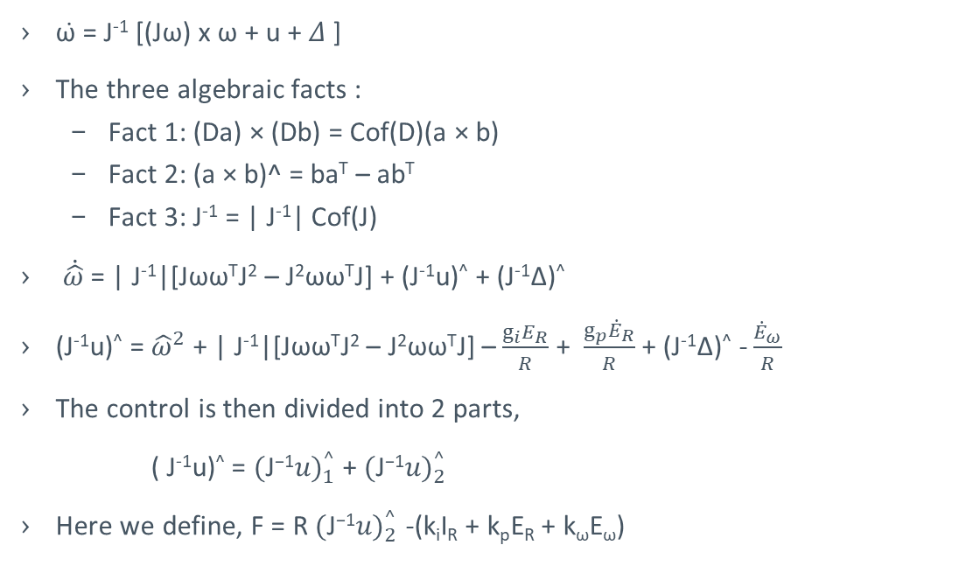
Problem Reformulation Under SO(3) Framework and Entry-Wise Stabilization
ω̇ = J⁻¹ [(Jω) x ω + u + 𝛥 ]
The three algebraic facts :
Fact 1: (Da) × (Db) = Cof(D)(a × b)
Fact 2: (a × b)^ = ba^{T} – ab^{T}
Fact 3: J⁻¹ = | J⁻¹| Cof(J)
$\dot{\hat{ω}}$ = | J⁻¹|[Jωω^{T}J² – J²ωω^{T}J] + (J⁻¹u)^ + (J⁻¹∆)^
(J⁻¹u)^ = ${\hat{ω}}^{2}$ + | J⁻¹|[Jωω^{T}J² – J²ωω^{T}J] – $\frac{g_{i}E_{R}}{R}$ + $\frac{g_{p}{\dot{E}}_{R}}{R}$ + (J⁻¹∆)^ - $\frac{{\dot{E}}_{ω}}{R}$
The control is then divided into 2 parts,
( J⁻¹u)^ = ${(\text{J}\text{−}\text{1}u)}_{1}^{^}$ + ${(\text{J}\text{−}\text{1}u)}_{2}^{^}$
Here we define, F = R ${(\text{J}\text{−}\text{1}u)}_{2}^{^}$ -(k_{i}I_{R} + k_{p}E_{R} + k_{ω}E_{ω})

Slide 11
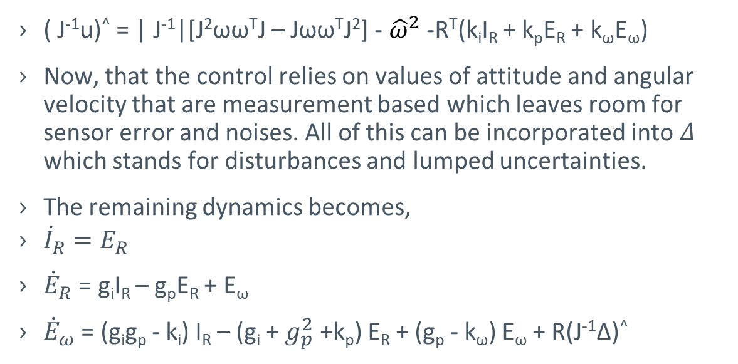
Problem Reformulation Under SO(3) Framework and Entry-Wise Stabilization
( J⁻¹u)^ = | J⁻¹|[J²ωω^{T}J – Jωω^{T}J²] - ${\hat{ω}}^{2}$ -R^{T}(k_{i}I_{R} + k_{p}E_{R} + k_{ω}E_{ω})
Now, that the control relies on values of attitude and angular velocity that are measurement based which leaves room for sensor error and noises. All of this can be incorporated into 𝛥 which stands for disturbances and lumped uncertainties.
The remaining dynamics becomes,
${\dot{I}}_{R}=E_{R}$
${\dot{E}}_{R}$ = g_{i}I_{R} – g_{p}E_{R} + E_{ω}
${\dot{E}}_{ω}$ = (g_{i}g_{p} - k_{i}) I_{R} – (g_{i} + $g_{p}^{2}$ +k_{p}) E_{R} + (g_{p} - k_{ω}) E_{ω} + R(J⁻¹∆)^

Slide 12
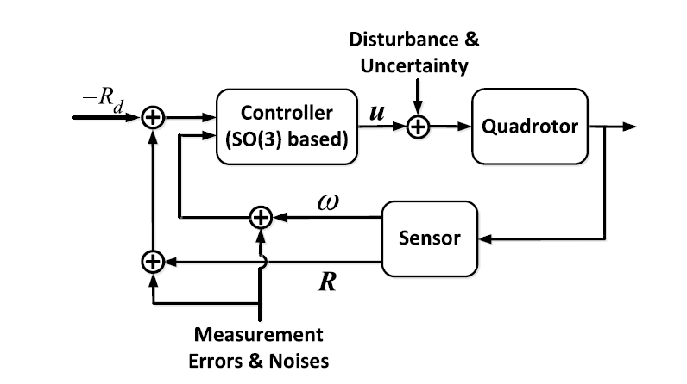
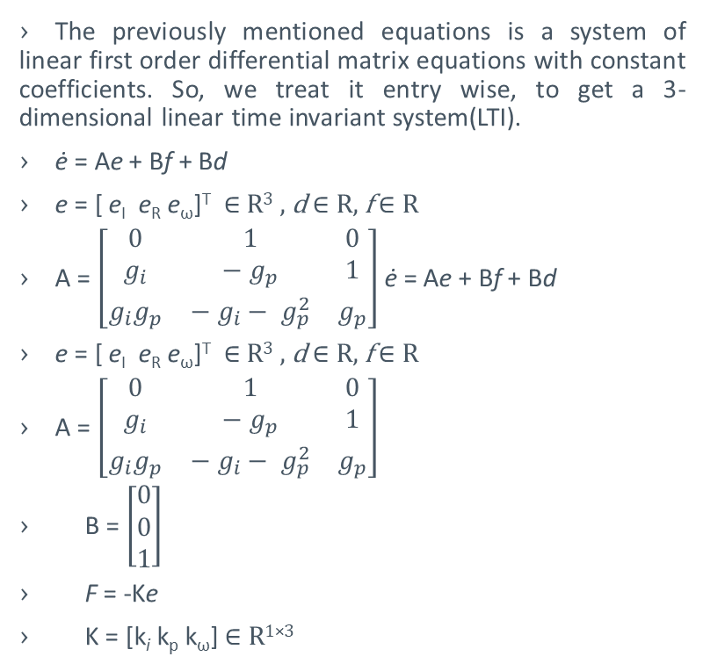
Problem Reformulation Under SO(3) Framework and Entry-Wise Stabilization
The previously mentioned equations is a system of linear first order differential matrix equations with constant coefficients. So, we treat it entry wise, to get a 3-dimensional linear time invariant system(LTI).
ė = Ae + Bf + Bd
e = [ e_{I} e_{R} e_{ω}]^{T} ∈ R³ , d ∈ R, f ∈ R
A = $\left[\begin{matrix}0 & 1 & 0 \\ g_{i} & − g_{p} & 1 \\ g_{i}g_{p} & − g_{i}− g_{p}^{2} & g_{p}\end{matrix}\right]$ ė = Ae + Bf + Bd
e = [ e_{I} e_{R} e_{ω}]^{T} ∈ R³ , d ∈ R, f ∈ R
A = $\left[\begin{matrix}0 & 1 & 0 \\ g_{i} & − g_{p} & 1 \\ g_{i}g_{p} & − g_{i}− g_{p}^{2} & g_{p}\end{matrix}\right]$
B = $\left[\begin{matrix}0 \\ 0 \\ 1\end{matrix}\right]$
F = -Ke
K = [k_{i} k_{p} k_{ω}] ∈ R^{1×3}
e_{I} is the corresponding entry of the error matrix I_{R}
e_{R} is the corresponding entry of the error matrix E_{R}
e_{ω} is the corresponding entry of the error matrix E_{ω}
Scalar control f is the corresponding entry of F
d is the corresponding entry of the limped disturbances and/ or uncertainties.

Slide 13
Gain Design of the Nominal System
This section defines the stabilizing state feedback gain K
2 designs have been discussed
Classical LQR design,
Specialized design.

Slide 14
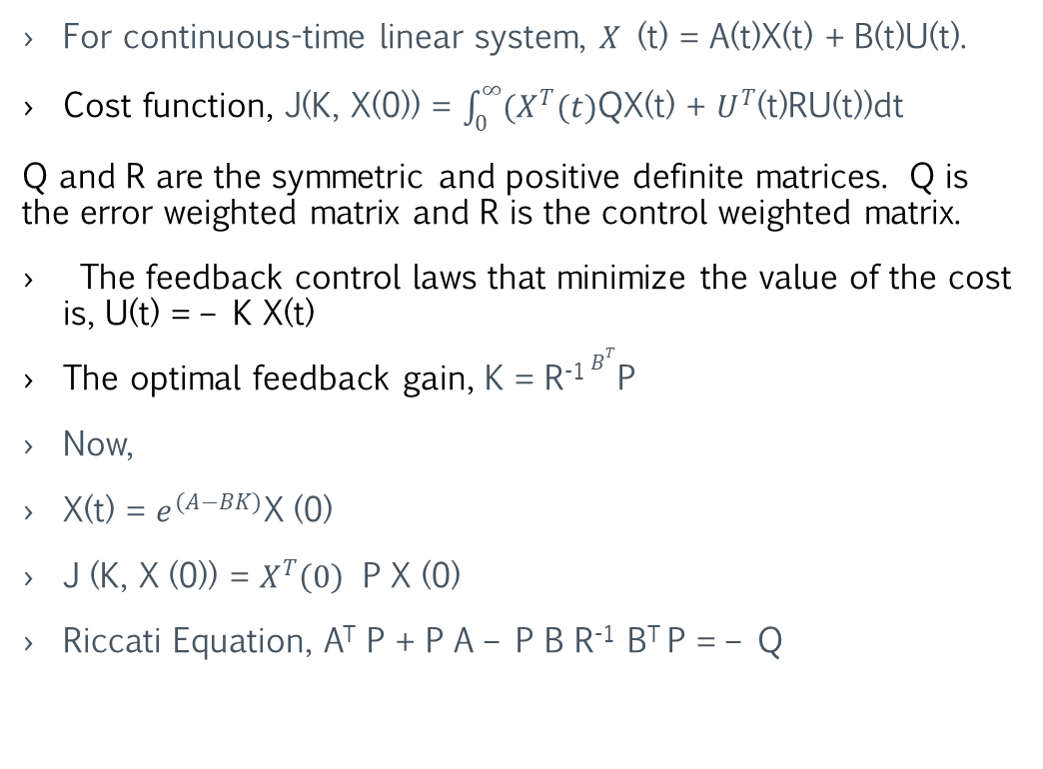
For continuous-time linear system, 𝑋 (t) = A(t)X(t) + B(t)U(t).
Cost function, J(K, X(0)) = $\int_{0}^{∞}{{(X}^{T}(t)}$QX(t) + $U^{T}$(t)RU(t))dt
Q and R are the symmetric and positive definite matrices. Q is the error weighted matrix and R is the control weighted matrix.
The feedback control laws that minimize the value of the cost is, U(t) = – K X(t)
The optimal feedback gain, K = R⁻¹$B^{T}$P
Now,
X(t) = $e^{(A−BK)}$X (0)
J (K, X (0)) = $X^{T}\left(0\right)$ P X (0)
Riccati Equation, A^{T} P + P A – P B R⁻¹ B^{T} P = – Q
Standard LQR Design

Slide 15
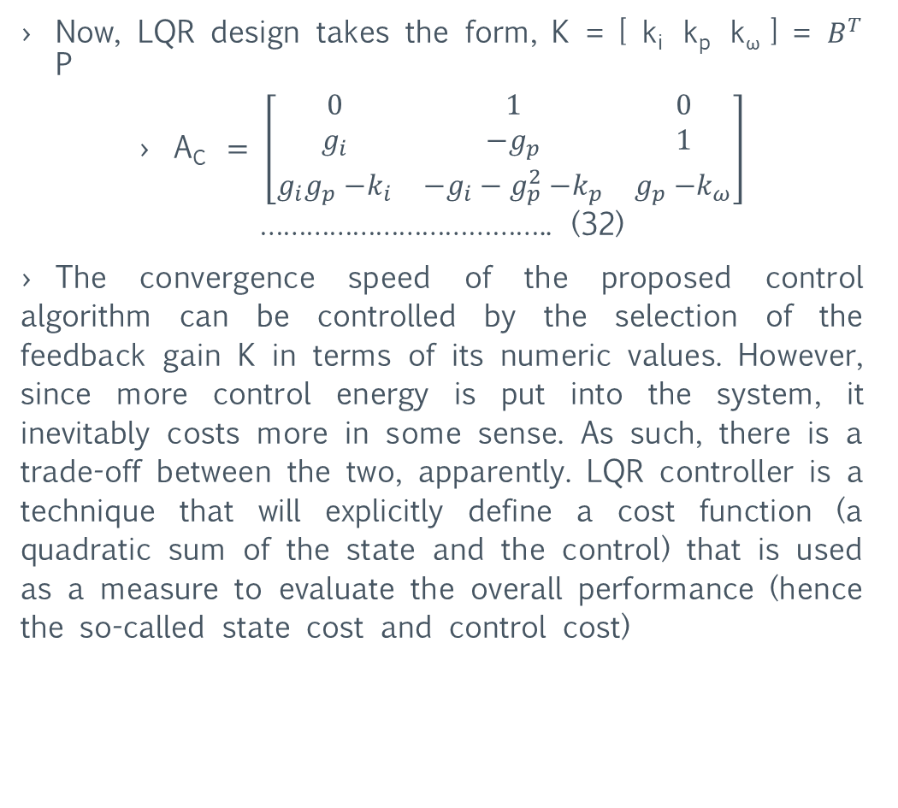
Now, LQR design takes the form, K = [ k_{i} k_{p} k_{ω} ] = $B^{T}$ P
A_{C} $= \left[\begin{matrix}0 & 1 & 0 \\ g_{i} & {−g}_{p} & 1 \\ g_{i}g_{p}{−k}_{i} & {−g}_{i}−g_{p}^{2}{−k}_{p} & g_{p}{−k}_{ω}\end{matrix}\right]$ ……………………………….. (32)
The convergence speed of the proposed control algorithm can be controlled by the selection of the feedback gain K in terms of its numeric values. However, since more control energy is put into the system, it inevitably costs more in some sense. As such, there is a trade-off between the two, apparently. LQR controller is a technique that will explicitly define a cost function (a quadratic sum of the state and the control) that is used as a measure to evaluate the overall performance (hence the so-called state cost and control cost)
A. Standard LQR Design

Slide 16
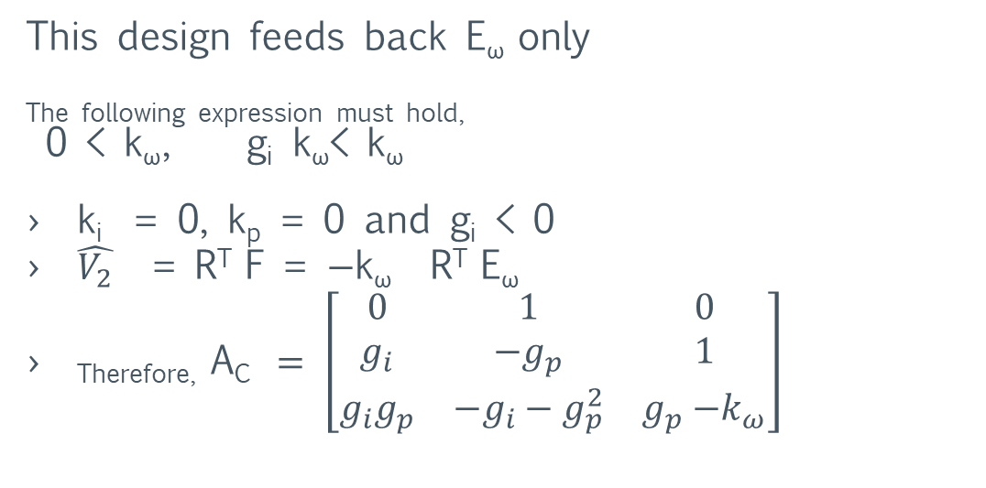
Gain design of the nominal system
This design feeds back E_{ω} only
The following expression must hold,
0 < k_{ω}, g_{i} k_{ω}< k_{ω}
k_{i} = 0, k_{p} = 0 and g_{i} < 0
$\hat{V_{2}}$ = R^{T} F = $−$k_{ω} R^{T} E_{ω}
_{Therefore,} A_{C} $= \left[\begin{matrix}0 & 1 & 0 \\ g_{i} & {−g}_{p} & 1 \\ g_{i}g_{p} & {−g}_{i}−g_{p}^{2} & g_{p}{−k}_{ω}\end{matrix}\right]$
B. Specialized Design

Slide 17
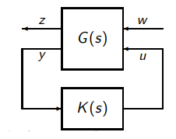
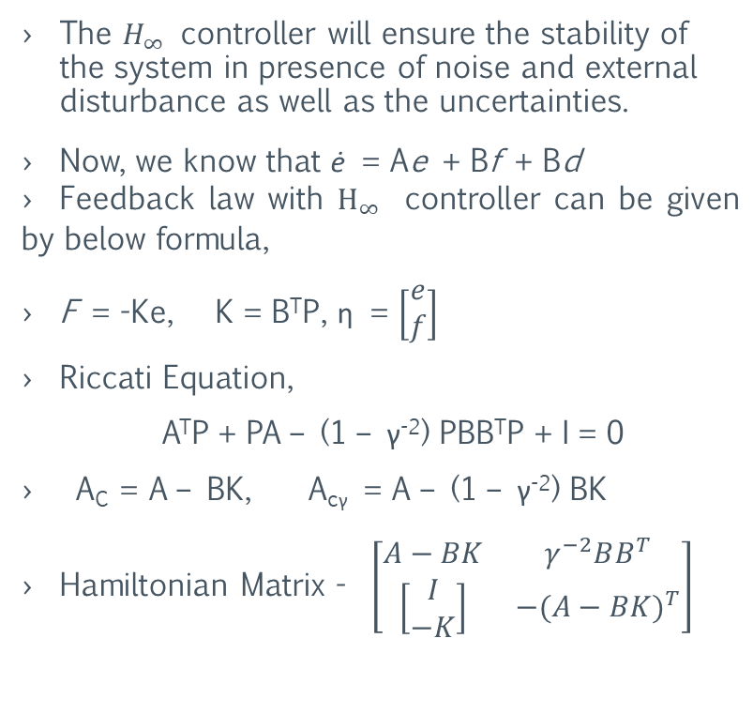
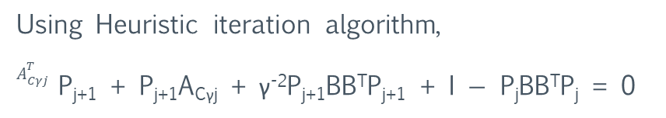
Classical Robust Control Design
The $H_{∞}$ controller will ensure the stability of the system in presence of noise and external disturbance as well as the uncertainties.
Now, we know that ė = Ae + Bf + Bd
Feedback law with $H_{∞}$ controller can be given by below formula,
F = -Ke, K = B^{T}P, η = $\left[\begin{matrix}e \\ f\end{matrix}\right]$
Riccati Equation,
A^{T}P + PA – (1 – γ⁻²) PBB^{T}P + I = 0
A_{C} = A – BK, A_{cγ} = A – (1 – γ⁻²) BK
Hamiltonian Matrix - $\left[\begin{matrix}A−BK & γ^{−2}BB^{T} \\ \left[\begin{matrix}I \\ −K\end{matrix}\right] & {−(A−BK)}^{T}\end{matrix}\right]$
Using Heuristic iteration algorithm,
$A_{Cγj}^{T}$ P_{j+1} + P_{j+1}A_{Cγj} + γ⁻²P_{j+1}BB^{T}P_{j+1} + I $−$ P_{j}BB^{T}P_{j} = 0
Notes:
There are many other schemes like sliding-mode controls, disturbance-tailored super twisting algorithm, multivariable super-twisting sliding mode approach etc... Ideally, these control algorithms should perform better than the $H_{∞}$ design presented above, but the trade-off apparently is that they are computationally more demanding/costly due to their structural complexities. Unlike the proposed static $H_{∞}$ design, those sliding-mode controller and the-like are dynamics, hence are more involved from the implementation point of view.

Slide 18
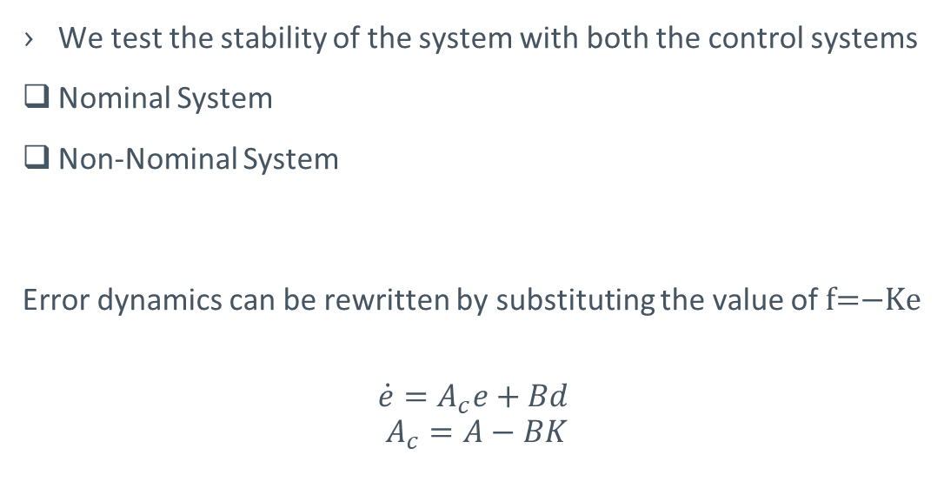
Stability of Closed Loop System
We test the stability of the system with both the control systems
Nominal System
Non-Nominal System
Error dynamics can be rewritten by substituting the value of f=$−$Ke
$$\dot{e}=A_{c}e+Bd$$
$$A_{c}=A−BK$$

Slide 19
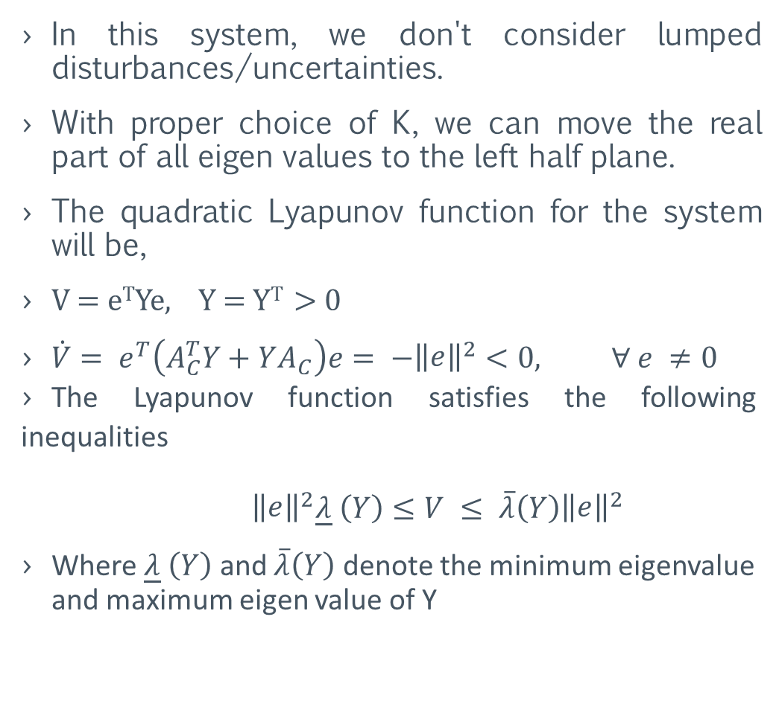
A. NOMINAL SYSTEM
In this system, we don't consider lumped disturbances/uncertainties.
With proper choice of K, we can move the real part of all eigen values to the left half plane.
The quadratic Lyapunov function for the system will be,
V = e^{T}Ye, Y = Y^{T} > 0
$\dot{V}= e^{T}\left(A_{C}^{T}Y+YA_{C}\right)e= −{\left\|\begin{matrix}e\end{matrix}\right\|}^{2}<0, ∀ e ≠0$
The Lyapunov function satisfies the following inequalities
${\left\|\begin{matrix}e\end{matrix}\right\|}^{2}\underline{λ} \left(Y\right)≤V ≤ \overline{λ}\left(Y\right){\left\|\begin{matrix}e\end{matrix}\right\|}^{2}$
Where $\underline{λ} \left(Y\right)$ and $\overline{λ}\left(Y\right)$ denote the minimum eigenvalue and maximum eigen value of Y

Slide 20
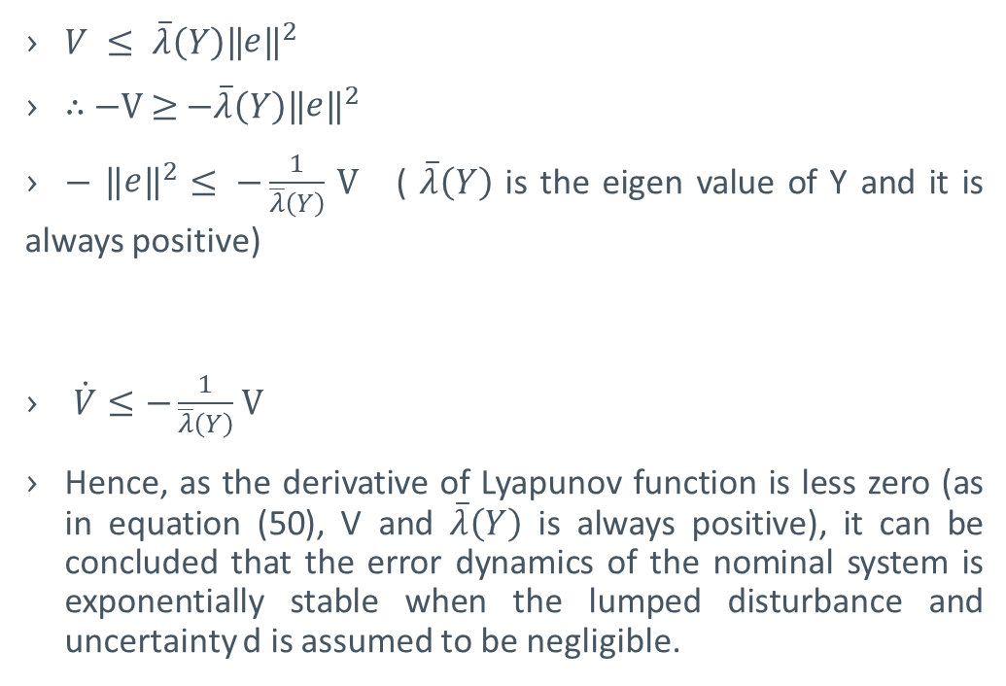
A. NOMINAL SYSTEM
$V ≤ \overline{λ}\left(Y\right){\left\|\begin{matrix}e\end{matrix}\right\|}^{2}$
∴ $−$V ≥ $−\overline{λ}\left(Y\right){\left\|\begin{matrix}e\end{matrix}\right\|}^{2}$
$−$ ${\left\|\begin{matrix}e\end{matrix}\right\|}^{2}$ $≤ −\frac{1}{\overline{λ}\left(Y\right)}$ V ( $\overline{λ}\left(Y\right)$ is the eigen value of Y and it is always positive)
$\dot{V}≤−\frac{1}{\overline{λ}\left(Y\right)}$ V
Hence, as the derivative of Lyapunov function is less zero (as in equation (50), V and $\overline{λ}\left(Y\right)$ is always positive), it can be concluded that the error dynamics of the nominal system is exponentially stable when the lumped disturbance and uncertainty d is assumed to be negligible.

Slide 21
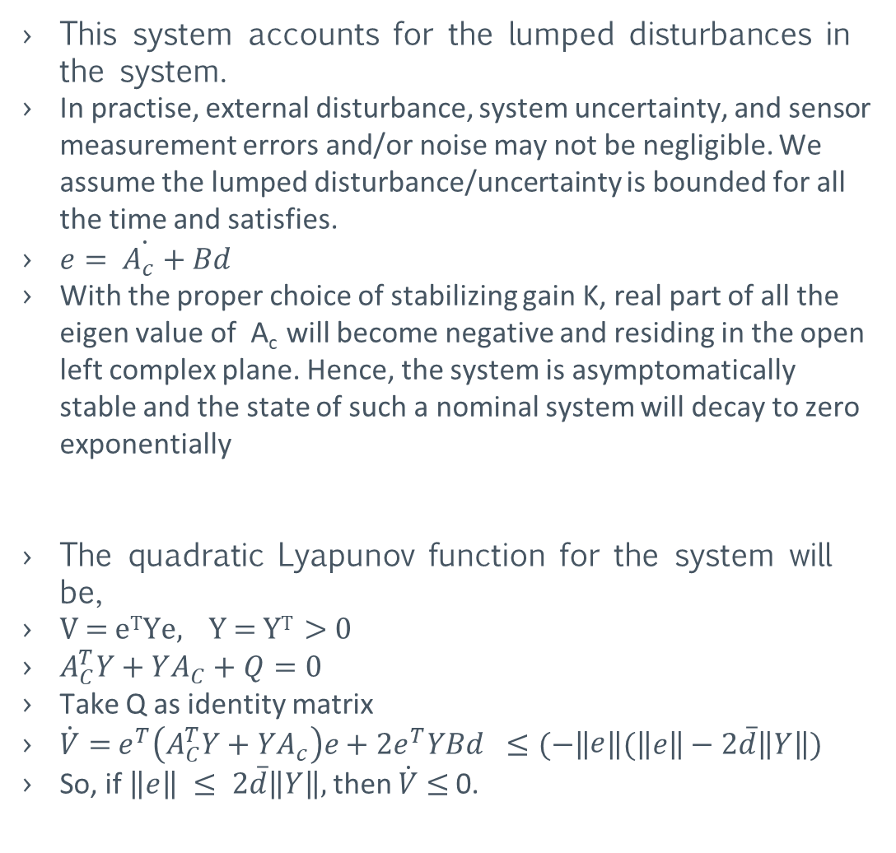
NON-NOMINAL SYSTEM
This system accounts for the lumped disturbances in the system.
In practise, external disturbance, system uncertainty, and sensor measurement errors and/or noise may not be negligible. We assume the lumped disturbance/uncertainty is bounded for all the time and satisfies.
$\dot{e= A_{c}+Bd}$
With the proper choice of stabilizing gain K, real part of all the eigen value of A_{c} will become negative and residing in the open left complex plane. Hence, the system is asymptomatically stable and the state of such a nominal system will decay to zero exponentially
The quadratic Lyapunov function for the system will be,
V = e^{T}Ye, Y = Y^{T} > 0
$A_{C}^{T}Y+YA_{C}+Q=0$
Take Q as identity matrix
$\dot{V}=$ $e^{T}\left(A_{C}^{T}Y+YA_{c}\right)e+2e^{T}YBd$ $≤(−\left\|\begin{matrix}e\end{matrix}\right\|(\left\|e\right\|−2\overline{d}\left\|Y\right\|)$
So, if $\left\|e\right\| ≤ 2\overline{d}\left\|Y\right\|,$ then $\dot{V}$ $≤$ 0.

Slide 22
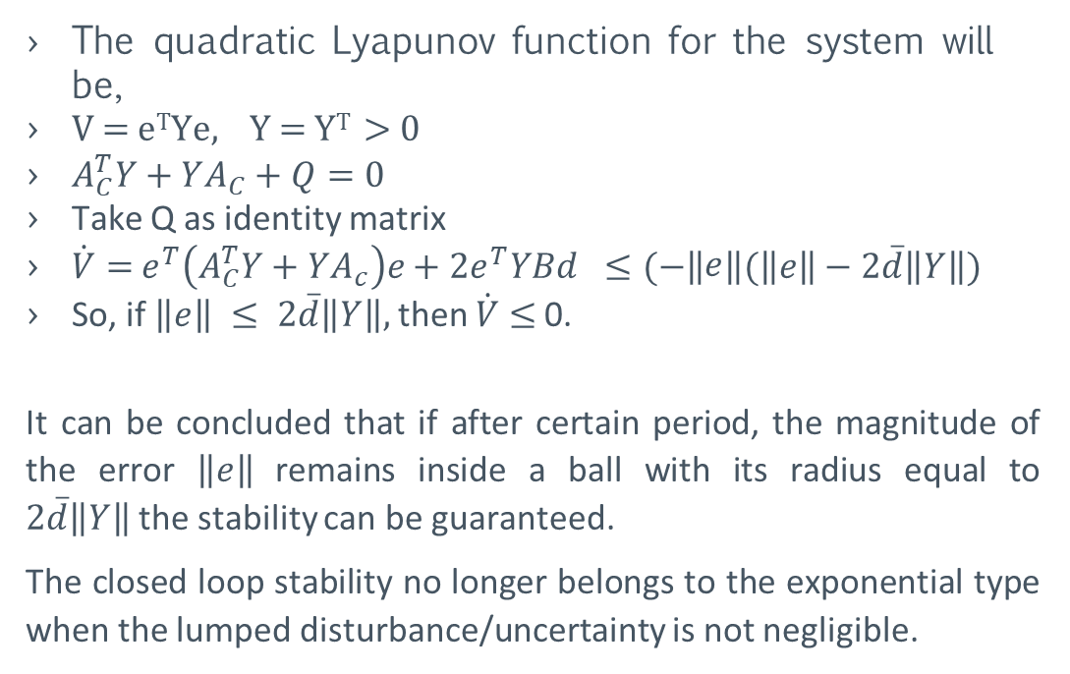
NON-NOMINAL SYSTEM
The quadratic Lyapunov function for the system will be,
V = e^{T}Ye, Y = Y^{T} > 0
$A_{C}^{T}Y+YA_{C}+Q=0$
Take Q as identity matrix
$\dot{V}=$ $e^{T}\left(A_{C}^{T}Y+YA_{c}\right)e+2e^{T}YBd$ $≤(−\left\|\begin{matrix}e\end{matrix}\right\|(\left\|e\right\|−2\overline{d}\left\|Y\right\|)$
So, if $\left\|e\right\| ≤ 2\overline{d}\left\|Y\right\|,$ then $\dot{V}$ $≤$ 0.
It can be concluded that if after certain period, the magnitude of the error $\left\|e\right\|$remains inside a ball with its radius equal to $2\overline{d}\left\|Y\right\|$the stability can be guaranteed.
The closed loop stability no longer belongs to the exponential type when the lumped disturbance/uncertainty is not negligible.

Slide 23
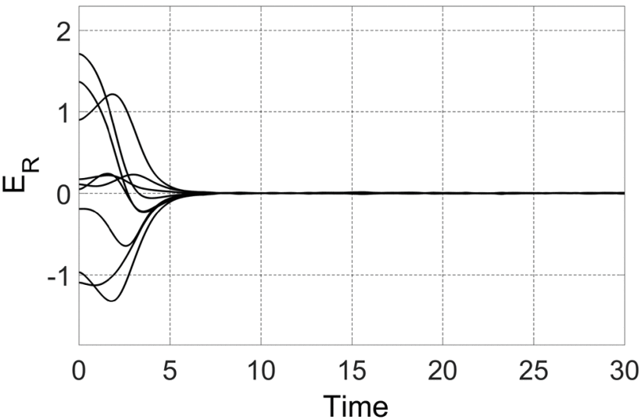
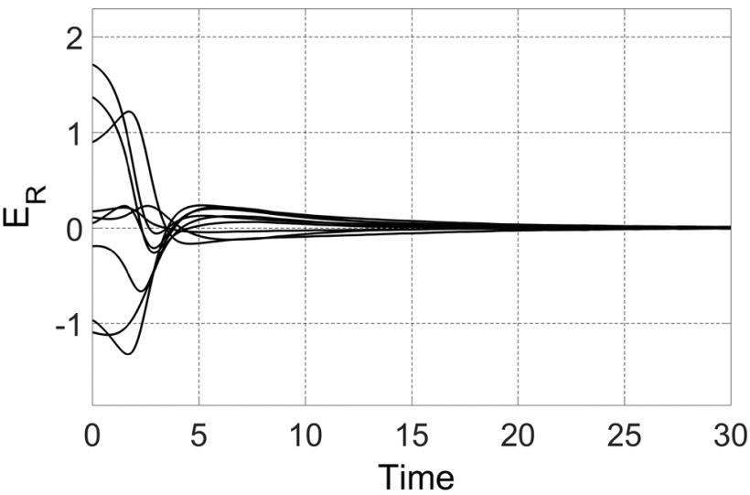
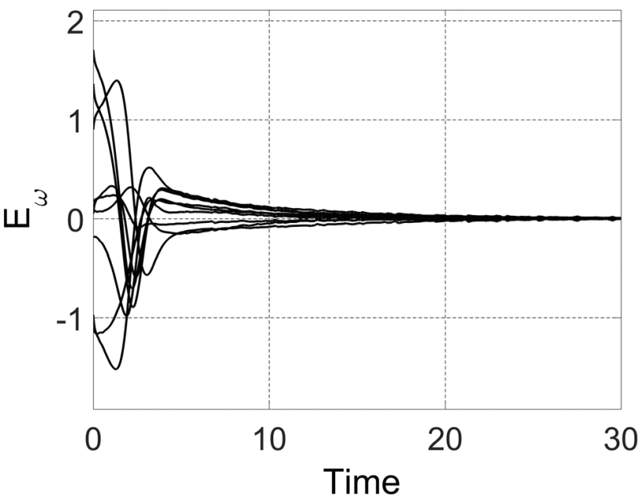
Validation and Performance Assessment
E_{ω} feedback
H∞ design

Slide 24
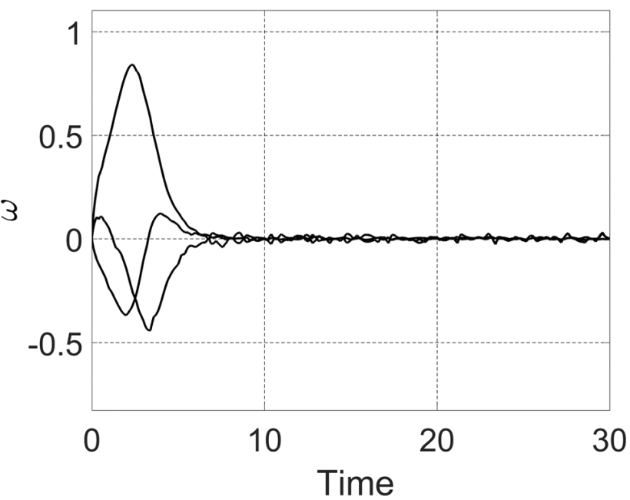
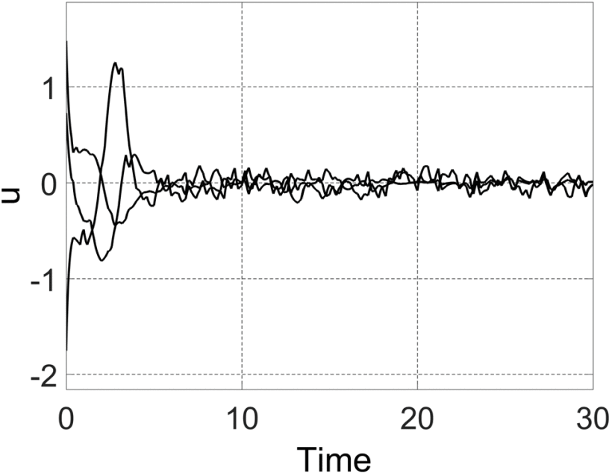
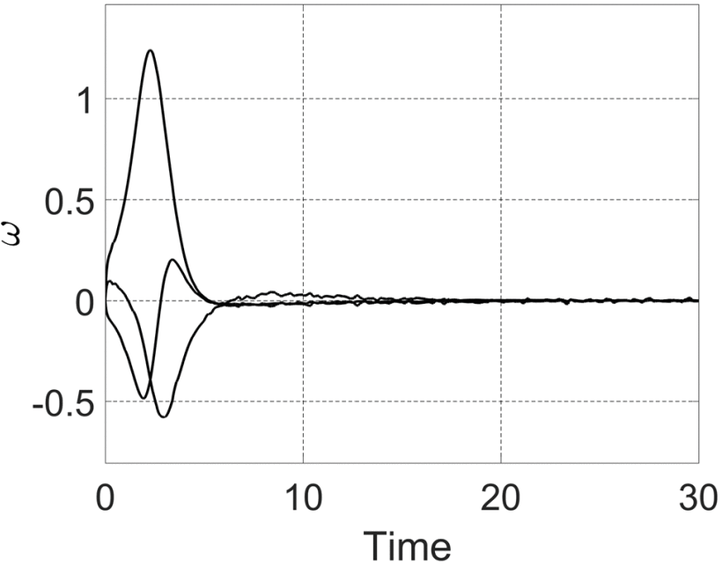
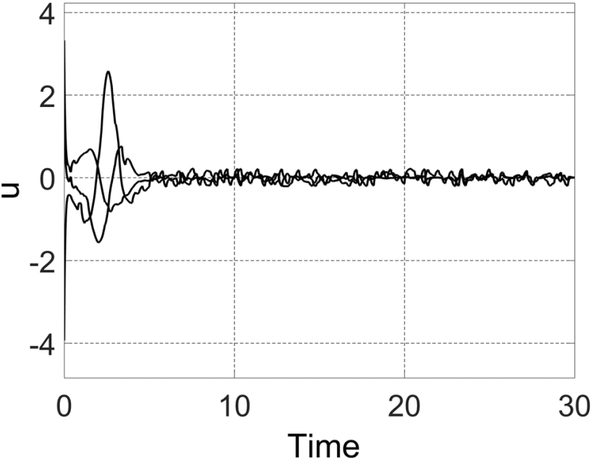
Validation and Performance Assessment
E_{ω} feedback
H∞ design

Slide 25
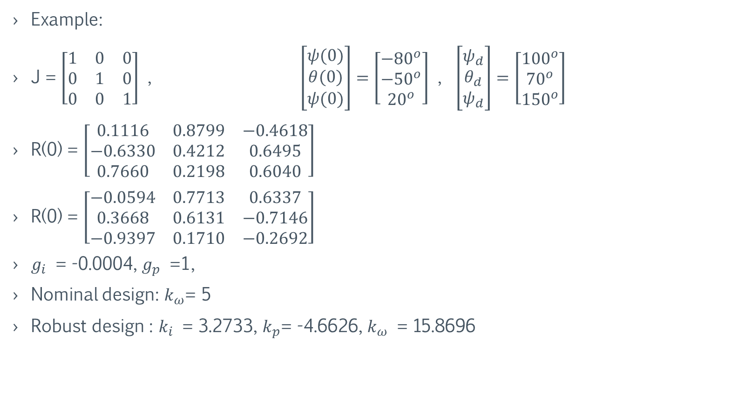
Validation and Performance Assessment
Example:
J = $\left[\begin{matrix}1 & 0 & 0 \\ 0 & 1 & 0 \\ 0 & 0 & 1\end{matrix}\right]$ , $\left[\begin{matrix}ψ(0) \\ θ(0) \\ ψ(0)\end{matrix}\right]=\left[\begin{matrix}−{80}^{o} \\ {−50}^{o} \\ {20}^{o}\end{matrix}\right]$ , $\left[\begin{matrix}ψ_{d} \\ θ_{d} \\ ψ_{d}\end{matrix}\right]=\left[\begin{matrix}{100}^{o} \\ {70}^{o} \\ {150}^{o}\end{matrix}\right]$
R(0) = $\left[\begin{matrix}0.1116 & 0.8799 & −0.4618 \\ −0.6330 & 0.4212 & 0.6495 \\ 0.7660 & 0.2198 & 0.6040\end{matrix}\right]$
R(0) = $\left[\begin{matrix}−0.0594 & 0.7713 & 0.6337 \\ 0.3668 & 0.6131 & −0.7146 \\ −0.9397 & 0.1710 & −0.2692\end{matrix}\right]$
$g_{i}$ = -0.0004, $g_{p}$ =1,
Nominal design: $k_{ω}$= 5
Robust design : $k_{i}$ = 3.2733, $k_{p}$= -4.6626, $k_{ω}$ = 15.8696

Slide 26
Validation and Performance Assessment
We conducted the simulations with the above-mentioned data to generate trajectories of errors, angular velocities, controls, and the disturbance put into the system. However, the plots we received from our simulations were slightly different from the plots provided in the paper. Therefore, to provide accurate results, we have considered the plots provided in the paper.
The simulations clearly portray that both the proposed schemes work well when put under noticeable disturbances and initial attitude errors. All the undesired errors dropped to small values promptly. However, the non-robust design cannot guarantee stability as it does not have disturbance attenuation whereas the robust design does, which leads to the conclusion that robust design is a better approach.

Slide 27
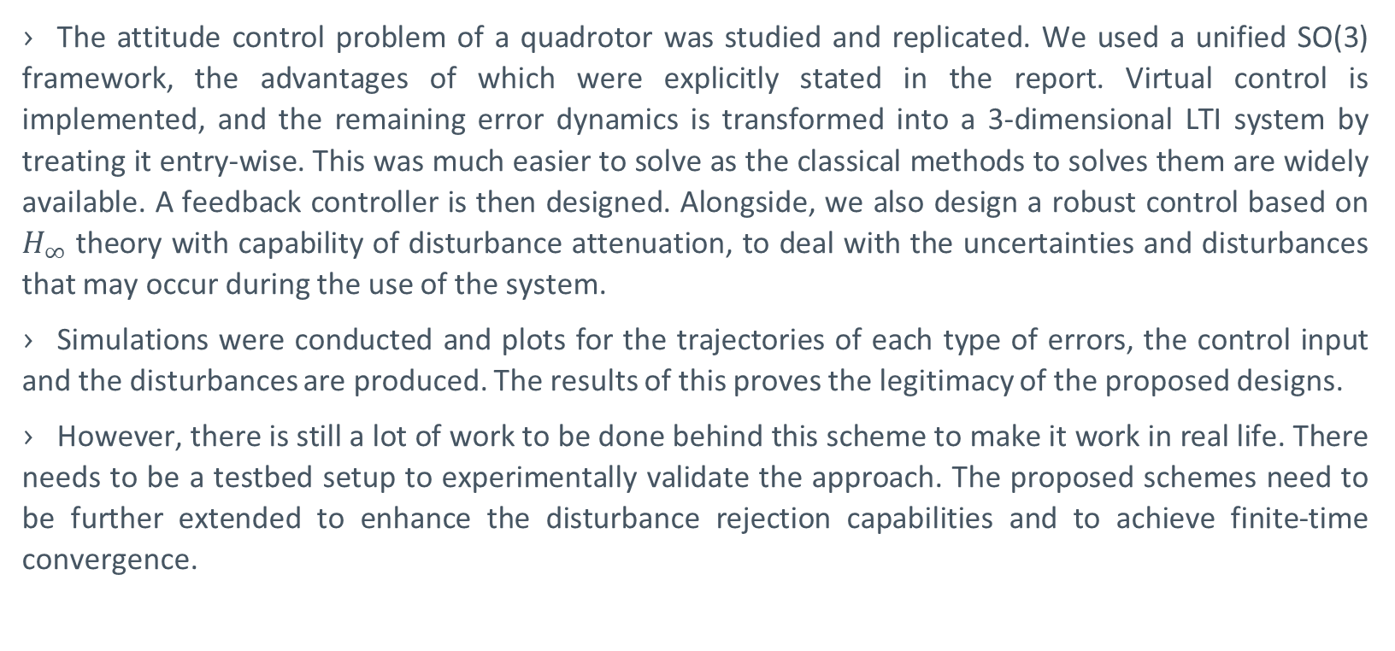
Conclusion
The attitude control problem of a quadrotor was studied and replicated. We used a unified SO(3) framework, the advantages of which were explicitly stated in the report. Virtual control is implemented, and the remaining error dynamics is transformed into a 3-dimensional LTI system by treating it entry-wise. This was much easier to solve as the classical methods to solves them are widely available. A feedback controller is then designed. Alongside, we also design a robust control based on $H_{∞}$ theory with capability of disturbance attenuation, to deal with the uncertainties and disturbances that may occur during the use of the system.
Simulations were conducted and plots for the trajectories of each type of errors, the control input and the disturbances are produced. The results of this proves the legitimacy of the proposed designs.
However, there is still a lot of work to be done behind this scheme to make it work in real life. There needs to be a testbed setup to experimentally validate the approach. The proposed schemes need to be further extended to enhance the disturbance rejection capabilities and to achieve finite-time convergence.

