Slide 1
Capstone Project
IPL T20 Cricket Analysis

Slide 2
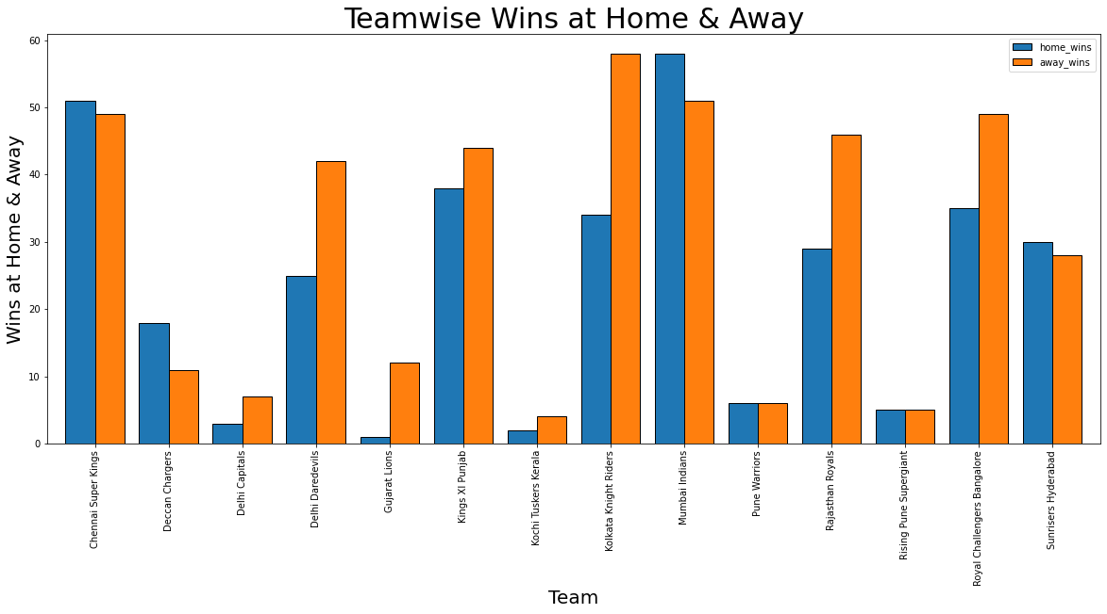
Analysis of Teamwise Wins

Slide 3
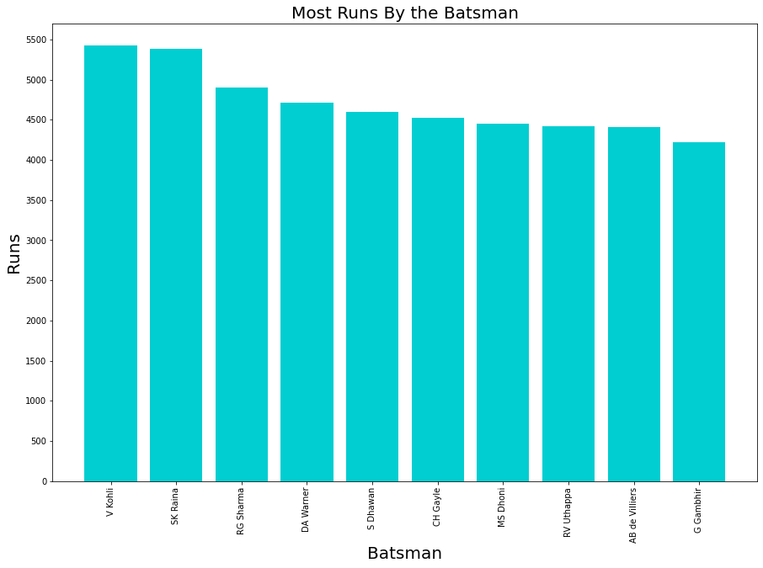
Analysis of Batsman

Slide 4
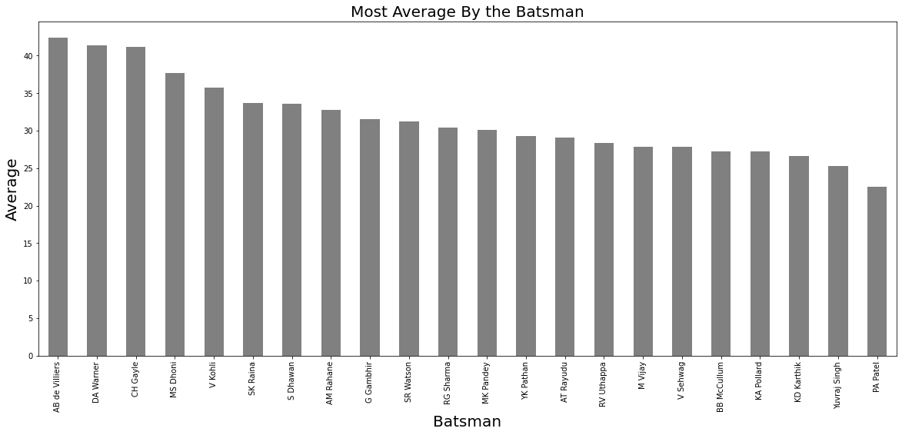
Analysis of Average

Slide 5
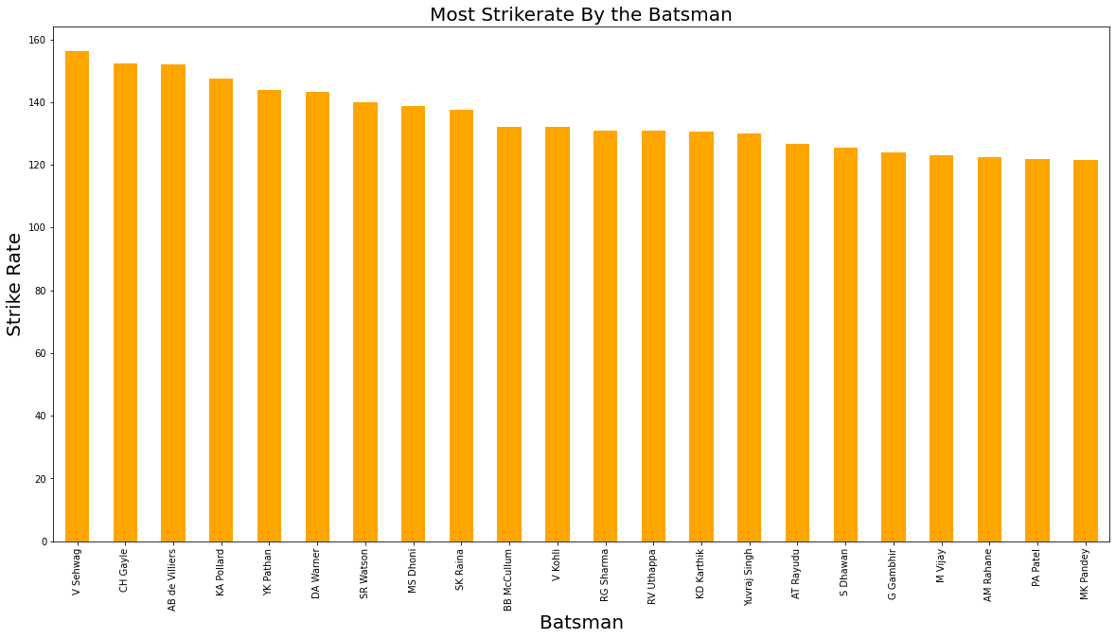
Analysis of Strike Rate

Slide 6
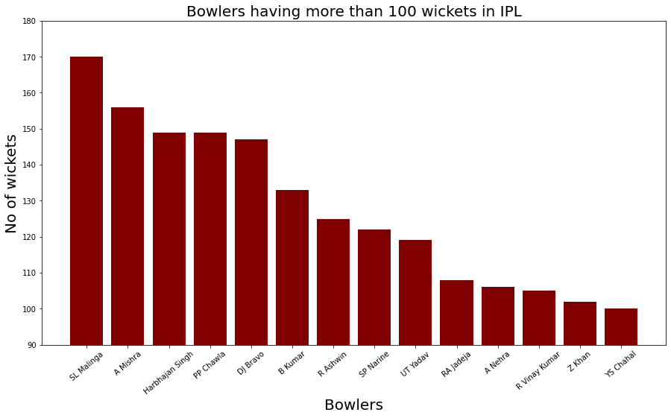
Analysis of Bowler

Slide 7
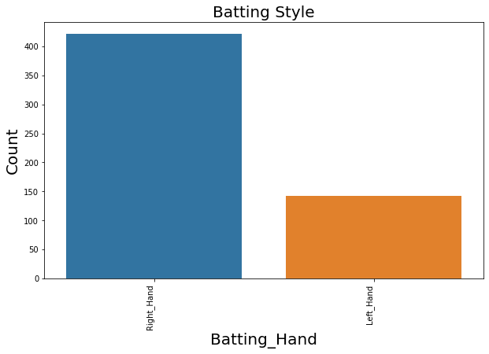
Analysis on Batting Style

Slide 8
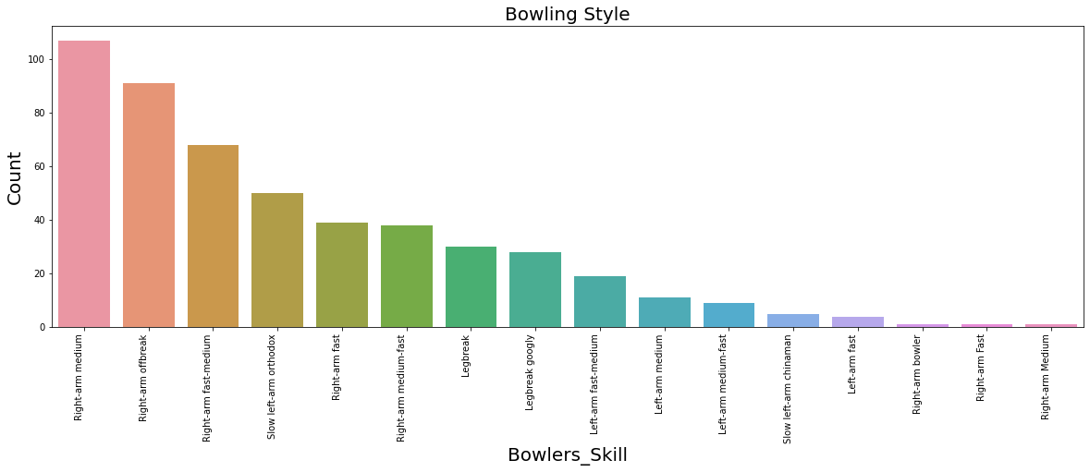
Analysis on Bowling Style

