Slide 1
Capstone Project
IPL T20 Cricket Analysis

Slide 2

Team Consists of: 1. Ameen Attar 2. Pradip Solanki 3. Hrithik Chourasia 4. Vridhi Parmar

Slide 3

Content
Introduction
Dataset Summary
Season Wise Analysis
Player wise Analysis
Team Wise Analysis
Player Rankings
Player Segmentation
Challenges
Conclusion

Slide 4
Introduction
Indian Premier League(IPL) is a professional Twenty20 cricket league inIndia contested during March or April and May of every year by eight teams representing eight different cities in India.
The league was founded by the Board of Control for Cricket in India(BCCI) in 2008 and now it is the most attended cricket league in the world.
In 2010, the IPL became the first sporting event in the world to be broadcasted live on YouTube.

Slide 5
All Dataset
The datasets we are working on are:
1. Matches.csv
2. Players.xlsx
3. Deliveries.csv
4. Teams.csv
5. Most_runs_average_strikerate.csv
6. Teamwise_home_and_away.csv

Slide 6
Dataset Summary
Dataset name: Matches Dataset
Shape: Rows - 756
Columns - 18
Important columns: id, Season, city, date, team1, team2, toss-winner, toss-decision, result, dl-applied, winner, win by runs, win by wickets, player of match, venue, umpire1, umpire2, umpire3

Slide 7
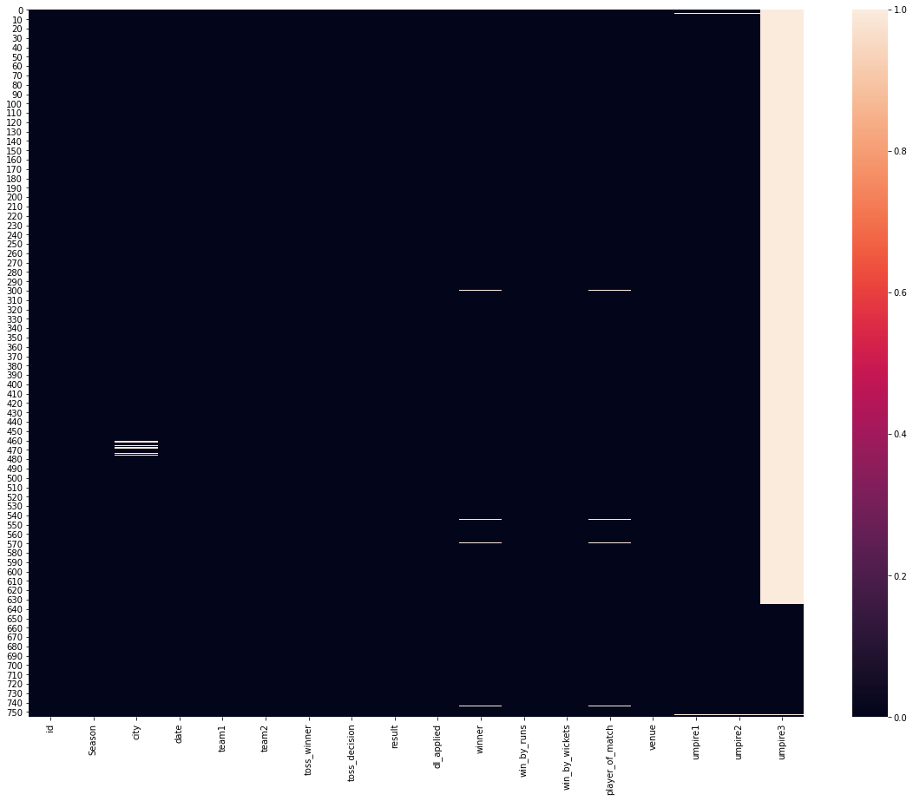
Heat map for missing values in matches dataset

Slide 8
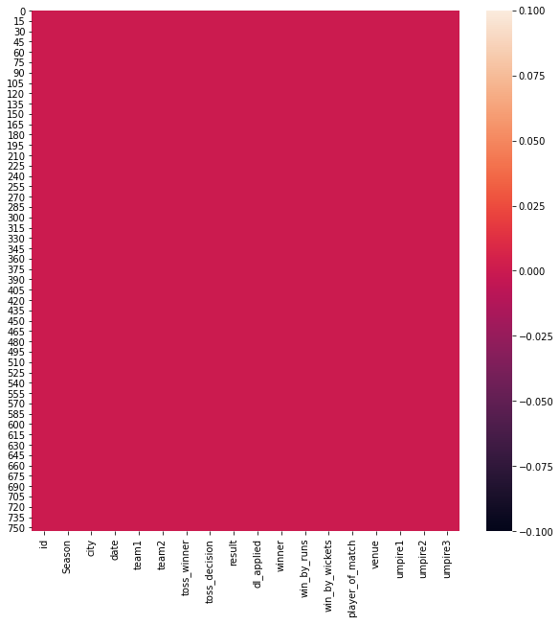
Heat map after filling up the missing values in matches dataset

Slide 9
Dataset Summary
Dataset name: Players Dataset
Shape: Rows - 556
Columns - 5
Important columns: Player Name, DOB, Batting-Hand, Bowling-Skill, Country

Slide 10
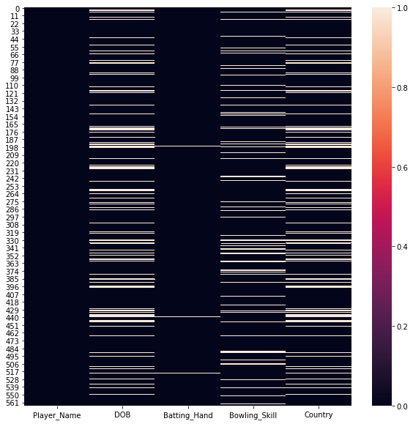
Heat map for missing values in players dataset

Slide 11
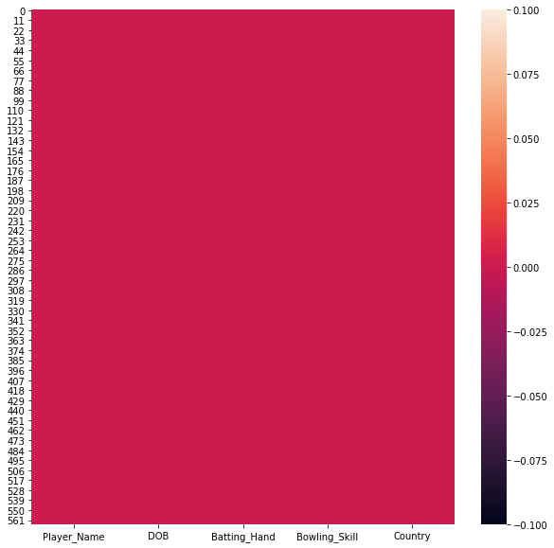
Heat map after filling up the missing values in players dataset

Slide 12
Dataset Summary
Dataset name: Deliveries Dataset
Shape: Rows - 179078
Columns - 21
Important columns: match-id, inning, batting-team, bowling-team, over, ball, batsman, non-striker, bowler, is-super-over, wide-runs, bye-runs, leg-bye-runs, no-ball-runs, penalty-runs, batsman-runs, extra-runs, total-runs, player-dismissed, dismissal-kind, fielder.

Slide 13
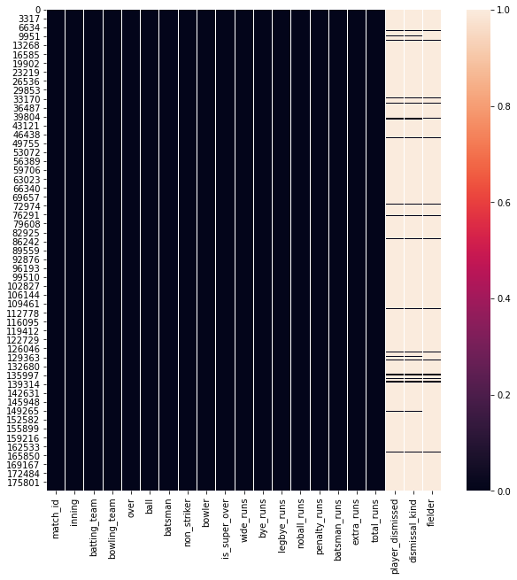
Heat map for missing values in deliveries dataset

Slide 14
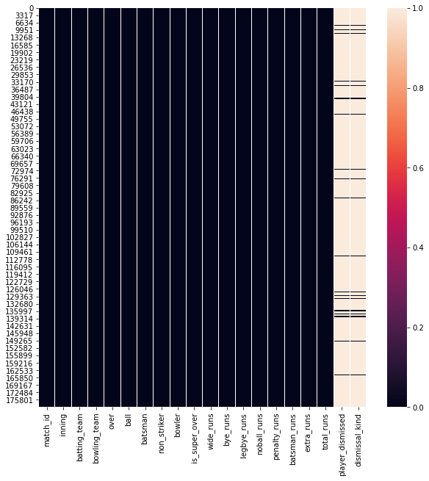
Heat map after dropping off the fielders column from deliveries dataset

Slide 15
Dataset Summary
Dataset name: Most Runs Average Strike-rate Dataset
Shape: Rows - 516
Columns - 6
Important columns: Batsman, total-runs, out, number-of-balls, average, strike-rate

Slide 16
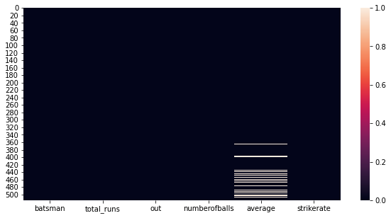
Heat map for missing values in most runs average strike-rate dataset

Slide 17
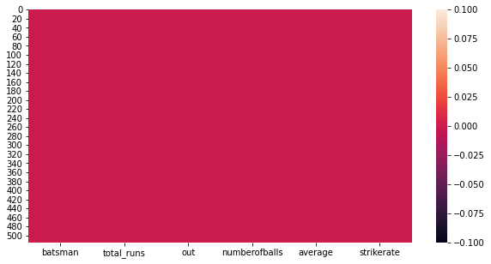
Heat map after filling up the missing values in most runs average strike-rate dataset

Slide 18
Expectations
01. The Number of 6's Scored in a season
02. Total runs scored
03. Number of half centuries by each batsman
04. Number of centuries by each batsman
05. Comparison between the teams
06. Batsman who scored the most number of dot balls.
07. Most common dismissal type in IPL
08. Bowler having more than 100 wickets in IPL
09. No of matches each season
10. No of matches on a particular Venue
11. No of matches played by each team
12. Number of wins per team
13. Top players of the match
14. How lucky are the toss wining team
15. Batsman Analysis
16. The Number of 4's Scored in a season

Slide 19
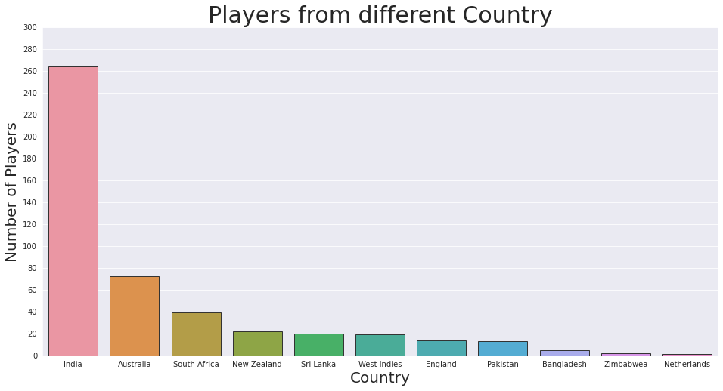
Number of Players from different Country

Slide 20
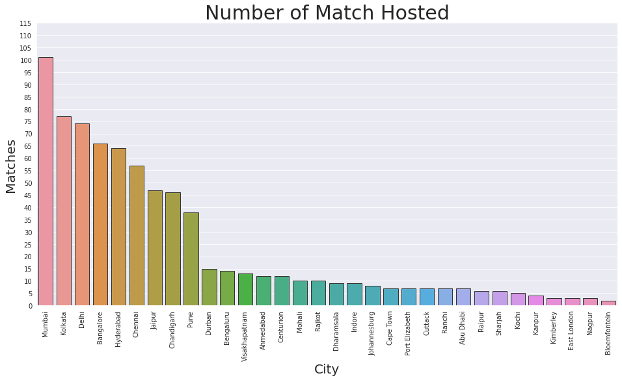
Which City have Hosted most Matches?

Slide 21
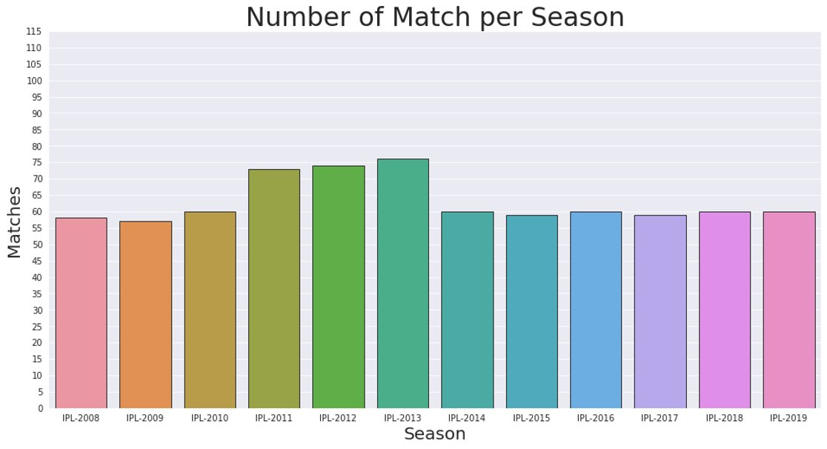

Slide 22
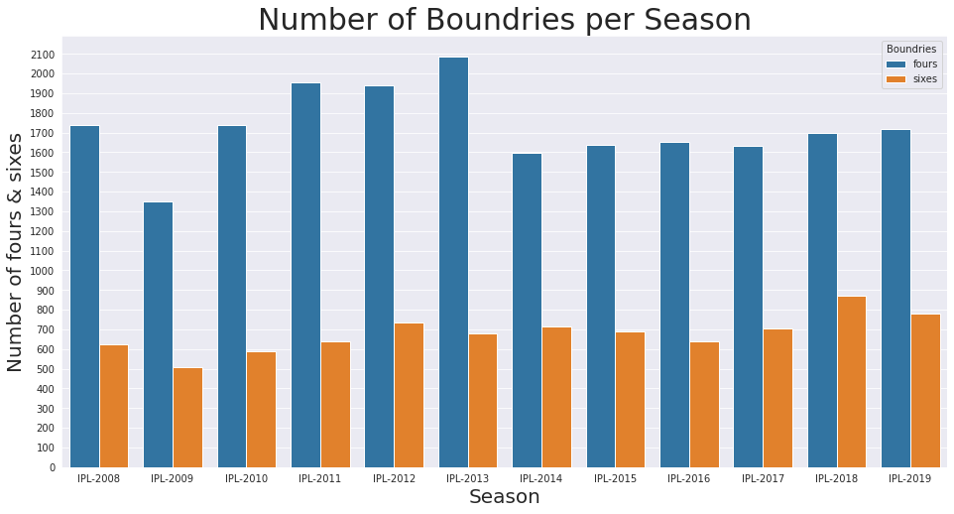

Slide 23
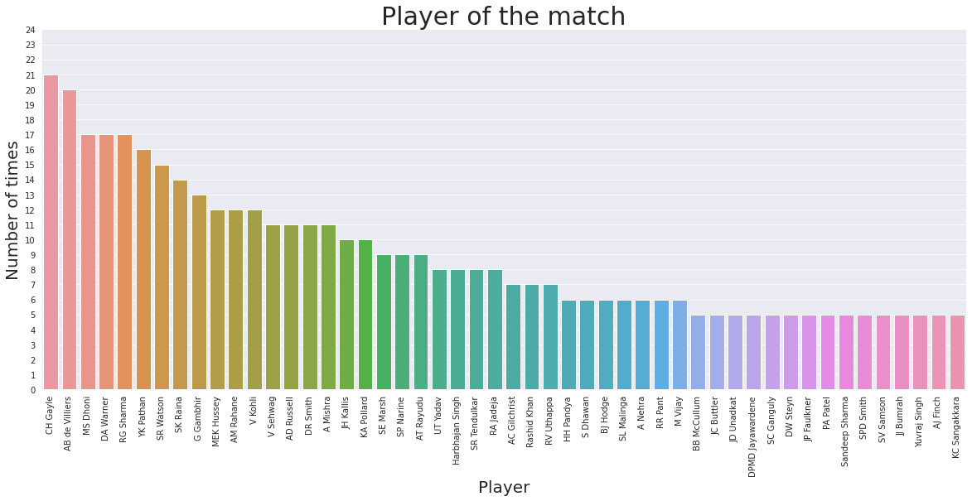
Who won player of the match award most frequently?

Slide 24
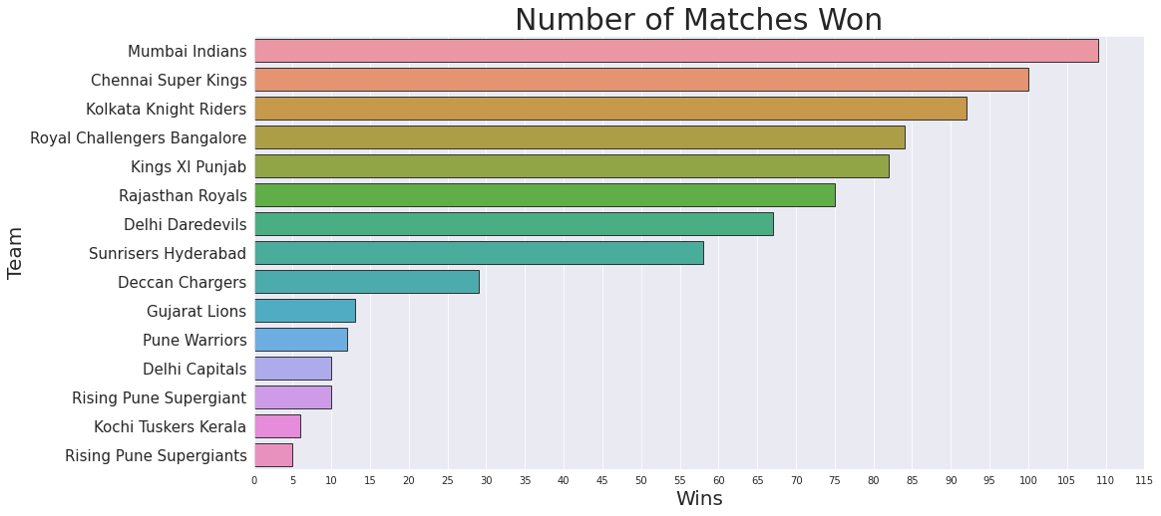
Who won most matches?

Slide 25
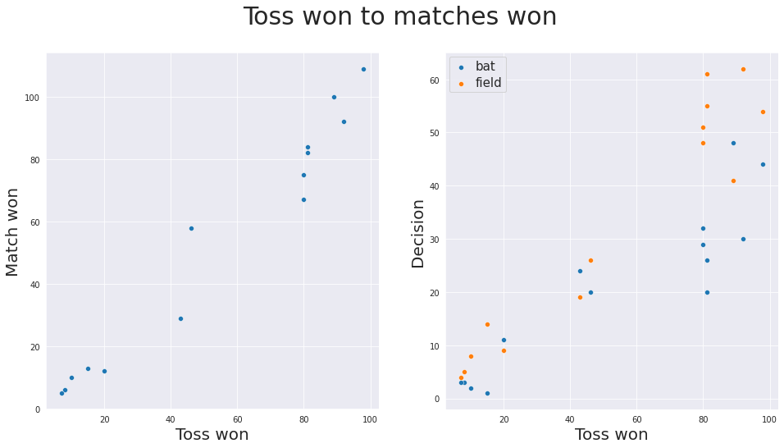
Does winning the toss increases chance of winning the game?

Slide 26
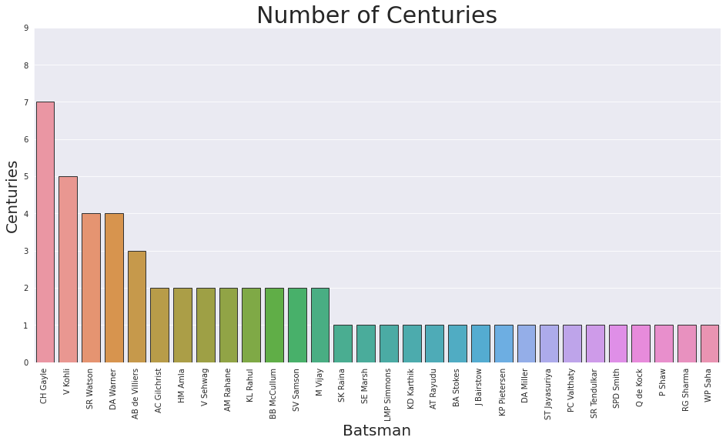

Slide 27
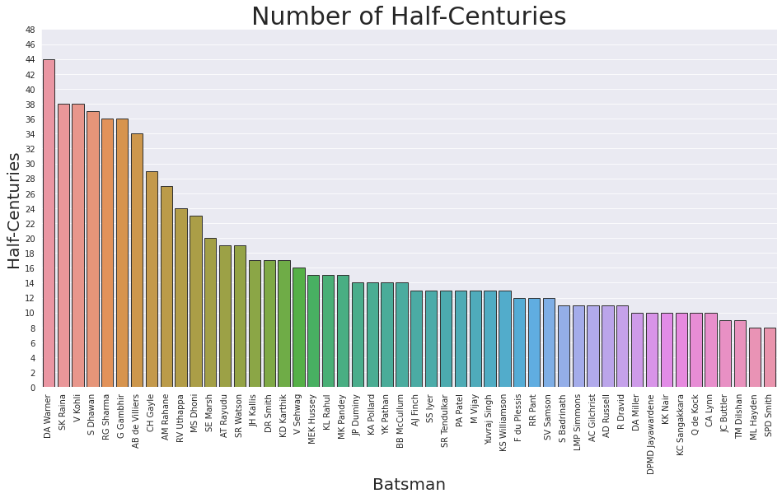

Slide 28
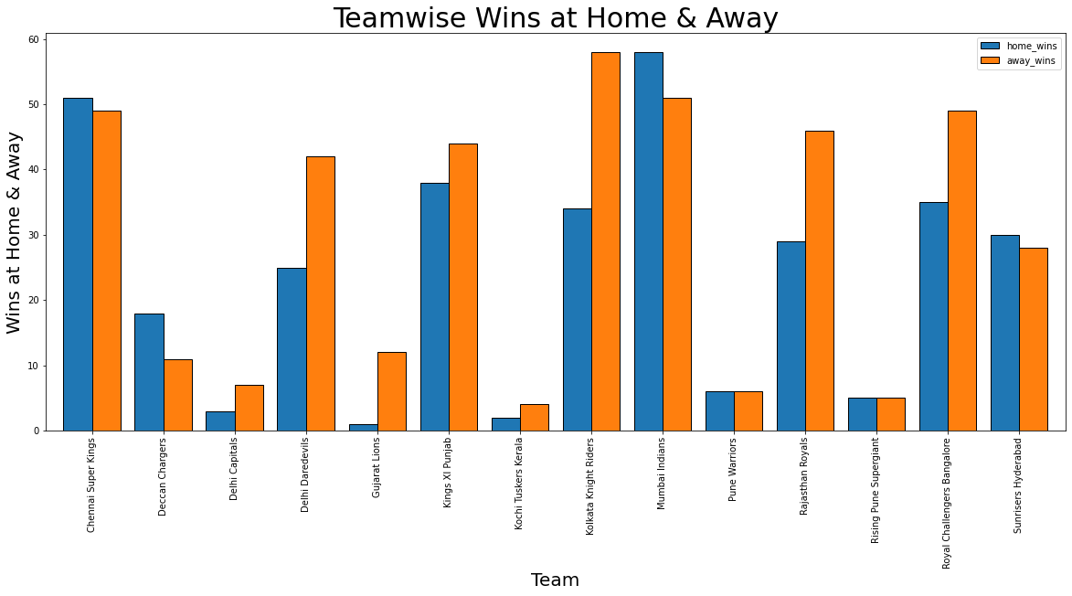
Analysis of Teamwise Wins

Slide 29
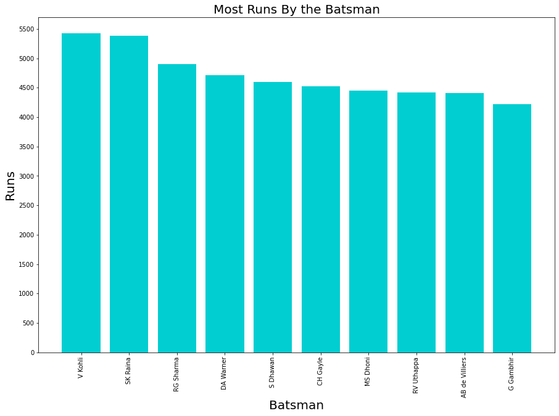
Analysis of Batsman

Slide 30
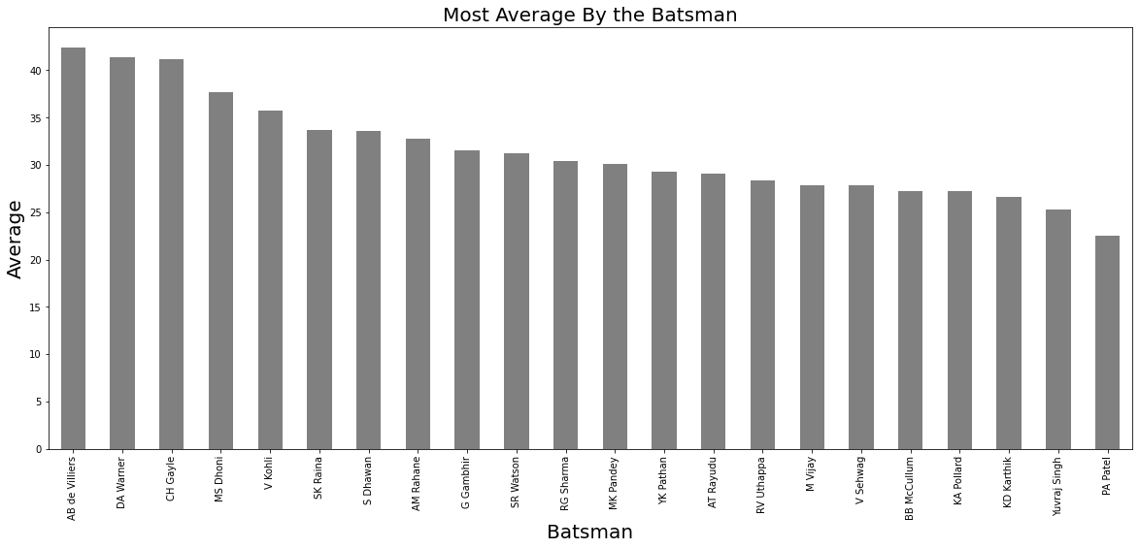
Analysis of Average

Slide 31
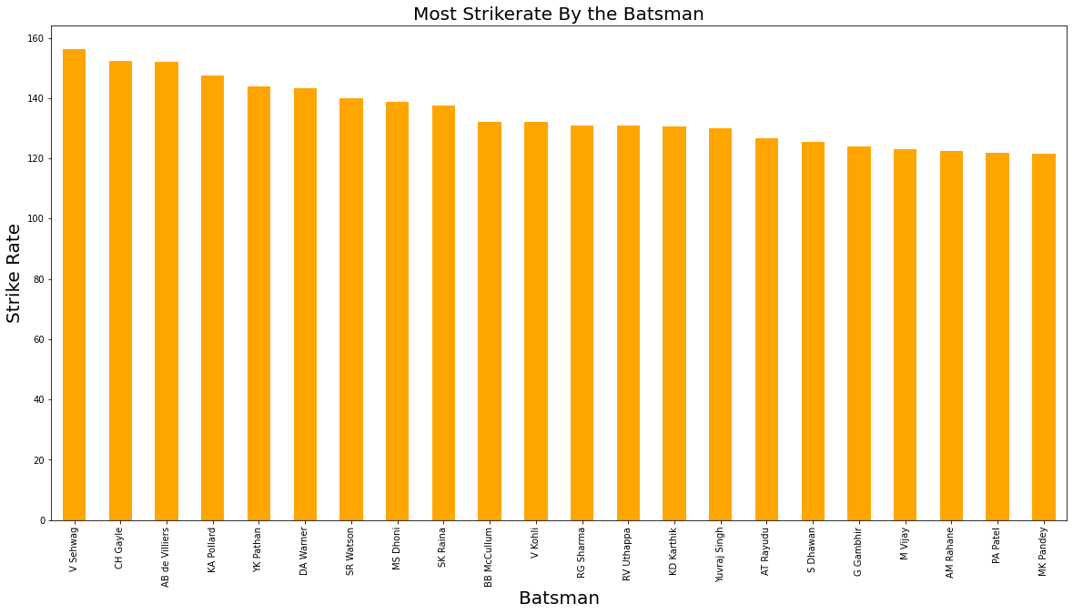
Analysis of Strike Rate

Slide 32
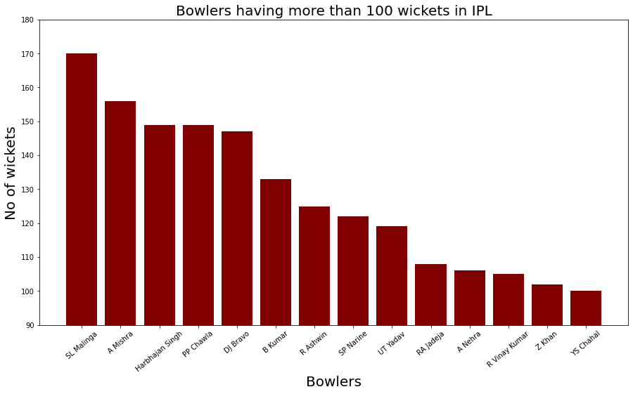
Analysis of Bowler

Slide 33
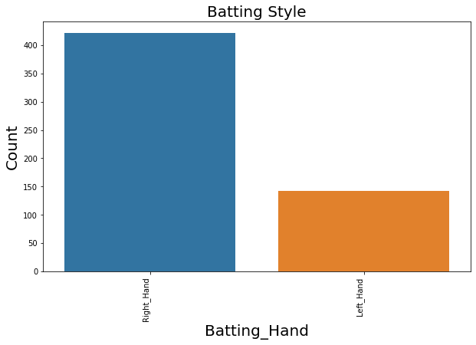
Analysis on Batting Style

Slide 34
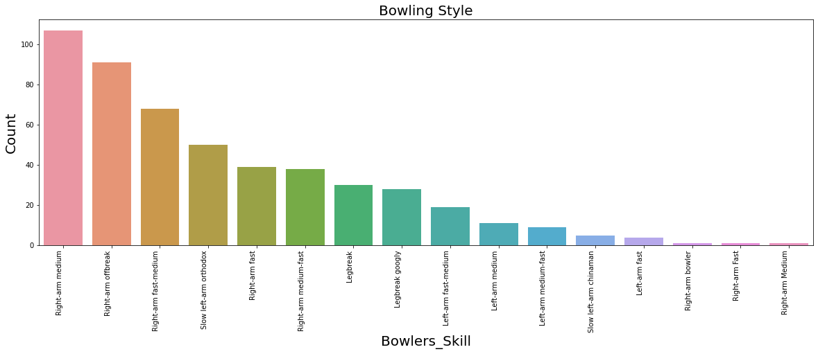
Analysis on Bowling Style

Slide 35
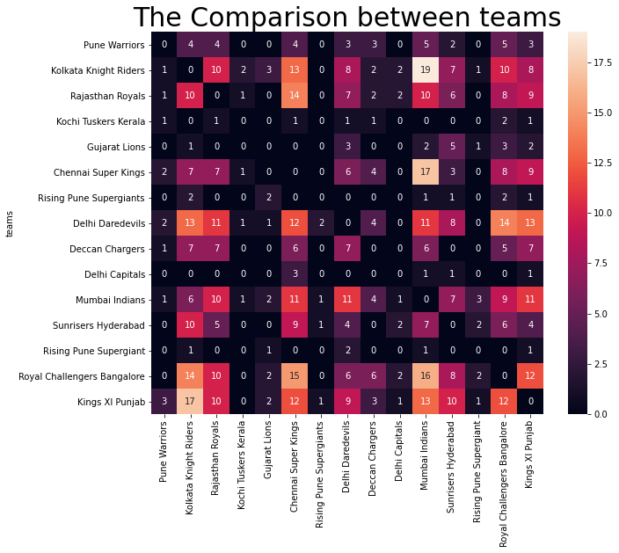
.

Slide 36
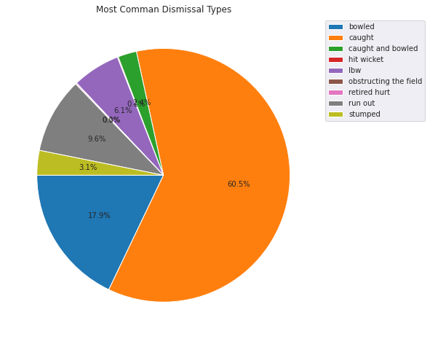

Slide 37
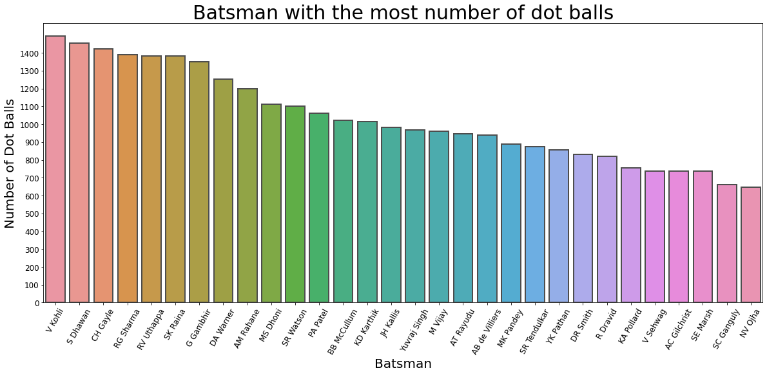

Slide 38
Challenges
> Lots of Nan Values in Datasets.
> For analysis we had to combine data from different datasets.
> We have to deal with un useful data from most of datasets.
> Due to No. of Datasets, it took time to analyze all of the things.

Slide 39
Conclusion
1. The number of matches each season is lies between 50 to 80 matches.
2. The most number of Matches were hosted in Mumbai and the least were hosted in Venue Bloemfontein.
3. The most number of players were from India and the least number of players were playing from Netherland.
4. After winning the toss most of the teams choose to Field.
5. The most number of Matches were won by Mumbai Indians with around 109 wins.
6. In team comparison we observed that Kolkata Knight Riders lose most of the matches against Mumbai Indians loosing more than 19 matches.
7. The batsman who played most number of dot balls is Virat Kohli.
8. The most Dismissal type in IPL is caught out.

Slide 40
9. The most Half Centuries was scored by D. A. Warner.
10. The Player who won most of the Man of The Match was Chris Gayle
11. The average number of Four's and Six's per season lies somewhere around 1800 and 850 respectively.
12. The most full centuries was scored by Chris Gayle.
13. The most common bowling style is right-arm medium.
14. Most of the batsman are right-handers
15. V. Sehwag have the highest strike rate.
16. S.L. Malinga have the highest number of wickets in the IPL

