Slide 1
Capstone Project
IPL T20 Cricket Analysis

Slide 2
Team Consists of : 1. Pradip Solanki 2. Hrithik Chourasia 3. Vridhi Parmar 4. Ameen Attar

Slide 3
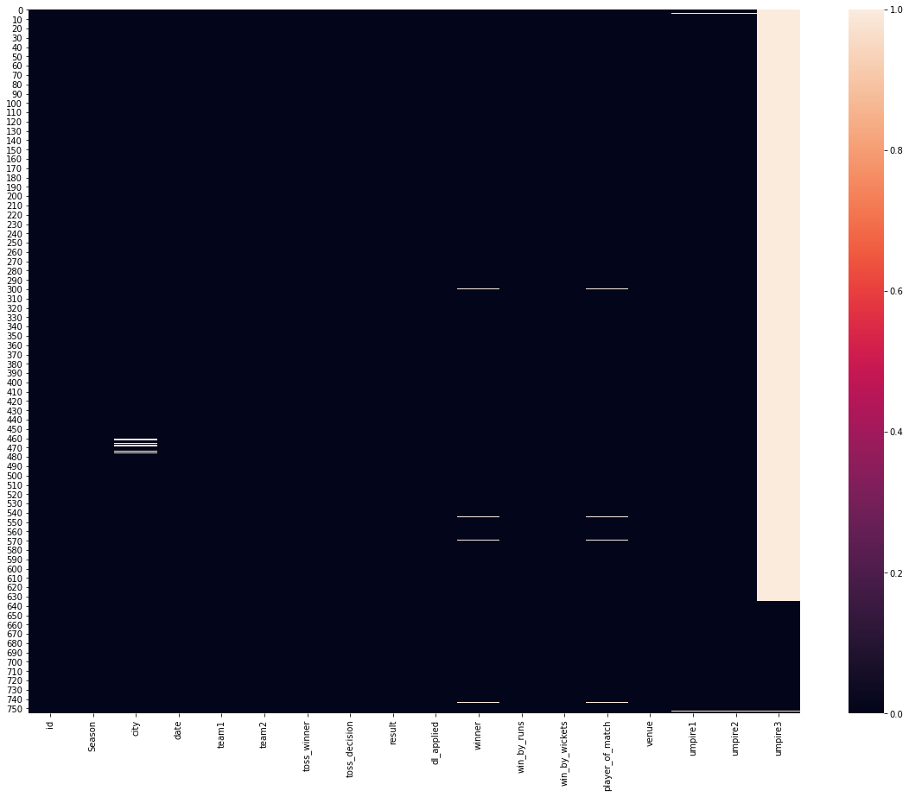
Heat map for missing values in matches dataset

Slide 4
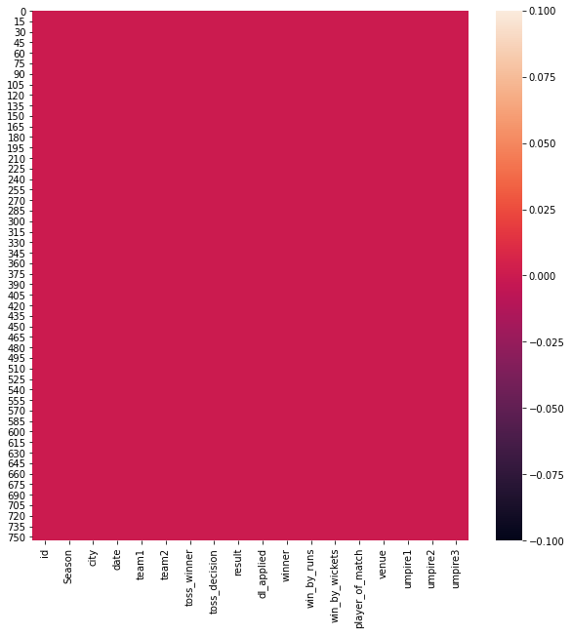
Heat map after filling up the missing values in matches dataset

Slide 5
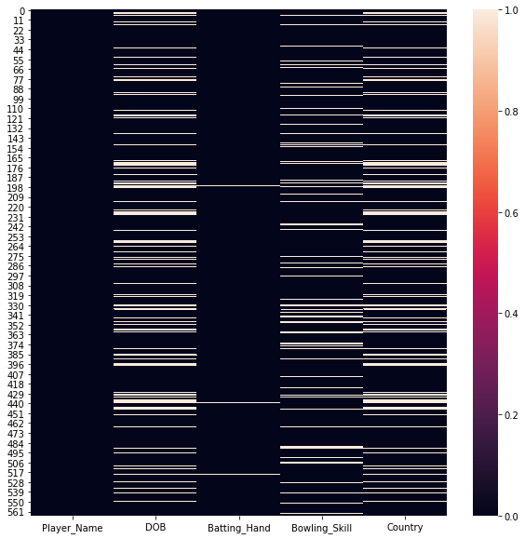
Heat map for missing values in players dataset

Slide 6
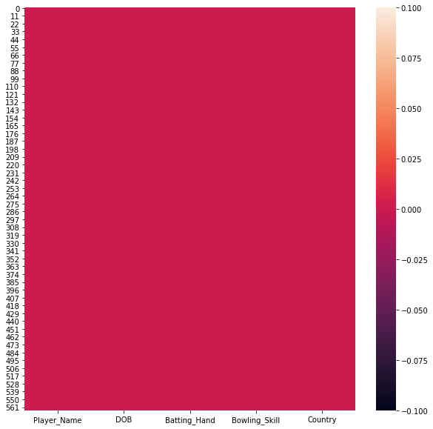
Heat map after filling up the missing values in players dataset

Slide 7
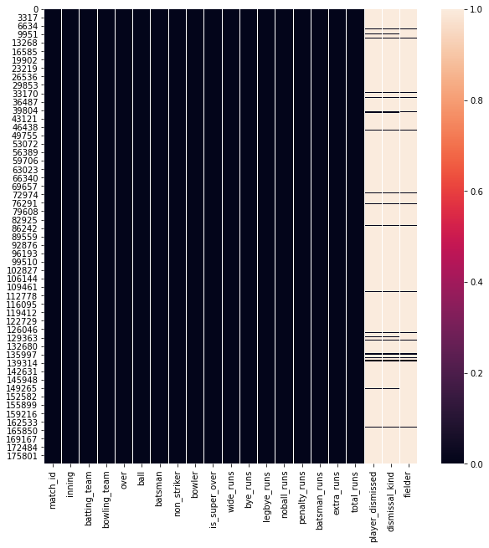
Heat map for missing values in deliveries dataset

Slide 8
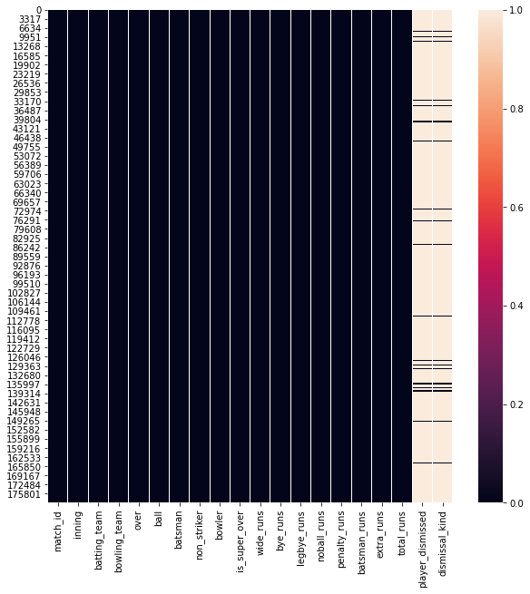
Heat map after dropping off the fielders column from deliveries dataset

Slide 9
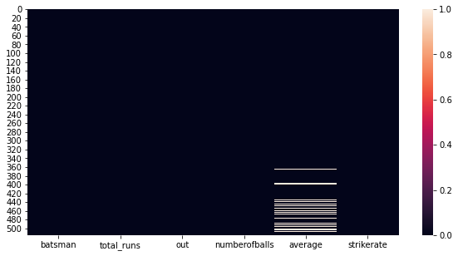
Heat map for missing values in most runs average strikerate dataset

Slide 10
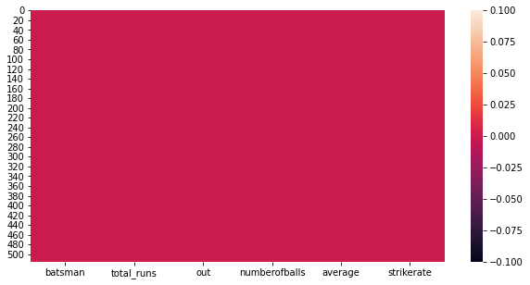
Heat map after filling up the missing values in most runs average strikerate dataset

Slide 11
Expectations goes here

Slide 12
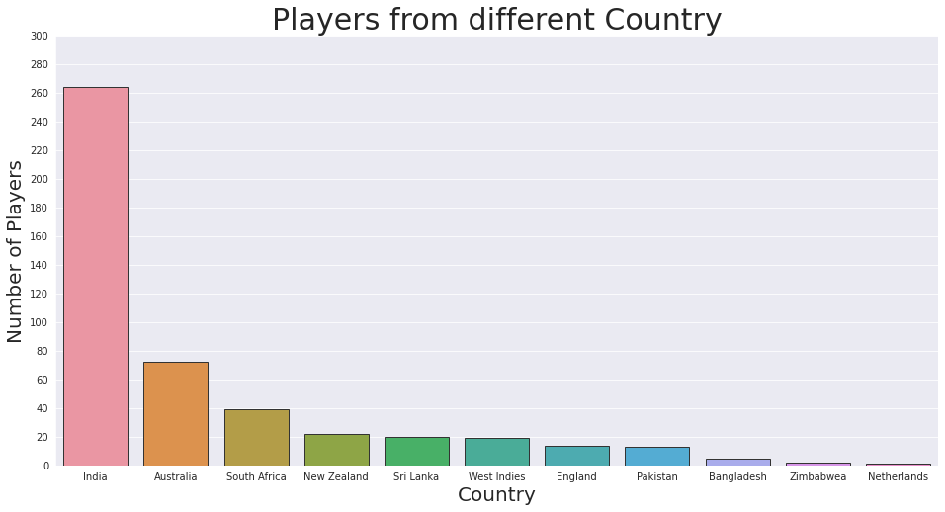
Number of Players from different Country

Slide 13
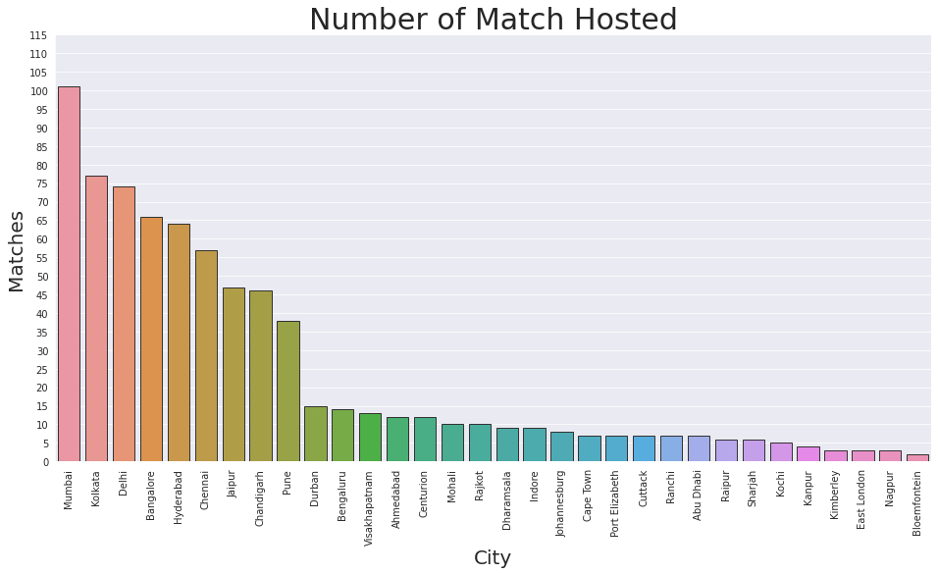
Which city have hosted most matches?

Slide 14
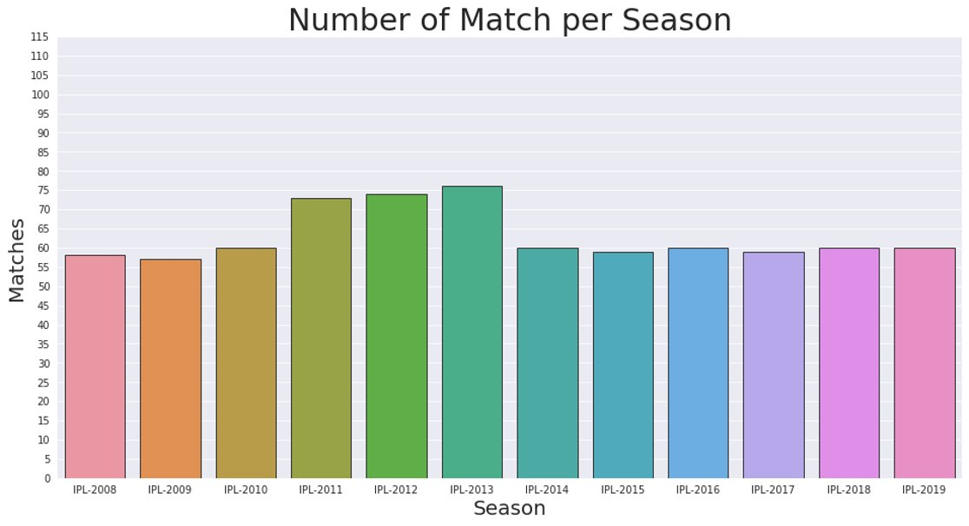

Slide 15
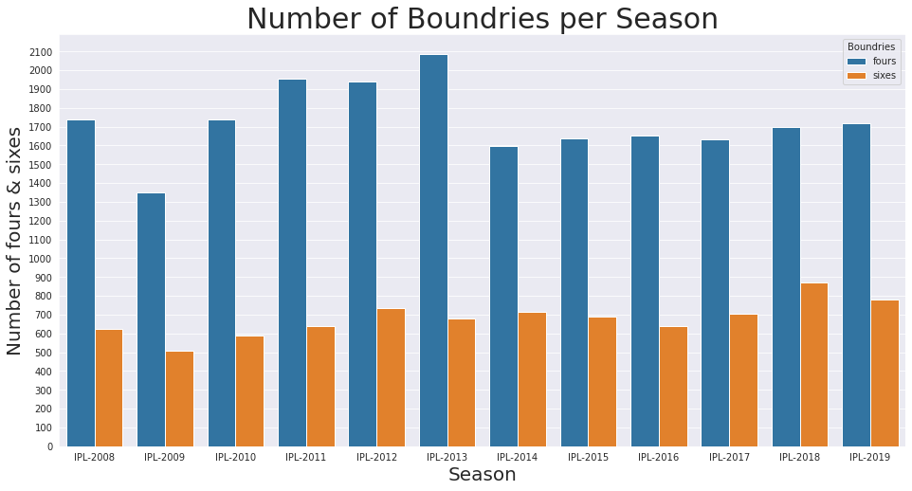

Slide 16
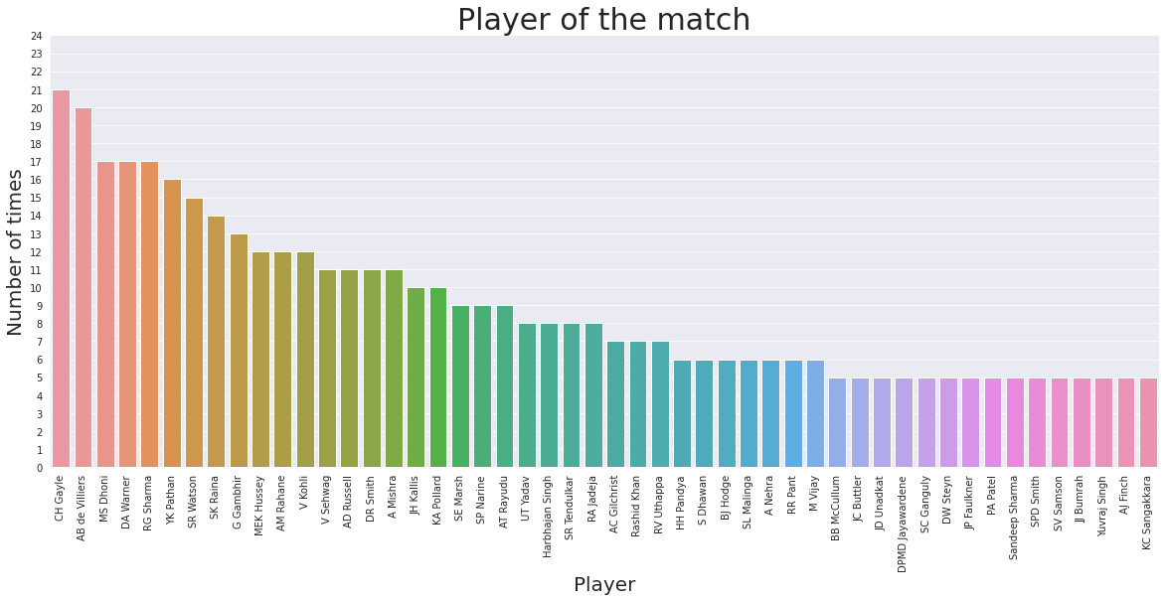
Who won player of the match award most frequently?

Slide 17
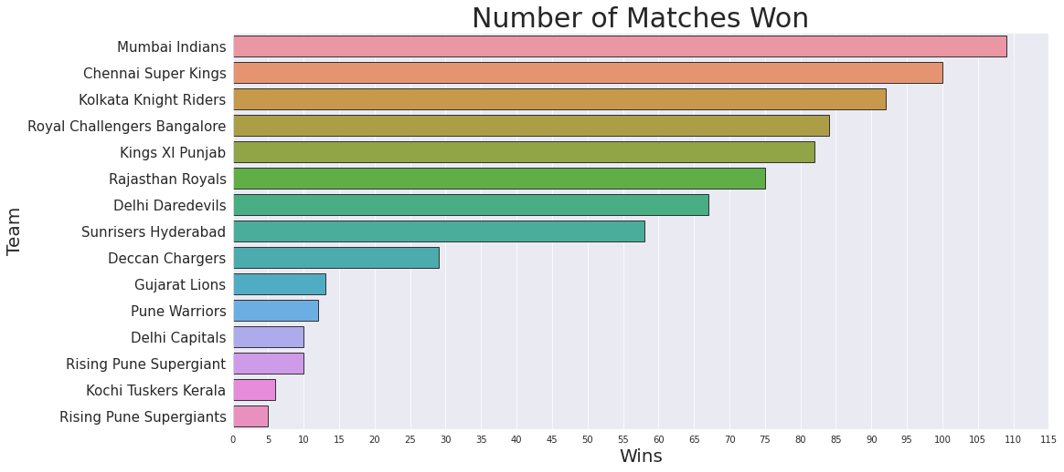
Who won most matches?

Slide 18
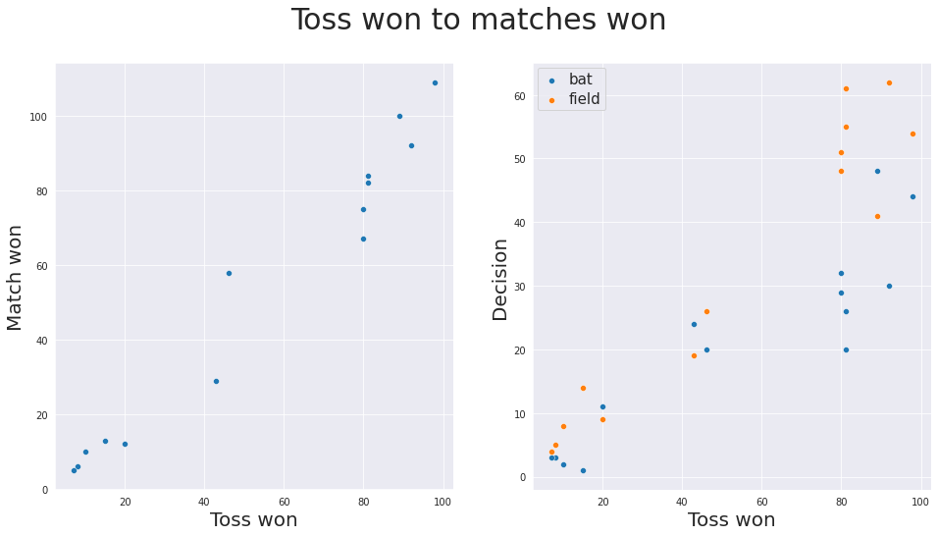
Does winning the toss increases chance of winning the game?

Slide 19
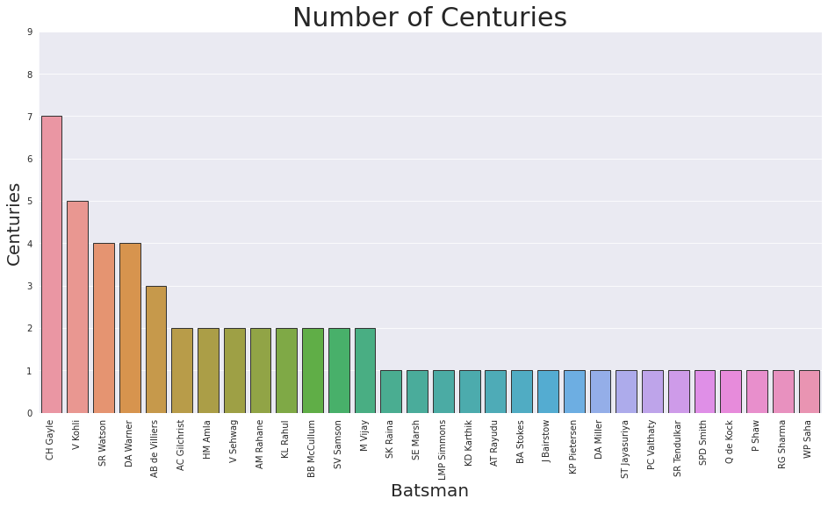

Slide 20
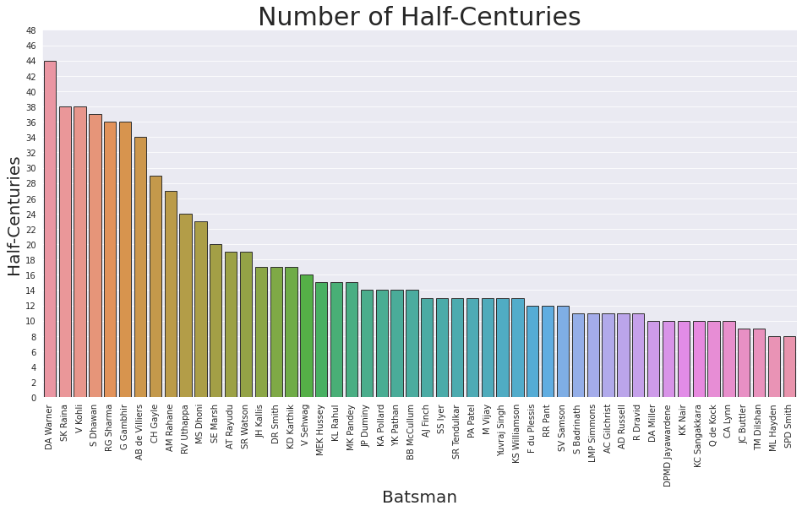

Slide 21
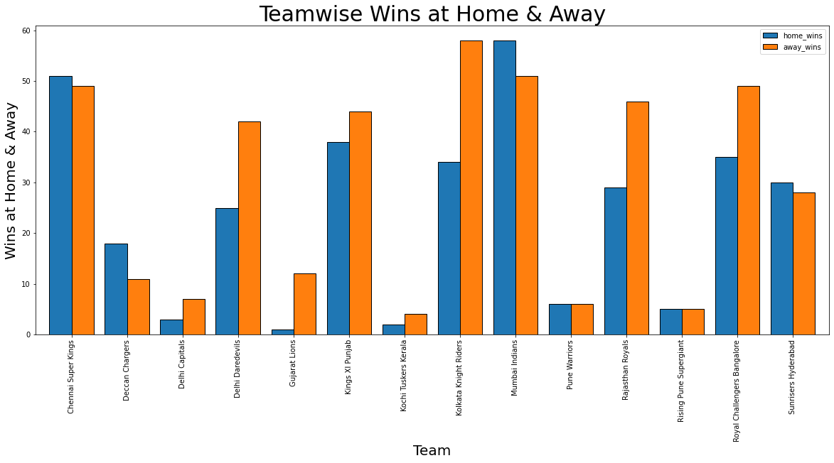
Analysis of Teamwise Wins

Slide 22
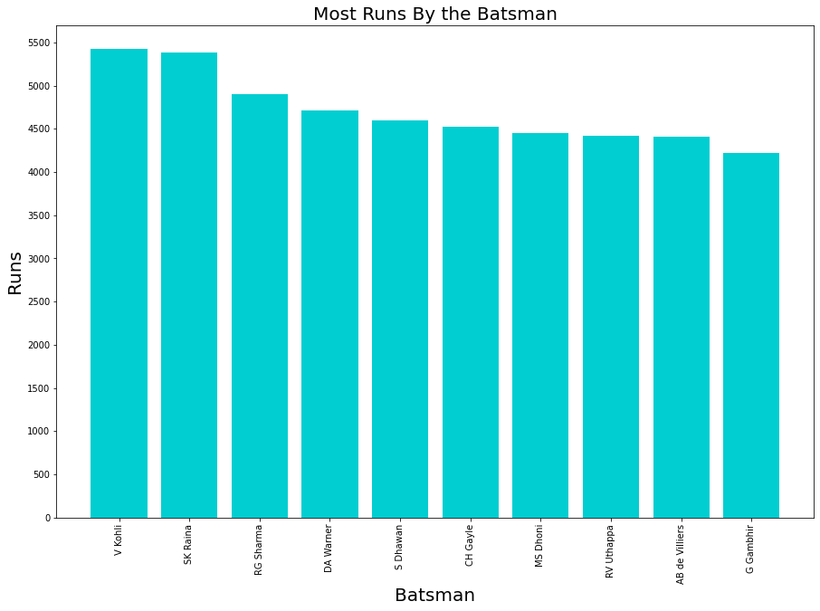
Analysis of Batsman

Slide 23
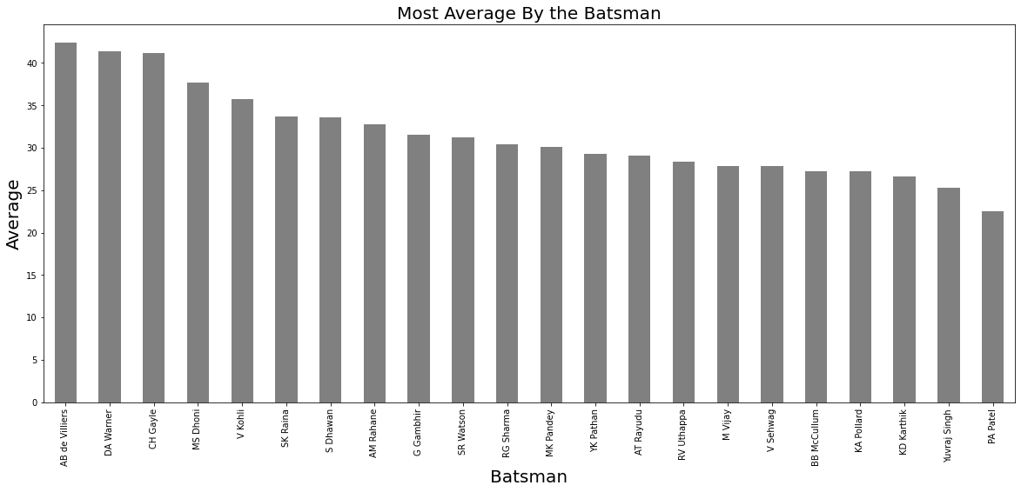
Analysis of Average

Slide 24
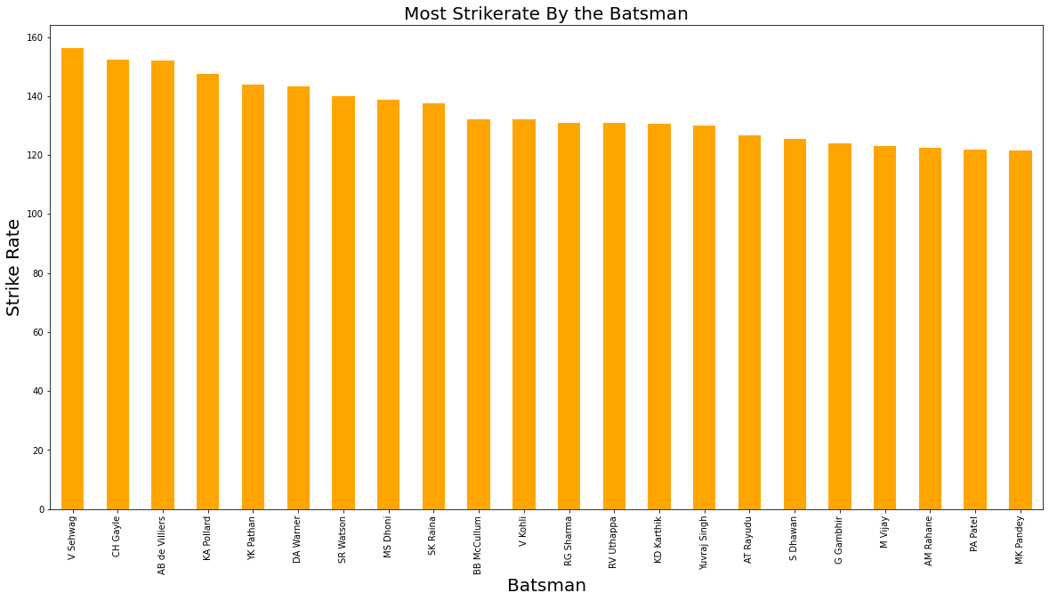
Analysis of Strike Rate

Slide 25
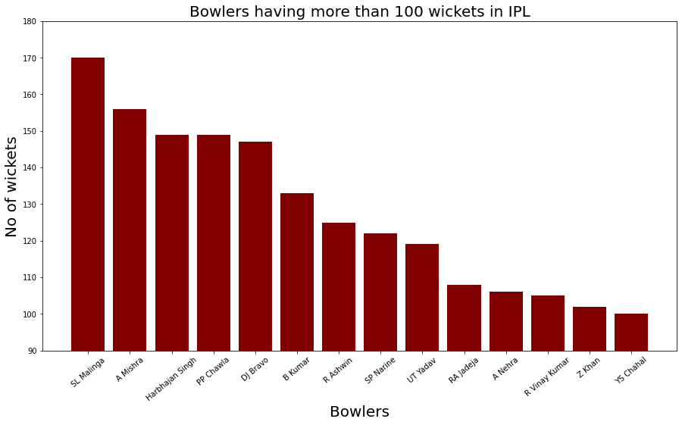
Analysis of Bowler

Slide 26
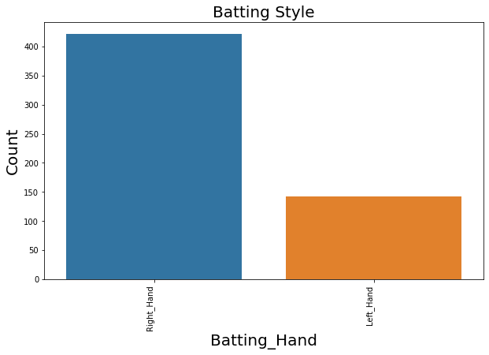
Analysis on Batting Style

Slide 27
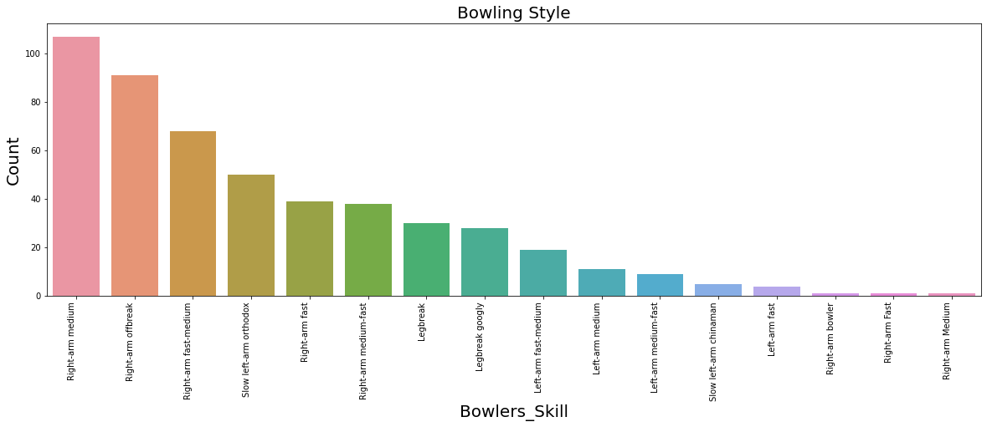
Analysis on Bowling Style

Slide 28
Vridhi's part go here

