Slide 1
Capstone Project
IPL T20 Cricket Analysis

Slide 2
Ameen's part goes here ameen add our names in first slide please

Slide 3
Expectations goes here

Slide 4
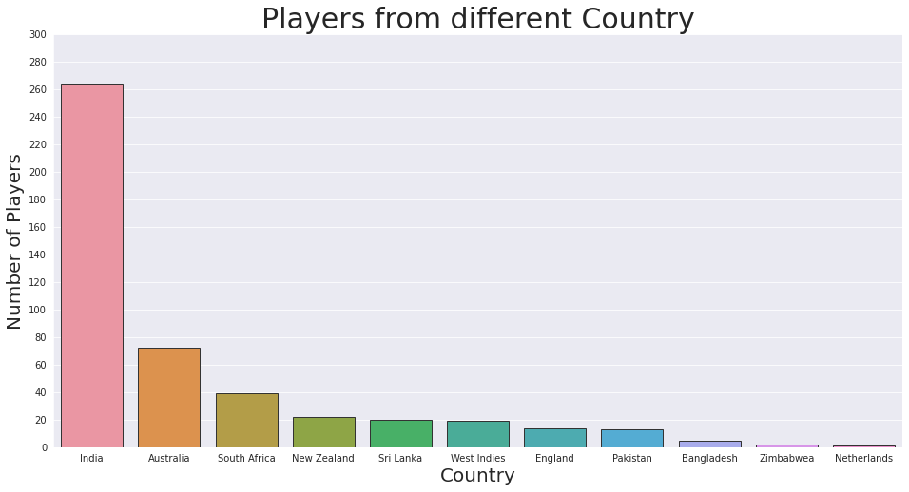
Number of Players from different Country

Slide 5
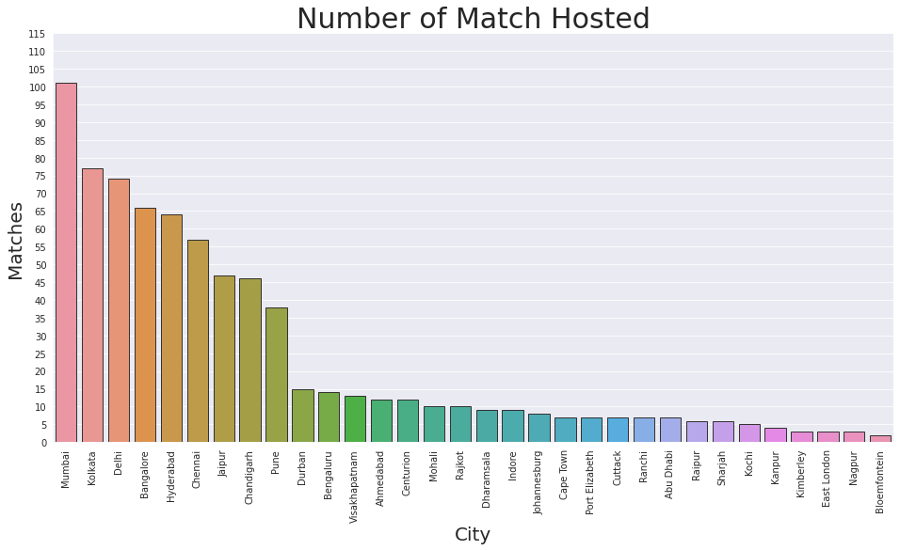
Which city have hosted most matches?

Slide 6
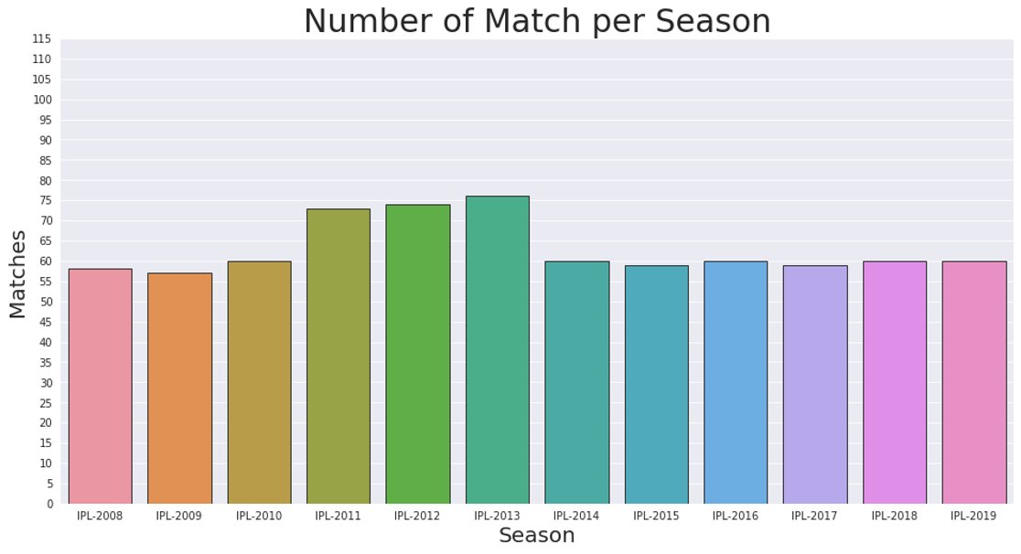

Slide 7
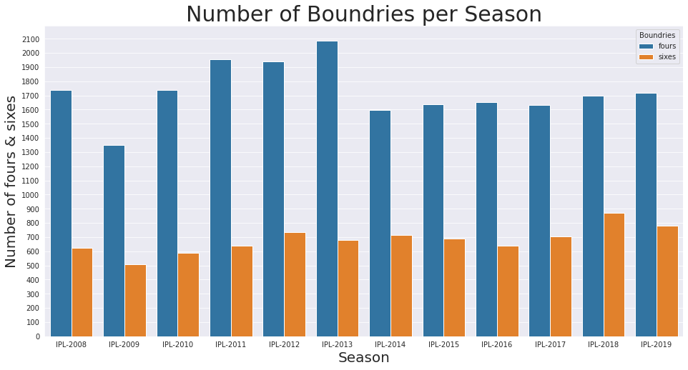

Slide 8
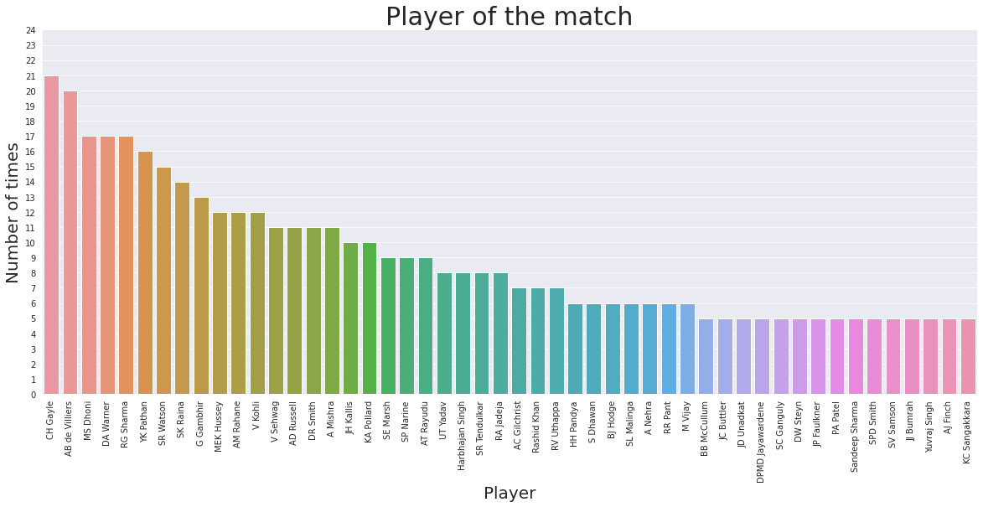
Who won player of the match award most frequently?

Slide 9
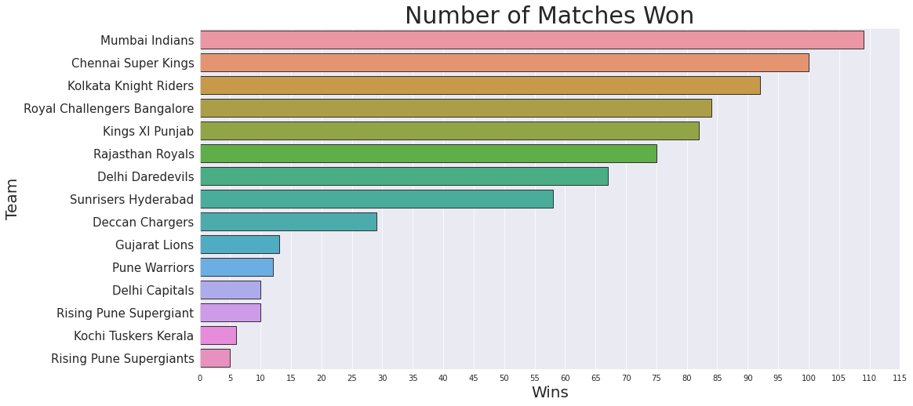
Who win most matches?

Slide 10
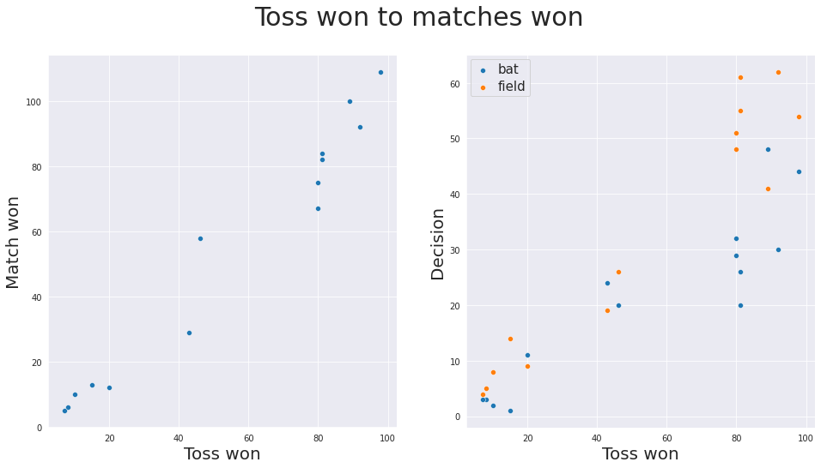
Does winning the toss increases chance of winning the game?

Slide 11
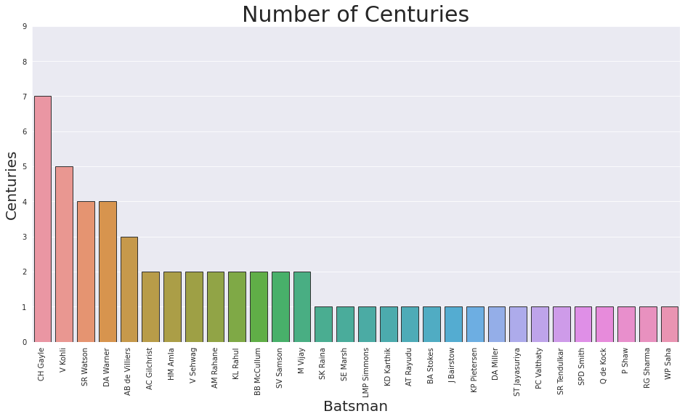

Slide 12
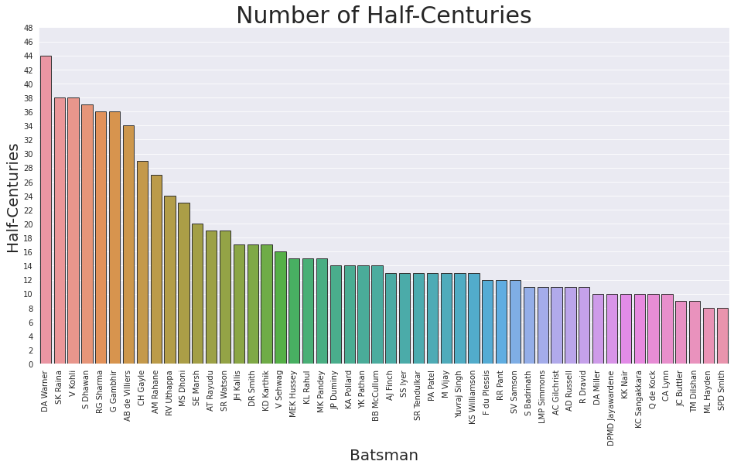

Slide 13
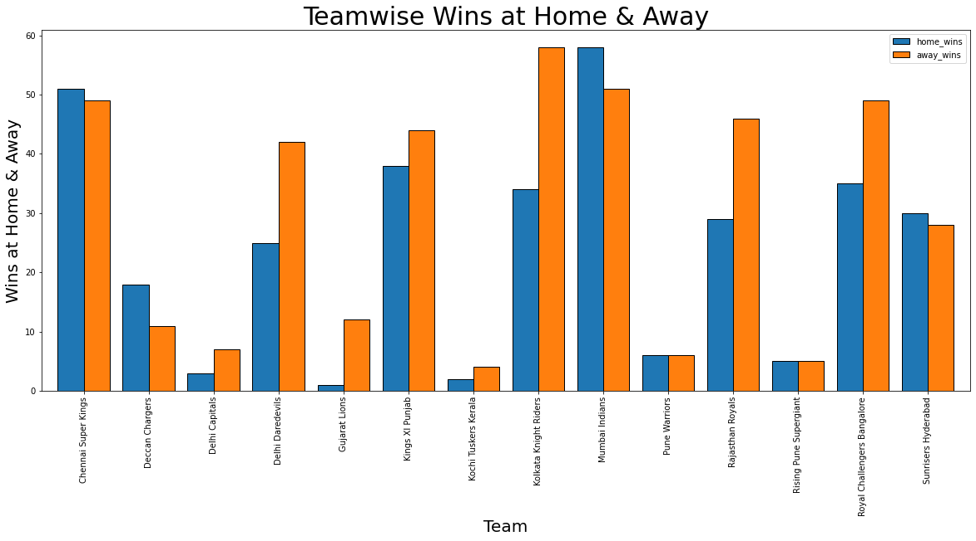
Analysis of Teamwise Wins

Slide 14
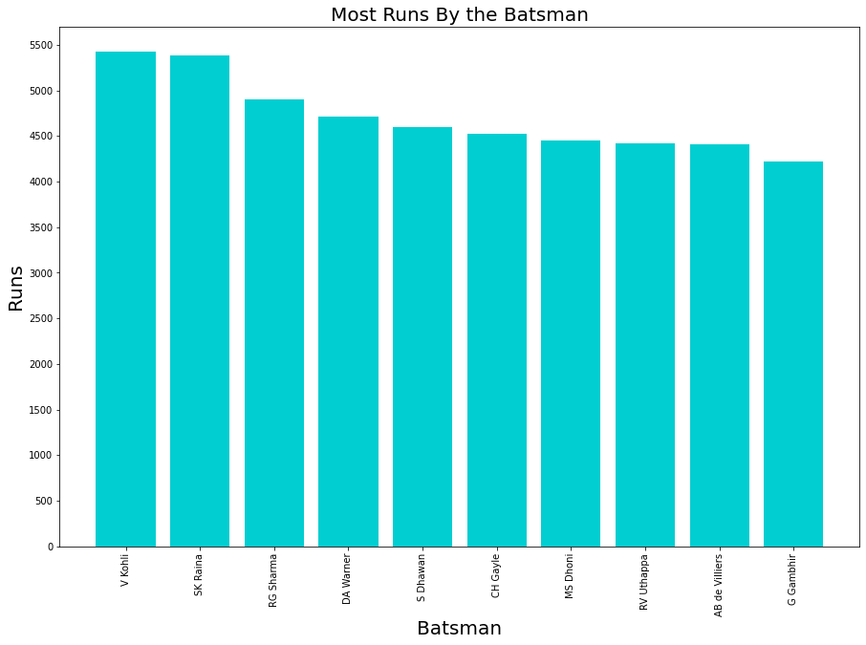
Analysis of Batsman

Slide 15
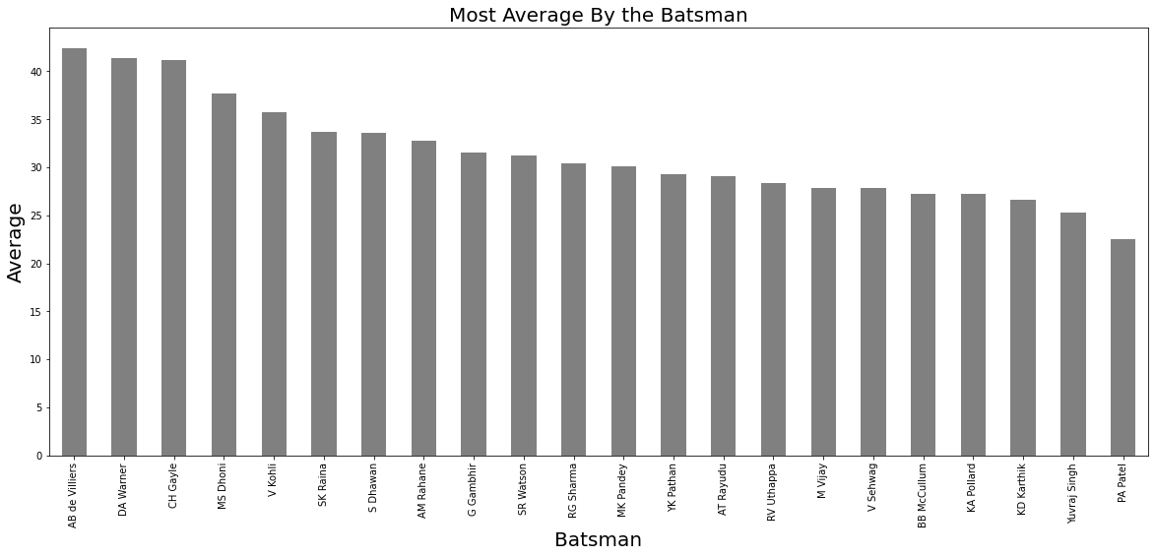
Analysis of Average

Slide 16
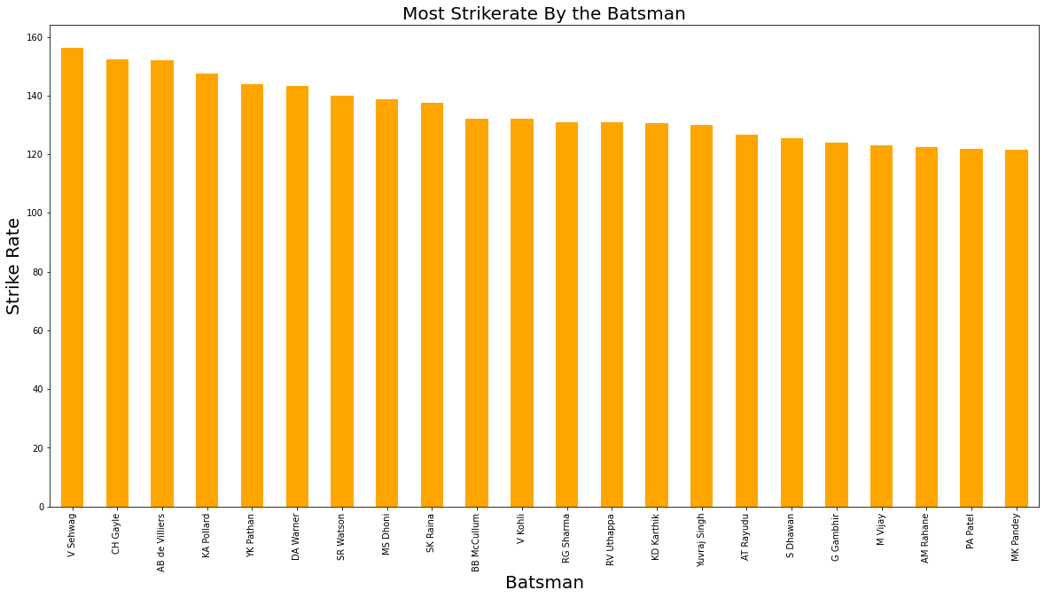
Analysis of Strike Rate

Slide 17
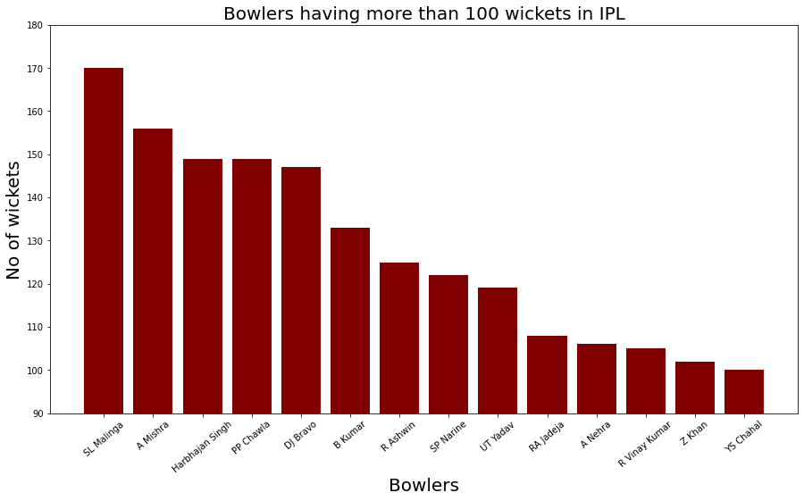
Analysis of Bowler

Slide 18
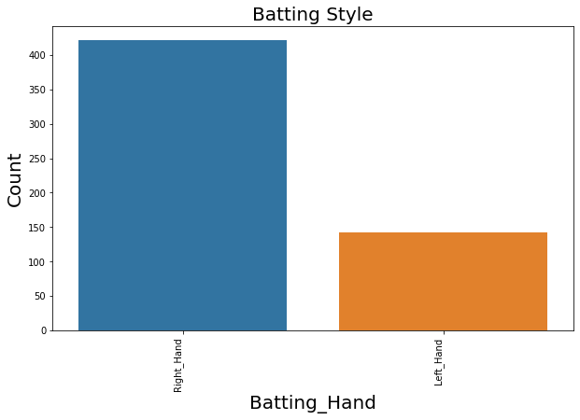
Analysis on Batting Style

Slide 19
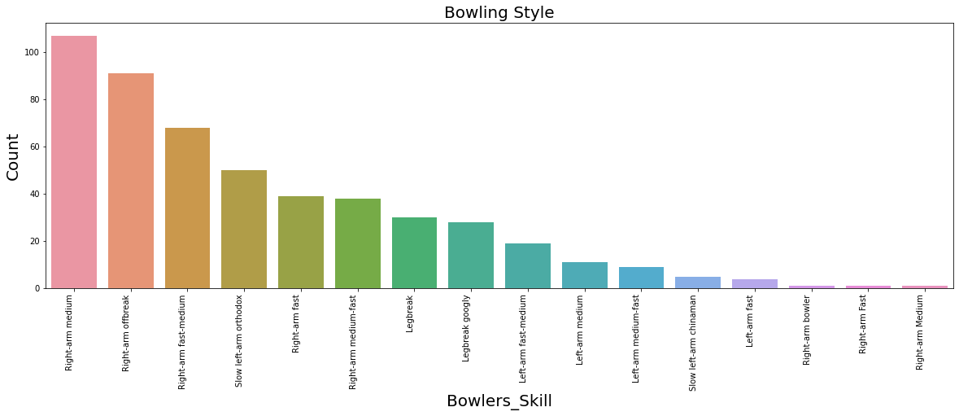
Analysis on Bowling Style

Slide 20
Vridhi's part go here

