Slide 1
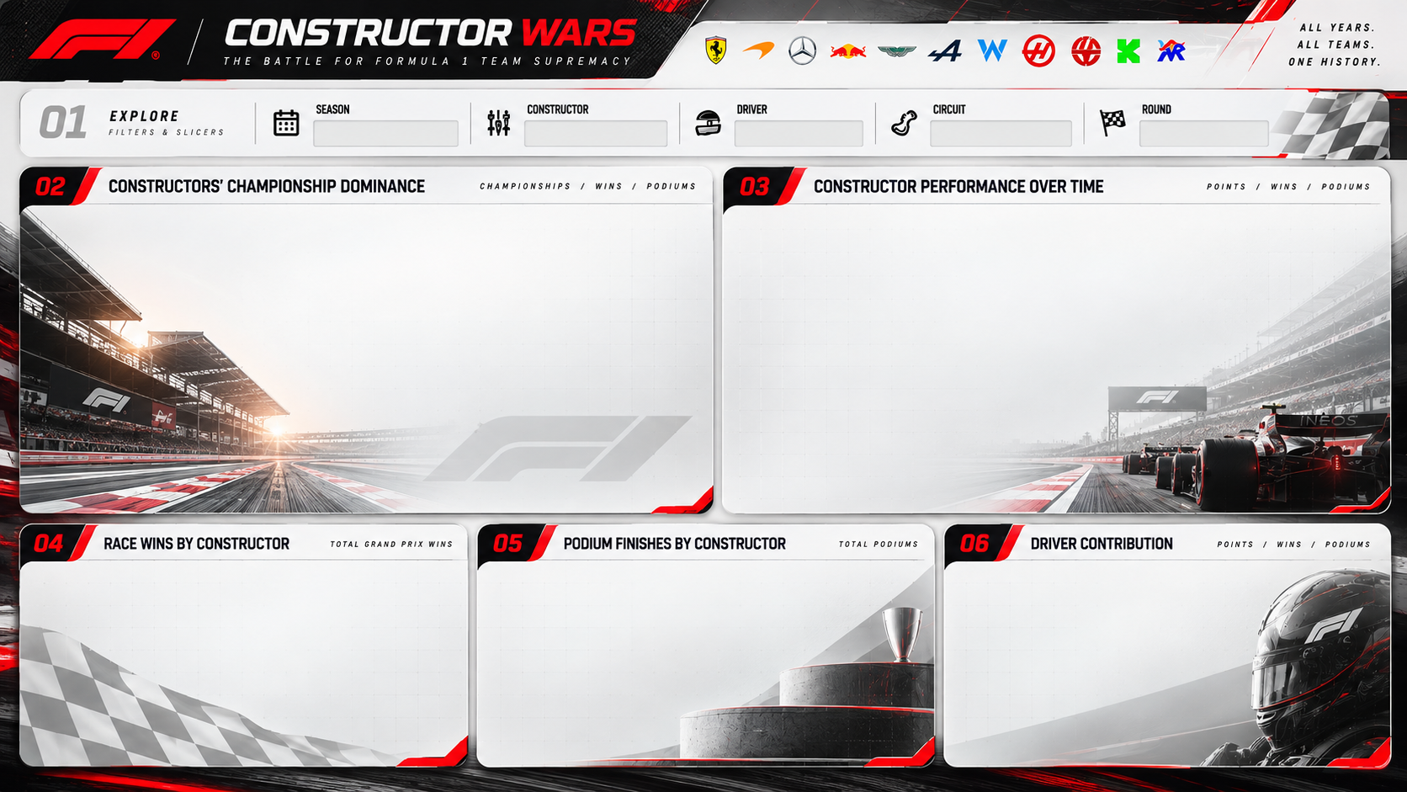
FORMULA 1 / DATA VISUALISATION
CONSTRUCTOR
WARS
THE BATTLE FOR TEAM SUPREMACY
A historical analytics dashboard exploring constructor titles,
Grand Prix wins, podiums and driver performance.
1950–2026*
*2026 season may be incomplete
PROJECT PRESENTATION • ADS FOUNDATION
CONSTRUCTOR WARS / HISTORICAL F1 ANALYTICS
01

Slide 2
01 / PROJECT OVERVIEW
One sport. Decades of data. A changing order.
A dashboard-led investigation of Formula 1 team and driver performance.
28,180
27,590
590
865
213
EMBEDDED RECORDS
GRAND PRIX ROWS
SPRINT ROWS
DRIVER ENTITIES
CONSTRUCTOR ENTITIES
THE QUESTIONS
DATA COVERAGE
• Which constructors have accumulated the most championship titles?
• How do race wins and podiums change the historical leaderboard?
• Which drivers stand out on wins and recorded points?
• How does the volume of recorded points change across seasons?
1950–2026
1,165 race/event entries • 78 circuits
Source: data embedded in the supplied HTML dashboard. 2026 is not a completed season.
CONSTRUCTOR WARS / HISTORICAL F1 ANALYTICS
02

Slide 3
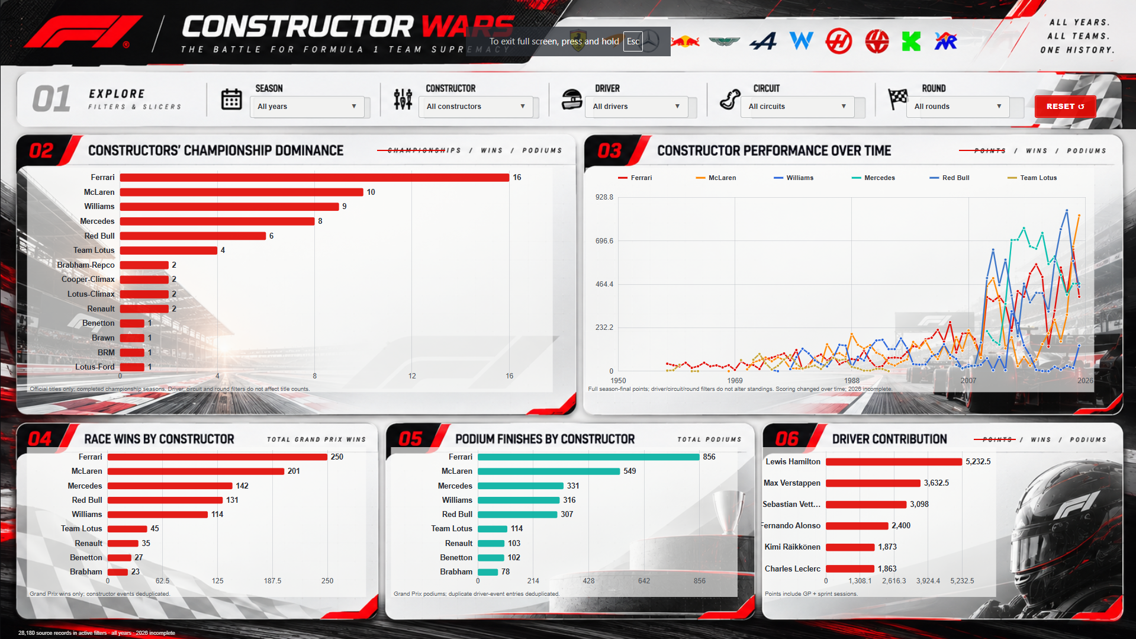
02 / DASHBOARD EXPERIENCE
A single view for exploring the season-by-season story
Searchable filters let viewers narrow the same visual story by season, constructor, driver, circuit and round.
INTERACTION DESIGN
• Season range selection
• Constructor, driver and circuit filters
• Round filtering and reset control
• Metric switching for titles, wins, podiums and points
• Coordinated views for comparative exploration
CONSTRUCTOR WARS / HISTORICAL F1 ANALYTICS
03

Slide 4
03 / CONSTRUCTOR PERFORMANCE
Championships tell one story; race wins tell another
Title totals and Grand Prix wins are separate measures of sustained success and race-day execution.
Top constructors by championship-title indicator
Top constructors by Grand Prix wins
Interpretation: championship totals reward season-long consistency; race wins capture individual event victories. Do not treat these metrics as interchangeable.
CONSTRUCTOR WARS / HISTORICAL F1 ANALYTICS
04

Slide 5
04 / CONSISTENCY
Podiums measure repeat competitiveness
A podium count captures more than victories: it highlights teams that repeatedly finish near the front.
Top constructors by recorded Grand Prix podium finishes
HOW TO READ THIS
• Wins show conversion into first place.
• Podiums broaden the view to 1st–3rd finishes.
• A team can have a strong podium count without leading the win table.
• Historical comparisons depend on the source's podium flag and race coverage.
CONSTRUCTOR WARS / HISTORICAL F1 ANALYTICS
05

Slide 6
05 / DRIVER PERFORMANCE
Individual excellence within a team sport
The driver views complement constructor-level totals by showing who converted opportunities into results.
Top drivers by Grand Prix wins
Top drivers by points recorded in source rows
Caution: career points span scoring systems that changed substantially over F1 history; raw totals are not fully comparable across eras.
CONSTRUCTOR WARS / HISTORICAL F1 ANALYTICS
06

Slide 7
06 / SEASON TREND
Recorded points rise and fall with the sport's changing structure
The line is a descriptive view of recorded Grand Prix points, not a normalized measure of competitiveness.
Total points recorded per season (sampled for readability)
WHY THE TREND CHANGES
• Scoring rules changed across decades.
• Calendar length and race counts changed.
• Sprint events are excluded from this line.
• 2026 values represent an incomplete season.
CONSTRUCTOR WARS / HISTORICAL F1 ANALYTICS
07

Slide 8
07 / METHODOLOGY
Clear rules keep the comparisons honest
The calculations follow the embedded HTML dashboard's field conventions wherever they are identifiable.
AGGREGATION RULES
LIMITATIONS TO STATE
• Grand Prix wins and podiums use GP rows only; sprint rows are excluded.
• Race-level duplicate rows are deduplicated for win counts.
• Driver points sum the points field recorded on each source row.
• Season trend sums points across GP rows by year.
• Constructor titles use the embedded season-summary indicator.
• 2026 is incomplete and should not be compared as a finished season.
• Points totals are not normalized for historical scoring changes.
• The HTML file does not visibly document the original data provider.
• Season-summary/title field semantics should be checked against a data dictionary before formal publication.
CONSTRUCTOR WARS / HISTORICAL F1 ANALYTICS
08

Slide 9
08 / WHAT THE DASHBOARD HELPS REVEAL
Turn the leaderboard into a story
Use the interactive filters to test these comparisons rather than relying on a single all-time ranking.
LONG-TERM DOMINANCE
RACE-DAY EXECUTION
Championship totals highlight teams that repeatedly built title-winning seasons.
Grand Prix wins show who converted pace and opportunity into victories.
REPEATABILITY
ERA CONTEXT
Podiums reveal sustained front-running performance beyond wins alone.
Raw points totals need historical context before comparing drivers across generations.
Recommended next step: validate the dataset source and document each field before making definitive historical claims.
CONSTRUCTOR WARS / HISTORICAL F1 ANALYTICS
09

Slide 10
09 / CONCLUSION
A strong foundation for historical sports analytics
Constructor Wars combines interactive exploration with transparent, reproducible chart logic.
PROJECT TAKEAWAYS
DATA & TOOLING
• A multi-decade view of constructor and driver performance.
• Five complementary lenses: titles, wins, podiums, driver points and season trend.
• Interactive filters support focused comparisons by season and entity.
• Careful metric definitions are essential when historical rules and datasets change.
• Basis: supplied interactive HTML dashboard and its embedded data.
• Charts: editable PowerPoint chart objects.
• Visual theme: F1-inspired red, charcoal and warm white.
• External dataset provenance was not visible in the supplied HTML.
THANK YOU
CONSTRUCTOR WARS / HISTORICAL F1 ANALYTICS
10

