Slide 1
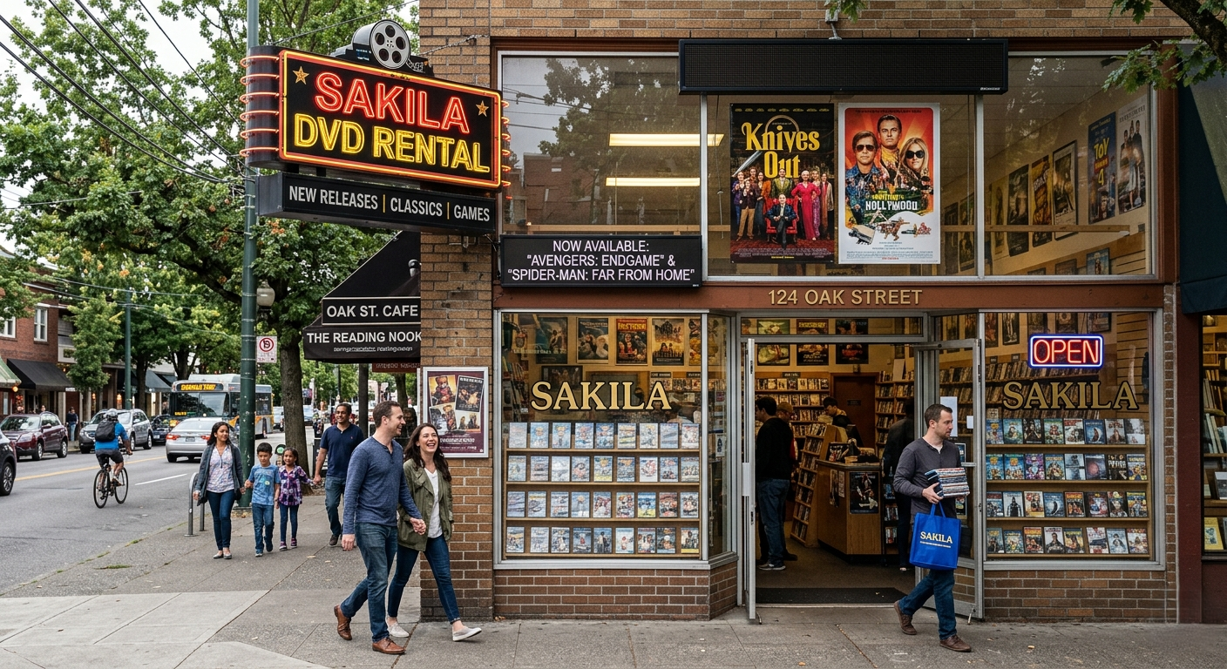
Power BI Dashboard Overview

Slide 2

SAKILA MOVIE RENTAL STORE DATA ANALYSIS
POWER BI DASHBOARD PROJECT
JAGI PRADIP RAO
pradip.jagi@gmail.com

Slide 3

INTRODUCTION
Overview
This provides insights into customer behaviour, average revenue, most rented films, rental duration, sales, staff analysis.

Slide 4

Dataset Includes:
Actor data
Film data
Film category data
Payment data
Store data
City data
Country data
Staff data
Customer data
Rental data
Project Overview:
customer behaviour
film inventory management
enhance customer satisfaction
improve staff performance
streamline store operations

Slide 5

Data Cleaning & Data Transformation
Data Cleaning Steps.
Handled missing values (NULLS replaced/removed).
Fixed incorrect date formats.
Removed duplicate records·
Standardized column names·
Corrected data types (text, date, numeric)
Data Transformation.
Created calculated columns (e.g., Tenure, Manager Name).
Merged and related tables.
Ensured consistency across datasets
Data Quality Improvements.
Improved accuracy and reliability.
Prepared data for analysis and visualization
"I cleaned and transformed the data to ensure accuracy, consistency, and readiness for Power BI analysis."

Slide 6

EDA Insights
Repeat customers dominate
Top films drive rentals
Revenue varies by category

Slide 7
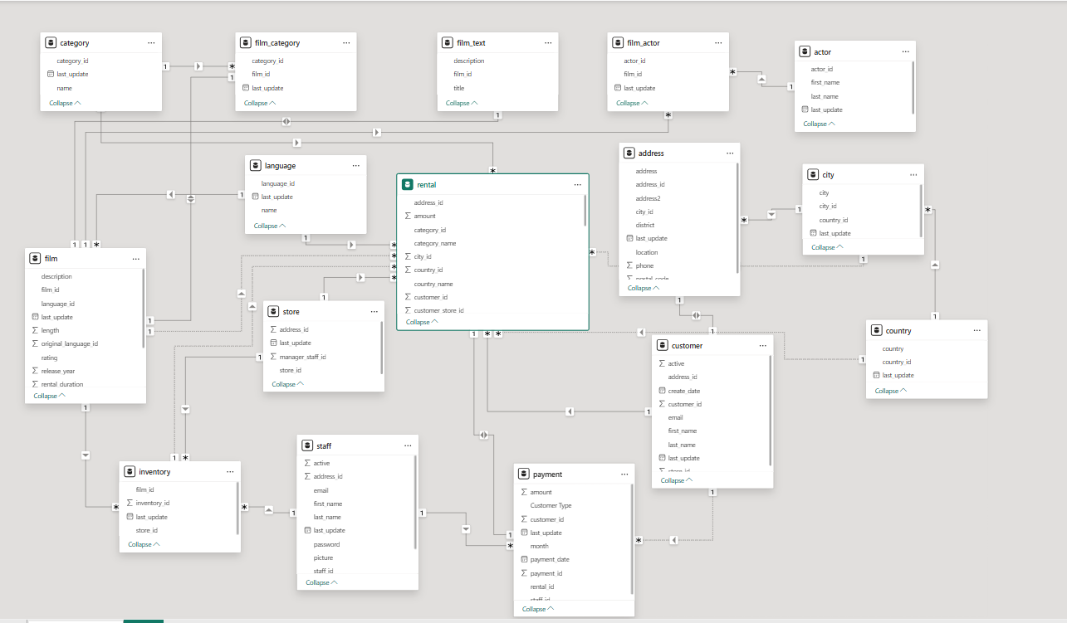
Data Model (ER Diagram)
Relationships
• One-to-Many relationships used
• Connected via primary and foreign keys
• Ensures efficient data filtering
Data model overview:
Implemented star schema
Central Facts table:
Rental
Payments
Dimensional Tables:
Customer
address, city, country
Film
Category
Film category
Inventory
Staff
Store

Slide 8
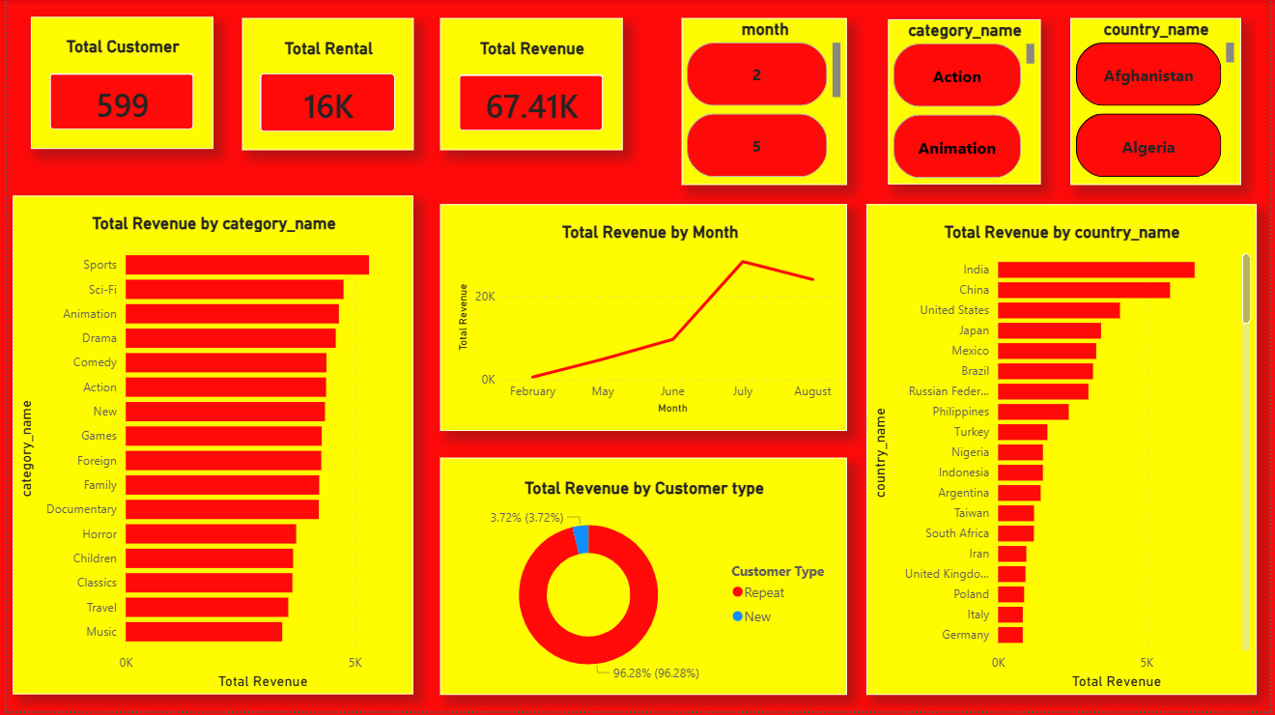
Dashboard Pages
Overview
Key features:
Revenue & business Performance:
Total Revenue is 67.41k showing overall business strength
Customer Behaviour:
96.28% customers are repeat customers showing strong customer retention.
Top performing categories:
Sports, sci-fi, Animation
Low performing categories:
Music, travel
Top revenue countries:
India, china, united states

Slide 9
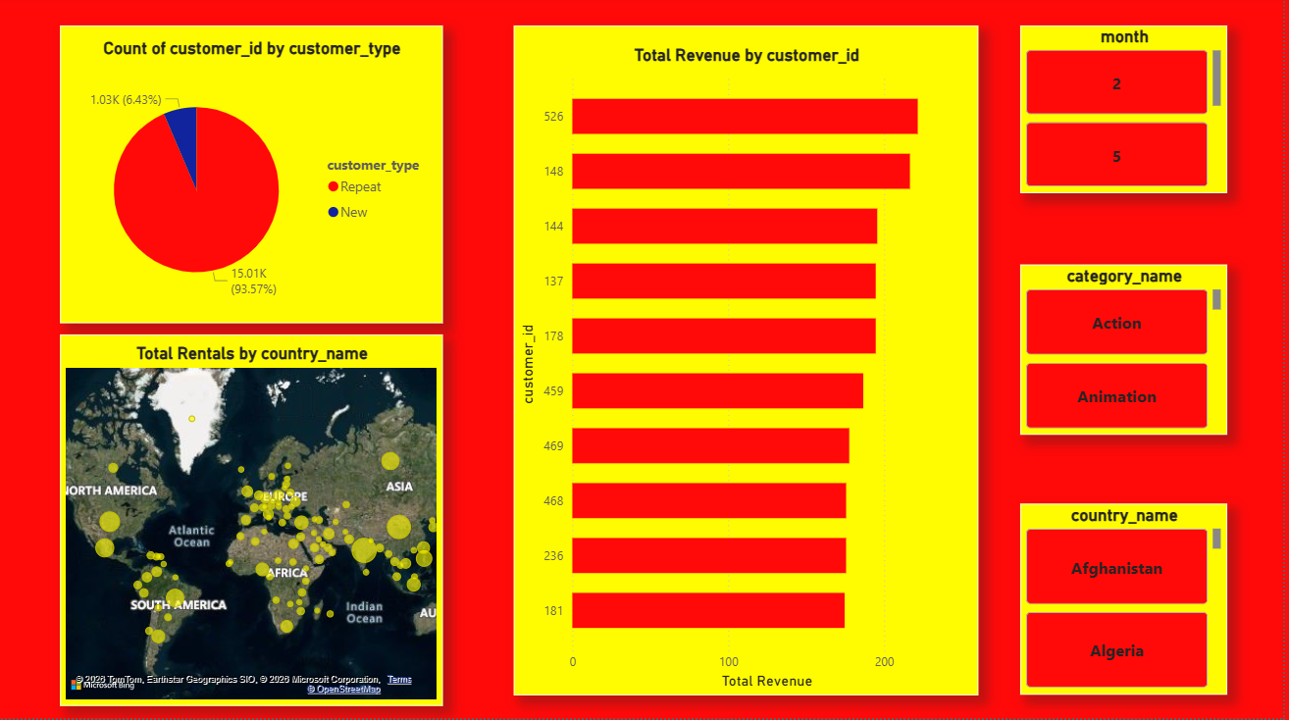
• Customer Analysis
Key Features:
Customer segmentation:
Repeat customers are approximately 96%
Top customers:
Few customers contribute highest revenue (pareto principle 80/20 rule)
Geographic distribution:
Customers spread globally

Slide 10
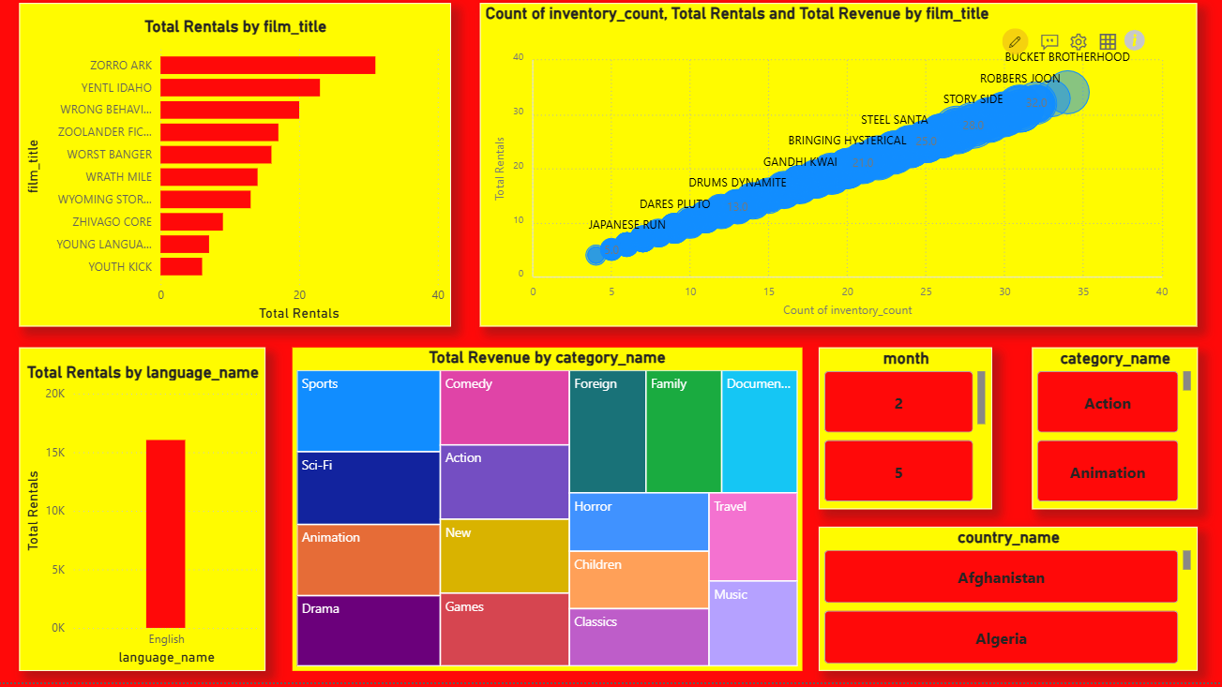
• Film Inventory analysis
Key Features:
Film Performance:
Top film are zorro ark, Ventilation, etc
Inventory vs demand:
More inventory → more rentals
Language Analysis:
English dominates rentals. Customer preference is language-driven
Category Revenue:
Top categories:
Sports, Comedy, Sci-Fi. Revenue concentrated in few genres

Slide 11
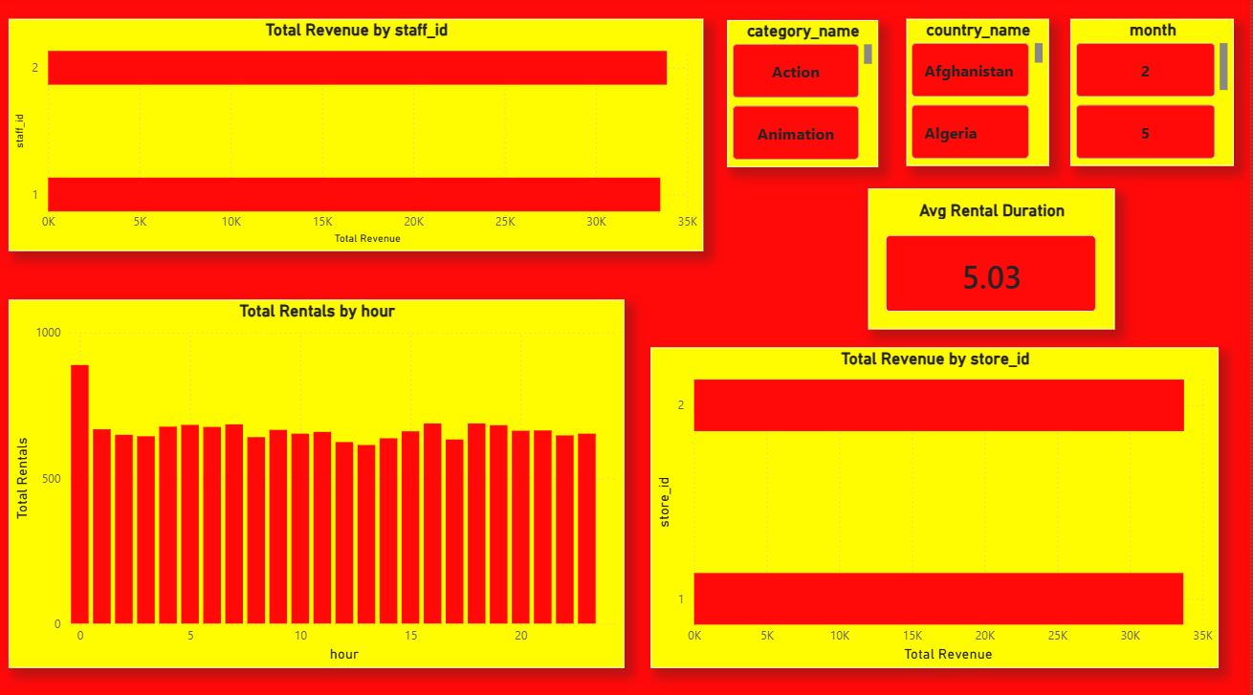
• STAFF & OPERATIONS ANALYSIS
Key features:
Staff Performance:
Staff ID 2 generates slightly higher revenue
Rental Timing:
Rentals are consistent throughout the day. Slight peak at early hours (0–2)
Store Performance:
Store ID 2 performs better than Store 1.
Rental Duration:
Average rental duration ≈ 5 days.

Slide 12
Conclusion & Key Takeaways
Business Takeaways
Strong customer retention model
Revenue driven by:
. Top customers
· Top categories
Inventory plays critical role in demand
Business shows seasonal trends
Geographic expansion opportunities exist

Slide 13
Thank You
End of Presentation

