Slide 1
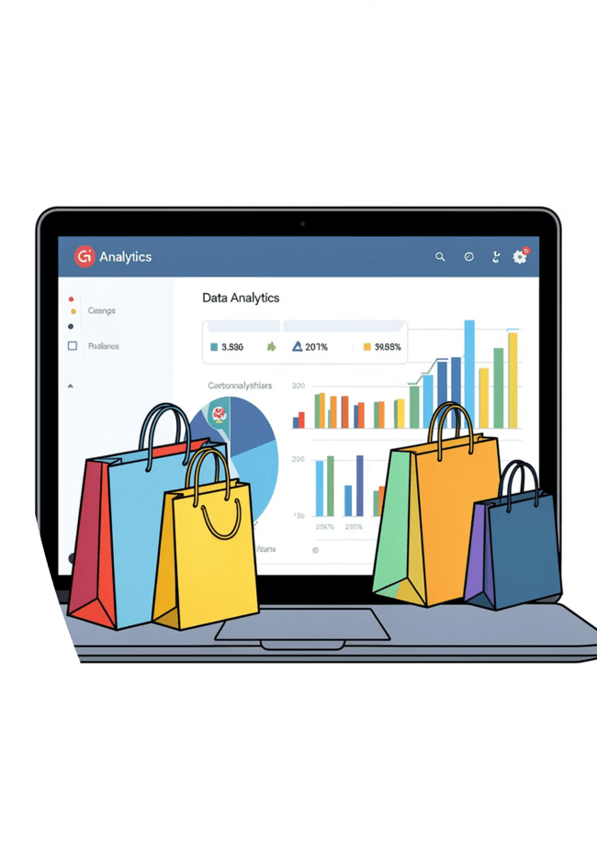
Customer Shopping Behavior Analysis
Uncovering insights from 3,900 transactions across product categories — spending patterns, customer segments, and subscription behavior to guide strategic decisions.

Slide 2
Dataset at a Glance
3,900
18
Purchases
Columns
Transactional records analyzed
Demographics, purchases & behavior
37
50
Missing Values
Locations
In Review Rating column only
Geographic coverage
Key features include customer demographics (Age, Gender, Location, Subscription Status), purchase details (Item Purchased, Category, Purchase Amount, Season, Size, Color), and shopping behavior (Discount Applied, Previous Purchases, Frequency, Review Rating, Shipping Type).

Slide 3
Data Preparation in Python
1
Load & Explore
2
Clean Missing Data
Imported dataset via pandas; used df.info() and .describe() for initial structure checks.
Imputed missing Review Rating values using median rating per product category.
3
Database Integration
4
Feature Engineering
Loaded cleaned DataFrame into PostgreSQL for SQL analysis.
Created age_group bins and purchase_frequency_days; dropped redundant promo_code_used column.

Slide 4
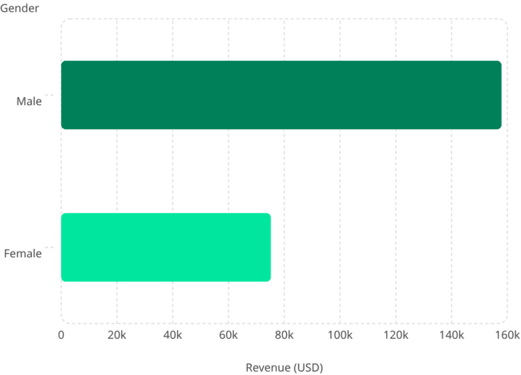
Revenue & High-Spending Insights
Revenue by Gender
Male customers generated $157,890 vs. $75,191 from female customers — more than double the revenue.
High-Spending Discount Users
839 customers used discounts yet still spent above the average purchase amount — indicating strong price sensitivity paired with high purchase intent.

Slide 5
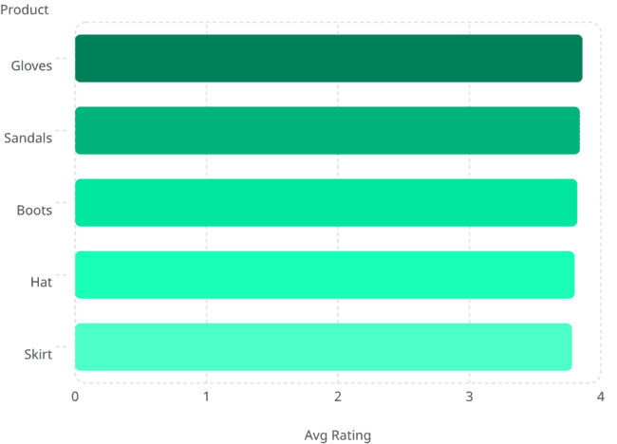
Top Products & Shipping Analysis
Top 5 Products by Rating
Gloves lead with a 3.86 average rating; all top products cluster tightly between 3.78–3.86.
Shipping Type Comparison
Express shipping averages $60.48 vs. $58.46 for Standard — a modest but consistent premium.

Slide 6
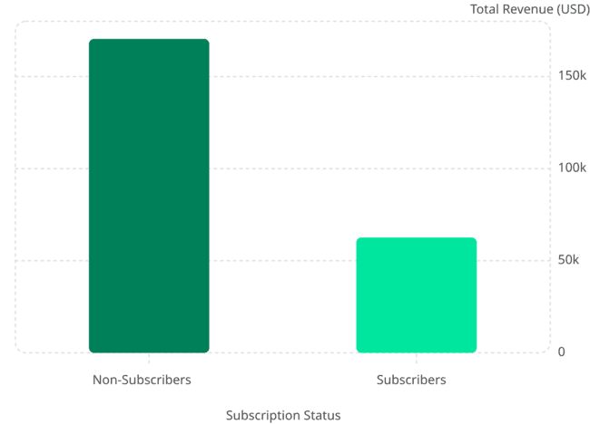
Subscribers vs. Non-Subscribers
Key Findings
73% Non-Subscribers
2,847 customers, generating $170,436 in total revenue.
27% Subscribers
1,053 customers, generating $62,645 — significant untapped potential.
Near-Identical Avg Spend
Avg spend is nearly equal: $59.87 (non-subscribers) vs. $59.49 (subscribers).

Slide 7
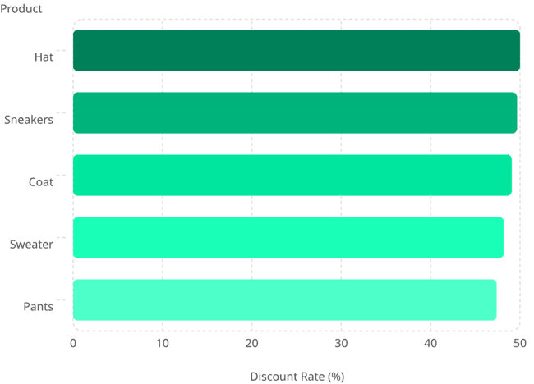
Discount Dependency & Customer Segmentation
Most Discount-Dependent Products
Hat leads at 50% discount rate; all top 5 products show ~47–50% of purchases involve discounts.
Customer Segments
Loyal
Returning
New
3,116 customers
701 customers
83 customers

Slide 8


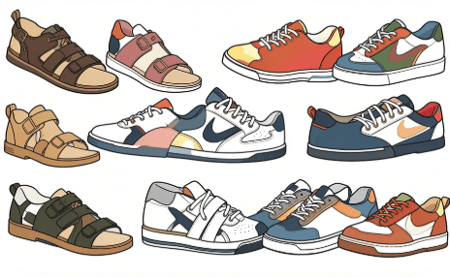
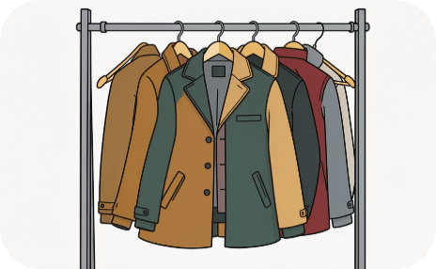
Top Products by Category
Most purchased items within each of the four product categories:
Accessories
Clothing
Footwear
Outerwear
Jewelry — 171 orders
Sunglasses — 161 orders
Belt — 161 orders
Blouse — 171 orders
Pants — 171 orders
Shirt — 169 orders
Sandals — 160 orders
Shoes — 150 orders
Sneakers — 145 orders
Jacket — 163 orders
Coat — 161 orders

Slide 9

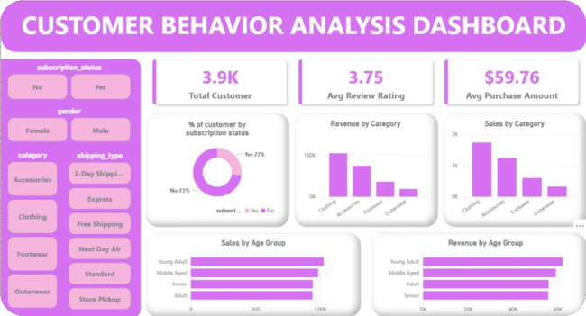
Power BI Dashboard
Dashboard Highlights
Key Metrics: 3.9K customers · $59.76 avg purchase · 3.75 avg rating
Subscription Breakdown: Donut chart — 27% subscribers, 73% non-subscribers
Revenue & Sales by Category: Bar charts for Clothing, Accessories, Footwear, Outerwear
Revenue by Age Group: Horizontal bars — Young Adult leads at $62,143

Slide 10
Business Recommendations
Boost Subscriptions
Loyalty Programs
Review Discount Policy
Promote exclusive subscriber benefits to convert the 73% non-subscriber base.
Reward repeat buyers to grow the Loyal segment (currently 3,116 customers).
Balance sales boosts with margin control — ~50% of top products are discount-dependent.
Targeted Marketing
Product Positioning
Focus on high-revenue age groups (Young Adults) and express-shipping users.
Highlight top-rated and best-selling products in marketing campaigns.

