Slide 1
IT Process / Workflow

Slide 2
Team Details

Slide 3
Team Hierarchy
Amardeep Kumar
Bhupendra Singh
Bhan Singh(Server Support)
Kumar Virbhadra
Virendra Garg
Kamendra Chauhan
Satyaban Ray (FM)
Sudeep Singh
Kunal Patra
Subhash Singh
Pradeep Agrahari (Desktop Support)
Ashwani Kumar
Hirdesh Dixit
Saurabh Batham
Raja Sharma
Anil Singh
Khushwant Kushwah

Slide 4
Work Flow of Desktop Support Team

Slide 5
Daily Tasks
Daily Conference Room Internet, Machine and Voice testing.
Daily Camera Status check
Daily Internet & Voice Testing of All US/EU offices
Weekly Machine Inspections & reports
Monthly Hardware Inventory check
Quarterly software Inventory check

Slide 6

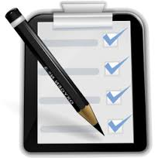

User Creates ticket and it gets Assigned to respective System Admin

Slide 7
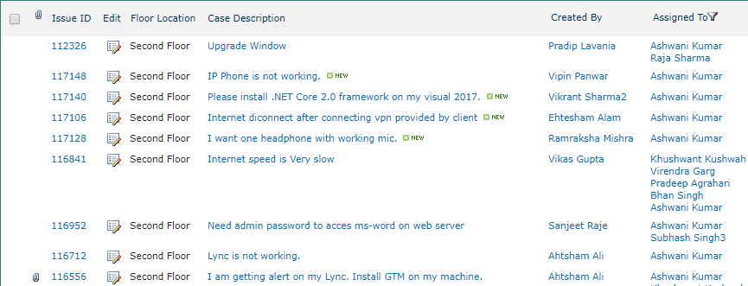
We received the Ticket on Backbone (IT-Helpdesk)

Slide 8
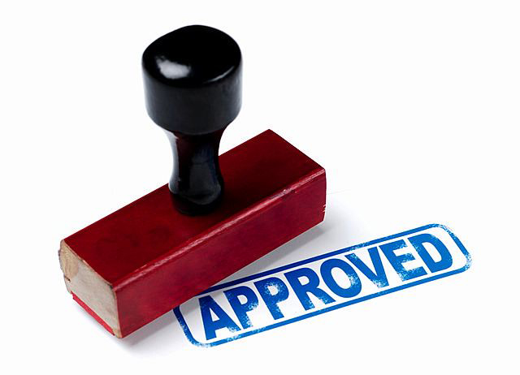
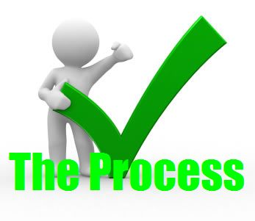

Following Process
Check if Approval/Permission is required from FM/PM/DO then Proceed accordingly

Slide 9


Work on Tickets
Quickly move to user’s desk or take remote.
System Admin Starts working on ticket and resolves issue up to users satisfaction.

Slide 10
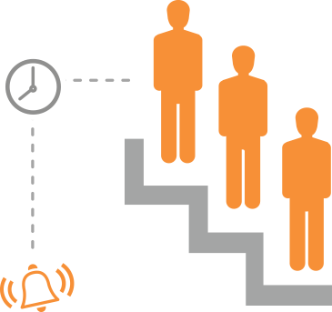
Escalation to Server team
System Admin Escalate issue to Next Level (If required) and follow up.

Slide 11
User Handling
As we are in IT Department, We should be very polite with User.
We should always listen their query and provide the solution accordingly.
Sometimes User gets very Hyper, We should not get Hyper at that time, You can Escalate the case to our Seniors.
We should always try to provide Better and Permanent Solution instead of Temporary solution.
We should not get personal with Users.
We should not provide access to anything on adhoc request to any one.
We should be strict with process and polite with our nature.

Slide 12
Task Prioritization
We should always prioritize our task and work accordingly.
Prioritizing the task keeps us away from big mess.
We should also not avoid the task with least Priority.
For Example:
You have two different Task
Task 1: User is not able to login on his system,
Task 2: Another User is having some issue with his mouse,
Here Task 1 Having More priority than Task 2.
With our Common sense and Work Structure of Organization, We can prioritize our Task easily.

Slide 13
Escalation Matrix
As we work in a Team, We should not waste our time in One Task.
We have facility to Escalate the Task to Server team, but before Escalating the Task We should mention the Steps which we have performed to fix that issue, Also All the Basic information should be there.
If Any Exception is there to work on that System, We should also Mention the same in ticket and then we can Escalate the task. It will provide ease to Server team and they can resolve it soon.

Slide 14
Approval Process
There are Multiple points Where we are making some mistakes at the time of taking Approval.
Below are the Few Points which can help us to take approval. I shall be sharing the details covering most of the situations.
SN. | User Type | Applications/ Cases | Edition /Version | Need to take approval
1 | TM/ TL | MS SQL Express | Express Edition | No need to take approval
2 | TM/ TL | MS SQL development Edition | 2008,2008R2, 2012, 2014 | No need to take approval
3 | TM/ TL | MS SQL Enterprise Edition | 2008,2008R2, 2012, 2014 | We need to install the Developer Edition
4 | TM | MS Office | Standard Version (if not present) | No need to take approval, By the way we need to provide MS Office in All the systems with initial setup
5 | TM | MS Office | Professional or Pro+ | Need to take approval From FM keeping Satyaban in CC
6 | TM | MS Office | In case of Second Version | Yes, Take approval from FM

Slide 15
SN. | User | Applications/ Cases | Edition /Version | Need to take approval
7 | TL | MS Office | initially we need to install Pro+ | No need to take approval
8 | TL | MS Office | In case of Second Version | Need to take approval from FM.
9 | TM | Visual Studio | If person belongs to .net floor | Install First Visual Studio without approval
10 | TM | Visual Studio | If person does not belongs to .net floor | Take Approval from FM with Duration
11 | TM | Visual Studio | In case of Second version | Take approval from FM ( Check if we can uninstall the older version)
12 | TM | MS Visio | Standard Edition | Take Approval from FM with Duration
13 | TL | MS Visio | Standard Edition | No need to take approval
14 | TM/TL | QA Environment Creation | On Data-Prod Server | No need to take approval
15 | TM/TL | QA Environment Creation | On Web Server (With External Access) | Take Approval from DO keeping FM/ PM and Prem Sir in CC. Also Ask for Public IP.
16 | TM/TL | Database creation | on Data-Prod Server | No need to take approval
Please Find the below backbone URL for More Details on Approval Process.
Approval Process List

Slide 16
E-Mail Communication
We should always keep everything in Written.
We should avoid to work on Oral Communication.
I would suggest every one to read their Mails and whenever you are in To, Always Reply with Current Status.
We should Always mark a reminders in our outlook to take Follow-up on any issue.
Emails should be polite and it should cover all the points which you want to communicate with recipients.
Whenever you have been asked to share details, its better to create tables in Excel and paste it in mail rather than making bullet points or paragraph. It keeps all the information clear.
Whenever We need to provide any hardware to User, We should take confirmation from Users on Emails keeping Itsupport and his FM in CC. And take follow-up after Time Duration expires.
We should not Share ID and Password in Single E-Mail, Use Different Channel for password to only required recipients, May be Call/ voice Mail.
Whenever you get any task from Higher authority, Please inform your TL regarding the same.

Slide 17
Updating Ticket
This is very important Task, We should always keep our tickets updated with Current Status.
What ever task we have performed, We should always update the same in ticket.
User can also check the Status from Ticket.
If any ticket is pending from users Side, Keep updating the ticket and ask for details. We can also email / call to User for any information required to resolve that issue.

Slide 18
Working on Report
Always try to provide the Reports on Time, If you are busy with any other task, you can inform you TL for the same and ask for time.
Weekly Machine Inspection Report: Please try to provide the report on Wednesday Every Week.
We should always share the reports in Exact Format in which its asked, It will help our TL to make a consolidated report.

Slide 19
Working on New Joinee ticket
Whenever we have been assigned to any ticket for New Joinee, We should share all the New Joinee Details to HR and jobs keeping Itsupport in CC.
Configure Machine with basic software for him at provided location.
Configure his mail account in outlook and sent test mail.
Update the AD, Asset accordingly on same day.
After updating everything including Emp ID, We can close the ticket.
In Case User not joined, We will not get his EMP ID and then we can take action according to mentioned comment in ticket from Jobs team.

Slide 20
Machine configuration for New Joinee
There is a list of Basic software, which should be installed on New Joinee machines.
MS Office Standard Edition (Activated)
Notepad++
Adobe Reader
Google Chrome
Mozilla Firefox
7zip
Remote Desktop should be enabled
Windows should be activated
Power option should be configured for never sleep and shutdown.
Machine should in in Domain
Install the SCCM Client in Machine
Install McAfee Client.
Machine Name should be in proper format (Chetuiwk<……>)
Update the ASM accordingly.

Slide 21
Working on Seat Movement Tickets
Whenever We received any ticket for Seat Movement across the building, First We should configure a new machine for user at provided location
Then We should ask the Respective Floor Admin to send the user from his floor, Also share the ticket with him.
Once User Come to you building, You can update the AD and ASM accordingly, but make sure that ASM should be update at both side.
Sometimes, Users are still busy with his old projects and His TL Denies His Movement, You can Take approval from His FM and update the same in Ticket.

Slide 22
Daily Task
Check Conference Rooms on your respective Floors, Its should be up and running fine. Its most Priority task for us, and we should never skip this. Whenever you found any issue, Inform our TL Keeping Satyaban in CC and work to fix the issue immediately.
Check Camera status and share the report to our TL keeping Itsupport and Satyaban in Loop. Report should be shared before 3:30 PM.
If any Camera is down or not working, inform our TL, Open a ticket in IT Helpdesk and work accordingly to fix it.
Check you Emails and tickets on regular basis and perform accordingly.
At end of the day, Send 5:15 Report on regular basis.

Slide 23
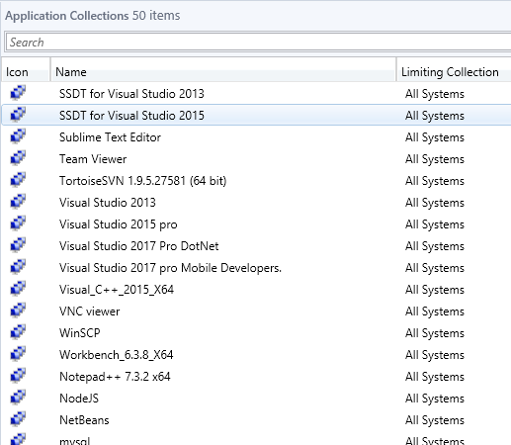
Software Installation Using SCCM server
Since we are Moving Towards Atomization, We Use SCCM server for most of the Installation task.
Every Machines having SCCM Client installed, With the Help of this ,We can Push the available Packages in the system through it.
Below is the snap of Few applications which are prepared in SCCM Server and can be pushed in the system.
We just need to add the desired machine in required collection and it will install automatically.

Slide 24
ASM Update at every step
At every step of assigning Hardware and removing hardware, We need to update the ASM accordingly.
For Ex.
Seat movement (Update the ASM accordingly)
New Joinee (Assign the provided system)
Hardware ticket (Update ASM if you replace any Hardware)
Extra machine assignment (Update the ASM accordingly)
Exit user (Remove the Assets assigned to him and keep it in Store)
Project Roll off (Check for any Extra Devices given, take it in IT Custody)

Slide 25
Work on TM/ TL Change
Whenever we received the Mail from DO/ FM for any Modification in Resourcing We need to update the things accordingly.
TM Addition: Provide the AD/ project Plan access to New user and update the Manager, Ext accordingly.
TM change: provide the AD/ project Plan access to New User and Update the Manager, Ext accordingly. Remove the access from old user and update the Manager and Ext. accordingly.
TL Change: provide the AD/ Project Plan access to New TL and update the Manager of all the TM of Same Technology, Remove the access from Old TL.

Slide 26
Tips and tricks
Most of the Issues can be resolved after discussing with User.
We should always start our troubleshooting steps from basics.
Checking Event logs and application related logs can help us to determine the issue.
We should take the help from Google whenever we stuck in any issue.
We should always keep the tickets updated with current status.

Slide 27
Do’s and Don’t
We should avoid working on verbal Communication.
We should Never Share our Passwords to Any one.
Without Taking Approval from Prem Khatri, We should not work on Clients Machine. Although We can provide our suggestions to User to resolve the issue in Clients Environment.
We should avoid to work on User’s Desk, Every thing can be handled from Remote Until and unless any hardware issue arises.
We should always collect Hardware's from User’s Desk whenever User moves to different Buildings or Exits. It will help us to count the available Hardware.
We should avoid to work on E-mails from users, Always ask for ticket.
We should always attend the calls, If your Teammate is not on his seat, We should answer the calls ringing on his desk.
Never Work on Clients Machine without Approval from Prem Khatri.
We should always avoid to take long breaks or in groups.

Slide 28
Thanks

