Slide 1



SARCATHON
Pan-IIT Competition
Project: Smart FAQ Module for SARAS AI Institute
Pradipta Sundar Sahoo
Indian Institute of Technology (IIT) Roorkee
pradipta_ss@ch.iitr.ac.in

Slide 2
Agenda
About the project
Features
Proposed Solution
Results
Access links
Tip: Use links to go to a different page inside your presentation.
How: Highlight text, click on the link symbol on the toolbar, and select the page in your presentation you want to connect.
Future Advancements
Setup Instructions
Usage
File Structure

Slide 3

About
Goal: Develop a Smart FAQ Module for the SARAS AI Institute website that improves user experience by intelligently returning relevant FAQ entries based on user queries.
Key Objectives:
Provide accurate and fast answers.
Ensure easy integration into the existing website.
Use open-source technologies for a cost-effective, scalable solution.
BACK TO AGENDA PAGE

Slide 4



Key Features
Relevance
Latency
User-Friendly
Matches user queries to the most relevant FAQs using NLP techniques.
Optimized for quick response times even with large datasets.
Clean, intuitive interface for easy interaction.
Scalability
Customizable
Handles large volumes of FAQs and multiple user queries.
Easily adaptable to new FAQs and evolving user needs.
BACK TO AGENDA PAGE

Slide 5

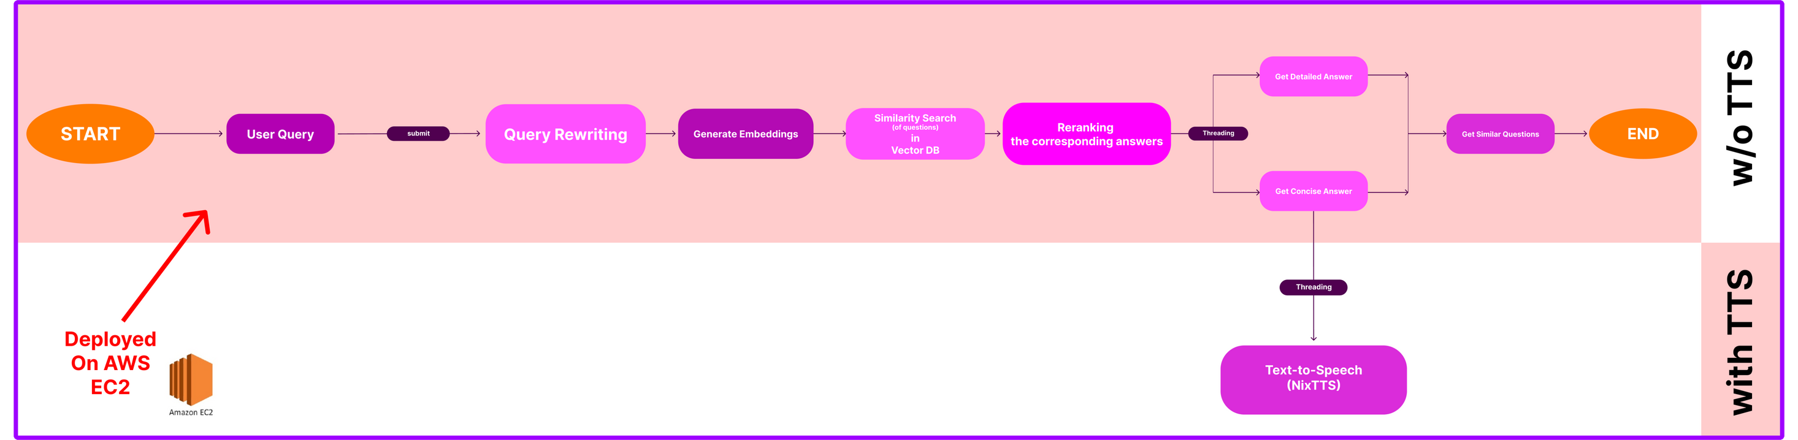
Prosposed Solution
BACK TO AGENDA PAGE

Slide 6






Techniques used
Natural Language Understanding: Uses OpenAI's language models to understand and interpret user queries.
Similarity Search: Employs FAISS for fast and accurate similarity matching with the FAQ database.
Query Rewriting: Enhances the clarity and relevance of user queries for better search results.
Concise & Detailed Responses: Provides both quick and in-depth answers based on user preference.
Text-to-Speech (TTS) Option: Converts the concise response to audio using NixTTS for added accessibility (optional)
User-Friendly Interface: A clean, intuitive interface for easy interaction.
ADDED FEW MORE Questions: For robustness.
Technology used
OpenAI: For natural language processing and embeddings.
HuggingFace: Have also implemented using hugging face.
Pinecone: used it as vector DB.
FAISS: For efficient similarity search on the FAQ database.
Streamlit: For building a responsive web interface.
NixTTS: For converting text responses to audio.
pyaudio & wave: For audio playback in the TTS version.
Python: Primary programming language for backend logic.
AWS: Deployed it using AWS EC2.
BACK TO AGENDA PAGE

Slide 7

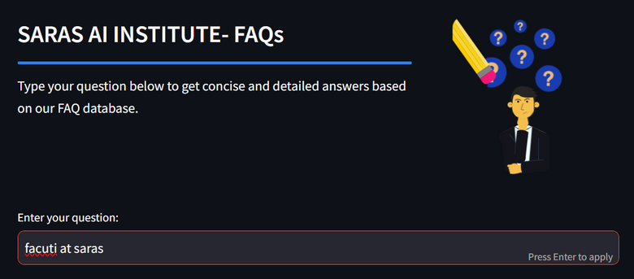
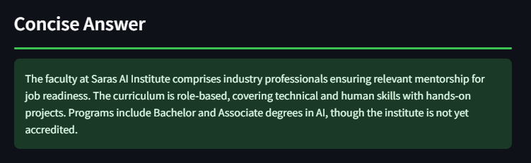
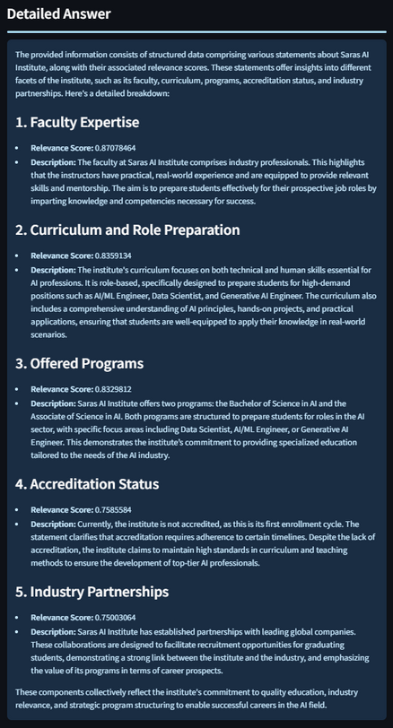
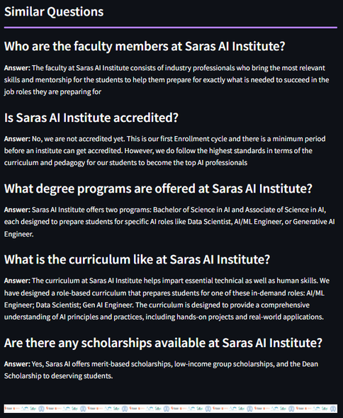
Query
knowingly did a typo,
handled by query rewriting.
Rerank based on relevance score
Concise Answer
Detailed Answer
Output :
Similar Questions
Using vector search, found similar top-k questions
Results

Slide 8
Live Access Link:
SMART FAQ System- SARAS AI
Demo Video Link:
Demo Video Link
Access Links
Github Link:
Github Repo Link
BACK TO AGENDA PAGE

Slide 9

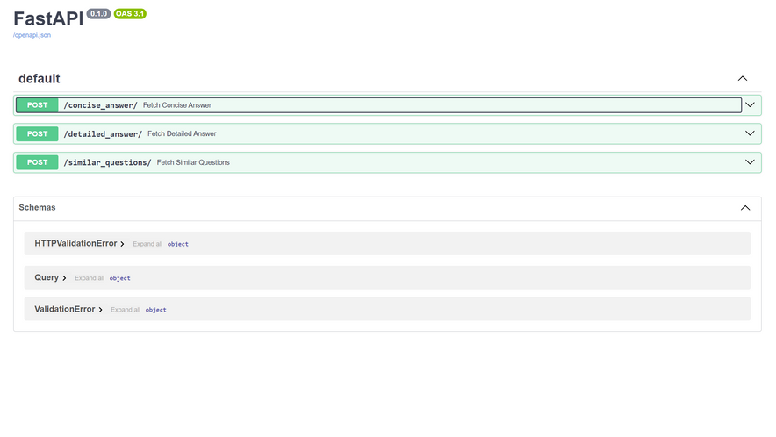
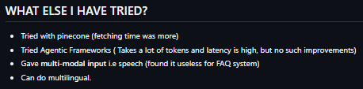
Future
Advancements
Multimodal input and output:
have already been implemented.(in repo). But do we actually need it?
Multilingual:
knows how to implement. Could be useful !!!.
Faster Inference :
could use small llms.
Scalability:
have already implemented a FastAPI code. It could be used for production. (in repo).
Relevance:
Reranked all results according to relevance. May a more robust way be done.
More robust:
I have already some extra info about SARAS AI. But more info can be fed.
Cost-effective:
Instead of EC2, can be deployed in serverless instances.
More intermediate stuffs can be removed to lower the tokens count.

Slide 10
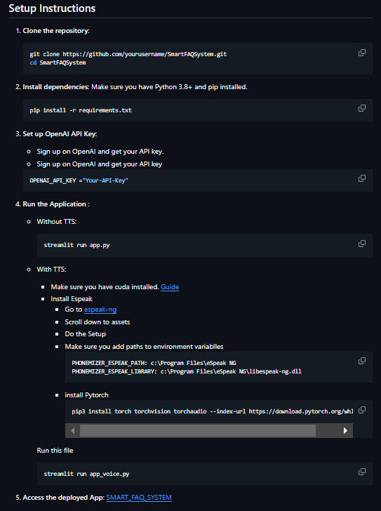
Setup
Instructions
Github Repo Link
BACK TO AGENDA PAGE

Slide 11
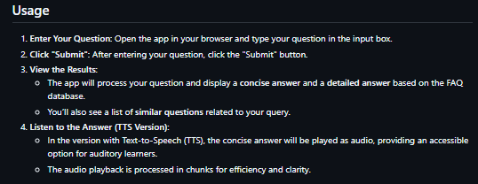
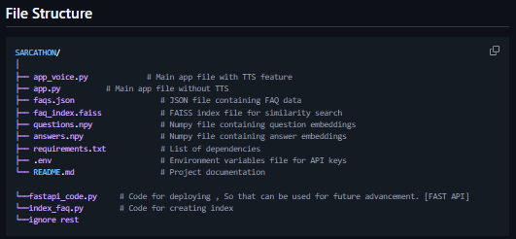
Usage
Github Repo Link
File Structure
Github Repo Link
BACK TO AGENDA PAGE

Slide 12
BACK TO AGENDA PAGE
Thank You

