Slide 1
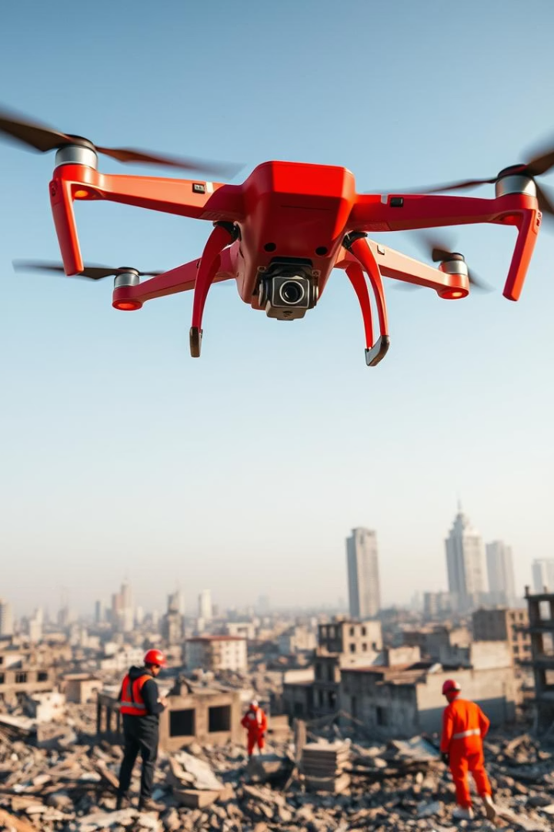
Drones for Disaster Response and Recovery
AI-Driven Solutions for Real-Time Crisis Management
This project presents AI-enhanced drones transforming disaster management.
By: - Pradipta Shanu
Roll No. : -60915611624

Slide 2
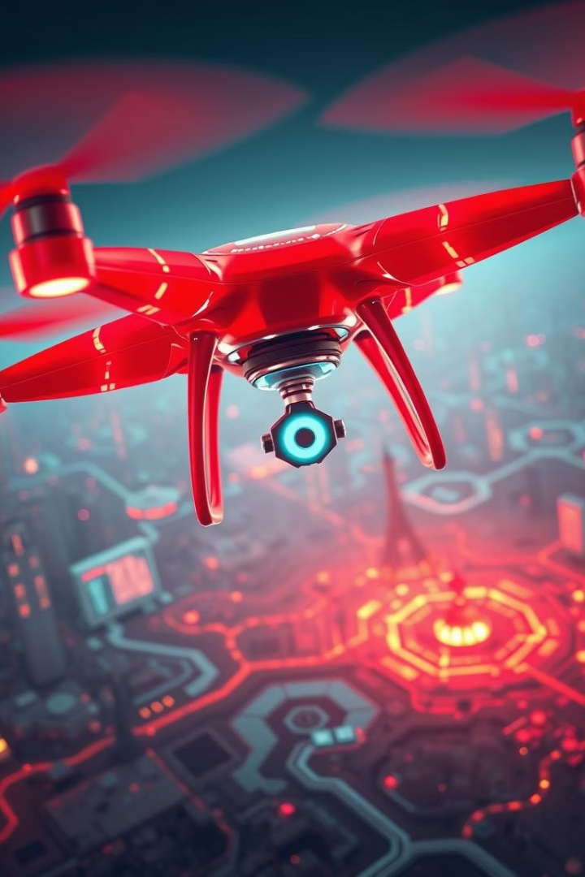
Abstract and Keywords
Abstract Summary
Technical Focus
Drones integrated with AI improve disaster response via rapid situational awareness and efficient rescue.
Hybrid CNN and reinforcement learning models enhance target recognition and swarm coordination.
Keywords
Drones, Disaster Response, AI, Machine Learning, Real-Time Monitoring, Swarm Intelligence

Slide 3
Introduction and Literature Review
Context
Key Studies
Disasters are increasingly frequent, challenging traditional response methods.
AI-Based Human Rescue: Audio signal detection in noisy environments.
AI-enabled drones provide real-time data and autonomous decision-making capabilities.
Deep Learning for Damage Assessment and Prioritization.
Autonomous Climate Disaster Tracking with AI navigation.

Slide 4
Methodology: Drone Technologies and AI Models
Drone Hardware
AI Models
RGB, Thermal, LiDAR, Multispectral sensors
CNNs, YOLO for object detection
LoRaWAN, 5G, Satellite communication
Semantic segmentation for environment mapping
Advanced batteries and hybrid power systems
Reinforcement learning for navigation and swarm coordination
Payloads: medical supplies, comm relays, rescue tools
Edge computing for on-board real-time processing

Slide 5
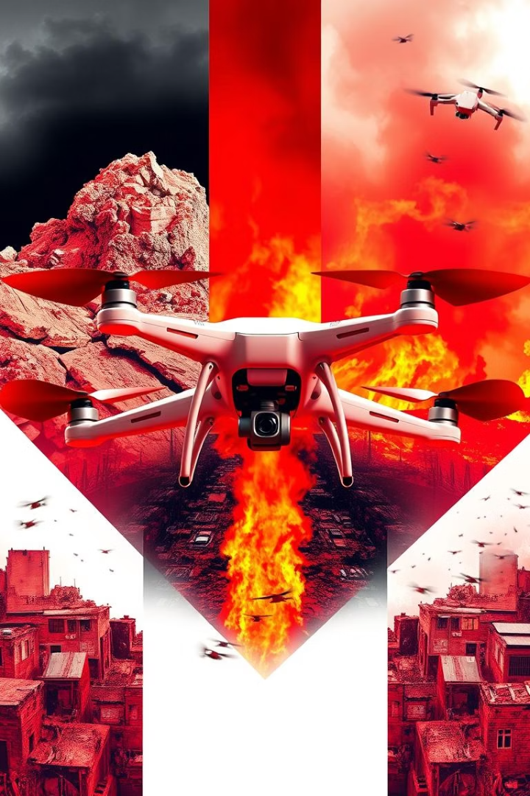
Case Studies: Real-World Applications
2015 Nepal Earthquake
Australian Wildfires 2019-2020
Drones mapped inaccessible areas, identified collapsed structures for efficient resource allocation.
Thermal drones tracked fire spread, enabling strategic containment and damage assessment.
Turkish Earthquake 2023
Drone swarms deployed with advanced coordination identified survivors and safe routes rapidly.

Slide 6

Ethical and Policy Considerations
Privacy
Ensure data protection and clarify rules on consent during emergencies.
Security
Implement encryption and strict data storage to protect against cyber threats.
Ethical AI
Use diverse training data; apply explainability to increase trust in AI.
Regulations
Compliance with airspace laws and foster international cooperation for cross-border crises.

Slide 7

Proposed Hybrid AI Model and Swarm Coordination
Simulation & Testing
Swarm Algorithms
Extensive virtual scenarios and field trials ensure performance and reliability.
Hybrid AI Model
Multi-agent learning enables cooperative area coverage and dynamic task allocation.
Combines CNN feature extraction with reinforcement learning for adaptive detection.

Slide 8
Experimental Results and Hardware Setup
Results
Hardware
92% accuracy with hybrid model vs. 85% baseline
STM32F411 Custom Flight Controller
25% more efficient swarm coverage
Raspberry Pi 5 with YOLO model
20% faster response time, 15% lower energy use
OAK-D Lite Depth sensing camera

Slide 9
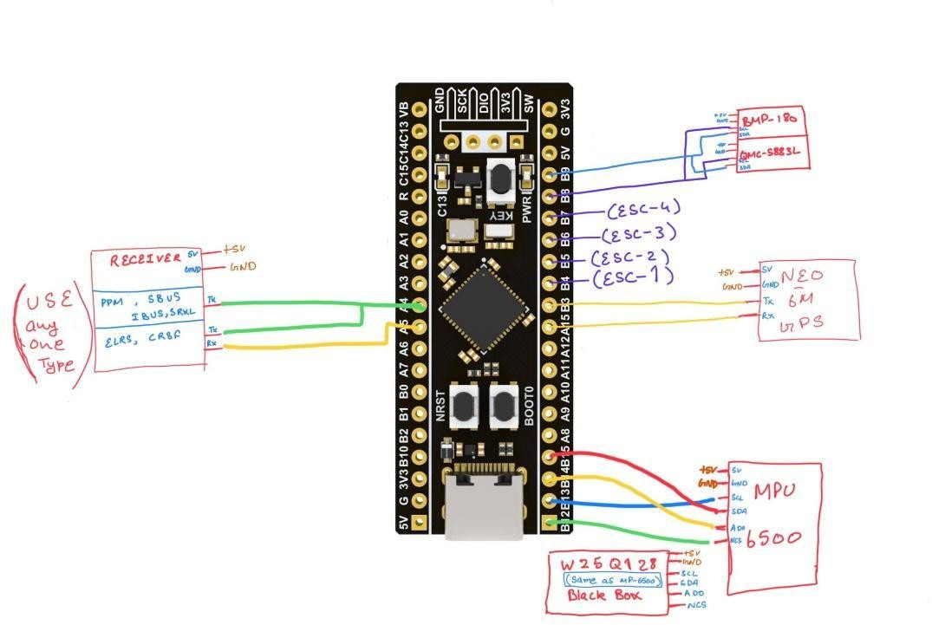

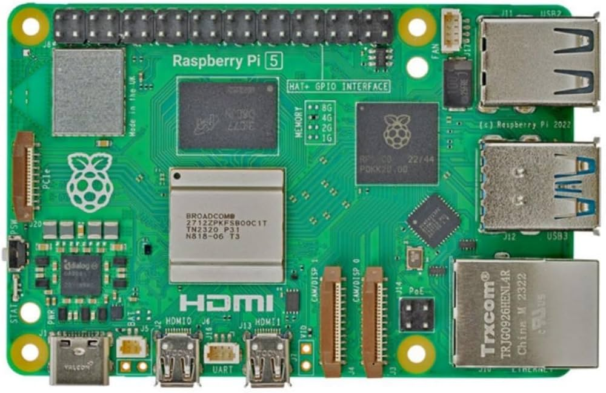
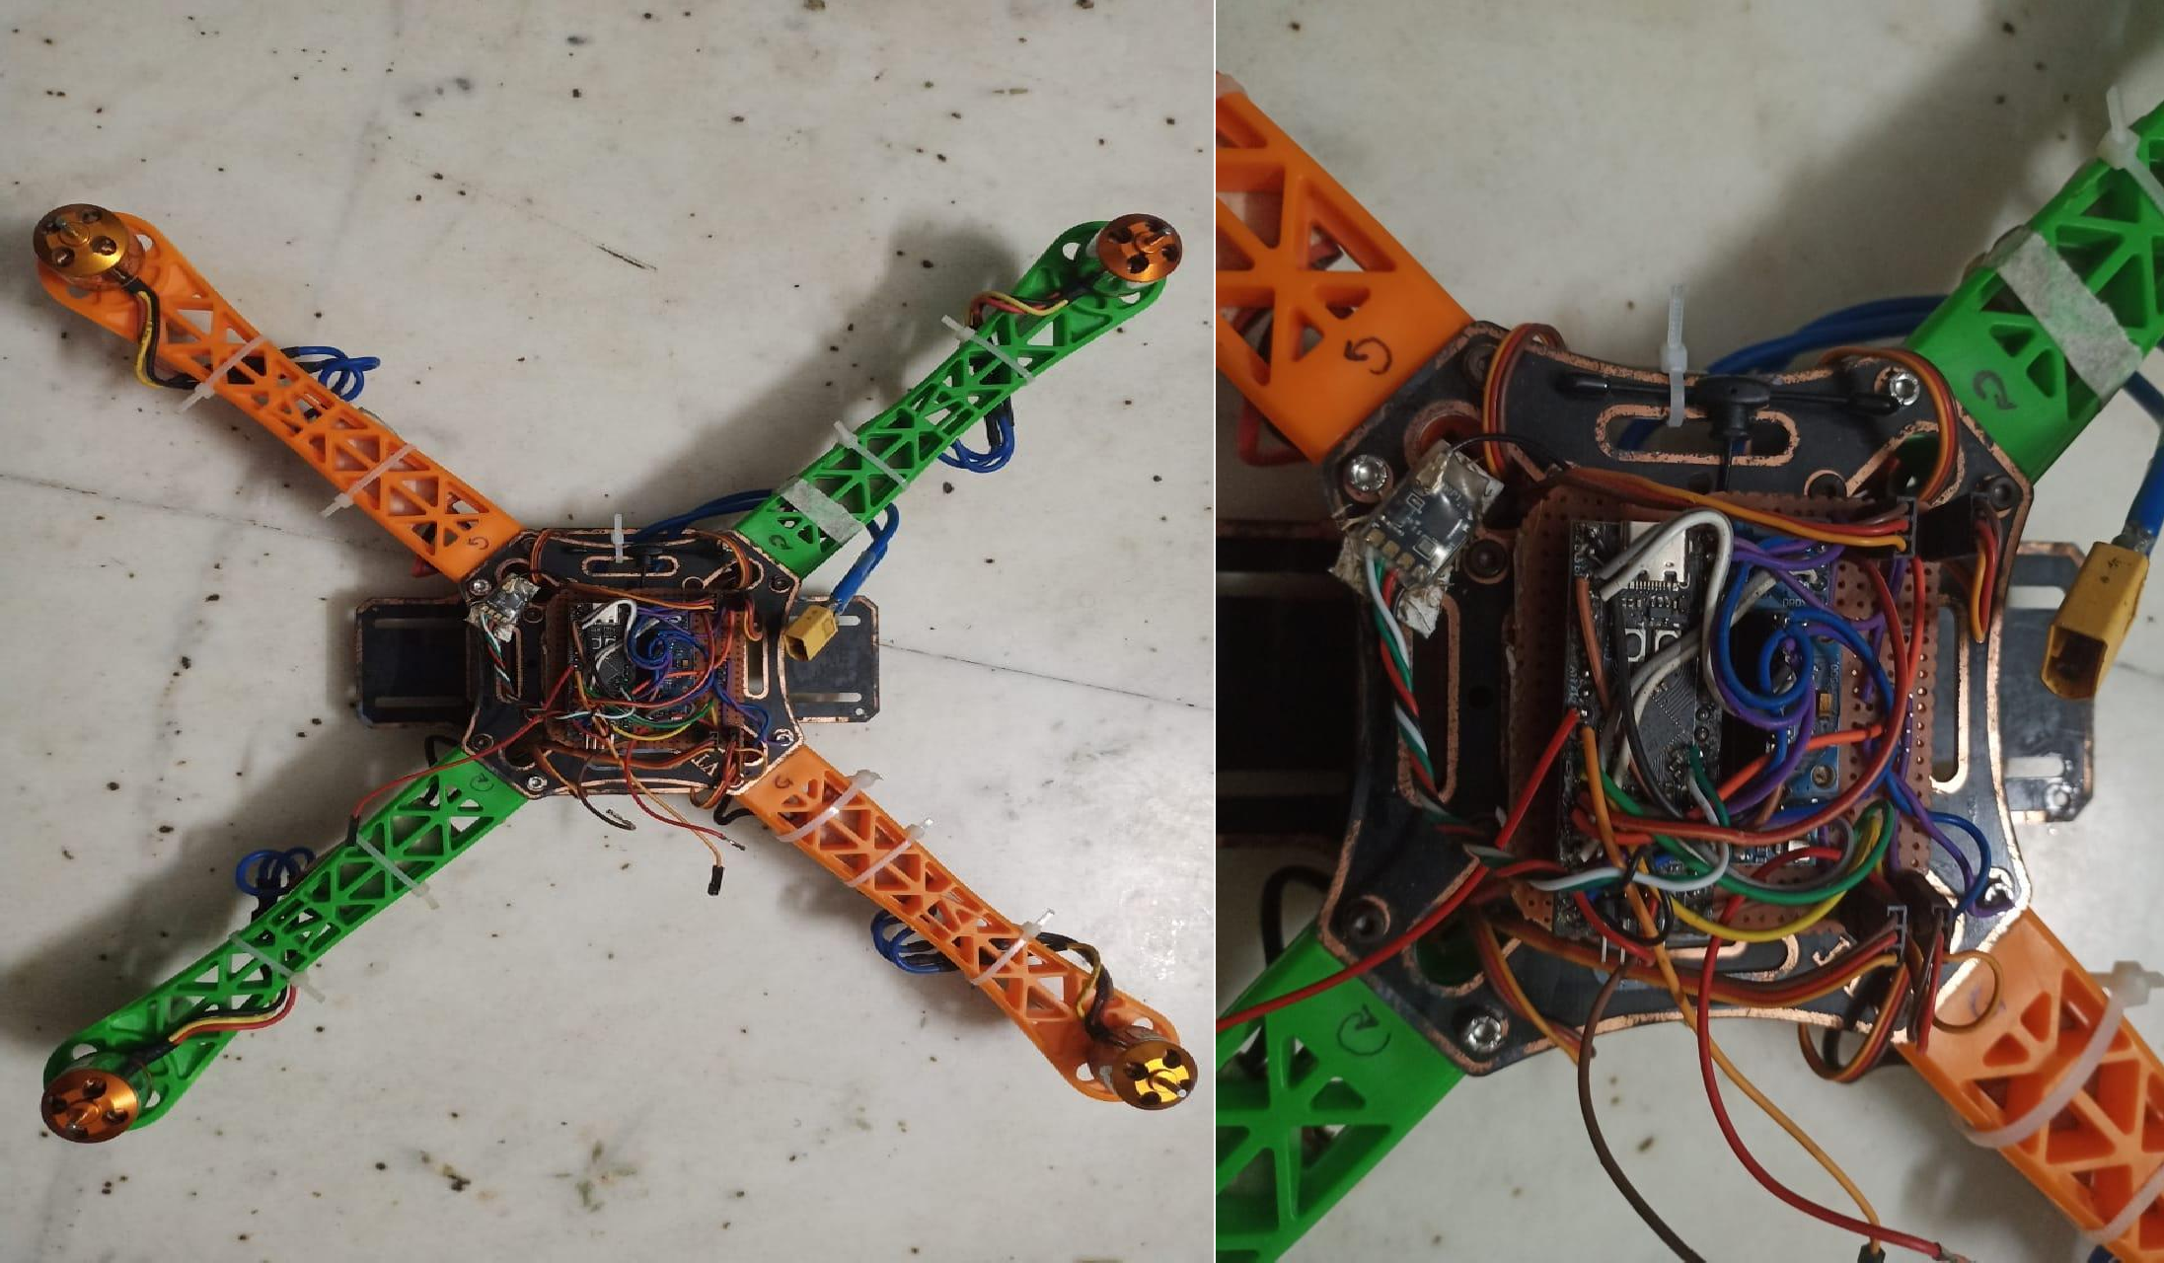
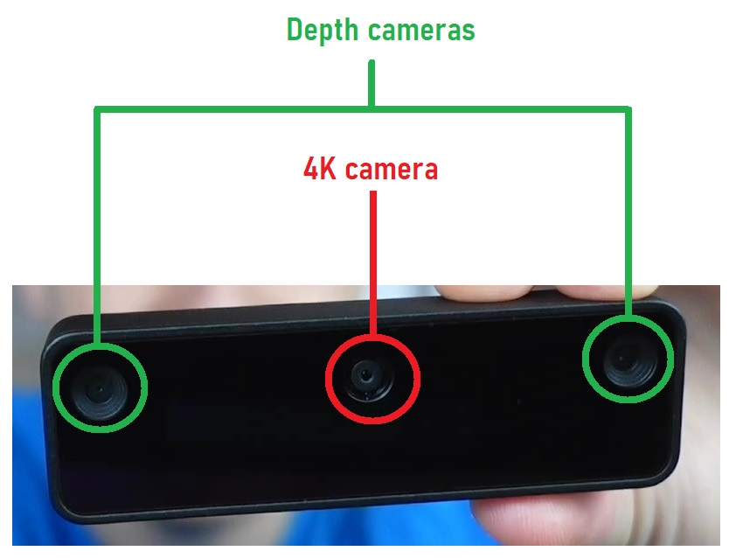
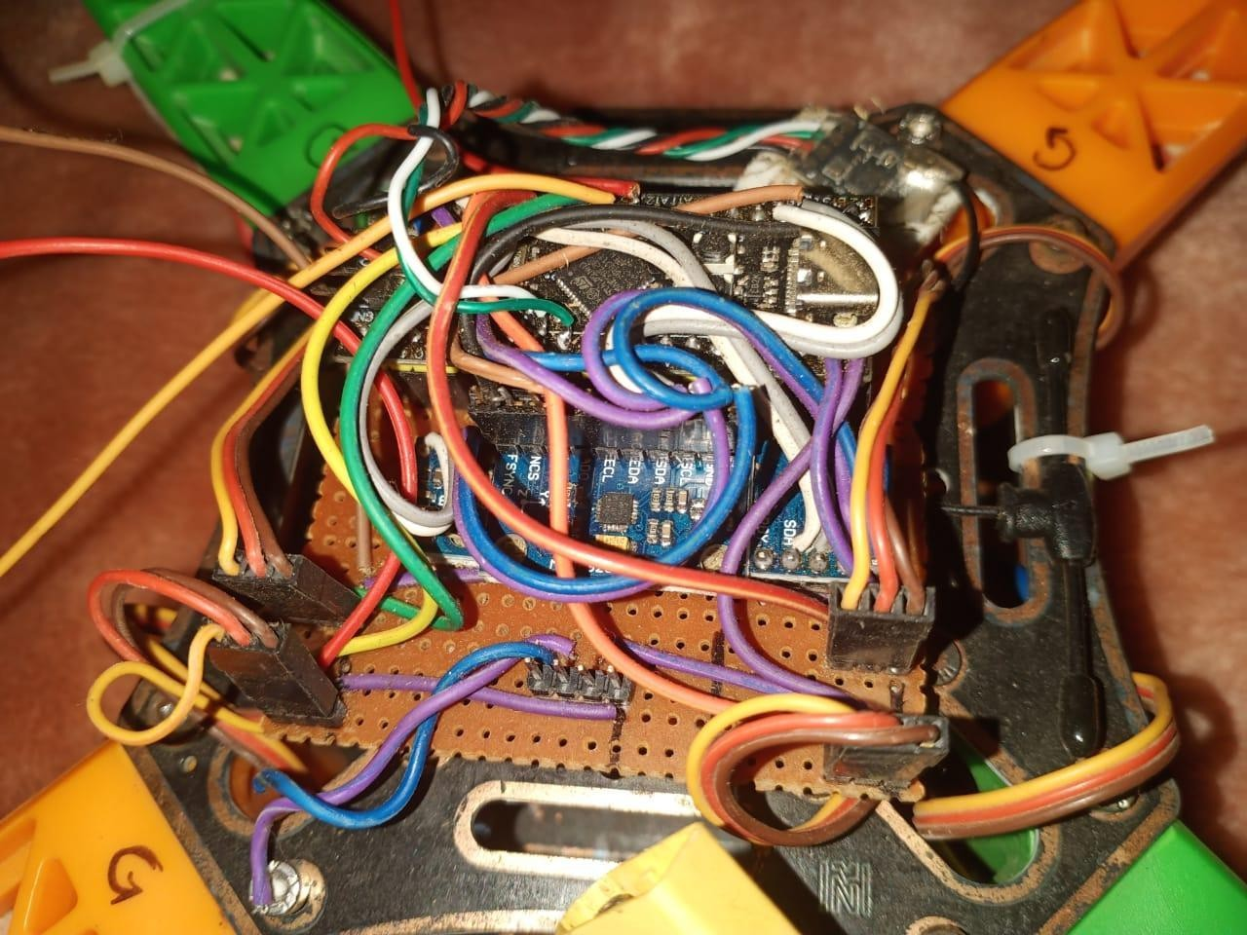
Test Setup

Slide 10
Future Improvements and Emerging Technologies
Explainable AI
Biodegradable Drones
Improve model transparency for accountability and user trust.
Reduce environmental impact with eco-friendly materials for disposable drones.
Federated Learning
Advanced Power Systems
Collaborative model training without data sharing preserves privacy.
Explore graphene batteries and hydrogen fuel cells for longer missions.
Integration with IoT and satellite data will enable systemic crisis management.

Slide 11
Thank You!!

