Slide 1

AstroSage Analysis
Unlocking Insights for Operational Excellence
PRADNYA BHALERAO

Slide 2
Problem Statement
AstroSage faces challenges in optimizing operations and enhancing customer engagement.
High call volumes during peak hours causing capacity issues.
Significant variations in astrologer performance and user satisfaction.
Inefficient refund policies reducing customer trust.
Objective: To enhance operational efficiency, customer satisfaction, and profitability through data-driven strategies

Slide 3
Data Overview
The AstroSage app data, covering astrologer earnings, user interactions, refunds, and ratings, provides insights into how call volume, time, and guru ratings impact revenue and user experience.
Analyzing over 5,000 consultations across 25 states and 150 cities enables the improvement of operational efficiency, customer satisfaction, and profitability, ultimately creating a call center that resolves issues and delights customers.

Slide 4
Astrologers' Metrics and Revenue Insights
Metrics include chats, call hours, astrologers' ratings, refunds, and earnings.
Timeframe: Recent data trends captured for analysis.
Focus Areas: Call and chat statuses, revenue trends, and user feedback.
Key Metrics: Total Chats: 60
Astrologer's Earnings: ₹99,146.57
Net Amount: ₹2,13,987.31
High Rating: 7.5

Slide 5
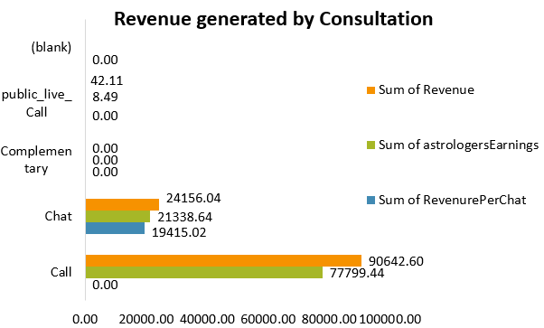
Analysis - Revenue Generation
A key insight from the data is the direct correlation
between consultations and revenue generation.
A visualization of revenue by consultation types clearly indicates which
types generate more income,
allowing the team to focus on high-performing consultation methods.
This insight can lead to targeted marketing or promotions to boost the more profitable consultations.

Slide 6
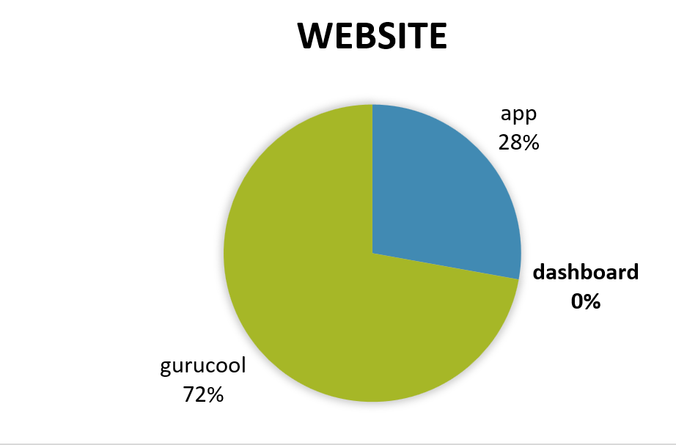
Website Performance
The website metrics show that a majority of users access the AstroSage app via the mobile app, with a smaller percentage visiting through the web portal.
This insight suggests that mobile app optimization and marketing should be prioritized to better cater to the user base and enhance the overall customer experience.

Slide 7
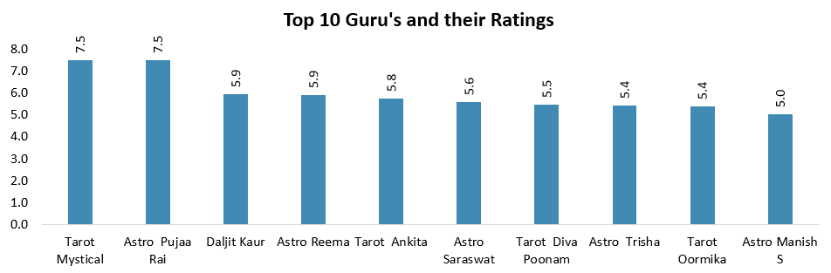
Guru Rating Analysis
The data shows that top-rated astrologers have more consultations and higher earnings, emphasizing the importance of expertise in customer satisfaction.
Identifying and rewarding top-rated astrologers can encourage service improvement. The rating distribution reveals significant variation in user satisfaction.

Slide 8
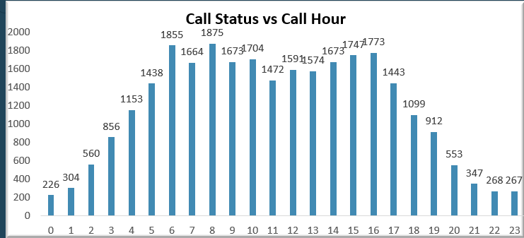
Call Status vs Hour
Analysis of call status and time of day shows that maximum calls occur between 12 PM - 4 PM, with a high number of busy calls indicating capacity issues.
This insight helps optimize astrologer scheduling and support during peak hours.
Call data analysis shows peak hours with high consultation volumes and lower activity during other times.
This insight highlights capacity issues, helping optimize astrologer scheduling during busy periods to maximize earnings and engagement.

Slide 9
Date vs. Call Volume
Peak Days: Identify high call volumes on specific dates (e.g., weekends, holidays).
Trends: Observe increasing, decreasing, or consistent daily trends.
Spikes: Highlight unusual spikes due to events or campaigns.
Patterns: Spot weekly or seasonal variations in call volumes.
Optimization: Use trends to adjust staffing or resources on busy days.

Slide 10
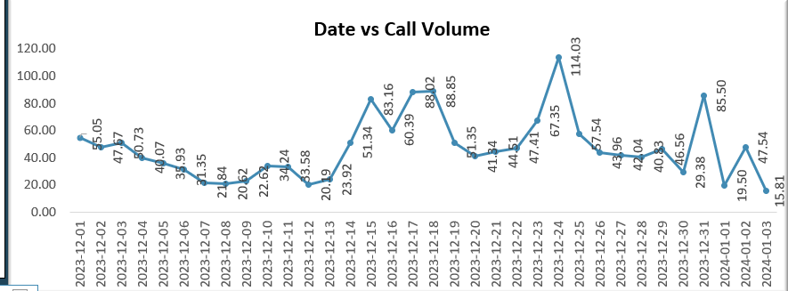

Slide 11
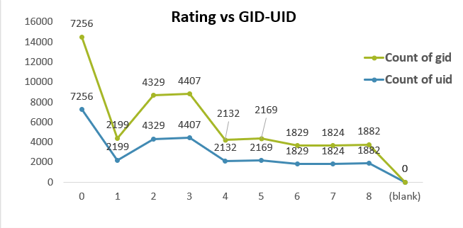
Rating vs GID & UID
GID vs Rating: Identify high-performing groups (GIDs with ratings >7.5)
and low-rated ones needing improvement.
UID vs Rating: Spot top-performing UIDs with high ratings and low-rated ones for feedback.
Trends: Compare averages to find overall satisfaction patterns by group and individual.

Slide 12
Chat and Call Status
Chat Status Insights:
Engagement: 60 chats completed, earning ₹99,146.57 (₹1,652.44/chat).
Satisfaction: High rating of 7.5 indicates good performance but room for improvement.
Opportunity: Focus on user feedback to further enhance chat quality and revenue.
Call Status Insights:
Revenue: Significant contribution to the net amount (₹2,13,987.31).
Efficiency: Analyze call durations and drop rates to optimize operations.
Improvement: Address peak-time bottlenecks with better queue management

Slide 13
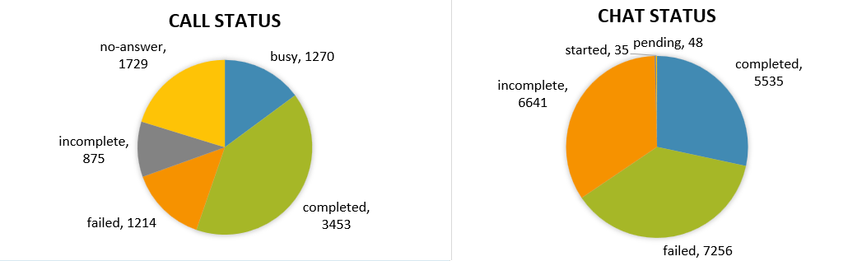
Call & Chat Status

Slide 14
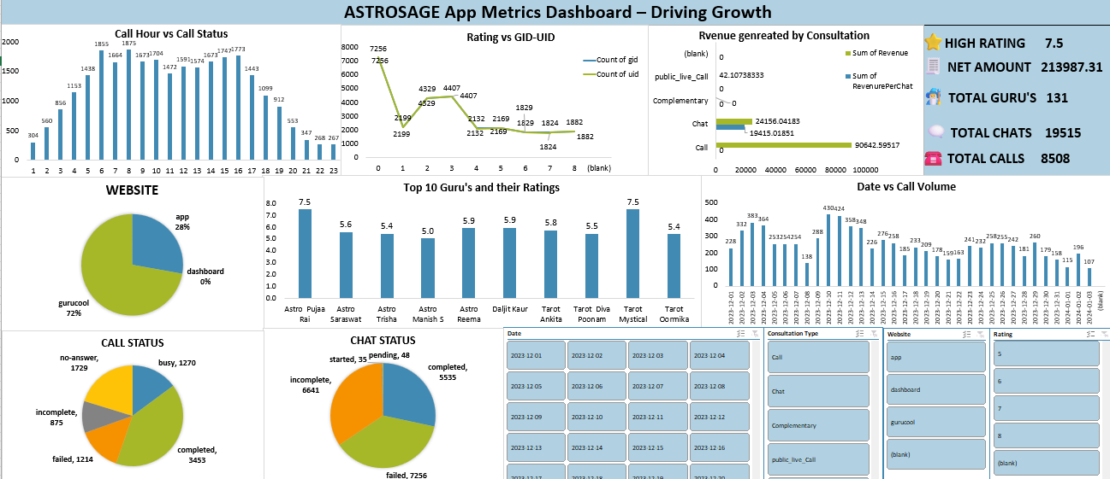

Slide 15
Strategic Recommendations
Hire More Agents: High call volumes during peak times cause long wait times and dissatisfaction. Impact: Reduced wait times and improved customer satisfaction.
Upgrade Call Center Technology: Inefficient systems lead to longer handle times. Impact: Streamlined processes and better scalability with AI-powered tools.
Implement Targeted Training: Poor agent performance affects satisfaction scores. Impact: Skilled agents deliver consistent service, improving customer ratings.

Slide 16

Optimize Workload Distribution: Uneven workloads cause burnout and inefficiency.
Impact: Balanced workloads improve productivity and service quality.
Develop Strategies for Peak Call Periods: Inefficiencies during peak times hurt satisfaction scores.
Impact: Better scheduling and resource allocation ensure high satisfaction during busy periods.
These strategies will enhance operational efficiency, customer satisfaction, and profitability for AstroSage.

Slide 17
Conclusion
In conclusion, the AstroSage app data provides valuable insights into how different factors, such as time of day, guru ratings, and consultation types, influence overall app performance.
By focusing on peak performance periods, optimizing guru availability, and adjusting refund policies, AstroSage can enhance its revenue generation, customer satisfaction, and growth strategies.

Slide 18
Reference
This analysis was conducted based on a dataset provided and tools like Excel .
1. Dataset: Provided dataset containing consultation type, ratings, earnings, and location data.
2. Tools Used: Microsoft Excel: For data cleaning, transformation, and visualization (bar graphs, line graphs, pie charts, histograms, and pivot tables).
3. Methodology References: Standard data analysis practices: Data cleaning, handling missing values, and removing duplicates.
4.Visualization techniques: Common chart types used in business intelligence for effective data representation.

