Slide 1

IPL
ANALYSIS
Optimizing Player Selection and
Auction Strategies for RCB
Presented by- Pradnya Bhalerao
Date- 29-1-2025

Slide 2
Introduction
Context:
RCB is a prominent IPL franchise with a passionate fan base.
Preparing for the 2017 mega player auction to enhance team performance.
Objective:
Provide a data-driven approach for optimizing player selection and auction strategies.
Identify top-performing players who offer the best value for money.
Data Sources:
Player statistics (batting, bowling, fielding).
Historical auction data.
Match contributions.
Significance:
Insights will help RCB make informed decisions during the auction.
Focus on both on-field performance and financial considerations.

Slide 3
Problem Statement
Key Question:
How can RCB identify and select top-performing players for the 2017 mega auction?
Objective:
Analyze player performance from the 2017 mega auction to identify top-performing players.
Challenges:
Select high-performing players while optimizing budget.
Expected Outcome:
Recommendations for player selection and auction investment strategies.

Slide 4
Data Overview
Core Entities:
Player: Details about players (ID, name, role).
Match: Information on matches (ID, date, winner, venue).
Team: Teams participating in the IPL (ID, name).
Venue: Locations of matches (ID, name, city, country).
Performance Tracking:
Ball by Ball: Events for each ball (runs, wickets, player involvement).
Wickets Taken: Dismissals (bowler, fielder, player out).
Extra Runs: Extra runs conceded (wides, no-balls).
Match Outcomes:
Outcome: Match results (winning team, outcome type).
Win By: Method and margin of victory.
Player Awards:
Season: Season details and awards (Man of the Series, Orange Cap, Purple Cap).
Rolee: Player roles and skills.
Supporting Entities:
City & Country: Geographical context for venues.
Umpire: Details about match officials.
Toss Decision: Outcome of the toss.

Slide 5
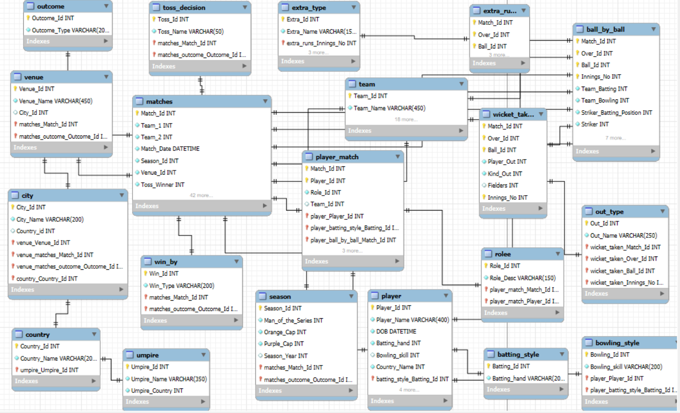
Database Schema

Slide 6
Consistent Player Performance Analysis
Objective
Analysis
Outstanding All-Rounders: Excel in runs and wickets.
Inconsistent Contributors: Occasional performance, less reliable.
Balanced Performers: Equal runs and wickets are key assets.
Insights:
Key Players: 500+ runs or 20+ wickets.
Performance Metrics: Established thresholds.
Seasonal Consistency: Reliability over multiple seasons.
Role Analysis: Strengths of batsmen vs. bowlers.

Slide 7
Venue Performance Analysis
Analysis
1:1 Correlation: The number of 'Man of the Match' awards matches the number of matches hosted at each venue, indicating standout performers in every match.
Significance of Venues: Consistent counts across venues confirm that 'Man of the Match' is awarded in every match without exception.
Implications: No venue significantly outperforms others in producing 'Man of the Match' awards; the distribution is uniform.
Insight:
Every match has a corresponding "Man of the Match" award, reflecting consistent performance recognition.

Slide 8
Impact of Toss Decisions on Match Outcomes
Subjective
Analysis:
Toss Decision: Teams fielding first after winning the toss show a higher success rate.
Venue Consistency: Certain venues favor chasing, likely due to factors like dew.
Insights:
Winning the toss and fielding first improves chances of success.
Night games at specific venues strongly favor chasing teams.

Slide 9
Analysis of Batting and Bowling Styles Among Players
Analysis
Versatile Players: The data identifies players performing well in both batting and bowling, showcasing their all-rounder abilities.
Skill Diversity: A variety of batting and bowling styles are evident, offering tactical flexibility to teams.
Insights
Teams can leverage all-rounders for balance and adaptability in games.
Diversity in playing styles enables strategic matchups against opponents.

Slide 10
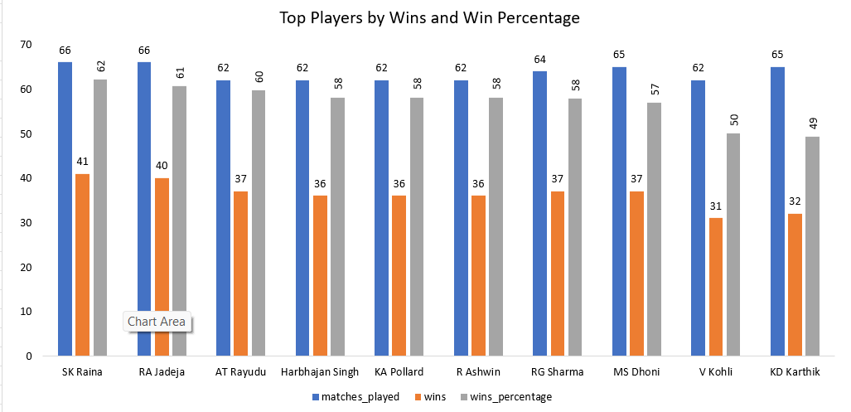
Assessing Players' Influence on Team Morale and Success
Analysis
'Man of the Match' winners boost morale and success.
High win rates indicate key influencers.
Captains and all-rounders shape team dynamics.
Insights
Retain impactful players for morale and performance.
Leadership and versatility are crucial for success.

Slide 11
Win Margin and High-Scoring Match Insights
Analysis:
Win Margins: Large win margins indicate dominant performances and high scores.
Player Impact: Players with high average runs are crucial to team success.
Team Strength: Teams with high win margins have strong batting and bowling lineups.
Insights:
Key Players: Identifying top performers can guide recruitment.
Strategic Models: High-performing teams set benchmarks for success.
Viewership: High-scoring matches boost viewer engagement.

Slide 12
Performance Snapshot: Total Matches, Results, and Success Rate
Analysis
Strong home performance contrasts with poor away results, showing adaptability issues.
RCB's low win percentage reflects inconsistency in securing victories.
Over-reliance on key players highlights a lack of squad depth.
Insights
Focus on improving performance in away conditions.
Build a balanced squad with consistent contributions from all players.

Slide 13
Strategic Recommendation
Player Recruitment: Target players with consistent performance metrics in batting and bowling.
Venue Strategies: Tailor game plans based on historical venue performance data.
Toss Optimization: Use historical data to inform toss decisions for batting or bowling first.
Diverse Skill Sets: Build a balanced team with varied batting and bowling styles.
Team Morale: Foster a positive culture and teamwork to enhance player morale.
Performance Monitoring: Regularly analyze performance metrics to identify trends and adjust strategies.
High-Scoring Insights: Study high-scoring matches to apply successful tactics in future games.

Slide 14
Conclusion
Summary of Analysis:
Conducted a data-driven analysis of player performance using historical data from IPL.
Key Findings:
Highlighted consistent performers and emerging talents.
Analyzed performance trends and the impact of match conditions.
Strategic Recommendations:
Suggested targeting consistent players and investing in versatile all-rounders.
Emphasized the importance of balancing the squad with experienced and young talent.
Final Thought:
A well-informed player selection strategy will enhance RCB's chances of success in the 2017 season and beyond.

