Slide 1
InDex
PROBLEM DEFINITION
INTRODUCTION
MOTIVATION
LITERATURE SURVEY
BLOCK DIAGRAM OF MODEL
IMPLEMENTATION OF MODEL
CONCLUSION
FUTURE ENHANCEMENT
REFERENCES
1

Slide 2

Problem definition:
To develop a model for processing and recognition of the images in autonomous vehicles.

Slide 3
Introduction-
As the technology is evolving there is a greater need of automated, fully connected and online vehicles. Cameras are fitted on these autonomous vehicles and the images are captured at every moment through the cameras. These images are then can processed through the system that we have designed. Canny edge detection algorithm is first applied on the image and edges can be determined in the image which helps it to the easy identification of the lanes. After that image is transferred to the grayscale image so that all the noise can be removed from the image and easy to process. Hough transform technique can be applied to the image hence, the straight lines can be identified in the image and image and lane lines can be detected. This also detects the obstacles on the way of the vehicle like other vehicles that are also running on the road, people walking on the road, traffic signals and signs etc. so the proposed system can be designed using this technique for the autonomous vehicles.

Slide 4
Motivation-
Autonomous vehicle is one of the popular study in the field of computer vision. Many researchers work in this to improve the image recognition using deep learning techniques.
Image processing helps to develop various applications that todays world needs the most.
Autonomous vehicle will be the future of the transportation. As machine learning and Artificial intelligence is now added to every part of our life.

Slide 5
Literature Survey-
Index | Paper Name | Author Name | Conclusion
1 | Research on image classification methods based on DCNN | Chao Ma, Xianyong Yi and Chenglong Yu | discussed about the large amount of image data produced by the various applications of the internet and study how to use this data to get the useful information from this data.
2 | Image classification using small Convolutional Neural Network | Shyava Tripathi | discussed the biological neural network with the Deep Covolutional Neural networks it applies various layers of feature recognision on the large dataset of the images and gives accurate output to the user.
3 | Application Of Deep Convolution Neural Network | JIUDONG YANG, JIANPING LI | discussed about applications of the CNN and covered the basics of the CNN for the features recognision and accurate output. covered pooling layer,flattening layer, fully connected layer.etc.

Slide 6
4 | Simple Convolutional Neural Network on Image Classification | Tianmei Guo, Jiwen Dong ,Henjian LiˈYunxing Gao | It basically it worked to find the optimal algorithm for the field of image classification in the computer vision.
5 | Deep learning based image recognition for autonomous driving | Hironobu Fujiyoshi, Tsubasa Hirakawa, Takayoshi Yamashita | It works on basic idea and feature recognition. It also promotes to study deeper so that it can study to identify the obstacles and learn to control and judgement of the autonomous vehicle
6 | Autonomous Driving through Intelligent Image Processing and Machine Learning” | Michael Krodel and Klaus-Dieter Kuhnert | It studies the algorithm where they provided image dataset to the program and program analyzes pixels.image is classified into tiles. Tiles are then divided into pixels of size n*n.

Slide 7
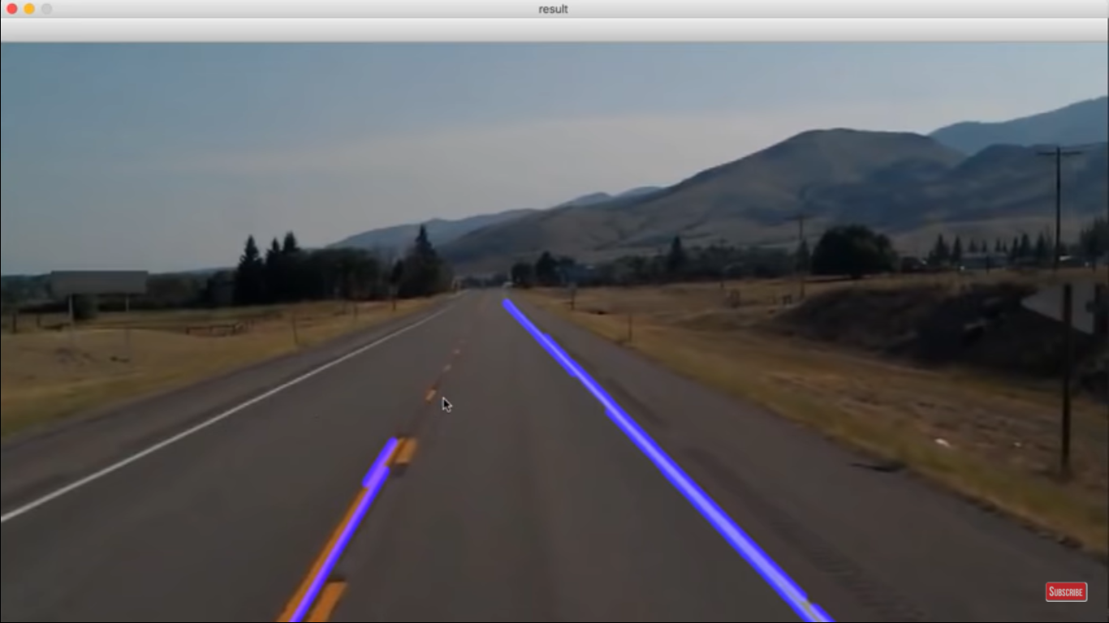
Block diagram of Concept
GrayScale Conversion
Gaussian Blur
Canny Edge detection
Finding the region of interest
Optimization
Hough Transform

Slide 8
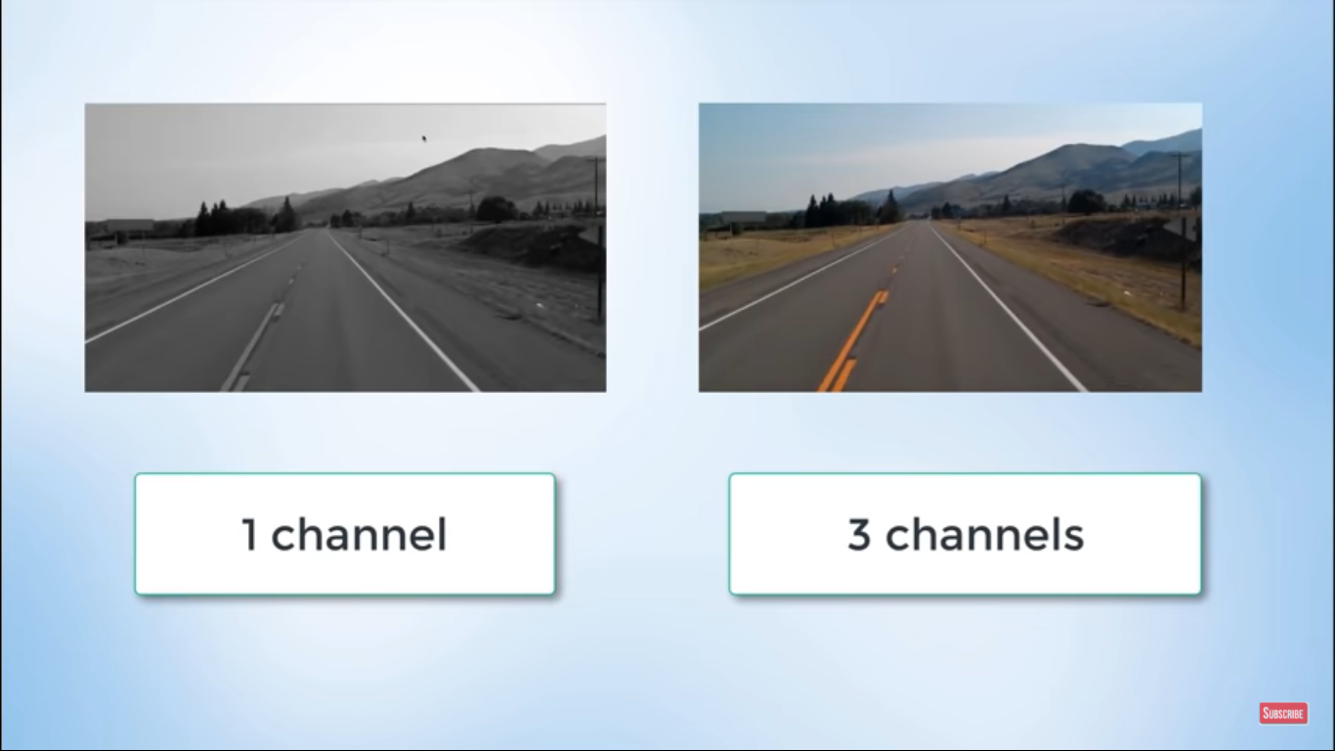
Grayscale Conversion-
1 color channel is more efficient than 3 channel-

Slide 9
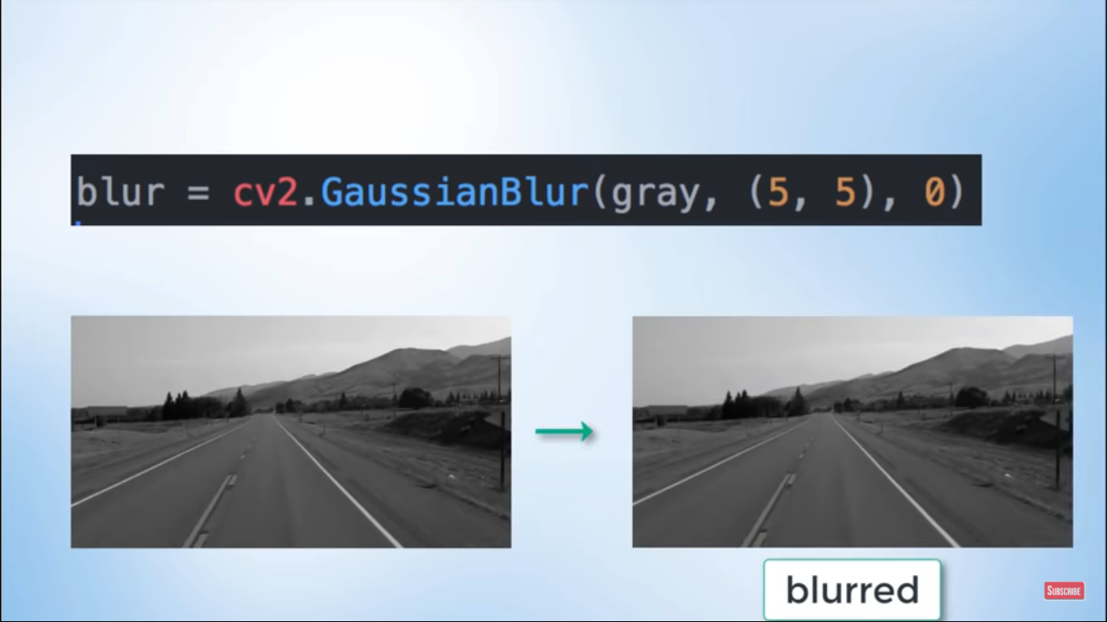
Guassian Blur Filter-
Removal of noise from image

Slide 10
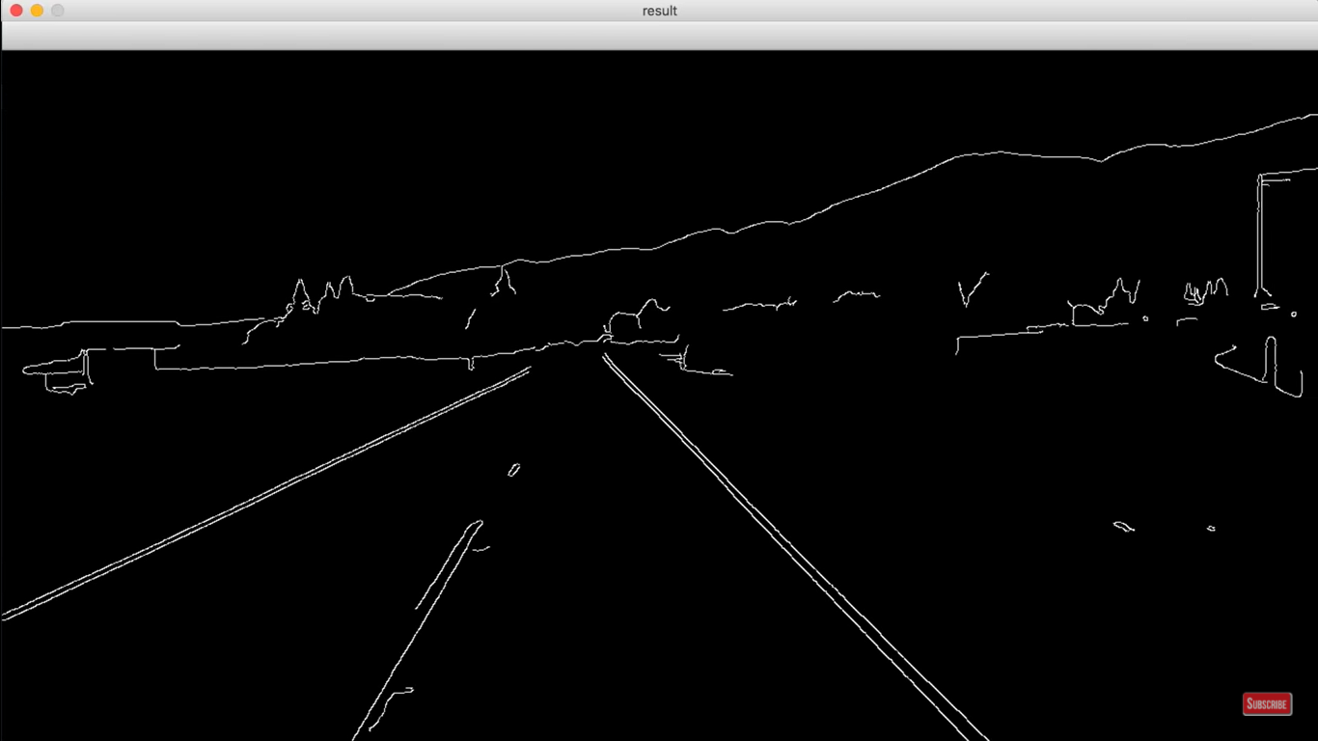
Canny Edge Detection:
Gradient changes identification
Derivative function , pygain function , avg , 50-50, derivative find , drastic change detect as edge, derivative large then detect as edge ,

Slide 11

Finding Region of interest:
Polygon of triangular shape
Masking of image, triangle shape poly gaon draw
And paste image drawn by canny edge, merge it

Slide 12
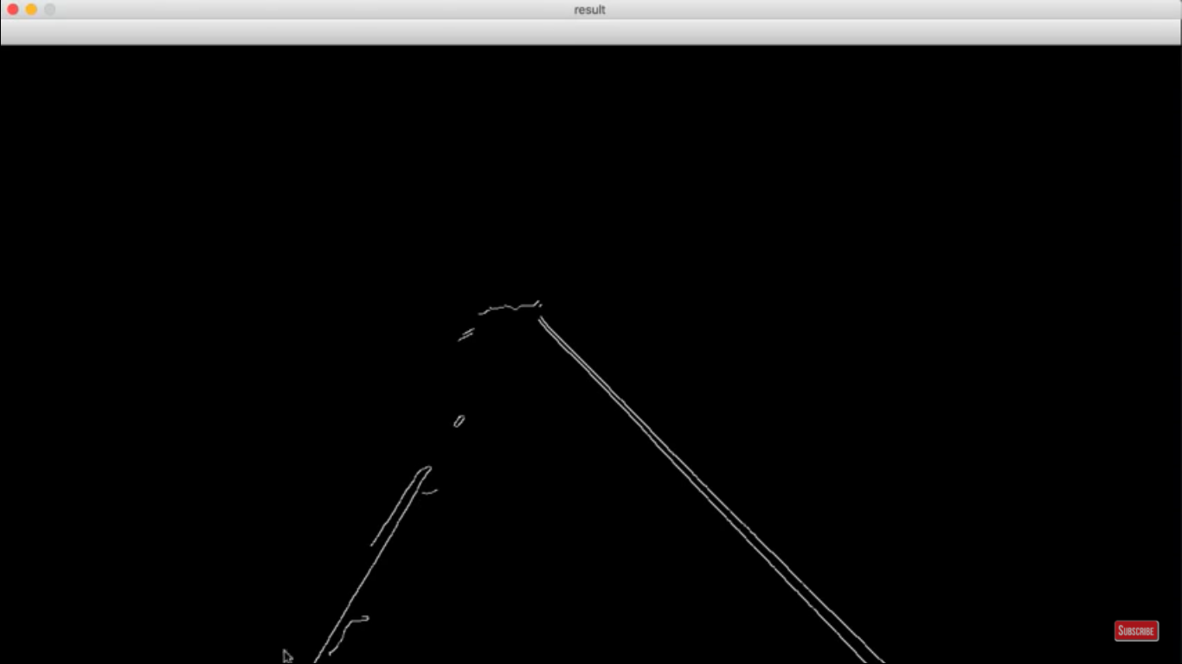
Region of interest:
&
& operation-
Bitwise and operator thrugh mearge
=

Slide 13
Hough Transform:
Connection of series of points and getting optimal image Continues line connected by HT

Slide 14
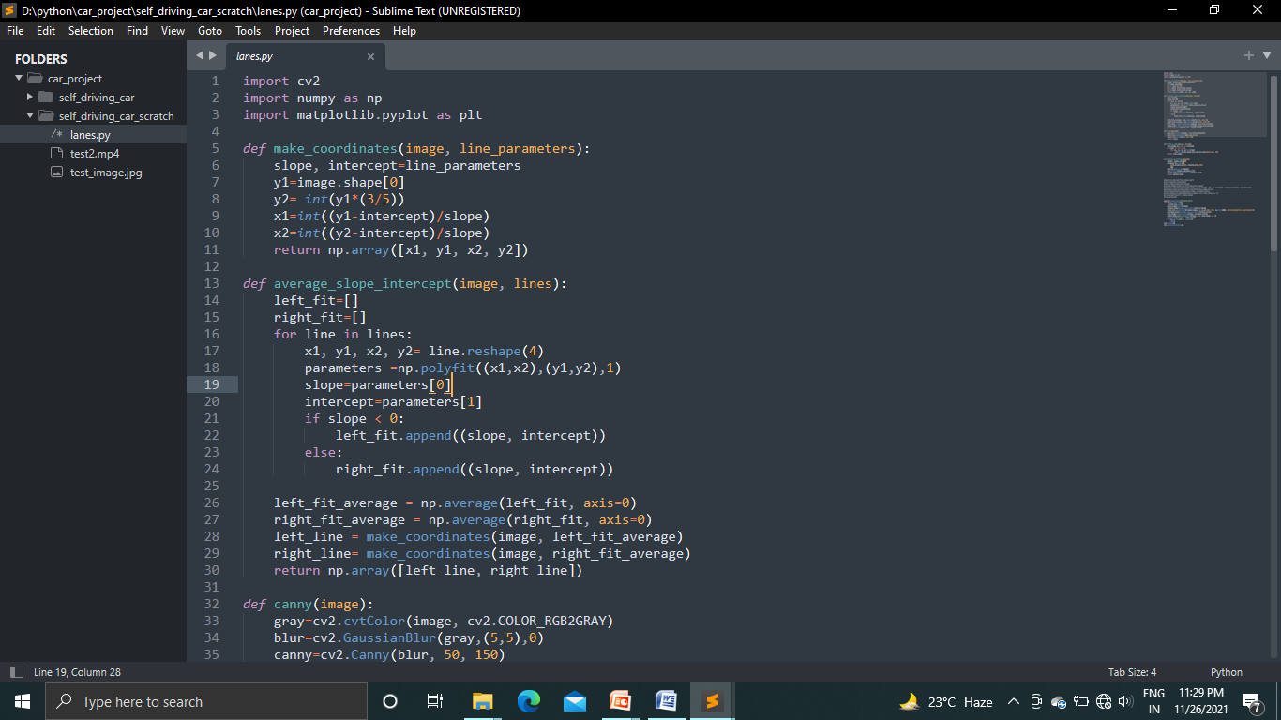
Implementation-

Slide 15
Conclusion
Since AI Ml has given a lot of change to our life using it in the field of vehicles is surely a great idea.
It will bring a great change in our society.
By studying this got the basic Idea of how the image processing will be done in the an autonomous vehicles,

Slide 16
FUTURE ENHANCEMENT
Feature Identification
Taking decisions
Identification of the obstacles.
Identification of signs and symbols.
16

Slide 17
ReFERENCES-
https://www.youtube.com/watch?v=eLTLtUVuuy4
https://towardsdatascience.com/carnd-project-1-lane-lines-detection-a-complete-pipeline-6b815037d02c?p=6665d6e1089b
Hironobu Fujiyoshi, Tsubasa Hirakawa, Takayoshi Yamashita, “Deep learning-based image recognition for autonomous driving”,IATSS Research,Volume 43, Issue 4,2019.
Krödel, Michael & Kuhnert, Klaus-Dieter. (2001). “Autonomous Driving through Intelligent Image Processing and Machine Learning”. 712-718. 10.1007/3-540-45493-4_70.
17
17

