Slide 1
VyanjanVibes Food Ordering system
Presented By
Pradnya Tukaram Patil -243178
Pratibha Hanumant Tonpe-243184

Slide 2

Index
Introduction
Architecture
Technology platform used for project
User roles and responsibilities
Future extensions or scope
Conclusion

Slide 3
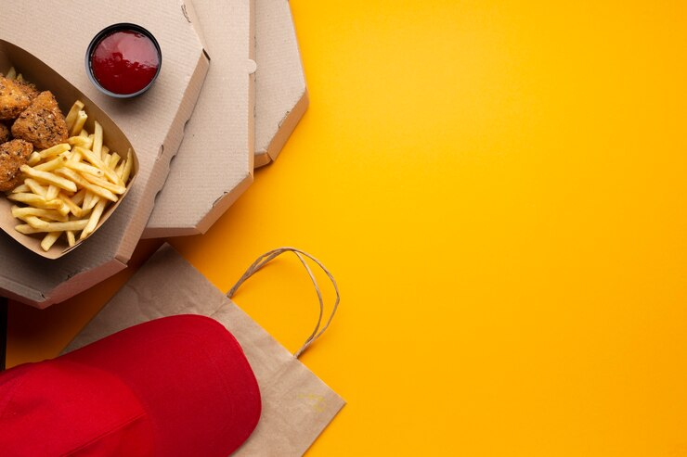
Introduction
Purpose :-
The "Food Ordering System" project is designed to streamline the process of ordering food from restaurants. It offers a user-friendly interface for customers to browse restaurant menus, manage their cart, and place orders with ease. For restaurant owners, the system simplifies managing their menu items, processing orders, and handling customer interactions. By automating various aspects of food ordering and management.

Slide 4

Architecture :-
Front End :- React JS (Version 18) , Bootstrap 5.3.3,MUI
Back End :- Java 11, Spring Boot 3.9.18
Database :- MySQL 8
Database :- MySQL 8.0. 34

Slide 5

Reason for selecting the specific technology :-
React allows developers to create large web applications that can change data, without reloading the page. The main purpose of React is to be fast, scalable, and simple. It works only on user interfaces in the application.
Spring Boot provides a flexible way to configure Java Beans, XML configurations, and Database Transactions. It provides a powerful batch processing and manages REST endpoints. In Spring Boot, everything is auto configured; no manual configurations are needed.

Slide 6

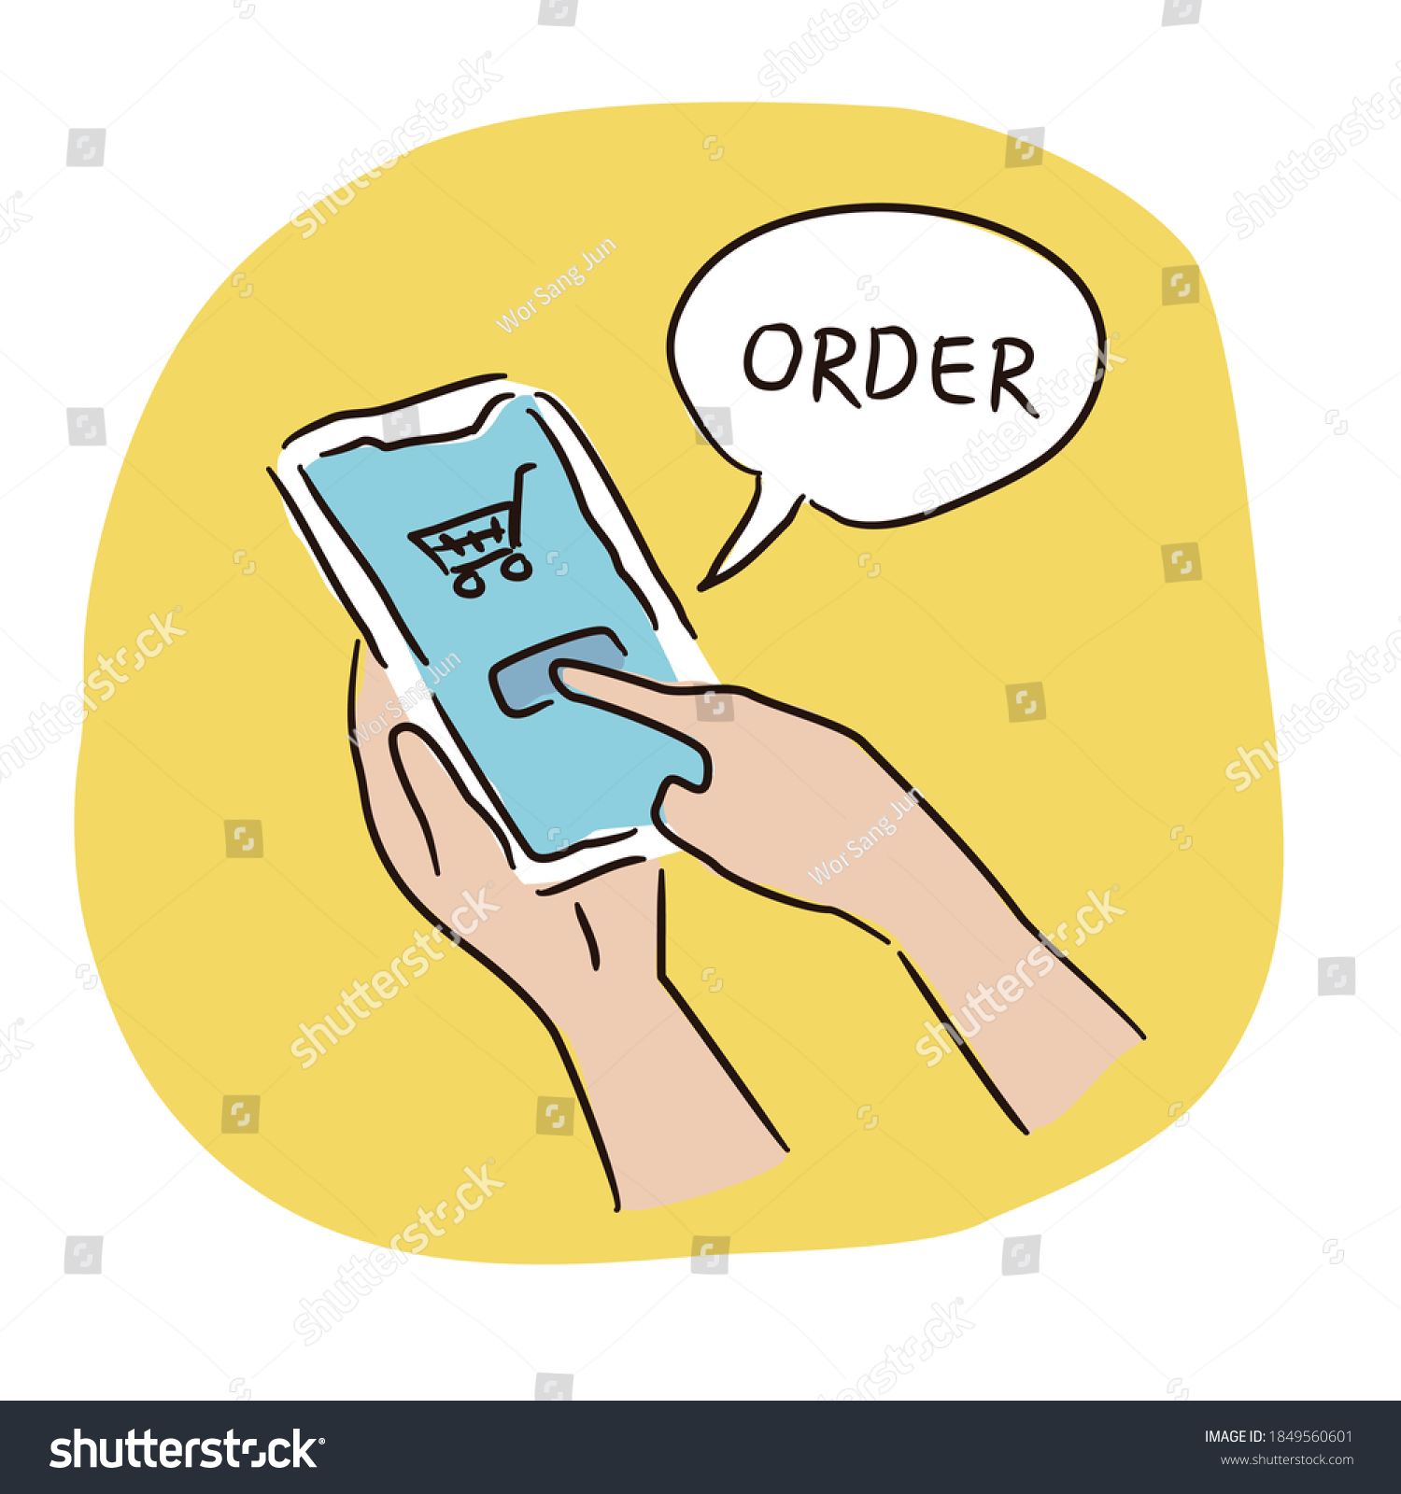
User Roles And Responsibilities :-
Food Ordering System consists of three roles described as below :-
Admin
User/Customer
Restaurant

Slide 7

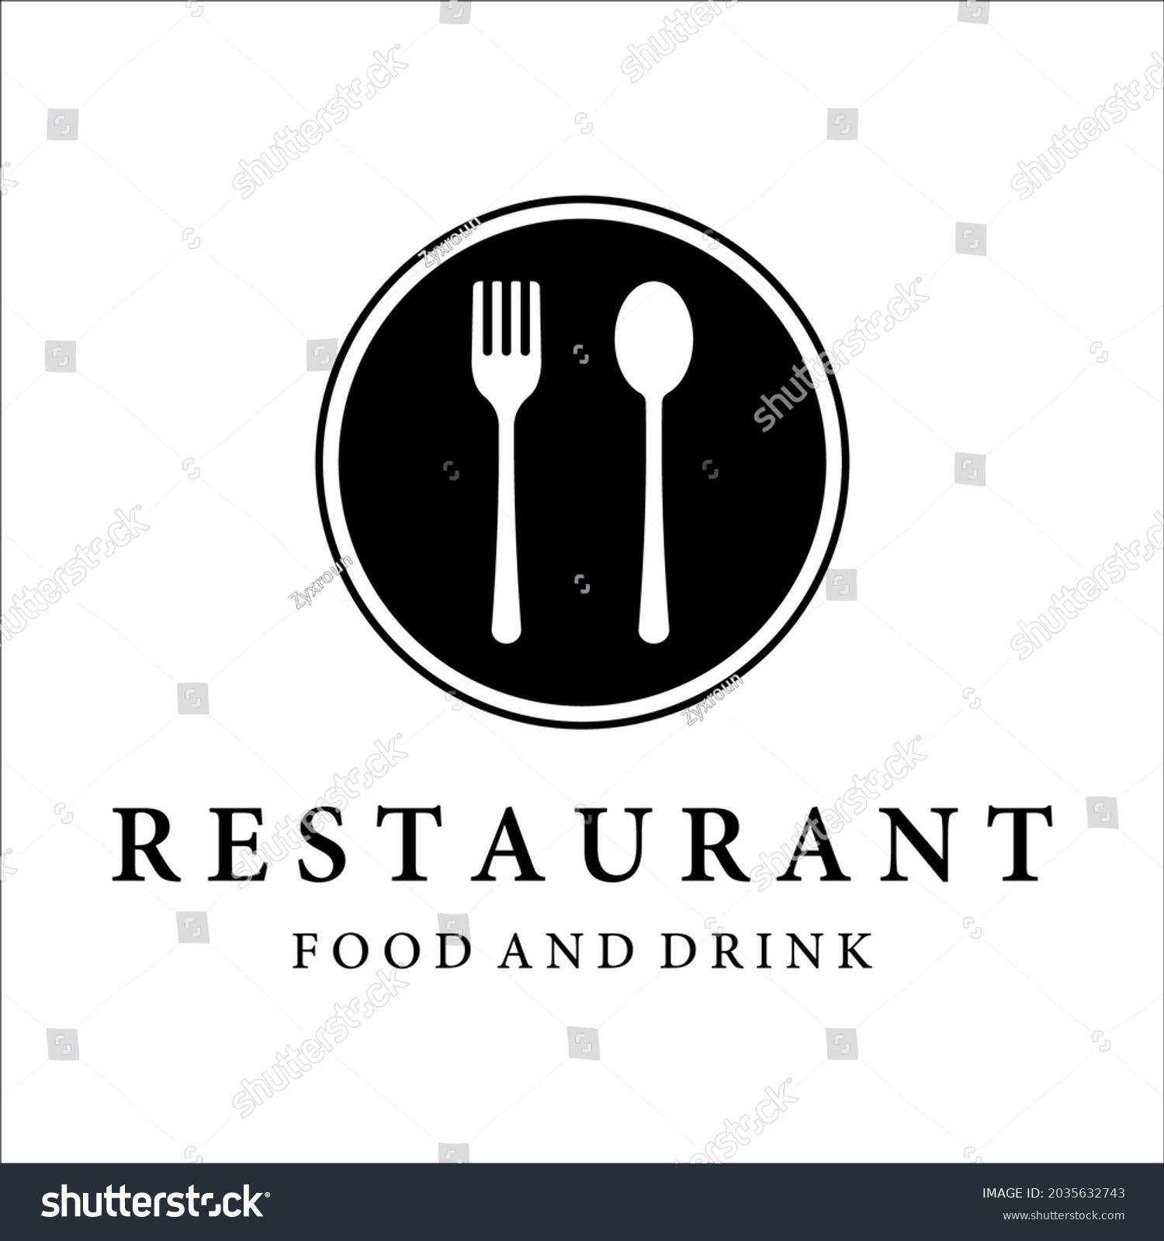

User Classes
Customer
Restaurant
Admin
In this module, customers can register and manage their profiles, explore restaurant menus, place food orders, and track their order status.
In this module, restaurant owners can register and manage their profiles. they can update their menu items, process customer orders, and track order statuses..
In this module Admin can manage restaurants and customers. Will manage the restaurants.

Slide 8
User Module
After successful registration ,the User can
Users can search for restaurant menus,
Users can update their profile information, including their personal details, address
Users can order food from various restaurants

Slide 9
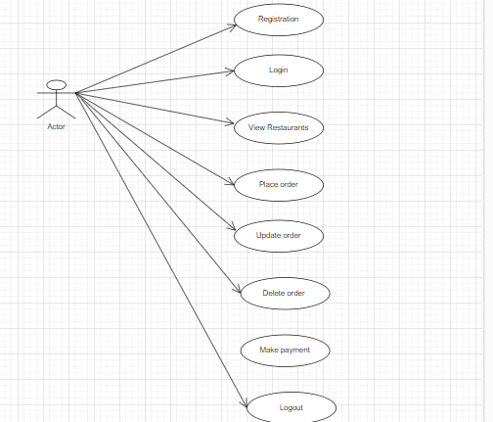
Use Case diagram for Customers/Users

Slide 10

Restaurant Module
After successful registration and authentication, the restaurant can
Upload menus .
The restaurant can edit his/her profile ,
Can manage restaurant menu

Slide 11
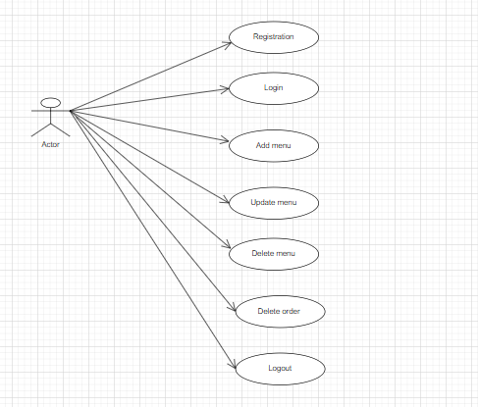
Use Case diagram for Rs

Slide 12
Admin Module
The Admin can
He /she can see applicant details ,
Manage account and delete restaurant account.

Slide 13
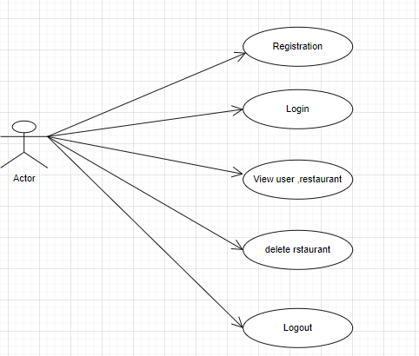
Use Case diagram for Admin

Slide 14

Future extensions or scope :-
AI-Powered Recommendations:
Provide highly personalized food recommendation on user reference
Mobile App Development:
Access via smartphones with a mobile app.
Voice assistance:
Ordering become more common

Slide 15
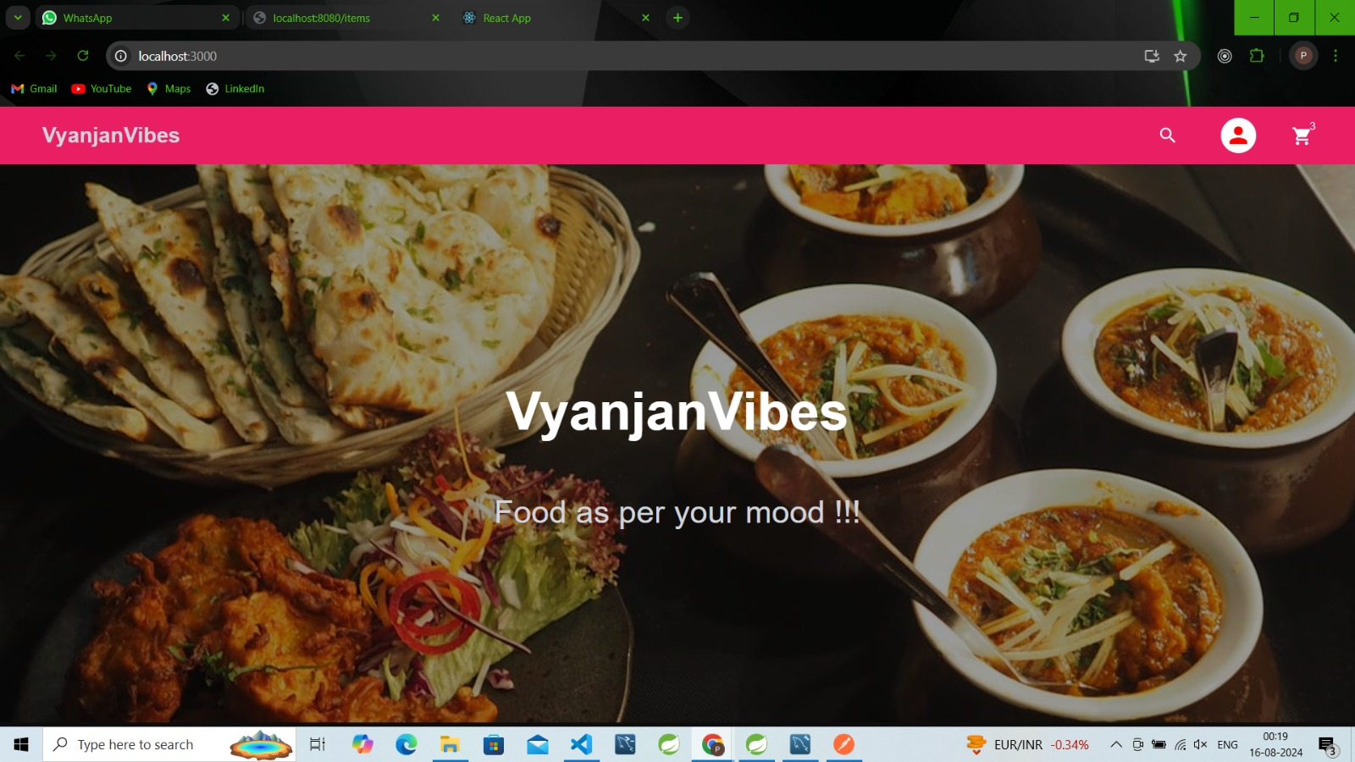
HomePage

Slide 16
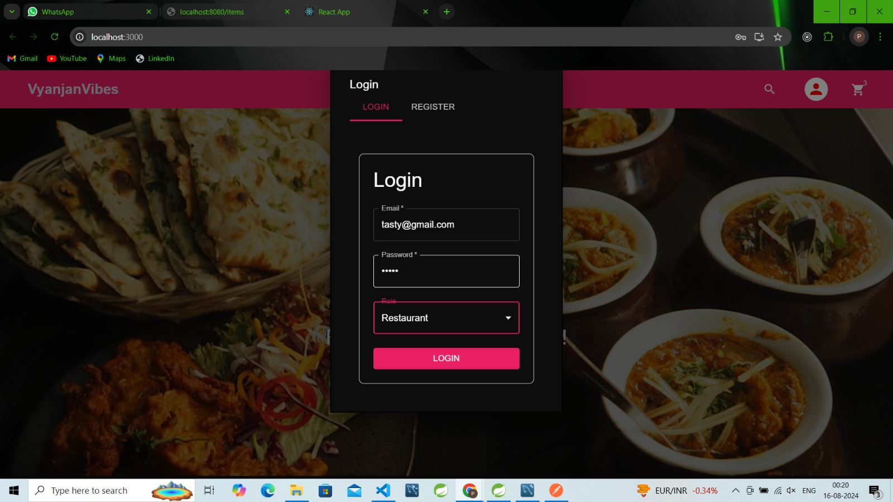
Restaurant Registration

Slide 17
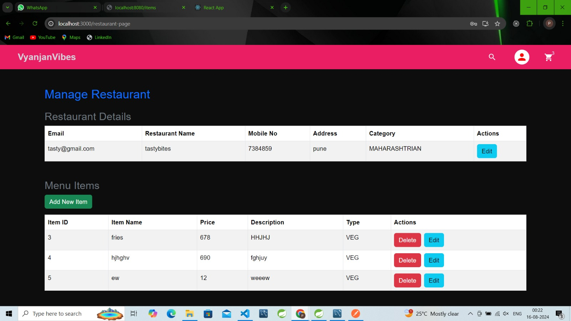
Restaurant Dashboard

Slide 18
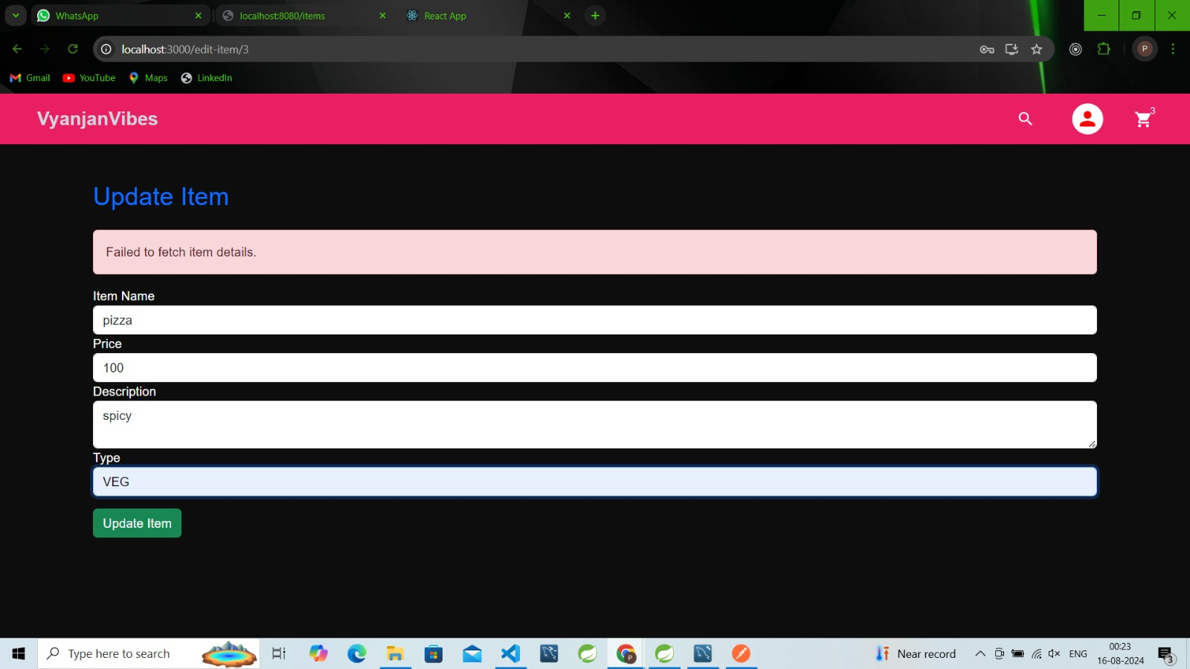
Manage Restaurant

Slide 19
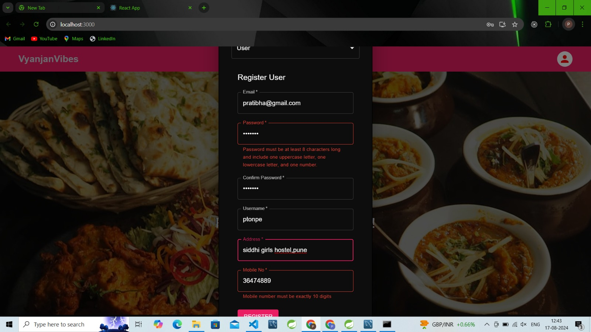
User Registration

Slide 20
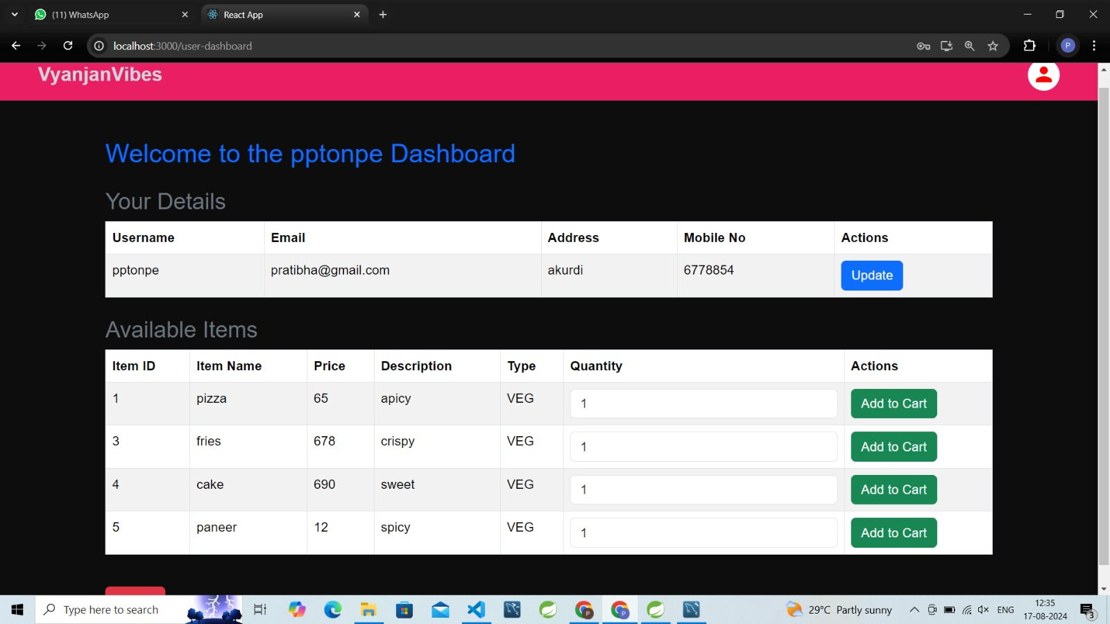
User Dashboard

Slide 21
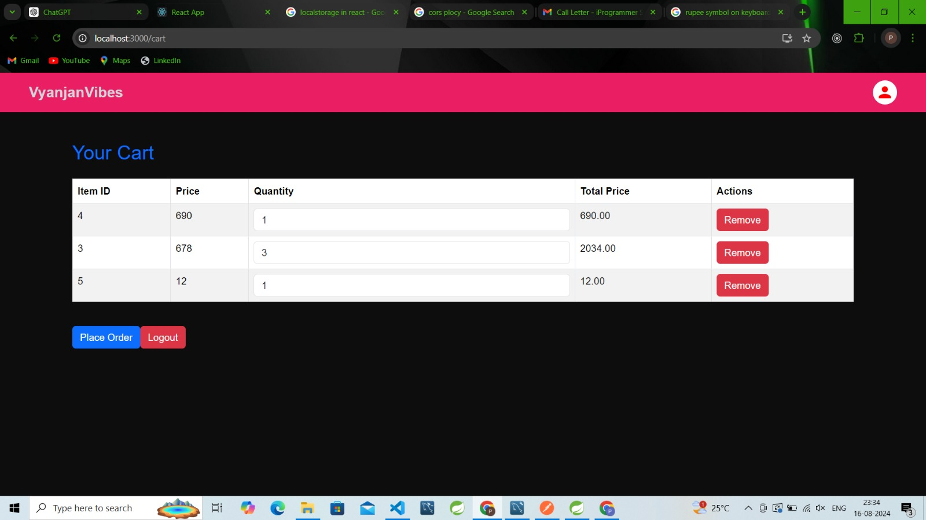
Cart View

Slide 22
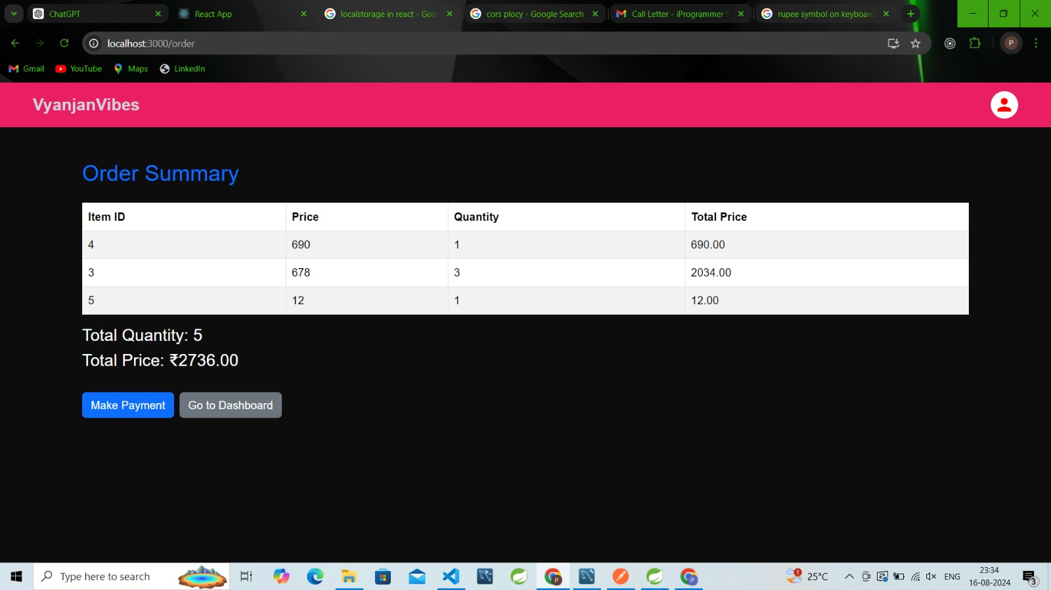
Order View

Slide 23
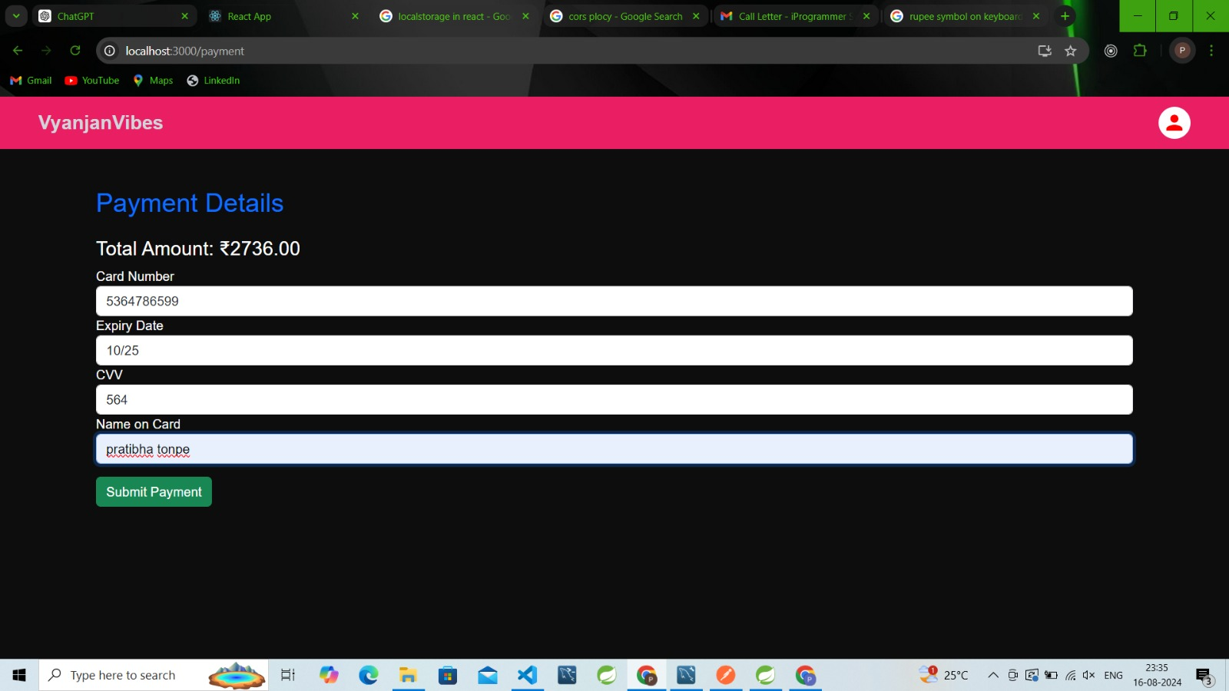
Payment View

Slide 24
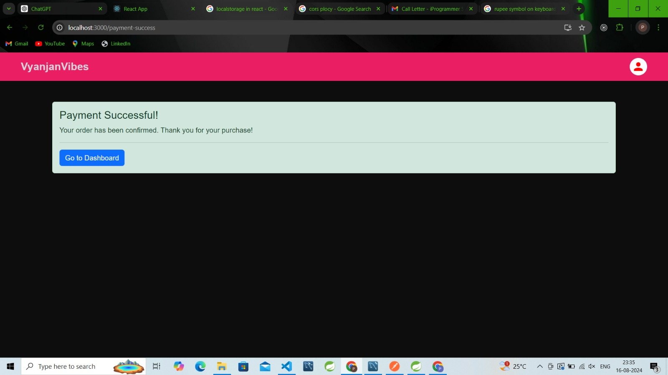
Confirmation Page

Slide 25

Conclusion :-
The food ordering system has revolutionized the way customers interact with restaurants, offering a seamless and efficient platform for both parties. By digitizing the ordering process, it eliminates the traditional barriers of time and location, allowing customers to access a wide range of dining options with just a few clicks. This system enhances customer satisfaction through convenience and reliability while providing restaurants with a scalable solution to manage orders and grow their business.
Looking forward, the system holds the potential for further innovations, such as incorporating personalized recommendations, real-time analytics for restaurants, and enhanced user experiences through AI and machine learning. The food ordering system is not just a tool for today's market but a foundation for future advancements in the food service industry.

Slide 26
Thank You

