Slide 1

TATYASAHEB KORE INSTITUTE OF ENGINEERING AND TECHNOLOGY WARANANAGAR- 416 113 (An Autonomous Institute) Department of Computer Science & Engineering Academic Year (2021-22)

Slide 2

PRESENTED BY – Group B8
SPORT SCHEDULING SYSTEM
1.Nisha Vilas Shete | 146
2.Mrunal Prakash Patil | 144
3.Sakshi Suresh Nalawade | 126
4.Pradnya Tukaram Patil | 147
Project Guide -
Prof. A.G.PATIL

Slide 3
Content: •Introduction • Existing System • Problem Statement • Proposed Work • Development Environment • Deployment Environment • Feasibility Study • Functional & Non-Functional Requirement • Project Scope • SRS • Reference

Slide 4

Introduction : • Web Application of Sport Scheduling System • Domain: Web Development

Slide 5
Motivation: • To provide information and manage the system regarding sports event of the college. • To reduce the human efforts or as well as to reduce the lot of paper work. • To reduce the time which is required by the work that are manually done. • To provide facility of easy result generation and view rankings. • Easy to access the system from anywhere at any time.

Slide 6
Existing System: • It is a Pen paper method • Score Sheet • Not an automated system

Slide 7
Drawback of Existing System: • Time Consuming method. • Lots of errors . • Overlapping of schedules. • There is no such system at local level

Slide 8
Problem Statement : Proposed system is used to automate sport scheduling and displaying results for any sport tournament or sport event. The proposed work is distributed in following five phases: 1.Design tournament and sport activities. 2.Registration of individual or teams with specified categories. 3.Avaliability of resources. 4.Scheduling 5.Result

Slide 9
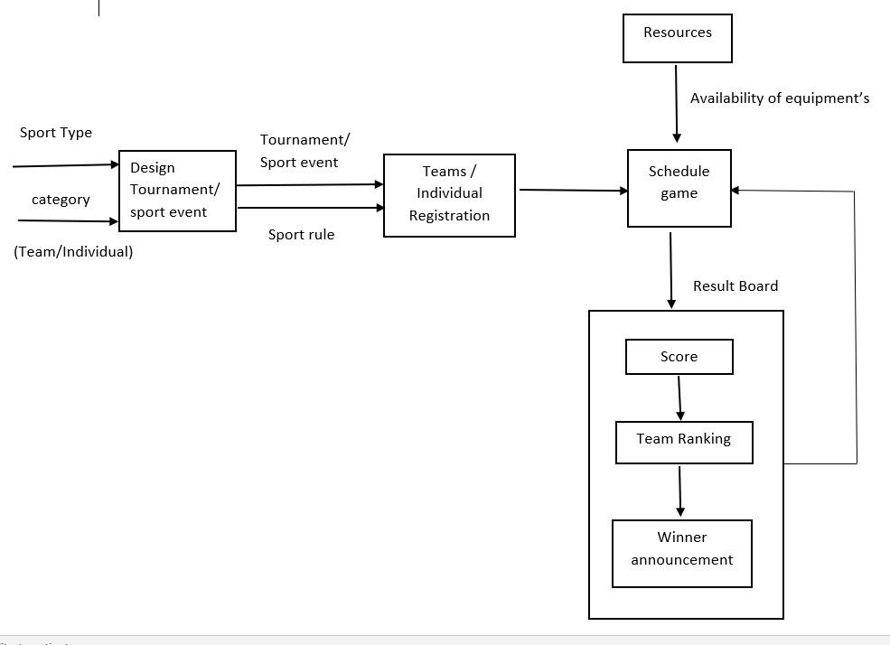
Proposed work: Block Diagram:

Slide 10
Module : 1.Design of tournament / Sport event 2.Registration 3.Availability of Resources 4.Scheduling 5.Result

Slide 11
Feasibility Study : • Technical Feasibility : We require html, CSS, JavaScript language for frontend and php for backend. In Database connectivity we use Xampp server for developing web application.

Slide 12
Legal Feasibility : -Absolutely legally doable. -No threats to user’s/institute’s confidential data. - Not contain copyright issues . - From above it is clear that sport scheduling system is legally feasible with no potential infringement

Slide 13
Requirement Gathering : Functional Requirement : •Scheduling are categories by two part: 1. Data Requirement:- Schedule Team Size Rule Resources 2. Process Requirement: Round Robin algorithm

Slide 14
Non-Functional Requirement : • Authentication : System check username and password every time . • Security: Secure access of confidential data (user details). • Availability & Reliability: It is available anytime and anywhere. • Usability: It is easy to handle this software and there is simple user interface that does not contain any complex design.

Slide 15
Development Environment: •Software Requirements: Operating system: Windows 7/8/10 System type: 64-bit operating system •Hardware Requirements: Processor: Intel(R) Core(TM) i3-5015U CPU @2.10GHZ RAM: 2.00GB Hard Disk: 500 GB

Slide 16
Deployment Environment: •Software Requirements: DBMS used: MySQL User Interface: XAMPP 8.1.6-0 Local Server with MySQL Programming language : PHP, HTML, php,JavaScript

Slide 17
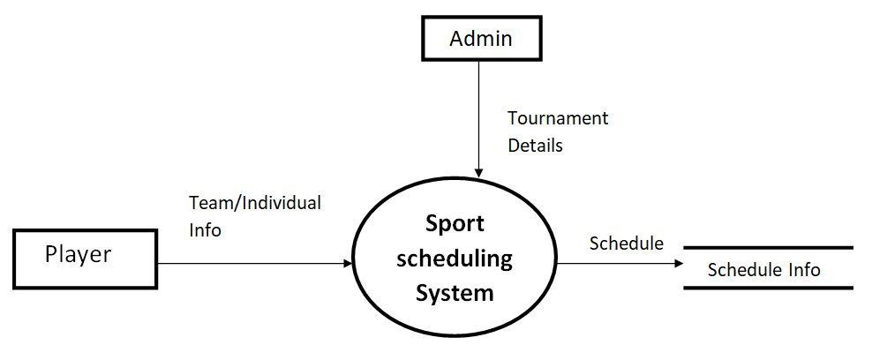
System Modeling & Design : 1)DFD Level 0: fig. Data Flow Diagram Level 0

Slide 18
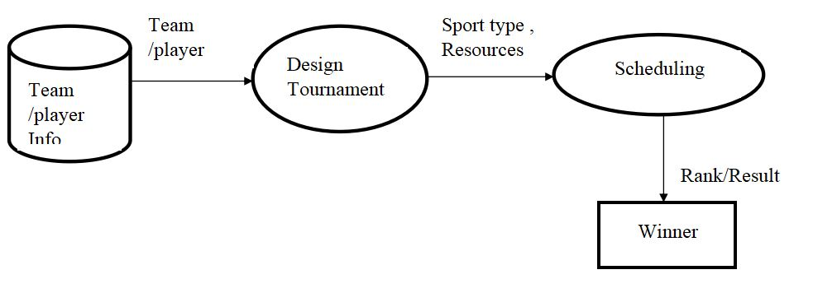
2)DFD Level 1: fig. Data Flow Diagram Level1

Slide 19
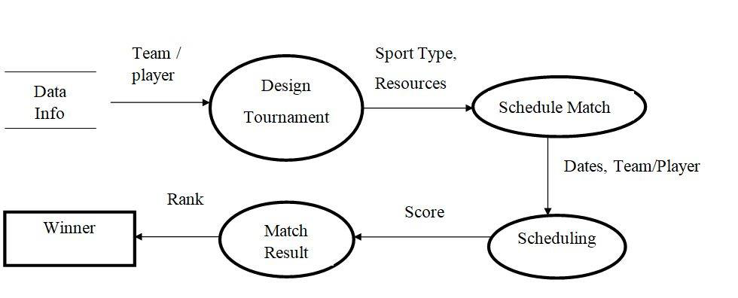
3)DFD Level 2: fig. Data Flow Diagram Level2

Slide 20
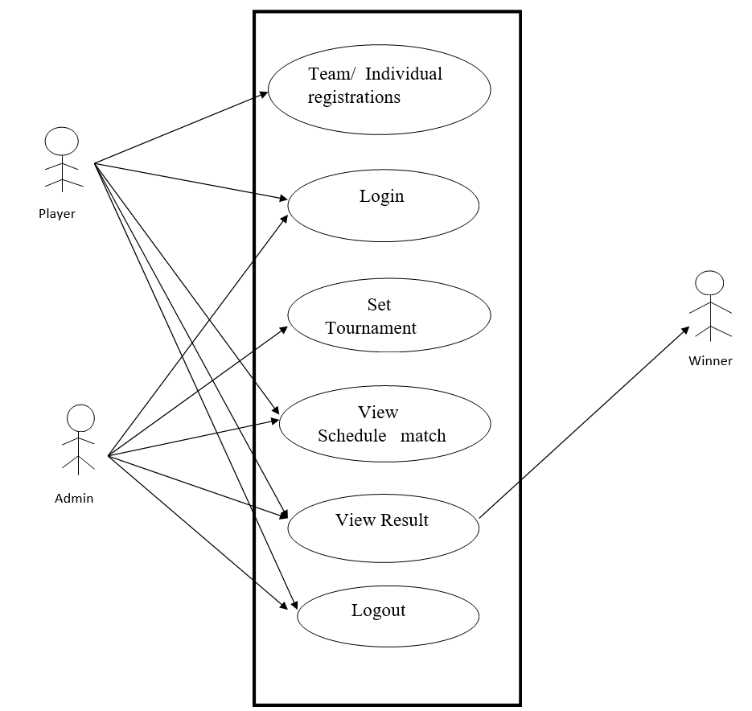
Use Case Diagram:

Slide 21
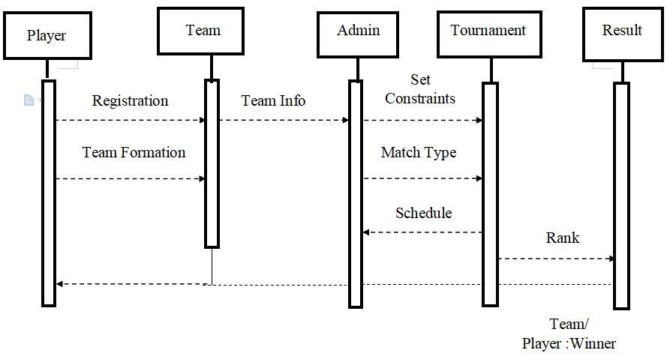
Sequence Diagram:

Slide 22
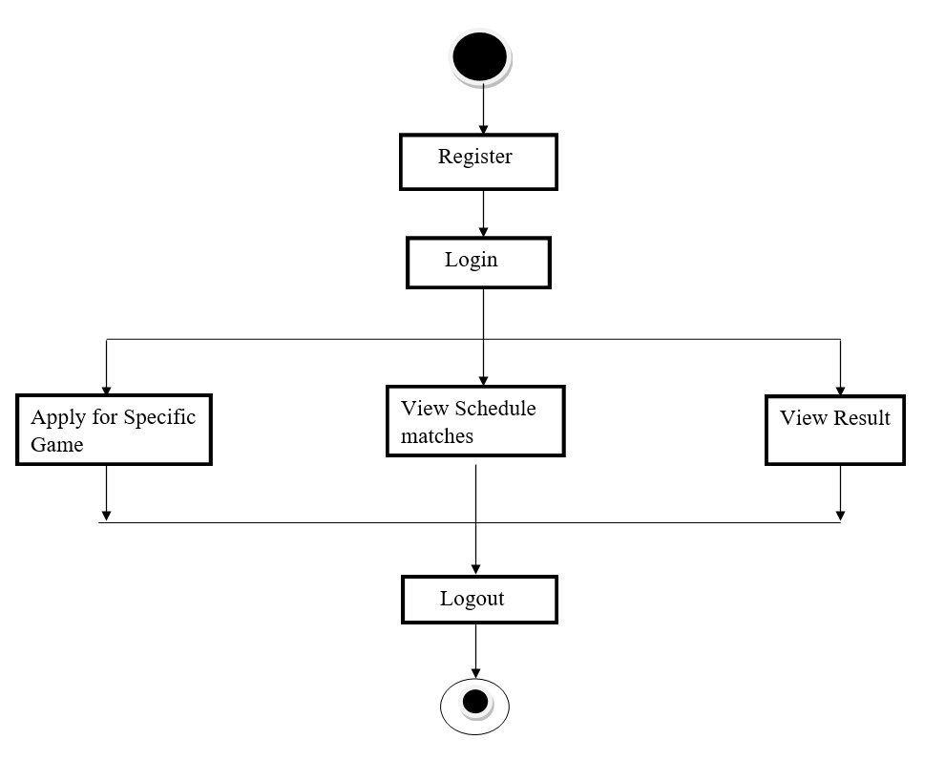
Activity Diagram: 1)Activity diagram for Player:

Slide 23
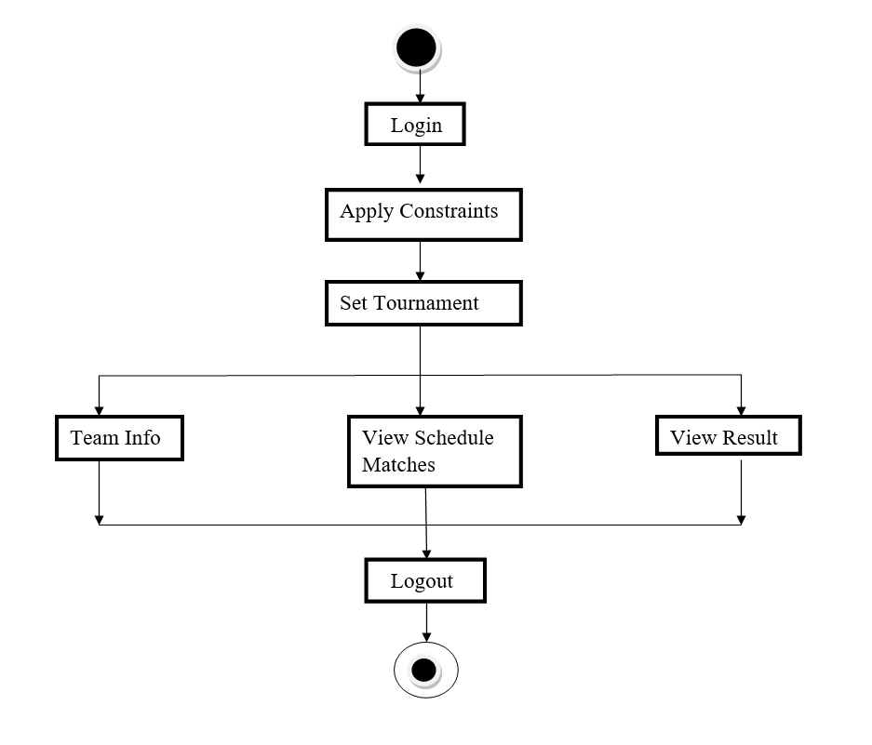
2)Activity diagram for Admin:

Slide 24
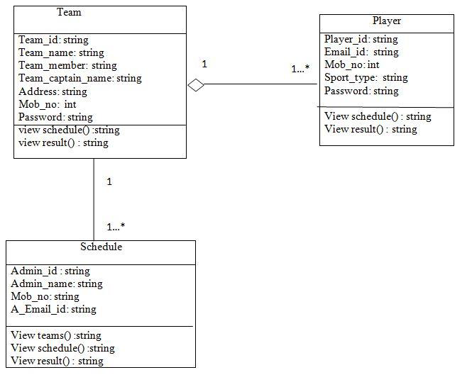
Class Diagram:

Slide 25
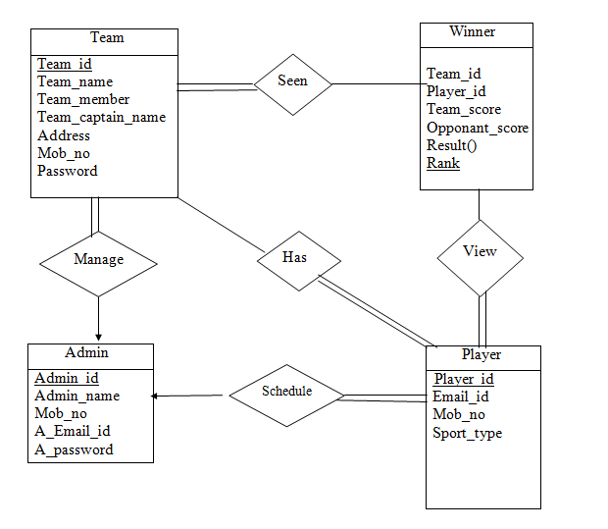
E-R Diagram:

Slide 26
Reduction of E-R: Team(team_id,team_name,team_member,team_captain_name,address,mob_no, password) Winner (team_id, rank, player_id, team_score, opponent_score) Admin(Admin_id, Admin_name, mob_no, a_email_id, a_password ) Player(player_id, email_id, p_mob_no, sport_type ) Seen(team_id, rank) Manage(admin_id, team_id) View( player_id, rank) Has(team_id, player_id) Schedule (admin_id,player_id )

Slide 27
Project Scope : • Our Primary goal in this project is to include more functionality & resources are available as per user requirement.

Slide 28
REFERENCES: Research Papers: 1.A three-field classification and unified data format for round-robin sports timetabling. Van Bulck D, Goossens D, Sch ̈onberger J, Guajardo M: RobinX 2.Scheduling Double Round-Robin Sports Tournaments Carlos Lamas-Fernandez·AntonioMartinez-Sykora·Chris N Potts 3. https://www.javatpoint.com/os-round-robin-scheduling-example 4. https://7esl.com/sports-and-games-vocabulary 5. T. Januario, S. Urrutia, A new neighborhood structure for round robin scheduling problems, Computers & Operations Research 6. S. Duran, O. Ö. Özener, E. Yakıcı, League scheduling and game bundling in sports industry, Computers & Industrial Engineering

Slide 29
Thank You

