Slide 1

DR. BABASAHEB AMBEDKAR TECHNOLOGICAL UNIVERSITY, LONERE
.
SHARAD INSTITUTE OF TECHNOLOGY COLLEGE OF ENGINEERING, YADRAV, ICHALKARANJI
AN AUTONOMOUS INSTITUTE
DEPARTMENT OF
Computer Science and Engineering
A PROJECT PRESENTATION ON
“College E-Notice Board”

Slide 2
PRESENTED BY-
1. Pratibha Subhash Koravi.
2. Pradnya Prakash Patil.
3. Aarti Chandrakant Madihali.
4. Manasi Adinath Patil.

Slide 3
College E-Notice Board
A mini project using Reportlab
Technical Guide : Mr. P. B. Patil

Slide 4
Introduction
A web-based noticeboard system designed for educational institutions.
Allows admins to post notices and students to access them online.
Students receive email alerts for updates and OTP for password reset.
Replaces manual noticeboard with a digital, paperless system.

Slide 5
Objectives
To provide a simple and user-friendly interface for admin and students.
To maintain a secure database of students and notices.
To provide secure login and registration for students and admin.
To allow file attachments while posting notices.
To send email notifications automatically.

Slide 6
Technologies used
Frontend: HTML, CSS, Bootstrap
Backend: Python Flask Framework
Database: SQLite
Mail Service: Flask-Mail (SMTP using Gmail)
Libraries: SQLAlchemy, Werkzeug, Jinja2

Slide 7
Key Features
Email Notification System
Secure Password Hashing (Scrypt)
OTP-based Password Reset
File Upload & Download Feature
Admin Dashboard with User Control
Responsive Web Design

Slide 8
Advantages
Reduces manual work and paperwork.
Time-saving and easy access.
Secure and user-friendly.
Instant updates for all students.
Efficient notice management system.

Slide 9
Limitations
Internet connection required.
Email notifications depend on configuration.
No mobile app version yet.
Limited to basic user roles (Admin and Student).
No advanced analytics or tracking features.

Slide 10
Future Scope
Develop mobile app version.
Add multi-admin and teacher roles.
Enable push notifications.
Integrate with college ERP systems.
Add analytics dashboard for reports.

Slide 11
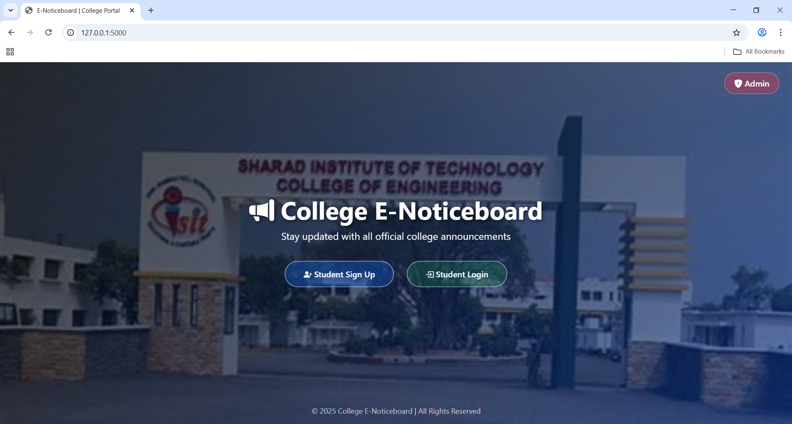
Output

Slide 12
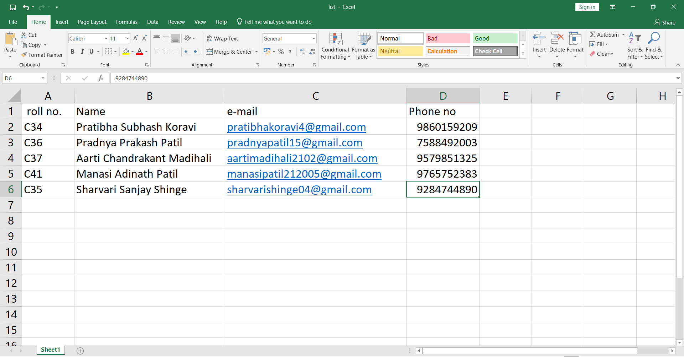

Slide 13
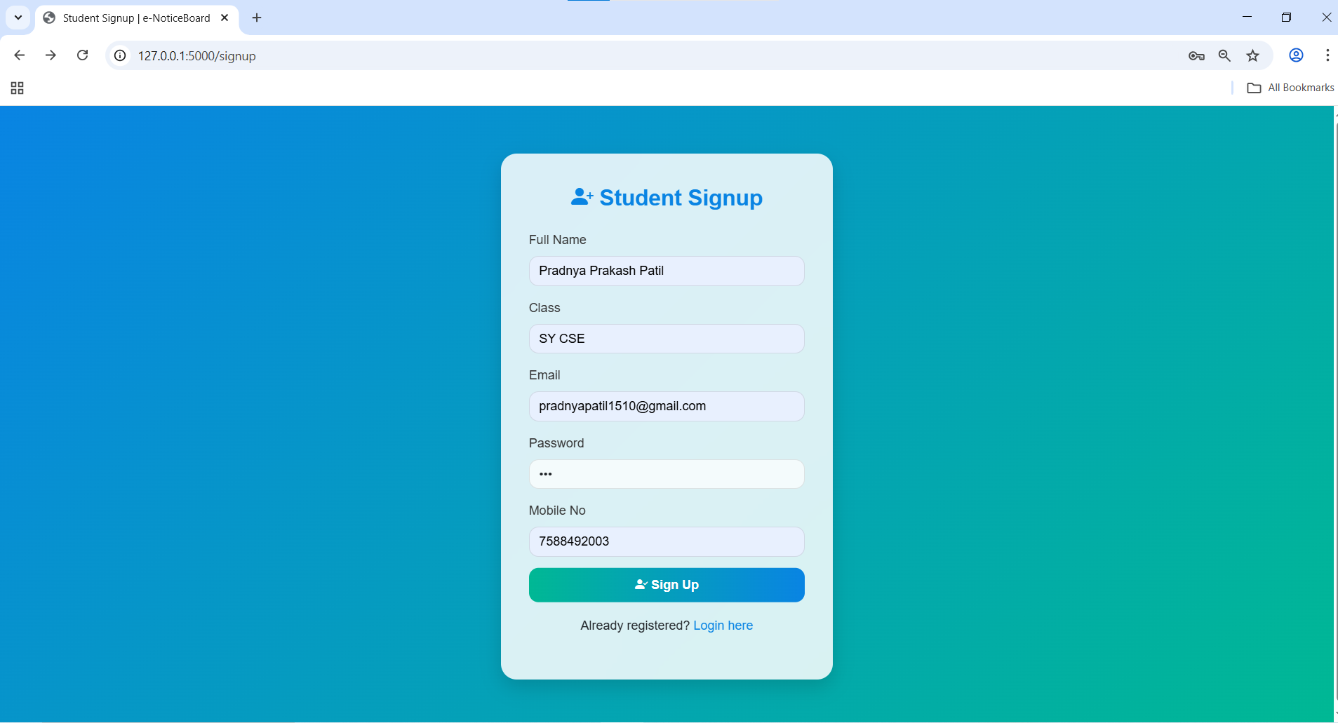

Slide 14
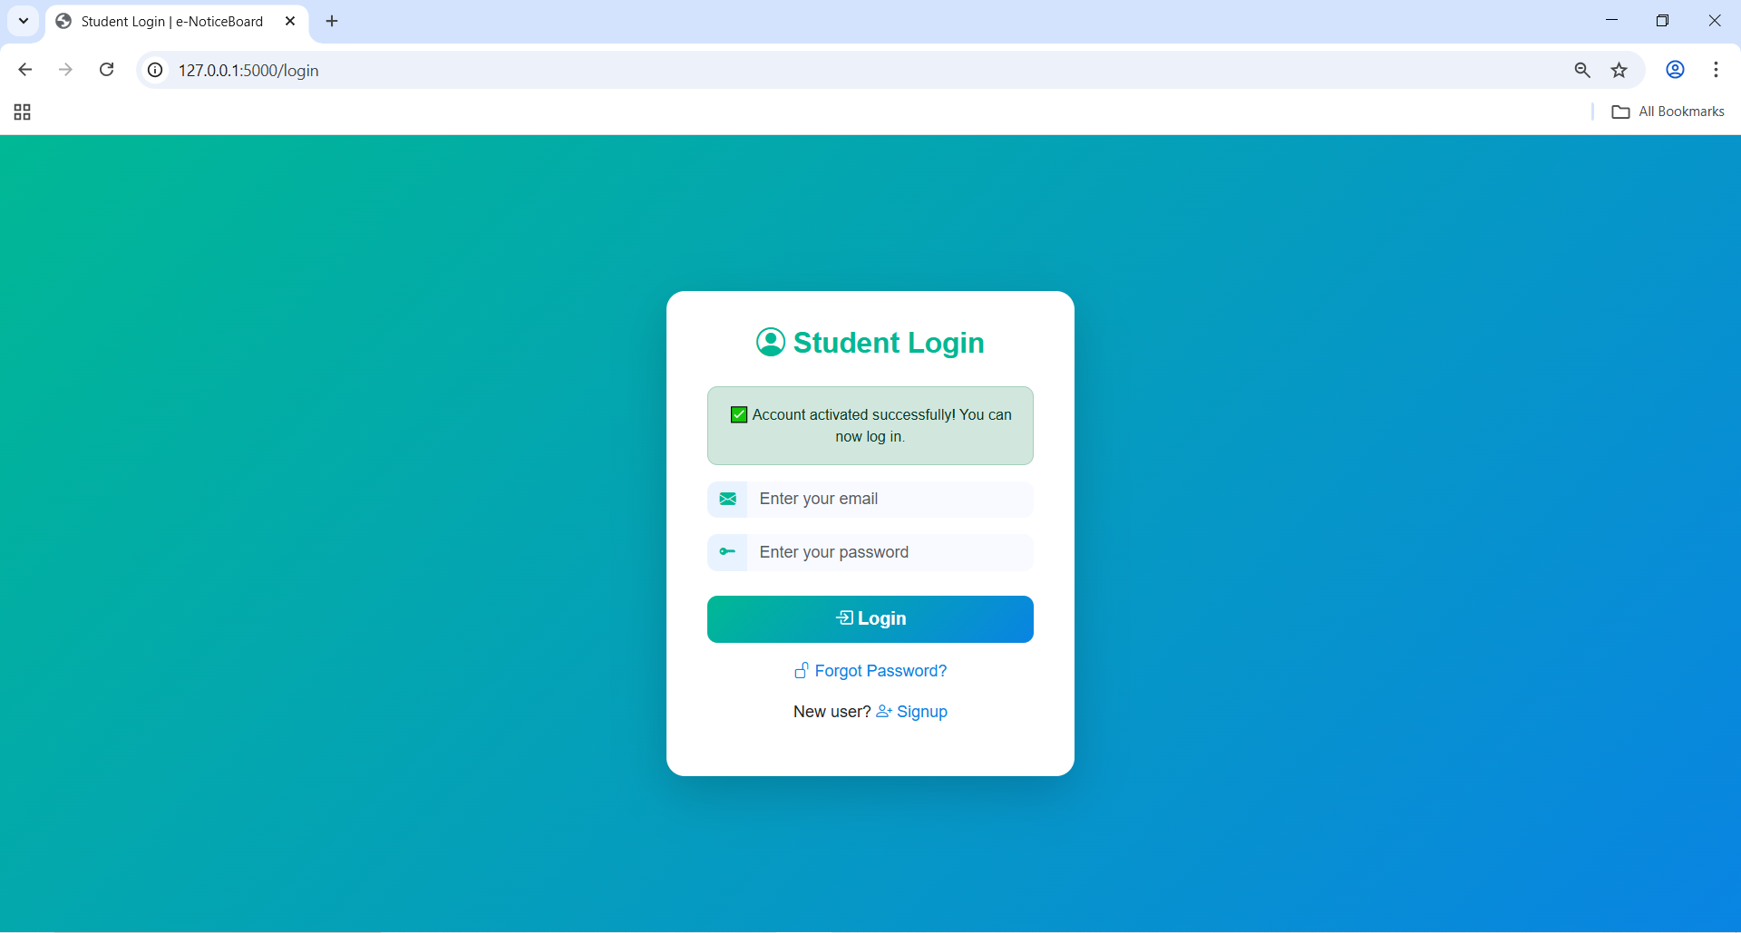

Slide 15
Conclusion
Provides an efficient and modern solution for sharing notices.
Ensures faster communication and reduces paperwork.
Secure, reliable, and easily extendable for future needs.

Slide 16
Thank you

