Slide 1



PROJECT TITLE:
ONLINE BANKING SYSTEM
(For Bank Employees)

Slide 2
PROJECT TEAM:
UNDER THE GUIDANCE OF VARSHA HOLE MAM
BRANCH-AIML BATCH-C2
Vinay Jadhav (2021600026)
Pradnyesh Jain (2021600027)

Slide 3






04
TABLE OF CONTENTS
01
02
Data Structures Used and Modules
Project Title
05
Content Beyond Content Covered
PROJECT STAGES
Details Of Algorithm Use
Problem Statment
MAJO REQUIREMENTS
Benefits
03
06
07
Flow Chart Of The Process
Getting Followed
08
Output Test Cases
CaseOOsOOutput Test
Cases
utput Test Cases

Slide 4



PROBLEM STATEMENT

Slide 5




Online Banking System Is an Application for maintaining all the accounts in the Bank . The System provides the access to the Bank Employees to create/search/delete/edit account,deposit/withdraw cash ,check the details of the particular customer,check logs of user etc .
So,in short it provides Bank Employees to manage all the bank accounts in their particular Bank.

Slide 6


The Following Presentation provides
the Specification For
THEM US
The System

Slide 7





BENEFITS
Provide Flexibility
Reducing Manpower
For doing work more accurately
For faster performance
Better access to Bank Records

Slide 8


Data Structures Used

Slide 9
LANGUAGE USED – C++
The Data Structures used here For the implementation of Banking System is AVL Trees , Linked List

Slide 10


MODULES:
CREATE ACCOUNT
SEARCH ACCOUNT
DELETE ACCOUNT
EDIT ACCOUNT
SHOW LIST OF ALL
ACCOUNTS
CHECK ACCOUNT INFO
DEPOSIT CASH
WITHDRAW CASH

Slide 11






Content Covered Beyond Syllabus
Ssystem()
The system() function is a part of the C/C++ standard library. It is used to pass the commands that can be executed in the command processor or the terminal of the operating system, and finally returns the command after it has been completed.
<stdlib. h> or <cstdlib> should be included to call this function
ostringstream():to mainly convert strings to integer
setw() To set Width Of Table
time() Returns The Current Time

Slide 12



Details Of The Algorithm Used

Slide 13





So Basically we are using Here,2 Data Structures AVL trees & linked List
AVL We are Using Mainly For Creation,Searching,Deleting,changing Info,Withdrawing,Depositing Money & Checking Account Pin
Avl trees Rotations Are the key Here!!
Linked List is Used Mainly For Handling The Logs ,Displaying Data

Slide 14




So,First there Will be 3 Options Given :ADMIN LOGINN
STAFF LOGIN
ATM PANEL
Then,Admin will be Given 7 options like creation , searching, deleting,editing
Also,Staff will be Given 5 options like CheckAccount , Deposit/ Withdraw Cash
Also,Atm Panel Will be given right to withdraw Cash.

Slide 15








Flow Chart Of The Process Getting Followed

Slide 16




Logs of user
ADMIN PANEL
STAFF PANEL
Stores logs of a particular
active user
It has only access for checking account info,checking user’s logs ,also it can withdraw/deposit as per need
It manages
creation,deletion,searchin g,editing of a particular account
BANKING SYSTEM
Accounts Record
Account Info
List of all the accounts
It show all the info of
the particular account
ATM PANELa
Its ultimate motive is to withdraw cash

Slide 17
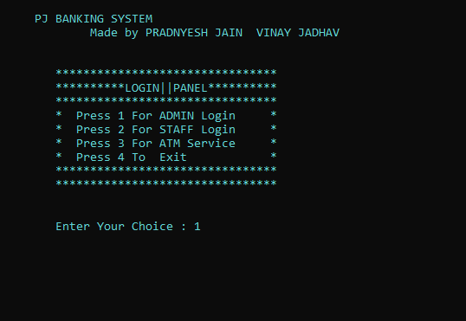
Output Test Cases

Slide 18




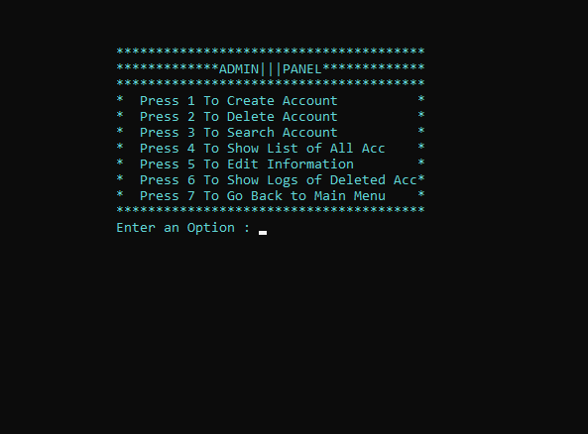
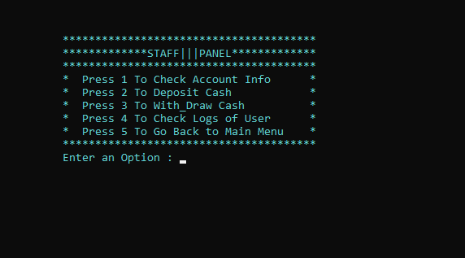







Slide 19
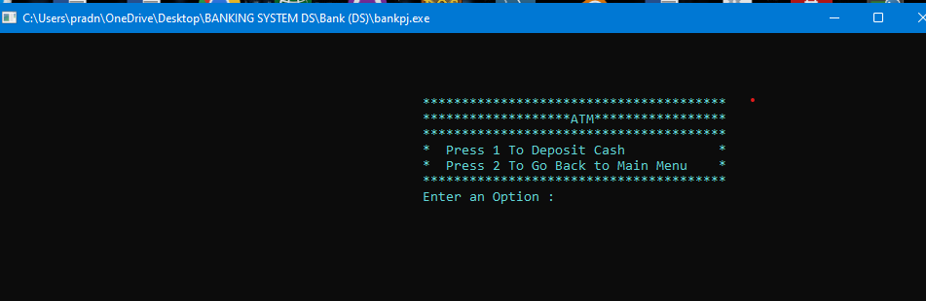
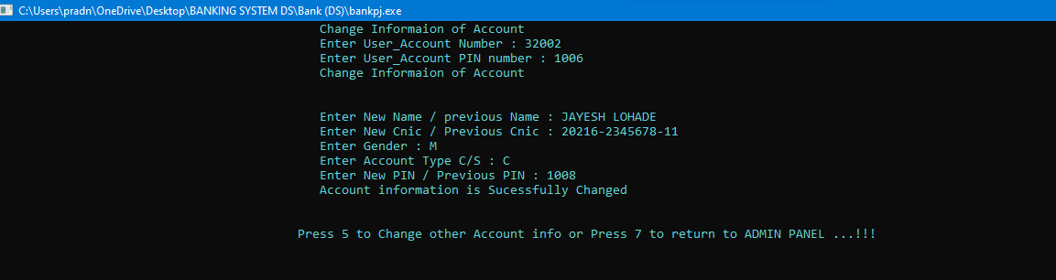

Slide 20
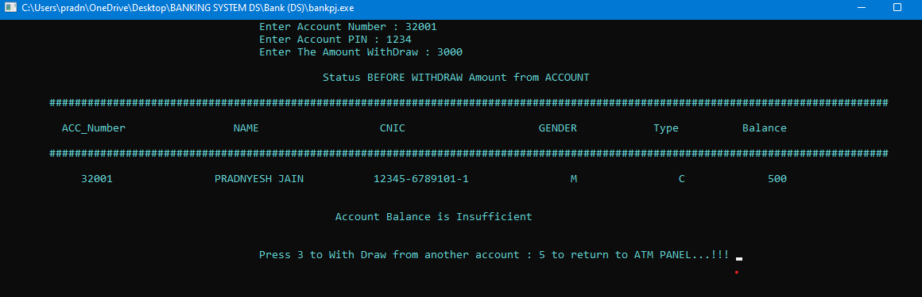
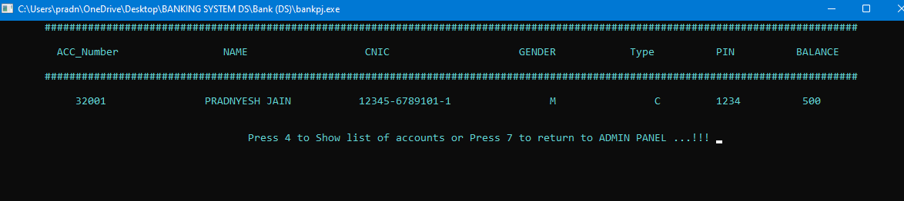

Slide 21
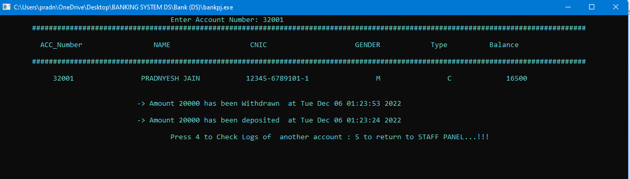


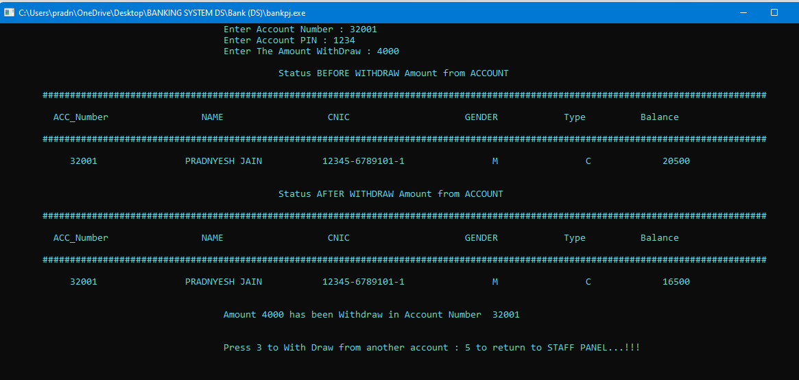

Slide 23
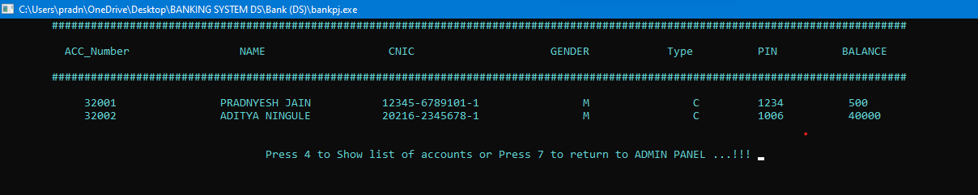
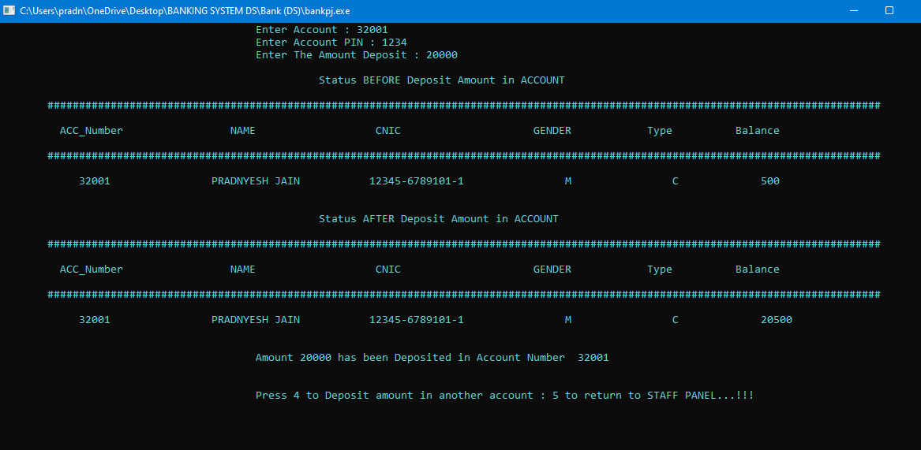

Slide 24

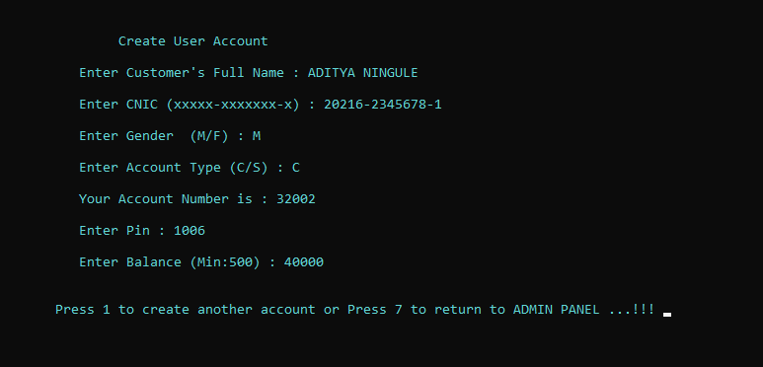
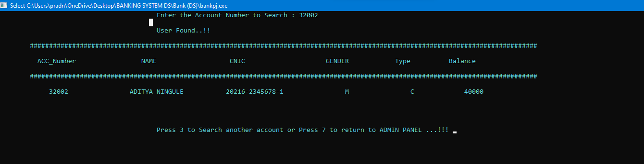

Slide 25
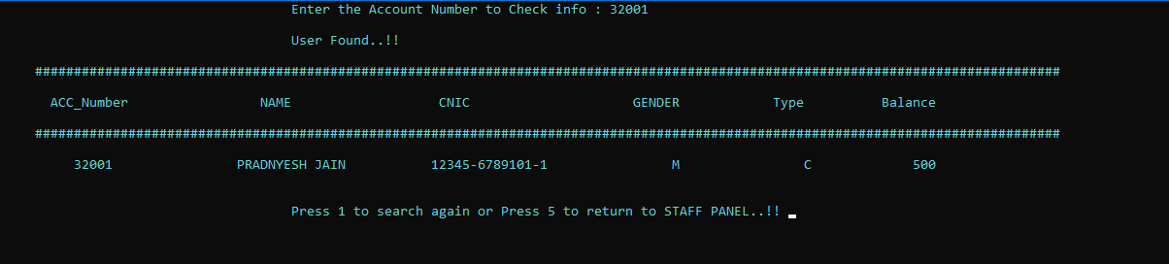

Slide 26
Sources: Wikipedia
Links:
https://www.istockphoto.com/photo/flow-chart-diagram-concept-gm490245946-75106001
https://stock.adobe.com/in/search?k=%22test+cases%22&as_campaign=ftmigration2&as_channel=dpcft &as_campclass=brand&as_source=ft_web&as_camptype=acquisition&as_audience=users&as_content= closure_tag-page&asset_id=420164605
https://www.pexels.com/photo/black-screen-with-code-4164418/
https://www.google.com/search?q=online+banking+sysytem+phtos&rlz=1C1UEAD_enIN996IN996&oq=o nline+banking+sysytem+phtos&aqs=chrome..69i57j33i10i160l2.9070j0j7&sourceid=chrome&ie=UTF- 8#imgrc=1szzhUaro2PBgM

Slide 27
THANK YOU !!

