Slide 1
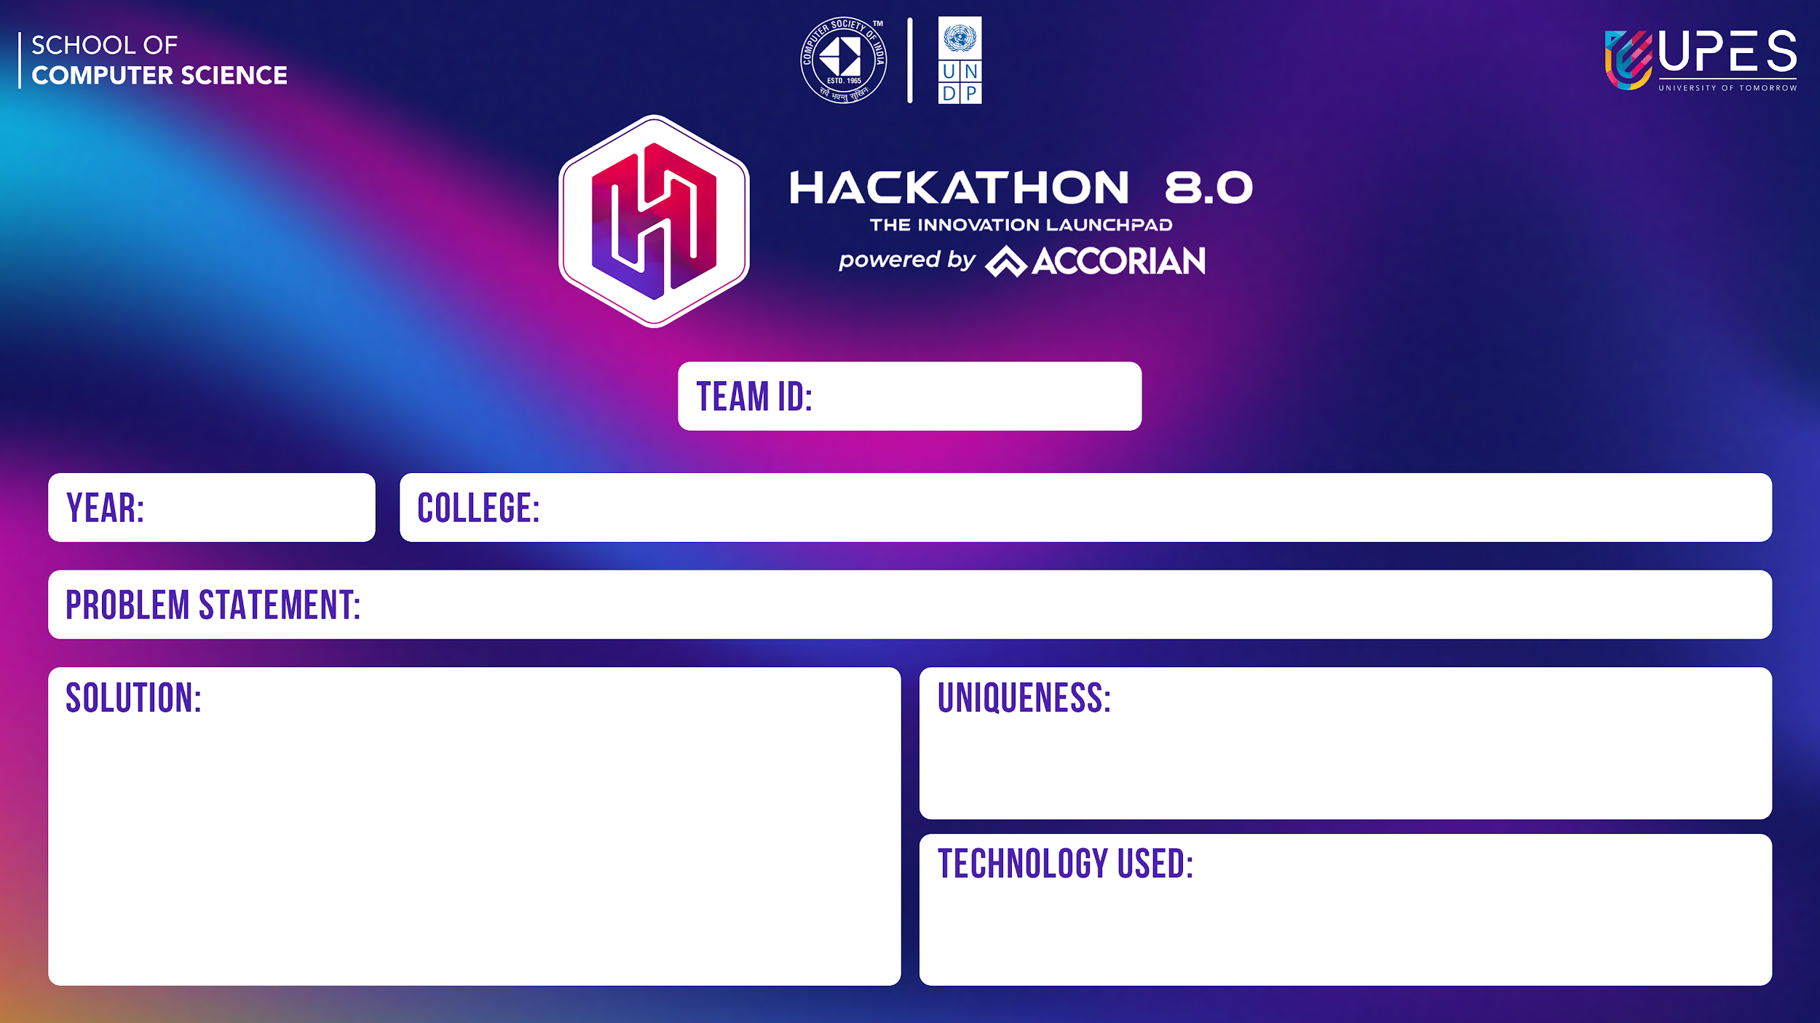
HCK8074
1st
UPES
A Real-Time Early Warning System for natural disasters such as Avalanches and Forest Fires
Our solution is a real-time early warning system designed to detect and mitigate natural disasters such as avalanches and forest fires. Leveraging advanced technologies, including real-time data monitoring, image analysis, and user interaction, our system provides timely alerts and warnings to authorities and individuals.
Monitoring data in real-time, utilizing images, and allowing users to provide latitude and longitude for detection.
TensorFlow,Flask,GCP,skLearn,pandas,requests,Django,mongoDB,Google Api’s.

Slide 2

Key components of our solution include:
Real-time Data Monitoring: We continuously monitor data from various sources, including sensors, satellite imagery, and weather stations, to detect signs of potential disasters.
Image Analysis: Using machine learning algorithms, we analyze satellite imagery to identify patterns indicative of avalanches and forest fires. This includes detecting changes in terrain morphology and identifying smoke plumes.
User Interaction: Our system allows users to provide their latitude and longitude coordinates, enabling personalized alerts based on their location. Users can also report observations and receive relevant information tailored to their needs.
Early Warning Alerts: When our system detects signs of imminent danger, it issues early warning alerts to relevant authorities and individuals. These alerts include actionable recommendations for mitigating risks and ensuring public safety.
Proactive Disaster Management: By providing early warnings and facilitating proactive response measures, our solution helps minimize the impact of natural disasters on communities, infrastructure, and the environment.

