Slide 1

"ATM Innovations: Revolutionizing the Banking Experience"

Slide 2
INTRODUCTION
An Automated Teller Machine (ATM) is a self-service machine that allows bank
customers to carry out a variety of financial transactions without the need for
human assistance. These machines are typically located in convenient public
places like shopping malls, airports, train stations, and bank branches.
The first ATM was introduced in the late 1960s and since then, they have
become an essential part of the modern banking system. With an ATM,
customers can withdraw cash, check account balances, transfer funds
between accounts, and perform other basic banking functions.
ATMs are typically accessed using a plastic card that contains a magnetic stripe
or a microchip. Customers insert their card into the ATM and enter a personal
identification number (PIN) to authenticate their identity. Once authenticated,
they can select the desired transaction from a menu on the screen and follow
the on-screen prompts to complete the transaction.

Slide 3
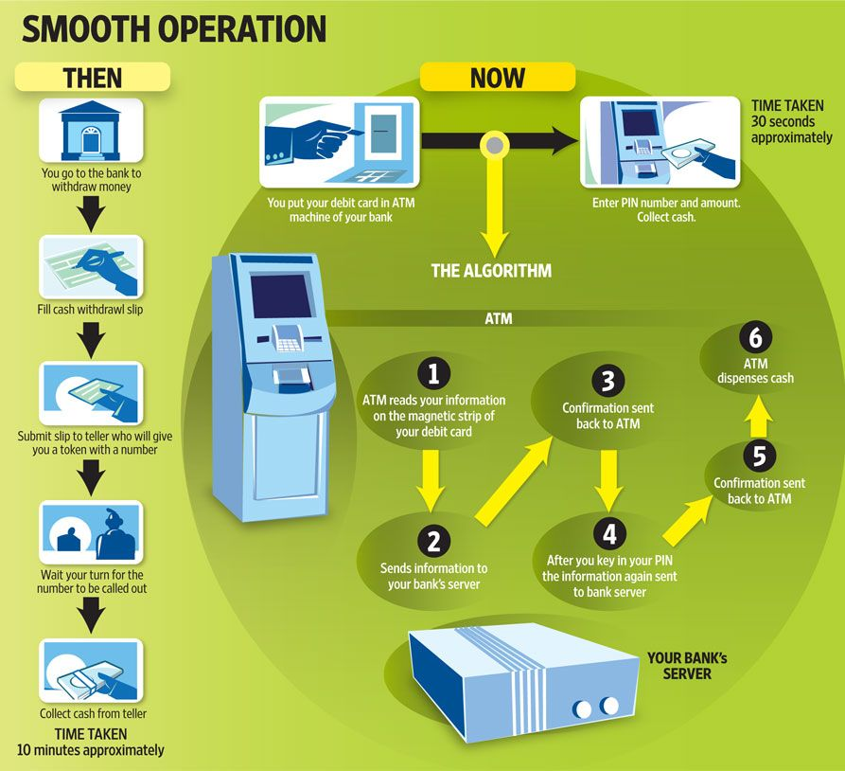

Slide 4
System Requirement
Hardware requirements
Central processing unit (CPU): A high-performance CPU is required to run the operating system and handle the processing of ATM transactions.
Memory: Sufficient memory is necessary to ensure that the system can handle multiple transactions simultaneously and maintain the required speed and performance.
Storage: Adequate storage is needed to store the ATM software, transaction logs, and other data that the system needs to operate.
Input/output devices: An ATM requires various input/output devices, such as a touch screen display, keypad, card reader, receipt printer, cash dispenser, and deposit module.
Network connectivity: The ATM must have a reliable and secure network connection to the financial institution's servers and other systems.
Security features: The ATM must include advanced security features to protect customer information and prevent fraud, such as encryption, anti-skimming technology, and physical security measures like locks and alarms.
1.

Slide 5
2. Software requirements
Operating System: An operating system like Windows or Linux is required to run the ATM software and manage the system resources.
ATM Software: The ATM software is responsible for managing user interactions, processing transactions, and communicating with the financial institution's servers and other systems.
Security Software: Advanced security software is necessary to protect customer information and prevent fraud, including encryption, anti-skimming technology, and real-time monitoring.
Network Software: Network software is needed to manage the network connection and facilitate communication between the ATM and the financial institution's servers and other systems.
Database Software: Database software is required to store and manage transaction data, user profiles, and other critical information.
Application Programming Interfaces (APIs): APIs are needed to integrate with other banking systems and services, including mobile banking apps and third-party payment processors.

Slide 6
What is an ATM Card?
ATM cards are payment cards issued by banks. They are linked to your bank account, and you can use them for withdrawing money from ATMs. Most of the ATM cards can now be used for online and offline transactions.
Debit Cards were then introduced to eliminate this limitation. You can now use debit cards for withdrawing money as well as for online and offline transactions. You can get one by opening a Savings Account at a bank.
Most of the banks now offer custom cards with the name of the account holder mentioned on the card. Apart from your name, the validity of the card, 16-digit card number, logo of card network, and Card Verification Value (CVV) is mentioned on the card. The latest ATM cards also feature a Europay Mastercard and Visa (EVM) chip.

Slide 7
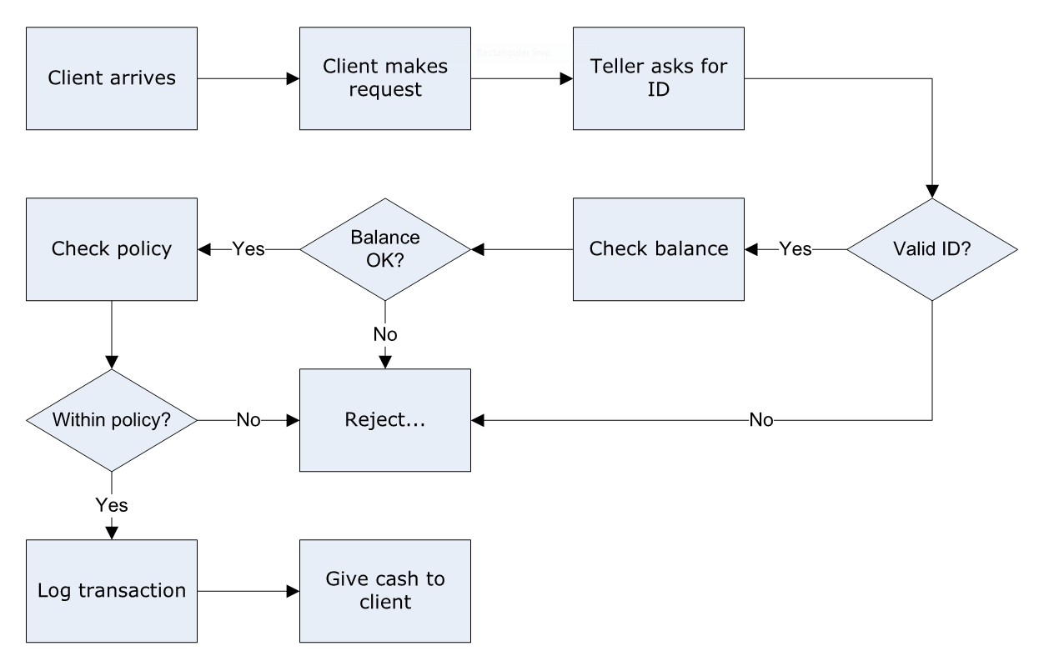
FLOWCHART

Slide 8
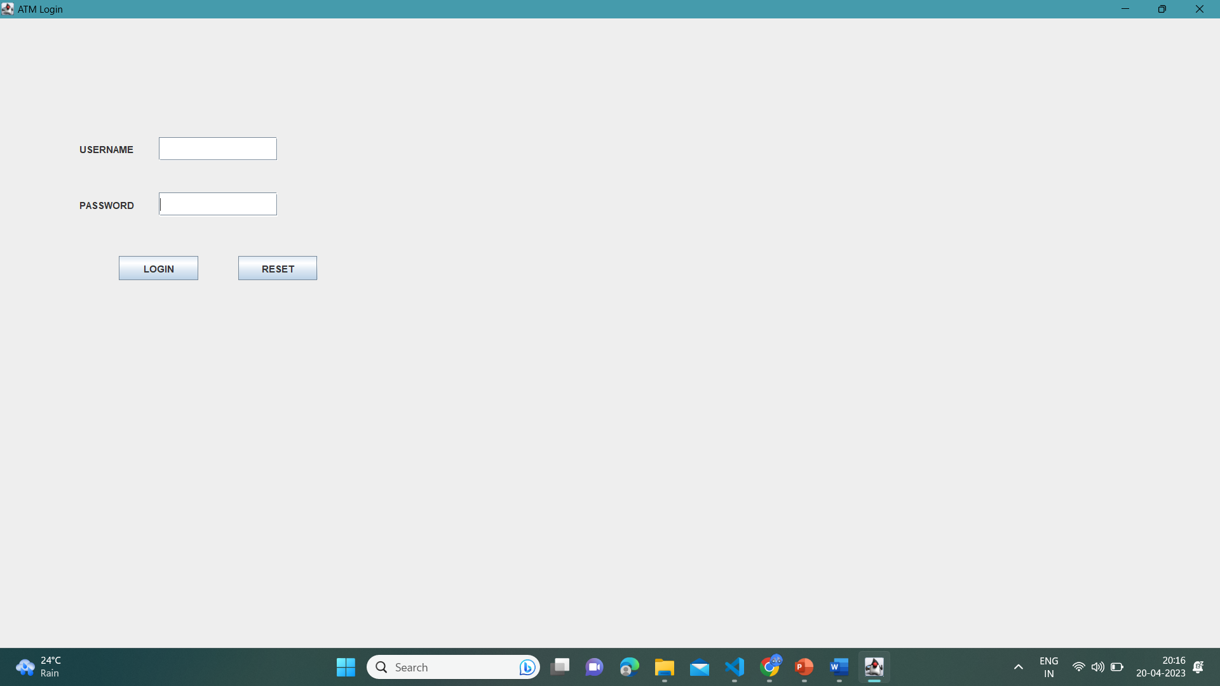
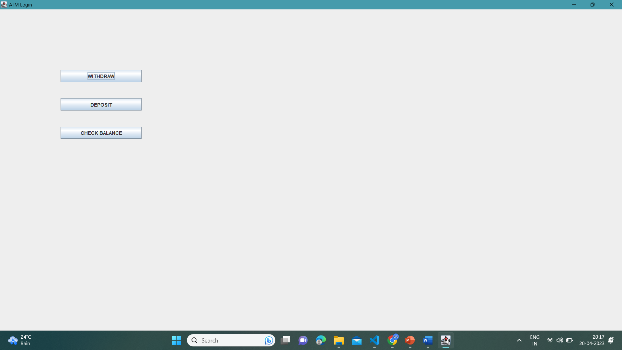
output

Slide 9
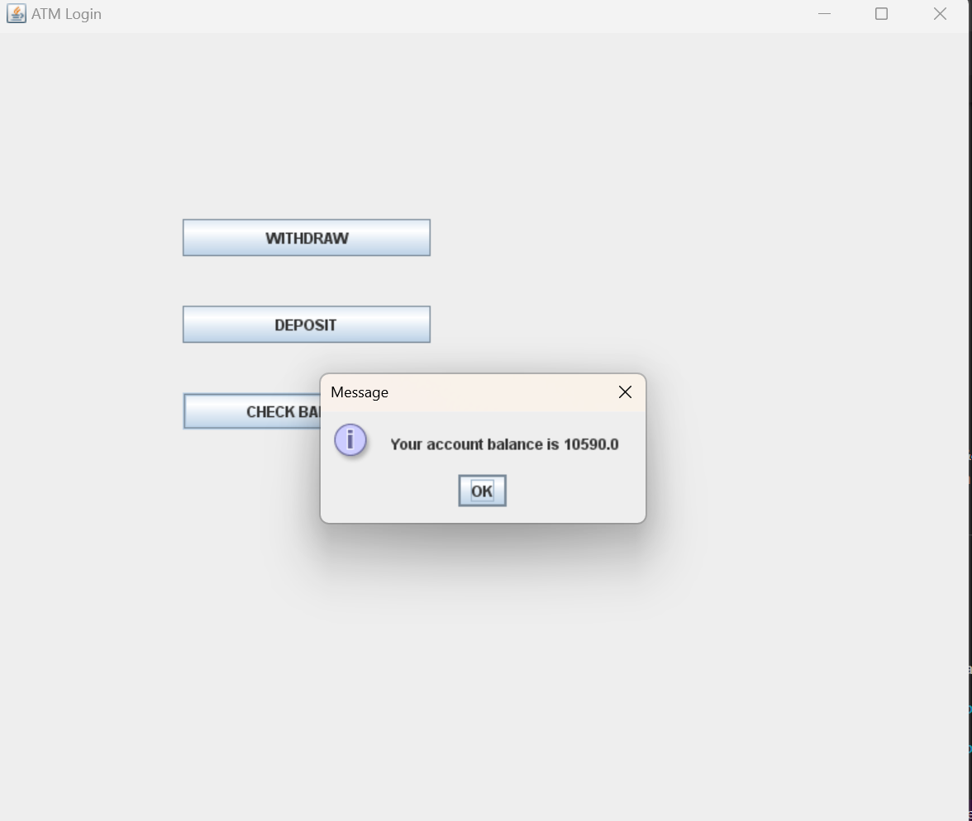
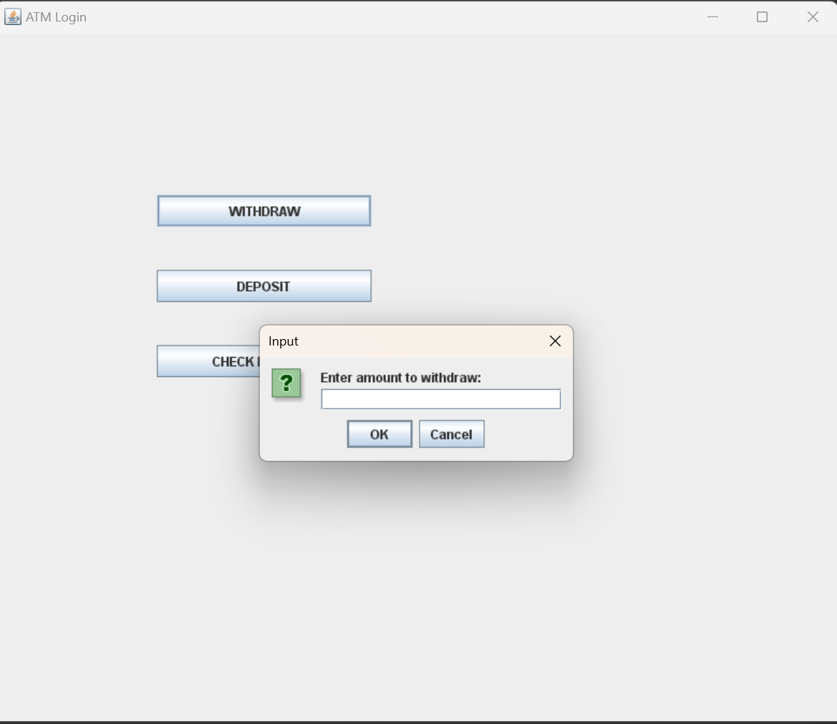

Slide 10
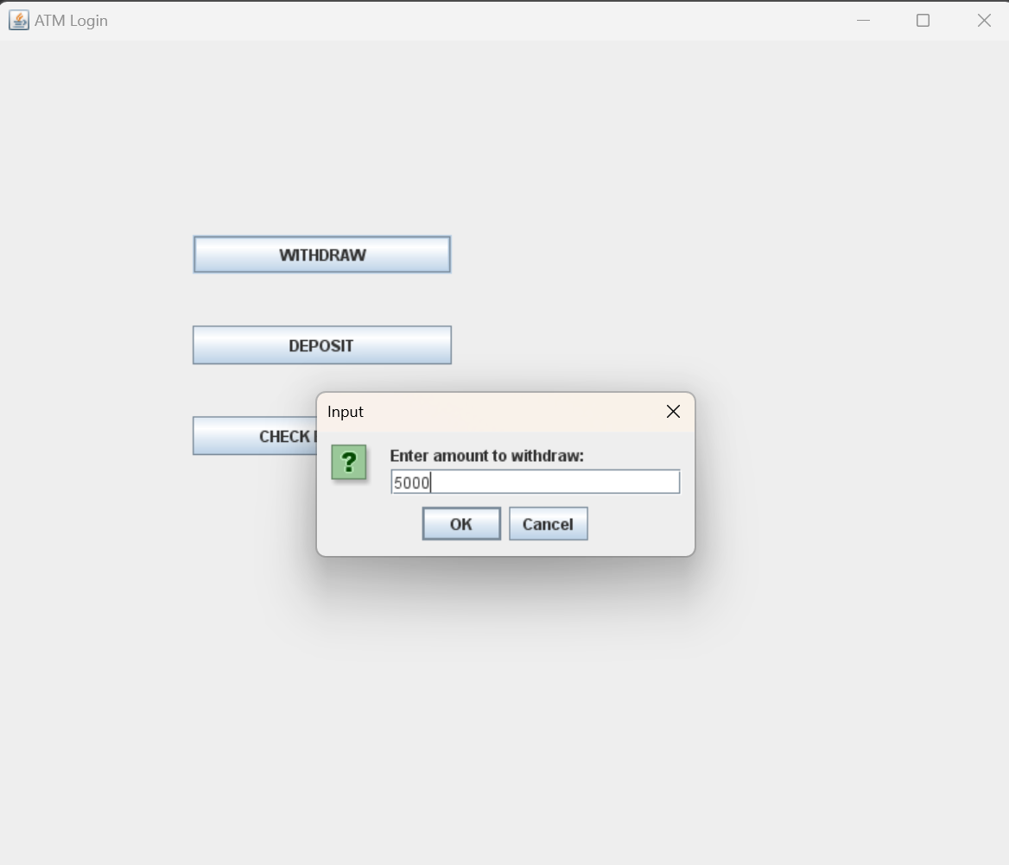
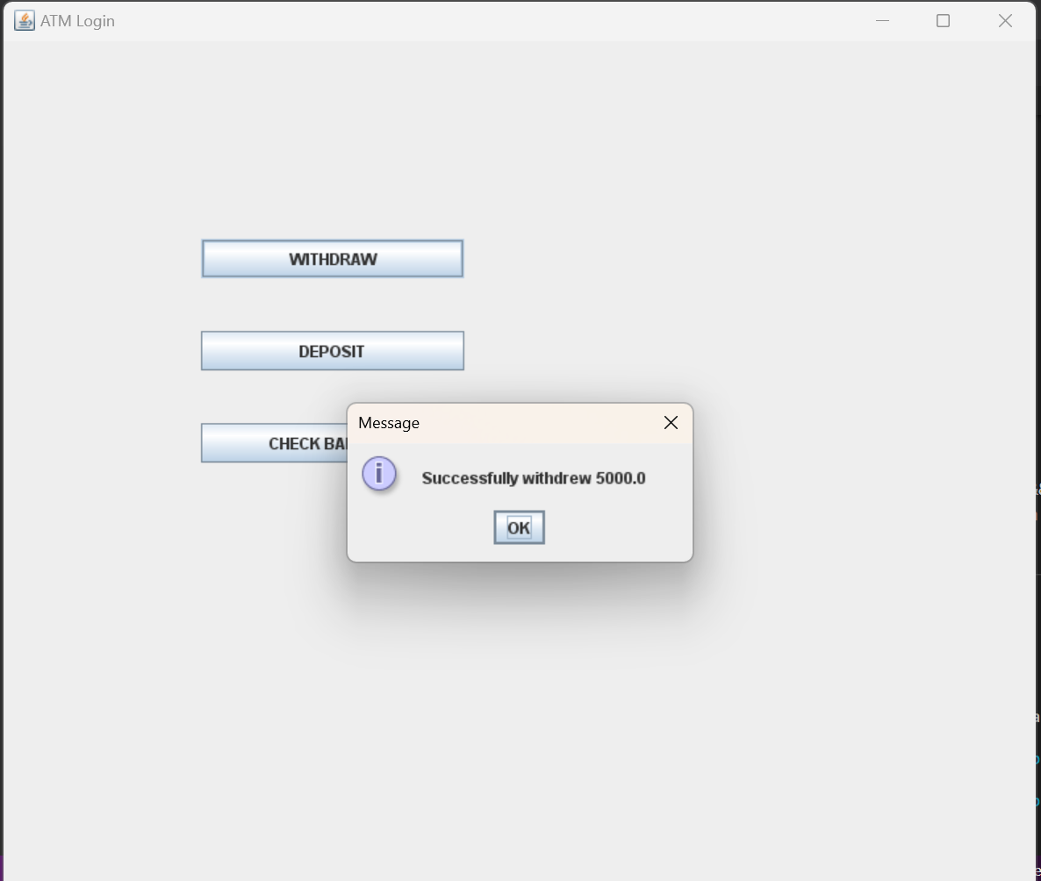

Slide 11
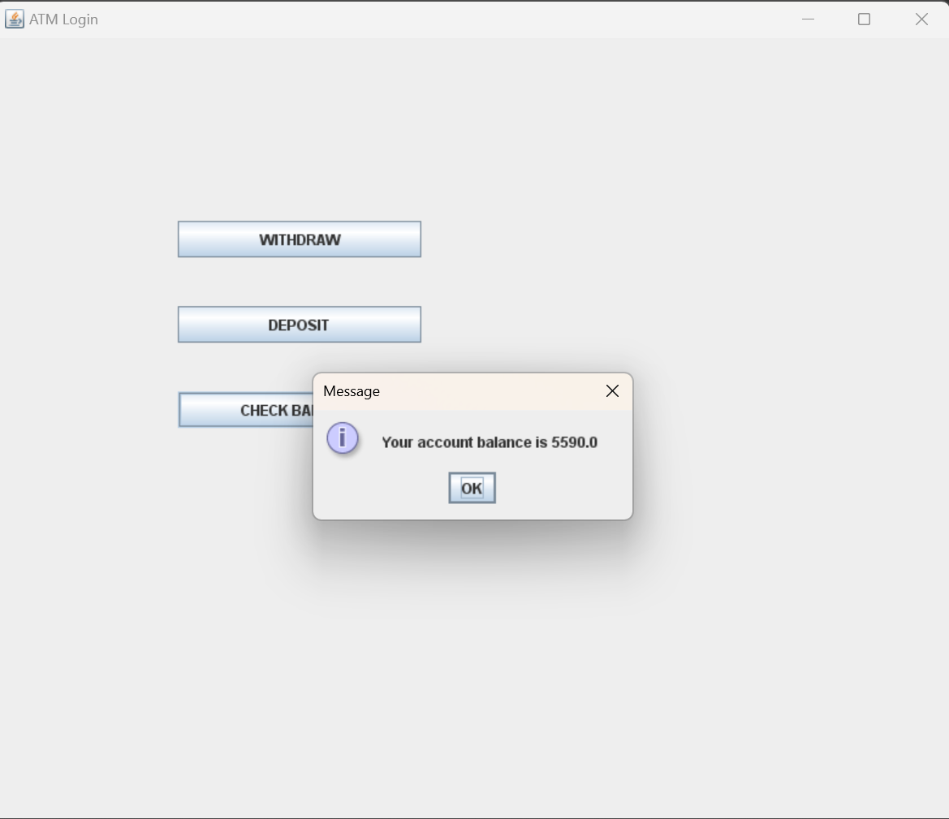
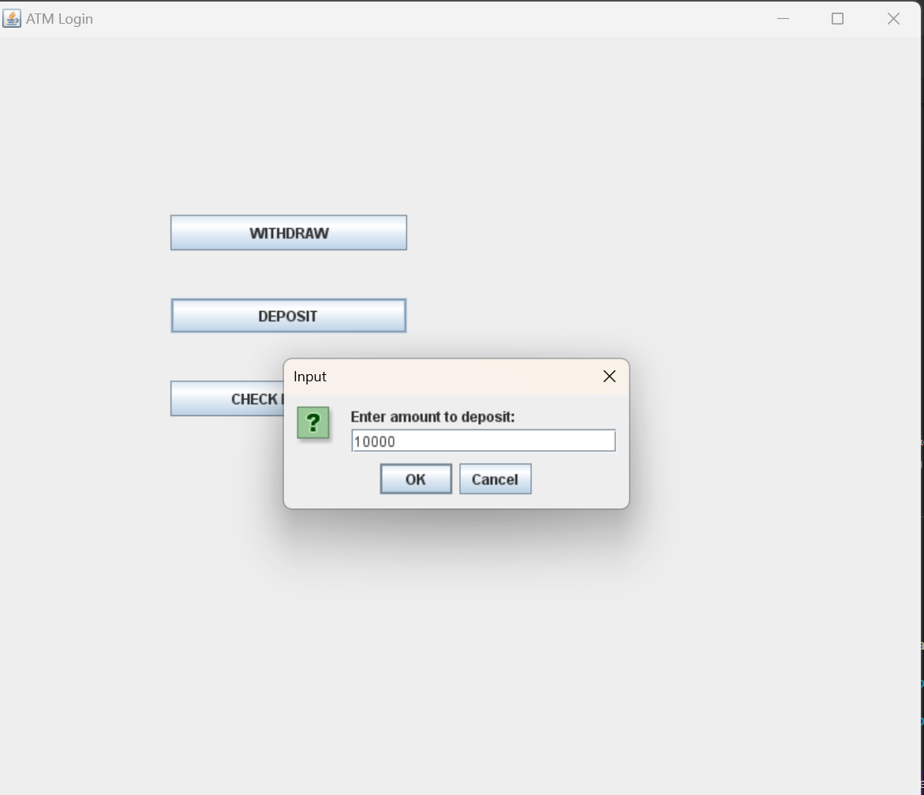

Slide 12
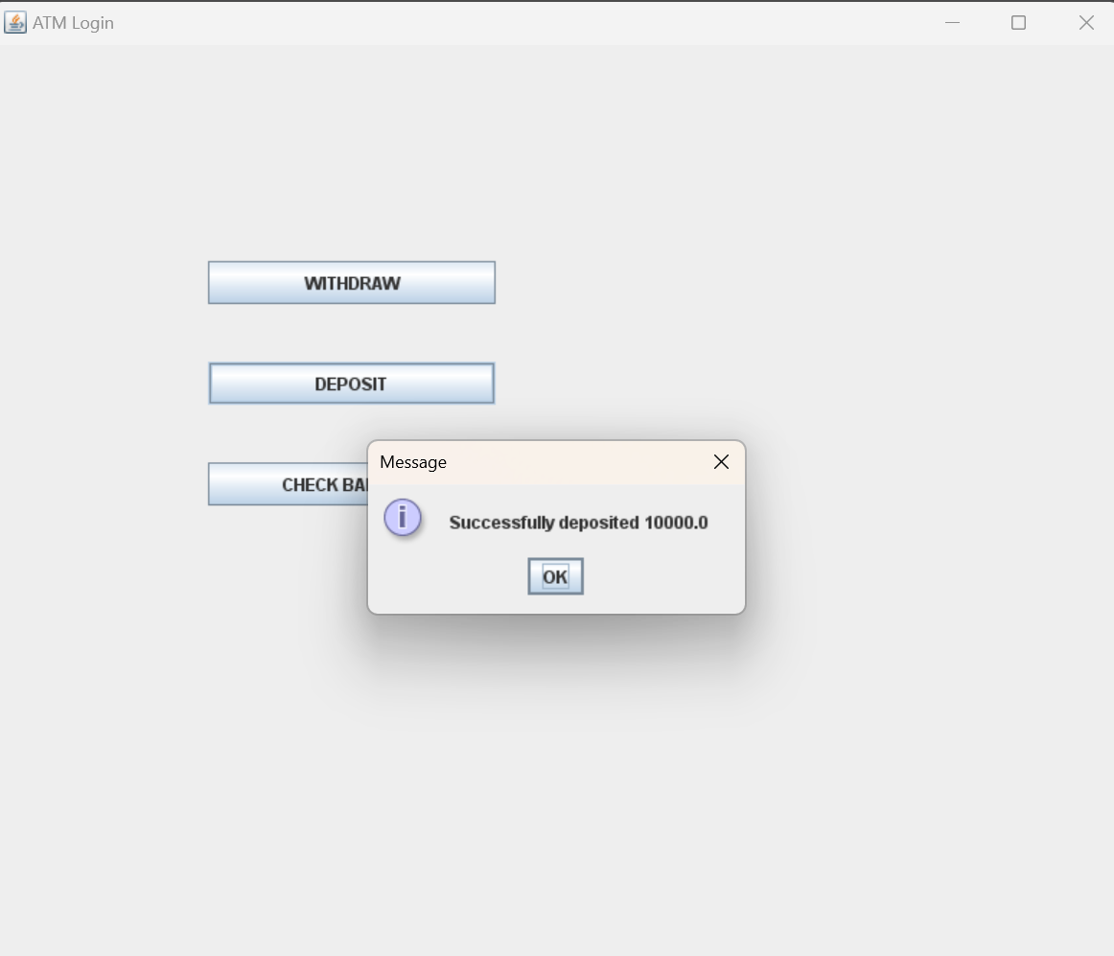


Slide 13
Conclusion
ATMs are an important part of the modern banking system, providing customers with easy and convenient access to financial services. The benefits of ATMs include their availability 24/7, accessibility in various locations, time-saving, increased efficiency, security, and quick access to cash.
The success of ATM systems relies on the integration of advanced hardware and software components, including high-performance CPUs, adequate memory and storage, input/output devices, network connectivity, and security features like encryption and anti-skimming technology. The software requirements for an ATM system include the operating system, ATM software, security software, network software, database software, and APIs.
Overall, ATMs have revolutionized the banking industry, making it easier and more convenient for customers to perform transactions, access their accounts, and manage their finances. As technology continues to advance, we can expect to see further innovations in the ATM industry, providing even more benefits to customers and financial institutions alike.

Slide 14
THANK YOU !

