Slide 1
Introduction to Data Science

Slide 2
Banking Analytics
Data Science -- Why all the excitement?
Where does data come from?
Data Science
Introduction
Why Data Science
Data Scientists
What do they do?
Major/Concentration in Data Science
What courses to take.
How to do Data Science?
Who are Data Scientists?

Slide 3
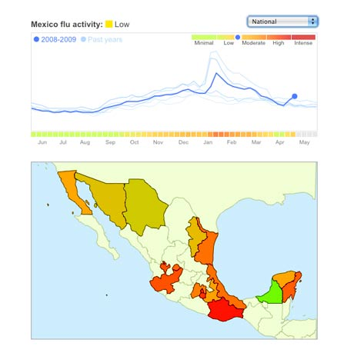
Why the all the Excitement?
Exciting new effective applications of data analytics
Example
Google Flu Trends:
Detecting outbreaks two weeks ahead of CDC data
New models are estimating which cities are most at risk for spread of the Ebola virus.
Prediction model is built on Various data sources, types and analysis.

Slide 4
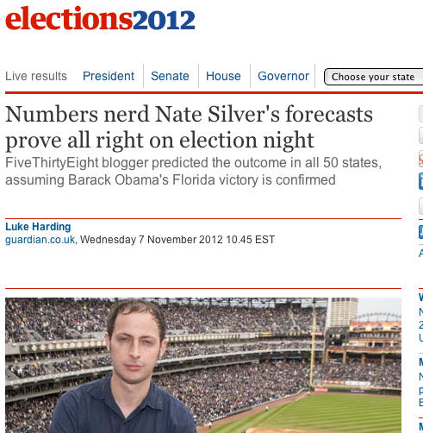
Why the all the Excitement?
Predicting political champagne and election Outcome:
Mr. Obama’s campaign operations, they recruited a team of behavioral scientists to build an extraordinarily ophisticated database
…that allowed the Obama campaign not only to alter the very nature of the electorate, making it younger and less white, but also to create a portrait of shifting voter allegiances. The power of this operation stunned Mr. Romney’s aides on election night, as they saw voters they never even knew existed turn out in places like Osceola County, Fla.
-- New York Times, Wed Nov 7, 2012

Slide 5
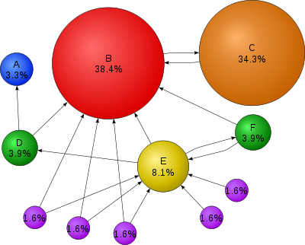
PageRank: The web as a behavioral dataset

Slide 6
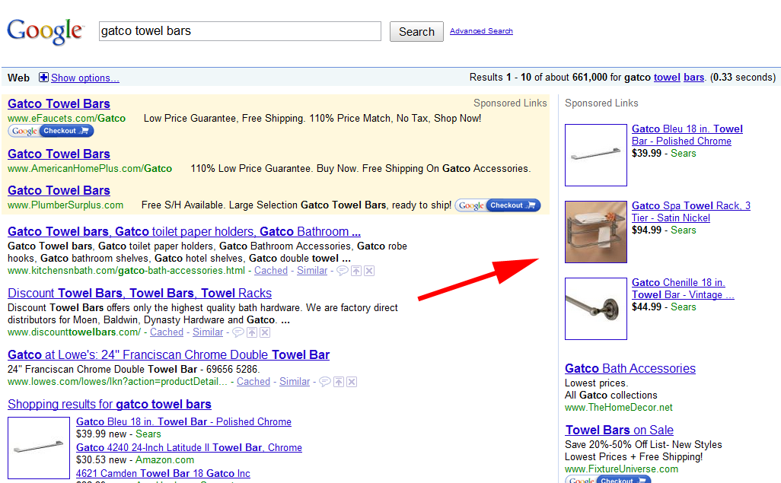
Sponsored search
Google revenue around $50 bn/year from marketing, 97% of the companies revenue.
Sponsored search uses an auction – a pure competition for marketers trying to win access to consumers.
In other words, a competition for models of consumers – their likelihood of responding to the ad – and of determining the right bid for the item.
There are around 30 billion search requests a month. Perhaps a trillion events of history between search providers.
Google Adwords and Adsense

Slide 7
Other Data Science Applications
Transaction Databases → Recommender systems (NetFlix), Fraud Detection (Security and Privacy)
Wireless Sensor Data → Smart Home, Real-time Monitoring, Internet of Things
Text Data, Social Media Data → Product Review and Consumer Satisfaction (Facebook, Twitter, LinkedIn), E-discovery
Software Log Data → Automatic Trouble Shooting (Splunk)
Genotype and Phenotype Data → Epic, 23andme, Patient-Centered Care, Personalized Medicine

Slide 8
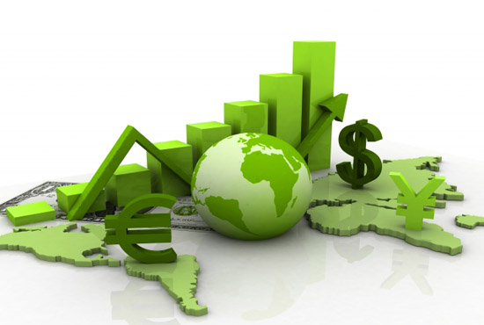
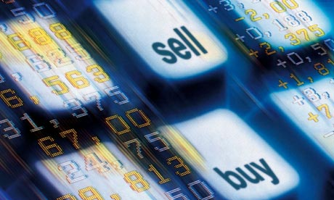


Where does data come from?
Data All Around
Lots of data is being collected and warehoused
Web data, e-commerce
Financial transactions, bank/credit transactions
Online trading and purchasing
Social Network

Slide 9
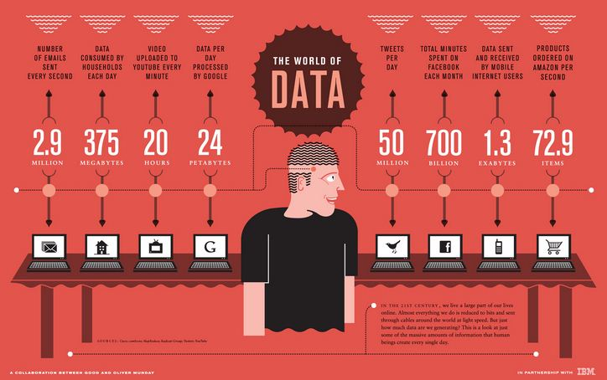
How Much Data Do We have?
Google processes 20 PB a day (2008)
Facebook has 60 TB of daily logs
eBay has 6.5 PB of user data + 50 TB/day (5/2009)
1000 genomes project: 200 TB
Cost of 1 TB of disk: $35
Time to read 1 TB disk: 3 hrs. (100 MB/s)

Slide 10
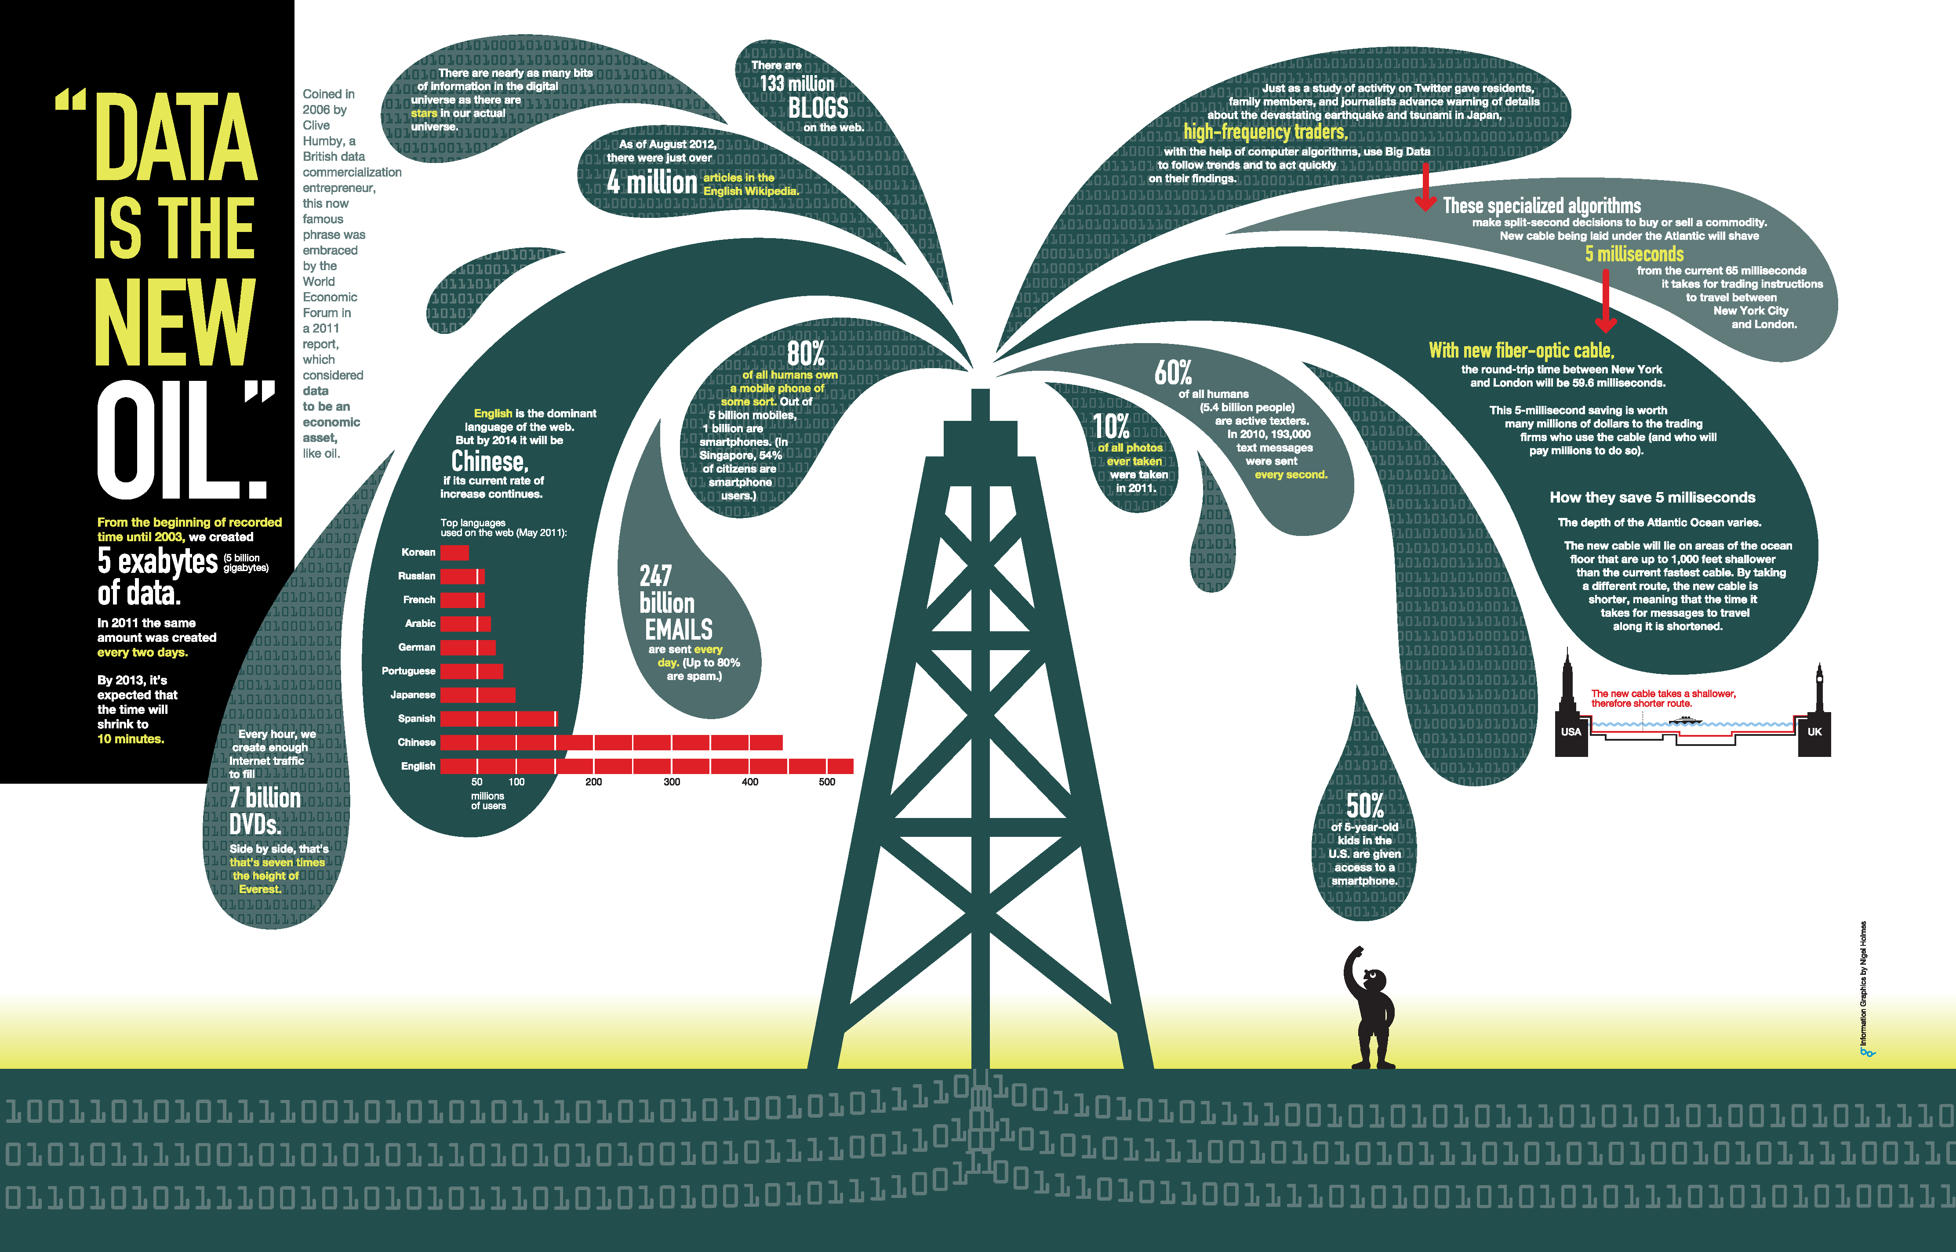
“Data is the New Oil” – World Economic Forum 2011

Slide 11
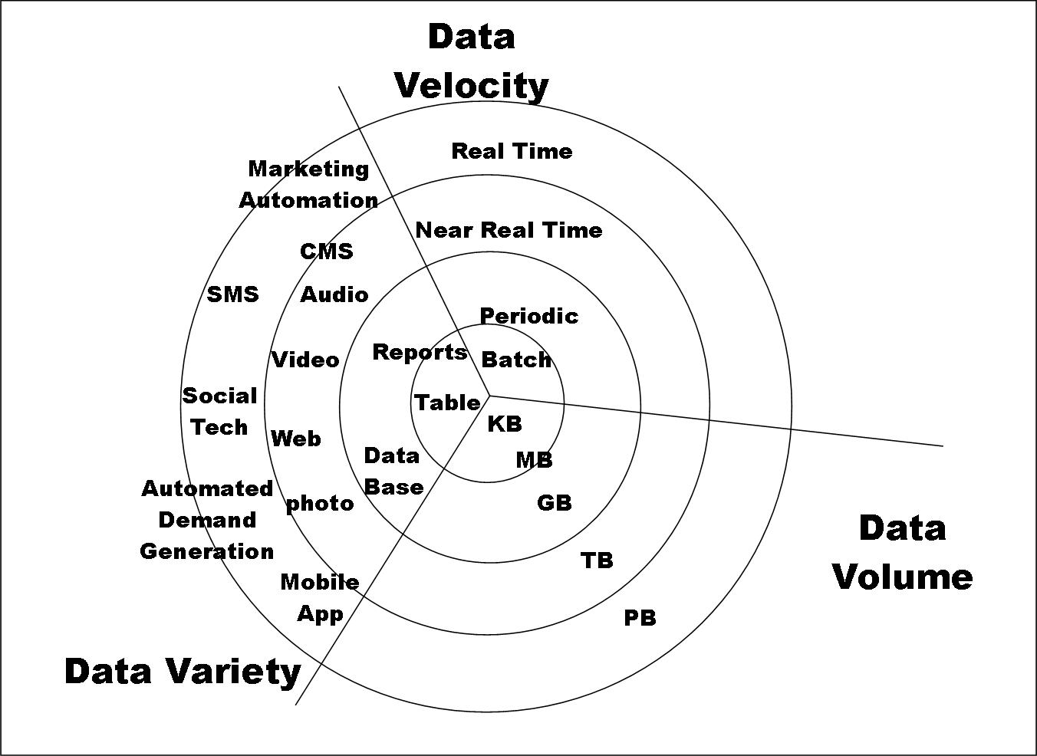
Big Data
Big Data is any data that is expensive to manage and hard to extract value from
Volume
The size of the data
Velocity
The latency of data processing relative to the growing demand for interactivity
Variety and Complexity
the diversity of sources, formats, quality, structures.
Veracity
Data Quality
Value
Information for Decision Making

Slide 12
Types of Data We Have
Relational Data (Tables/Transaction/Legacy Data)
Text Data (Web)
Semi-structured Data (XML)
Graph Data
Social Network, Semantic Web (RDF), …
Streaming Data
You can afford to scan the data once

Slide 13
What To Do With These Data?
Aggregation and Statistics
Data warehousing and OLAP
Indexing, Searching, and Querying
Keyword based search
Pattern matching (XML/RDF)
Knowledge discovery
Data Mining
Statistical Modeling

Slide 14
What is Data Science?
Data Science is the science which uses computer science, statistics and machine learning, visualization and human-computer interactions to collect, clean, integrate, analyze, visualize, interact with data to create data products.
Data science (DS) is a multidisciplinary field of study with goal to address the challenges in big data
Data science principles apply to all data – big and small

Slide 15
What is Data Science?
Theories and techniques from many fields and disciplines are used to investigate and analyze a large amount of data to help decision makers in many industries such as science, engineering, economics, politics, finance, and education
Computer Science
Pattern recognition, visualization, data warehousing, High performance computing, Databases, AI
Mathematics
Mathematical Modeling
Statistics
Statistical and Stochastic modeling, Probability.

Slide 16
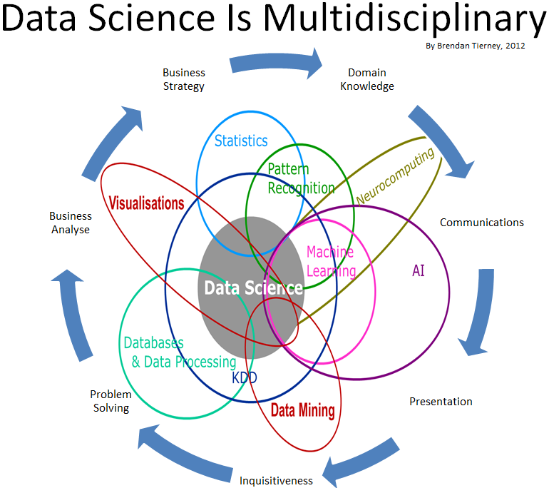
Data Science

Slide 17
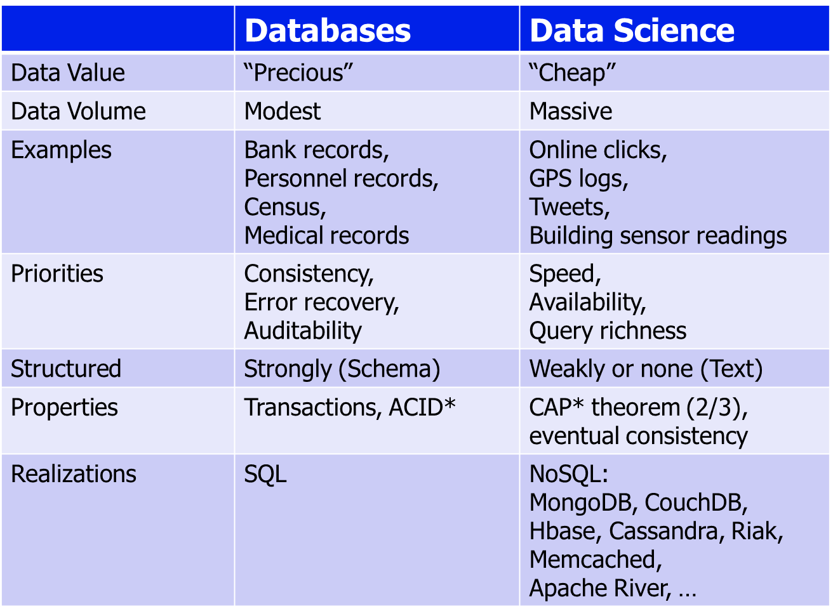
Contrast: Databases

Slide 18
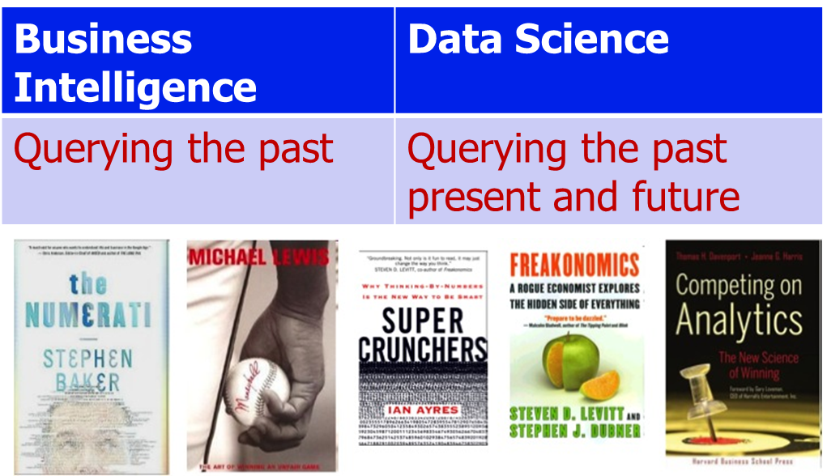
Contrast: Business Intelligence

Slide 19
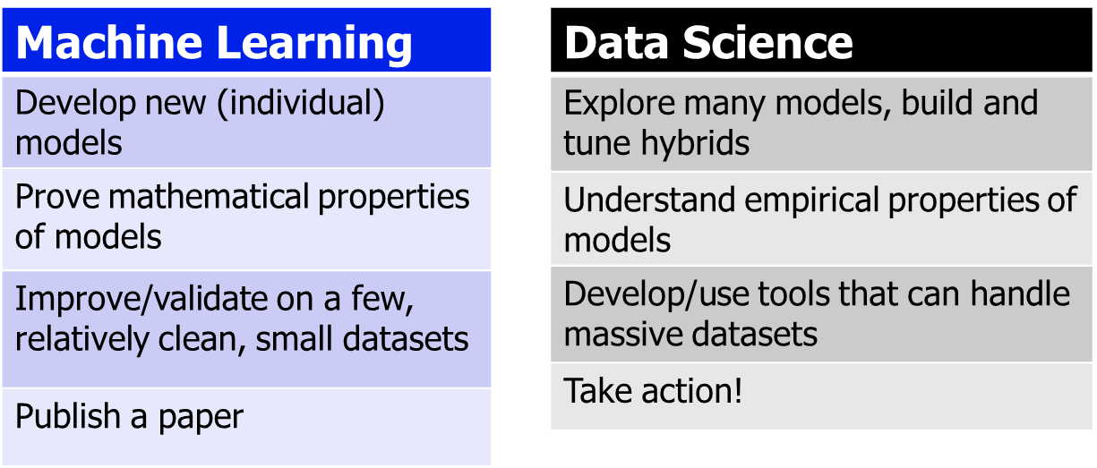
Contrast: Machine Learning

Slide 20
Real Life Examples
Companies learn your secrets, shopping patterns, and preferences
For example, can we know if a woman is pregnant, even if she doesn’t want us to know? Target case study
Data Science and election (2008, 2012)
1 million people installed the Obama Facebook app that gave access to info on “friends”

Slide 21
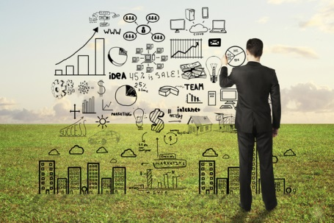
Data Scientists
Data Scientist
The Sexiest Job of the 21st Century
They find stories, extract knowledge. They are not reporters

Slide 22
Data Scientists
Data scientists are the key to realizing the opportunities presented by big data. They bring structure to it, find compelling patterns in it, and advise executives on the implications for products, processes, and decisions

Slide 23
What do Data Scientists do?
National Security
Cyber Security
Business Analytics
Engineering
Healthcare
And more ….

Slide 24
Acknowledgements
Introduction to Data Science - Kamal Al Nasr, Matthew Hayes and Jean-Claude Pedjeu
Introduction to Data Science - Prof. Daisy Zhe Wang

