Slide 1
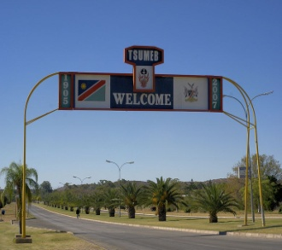
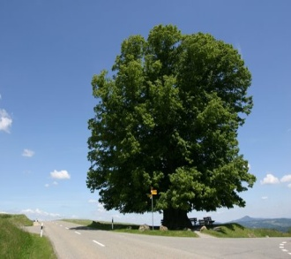
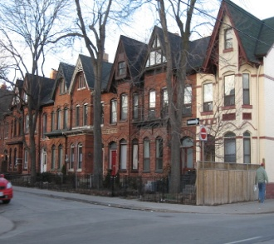

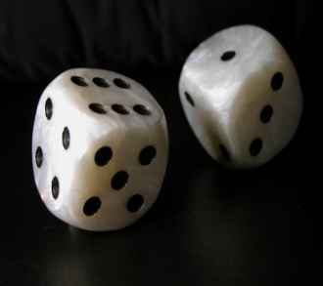
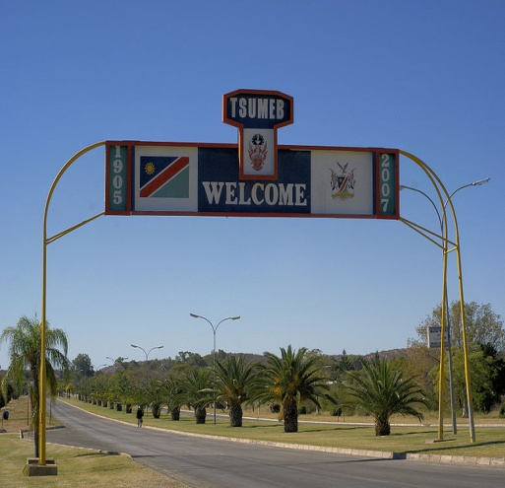
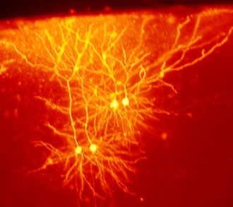
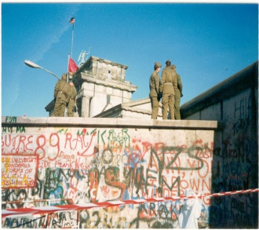
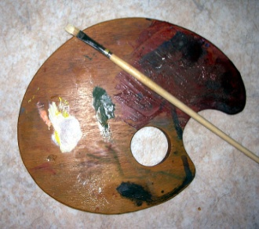
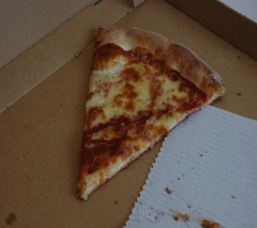
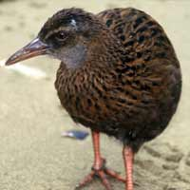
Introduction to Classification

Slide 2
What is classification?
A machine learning task that deals with identifying the class to which an instance belongs
A classifier performs classification
Classifier
( Textual features : Ngrams )
( Age, Marital status,
Health status, Salary )
( Perceptive inputs )
Test instance
Attributes
(a1, a2,… an)
Discrete-valued
Class label
Category of document? {Politics, Movies, Biology}
Steer? { Left, Straight, Right }
Issue Loan? {Yes, No}

Slide 3
Illustrating Classification Task

Slide 4
Classification learning
Training
phase
Testing
phase
Learning the classifier
from the available data
‘Training set’
(Labeled)
Testing how well the classifier
performs
‘Testing set’

Slide 5
Evaluating classifiers
Outcome:
Accuracy
Confusion matrix
If cost-sensitive, the expected cost of classification ( attribute test cost + misclassification cost) etc.

Slide 6
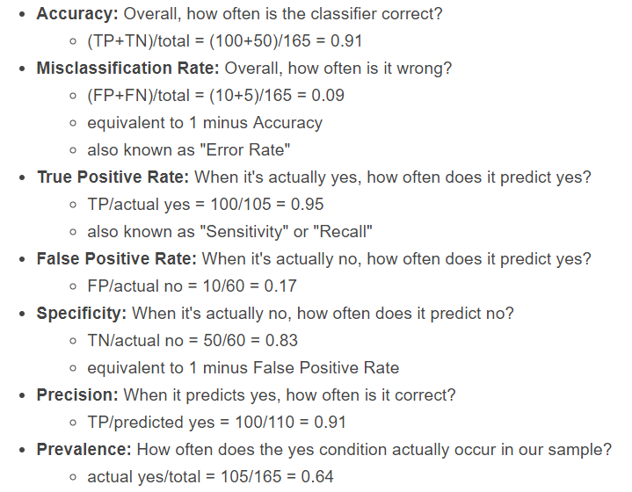
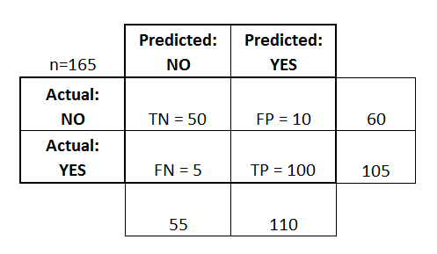
Confusion matrix

Slide 7
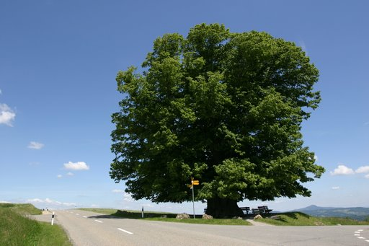
Decision Trees

Slide 8
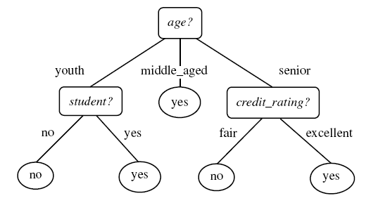
Example tree
Intermediate nodes : Attributes value tests
Edges : Attribute value
Leaf nodes : Class predictions
Example algorithms: ID3, C4.5, SPRINT, CART

Slide 9
Decision Tree schematic
Training data set
a1 a2 a3 a4 a5 a6
a1 a2 a3 a4 a5 a6
X
Y
Z
Impure node,
Select best attribute
and continue
Impure node,
Select best attribute
and continue
Pure node,
Leaf node:
Class RED

Slide 10
Apply Model to Test Data
Test Data
Start from the root of tree.
Refund
Yes
No
NO
MarSt
Single, Divorced
Married
TaxInc
NO
< 80K
> 80K
NO
YES

Slide 11
Apply Model to Test Data
Test Data
Refund
Yes
No
NO
MarSt
Single, Divorced
Married
TaxInc
NO
< 80K
> 80K
NO
YES

Slide 12
Apply Model to Test Data
Test Data
Refund
Yes
No
NO
MarSt
Single, Divorced
Married
TaxInc
NO
< 80K
> 80K
NO
YES

Slide 13
Apply Model to Test Data
Test Data
Refund
Yes
No
NO
MarSt
Single, Divorced
Married
TaxInc
NO
< 80K
> 80K
NO
YES

Slide 14
Apply Model to Test Data
Test Data
Refund
Yes
No
NO
MarSt
Single, Divorced
Married
TaxInc
NO
< 80K
> 80K
NO
YES

Slide 15
Apply Model to Test Data
Test Data
Refund
Yes
No
NO
MarSt
Single, Divorced
Married
Assign Cheat to “No”
TaxInc
NO
< 80K
> 80K
NO
YES

Slide 16
How to Build Decision Trees
Greedy strategy.
Split the records based on an attribute test that optimizes certain criterion.
Issues
Determine how to split the records
How to specify the attribute test condition?
How to determine the best split?
Determine when to stop splitting

Slide 17
How to specify the attribute test condition
Idea: choose attribute that leads to greatest increase in “purity”
Depends on attribute types
Nominal
Ordinal
Continuous
Depends on number of ways to split
2-way split
Multi-way split

Slide 18
Splitting Based on Nominal Attributes
Multi-way split: Use as many partitions as distinct values.
Binary split: Divides values into two subsets. Need to find optimal partitioning.
CarType
Family
Luxury
Sports
CarType
OR
CarType
{Sports, Luxury}
{Family, Luxury}
{Family}
{Sports}

Slide 19
Splitting Based on Continuous Attributes
Different ways of handling
Discretization to form an ordinal categorical attribute
Static – discretize once at the beginning
Dynamic – ranges can be found by equal interval bucketing, equal frequency bucketing (percentiles), or clustering.
Binary Decision: (A < v) or (A ≥ v)
consider all possible splits and finds the best cut
can be more compute intensive

Slide 20
How to determine the Best Split
Before Splitting: 10 records of class 0, 10 records of class 1
Which test condition is the best?

Slide 21
How to determine the Best Split
Greedy approach:
Nodes with homogeneous class distribution are preferred
Need a measure of node impurity:
Non-homogeneous,
High degree of impurity
Homogeneous,
Low degree of impurity

Slide 22
Measures of Node Impurity
Entropy
Gini Index
Misclassification error

Slide 23
Entropy
Entropy (impurity) of a set of examples, S, relative to a binary classification is:
where p₁ is the fraction of positive examples in S and p₀ is the fraction of negatives.
If all examples are in one category, entropy will be zero
If examples are equally mixed (p₁=p₀=0.5), entropy is a maximum of 1.
For multi-class problems with c categories, entropy generalizes to:

Slide 24
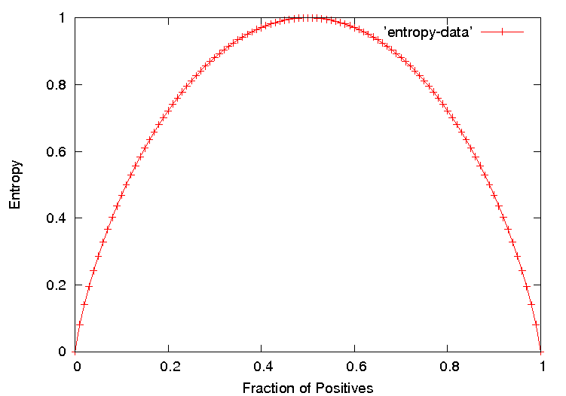
Entropy Plot for Binary Classification

Slide 25
Information Gain
The information gain of a attribute F is the expected reduction in entropy resulting from splitting on this feature.
where S_{v} is the subset of S having value v for feature F.
Entropy of each resulting subset weighted by its relative size.

Slide 26

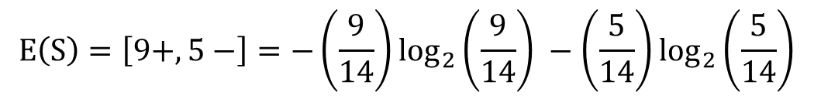
Example
$E\left(S\right)=−P_{⊕}\log_{2}{P_{⊕}} −$ $P_{⊖}\log_{2}{P_{⊖}}$
$$E\left(S\right)=\left[9+,5−\right]=−\left(\frac{9}{14}\right)\log_{2}\left(\frac{9}{14}\right) −\left(\frac{5}{14}\right)\log_{2}\left(\frac{5}{14}\right)$$
$$E\left(S\right)=0.94$$
$$E\left({Outlook}_{sunny}\right)= \left[2+,3−\right]=−\left(\frac{2}{5}\right)\log_{2}\left(\frac{2}{5}\right) −\left(\frac{3}{5}\right)\log_{2}\left(\frac{3}{5}\right)=0.971$$
$E\left({Outlook}_{overcast}\right)=\left[4+,0−\right]=−\left(\frac{4}{4}\right)\log_{2}\left(\frac{4}{4}\right) −\left(\frac{0}{4}\right)\log_{2}\left(\frac{0}{4}\right)$ = 0
S: Data set
$$E\left({Outlook}_{rainy}\right)= \left[3+,2−\right]=−\left(\frac{3}{5}\right)\log_{2}\left(\frac{3}{5}\right) −\left(\frac{2}{5}\right)\log_{2}\left(\frac{2}{5}\right)=0.971$$

Slide 27
Example
$$E\left({Temperature}_{hot}\right)= \left[2+,2−\right]=−\left(\frac{2}{4}\right)\log_{2}\left(\frac{2}{4}\right) −\left(\frac{2}{4}\right)\log_{2}\left(\frac{2}{4}\right)=1$$
$E\left({Temperature}_{moderate}\right)=\left[4+,2−\right]=−\left(\frac{4}{6}\right)\log_{2}\left(\frac{4}{6}\right) −\left(\frac{2}{6}\right)\log_{2}\left(\frac{2}{6}\right)$ = 0.918
$$E\left({Temperature}_{cold}\right)= \left[3+,1−\right]=−\left(\frac{3}{4}\right)\log_{2}\left(\frac{3}{4}\right) −\left(\frac{1}{4}\right)\log_{2}\left(\frac{1}{4}\right)=0.811$$
$$E\left({Humidity}_{high}\right)= \left[3+,4−\right]=−\left(\frac{3}{7}\right)\log_{2}\left(\frac{3}{7}\right) −\left(\frac{4}{7}\right)\log_{2}\left(\frac{4}{7}\right)=0.985$$
$E\left({Humidity}_{normal}\right)=\left[6+,1−\right]=−\left(\frac{6}{7}\right)\log_{2}\left(\frac{6}{7}\right) −\left(\frac{1}{7}\right)\log_{2}\left(\frac{1}{7}\right)$ = 0.592
S: Data set

Slide 28
Example
$$E\left({Wind}_{weak}\right)=\left[6+,2−\right]=−\left(\frac{6}{8}\right)\log_{2}\left(\frac{6}{8}\right) −\left(\frac{2}{8}\right)\log_{2}\left(\frac{2}{8}\right)=0.811$$
$E\left({Wind}_{strong}\right)=\left[3+,3−\right]=−\left(\frac{3}{6}\right)\log_{2}\left(\frac{3}{6}\right) −\left(\frac{3}{6}\right)\log_{2}\left(\frac{3}{6}\right)$ = 1
S: Data set

Slide 29
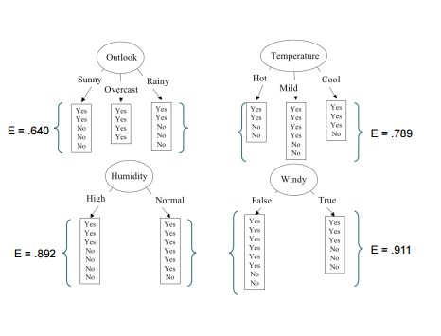
Example
S: Data set

Slide 30
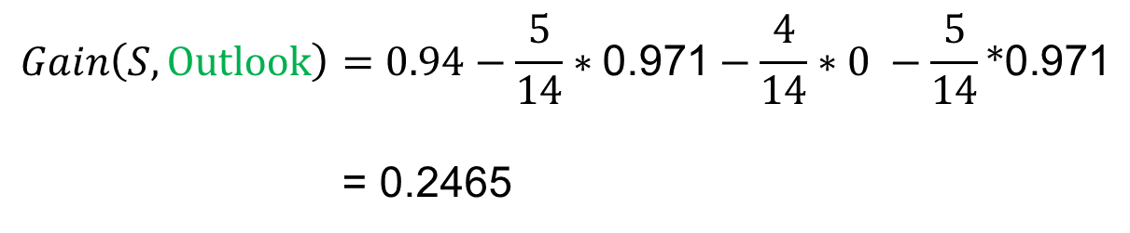
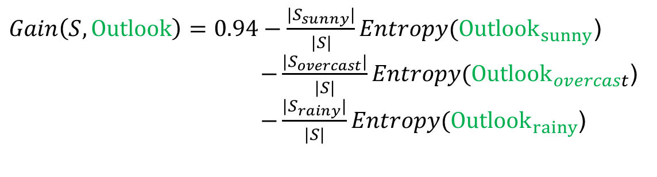
Example
$Gain\left(S,Outlook\right)=0.94−\frac{{|S}_{sunny}|}{|S|}Entropy({Outlook}_{sunny}$) $−\frac{{|S}_{overcast}|}{|S|}Entropy({Outlook}_{overcast}$)
$−\frac{{|S}_{rainy}|}{|S|}Entropy({Outlook}_{rainy}$)
$$Gain\left(S,Outlook\right)=0.94−\frac{5}{14}∗\text{0.971}−\frac{4}{14}∗0 −\frac{5}{14}\text{∗}\text{0.971}$$
= 0.2465
S: Data set

Slide 31
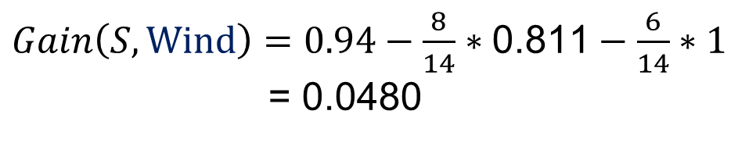
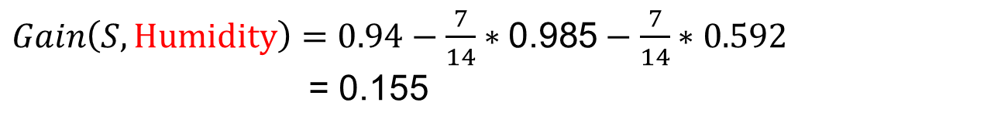
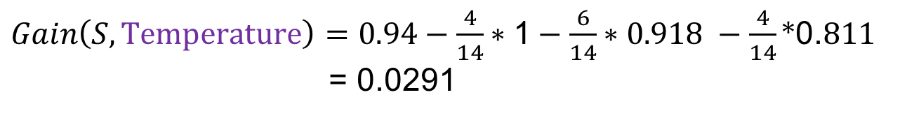
Example
$Gain\left(S,Temperature\right)=0.94−\frac{4}{14}∗\text{1}−\frac{6}{14}∗0.918 −\frac{4}{14}\text{∗}\text{0.}811$
= 0.0291
$Gain\left(S,Humidity\right)=0.94−\frac{7}{14}∗\text{0.985}−\frac{7}{14}∗0.592$
= 0.155
$Gain\left(S,Wind\right)=0.94−\frac{8}{14}∗\text{0.811}−\frac{6}{14}∗1$ = 0.0480
S: Data set

Slide 32
Example
D₁, D_{2,} D₁,…, D₁₄
[9+, 5-]
Outlook
Sunny
Overcast
Rainy
D₁, D_{2,} D₈, D₉, D₁₁
[2+, 3-]
D₃, D_{7,} D₁₂, D₁₃
[4+, 0-]
D₄, D_{5,} D₆, D₁₀, D₁₄
[3+, 2-]
?
Yes
?
S: Data set
Which attribute should be tested here ?

Slide 33
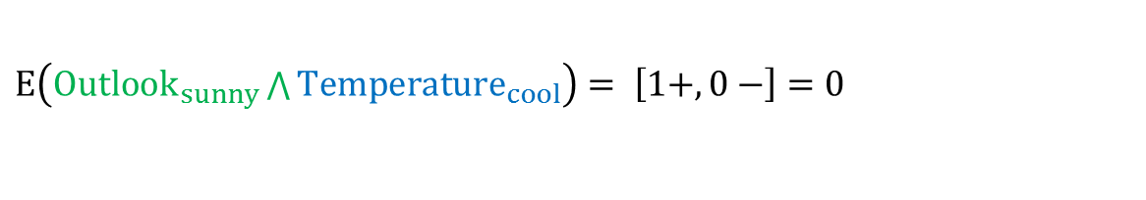
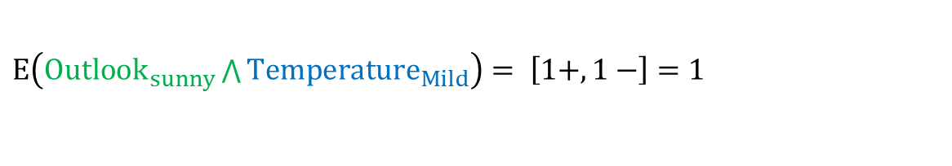
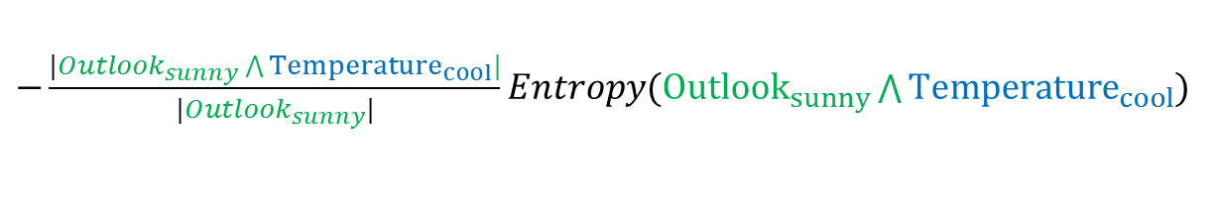

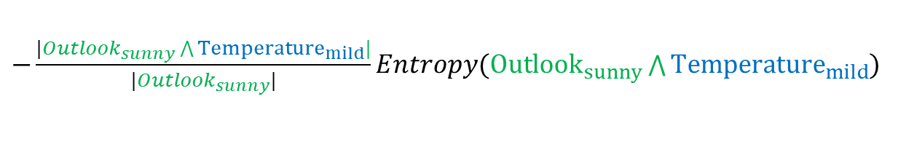
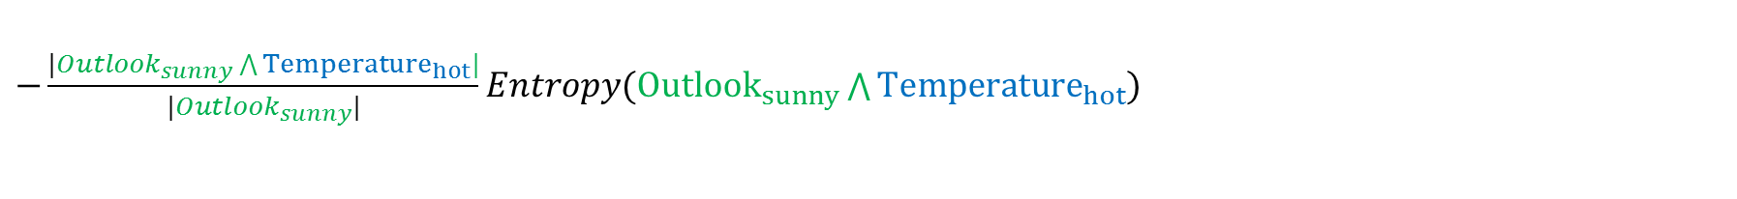
Example
$$E\left({Outlook}_{sunny}\right)= \left[2+,3−\right]=−\left(\frac{2}{5}\right)\log_{2}\left(\frac{2}{5}\right) −\left(\frac{3}{5}\right)\log_{2}\left(\frac{3}{5}\right)=0.971$$
$E\left({Outlook}_{sunny}\bigwedge{Temperature_{hot}}\right)= \left[0+,2−\right]$ $=0$
$E\left({Outlook}_{sunny}\bigwedge{Temperature_{Mild}}\right)= \left[1+,1−\right]$ $=1$
$E\left({Outlook}_{sunny}\bigwedge{Temperature_{cool}}\right)= \left[1+,0−\right]$ $=0$
$$Gain\left({Outlook}_{sunny}, Temperature\right)=E({Outlook}_{sunny})$$
$−\frac{|{Outlook}_{sunny}\bigwedge{Temperature_{hot}}|}{|{Outlook}_{sunny}|}Entropy({Outlook}_{sunny}\bigwedge{Temperature_{hot}}$)
$−\frac{|{Outlook}_{sunny}\bigwedge{Temperature_{mild}}|}{|{Outlook}_{sunny}|}Entropy({Outlook}_{sunny}\bigwedge{Temperature_{mild}}$)
S: Data set
$−\frac{|{Outlook}_{sunny}\bigwedge{Temperature_{cool}}|}{|{Outlook}_{sunny}|}Entropy({Outlook}_{sunny}\bigwedge{Temperature_{cool}}$)

Slide 34
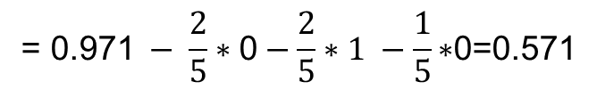

Example
$$Gain\left({Outlook}_{sunny}, Temperature\right)=$$
$$\text{= }\text{0.971} − \frac{2}{5}∗\text{0}−\frac{2}{5}∗1 −\frac{1}{5}\text{∗}\text{0}\text{=0.571}$$
S: Data set

Slide 35
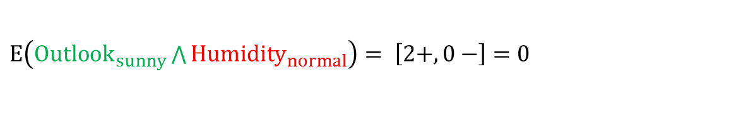

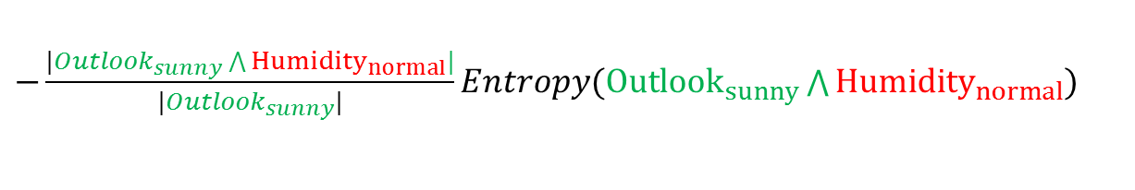
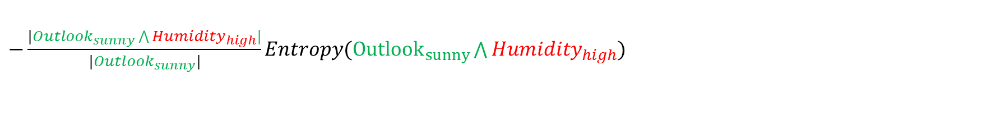
Example
$$E\left({Outlook}_{sunny}\right)= \left[2+,3−\right]=−\left(\frac{2}{5}\right)\log_{2}\left(\frac{2}{5}\right) −\left(\frac{3}{5}\right)\log_{2}\left(\frac{3}{5}\right)=0.971$$
$E\left({Outlook}_{sunny}\bigwedge{Humidity_{high}}\right)= \left[0+,3−\right]$ $=0$
$E\left({Outlook}_{sunny}\bigwedge{{Humidity}_{normal}}\right)= \left[2+,0−\right]$ $=0$
$$Gain\left({Outlook}_{sunny},Humidity\right)=E({Outlook}_{sunny})$$
$−\frac{|{Outlook}_{sunny}\bigwedge{Humidity_{high}}|}{|{Outlook}_{sunny}|}Entropy({Outlook}_{sunny}\bigwedge{Humidity_{high}}$)
$−\frac{|{Outlook}_{sunny}\bigwedge{{Humidity}_{normal}}|}{|{Outlook}_{sunny}|}Entropy({Outlook}_{sunny}\bigwedge{{Humidity}_{normal}}$)
S: Data set
$$Gain\left({Outlook}_{sunny},Humidity\right)=0.971 −\frac{3}{5}∗\text{0}−\frac{2}{5}∗0 \text{=0.}\text{9}\text{71}$$

Slide 36
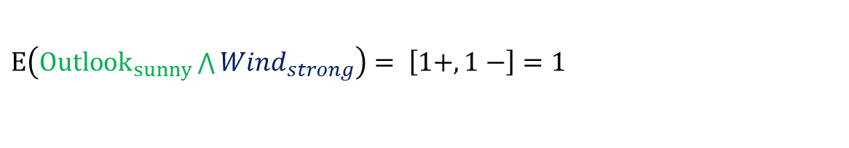
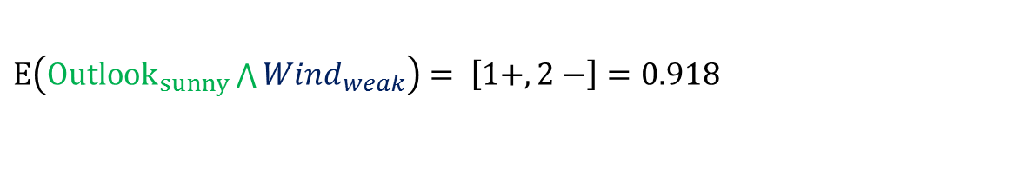
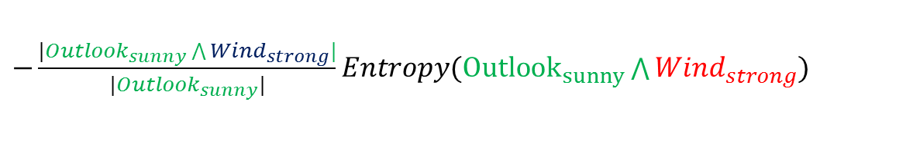
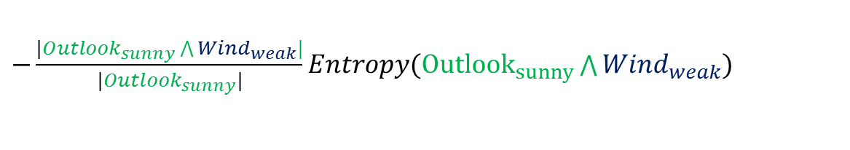
Example
$$E\left({Outlook}_{sunny}\right)= \left[2+,3−\right]=−\left(\frac{2}{5}\right)\log_{2}\left(\frac{2}{5}\right) −\left(\frac{3}{5}\right)\log_{2}\left(\frac{3}{5}\right)=0.971$$
$E\left({Outlook}_{sunny}\bigwedge{Wind_{weak}}\right)= \left[1+,2−\right]$ $=0.918$
$E\left({Outlook}_{sunny}\bigwedge{Wind_{strong}}\right)= \left[1+,1−\right]$ $=1$
$$Gain\left({Outlook}_{sunny},wind\right)=E({Outlook}_{sunny})$$
$−\frac{|{Outlook}_{sunny}\bigwedge{Wind_{weak}}|}{|{Outlook}_{sunny}|}Entropy({Outlook}_{sunny}\bigwedge{Wind_{weak}}$)
$−\frac{|{Outlook}_{sunny}\bigwedge{Wind_{strong}}|}{|{Outlook}_{sunny}|}Entropy({Outlook}_{sunny}\bigwedge{Wind_{strong}}$)
S: Data set
$$Gain\left({Outlook}_{sunny},Wind\right)=0.971 −\frac{3}{5}∗\text{0.918}−\frac{2}{5}∗1 \text{=}\text{0}\text{.02}\text{0}$$

Slide 37
Example
D₁, D_{2,} D₁,…, D₁₄
[9+, 5-]
Outlook
Sunny
Overcast
Rainy
D₁, D_{2,} D₈, D₉, D₁₁
[2+, 3-]
D₃, D_{7,} D₁₂, D₁₃
[4+, 0-]
D₄, D_{5,} D₆, D₁₀, D₁₄
[3+, 2-]
Humidity
Yes
?
High
Normal
D₁, D_{2,} D₈, [0+, 3-]
D₉, D₁₁
[2+, 0-]
No
Yes
S: Data set
Which attribute should be tested here ?

Slide 38
Triangles and Squares
Data Set:
A set of classified objects
.
.
.
.
.
.

Slide 39
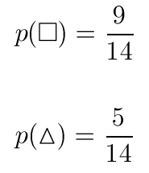

Entropy
5 triangles
9 squares
class probabilities
entropy
.
.
.
.
.
.

Slide 40



Entropy reduction by data set partitioning
.
.
.
.
.
.
.
.
red
Color?
green
.
yellow
.
.
.

Slide 41







Entropija vrednosti atributa
.
.
.
.
.
.
.
.
red
Color?
green
.
yellow
.
.
.

Slide 42
Information Gain
.
.
.
.
.
.
.
.
red
Color?
green
.
yellow
.
.
.

Slide 43
Information Gain of The Attribute
Attributes
Gain(Color) = 0.246
Gain(Outline) = 0.151
Gain(Dot) = 0.048
Heuristics: attribute with the highest gain is chosen
This heuristics is local (local minimization of impurity)

Slide 44
.
.
.
.
.
.
.
.
red
Color?
green
.
yellow
.
.
.
Gain(Outline) = 0.971 – 0 = 0.971 bits
Gain(Dot) = 0.971 – 0.951 = 0.020 bits

Slide 45
.
.
.
.
.
.
.
.
red
Gain(Outline) = 0.971 – 0.951 = 0.020 bits
Gain(Dot) = 0.971 – 0 = 0.971 bits
Color?
green
.
yellow
.
.
.
solid
.
Outline?
dashed
.

Slide 46
.
.
.
.
.
.
.
.
red
.
yes
Dot?
.
Color?
no
green
.
yellow
.
.
.
solid
.
Outline?
dashed
.

Slide 47
Decision Tree
.
.
.
.
.
.
Color
red
green
yellow
Dot
square
Outline
yes
no
dashed
solid
triangle
square
triangle
square

