Slide 1
Dimensionality Reduction

Slide 2
Outline
Linear Algebra
Dimensionality Reduction
Principal Component Analysis (PCA)
Singular Value Decomposition (SVD)
Applications

Slide 3
What is a Vector ?
Think of a vector as a directed line segment in N-dimensions! (has “length” and “direction”)
Basic idea: convert geometry in higher dimensions into algebra!
Once you define a “nice” basis along each dimension: x-, y-, z-axis …
Vector becomes a 1 x N matrix!
v = [a b c]^{T}
y
v
x
Notes:
From 2D to 3D
In 2D,(a,b) is the point, combined with origin, [a,b]’is a direction.
upgrade to 3D, [a b c]’also can decide a direction
2. Emphasize the transpose and column vector

Slide 4
Vector Addition: A+B
A+B
A+B = C
C
B
A

Slide 5
Scalar Product: av
av
v
Change only the length (“scaling”), but keep direction fixed.
Notes:
A scalar is just a number, no direction included.
So scalar product does not change direction.

Slide 6

Vectors: Dot Product
Think of the dot product as a matrix multiplication
The magnitude is the dot product of a vector with itself
$$A.B=0 ⟹A⊥B$$
The dot product is also related to the angle between the two vectors

Slide 7
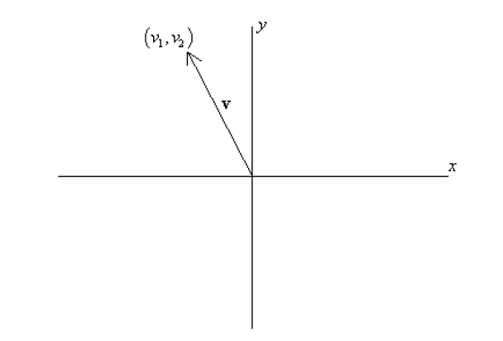
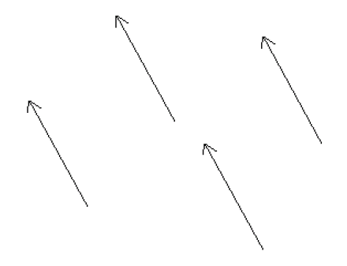
Bases & Orthonormal Bases
Basis (or axes): frame of reference
vs
Basis: a space is totally defined by a set of vectors – any point is a linear combination of the basis
Ortho-Normal: orthogonal + normal
[Sneak peek:
Orthogonal: dot product is zero
Normal: magnitude is one

Slide 8
What is a Matrix?
A matrix is a set of elements, organized into rows and columns
rows
columns

Slide 9
Basic Matrix Operations
Addition, Subtraction, Multiplication: creating new matrices (or functions)
Just add elements
Just subtract elements
Multiply each row by each column
Notes:
Addition and subtraction must be done in same dimension
Do multiplication together

Slide 10
Inverse of a Matrix
Identity matrix: AI = A
Inverse exists only for square matrices that are non-singular
Some matrices have an inverse, such that: AA⁻¹ = I
Inversion is tricky: (ABC)⁻¹ = C⁻¹B⁻¹A⁻¹
Derived from non-commutativity property

Slide 11
Determinant of a Matrix
Used for inversion
If det(A) = 0, then A has no inverse

Slide 12
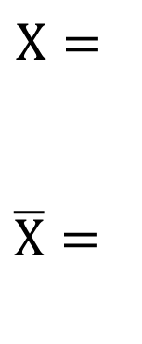
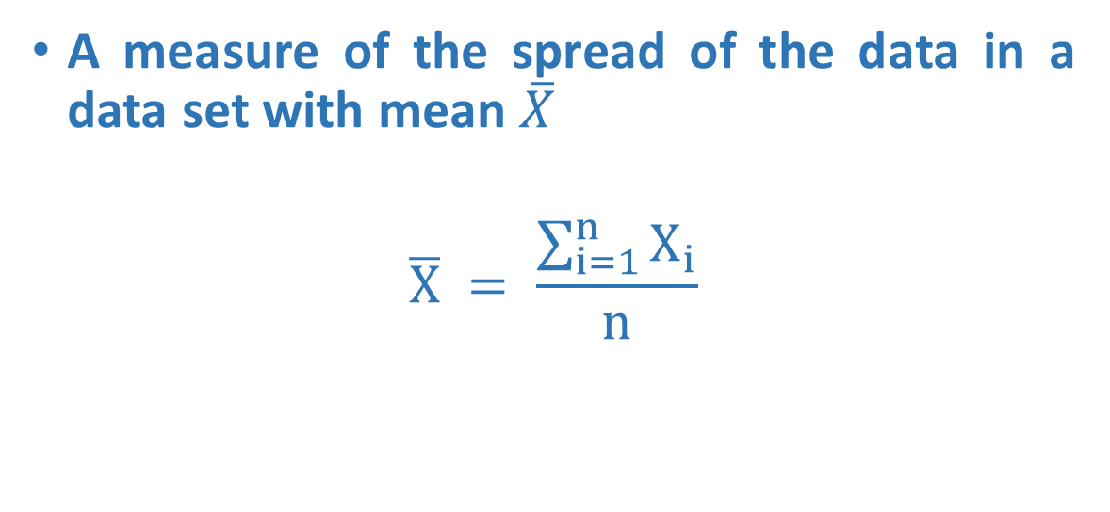
Mean
A measure of the spread of the data in a data set with mean $\overline{X}$
$$\overline{X} = \frac{\sum_{i=1}^{n}{X_{i}}}{n}$$
Attribute 1
4
3
3
$$X=$$
$\overline{X}=$

Slide 13
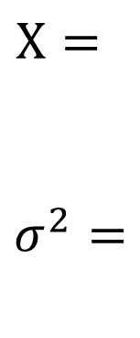
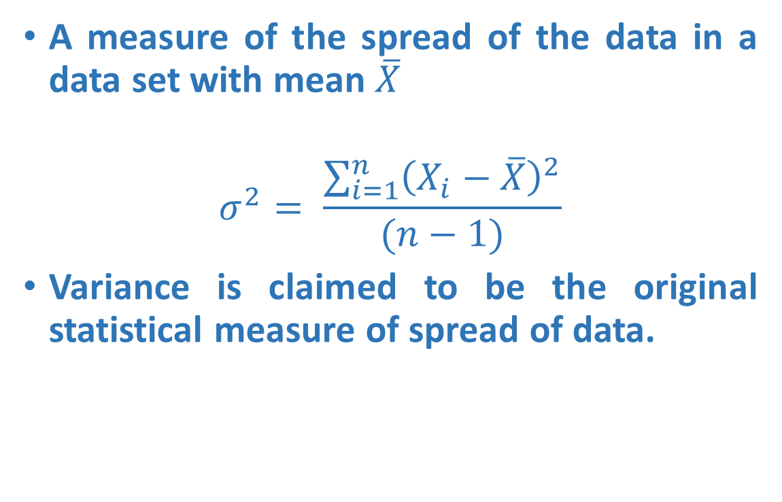
Variance
A measure of the spread of the data in a data set with mean $\overline{X}$
$$σ^{2}= \frac{\sum_{i=1}^{n}{{\left(X_{i}−\overline{X}\right)}^{2}}}{(n−1)}$$
Variance is claimed to be the original statistical measure of spread of data.
Attribute 1
4
3
3
$$X=$$
$σ^{2}=$

Slide 14
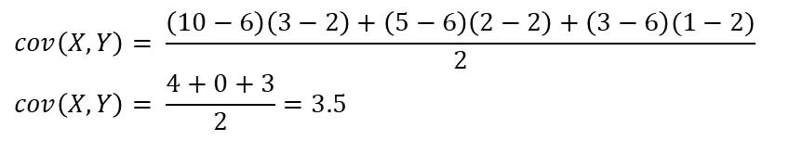
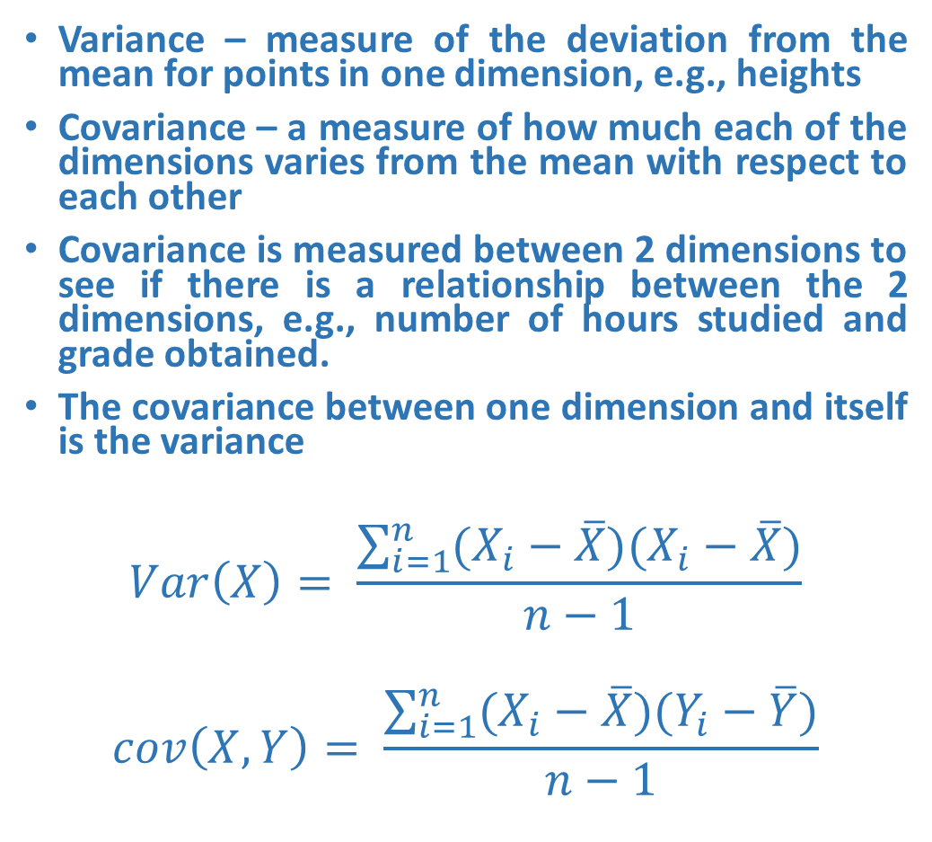
Covariance
Variance – measure of the deviation from the mean for points in one dimension, e.g., heights
Covariance – a measure of how much each of the dimensions varies from the mean with respect to each other
Covariance is measured between 2 dimensions to see if there is a relationship between the 2 dimensions, e.g., number of hours studied and grade obtained.
The covariance between one dimension and itself is the variance
$$Var\left(X\right)= \frac{\sum_{i=1}^{n}{(X_{i}−\overline{X})(X_{i}−\overline{X})}}{n−1}$$
$$cov\left(X, Y\right)= \frac{\sum_{i=1}^{n}{(X_{i}−\overline{X})(Y_{i}−\overline{Y})}}{n−1}$$
X | Y
10 | 3
5 | 2
3 | 1
Mean | 6 | 2
$$cov\left(X,Y\right)= \frac{\left(10−6\right)\left(3−2\right)+\left(5−6\right)\left(2−2\right)+\left(3−6\right)(1−2)}{2}$$
$$cov\left(X,Y\right)= \frac{4+0+3}{2}=3.5$$

Slide 15
Covariance
What is the interpretation of covariance calculations?
Say you have a 2-dimensional data set
X: number of hours studied for a subject
Y: marks obtained in that subject
And assume the covariance value (between X and Y) is: 104.53
What does this value mean?

Slide 16
Covariance
Exact value is not as important as its sign.
A positive value of covariance indicates that both dimensions increase or decrease together, e.g., as the number of hours studied increases, the grades in that subject also increase.
A negative value indicates while one increases the other decreases, or vice-versa, e.g., active social life vs. performance in CS Dept.
If covariance is zero: the two dimensions are independent of each other, e.g., heights of students vs. grades obtained in a subject.
Covariance calculations are used to find relationships between dimensions in high dimensional data sets (usually greater than 3) where visualization is difficult.

Slide 17
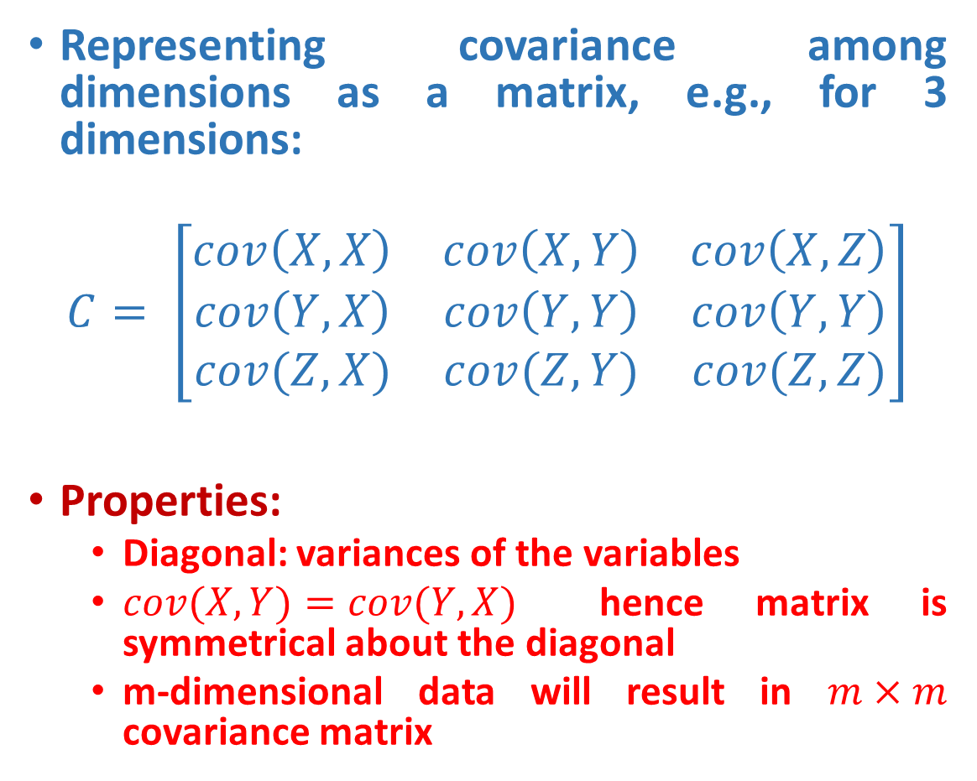
Covariance Matrix
Representing covariance among dimensions as a matrix, e.g., for 3 dimensions:
$$C= \left[\begin{matrix}cov\left(X,X\right) & cov\left(X,Y\right) & cov\left(X,Z\right) \\ cov\left(Y,X\right) & cov\left(Y,Y\right) & cov\left(Y,Y\right) \\ cov(Z,X) & cov(Z,Y) & cov(Z,Z)\end{matrix}\right]$$
Properties:
Diagonal: variances of the variables
$cov(X,Y)=cov(Y,X)$ hence matrix is symmetrical about the diagonal
m-dimensional data will result in $m×m$ covariance matrix

Slide 18
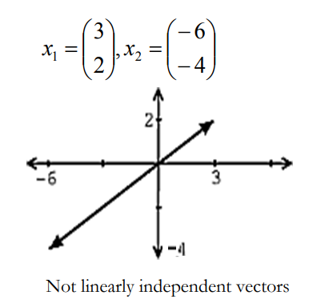
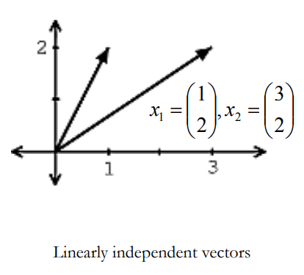
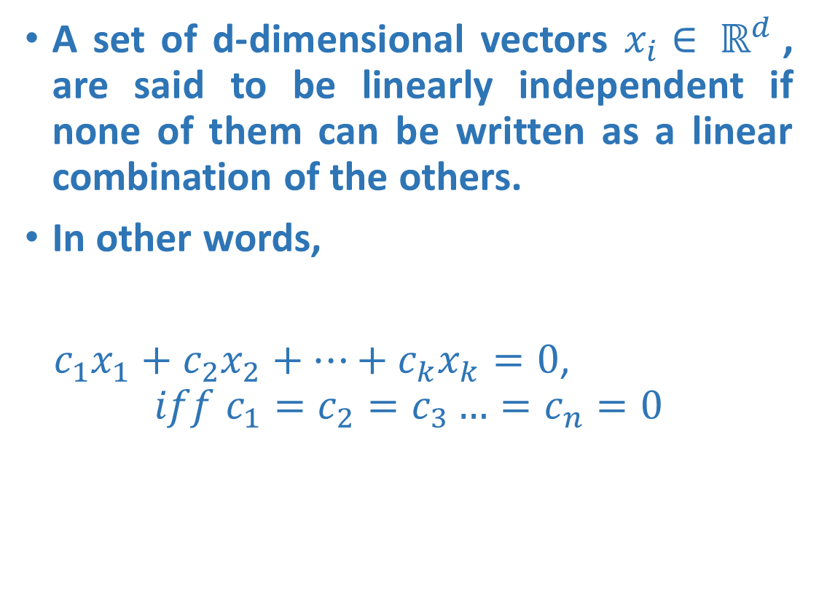
Linear Independence
A set of d-dimensional vectors $x_{i}∈ ℝ^{d}$, are said to be linearly independent if none of them can be written as a linear combination of the others.
In other words,
$c_{1}x_{1}+c_{2}x_{2}+…+c_{k}x_{k}=0$,
$$iff c_{1}=c_{2}=c_{3}…=c_{n}=0$$

Slide 19
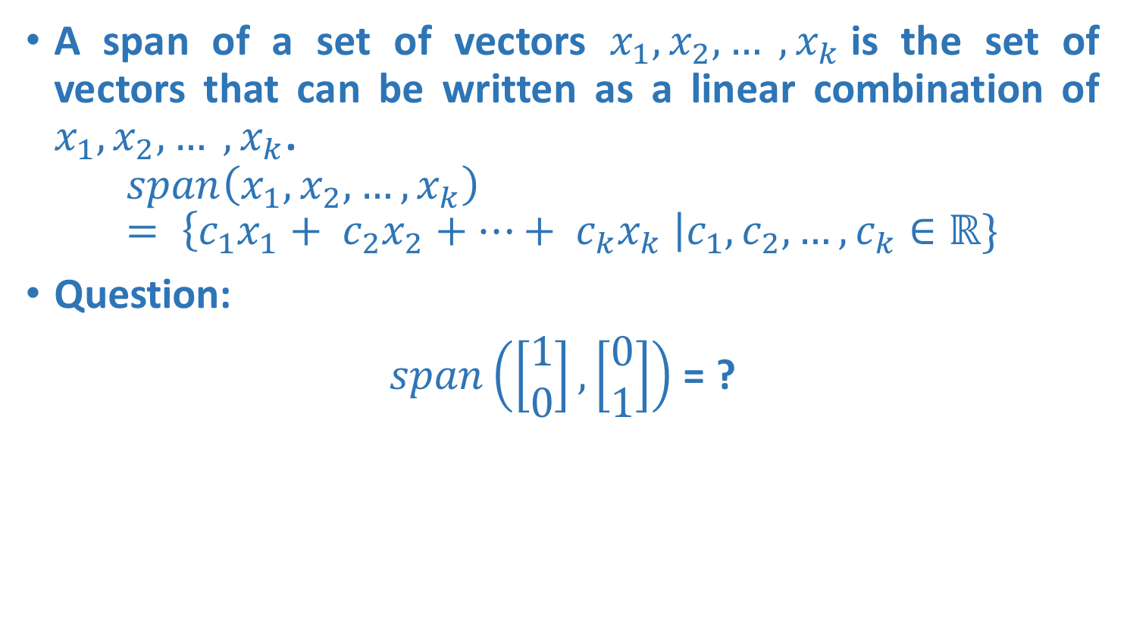
Span
A span of a set of vectors $x_{1}, x_{2}, … , x_{k}$is the set of vectors that can be written as a linear combination of $x_{1}, x_{2}, … , x_{k}$.
$$span\left(x_{1}, x_{2},…, x_{k}\right)= \left\{c_{1}x_{1}+ c_{2}x_{2}+…+ c_{k}x_{k} \right|c_{1},c_{2},…,c_{k}∈ℝ\}$$
Question:
$span\left(\left[\begin{matrix}1 \\ 0\end{matrix}\right], \left[\begin{matrix}0 \\ 1\end{matrix}\right]\right)$ = ?

Slide 20
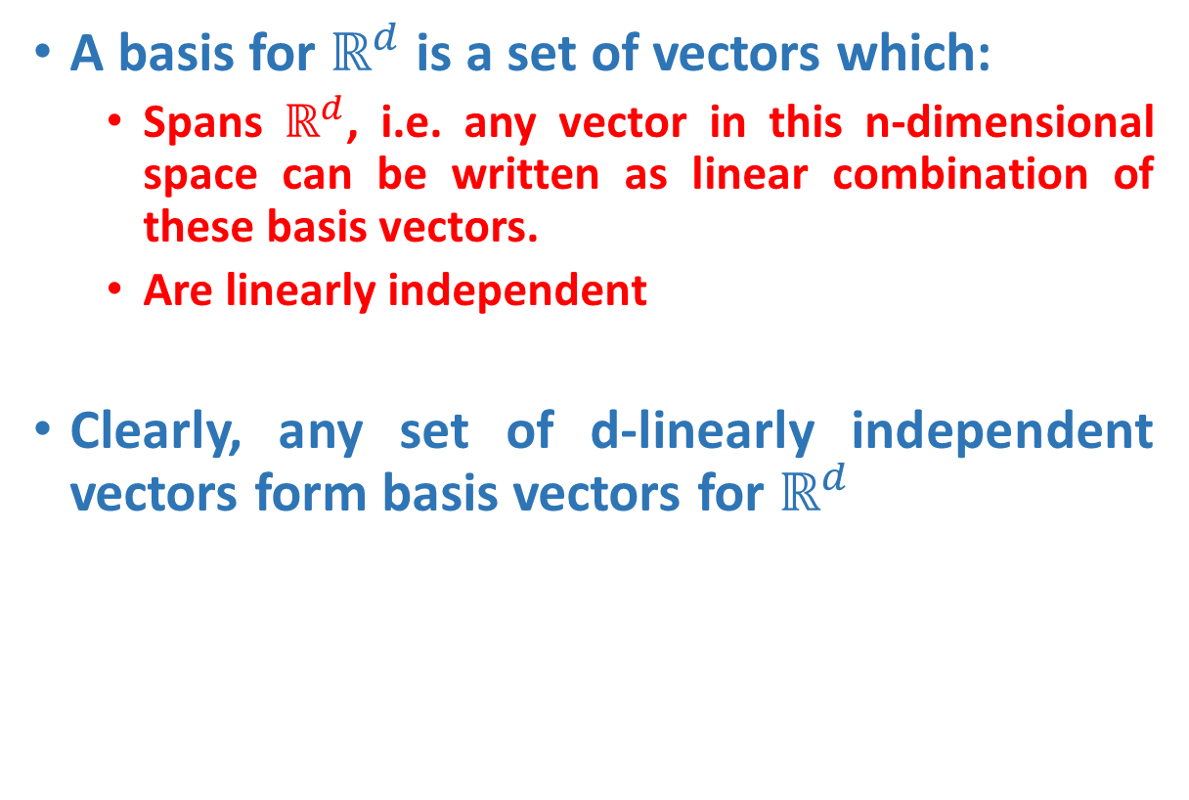
Basis
A basis for $ℝ^{d}$ is a set of vectors which:
Spans $ℝ^{d}$, i.e. any vector in this n-dimensional space can be written as linear combination of these basis vectors.
Are linearly independent
Clearly, any set of d-linearly independent vectors form basis vectors for $ℝ^{d}$

Slide 21
Orthogonal/Orthonormal Basis
Two vectors v₁ and v₂ are orthogonal if
v₁ and v₂ are orthonormal if they are orthogonal and

Slide 22
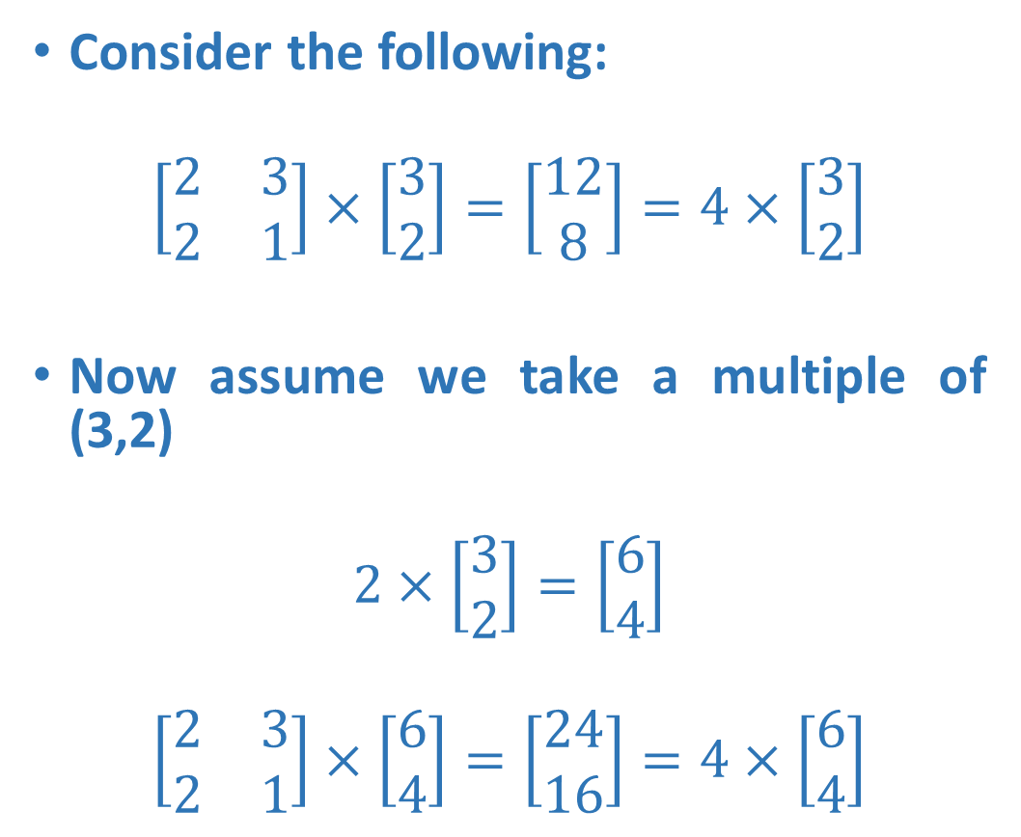
Transformation Matrices
Consider the following:
$$\left[\begin{matrix}2 & 3 \\ 2 & 1\end{matrix}\right]×\left[\begin{matrix}3 \\ 2\end{matrix}\right]=\left[\begin{matrix}12 \\ 8\end{matrix}\right]=4×\left[\begin{matrix}3 \\ 2\end{matrix}\right]$$
Now assume we take a multiple of (3,2)
$$2×\left[\begin{matrix}3 \\ 2\end{matrix}\right]=\left[\begin{matrix}6 \\ 4\end{matrix}\right]$$
$$\left[\begin{matrix}2 & 3 \\ 2 & 1\end{matrix}\right]×\left[\begin{matrix}6 \\ 4\end{matrix}\right]=\left[\begin{matrix}24 \\ 16\end{matrix}\right]=4×\left[\begin{matrix}6 \\ 4\end{matrix}\right]$$

Slide 23
Transformation Matrices
Scale vector (3,2) by a value 2 to get (6,4)
Multiply by the square transformation matrix
And we see that the result is still scaled by 4.
WHY?
A vector consists of both length and direction. Scaling a vector only changes its length and not its direction. This is an important observation in the transformation of matrices leading to formation of eigenvectors and eigenvalues. Irrespective of how much we scale (3,2) by, the solution (under the given transformation matrix) is always a multiple of 4.

Slide 24
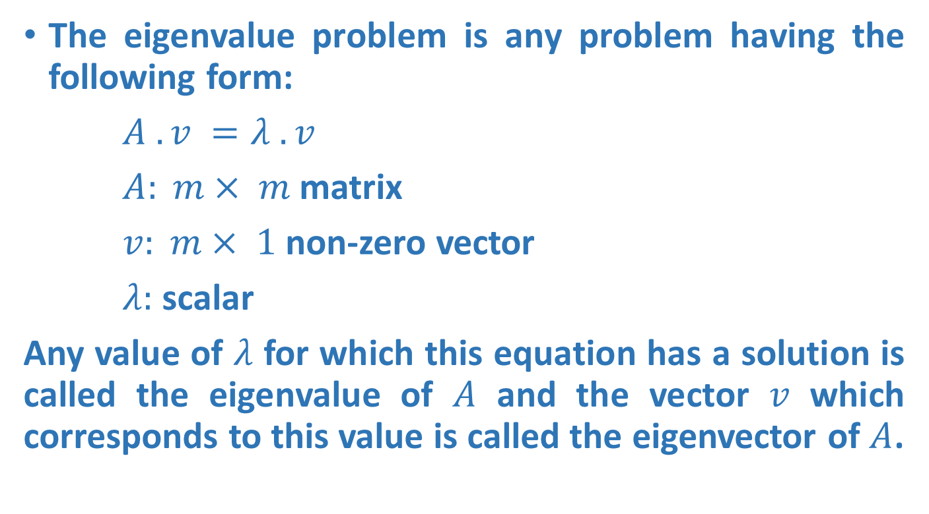
Eigenvalue Problem
The eigenvalue problem is any problem having the following form:
$A . v =λ . v$
$A: m× m$matrix
$v: m× 1$non-zero vector
$λ:$ scalar
Any value of $λ$ for which this equation has a solution is called the eigenvalue of $A$ and the vector $v$ which corresponds to this value is called the eigenvector of $A$.

Slide 25

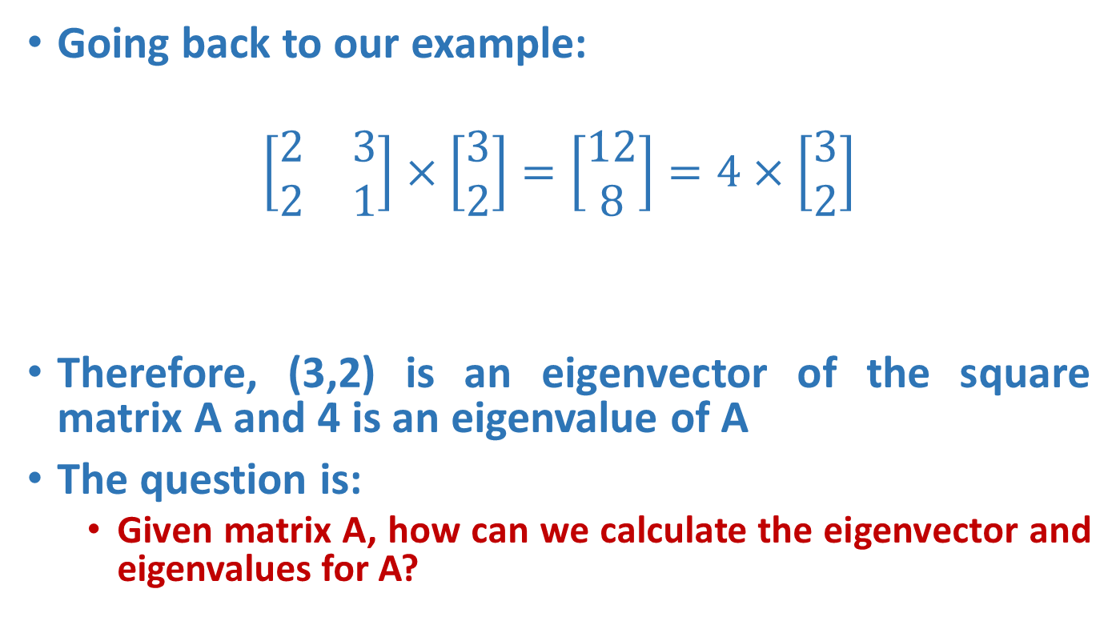


Eigenvalue Problem
Going back to our example:
$$\left[\begin{matrix}2 & 3 \\ 2 & 1\end{matrix}\right]×\left[\begin{matrix}3 \\ 2\end{matrix}\right]=\left[\begin{matrix}12 \\ 8\end{matrix}\right]=4×\left[\begin{matrix}3 \\ 2\end{matrix}\right]$$
Therefore, (3,2) is an eigenvector of the square matrix A and 4 is an eigenvalue of A
The question is:
Given matrix A, how can we calculate the eigenvector and eigenvalues for A?
A
$$×$$
v
$λ$
$$×$$
A

Slide 26
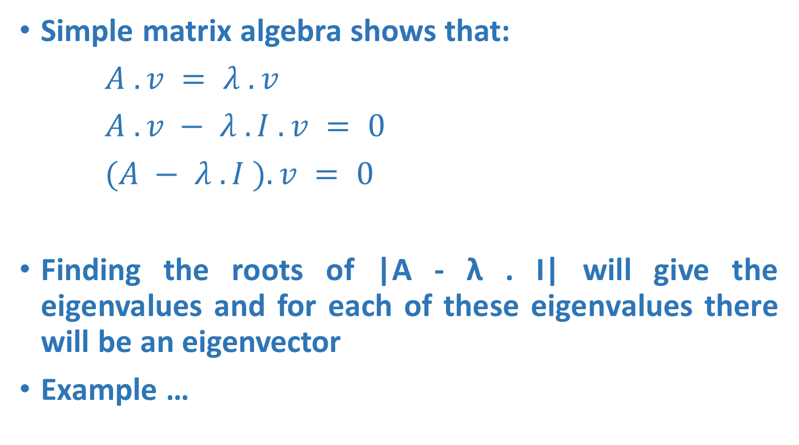
Calculating Eigenvectors & Eigenvalues
Simple matrix algebra shows that:
$A . v = λ . v$
$A . v − λ . I . v = 0$
$(A − λ . I ). v = 0$
Finding the roots of |A - λ . I| will give the eigenvalues and for each of these eigenvalues there will be an eigenvector
Example …

Slide 27
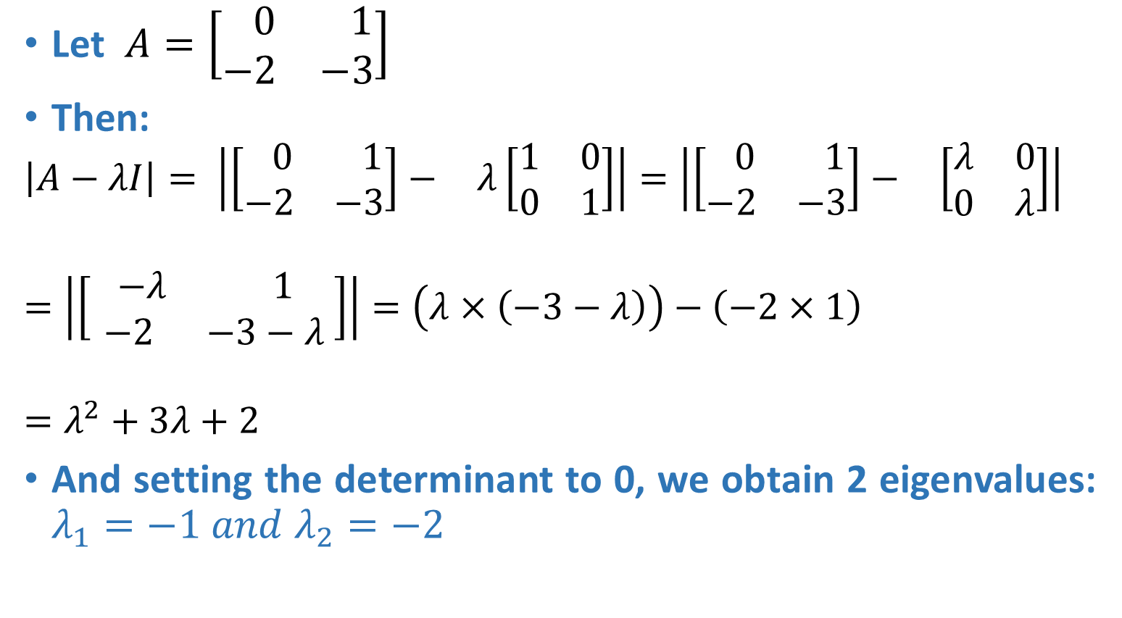
Calculating Eigenvectors & Eigenvalues
Let $A=\left[\begin{matrix} 0 & 1 \\ −2 & −3\end{matrix}\right]$
Then:
$$\left|A−λI\right|= \left|\begin{matrix}\left[\begin{matrix} 0 & 1 \\ −2 & −3\end{matrix}\right]− & λ\left[\begin{matrix}1 & 0 \\ 0 & 1\end{matrix}\right]\end{matrix}\right|=\left|\begin{matrix}\left[\begin{matrix} 0 & 1 \\ −2 & −3\end{matrix}\right]− & \left[\begin{matrix}λ & 0 \\ 0 & λ\end{matrix}\right]\end{matrix}\right|$$
$$=\left|\begin{matrix}\left[\begin{matrix} −λ & 1 \\ −2 & −3−λ \end{matrix}\right]\end{matrix}\right|=\left(λ×\left(−3−λ\right)\right)−\left(−2×1\right)$$
$$=λ^{2}+3λ+2$$
And setting the determinant to 0, we obtain 2 eigenvalues: $λ_{1}=−1 and λ_{2}=−2$

Slide 28

Calculating Eigenvectors & Eigenvalues
For $λ_{1}$the eigenvector is:
$\left(A−λ.I\right).v=0$
$\left[\begin{matrix}1 & 1 \\ −2 & −2\end{matrix}\right] \left[\begin{matrix}v_{11} \\ v_{12}\end{matrix}\right]=0$
$v_{11}+v_{12}=0$ and ${−2v}_{11}−2v_{12}=0$
$v_{11}={−v}_{12}$

Slide 29
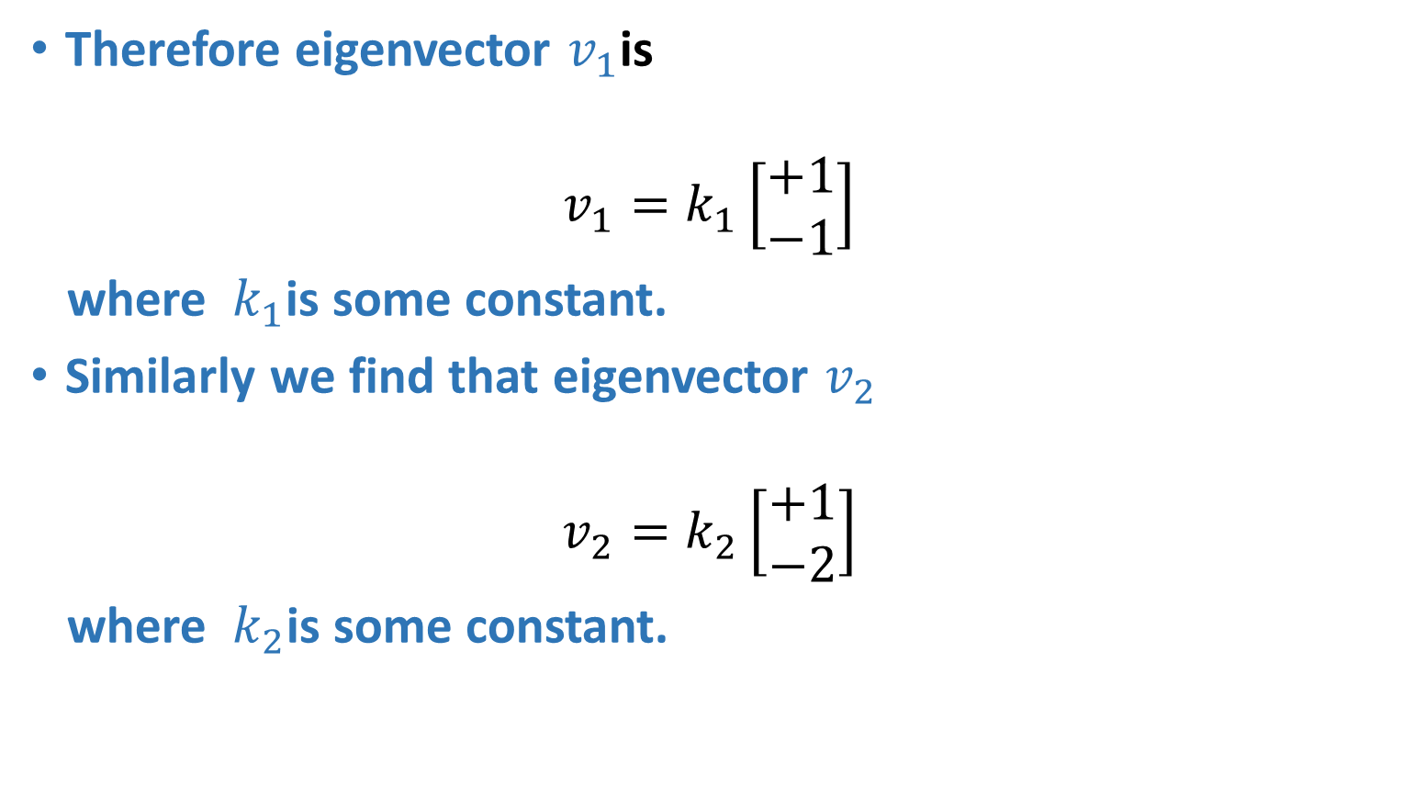
Calculating Eigenvectors & Eigenvalues
Therefore eigenvector $v_{1}$is
$$v_{1}=k_{1}\left[\begin{matrix}+1 \\ −1\end{matrix}\right]$$
where $k_{1}$is some constant.
Similarly we find that eigenvector $v_{2}$
$$v_{2}=k_{2}\left[\begin{matrix}+1 \\ −2\end{matrix}\right]$$
where $k_{2}$is some constant.

Slide 30
Properties of Eigenvectors and Eigenvalues
Eigenvectors can only be found for square matrices and not every square matrix has eigenvectors.
Given an m x m matrix (with eigenvectors), we can find n eigenvectors.
All eigenvectors of a symmetric* matrix are perpendicular to each other, no matter how many dimensions we have.
In practice eigenvectors are normalized to have unit length.

Slide 31
Dimensionality Reduction

Slide 32
Data Dimensionality
From a theoretical point of view, increasing the number of features should lead to better performance.
In practice, the inclusion of more features leads to worse performance (i.e., curse of dimensionality).
The number of training examples required increases exponentially with dimensionality.

Slide 33
The curse of dimensionality
Real data usually have thousands, or millions of dimensions
E.g., web documents, where the dimensionality is the vocabulary of words
Facebook graph, where the dimensionality is the number of users
Huge number of dimensions causes problems
Data becomes very sparse, some algorithms become meaningless
The complexity of several algorithms depends on the dimensionality and they become infeasible.

Slide 34
Dimensionality Reduction
Usually the data can be described with fewer dimensions, without losing much of the meaning of the data.
The data reside in a space of lower dimensionality
Essentially, we assume that some of the data is noise, and we can approximate the useful part with a lower dimensionality space.
Dimensionality reduction does not just reduce the amount of data, it often brings out the useful part of the data

Slide 35
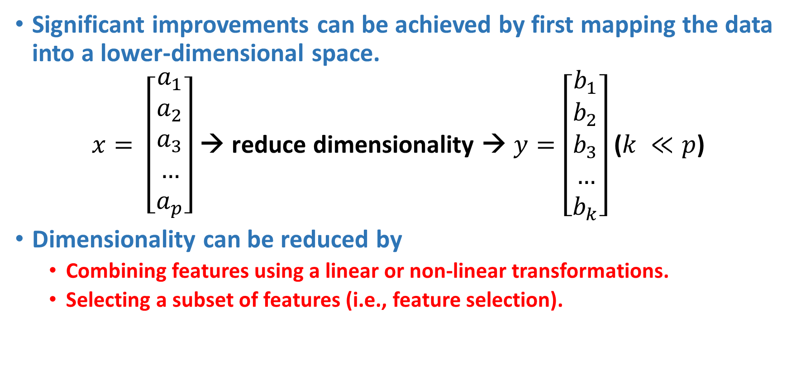
Dimensionality Reduction
Significant improvements can be achieved by first mapping the data into a lower-dimensional space.
$x= \left[\begin{aligned}a_{1} \\ a_{2} \\ a_{3} \\ … \\ a_{p}\end{aligned}\right]$ → reduce dimensionality → $y=\left[\begin{aligned}b_{1} \\ b_{2} \\ b_{3} \\ … \\ b_{k}\end{aligned}\right]$ ($k ≪p$)
Dimensionality can be reduced by
Combining features using a linear or non-linear transformations.
Selecting a subset of features (i.e., feature selection).

Slide 36
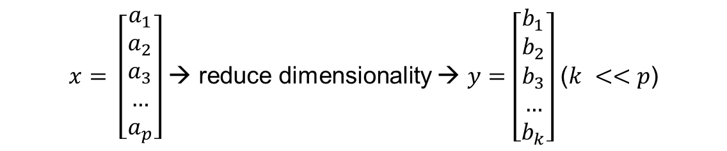
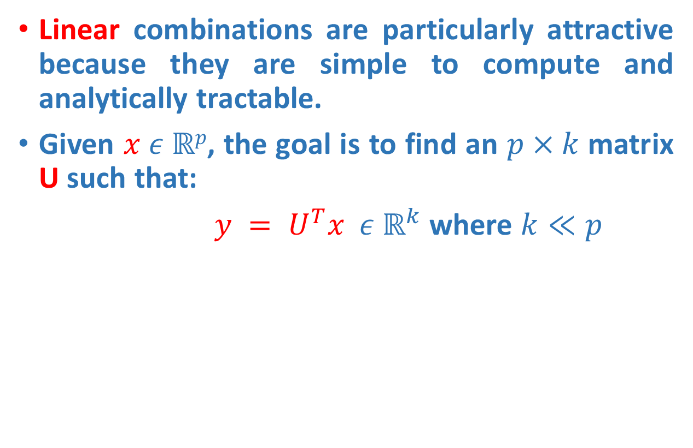
Dimensionality Reduction
Linear combinations are particularly attractive because they are simple to compute and analytically tractable.
Given $x ε ℝp$, the goal is to find an $p×k$matrix U such that:
$y = U^{T}x ε ℝ^{k}$ where $k≪p$
$x= \left[\begin{aligned}a_{1} \\ a_{2} \\ a_{3} \\ … \\ a_{p}\end{aligned}\right]$ → reduce dimensionality → $y=\left[\begin{aligned}b_{1} \\ b_{2} \\ b_{3} \\ … \\ b_{k}\end{aligned}\right]$ ($k <<p$)

Slide 37

Example of a problem
We collected p parameters about 100 students:
Height
Weight
Hair color
Average grade
…
We want to find the most important parameters that best describe a student.

Slide 38
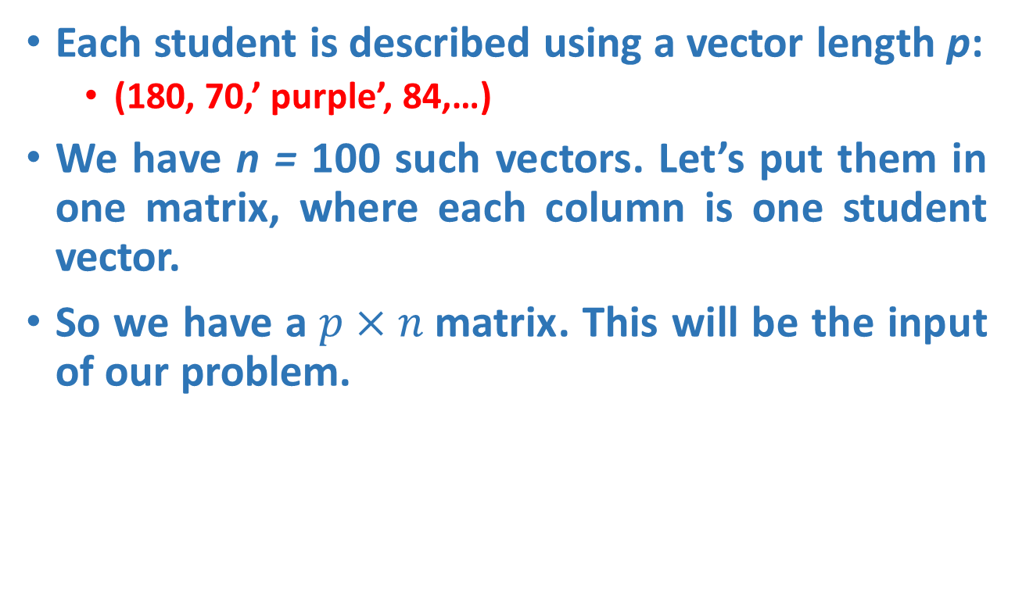
Example of a problem
Each student is described using a vector length p:
(180, 70,’ purple’, 84,…)
We have n = 100 such vectors. Let’s put them in one matrix, where each column is one student vector.
So we have a$p×n$matrix. This will be the input of our problem.

Slide 39
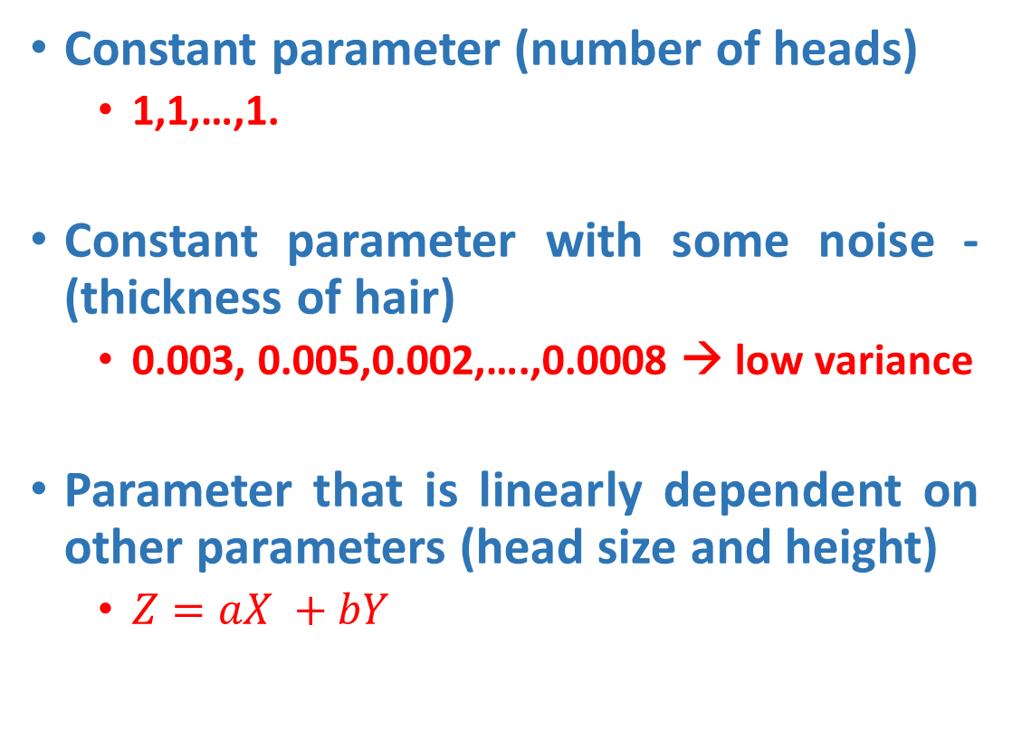
Which parameters can we ignore?
Constant parameter (number of heads)
1,1,…,1.
Constant parameter with some noise -(thickness of hair)
0.003, 0.005,0.002,….,0.0008 → low variance
Parameter that is linearly dependent on other parameters (head size and height)
$Z=aX +bY$

Slide 40
Which parameters do we want to keep?
Parameter that doesn’t depend on others (e.g. eye color), i.e. uncorrelated è low covariance.
• Parameter that changes a lot (grades)
The opposite of noise
High variance
Questions:
How we describe ‘most important’ features using math?
Variance
How do we represent our data so that the most important features can be extracted easily?
Change of basis

Slide 41
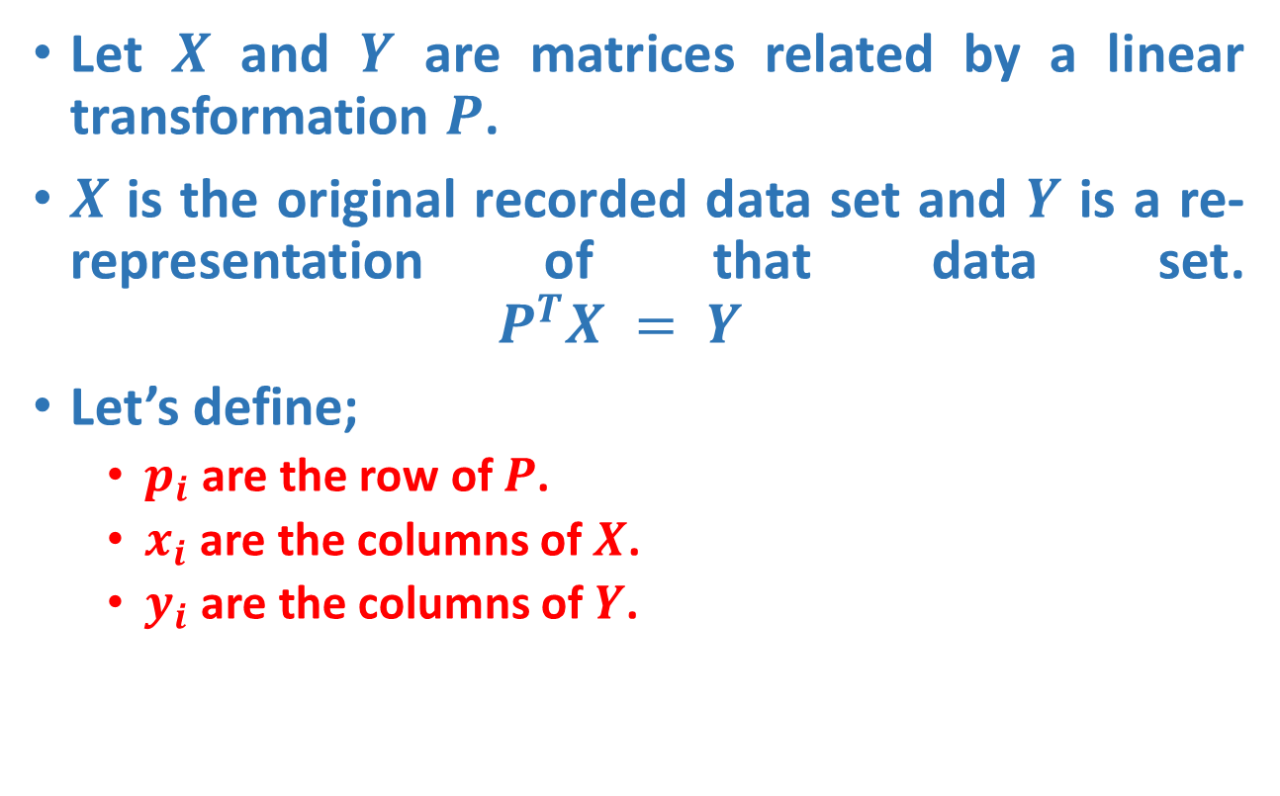
Change of Basis !!!
Let $X$ and $Y$ are matrices related by a linear transformation $P$.
$X$ is the original recorded data set and $Y$ is a re-representation of that data set. $P^{T}X = Y$
Let’s define;
$p_{i}$ are the row of $P$.
$x_{i}$ are the columns of $X$.
$y_{i}$ are the columns of $Y$.

Slide 42
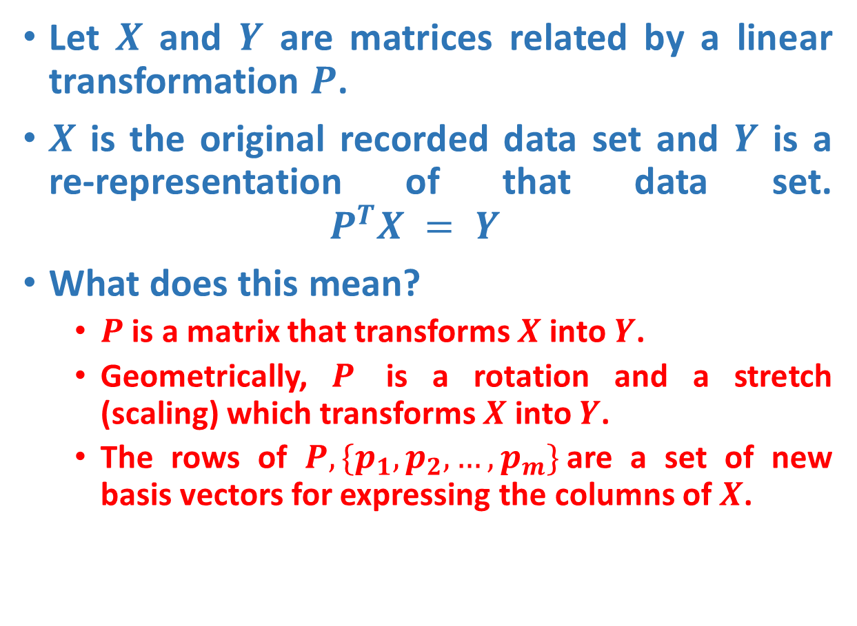
Change of Basis !!!
Let $X$ and $Y$ are matrices related by a linear transformation $P$.
$X$ is the original recorded data set and $Y$ is a re-representation of that data set. $P^{T}X = Y$
What does this mean?
$P$ is a matrix that transforms $X$ into $Y$.
Geometrically, $P$ is a rotation and a stretch (scaling) which transforms $X$ into $Y$.
The rows of $P, \{p_{1}, p_{2}, …,p_{m}\}$are a set of new basis vectors for expressing the columns of $X$.

Slide 43
Change of Basis !!!
Changing the basis doesn’t change the data – only its representation.
Changing the basis is actually projecting the data vectors on the basis vectors.
Geometrically, P is a rotation and a stretch of X.
If P basis is orthonormal (length = 1) then the transformation P is only a rotation.

Slide 44
What does “best express” the data mean ?!!!
As we’ve said before, we want to filter out noise and extract the relevant information from the given data set.
Hence, the representation we are looking for will decrease both noise and redundancy in the data set at hand.

Slide 45
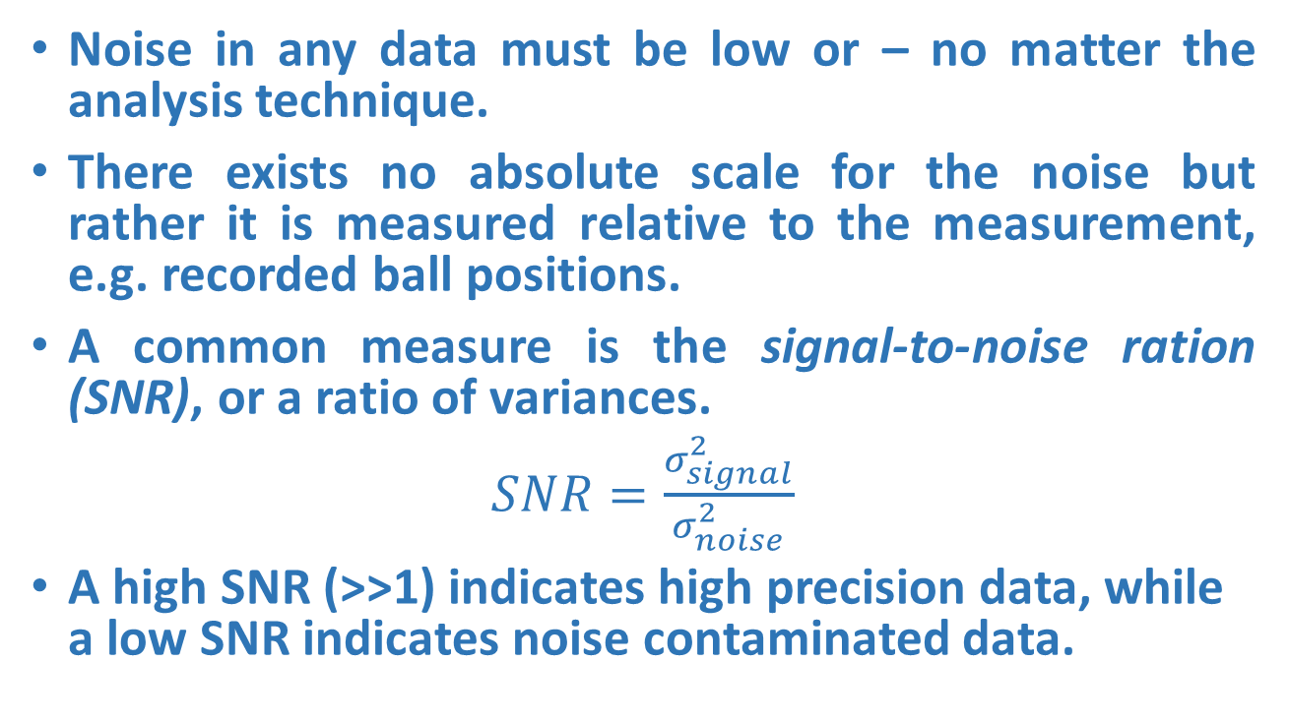
Noise
Noise in any data must be low or – no matter the analysis technique.
There exists no absolute scale for the noise but rather it is measured relative to the measurement, e.g. recorded ball positions.
A common measure is the signal-to-noise ration (SNR), or a ratio of variances.
$SNR=\frac{σ_{signal}^{2}}{σ_{noise}^{2}}$
A high SNR (>>1) indicates high precision data, while a low SNR indicates noise contaminated data.

Slide 46
Principal Component Analysis Maximum Variance Projection Method

Slide 47
Principal component analysis
Principal component analysis (PCA) is a way to reduce data dimensionality by finding a new set of variables, smaller than the original set of variables, that nonetheless retains most of the sample's information.
The new variables, called principal components (PCs), are uncorrelated, and are ordered by the fraction of the total information each retains.
PCA projects the data in the least square sense– it captures big (principal) variability in the data and ignores small variability.

Slide 48
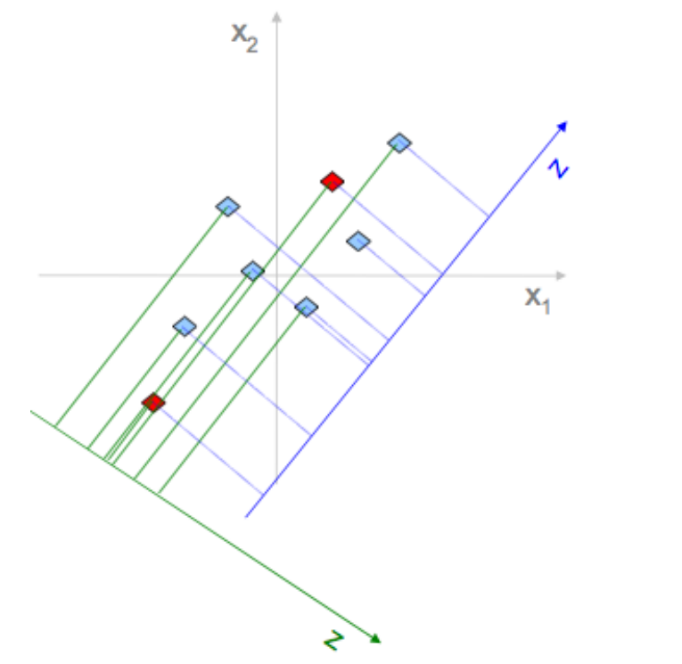
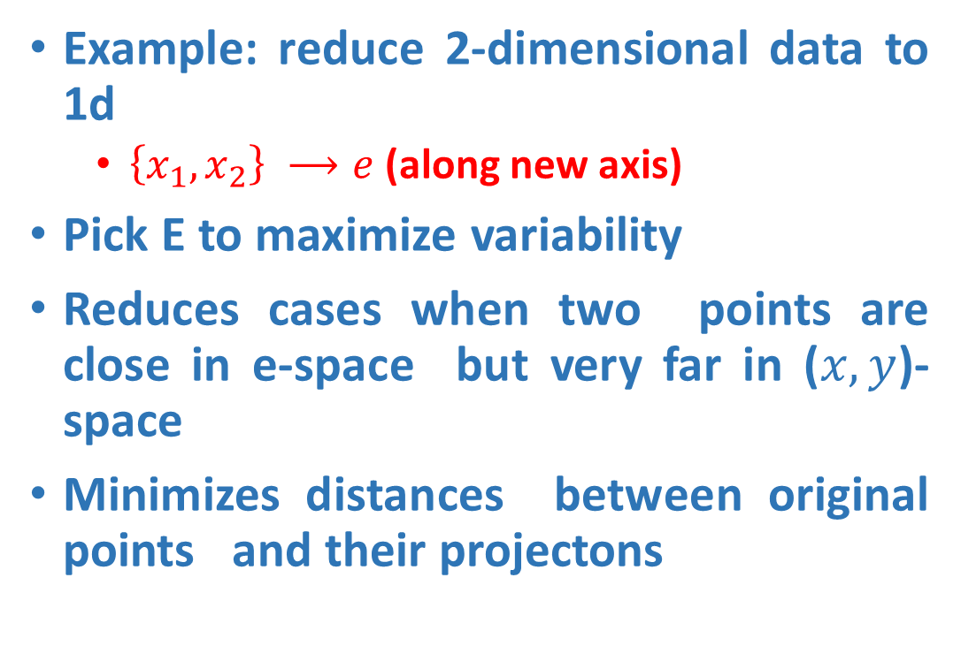
Why Variance
Example: reduce 2-dimensional data to 1d
$\left\{x_{1},x_{2}\right\} ⟶e$(along new axis)
Pick E to maximize variability
Reduces cases when two points are close in e-space but very far in ($x,y$)-space
Minimizes distances between original points and their projectons

Slide 49
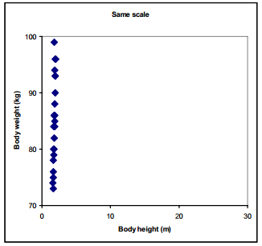
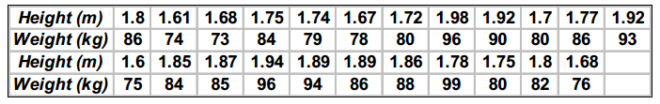
Pre-Processing of Data
Scaling
Variables often have substantially different numerical range
A variable with large range has a large variance, whereas a variable with a small range has a small variance
Since PCA is a maximum variance projection method, if follows that a variable with a large variance is more likely to be expressed in modeling than a low-variance variable
Example

Slide 50
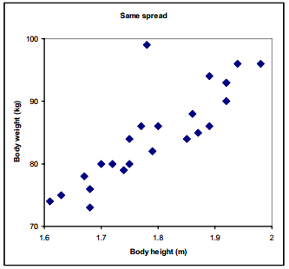
Pre-Processing of Data - Scaling
We can see that the data points only spread in the vertical direction because body weight has much larger numerical range than body height.
Lets zoom the Figure
There is strong correlation between body height and body weight, except for one outlier in the data.

Slide 51
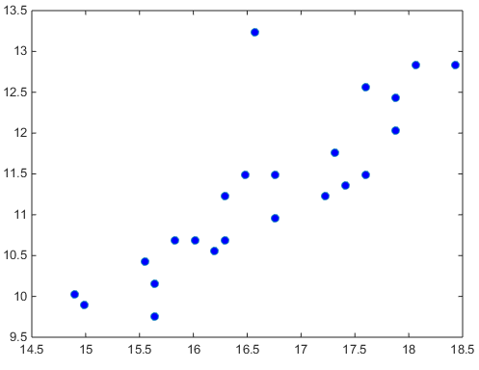
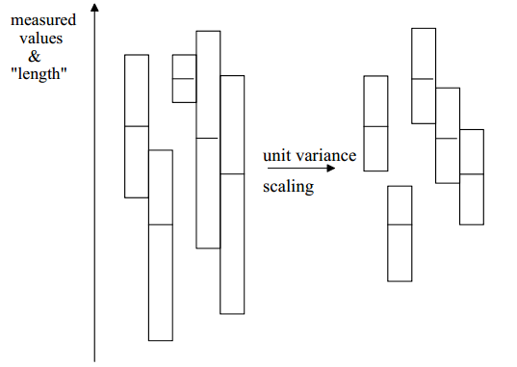
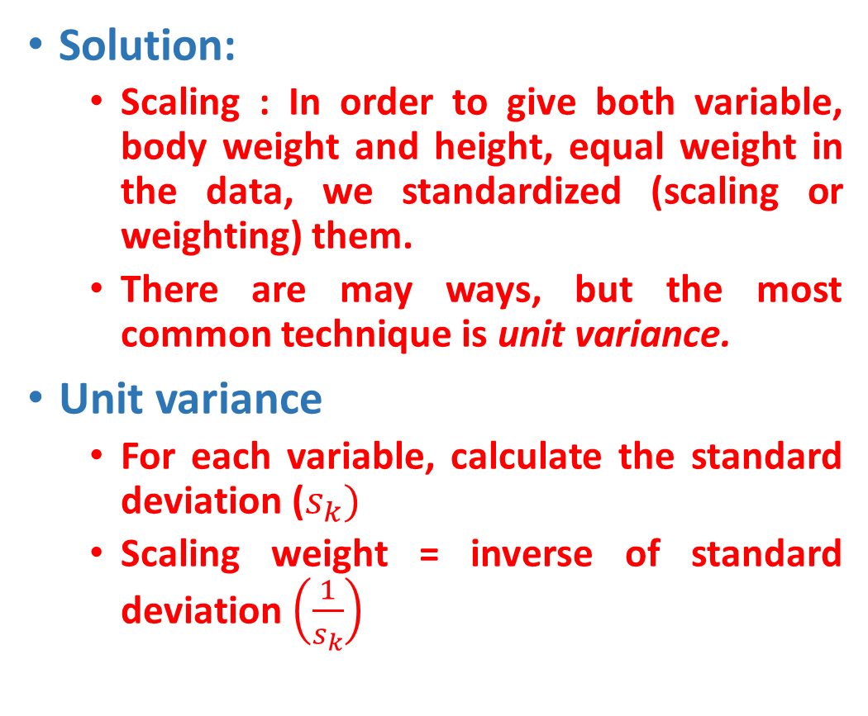
Pre-Processing of Data - Scaling
Solution:
Scaling : In order to give both variable, body weight and height, equal weight in the data, we standardized (scaling or weighting) them.
There are may ways, but the most common technique is unit variance.
Unit variance
For each variable, calculate the standard deviation ($s_{k})$
Scaling weight = inverse of standard deviation $\left(\frac{1}{s_{k}}\right)$

Slide 52
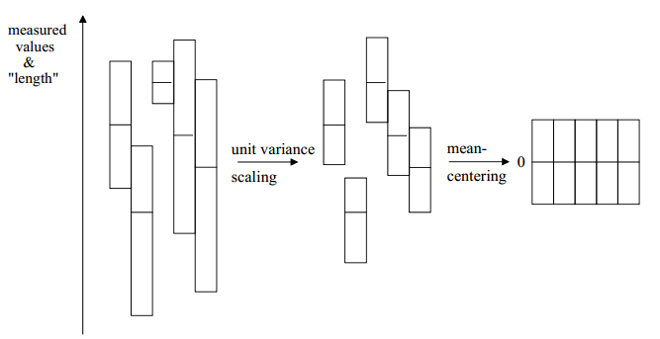
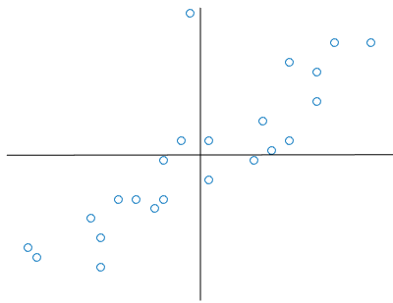
Pre-Processing of Data
Mean-Centering
This improves the interpretability of the model.
Calculate average value of each variable and then subtract from the data.

Slide 53
Geometric picture of principal components (PCs)
Here is a small dataset of opponents we have to fight.
Each data object is represented by its X-Y location in 2D space.
A randomly chosen object is show in orange.
weight
height

Slide 54
Geometric picture of principal components (PCs)
Let us z-normalize the data…
Each data object is still represented by its X-Y location in 2D space

Slide 55
Geometric picture of principal components (PCs)
Let us rotate the axis to find the highest variance
PC1

Slide 56
Geometric picture of principal components (PCs)
The idea is to rotate the axes so that the new axes (also called the principal components, i.e., PCs for short) are such that the variance of the data on each axis goes down from axis to axis.
The first new axis is called the first principal component (PC1) and it is in the direction of the greatest variance in the data.
Each new axis is constructed orthogonal to the previous ones and along the direction with the largest remaining variance.
PC1
PC2

Slide 57
Geometric picture of principal components (PCs)
Each data object is still represented by its location in 2D space.
However, instead of X-Y space, we are now in PC1-PC2 space.
Note that for our orange example, the value in PCI is large, and in PC2 is small.
This is true on average for all data points. Moreover, it is true by definition, this is what PCA does!
PC1
PC2
Scree plot

Slide 58
Geometric picture of principal components (PCs)
We can project the data onto just the PC1 axis
PC1
PC2

Slide 59
Geometric picture of principal components (PCs)
PC1
We can project the data onto just the PC1 axis. This means that PC2 no longer exist
This is a general trick.
Starting with any N dimensions, we can do PCA, and keep just n dimensions, n <=N, as use the n dimensions for clustering, classifying, indexing, plotting etc.

Slide 60
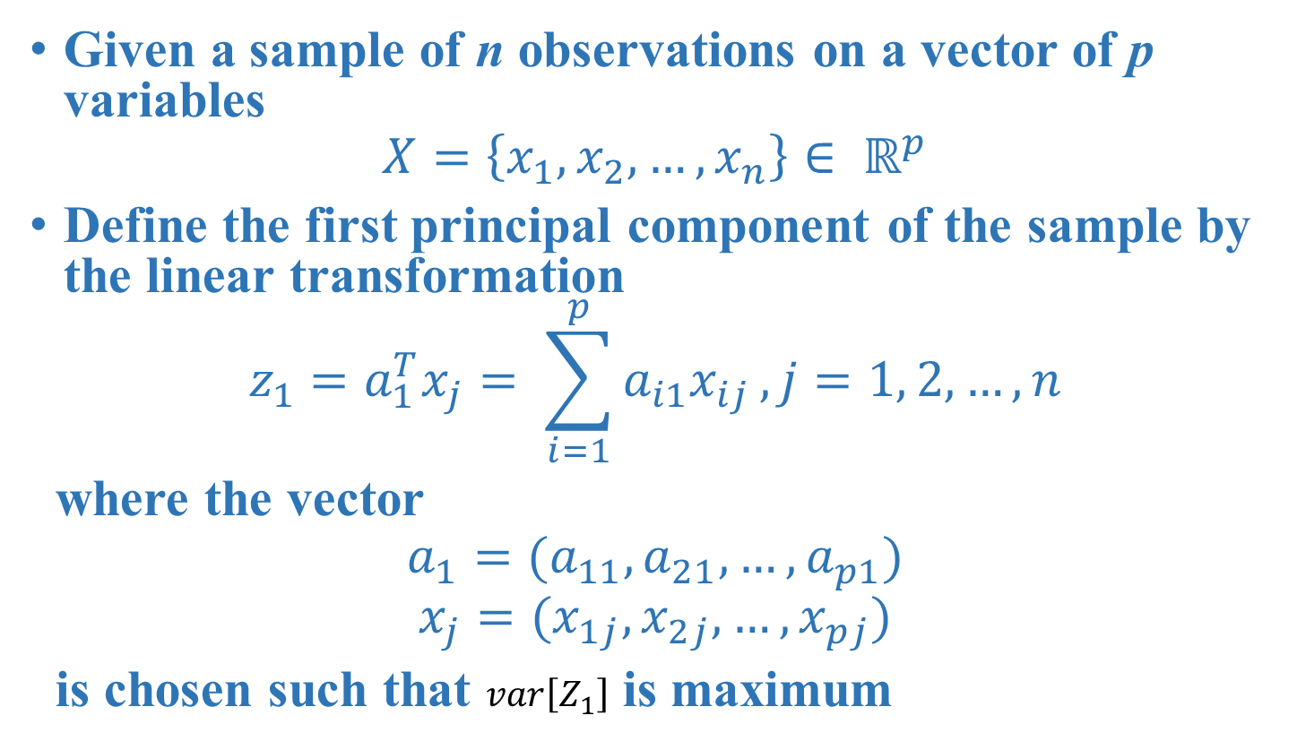
Algebraic definition of PCs
Given a sample of n observations on a vector of p variables
$$X=\left\{x_{1},x_{2},…, x_{n}\right\}∈ ℝ^{p}$$
Define the first principal component of the sample by the linear transformation
$$z_{1}=a_{1}^{T}x_{j}= \sum_{i=1}^{p}{a_{i1}x_{ij}}, j=1, 2, …, n$$
where the vector
$$a_{1}=(a_{11}, a_{21},…, a_{p1})$$
$$x_{j}=(x_{1j},x_{2j},…,x_{pj})$$
is chosen such that $var\left[Z_{1}\right]$ is maximum

Slide 61
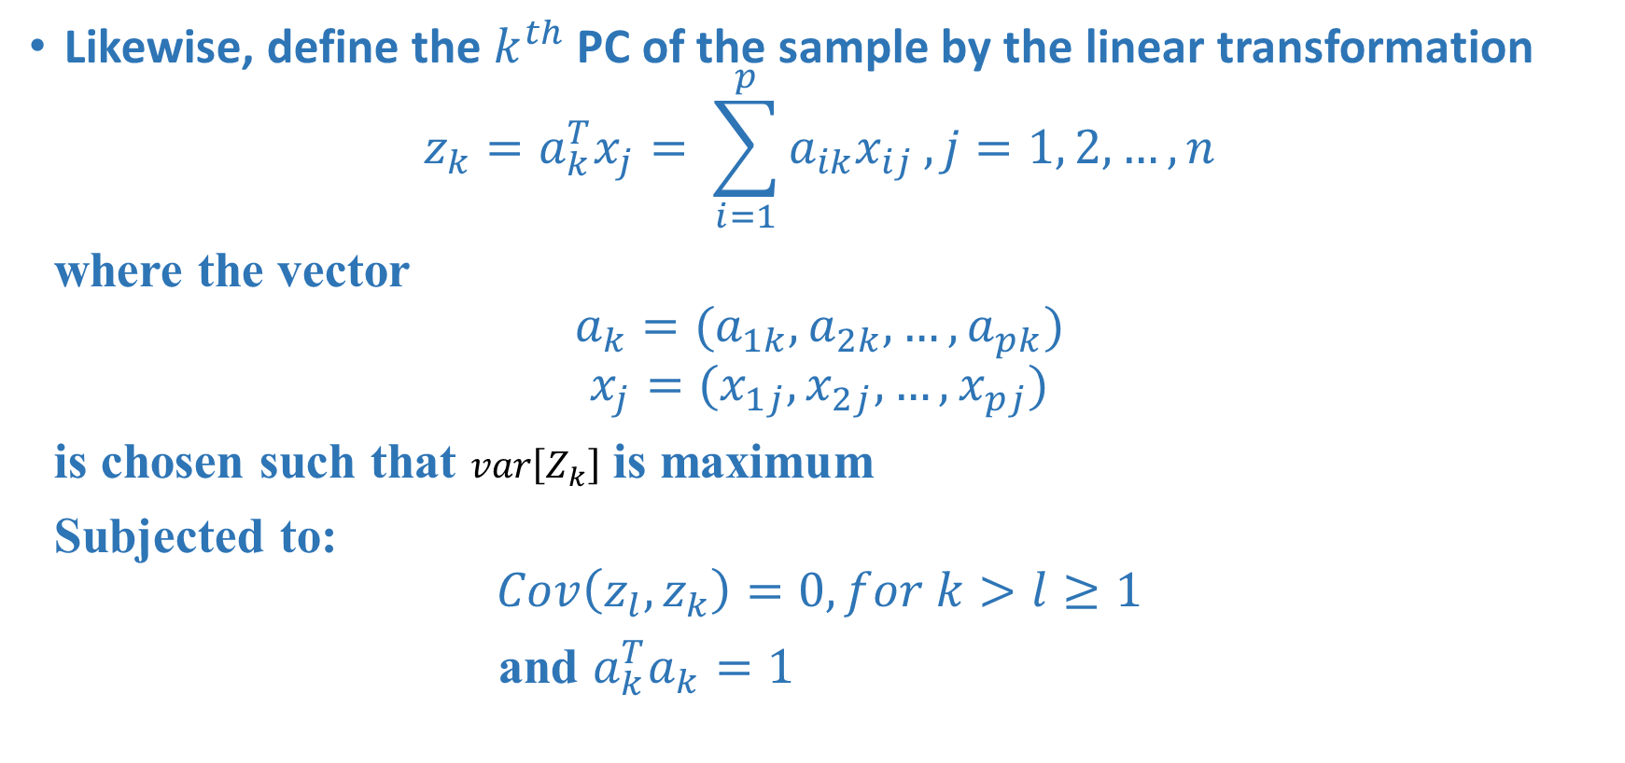
Algebraic definition of PCs
Likewise, define the $k^{th}$ PC of the sample by the linear transformation
$$z_{k}=a_{k}^{T}x_{j}= \sum_{i=1}^{p}{a_{ik}x_{ij}}, j=1, 2, …, n$$
where the vector
$$a_{k}=(a_{1k}, a_{2k},…, a_{pk})$$
$$x_{j}=(x_{1j},x_{2j},…,x_{pj})$$
is chosen such that $var\left[Z_{k}\right]$ is maximum
Subjected to:
$$Cov\left(z_{l},z_{k}\right)=0, for k>l≥1$$
and $a_{k}^{T}a_{k}=1$

Slide 62
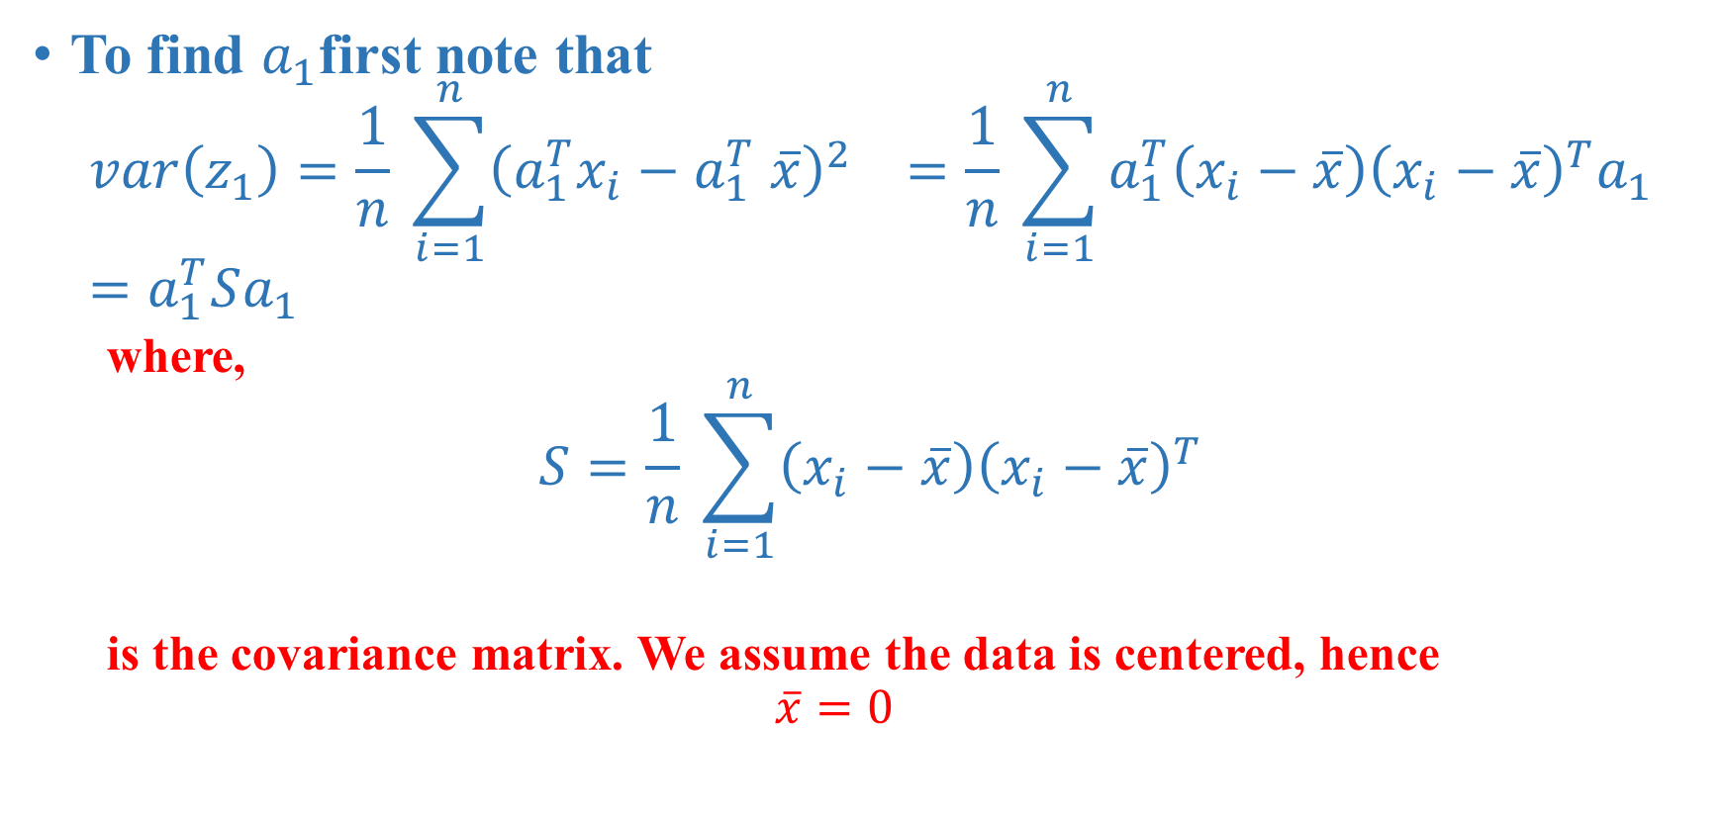
Algebraic derivation of coefficient vectors $a_{k}$
To find $a_{1}$first note that
$$var\left(z_{1}\right)=\frac{1}{n} \sum_{i=1}^{n}{{\left(a_{1}^{T}x_{i}−a_{1}^{T} \overline{x}\right)}^{2}} =\frac{1}{n} \sum_{i=1}^{n}{a_{1}^{T}\left(x_{i}−\overline{x}\right){\left(x_{i}−\overline{x}\right)}^{T}a_{1}}=a_{1}^{T}Sa_{1}$$
where,
$$S=\frac{1}{n} \sum_{i=1}^{n}{\left(x_{i}−\overline{x}\right){\left(x_{i}−\overline{x}\right)}^{T}}$$
is the covariance matrix. We assume the data is centered, hence
$$\overline{x}=0$$

Slide 63
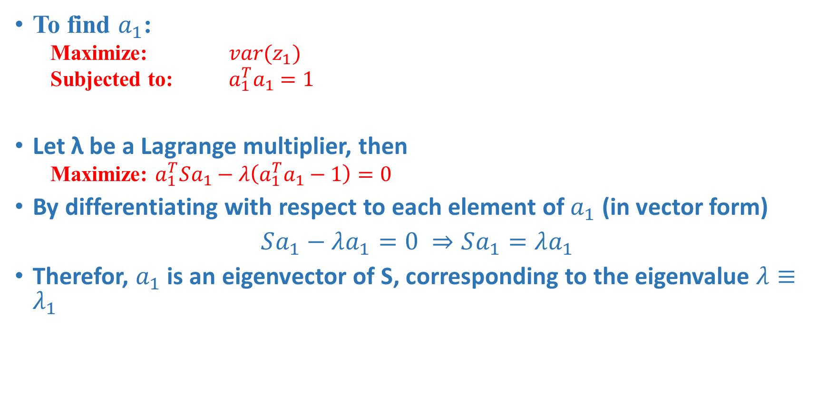
Algebraic derivation of coefficient vectors $a_{k}$
To find $a_{1}$:
Maximize: $var(z_{1})$
Subjected to: $a_{1}^{T}a_{1}=1$
Let λ be a Lagrange multiplier, then
Maximize: $a_{1}^{T}Sa_{1}−λ\left(a_{1}^{T}a_{1}−1\right)=0$
By differentiating with respect to each element of $a_{1}$ (in vector form)
$Sa_{1}−λa_{1}=0 ⇒Sa_{1}=λa_{1}$
Therefor, $a_{1}$ is an eigenvector of S, corresponding to the eigenvalue $λ≡λ_{1}$

Slide 64
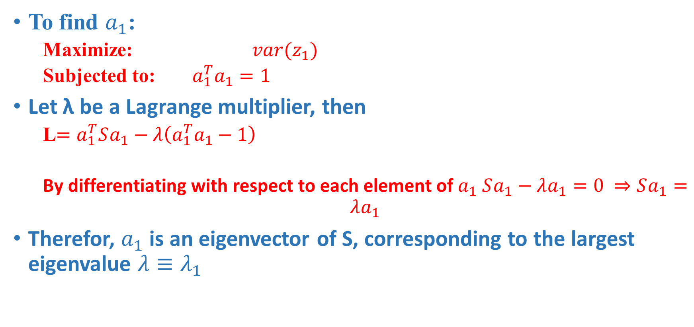
Algebraic derivation of coefficient vectors $a_{k}$
To find $a_{1}$:
Maximize: $var(z_{1})$
Subjected to: $a_{1}^{T}a_{1}=1$
Let λ be a Lagrange multiplier, then
L$=a_{1}^{T}Sa_{1}−λ\left(a_{1}^{T}a_{1}−1\right)$
By differentiating with respect to each element of $a_{1}$ $Sa_{1}−λa_{1}=0 ⇒Sa_{1}=λa_{1}$
Therefor, $a_{1}$ is an eigenvector of S, corresponding to the largest eigenvalue $λ≡λ_{1}$

Slide 65
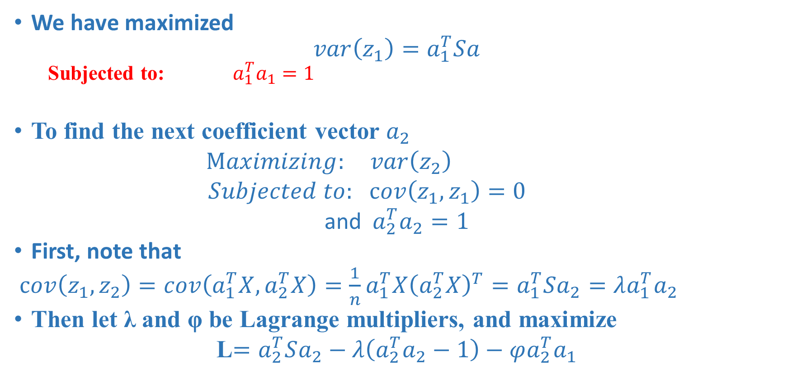
Algebraic derivation of coefficient vectors $a_{k}$
We have maximized
$$var\left(z_{1}\right)=a_{1}^{T}Sa$$
Subjected to: $a_{1}^{T}a_{1}=1$
To find the next coefficient vector $a_{2}$
$Maximizing: var\left(z_{2}\right)$
$Subjected to:$ $cov\left(z_{1},z_{1}\right)=0$
and${ a}_{2}^{T}a_{2}=1$
First, note that
$cov\left(z_{1},z_{2}\right)=cov\left(a_{1}^{T}X, a_{2}^{T}X\right)=\frac{1}{n}a_{1}^{T}X{\left(a_{2}^{T}X\right)}^{T}=a_{1}^{T}Sa_{2}=λa_{1}^{T}a_{2}$
Then let λ and φ be Lagrange multipliers, and maximize
L$=a_{2}^{T}Sa_{2}−λ\left(a_{2}^{T}a_{2}−1\right)−φa_{2}^{T}a_{1}$
uncorrelated

Slide 66
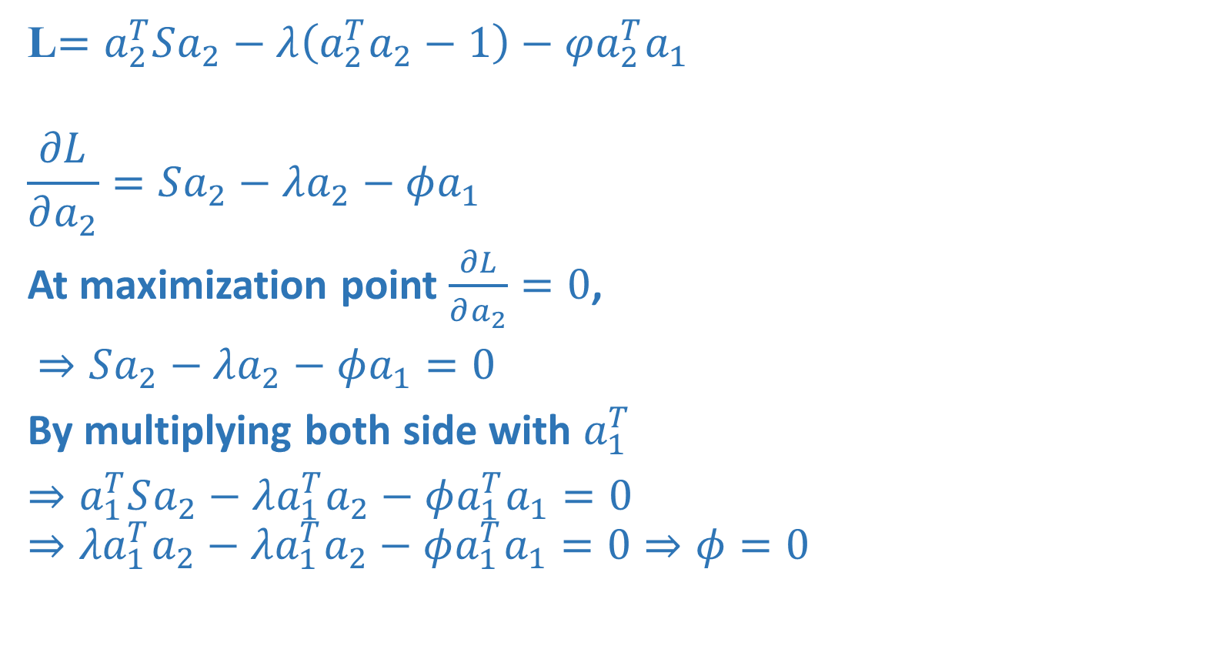
Algebraic derivation of coefficient vectors $a_{k}$
L$=a_{2}^{T}Sa_{2}−λ\left(a_{2}^{T}a_{2}−1\right)−φa_{2}^{T}a_{1}$
$$\frac{∂L}{∂a_{2}}=Sa_{2}−λa_{2}−φa_{1}$$
At maximization point $\frac{∂L}{∂a_{2}}=0$,
$⇒Sa_{2}−λa_{2}−φa_{1}=0$
By multiplying both side with $a_{1}^{T}$
$⇒a_{1}^{T}Sa_{2}−λ{a_{1}^{T}a}_{2}−φa_{1}^{T}a_{1}=0$
$$⇒{λa}_{1}^{T}a_{2}−λ{a_{1}^{T}a}_{2}−φa_{1}^{T}a_{1}=0⇒φ=0$$

Slide 67
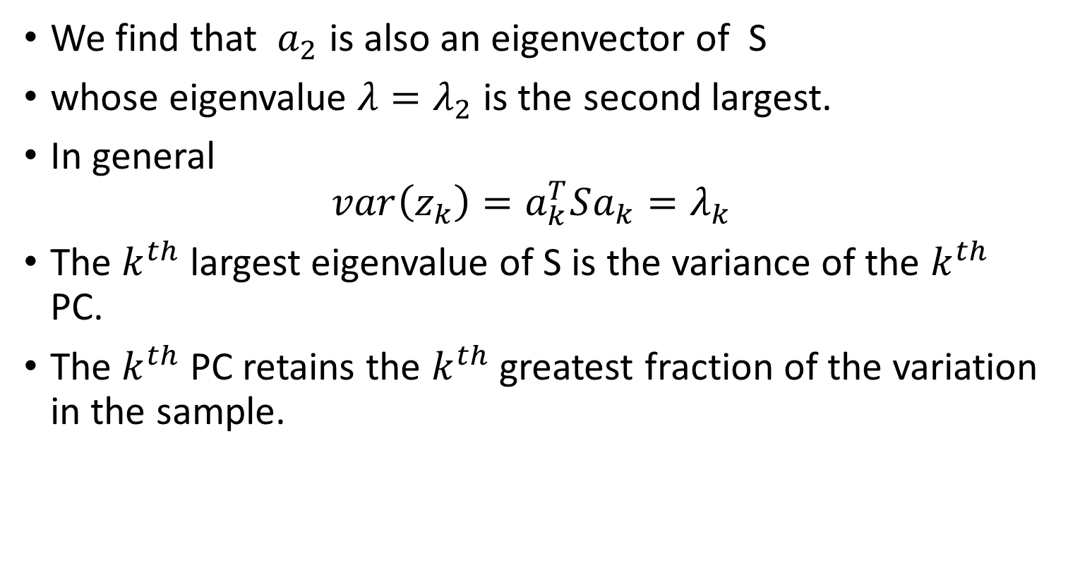
Algebraic derivation of coefficient vectors $a_{k}$
We find that $a_{2}$ is also an eigenvector of S
whose eigenvalue $λ=λ_{2}$ is the second largest.
In general
$$var\left(z_{k}\right)=a_{k}^{T}Sa_{k}=λ_{k}$$
The $k^{th}$ largest eigenvalue of S is the variance of the $k^{th}$ PC.
The $k^{th}$ PC retains the $k^{th}$ greatest fraction of the variation in the sample.

Slide 68
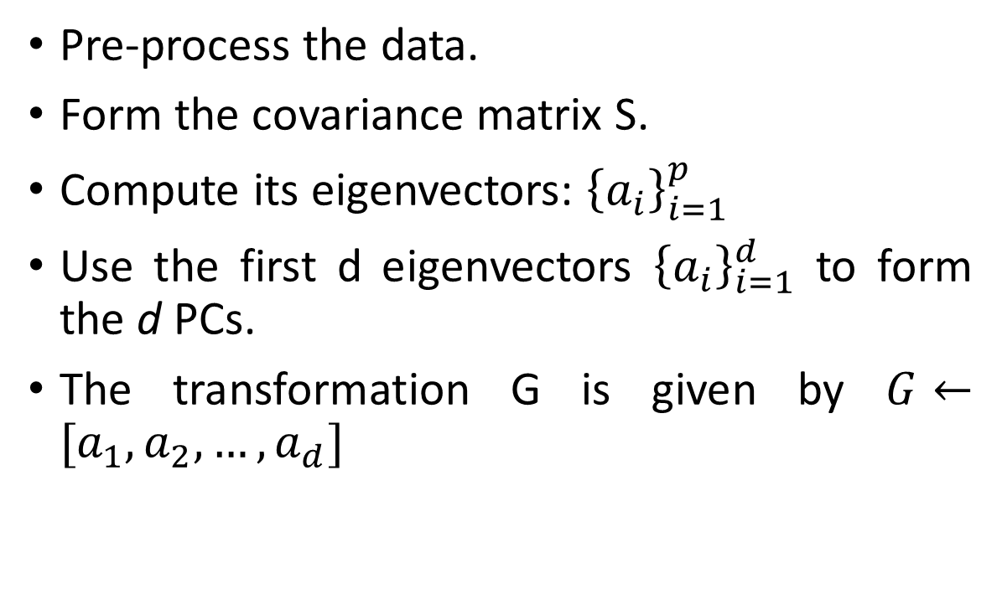
Main steps for computing PCs
Pre-process the data.
Form the covariance matrix S.
Compute its eigenvectors: ${\left\{a_{i}\right\}}_{i=1}^{p}$
Use the first d eigenvectors ${\left\{a_{i}\right\}}_{i=1}^{d}$ to form the d PCs.
The transformation G is given by $G←[a_{1}, a_{2},…, a_{d}]$

Slide 69
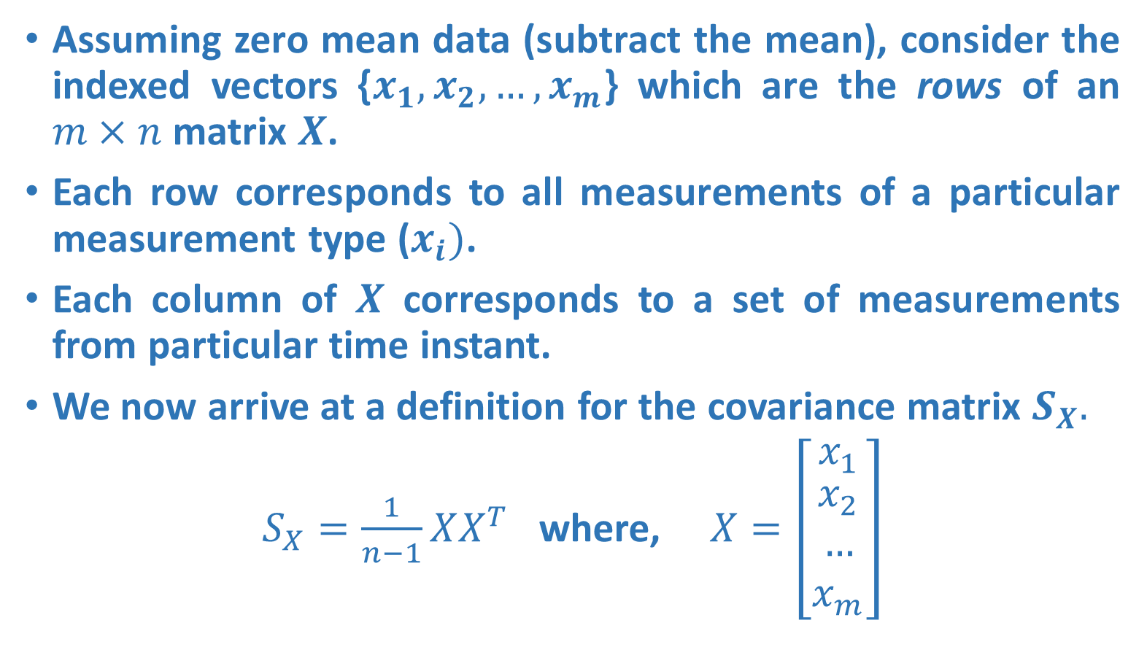
Covariance Matrix
Assuming zero mean data (subtract the mean), consider the indexed vectors {$x_{1}, x_{2}, …,x_{m}$} which are the rows of an $m×n$ matrix $X$.
Each row corresponds to all measurements of a particular measurement type ($x_{i})$.
Each column of $X$ corresponds to a set of measurements from particular time instant.
We now arrive at a definition for the covariance matrix $S_{X}.$
$S_{X}=\frac{1}{n−1}XX^{T}$ where, $X=\left[\begin{matrix}x_{1} \\ \begin{aligned}x_{2} \\ … \\ x_{m}\end{aligned}\end{matrix}\right]$

Slide 70
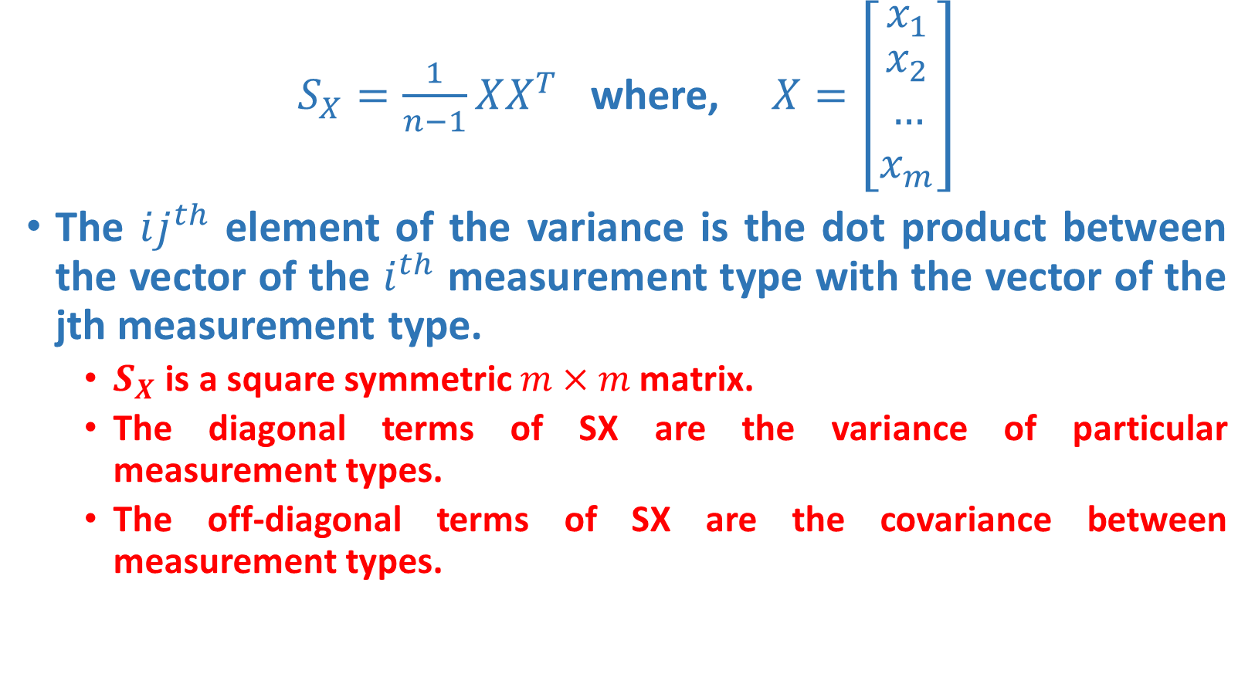
Covariance Matrix
$S_{X}=\frac{1}{n−1}XX^{T}$ where, $X=\left[\begin{matrix}x_{1} \\ \begin{aligned}x_{2} \\ … \\ x_{m}\end{aligned}\end{matrix}\right]$
The $ij^{th}$ element of the variance is the dot product between the vector of the $i^{th}$ measurement type with the vector of the jth measurement type.
$S_{X}$ is a square symmetric $m×m$ matrix.
The diagonal terms of SX are the variance of particular measurement types.
The off-diagonal terms of SX are the covariance between measurement types.

Slide 71
Diagonalize the Covariance Matrix
Our goals are to find the covariance matrix that:
Minimizes redundancy, measured by covariance. (off-diagonal), i.e. we would like each variable to co-vary as little as possible with other variables.
Maximizes the signal, measured by variance. (the diagonal)
Since covariance is non-negative, the optimized covariance matrix will be a diagonal matrix.

Slide 72

PCA Assumptions
PCA assumes that all basis vectors $\{p_{1}, . . . , p_{m}\}$are orthonormal.
Hence, in the language of linear algebra, PCA assumes P is an orthonormal matrix.
Secondly, PCA assumes the directions with the largest variances are the most “important” or in other words, most principal.
Why are these assumptions easiest?

Slide 73

Diagonalize the Covariance Matrix PCA Assumptions
By the variance assumption PCA first selects a normalized direction in m-dimensional space along which the variance in X is maximized – it saves this as $p_{1}$.
Again it finds another direction along which variance is maximized, however, because of the orthonormality condition, it restricts its search to all directions perpendicular to all previous selected directions.
This could continue until m directions are selected. The resulting ordered set of p’s are the principal components.
The variances associated with each direction $p_{i}$ quantify how principal each direction is. We could thus rank-order each basis vector $p_{i}$ according to the corresponding variances.
This pseudo-algorithm works, however we can solve it using linear algebra.

Slide 74
Reconstruction of Original Data
Reconstruction

Slide 75
Optimality property of PCA
Main theoretical result:
The matrix G consisting of the first d eigenvectors of the covariance matrix S solves the following min problem:
PCA projection minimizes the reconstruction error among all linear projections of size d.
reconstruction error

Slide 76
Singular Value Decomposition

Slide 77
Singular Value Decomposition
Singular value decomposition (SVD) can be looked at from three mutually compatible points of view.
SVD is a method for transforming correlated variables into a set of uncorrelated ones that better expose the various relationships among the original data items.
SVD is a method for identifying and ordering the dimensions along which data points exhibit the most variation.
SVD can be seen as a method for data reduction.

Slide 78
Geometric analysis of linear transformations
We want to know what a linear transformation A does
Need some simple and “comprehendible” representation of the matrix of A.
Let’s look what A does to some vectors
Since A(αv) = αA(v), it’s enough to look at vectors v of unit length
A

Slide 79

The geometry of linear transformations
A
A linear (non-singular) transform A always takes hyper-spheres to hyper-ellipses.
A

Slide 80
The geometry of linear transformations
A
Thus, one good way to understand what A does is to find which vectors are mapped to the “main axes” of the ellipsoid.
A

Slide 81
Geometric analysis of linear transformations
If we are lucky: A = V Λ V^{T}, V orthogonal (true if A is symmetric)
The eigenvectors of A are the axes of the ellipse
A

Slide 82
Symmetric matrix: eigen decomposition
In this case A is just a scaling matrix. The eigen decomposition of A tells us which orthogonal axes it scales, and by how much:
1
1
λ₁
A
λ₂

Slide 83
General linear transformations: SVD
In general A will also contain rotations, not just scales:
1
1
σ₂
σ₁
A

Slide 84
General linear transformations: SVD
1
1
σ₂
σ₁
A
orthonormal
orthonormal

Slide 85

Singular value decomposition (SVD)
For any $m× n$ matrix A, the following decomposition always exists:
$A=UΣV^{T}, A∈ℝ^{m×n}$
Where,
$U$ is $m×m$ orthogonal matrix i.e., $UU^{T}=U^{T}U=I_{m}$
$V$ is $n× n$ and orthogonal matrix i.e., $VV^{T}=V^{T}V=I_{n}$
$Σ$ is $m× n$ and diagonal with nonnegative entries on the diagonal – called singular values.
Columns of $U$are the eigenvectors of $AA^{T}$ (called the left singular vectors).
Columns of $V$are the eigenvectors of $A^{T}A$ (called the right singular vectors).
The non - zero singular values are the positive square roots of non - zero eigenvalues of $A^{T}A$ or $AA^{T}$

Slide 86

Singular value decomposition (SVD)
For any m x n real matrix A, the SVD consists of matrices U,S,V which are always real – this is unlike eigenvectors and eigenvalues of A which may be complex even if A is real.
The singular values are always non-negative, even though the eigenvalues may be negative.
While writing the SVD, the following convention is assumed, and the left and right singular vectors are also arranged accordingly:
$$σ_{1}≥σ_{2}≥…≥σ_{m}$$

Slide 87

Singular value decomposition (SVD)
If only $r < min⁡(m, n)$singular values are nonzero, the SVD can be represented in reduced form as follows:
$$A=UΣV^{T}, A∈ℝ^{m×n}$$
$$U∈ℝ^{m×r}$$
$$V∈ℝ^{n×r}$$
$$Σ∈ℝ^{r×r}$$

Slide 88
SVD and Rank-k approximations
A
=
U
Σ
V^{T}
features
sig.
significant
=
noise
noise
significant
noise
objects

Slide 89



Rank-k approximations ($A_{k}$)
$U_{k} (V_{k})$: Orthogonal matrix containing the top k left (right) singular vectors of A.
$Σ_{k}$: diagonal matrix containing the top k singular values of A
$A_{k}$ is an approximation of A
n x d
n x k
k x k
k x d
Is $A_{k}$ the best approximation of $A$ ?

Slide 90



Best Rank-k approximations ($A_{k}$): Eckart-Young theorem
Let A and B be any $m×n$ matrices, with B having rank at most k. Then
$$||A−A_{k}||_{F}≤||A−B||_{F}$$
$$||A−A_{k}||_{2}≤||A−B||_{2}$$
Frobenius Norm
$$||A||_{F}= \sqrt{\sum_{i=1}^{n}{\sum_{j=1}^{m}{{\left(a_{ij}\right)}^{2}}}}$$
$$||A||_{F}= \sqrt{Tr(A^{H}A)}$$
$$||A||_{F}=\sum_{i=1}^{n}{σ_{i}(A)}$$

Slide 91

Best Rank-k approximations ($A_{k}$): Eckart-Young theorem
Frobenius Norm
$$||A||_{F}^{2}=Tr(A^{T}A)$$
Let $A_{k}$ is the best rank-k approximation of A
$$||A−A_{k}||_{F}^{2}=Tr\left({\left(A−A_{k}\right)}^{T}\left(A−A_{k}\right)\right)$$
$$=Tr\left({\left(UΣV^{T}−UΣ_{k}V^{T}\right)}^{T}\left(UΣV^{T}−UΣ_{k}V^{T}\right)\right)$$
$$=Tr\left(\left(VΣU^{T}−VΣ_{k}U^{T}\right)\left(UΣV^{T}−UΣ_{k}V^{T}\right)\right)$$
$$=Tr\left(\left(VΣ−VΣ_{k}\right)U^{T}U\left(ΣV^{T}−Σ_{k}V^{T}\right)\right)$$
$$=Tr\left(V\left(Σ−Σ_{k}\right)\left(Σ−Σ_{k}\right)V^{T}\right)$$
$$=Tr\left(VV^{T}\left(Σ−Σ_{k}\right)\left(Σ−Σ_{k}\right)\right)$$
$$=\sum_{i=k+1}^{n}{σ_{i}^{2}(A)}$$

Slide 92

Best Rank-k approximations ($A_{k}$): Eckart-Young theorem
Let A and B be any $m×n$ matrices, with B having rank at most k. Then
$$||A−A_{k}||_{2}≤||A−B||_{2}$$
Lemma. Let A and B be any $m×n$ matrices, with B having rank at most k. $σ_{i+k}\left(A\right)≤σ_{i}\left(A−B\right).$
$ℓ_{2}$norm of a matrix is equal to its largest singular values
$||A−A_{k}||_{2}=σ\left(A−A_{k}\right)=σ_{k+1}(A)$
Which by the lemma (setting i=1) is at most
$$σ_{1}\left(A−B\right)=||A−B||_{2}$$

Slide 93

Power method for computing the SVD
Suppose that $A$ is $n × n$and that the eigenvalues are ordered:
$$λ_{1}≥λ_{2}≥λ_{3}≥…≥λ_{n}$$
Determining $λ_{1}$
Start with any nonzero vector $x_{0}$ and then iterate
$$x_{k+1}=\frac{Ax_{k}}{||Ax_{k}||_{F}}$$
Repeat Until $||x_{k+1}−x_{k}||$ is less than some small, chosen constant
Let $x$ be $x_{k}$ for that value of $k$ at which convergence is obtained.
To obtain the corresponding eigenvalue we simply compute $λ_{1} =x^{T}Ax$, which is the equation $Mx =λx$solved for $λ$, since $x$ is a unit vector.

Slide 94








Power method for computing the SVD
Let $A=\left[\begin{matrix}3 & 2 \\ 2 & 6\end{matrix}\right]$ and $x_{0}=\left[\begin{matrix}1 \\ 1\end{matrix}\right]$
To compute $x_{1}$, we multiply ${Ax}_{0}$ to get
The Frobenius norm of the ${Ax}_{0}$ is $\sqrt{5^{2}+8^{2}}=9.434$, then
For the next iteration, we compute
The Frobenius norm of the result is 6.971, so we divide to obtain
For the next iteration, we compute
The Frobenius norm of the result is 6.997, so we divide to obtain
The $x$ after convergence
$$\left[\begin{matrix}3 & 2 \\ 2 & 6\end{matrix}\right]\left[\begin{matrix}1 \\ 1\end{matrix}\right]=\left[\begin{matrix}5 \\ 8\end{matrix}\right]$$
$$x_{1}=\left[\begin{matrix}5/9.434 \\ 8/9.434\end{matrix}\right]=\left[\begin{matrix}0.534 \\ 0.848\end{matrix}\right]$$
$$\left[\begin{matrix}3 & 2 \\ 2 & 6\end{matrix}\right]\left[\begin{matrix}0.534 \\ 0.848\end{matrix}\right]=\left[\begin{matrix}3.286 \\ 6.148\end{matrix}\right]$$
$$x_{2}=\left[\begin{matrix}3.286/\text{6.971} \\ 6.148/\text{6.971}\end{matrix}\right]=\left[\begin{matrix}0.471 \\ 0.882\end{matrix}\right]$$
$$\left[\begin{matrix}3 & 2 \\ 2 & 6\end{matrix}\right]\left[\begin{matrix}0.471 \\ 0.882\end{matrix}\right]=\left[\begin{matrix}3.177 \\ 6.234\end{matrix}\right]$$
$$x_{3}=\left[\begin{matrix}3.177/6.997 \\ 6.234/6.997\end{matrix}\right]=\left[\begin{matrix}0.454 \\ 0.891\end{matrix}\right]$$
$$x =\left[\begin{matrix}0.447 \\ 0.894\end{matrix}\right]$$

Slide 95

Power method for computing the SVD
Hence,
$$λ_{1}=x^{T}Ax=\left[\begin{matrix}0.447 & 0.894\end{matrix}\right]\left[\begin{matrix}3 & 2 \\ 2 & 6\end{matrix}\right]\left[\begin{matrix}0.447 \\ 0.894\end{matrix}\right]=6.993$$
Determining $λ_{2}$
To find the second eigenpair we create a new matrix
$$A^{∗}=A − λ_{1}{xx}^{T}$$
Then, use power iteration on $A^{∗}$to compute its largest eigenvalue.
The obtained $x^{∗}$ and $λ^{∗}$correspond to the second largest eigenvalue and the corresponding eigenvector of matrix A.

