Slide 1
Comparison of Principal Component Analysis and Random Projection in Text Mining
INFS 795
Dr. Domeniconi
Steve Vincent
April 29, 2004

Slide 2
Outline
Introduction
Previous Work
Objective
Background on Principal Component Analysis (PCA) and Random Projection (RP)
Test Data Sets
Experimental Design
Experimental Results
Future Work

Slide 3
Introduction
“Random projection in dimensionality reduction: Applications to image and text data” from KDD 2001, by Bingham and Mannila compared principal component analysis (PCA) to random projection (RP) for text and image data
For future work, they said: “A still more realistic application of random projection would be to use it in a data mining problem”

Slide 4
Previous Work
In 2001, Bingham and Mannila compared PCA to RP for images and text
In 2001, Torkkola discussed both Latent Semantic Indexing (LSI) and RP in classifying text for very low dimension levels
  LSI is very similar to PCA for text data
  Used the Reuters-21578 data base
In 2003, Fradkin and Madigan discussed background of RP
In 2003, Lin and Gunopulos combined LSI with RP
  No real data mining comparison between the two

Slide 5
Objective
Principal Component Analysis (PCA):
  Find components that make projections uncorrelated by selecting the highest eigenvalues of the covariance matrix
  Maximizes retained variance
Random Projection (RP)
  Find components that make projections uncorrelated by multiplying by a random matrix
  Minimizes computations for a particular dimension size
Determine whether RP is a viable dimensionality reduction method

Slide 6
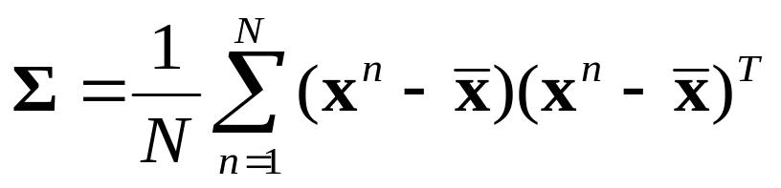
Principal Component Analysis
Normalize the input data then center the input data by subtracting the mean which results in X, used below
Compute the global mean and covariance matrix of X:
Compute the eigenvalues and eigenvectors of the covariance matrix
Arrange eigenvectors in the order of magnitude of their eigenvalues. Take the first d eigenvectors as principle components.
Put the d eigenvectors as columns in a matrix M.
Determine the reduced output E by multiplying M by X
Covariance

Slide 7
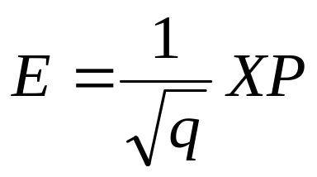

Random Projection
With X being an n x p matrix calculate E using:
with projection matrix P and q is the number of reduced dimensions
P, p x q, is a matrix with elements r_{ij}
  r_{ij} = random Gaussian
P can also be constructed in one of the following ways:
    r_{ij} = ±1 with probability of 0.5 each
    r_{ij} = *(±1) with probability of 1/6 each, or 0 with a probability of 2/3

Slide 8
SPAM Email Database
SPAM E-mail Database, generated June/July 1999
Determine whether email is spam or not
  Previous tests have generated an 7% misclassification error
Source of data: http://www.ics.uci.eud/~mlearn/MLRepository.html
Number of instances: 4,601 (1,813 Spam = 39.4%)

Slide 9
SPAM Email Database
Number of attributes: 58
Attributes:
  48 attributes = word frequency
  6 attributes = character frequency
  1 attribute = average length of uninterrupted sequence of capital letters
  1 attribute = longest uninterrupted sequence of capital letters
  1 attribute = sum of the length of uninterrupted sequences of capital letters
  1 attribute = class spam (1=Spam, 0=Not Spam)

Slide 10
Yahoo News Categories
Introduced in “Impact of Similarity Measures on Web-Page Clustering” by Alexander Strehl, et al.
    Located at: ftp://ftp.cs.umn/dept/users/boley/PDDPdata/
Data consists of 2,340 documents in 20 Yahoo news categories.
After stemming, the data base consists of 21,839 words
Strehl was able to reduce the number of words to 2,903 by selecting only those words that appear in 1% to 10% of all articles

Slide 11
Yahoo News Categories
Number of documents in each category
Category | No. | Category | No.
Business | 142 | E: Online | 65
Entertainment (E) | 9 | E: People | 248
E: Art | 24 | E: Review | 158
E: Cable | 44 | E: Stage | 18
E: Culture | 74 | E: Television | 187
E: Film | 278 | E: Variety | 54
E: Industry | 70 | Health | 494
E: Media | 21 | Politics | 114
E: Multimedia | 14 | Sports | 141
E: Music | 125 | Technology | 60
2,340 total

Slide 12
Revised Yahoo News Categories
Category | No.
Business | 142
Entertainment (Total) | 1,389
Health | 494
Politics | 114
Sports | 141
Technology | 60
Combined 15 Entertainment categories in one category

Slide 13
Yahoo News Characteristics
With the various simplifications and revisions, the Yahoo News Database has the following characteristics:
  2,340 documents
  2,903 words
  6 categories
Even with these simplifications and revisions, there are still too many attributes to do effective data mining

Slide 14
Experimental Design
Perform PCA and RP on each data set for wide range of dimension numbers
  Run RP multiple times due to random nature of algorithm
  Determine relative times for each reduction
Compare PCA and RP results in various data mining techniques
  This would include Naïve Bayes, Nearest Neighbor and Decision Trees
  Determine relative times for each technique
Compare PCA and RP on time and accuracy

Slide 15
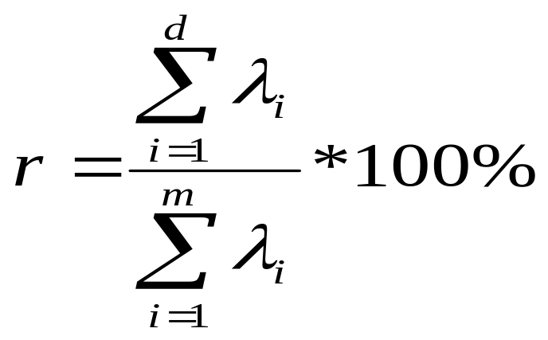
Retained Variance
Retained Variance (r) is the percentage of the original variance that the PCA reduced data set covers, the equation for this is:
where λ_{i} are the eigenvalues, m is the original number of dimensions, and d is the reduced number dimensions.
In many applications, r should be above 90%

Slide 16
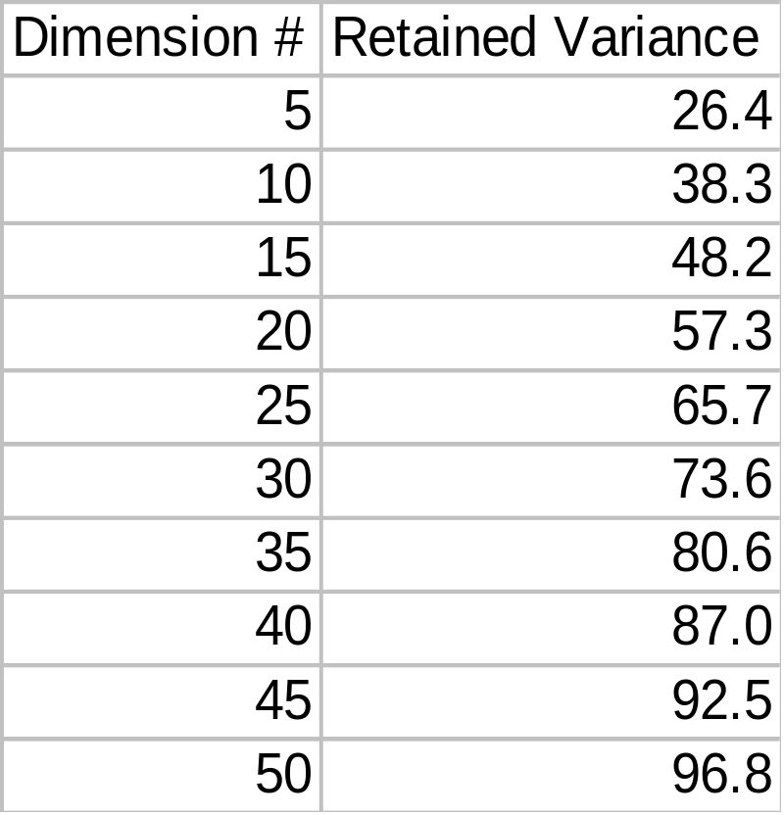
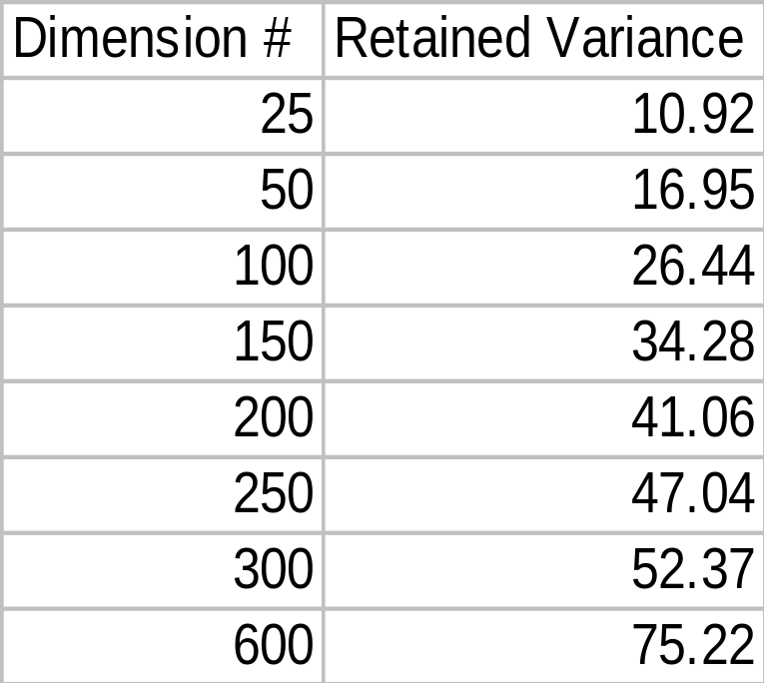
Retained Variance Percent
SPAM Database
Yahoo News Database

Slide 17
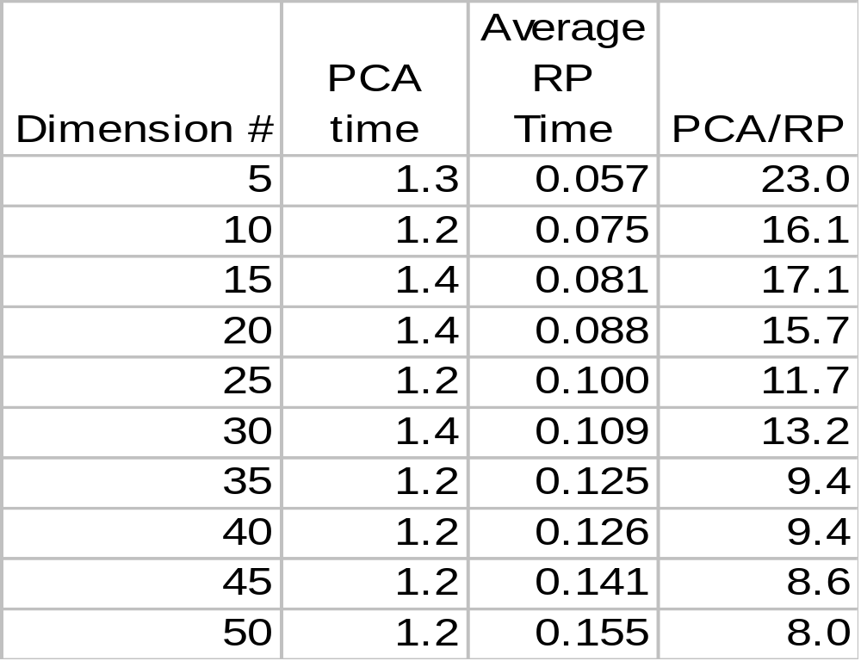
PCA and RP Time Comparison
SPAM Database
Time of PCA divided by Time of RP
Ran RP 5 times for each dimension
RP averages over 10 times faster than PCA
Times in Seconds
Reduction performed in Matlab on Pentium III 1 GHz computer with 256 MB RAM

Slide 18
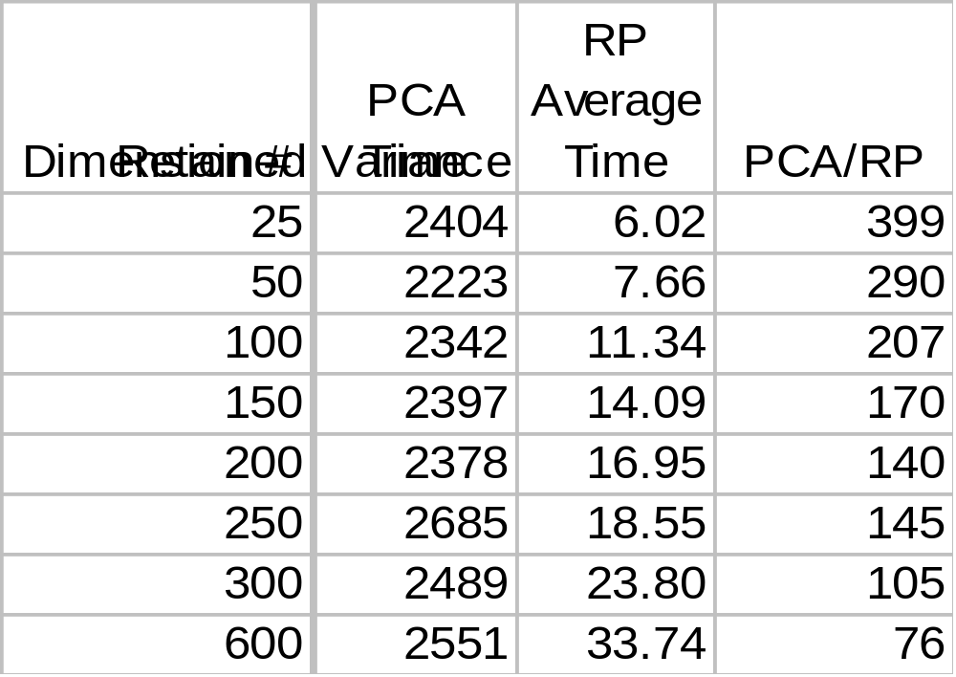
PCA and RP Time Comparison
Yahoo News Database
Time of PCA divided by the Time of RP
Ran RP 5 times for each dimension
RP averages over 100 times faster than PCA
Times in Seconds
Reduction performed in Matlab on Pentium III 1 GHz computer with 256 MB RAM

Slide 19
Data Mining
Explored various data mining techniques using the Weka software package. The following produced the best results:
  IB1: Nearest Neighbor
  J48: Decision Trees
The following produced poor results are will not be used:
  Naïve Bayes: Overall poor results
  SVM (SVO): Too slow with similar results to others

Slide 20
Data Mining Procedures
For each data set imported into Weka:
  Convert the numerical categories to nominal values
  Randomize the order of the entries
  Run J48 and IB1 the data
    Determine % Correct and check F-Measure statistics
Ran PCA once for each dimension number and RP 5 times for each dimension number
  Used 67% training/33% testing split
  Tested on 1564 for SPAM and 796 for Yahoo

Slide 21
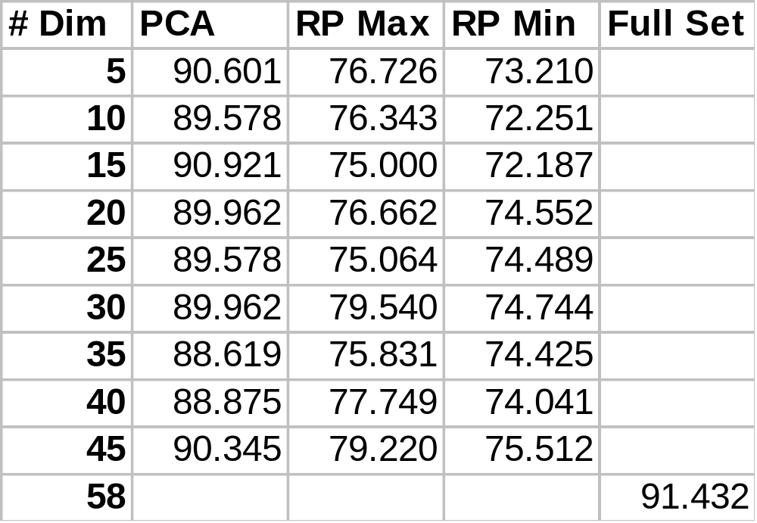
Results-J48 Spam Data
Percent Correct
PCA gave uniformly good results for all dimension levels
PCA gave results comparable to the 91.4% percent correct for the full data set
RP was 15% below full data set results

Slide 22
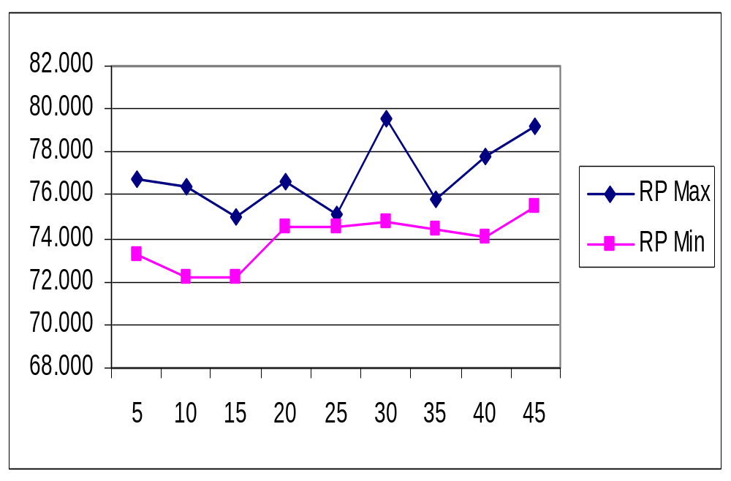
Results-J48 Spam Data
% Correct vs. Dimension #
RP gave consistent results with a very small split between maximum and minimum values

Slide 23
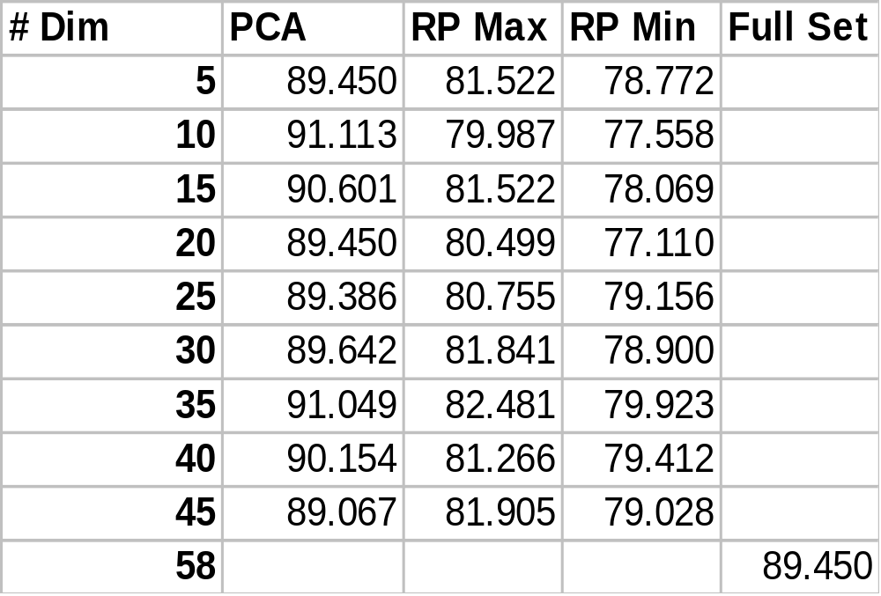
Results-IB1 Spam Data
Percent Correct
PCA gave uniformly good results for all dimension levels
PCA gave results comparable to the 89.5% percent correct for the full data set
RP was 10% below full data set results

Slide 24
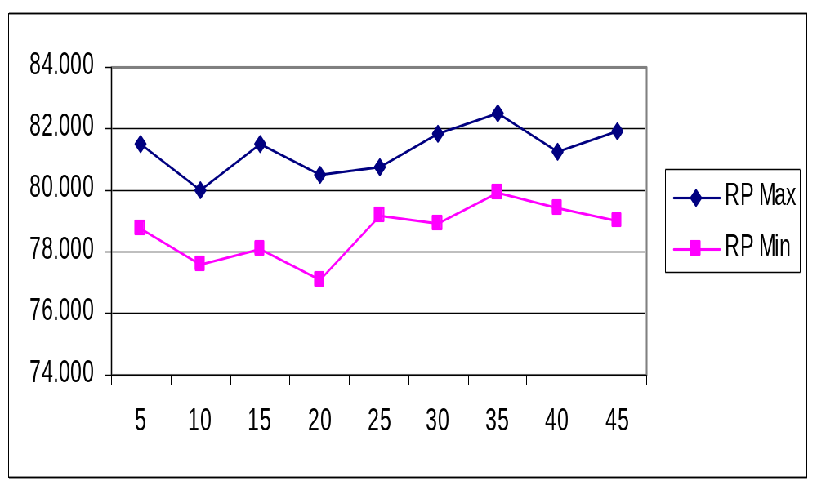
Results-IB1 Spam Data
% Correct vs. Dimension #
RP gave consistent results with a very small split between maximum and minimum values

Slide 25
Results SPAM Data
PCA gave consistent results for all dimension levels
  Expected lower dimension levels to not perform as well
RP gave consistent, but lower, results for all dimension levels
  Also expected lower dimension levels to not perform as well

Slide 26
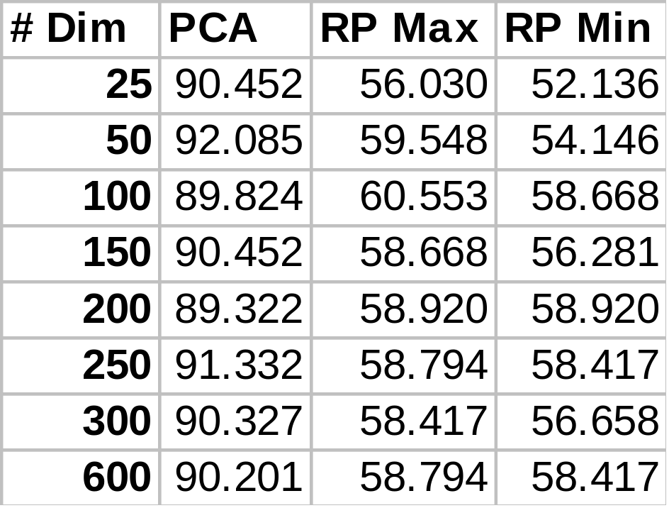
Results-J48 Yahoo Data
Percent Correct
PCA gave uniformly good results for all dimension levels
RP was over 30% below PCA results
Note: Did not run data mining on full data set due to large dimension number

Slide 27
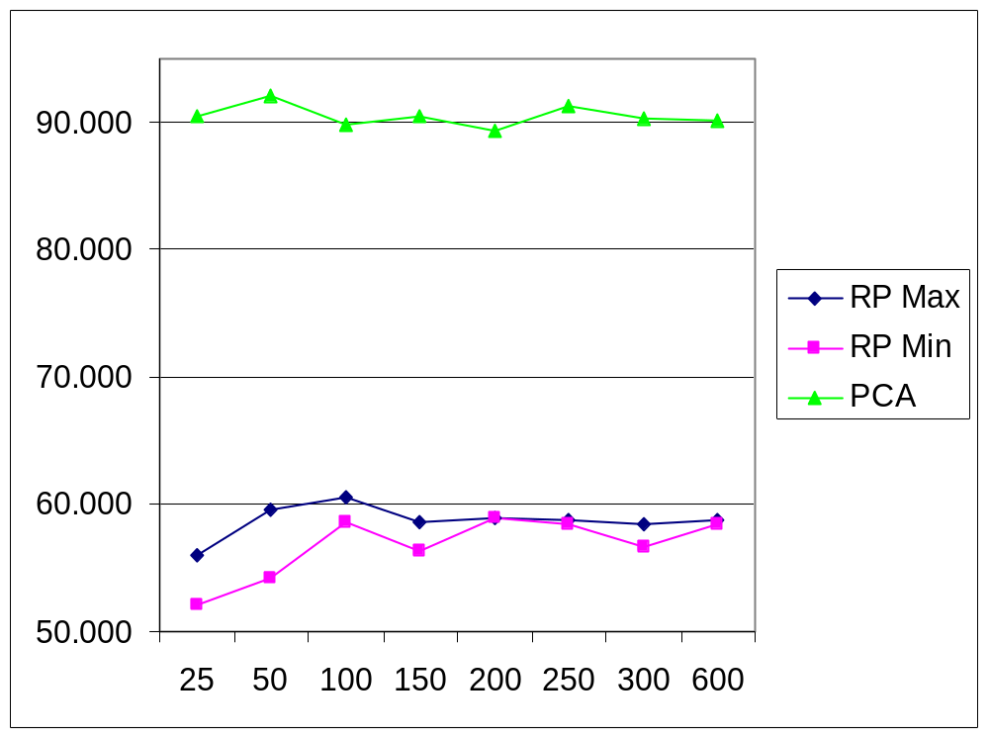
Results-J48 Yahoo Data
% Correct vs. Dimension #
RP gave consistent results with a very small split between maximum and minimum values
RP results were much lower than PCA

Slide 28
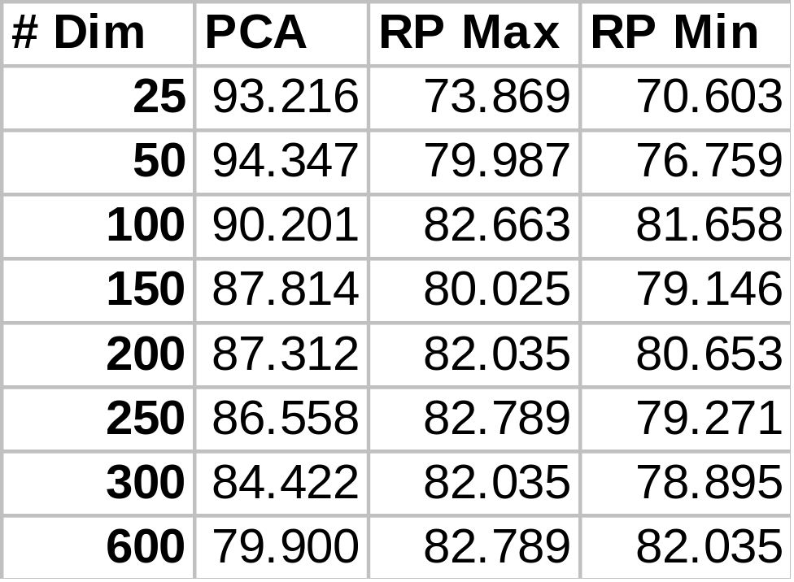
Results-IB1 Yahoo Data
Percent Correct
PCA percent correct decreased as dimension number increased
RP was 20% below PCA at low dimension numbers, decreasing to 0% at high dimension numbers
Note: Did not run data mining on full data set due to large dimension number

Slide 29
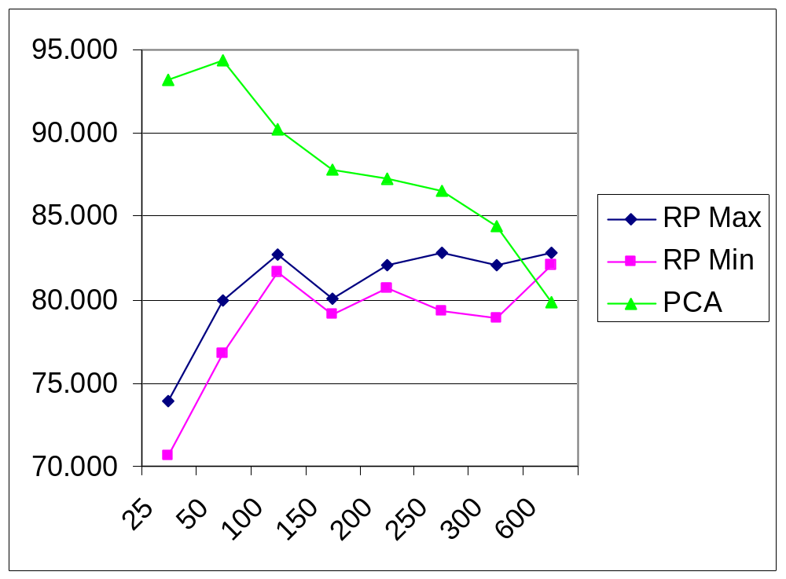
Results-IB1 Yahoo Data
% Correct vs. Dimension #
RP gave consistent results with a very small split between maximum and minimum values
RP results were similar to PCA at high dimension levels

Slide 30
Results Yahoo Data
PCA showed consistently high results for the Decision Tree output, but showed decreasing results for higher dimensions for Nearest Neighbor output
  Could be over fitting in Nearest Neighbor case
  Decision Tree has pruning to prevent over fitting

Slide 31
Results Yahoo Data
RP showed consistent results for both Nearest Neighbor and Decision Trees
  The lower dimension numbers gave slightly lower results
    Approximately 10-20% for dimension numbers less than 100
  The Nearest Neighbor results were 20% higher than Decision Tree results

Slide 32
Overall Results
RP gives consistent results with few inconsistencies over multiple runs
In general RP is faster by many orders (10 to 100) of magnitude over PCA but in most cases produced lower accuracy
The RP results are closer to PCA using the Nearest Neighbor data mining technique
Would suggest using RP if speed of processing is most important

Slide 33
Future Work
Need to examine additional data sets to determine if results are consistent
Both PCA and RP are linear tools. They map the original dataset using a linear mapping.
Examine deriving PCA using SVD for speed
A more general comparison would include non-linear dimensionality reduction methods such as:
  Kernel PCA
  SVM

Slide 34
References
E. Bingham and H. Mannila, “Random projection in dimensionality reduction: Applications to image and text data”, KDD 2001
D. Fradkin and D. Madigan, “Experiments with Random Projections for Machine Learning”, SOGLDD ’03, August 2003
J. Lin and D. Gunopulos, “Dimensionality Reduction by Random Projection and Latent Semantic Indexing”, Proceedings of the Text Mining Workshop, at the 3rd SIAM International Conference on Data Mining, May 2003
K. Torkkola, “Linear Discriminant Analysis in Document Classification”, IEEE Workshop on Text Mining (TextDM’2001), November 2001

Slide 35
Questions?

