Slide 1
Random Walk

Slide 2


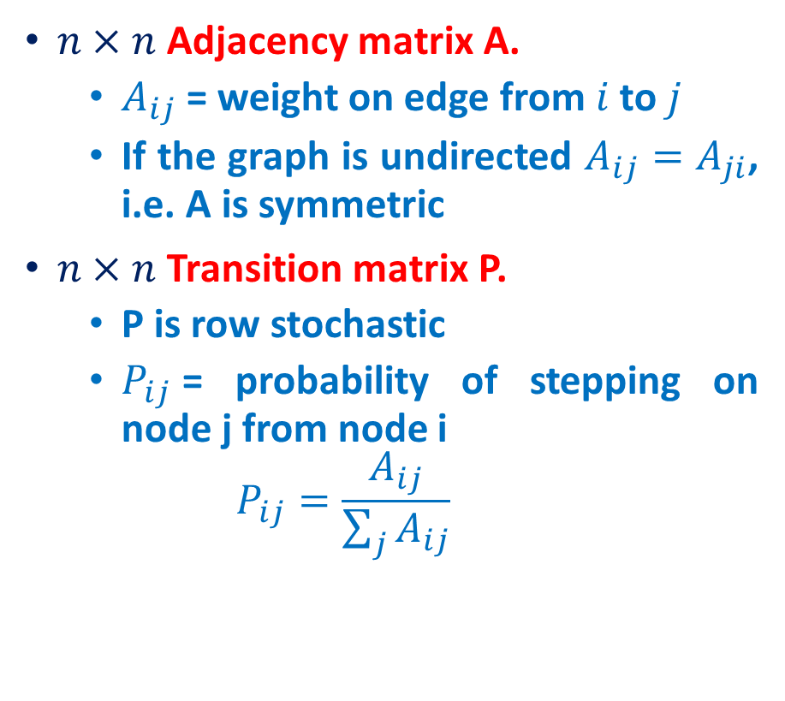
Adjacency matrix
$n×n$ Adjacency matrix A.
$A_{ij}$ = weight on edge from $i$ to $j$
If the graph is undirected $A_{ij}=A_{ji}$, i.e. A is symmetric
$n×n$ Transition matrix P.
P is row stochastic
$P_{ij}$= probability of stepping on node j from node i
$$P_{ij}=\frac{A_{ij}}{\sum_{j}{A_{ij}}}$$
Adjacency matrix A
Transition matrix P
1
1
1
1/2
1
1
1
1/2

Slide 3
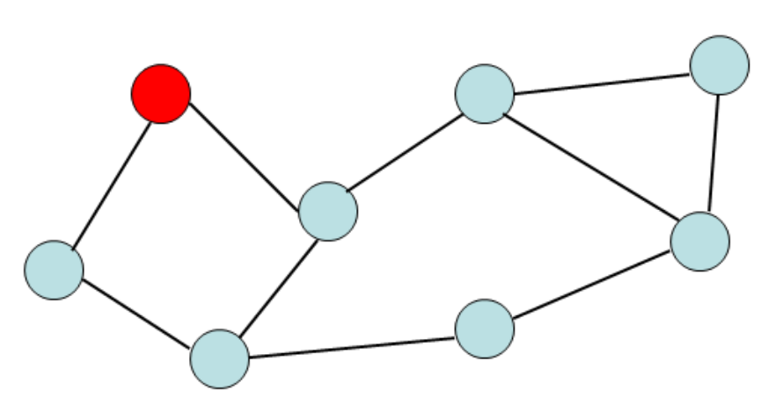
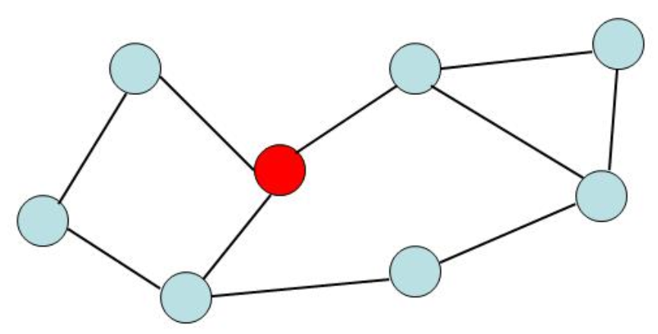
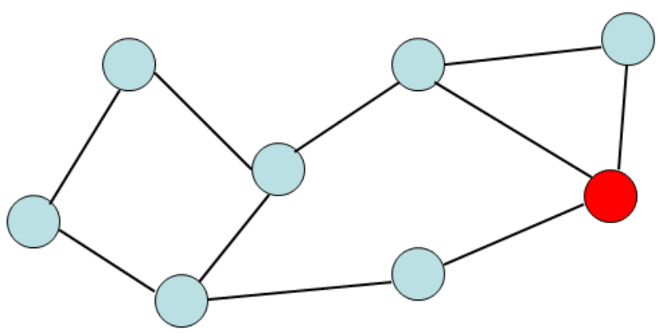
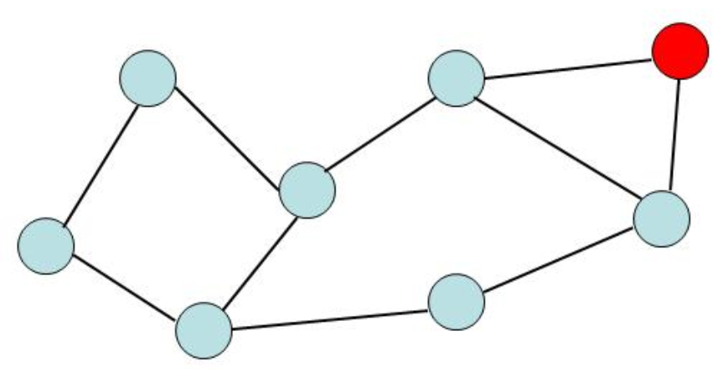
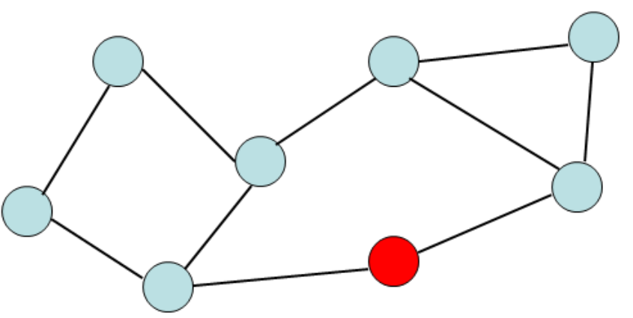
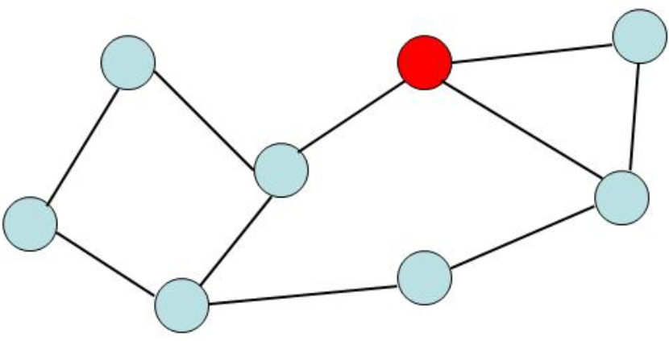
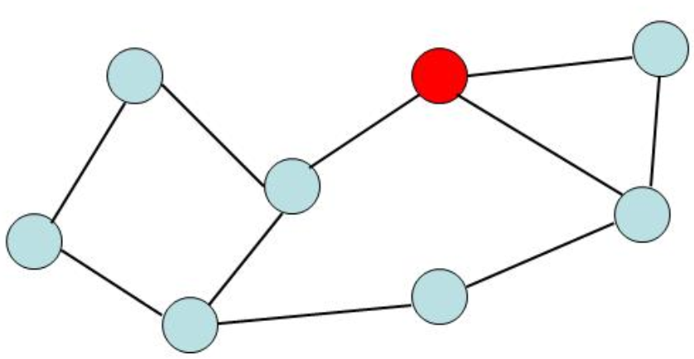
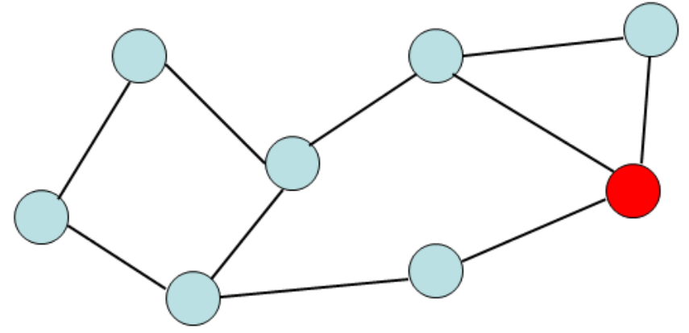
Random Walk
Given a graph and a starting point (node), we select a neighbor of it at random, and move to this neighbor;
Then we select a neighbor of this node and move to it, and so on;
The (random) sequence of nodes selected this way is a random walk on the graph

Slide 4
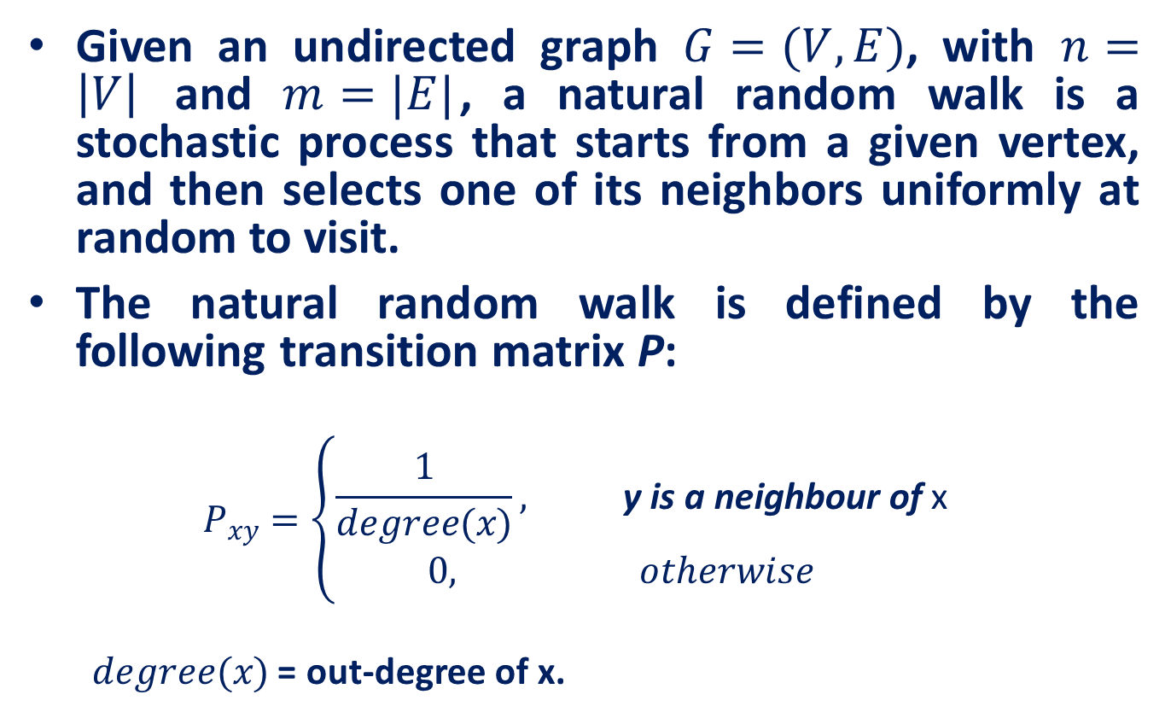
Natural Random Walk
Given an undirected graph $G=(V, E)$, with $n=\left|V\right|$ and $m=|E|$, a natural random walk is a stochastic process that starts from a given vertex, and then selects one of its neighbors uniformly at random to visit.
The natural random walk is defined by the following transition matrix P:
$$P_{xy}=\left\{\begin{aligned}\frac{1}{degree(x)}, \text{y} \text{is} \text{a} \text{neighbour} \text{of} \text{x} \\ 0, otherwise \end{aligned}\right.$$
$degree(x)$ = out-degree of x.

Slide 5
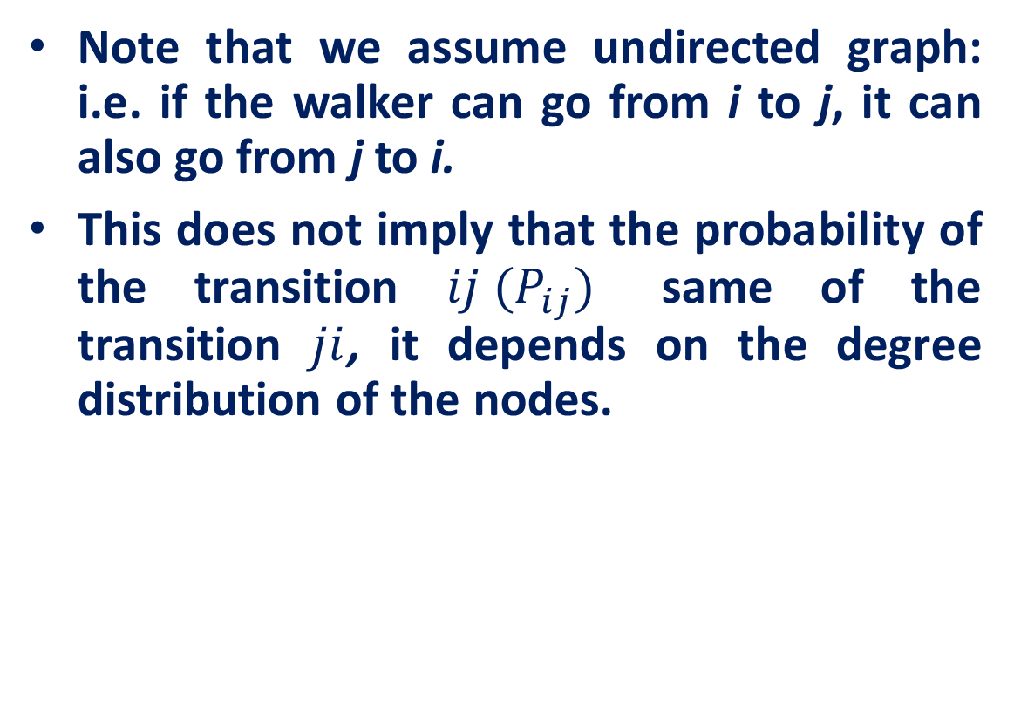
Natural Random Walk
Note that we assume undirected graph: i.e. if the walker can go from i to j, it can also go from j to i.
This does not imply that the probability of the transition $ij (P_{ij})$ same of the transition $ji$, it depends on the degree distribution of the nodes.

Slide 6
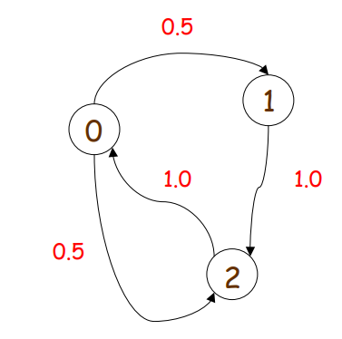
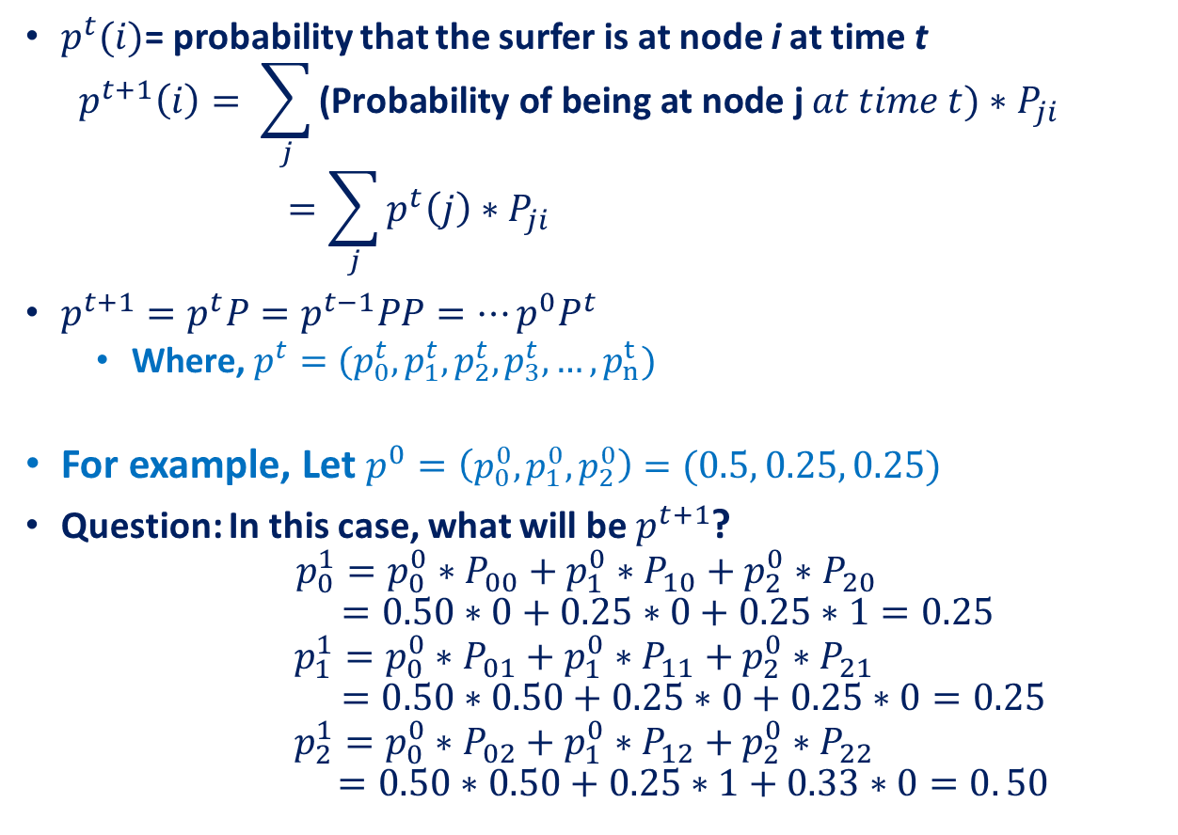
Probability Distributions
$p^{t}(i)$= probability that the surfer is at node i at time t
$$p^{t+1}\left(i\right)= \sum_{j}{\text{(}\text{Probability} \text{of} \text{being} \text{at} \text{node} \text{j} at time t)∗P_{ji}}$$
$$=\sum_{j}{p^{t}\left(j\right)∗P_{ji}}$$
$p^{t+1}=p^{t}P=p^{t−1}PP=…p^{0}P^{t}$
Where, $p^{t}=(p_{0}^{t}, p_{1}^{t},p_{2}^{t},p_{3}^{t},…,p_{n}^{t})$
For example, Let $p^{0}=\left(p_{0}^{0}, p_{1}^{0},p_{2}^{0}\right)=(0.5, 0.25, 0.25)$
Question: In this case, what will be $p^{t+1}$?
$$p_{0}^{1}=p_{0}^{0}∗P_{00}+p_{1}^{0}∗P_{10}+p_{2}^{0}∗P_{20}$$
$$=0.50∗0+0.25∗0+0.25∗1=0.25$$
$$p_{1}^{1}=p_{0}^{0}∗P_{01}+p_{1}^{0}∗P_{11}+p_{2}^{0}∗P_{21 }$$
$$=0.50∗0.50+0.25∗0+0.25∗0=0.25$$
$$p_{2}^{1}=p_{0}^{0}∗P_{02}+p_{1}^{0}∗P_{12}+p_{2}^{0}∗P_{22 }$$
$$=0.50∗0.50+0.25∗1+0.33∗0=0. 50$$

Slide 7
Page Rank

Slide 8
Motivation and Introduction
Why is Page Importance Rating important?
New challenges for information retrieval on the World Wide Web.
Huge number of web pages:
150 million by 1998
1000 billion by 2008
Diversity of web pages: different topics, different quality, etc.
What is PageRank?
A method for rating the importance of web pages objectively and mechanically using the link structure of the web.

Slide 9
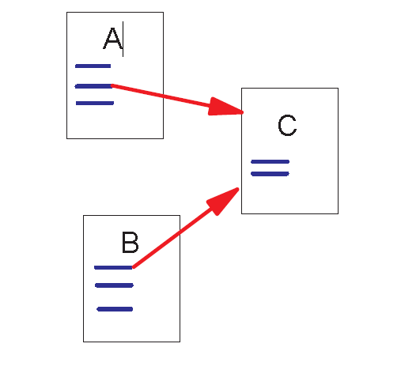
Link Structure of the Web
150 million web pages → 1.7 billion links
Backlinks and Forward links
A and B are C’s backlinks
C is A and B’s forward link
Intuitively, a webpage is important if it has a lot of backlinks
What if a webpage has only one link off www.yahoo.com?

Slide 10
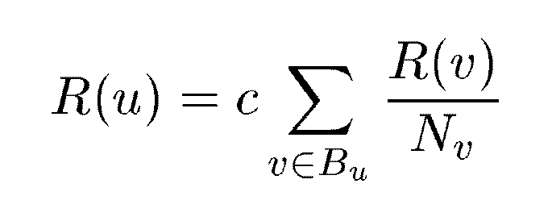
A Simple Version of PageRank
u: a web page
B_{u}: the set of u’s backlinks
N_{v}: the number of forward links of page v
c: the normalization factor to make ||R||_{L1} = 1 (||R||_{L1}= |R₁ + … + R_{n}|)

Slide 11
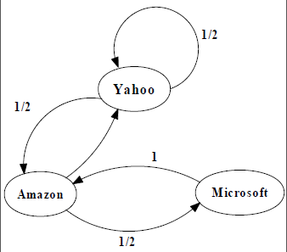
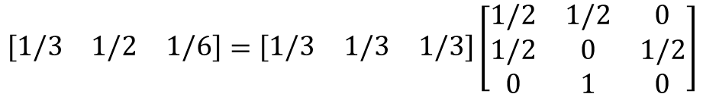
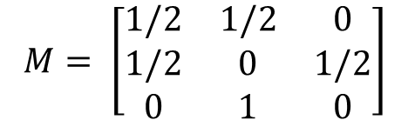
An example of Simplified PageRank
$$M= \left[\begin{matrix}1/2 & 1/2 & 0 \\ 1/2 & 0 & 1/2 \\ 0 & 1 & 0\end{matrix}\right]$$
$$[yahoo, Amazon, Microsoft]=\left[\begin{matrix}1/3 & 1/3 & 1/3\end{matrix}\right]$$
$$\left[\begin{matrix}1/3 & 1/2 & 1/6\end{matrix}\right]=\left[\begin{matrix}1/3 & 1/3 & 1/3\end{matrix}\right]\left[\begin{matrix}1/2 & 1/2 & 0 \\ 1/2 & 0 & 1/2 \\ 0 & 1 & 0\end{matrix}\right]$$
PageRank Calculation: first iteration

Slide 12
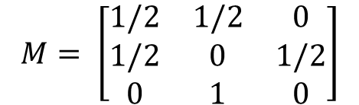
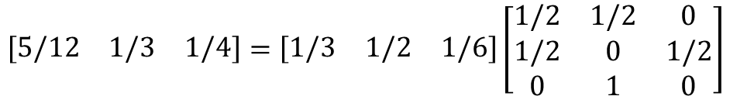
An example of Simplified PageRank
$$M= \left[\begin{matrix}1/2 & 1/2 & 0 \\ 1/2 & 0 & 1/2 \\ 0 & 1 & 0\end{matrix}\right]$$
$$[yahoo, Amazon, Microsoft]=\left[\begin{matrix}1/3 & 1/3 & 1/3\end{matrix}\right]$$
$$\left[\begin{matrix}5/12 & 1/3 & 1/4\end{matrix}\right]=\left[\begin{matrix}1/3 & 1/2 & 1/6\end{matrix}\right]\left[\begin{matrix}1/2 & 1/2 & 0 \\ 1/2 & 0 & 1/2 \\ 0 & 1 & 0\end{matrix}\right]$$
PageRank Calculation: second iteration

Slide 13
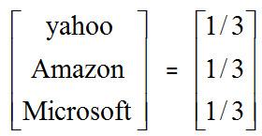
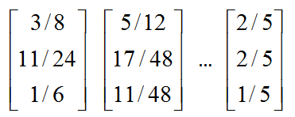
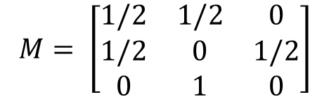



An example of Simplified PageRank
$$M= \left[\begin{matrix}1/2 & 1/2 & 0 \\ 1/2 & 0 & 1/2 \\ 0 & 1 & 0\end{matrix}\right]$$
$$\left[\begin{matrix}3/8 & 11/24 & 1/6\end{matrix}\right]$$
$$\left[\begin{matrix}11/24 & 17/48 & 11/48\end{matrix}\right]$$
$$\left[\begin{matrix}2/5 & 2/5 & 1/5\end{matrix}\right]$$
Convergence after some iterations

Slide 14
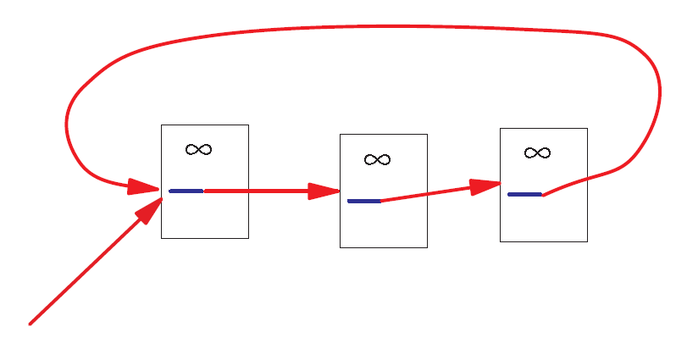
A Problem with Simplified PageRank
A loop:
During each iteration, the loop accumulates rank but never distributes rank to other pages!

Slide 15
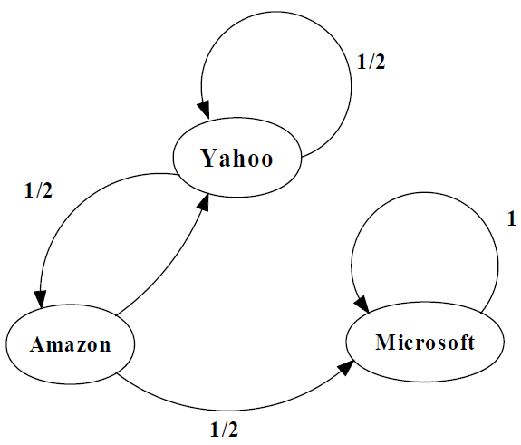
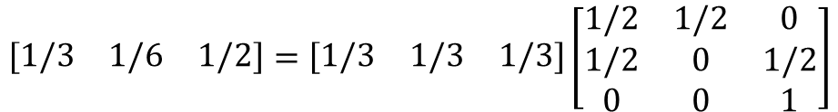
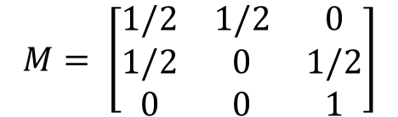
An example of Simplified PageRank
$$M= \left[\begin{matrix}1/2 & 1/2 & 0 \\ 1/2 & 0 & 1/2 \\ 0 & 0 & 1\end{matrix}\right]$$
$$[yahoo, Amazon, Microsoft]=\left[\begin{matrix}1/3 & 1/3 & 1/3\end{matrix}\right]$$
$$\left[\begin{matrix}1/3 & 1/6 & 1/2\end{matrix}\right]=\left[\begin{matrix}1/3 & 1/3 & 1/3\end{matrix}\right]\left[\begin{matrix}1/2 & 1/2 & 0 \\ 1/2 & 0 & 1/2 \\ 0 & 0 & 1\end{matrix}\right]$$
PageRank Calculation: first iteration

Slide 16
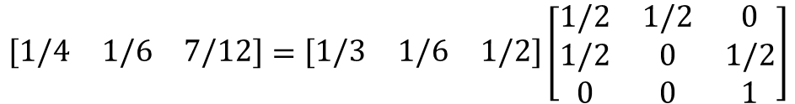
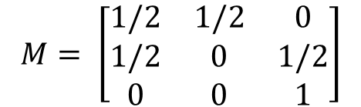
$$M= \left[\begin{matrix}1/2 & 1/2 & 0 \\ 1/2 & 0 & 1/2 \\ 0 & 0 & 1\end{matrix}\right]$$
$$[yahoo, Amazon, Microsoft]=\left[\begin{matrix}1/3 & 1/3 & 1/3\end{matrix}\right]$$
$$\left[\begin{matrix}1/4 & 1/6 & 7/12\end{matrix}\right]=\left[\begin{matrix}1/3 & 1/6 & 1/2\end{matrix}\right]\left[\begin{matrix}1/2 & 1/2 & 0 \\ 1/2 & 0 & 1/2 \\ 0 & 0 & 1\end{matrix}\right]$$
PageRank Calculation: Second iteration

Slide 17


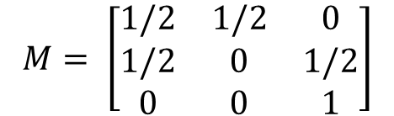

An example of Simplified PageRank
$$M= \left[\begin{matrix}1/2 & 1/2 & 0 \\ 1/2 & 0 & 1/2 \\ 0 & 0 & 1\end{matrix}\right]$$
$$[yahoo, Amazon, Microsoft]=\left[\begin{matrix}1/3 & 1/3 & 1/3\end{matrix}\right]$$
$$\left[\begin{matrix}5/24 & 1/8 & 2/3\end{matrix}\right]$$
$$\left[\begin{matrix}1/6 & 5/48 & 35/48\end{matrix}\right]$$
$$\left[\begin{matrix}0 & 0 & 1\end{matrix}\right]$$

Slide 18
Random Walks in Graphs
The Random Surfer Model
The simplified model: the standing probability distribution of a random walk on the graph of the web. simply keeps clicking successive links at random
The Modified Model
The modified model: the “random surfer” simply keeps clicking successive links at random, but periodically “gets bored” and jumps to a random page based on the distribution of E

Slide 19
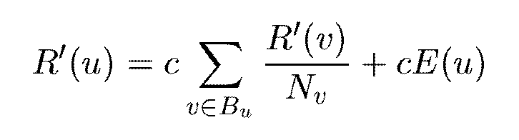
Modified Version of PageRank
E(u): a distribution of ranks of web pages that “users” jump to
when they “gets bored” after successive links at random.

Slide 20


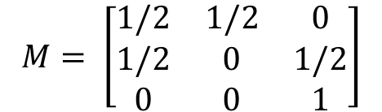



An example of Modified Version of PageRank
$$M= \left[\begin{matrix}1/2 & 1/2 & 0 \\ 1/2 & 0 & 1/2 \\ 0 & 0 & 1\end{matrix}\right]$$
$$[yahoo, Amazon, Microsoft]=\left[\begin{matrix}1/3 & 1/3 & 1/3\end{matrix}\right]$$
$$c_{1}=0.8, c_{2}=0.2$$
$$\left[\begin{matrix}0.333 & 0.333 & 0.333\end{matrix}\right]$$
$$\left[\begin{matrix}0.333 & 0.200 & 0.467\end{matrix}\right]$$
$$\left[\begin{matrix}0.280 & 0.200 & 0.520\end{matrix}\right]$$
$$\left[\begin{matrix}7/33 & 5/33 & 21/33\end{matrix}\right]$$

Slide 21
Dangling Links
Links that point to any page with no outgoing links
Most are pages that have not been downloaded yet
Affect the model since it is not clear where their weight should be distributed
Do not affect the ranking of any other page directly
Can be simply removed before page rank calculation and added back afterwards

Slide 22
Markov Chain

Slide 23
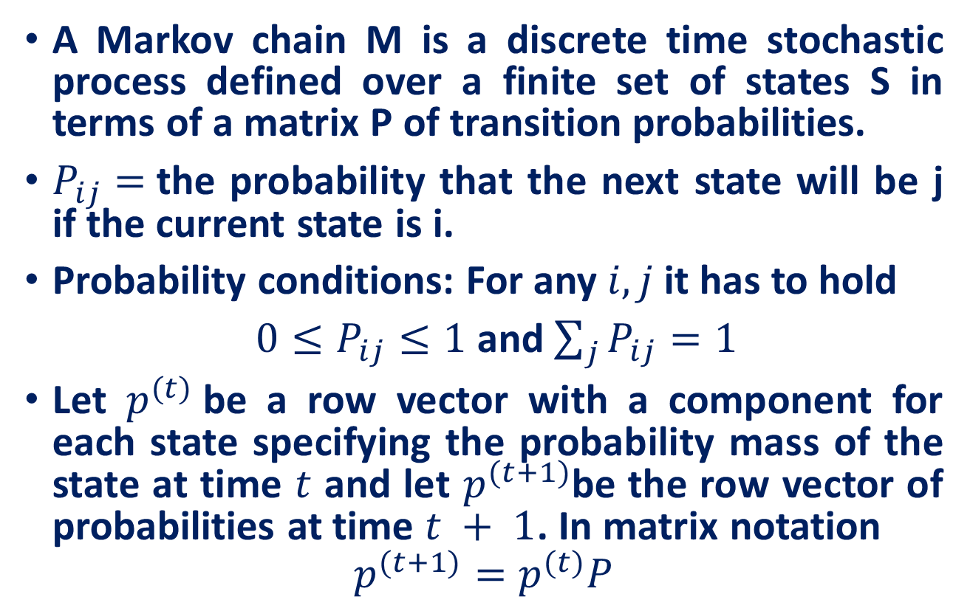
Markov Chain
A Markov chain M is a discrete time stochastic process defined over a finite set of states S in terms of a matrix P of transition probabilities.
$P_{ij}=$the probability that the next state will be j if the current state is i.
Probability conditions: For any $i, j$it has to hold
$0≤P_{ij}≤1$ and $\sum_{j}{P_{ij}}=1$
Let $p^{(t)}$be a row vector with a component for each state specifying the probability mass of the state at time $t$ and let $p^{(t+1)}$be the row vector of probabilities at time $t + 1$. In matrix notation
$$p^{(t+1)}=p^{(t)}P$$

Slide 24

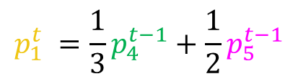





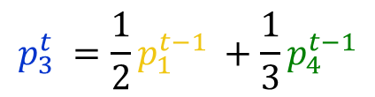

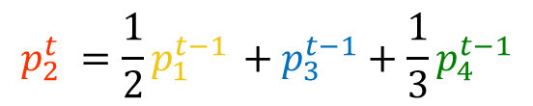

Memorylessness
At any time, the only information about the chain is the current state, not how the chain got there.
Question: what is the probability $p_{i}^{t}$ of being at node $i$after $t$ steps?
Memorylessness property: The next node on the walk depends only at the current node and not on the past of the process
$$v_{2}$$
$$p_{1}^{t} =\frac{1}{3}p_{4}^{t−1}+\frac{1}{2}p_{5}^{t−1}$$
$$v_{1}$$
$$p_{2}^{t} =\frac{1}{2}p_{1}^{t−1} +p_{3}^{t−1}+\frac{1}{3}p_{4}^{t−1}$$
$$v_{3}$$
$$p_{3}^{t} =\frac{1}{2}p_{1}^{t−1} +\frac{1}{3}p_{4}^{t−1}$$
$$p_{4}^{t} =\frac{1}{2}p_{5}^{t−1}$$
$$v_{5}$$
$$v_{4}$$
$$p_{5}^{t} = p_{2}^{t−1}$$

Slide 25
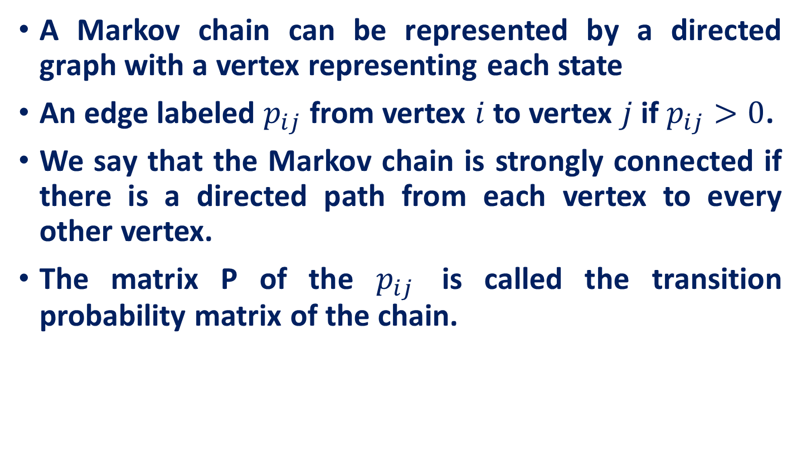
Markov Chain
A Markov chain can be represented by a directed graph with a vertex representing each state
An edge labeled $p_{ij}$ from vertex $i$ to vertex $j$ if $p_{ij}>0$.
We say that the Markov chain is strongly connected if there is a directed path from each vertex to every other vertex.
The matrix P of the $p_{ij}$ is called the transition probability matrix of the chain.

Slide 26

Markov Chain
$$p^{(t+1)}=p^{(t)}P$$
$$=\left(p^{\left(t−1\right)}P\right)P$$
$$=\left(\left(p^{\left(t−2\right)}P\right)P\right)P$$
$${=p}^{0}(P∗P∗P…\left(t+1\right) times)$$
.
.
.

Slide 27
















Markov Chain
$$\frac{1}{2}$$
1
0 | 1 | 0
0 | 0 | 1
1/2 | 1/2 | 0
$$1$$
$$1$$
3
$$P=$$
2
$$\frac{1}{2}$$
$$\frac{1}{2}$$
1
Let, random walker is at node 1 at time t=0
$$1$$
$$1$$
3
$$p_{0}=$$
1 | 0 | 0
2
$$\frac{1}{2}$$
0 | 1 | 0
0 | 0 | 1
1/2 | 1/2 | 0
$$\frac{1}{2}$$
$$p_{1}=$$
1 | 0 | 0
1
$$1$$
$$1$$
3
What will be the transition probability of Random walker at time t=1
$$p_{1}=$$
0 | 1 | 0
2
$$\frac{1}{2}$$

Slide 28
Markov Chain properties
accessible aperiodic
communicate recurrent
irreducible transient

Slide 29
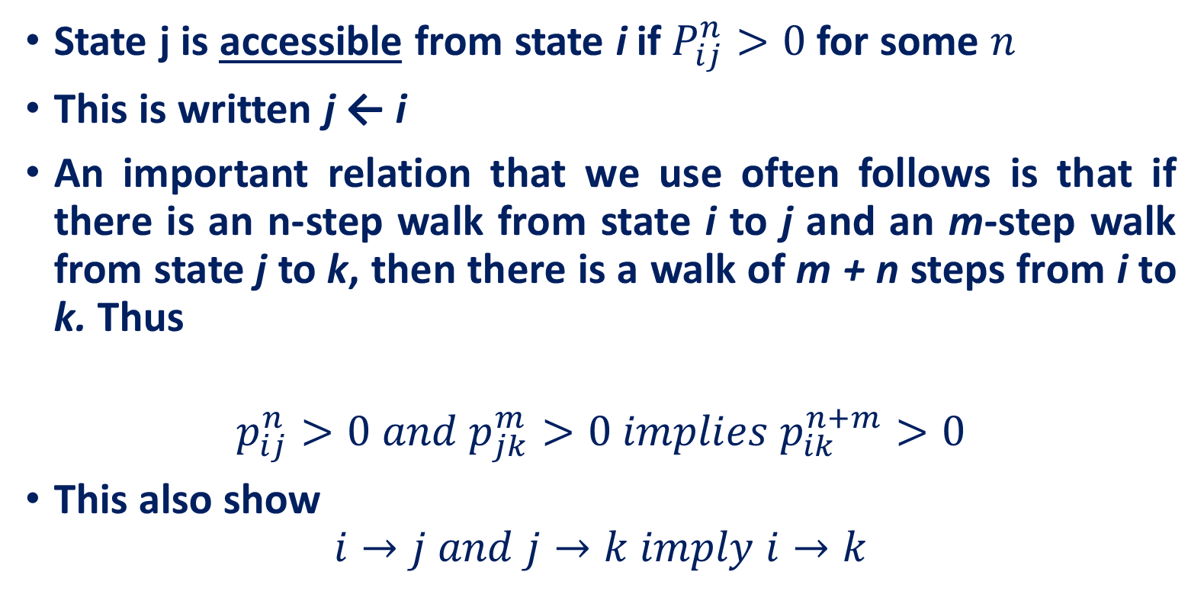
Accessibility
State j is accessible from state i if $P_{ij}^{n}>0$for some $n$
This is written j ← i
An important relation that we use often follows is that if there is an n-step walk from state i to j and an m-step walk from state j to k, then there is a walk of m + n steps from i to k. Thus
$$p_{ij}^{n}>0 and p_{jk}^{m}>0 implies p_{ik}^{n+m}>0$$
This also show
$$i→j and j→k imply i→k$$

Slide 30
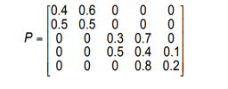
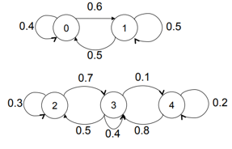
Accessibility
Example
Q. Which states are accessible from state 0?
States 0 and 1 are accessible from state 0
Q. Which states are accessible from state 3?
States 2, 3, and 4 are accessible from state 3

Slide 31
Communicability
States i and j communicate if state j is accessible from state i, and state i is accessible from state j (denote j ↔ i)
Communicability is
Reflexive: Any state communicates with itself
Symmetric: If state i communicates with state j, then state j communicates with state i
Transitive: If state i communicates with state j, and state j communicates with state k, then state i communicates with state k

Slide 32
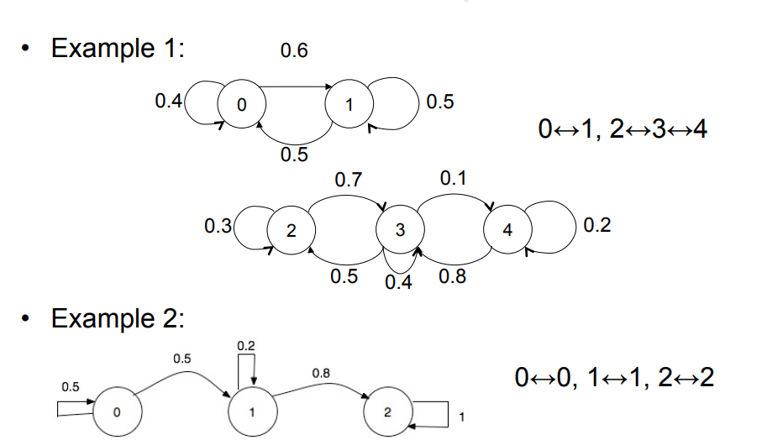
Communicability
Example
How many classes exist in the example 1?
{0,1} and {2,3,4}
How many classes exist in the example 2?
3 classes {0} {1} {2}

Slide 33
Irreducibility
Markov Chain is irreducible if all states belong to one class (all states communicate with each other)
If there exists some t for which p_{ij}^{(t)} >0 for all i and j, then all states communicate and the Markov chain is irreducible

Slide 34


Irreducible
All elements communicate
A
G
C
T
A
P =
G
C
T
$$i↔j for all i, j$$
$$p_{i,j}^{n}>0$$

Slide 35
Irreducibility
Is example given right is irreducible?
Reducible {0,1} {2,3,4}

Slide 36
Recurrent and Transient States
1
2
3
1
2
3
All the states are recurrent
State 2 and 3 are transient
State i is said to be
Recurrent if the process will definitely return to state I
Transient if there is a positive probability that the process will move to state j and never return to state
Absorbing if p _{ii} = 1, i.e. we can never leave that state (an absorbing state is a recurrent state)

Slide 37
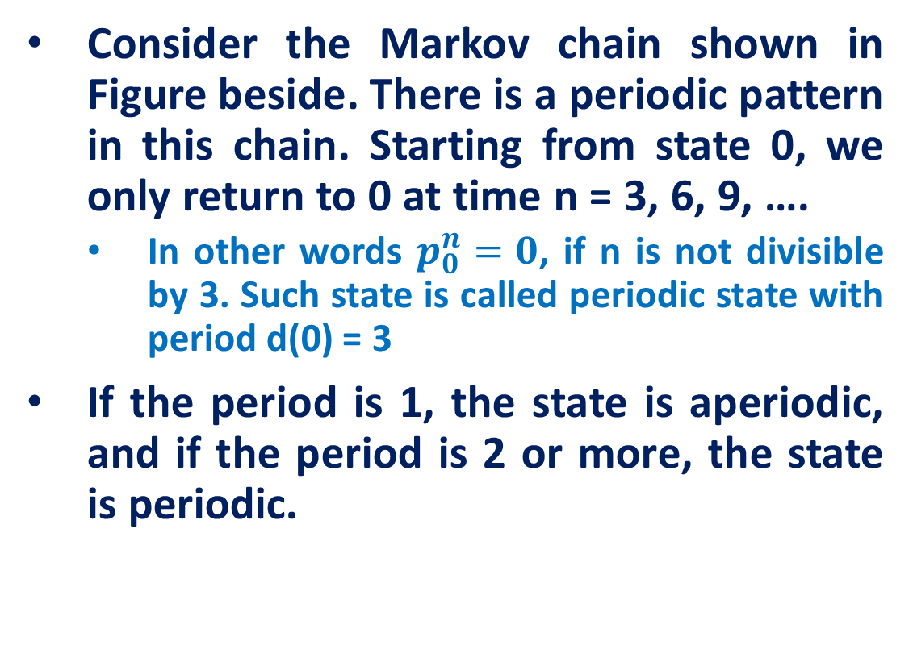
Periodicity
Consider the Markov chain shown in Figure beside. There is a periodic pattern in this chain. Starting from state 0, we only return to 0 at time n = 3, 6, 9, ….
In other words $p_{0}^{n}=0$, if n is not divisible by 3. Such state is called periodic state with period d(0) = 3
If the period is 1, the state is aperiodic, and if the period is 2 or more, the state is periodic.

Slide 38
Periodicity
Which of the following Markov chains are periodic?

Slide 39
Ergodic Markov Chains
In a finite-state Markov chain, not all states can be transient, so if there are transient states, the chain is reducible
If a finite-state Markov chain is irreducible, all states must be recurrent
In a finite-state Markov chain, a state that is recurrent and aperiodic is called ergodic
A Markov chain is called ergodic if all its states are ergodic.

Slide 40
Stationary Distribution
Markov chain converges to a unique limit probability vector, which we denote by π.
Executing one more step, starting from this limit distribution, we get back the same distribution.
In matrix notation, πP = π where P is the matrix of transition probabilities.
In fact, there is a unique probability vector (nonnegative components summing to one) satisfying πP = π and this vector is the limit.

Slide 41
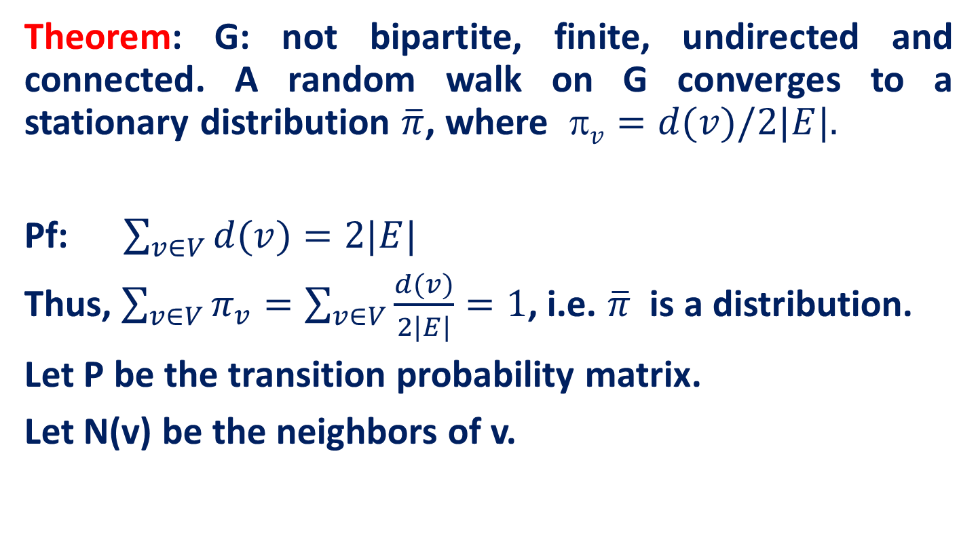
Stationary Distribution
Theorem: G: not bipartite, finite, undirected and connected. A random walk on G converges to a stationary distribution $\overline{π}$, where $ v=d(v)/2|E|.$
Pf: $\sum_{v∈V}{d(v)}=2|E|$
Thus, $\sum_{v∈V}{π_{v}}=\sum_{v∈V}{\frac{d(v)}{2|E|}}=1$, i.e. $\overline{π}$ is a distribution.
Let P be the transition probability matrix.
Let N(v) be the neighbors of v.

Slide 42
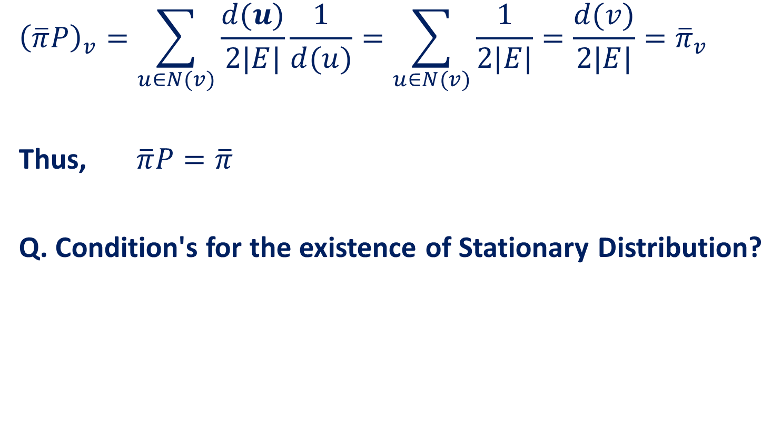
Stationary Distribution
$${\left(\overline{π}P\right)}_{v}=\sum_{u∈N(v)}{\frac{d(u)}{2|E|}\frac{1}{d(u)}}=\sum_{u∈N(v)}{\frac{1}{2|E|}=\frac{d(v)}{2|E|}}={\overline{π}}_{v}$$
Thus, $\overline{π}P=\overline{π}$
Q. Condition's for the existence of Stationary Distribution?

Slide 43
Stationary Distribution
If the graph is bipartite and V₁ and V₂ are its sets then if we start with V₁ we can not be on V₁ vertex in after odd number of transitions.
Therefore a steady state is not possible.
So we need for random walks on graphs that the graph is connected and not bipartite. The other property will follow.

Slide 44
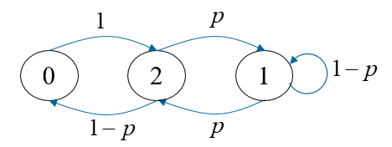
Example: Finite Markov Chain
Absent-minded professor uses two umbrellas when commuting between home and office. If it rains and an umbrella is available at her location, she takes it. If it does not rain, she always forgets to take an umbrella. Let p be the probability of rain each time she commutes. What is the probability that she gets wet on any given day?
Let state i be the number of umbrellas at her current location. Then i = 0 or i = 1 or i = 2
Each commute corresponds to a state transition.
If i = 0 then the other location she commutes to necessarily has two umbrellas.
Therefore, starting from i = 0 she goes to i = 2 with probability 1.
This Markov chain has a single recurrent class and all three states are aperiodic. Therefore, steady state probabilities exist.
Transition Matrix

Slide 45
Example: Finite Markov Chain

Slide 46
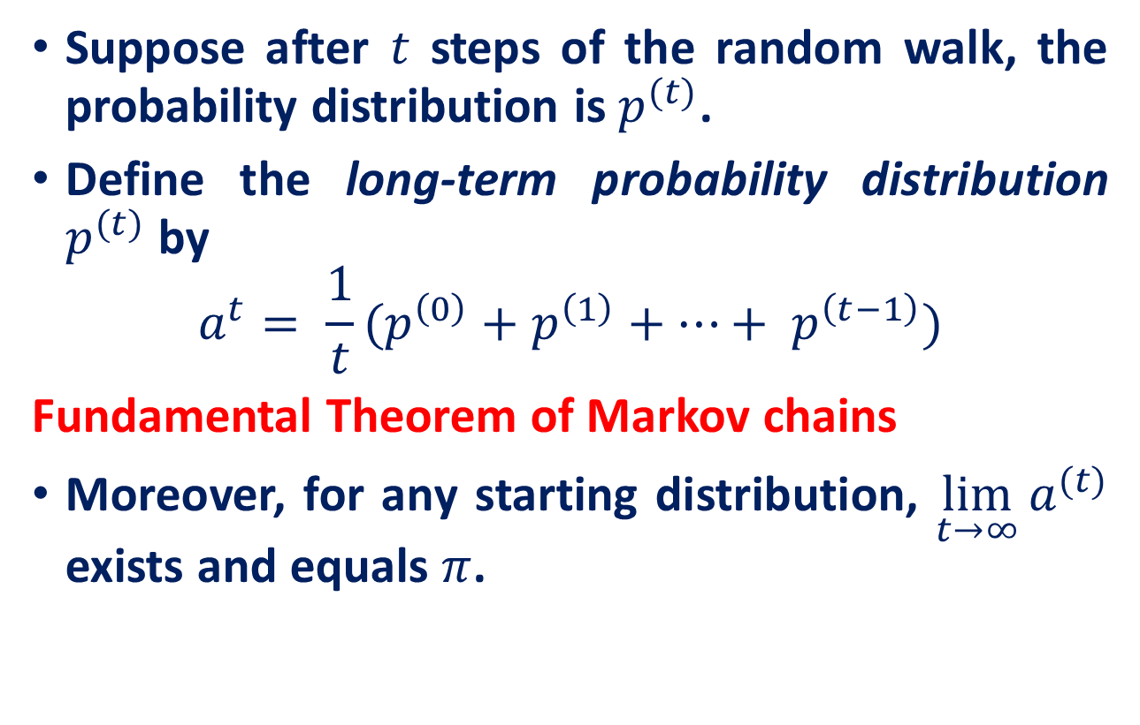
long-term probability distribution
Suppose after $t$ steps of the random walk, the probability distribution is $p^{(t)}$.
Define the long-term probability distribution $p^{(t)}$ by
$$a^{t}= \frac{1}{t}(p^{\left(0\right)}+p^{\left(1\right)}+…+ p^{\left(t−1\right)})$$
Fundamental Theorem of Markov chains
Moreover, for any starting distribution, $\lim_{t→∞}{a^{(t)}}$ exists and equals $π$.

Slide 47
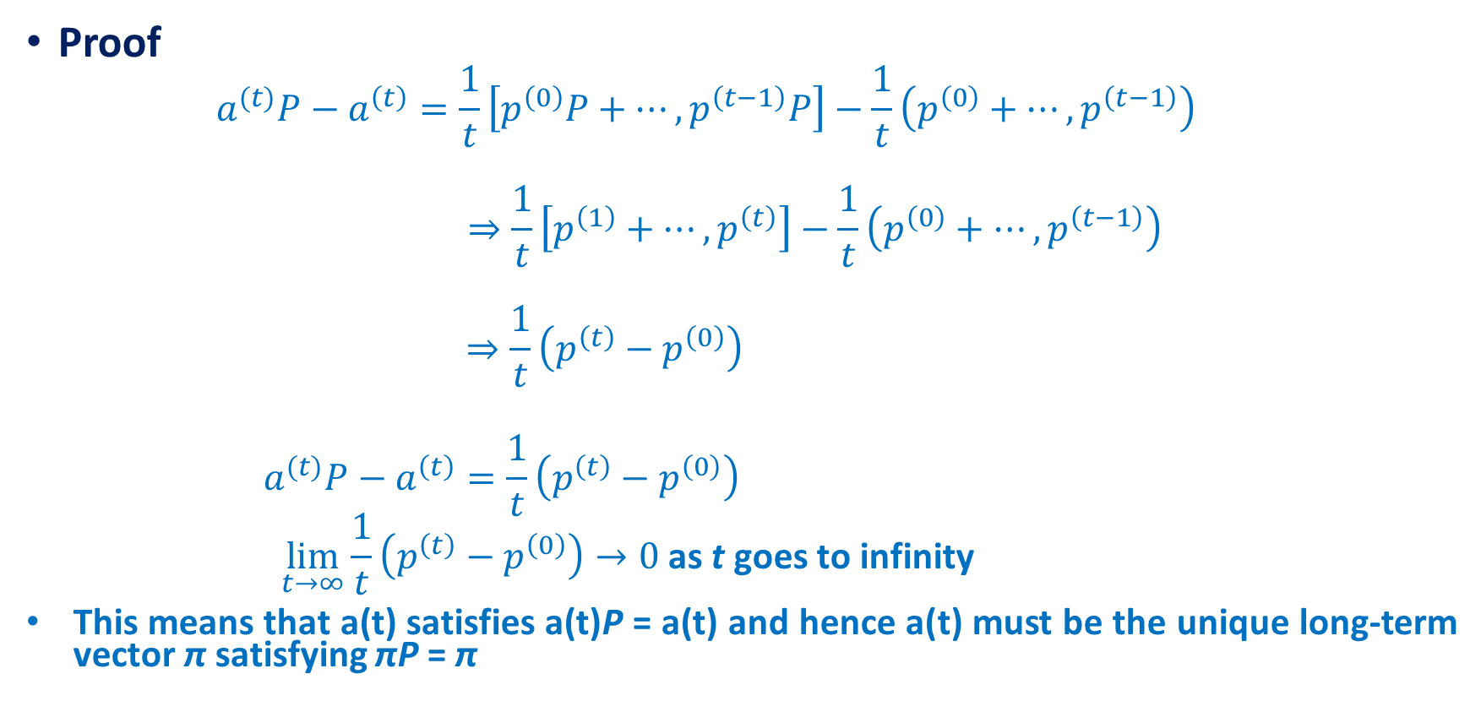
long-term probability distribution
Proof
$$a^{(t)}P−a^{\left(t\right)}=\frac{1}{t}\left[p^{\left(0\right)}P+…, p^{\left(t−1\right)}P\right]−\frac{1}{t}\left(p^{\left(0\right)}+…, p^{\left(t−1\right)}\right)$$
$$⇒\frac{1}{t}\left[p^{\left(1\right)}+…, p^{\left(t\right)}\right]−\frac{1}{t}\left(p^{\left(0\right)}+…, p^{\left(t−1\right)}\right)$$
$$⇒\frac{1}{t}\left(p^{\left(t\right)}−p^{\left(0\right)}\right)$$
$$a^{(t)}P−a^{\left(t\right)}=\frac{1}{t}\left(p^{\left(t\right)}−p^{\left(0\right)}\right)$$
$$\lim_{t→∞}{\frac{1}{t}\left(p^{\left(t\right)}−p^{\left(0\right)}\right)→0 \text{as} \text{t} \text{goes} \text{to} \text{infinity} }$$
This means that a(t) satisfies a(t)P = a(t) and hence a(t) must be the unique long-term vector π satisfying πP = π

Slide 48
Markov Chain
Example: gambler’s assets

Slide 49
Correspondence between terminology of random walks and Markov chains
Random walk | Markov Chain
Vertex | State
Strongly connected | Persistent, Irreducible
Aperiodic | Aperiodic
Strongly connected and aperiodic | Ergotic
Undirected graph | Time reversible

Slide 50
Random Walks on Undirected Graphs with Unit Edge Weights

Slide 51

Hitting time
The hitting time $h_{xy}$, sometimes called discovery time, is the expected time of a random walk starting at vertex x to reach vertex y.
Important Facts
Adding edges to a graph may either increase or decrease $h_{xy}$ depending on the particular situation.
Adding an edge can shorten the distance from x to y thereby decreasing $h_{xy}$ or the edge could increase the probability of a random walk going to some far off portion of the graph thereby increasing $h_{xy}$.
Another interesting fact is that hitting time is not symmetric.

Slide 52




Hitting time
Lemma: The expected time for a random walk starting at one end of a path of n vertices to reach the other end is $Θ(n^{2})$.
Proof: Consider walking from vertex 1 to vertex n in a graph consisting of a single path of n vertices. Let $h_{ij}$, $i<j$, be the hitting time of reaching$j$starting from i. Now $h_{12}$ = 1 and
$$h_{i,i+1}=\frac{1}{2}∗1+\frac{1}{2}∗1+\frac{1}{2}h_{i−1,i+1}=1+\frac{1}{2}\left(h_{i−1,i}+h_{i,i+1}\right),2≤i≤n−1$$
Solving for $h_{i,i+1}$ yields the recurrence
$$h_{i,i+1}=2+h_{i−1,i}$$
Solving the recurrence yields
$$h_{i,i+1}=2i−1$$
$i→i+1$
$i→i−1$
$i−1 →i+1$

Slide 53

Hitting time
$$h_{i,i+1}=2i−1$$
To get from 1 to n, go from 1 to 2, 2 to 3, etc. Thus
$$h_{1,n}=\sum_{i=1}^{n−1}{h_{i,i+1}=}\sum_{i=1}^{n−1}{(2i−1)}$$
$$=\sum_{i=1}^{n−1}{2i}−\sum_{i=1}^{n−1}{1}$$
$$=2\frac{n(n−1)}{2}−\left(n−1\right)$$
$$={\left(n−1\right)}^{2}$$

Slide 54

Commute time and Cover time
Commute time
The commute time, commute(x, y), is the expected time of a random walk starting at x reaching y and then returning to x.
$$commute(x, y) =h_{xy}+h_{yx}.$$
Cover time
The cover time of a graph G=(V,E) is the maximum over all $v∈V$of the expected time to visit all of the nodes in the graph by a random walk starting from v.

Slide 55
Random Walks in Euclidean Space

Slide 56


Random Walks in Euclidean Space
Random walks in Euclidean d-space consisting of fixed length steps parallel to the coordinate axes.
$ℝ^{d}$: d-dimensional Euclidean space
$ℤ^{d}$ = set of all d-tuples with integer coefficients
= $\{(z_{1}, . . . , z_{d}) :z_{i}∈ℤ\}$
A particle starts at the origin of $ℤ^{d}$. At each unit of time the particle randomly selects one of its 2d nearest neighbours and moves there. This is called a random walk.
For Example, on $ℤ^{2}$:
At each step the particle can move either up, down, left or right. This is sometimes called a drunkard’s walk.

Slide 57

drunkard’s walk
A “drunk” steps out of the bar and is so intoxicated that he stumbles at random.
Imagine the bar situated at the centre of a large grid of streets.
With each step the drunk is equally likely to go north, south, east or west.
Imagine that the drunk also has a home.
Now, suppose that we release the drunk and let him walk (randomly) and that
At the bar, he has a drink and leaves at the next time step.
At home, he has a nap and leaves at the next time step.

Slide 58
drunkard’s walk
CLAIM The drunkard returns to the bar infinitely often; but also returns home infinitely often.
IN FACT
In one dimension, the drunk will return to the bar infinitely often.
In two dimensions, the drunk will return to the bar infinitely often.
In three dimensions, the drunk will not return to the bar infinitely often. That is, he will go to the bar one final time, have his final drink, and wander off . . . never to return again.

Slide 59


drunkard’s walk
More formally, a simple random walk on $ℤ^{d}$ is a random walk in which the probability of moving from a point to any one of its $2d$ nearest neighbours is $1/2d$.
Example, simple random walk on $ℤ^{3}$
Choose any neighbour with probability 1/6.

Slide 60

random walk on $ℤ^{d}$ starting at the origin
Let $p_{esc}=Pr\{walk never returns to 0\}$
Definition:
A random walk is recurrent iff $p_{esc}$ = 0.
A random walk is transient iff $p_{esc}$ > 0.
Theorem:
A simple random walk on the d-dimensional lattice $ℤ^{d}$ is recurrent for d = 1 and d = 2, but is transient for d ≥ 3.
That is, for d = 1, 2 it is “certain” to return to the origin, but for d ≥ 3 it is not.
State i is said to be
Recurrent if the process will definitely return to state I
Transient if there is a positive probability that the process will move to state j and never return to state
Absorbing if p _{ii} = 1, i.e. we can never leave that state (an absorbing state is a recurrent state)

Slide 61

random walk on 1-D starting at the origin
let $u_{n} = Pr\{walk starting at 0 is at 0 on n^{th} step\}$
$$u_{0} = 1$$
Define a random variable as follows:
$$e_{n}= \left\{\begin{aligned}1,\text{if} \text{walker} \text{is} \text{at}\text{ 0 }\text{at} \text{time} \text{n} \\ 0,\text{otherwise} \end{aligned}\right.$$
Thus, the total number of times at 0.
$$T= \sum_{n=0}^{∞}{e_{n}}$$
Let m = expected number of times at 0.
So,
$$m=E\left[T\right]= \sum_{n=0}^{∞}{E[e_{n}]}$$
But, $E[e_{n}] = 1 · u_{n} + 0 · (1 − u_{n})$

Slide 62


random walk on1-D starting at the origin
So,
$$m=E\left[T\right]= \sum_{n=0}^{∞}{E[e_{n}]}=\sum_{n=0}^{∞}{u_{n}}$$
Recurrent $⇔∑u_{n}$ diverges transience$⇔∑u_{n}$ converges

Slide 63



random walk on1-D starting at the origin
To return to origin walker must take same number of steps left as right.
only even return times are possible
$$u_{2n}= {\left(\frac{1}{2}\right)}^{2n}∗\text{ (}\text{number} \text{possible} \text{paths}\text{) }$$
$$\text{=}\left(\begin{aligned}2n \\ n\end{aligned}\right){\left(\frac{1}{2}\right)}^{2n}$$
Stirling Formula: $n!≈ \sqrt{2πn}e^{−n}n^{n}$
$$u_{2n}=\frac{2n!}{n!\left(2n−n\right)!}{\left(\frac{1}{2}\right)}^{2n}$$
$$≈\frac{\sqrt{2π2n}e^{−2n}{(2n)}^{2n}}{{\left(\sqrt{2πn}e^{−n}n^{n}\right)}^{2}2^{(2n)}}=\frac{1}{\sqrt{πn}}$$
Thus
$$\sum_{n}{u_{2n}}≈\sum_{n}{\frac{1}{\sqrt{πn}}}$$
Simple random walk in one dimension is recurrent.
$\text{number} \text{of} \text{ways} \text{taking} \text{n} \text{steps} \text{to} \text{the} \text{right}\text{/}\text{left}$ out of 2n
$$\text{number} \text{of} \text{ways} \text{taking} \text{n} \text{steps} \text{to} \text{the} \text{right} \text{and} \text{n} \text{to} \text{the} \text{left}$$

Slide 64

random walk on 2-D starting at the origin
To return the walker must take . . .
same number of steps left as right, AND
the same number of steps up as down.
Now, there are 4 choices for the walker in making a jump, so there are$4^{2n}$ path of length 2n.
every path that returns in 2n steps has probability ${\left(\frac{1}{4}\right)}^{2n}$of occurring
The number of paths with k steps left, k steps right, n-k steps up, n-k steps down is
$$\left(\begin{aligned}2n \\ k,k,n−k,n−k\end{aligned}\right)=\frac{2n!}{k!k!\left(n−k!\right)\left(n−k\right)!}$$

Slide 65

random walk on 2-D starting at the origin
$$u_{2n}={\left(\frac{1}{4}\right)}^{2n}\sum_{k=0}^{n}{\frac{2n!}{k!k!\left(n−k!\right)\left(n−k\right)!}}$$
$$={\left(\frac{1}{4}\right)}^{2n}\sum_{k=0}^{n}{\frac{2n!n!n!}{n!n!k!k!\left(n−k!\right)\left(n−k\right)!}}$$
$$={\left(\frac{1}{4}\right)}^{2n}\left(\begin{aligned}2n \\ n\end{aligned}\right)\sum_{k=0}^{n}{{\left(\begin{aligned}n \\ k\end{aligned}\right)}^{2}}$$
Note
$$\sum_{k=0}^{n}{{\left(\begin{aligned}n \\ k\end{aligned}\right)}^{2}}=\left(\begin{aligned}2n \\ n\end{aligned}\right)$$
Hence
$$u_{2n}={\left(\frac{1}{2^{2n}}\left(\begin{aligned}2n \\ n\end{aligned}\right)\right)}^{2}$$

Slide 66

random walk on 2-D starting at the origin
$$u_{2n}={\left(\frac{1}{2^{2n}}\left(\begin{aligned}2n \\ n\end{aligned}\right)\right)}^{2}$$
it is just square of one dimensional result
$m= \sum_{n}{u_{2n}≈\sum_{n}{\frac{1}{πn}}}=∞$
Hence, Simple random in two dimensions is also recurrent.

Slide 67

random walk on 3-D starting at the origin
Similarly, In 3-D
$m= \sum_{n}{u_{2n}}K\sum_{n}{\frac{1}{n^{3/2}}}<∞$
Hence, Simple random in three dimensions is also transient.

Slide 68
Acknowledgements
Partial Reference List
Random Walks on Graphs: An Overview, Purnamitra Sarkar
Random Walks: Basic Concepts and Applications , Laura Ricci
The PageRank Citation Ranking: Bring Order to the web, Fei Li
A First Course in Stochastic Processes
Markov Chains and Random Walks

