Slide 1
Clustering Techniques

Slide 2
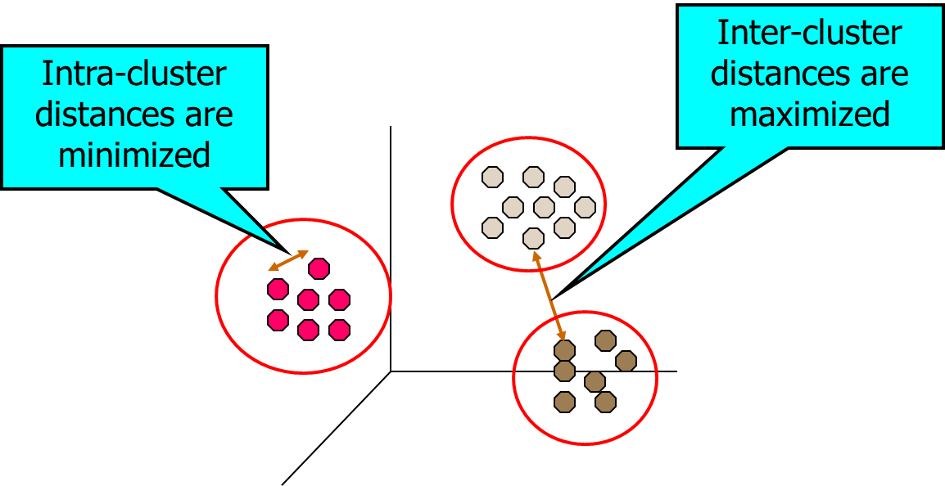
Clustering
Cluster: a collection of data objects
Similar to one another within the same cluster
Dissimilar to the objects in other clusters
Clustering is a technique for finding groups of objects such that the objects in a group will be similar (or related) to one another and different from (or unrelated to) the objects in other groups
Clustering is often called an unsupervised learning task as no class values denoting an a priori grouping of the data instances are given, which is the case in supervised learning.

Slide 3
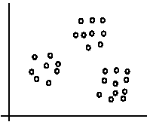
An illustration
The data set has three natural groups of data points, i.e., 3 natural clusters.

Slide 4
Notion of a Cluster can be Ambiguous
How many clusters?
Six Clusters
Two Clusters
Four Clusters

Slide 5
What Is Good Clustering?
A good clustering method will produce high quality clusters with
high intra-class similarity
low inter-class similarity
The quality of a clustering result depends on both the similarity measure used by the method and its implementation.

Slide 6
Examples of Clustering Applications
Marketing: Help marketers discover distinct groups in their customer bases, and then use this knowledge to develop targeted marketing programs
Land use: Identification of areas of similar land use in an earth observation database
Insurance: Identifying groups of motor insurance policy holders with a high average claim cost
City-planning: Identifying groups of houses according to their house type, value, and geographical location
Earth-quake studies: Observed earth quake epicenters should be clustered along continent faults

Slide 7
Requirements of Clustering in Data Mining
Scalability
Ability to deal with different types of attributes
Discovery of clusters with arbitrary shape
Minimal requirements for domain knowledge to determine input parameters
Able to deal with noise and outliers
Insensitive to order of input records
High dimensionality
Incorporation of user-specified constraints
Interpretability and usability

Slide 8
Major Clustering Approaches
Partitioning algorithms: Construct various partitions and then evaluate them by some criterion
Hierarchy algorithms: Create a hierarchical decomposition of the set of data (or objects) using some criterion
Density-based: A cluster is defined as a maximal set of density connected points
Grid-based: These algorithms partition the data space into a finite number of cells to form a grid structure and then form clusters from the cells in the grid structure. Clusters correspond to regions that are more dense in data points than their surroundings

Slide 9
Partitioning Clustering Approach
Partitioning algorithms construct partition of a database of N objects into a set of K clusters.
The partitioning clustering algorithm usually adopts the Iterative Optimization paradigm. It starts with an initial partition and uses an iterative control strategy.
It tries swapping data points to see if such a swapping improves the quality of clustering. When swapping does not yield any improvements in clustering, it finds a locally optimal partitioning
in principle, optimal partition achieved via minimizing the sum of squared distance to its “representative object” in each cluster
e.g., Euclidean distance

Slide 10
K-means algorithm
Given the cluster number K, the K-means algorithm is carried out in three steps after initialization:
Initialization: set seed points (randomly)
Assign each object to the cluster of the nearest seed point measured with a specific distance metric
Compute new seed points as the centroids of the clusters of the current partition (the centroid is the centre, i.e., mean point, of the cluster)
Go back to Step 1), stop when no more new assignment (i.e., membership in each cluster no longer changes)

Slide 11
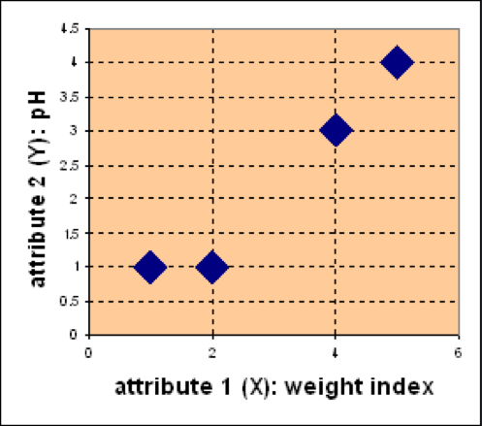
K-means - Example
Problem:
Suppose we have 4 types of medicines and each has two attributes (pH and weight index). Our goal is to group these objects into K=2 group of medicine.
Medicine | Weight | pH-Index
A | 1 | 1
B | 2 | 1
C | 4 | 3
D | 5 | 4
D
C
A
B

Slide 12
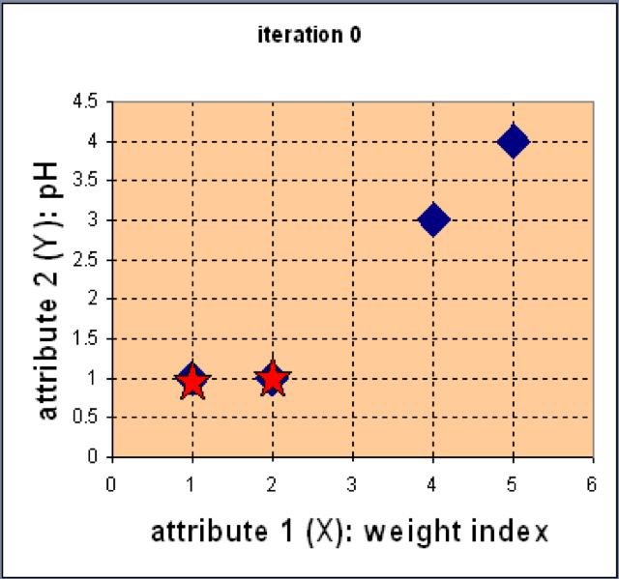
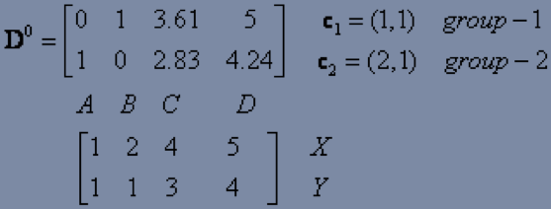
K-means - Example
Step 1: Use initial seed points for partitioning
Assign each object to the cluster
with the nearest seed point

Slide 13
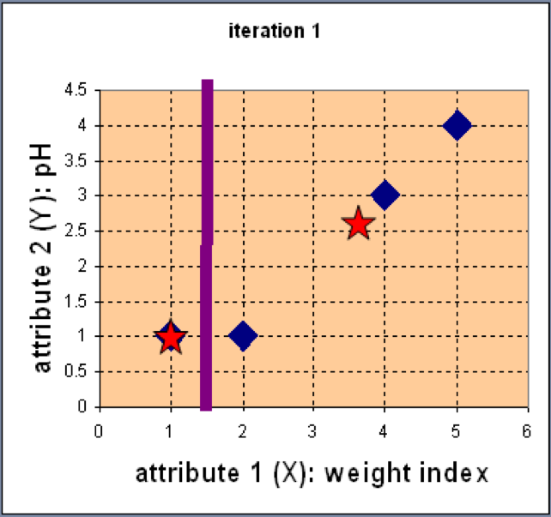
K-means - Example
Step 2: Compute new centroids of the current partition
Knowing the members of each cluster, now we compute the new centroid of each group based on these new memberships.

Slide 14
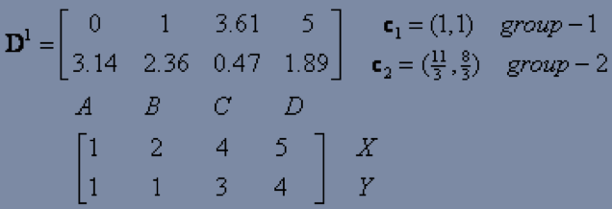
K-means - Example
Step 2: Renew membership based on new centroids
Compute the distance of all objects to the new centroids
Assign the membership to objects

Slide 15
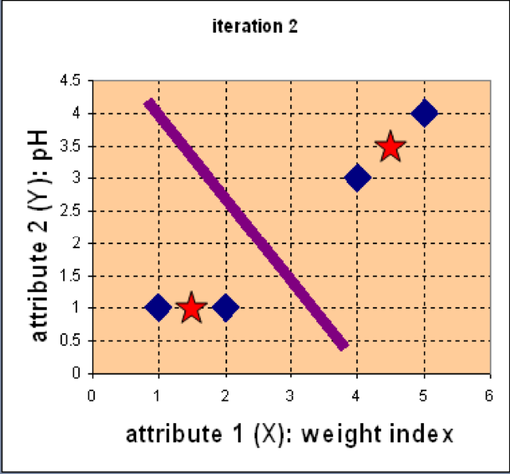
K-means - Example
Step 3: Repeat the first two steps until its convergence
Knowing the members of each cluster, now we compute the new centroid of each group based on these new memberships.

Slide 16
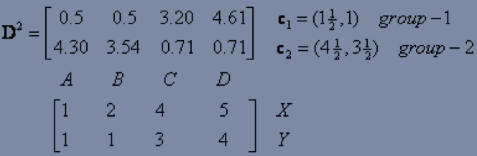
K-means - Example
Step 3: Repeat the first two steps until its convergence
Compute the distance of all objects to the new centroids
Stop due to no new assignment
Membership in each cluster no longer change

Slide 17
Strengths of k-means
Strengths:
Simple: easy to understand and to implement
Efficient: Time complexity: O(tkn), where n is the number of data points, k is the number of clusters, and t is the number of iterations.

Slide 18
Weaknesses of k-means
The algorithm is only applicable if the mean is defined.
The user needs to specify k.
The algorithm is sensitive to outliers
Outliers are data points that are very far away from other data points.
Outliers could be errors in the data recording or some special data points with very different values.

Slide 19
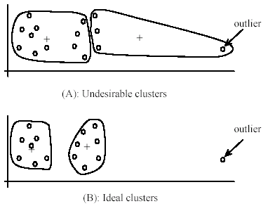
Weaknesses of k-means: Problems with outliers

Slide 20
Weaknesses of k-means: To deal with outliers
One method is to remove some data points in the clustering process that are much further away from the centroids than other data points.
To be safe, we may want to monitor these possible outliers over a few iterations and then decide to remove them.
Another method is to perform random sampling. Since in sampling we only choose a small subset of the data points, the chance of selecting an outlier is very small.
Assign the rest of the data points to the clusters by distance or similarity comparison, or classification

Slide 21
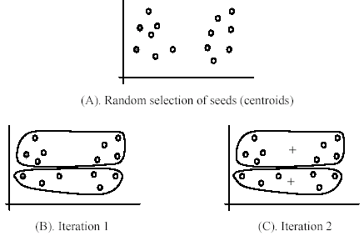
Weaknesses of k-means
The algorithm is sensitive to initial seeds.

Slide 22
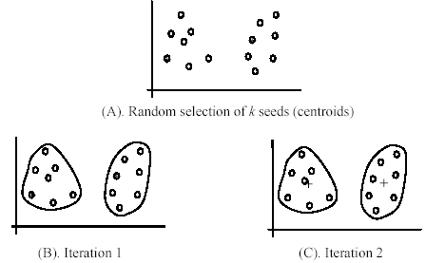
Weaknesses of k-means
If we use different seeds: good results
There are some methods to help choose good seeds

Slide 23
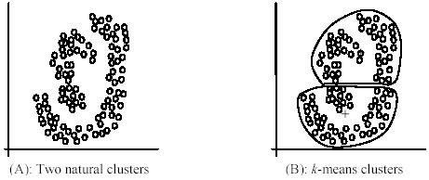
Weaknesses of k-means
The k-means algorithm is not suitable for discovering clusters that are not hyper-ellipsoids (or hyper-spheres).

Slide 24
The K-Medoids Clustering Method
Find representative objects, called medoids, in clusters
PAM (Partitioning Around Medoids)
The algorithm is intended to find a sequence of objects called medoids that are centrally located in clusters
The goal of the algorithm is to minimize the average dissimilarity of objects to their closest selected object.
PAM works effectively for small data sets, but does not scale well for large data sets
CLARA
CLARANS

Slide 25
PAM Partition Around Medoids
Pick a number, k, of random data items as medoids
Calculate
If TC_{mn} < 0, replace m by n and go back to 2
Assign every item to its nearest medoid
The pair (n,m) of medoid/non-medoid
with the smallest impact on clustering quality

Slide 26
Swapping Cost
For each pair of a medoid m and a non-medoid object h, measure whether h is better than m as a medoid
Use some distance measure, for example squared-error criterion
Compute E_{h}-E_{m}
Negative: swapping brings benefit
Choose the minimum swapping cost

Slide 27
K-medoids Example
X1 | 2 | 6
X2 | 3 | 4
X3 | 3 | 8
X4 | 5 | 7
X5 | 6 | 2
X6 | 6 | 4
X7 | 7 | 3
X8 | 7 | 4
X9 | 8 | 5
x10 | 7 | 6
Distances | to X5 | to X9
X1 | 8 | 7
X2 | 5 | 6
X3 | 9 | 8
X4 | 7 | 6
X6 | 2 | 3
X7 | 2 | 3
X8 | 3 | 2
x10 | 5 | 2
Assume k=2
Select X5 and X9 as medoids
Current clustering: {X2,X5,X6,X7},{X1,X3,X4,X8,X9,X10}

Slide 28
K-medoids Example
X1 | 2 | 6
X2 | 3 | 4
X3 | 3 | 8
X4 | 5 | 7
X5 | 6 | 2
X6 | 6 | 4
X7 | 7 | 3
X8 | 7 | 4
X9 | 8 | 5
x10 | 7 | 6
So, now let us choose some other point to be a medoid instead of X5 (6, 2). Let us randomly choose X1 (2, 6).
Not the new medoid set is: (2, 6) and (8, 5). Now repeating the same task as earlier:
Replace X5 by X1 | Before | to X1 | To X9 | Change
X1 | 7 | 0 | 0 | -7
X2 | 5 | 3 | 6 | -2
X3 | 8 | 3 | 8 | -5
X4 | 6 | 4 | 6 | -2
X5 | 0 | 8 | 5 | 5
X6 | 2 | 6 | 3 | 1
X7 | 2 | 8 | 3 | 1
X8 | 2 | 7 | 2 | 0
X9 | 0 | 0 | 0 | 0
x10 | 2 | 5 | 2 | 0
 |  |  |  | -9
Current clustering: {X1,X2,X3,X4},{X5,X6,X7,X8,X9,X10}

Slide 29
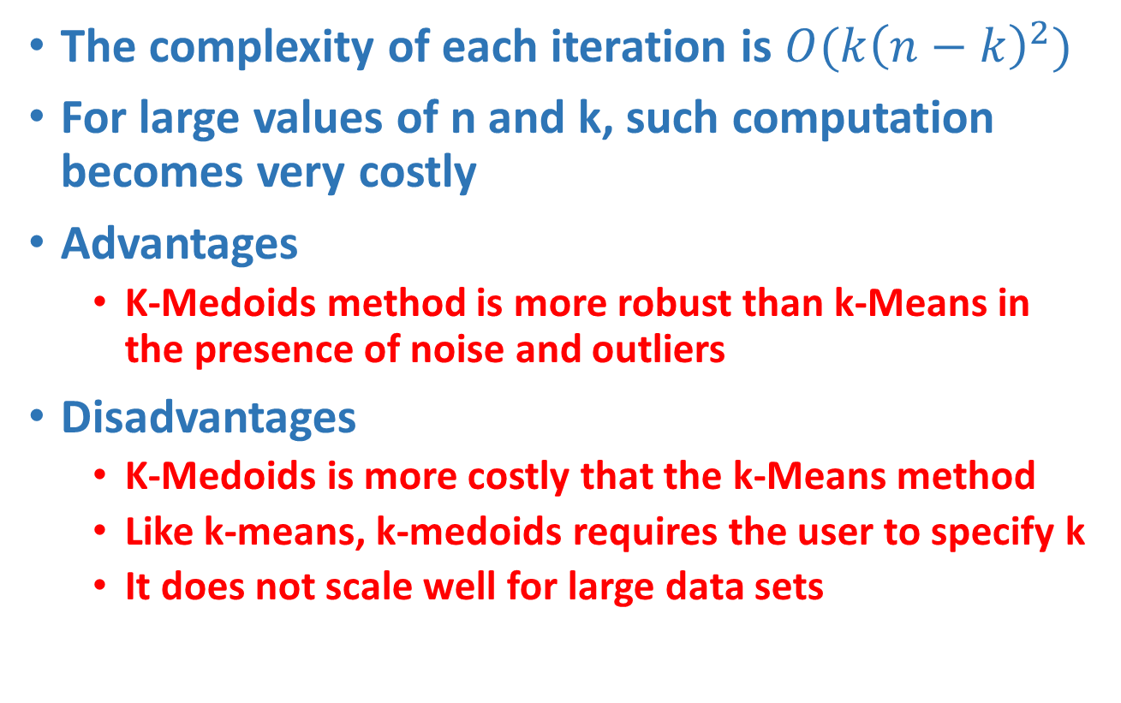
K-medoids Properties
The complexity of each iteration is $O(k{\left(n−k\right)}^{2})$
For large values of n and k, such computation becomes very costly
Advantages
K-Medoids method is more robust than k-Means in the presence of noise and outliers
Disadvantages
K-Medoids is more costly that the k-Means method
Like k-means, k-medoids requires the user to specify k
It does not scale well for large data sets

Slide 30
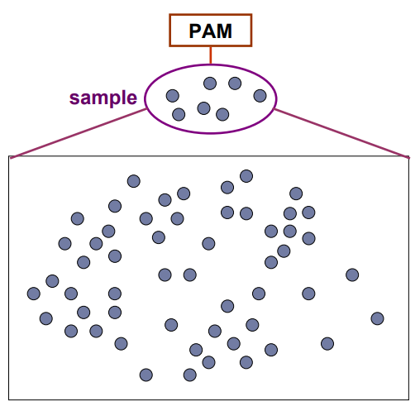
CLARA (Clustering Large Applications)
CLARA (Clustering Large Applications) uses a sampling-based method to deal with large data sets
A random sample should closely represent the original data
The chosen medoids will likely be similar to what would have been chosen from the whole data set

Slide 31
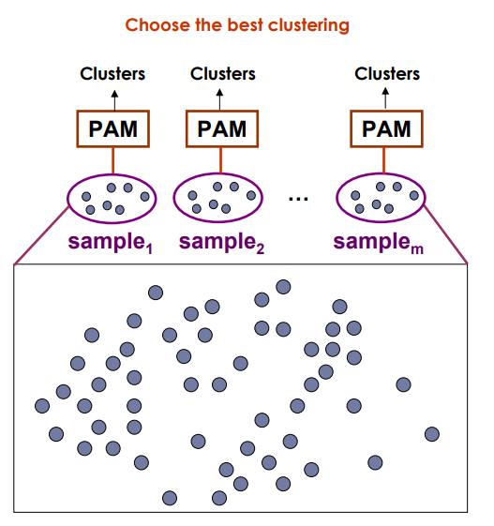
CLARA (Clustering Large Applications)
Draw multiple samples of the data set
Apply PAM to each sample
Return the best clustering

Slide 32
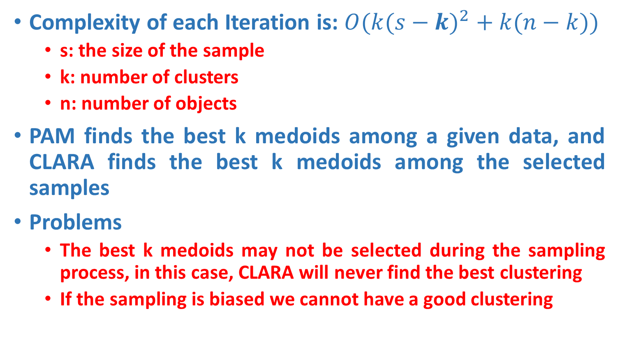
CLARA Properties
Complexity of each Iteration is: $O(k{(s−k)}^{2} + k(n−k))$
s: the size of the sample
k: number of clusters
n: number of objects
PAM finds the best k medoids among a given data, and CLARA finds the best k medoids among the selected samples
Problems
The best k medoids may not be selected during the sampling process, in this case, CLARA will never find the best clustering
If the sampling is biased we cannot have a good clustering

Slide 33
CLARA - Algorithm
Set mincost to MAXIMUM;
Repeat q times // draws q samples
Create S by drawing s objects randomly from D;
Generate the set of medoids M from S by applying the PAM algorithm;
Compute cost(M,D)
If cost(M, D)<mincost
Mincost = cost(M, D);
Bestset = M;
Endif;
Endrepeat;
Return Bestset;

Slide 34
Complexity of CLARA
Set mincost to MAXIMUM;
Repeat q times
Create S by drawing s objects randomly from D;
Generate the set of medoids M from S by applying the PAM algorithm;
Compute cost(M,D)
If cost(M, D)<mincost
Mincost = cost(M, D);
Bestset = M;
Endif;
Endrepeat;
Return Bestset;
O(1)
O((s-k)²*k+(n-k)*k)
O(1)
O((s-k)²*k)
O((n-k)*k)
O(1)

Slide 35
Hierarchical Clustering
Hierarchical Clustering Approach
A typical clustering analysis approach via partitioning data set sequentially
Construct nested partitions layer by layer via grouping objects into a tree of clusters (without the need to know the number of clusters in advance)
Use (generalised) distance matrix as clustering criteria
Agglomerative vs Divisive
Two sequential clustering strategies for constructing a tree of clusters
Agglomerative: a bottom-up strategy
Initially each data object is in its own (atomic) cluster
Then merge these atomic clusters into larger and larger clusters
Divisive: a top-down strategy
Initially all objects are in one single cluster
Then the cluster is subdivided into smaller and smaller clusters

Slide 36
Hierarchical Clustering
Agglomerative approach
Initialization:
Each object is a cluster
Iteration:
Merge two clusters which are
most similar to each other;
Until all objects are merged
into a single cluster
a
a b
b
a b c d e
c
c d e
d
d e
e
Step 0
Step 1
Step 2
Step 3
Step 4
bottom-up

Slide 37
Hierarchical Clustering
Divisive Approaches
Initialization:
All objects stay in one cluster
Iteration:
Select a cluster and split it into
two sub clusters
Until each leaf cluster contains
only one object
a
a b
b
a b c d e
c
c d e
d
d e
e
Step 4
Step 3
Step 2
Step 1
Step 0
Top-down

Slide 38
Dendrogram
A binary tree that shows how clusters are merged/split hierarchically
Each node on the tree is a cluster; each leaf node is a singleton cluster

Slide 39
Dendrogram
A clustering of the data objects is obtained by cutting the dendrogram at the desired level, then each connected component forms a cluster

Slide 40
Dendrogram
A clustering of the data objects is obtained by cutting the dendrogram at the desired level, then each connected component forms a cluster

Slide 41
How to Merge Clusters?
How to measure the distance between clusters?
Single-link
Complete-link
Average-link
Centroid distance
Distance?
Hint: Distance between clusters is usually defined on the basis of distance between objects.

Slide 42
How to Define Inter-Cluster Distance
Single-link
Complete-link
Average-link
Centroid distance
The distance between two clusters is represented by the distance of the closest pair of data objects belonging to different clusters.

Slide 43
How to Define Inter-Cluster Distance
Single-link
Complete-link
Average-link
Centroid distance
The distance between two clusters is represented by the distance of the farthest pair of data objects belonging to different clusters.

Slide 44
How to Define Inter-Cluster Distance
Single-link
Complete-link
Average-link
Centroid distance
The distance between two clusters is represented by the average distance of all pairs of data objects belonging to different clusters.

Slide 45
How to Define Inter-Cluster Distance
×
×
m_{i},m_{j} are the means of C_{i}, C_{j},
Single-link
Complete-link
Average-link
Centroid distance
The distance between two clusters is represented by the distance between the means of the cluters.

Slide 46
Cluster Distance Measures
Example: Given a data set of five objects characterized by a single continuous feature, assume that there are two clusters: C1: {a, b} and C2: {c, d, e}.
1. Calculate the distance matrix. 2. Calculate three cluster distances between C1 and C2.
a | b | c | d | e
1 | 2 | 4 | 5 | 6
Single link
Complete link
Average
 | a | b | c | d | e
a | 0 | 1 | 3 | 4 | 5
b | 1 | 0 | 2 | 3 | 4
c | 3 | 2 | 0 | 1 | 2
d | 4 | 3 | 1 | 0 | 1
e | 5 | 4 | 2 | 1 | 0

Slide 47
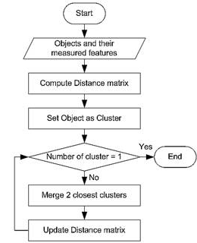
Agglomerative Algorithm
The Agglomerative algorithm is carried out in three steps:
Convert all object features into a distance matrix
Set each object as a cluster (thus if we have N objects, we will have N clusters at the beginning)
Repeat until number of cluster is one (or known # of clusters)
Merge two closest clusters
Update “distance matrix”

Slide 48
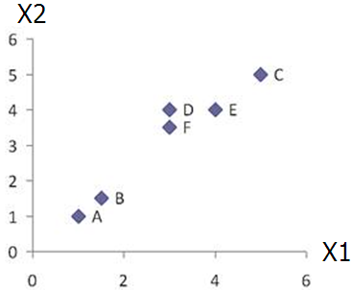
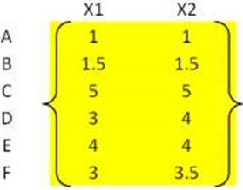
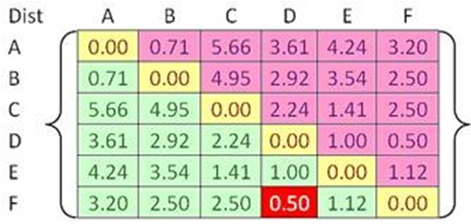


Example
Problem: clustering analysis with agglomerative algorithm
data matrix
Euclidean distance
distance matrix

Slide 49
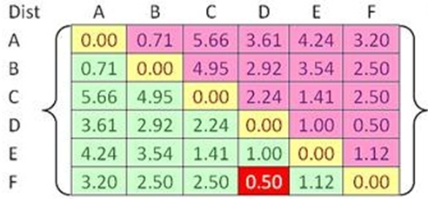
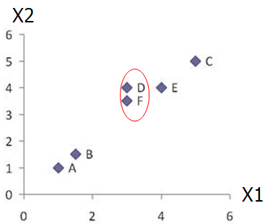
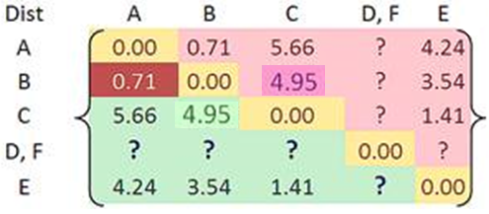

Example
Merge two closest clusters (iteration 1)

Slide 50
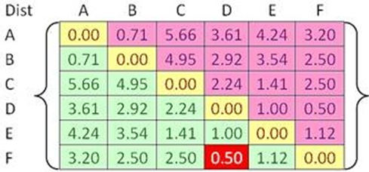

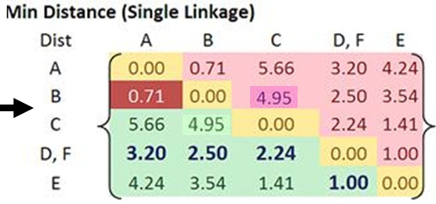
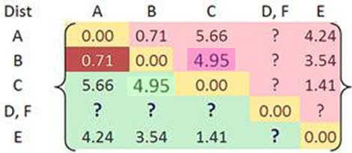
Example
Update distance matrix (iteration 1)

Slide 51
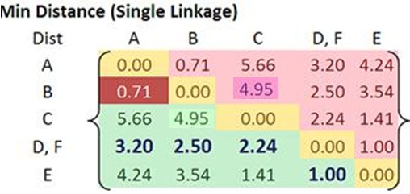
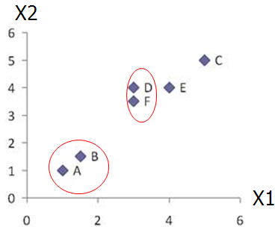
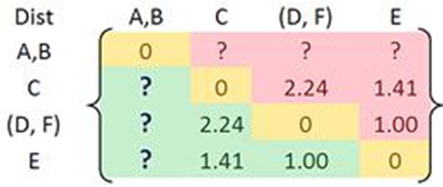
Example
Merge two closest clusters (iteration 2)

Slide 52
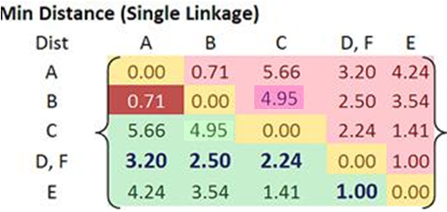
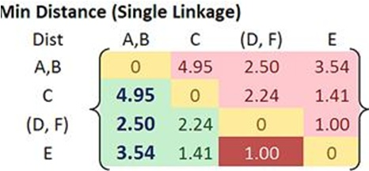

Example
Update distance matrix (iteration 2)

Slide 53
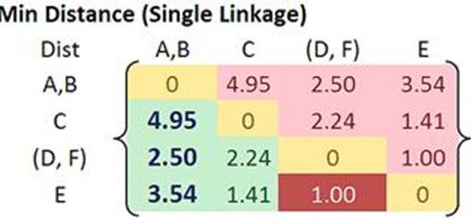
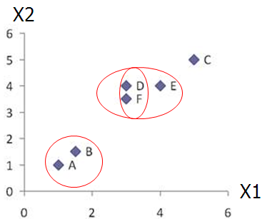
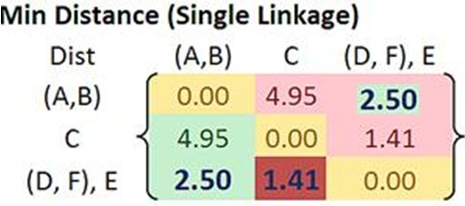

Example
Merge two closest clusters/update distance matrix (iteration 3)

Slide 54
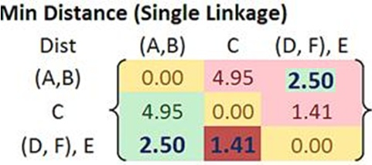
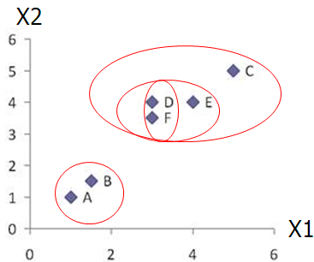
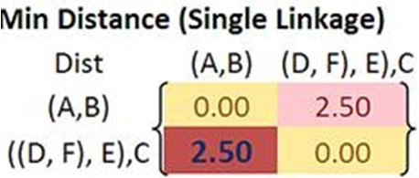

Example
Merge two closest clusters/update distance matrix (iteration 4)

Slide 55
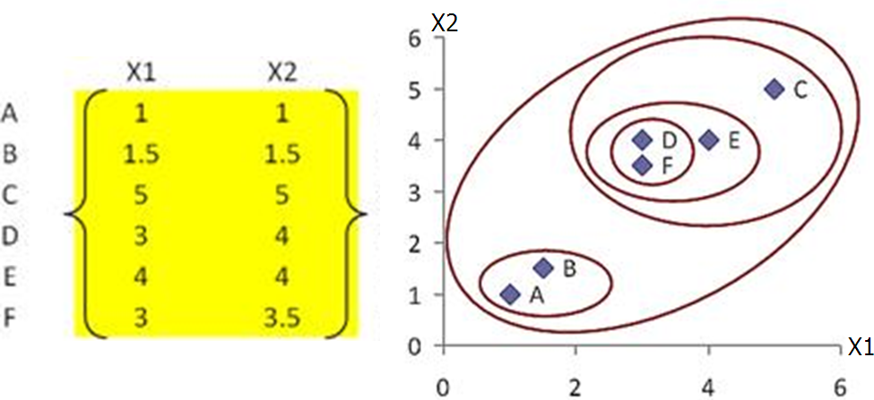
Example
Final result (meeting termination condition)

Slide 56
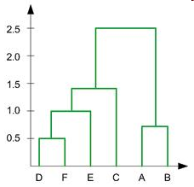
Example
Dendrogram tree representation
In the beginning we have 6
clusters: A, B, C, D, E and F
We merge clusters D and F into
cluster (D, F) at distance 0.50
We merge cluster A and cluster B
into (A, B) at distance 0.71
We merge clusters E and (D, F)
into ((D, F), E) at distance 1.00
We merge clusters ((D, F), E) and C
into (((D, F), E), C) at distance 1.41
We merge clusters (((D, F), E), C)
and (A, B) into ((((D, F), E), C), (A, B))
at distance 2.50
The last cluster contain all the objects,
thus conclude the computation
6
lifetime
5
4
3
2
object

Slide 57
Example
Dendrogram tree representation
For a dendrogram tree, its horizontal axis indexes all objects in a given data set, while its vertical axis expresses the lifetime of all possible cluster formation.
The lifetime of a cluster (individual cluster) in the dendrogram is defined as a distance interval from the moment that the cluster is created to the moment that it disappears by merging with other clusters.
6
lifetime
5
4
3
2
object

Slide 58
Which Distance Measure is Better?
Each method has both advantages and disadvantages; application-dependent, single-link and complete-link are the most common methods
Single-link
Can find irregular-shaped clusters
Sensitive to outliers, suffers the so-called chaining effects
Complete-link, Average-link, and Centroid distance
Robust to outliers
Tend to break large clusters
Prefer spherical clusters

Slide 59
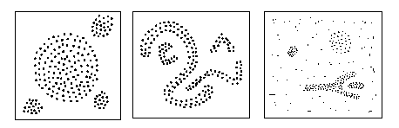
Density-Based Clustering Methods
Clustering based on local connectivity and density functions
Basic idea
Clusters are dense regions in the data space, separated by regions of lower object density
A cluster is defined as a maximal set of density connected points
Each cluster has a considerable higher density of points than outside of the cluster
Major features:
Discover clusters of arbitrary shape
Handle noise
One scan

Slide 60
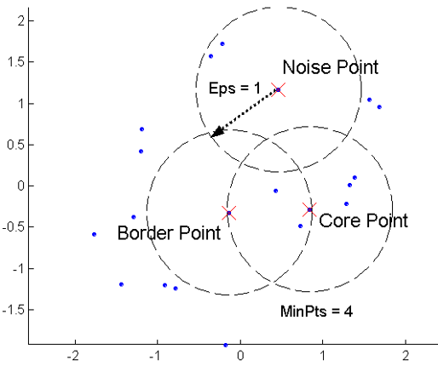
Density Based Spatial Clustering of Application of Noise (DBSCAN)
Two global parameters:
Eps: Maximum radius of the neighbourhood
MinPts: Minimum number of points in an Eps-neighbourhood of that point
Density = number of points within a specified radius r (Eps)
A point is a core point if it has more than a specified number of points (MinPts) within Eps
These are points that are at the interior of a cluster
A border point has fewer than MinPts within Eps, but is in the neighborhood of a core point
A noise point is any point that is not a core point or a border point.

Slide 61
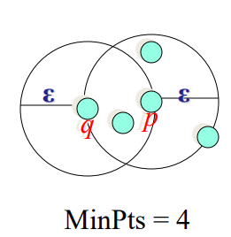
Density-reachability
An object q is directly density-reachable from object p, if p is a core object and q is in p’s Eps-neighborhood
q is directly density-reachable from p
p is not directly density-reachable from q
Density-reachability is asymmetric

Slide 62
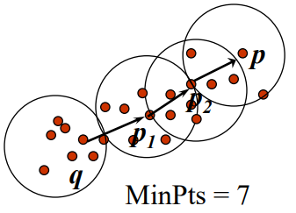
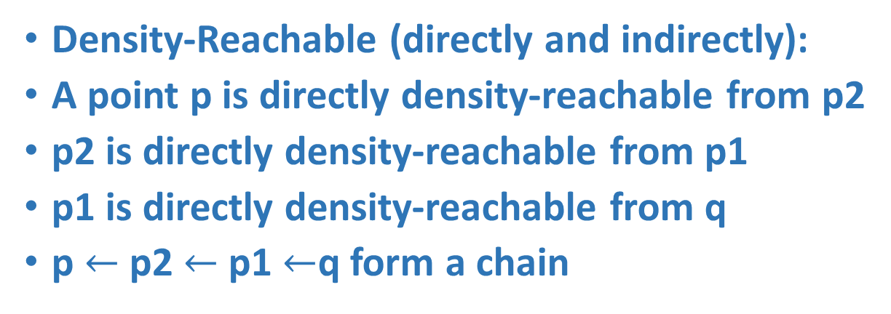
Density-reachability
Density-Reachable (directly and indirectly):
A point p is directly density-reachable from p2
p2 is directly density-reachable from p1
p1 is directly density-reachable from q
p $←$p2 $←$p1 $←$q form a chain
p is (indirectly) density-reachable from q
q is not density-reachable from p

Slide 63
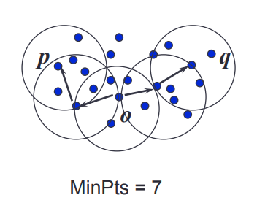
Density-Connectivity
A pair of points p and q are density-connected, If they are commonly density-reachable from a point o
Density-connectivity is symmetric

Slide 64
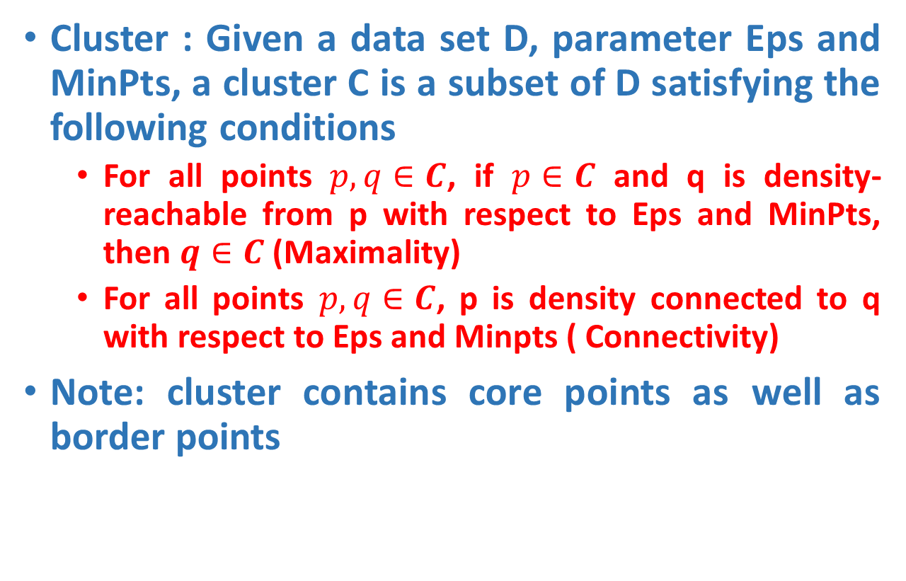
DBSCAN
Cluster : Given a data set D, parameter Eps and MinPts, a cluster C is a subset of D satisfying the following conditions
For all points $p, q∈C$, if $p∈C$ and q is density-reachable from p with respect to Eps and MinPts, then $q∈C$ (Maximality)
For all points $p, q∈C$, p is density connected to q with respect to Eps and Minpts ( Connectivity)
Note: cluster contains core points as well as border points

Slide 65
Review of Concepts
Is an object o in a cluster or an outlier?
Are objects p and q in the same cluster?
Are p and q density-connected?
Is o a core object?
Is o density-reachable by some core object?
Are p and q density-reachable by some object o?
Directly density-reachable
Indirectly density-reachable through a chain

Slide 66
DBSCAN-Algorithm
Input: The data set D
Parameter: ε, MinPts
For each object p in D
if p is a core object and not processed then
C = retrieve all objects density-reachable from p
mark all objects in C as processed
report C as a cluster
else mark p as outlier
end if
End For

Slide 67
DBSCAN-Example
Parameter
ε = 2 cm
MinPts = 3
for each o ∈ D do if o is not yet classified then if o is a core-object then collect all objects density-reachable from o and assign them to a new cluster. else assign o to NOISE

Slide 68
DBSCAN-Example
Parameter
ε = 2 cm
MinPts = 3
for each o ∈ D do if o is not yet classified then if o is a core-object then collect all objects density-reachable from o and assign them to a new cluster. else assign o to NOISE

Slide 69
DBSCAN-Example
Parameter
ε = 2 cm
MinPts = 3
for each o ∈ D do if o is not yet classified then if o is a core-object then collect all objects density-reachable from o and assign them to a new cluster. else assign o to NOISE

Slide 70
MinPts = 5
ε
P₁
ε
ε
C₁
P
P
C₁
C₁
1. Check the ε-neighborhood of p;
2. If p has less than MinPts neighbors then mark p as outlier and continue with the next object
3. Otherwise mark p as processed and put all the neighbors in cluster C
1. Check the unprocessed objects in C
2. If no core object, return C
3. Otherwise, randomly pick up one core object p₁, mark p₁ as processed, and put all unprocessed neighbors of p₁ in cluster C

Slide 71
ε
ε
C₁
C₁
ε
ε
C₁
C₁

Slide 72
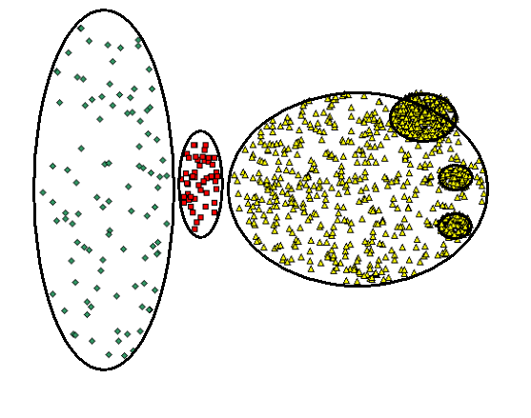
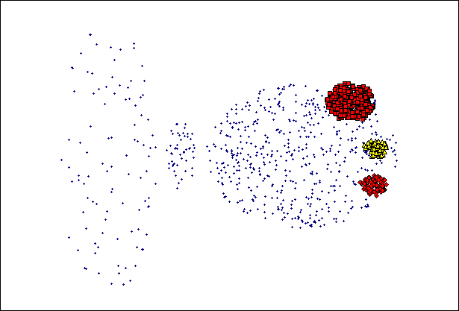
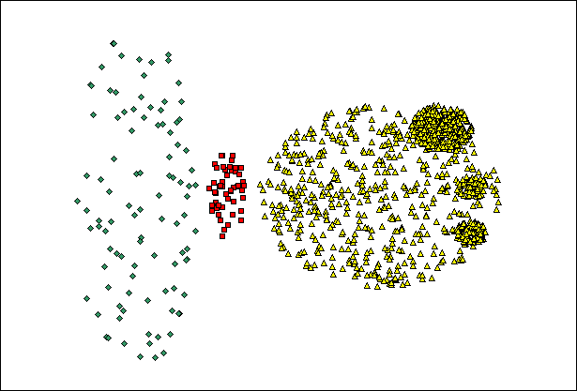
When DBSCAN Does NOT Work Well
Original Points
Cannot handle Varying densities
sensitive to parameters
(MinPts=4, Eps=9.75)

Slide 73


DBSCAN: Sensitive to Parameters

Slide 74
Density Based Clustering: Discussion
Advantages
Clusters can have arbitrary shape and size
Number of clusters is determined automatically
Can separate clusters from surrounding noise
Can be supported by spatial index structures
Disadvantages
Input parameters may be difficult to determine
In some situations very sensitive to input parameter setting

