Slide 1
Dimensionality reduction

Slide 2
Outline
From distances to points :
  MultiDimensional Scaling (MDS)
  FastMap
Dimensionality Reductions or data projections
Random projections
Principal Component Analysis (PCA)

Slide 3
Multi-Dimensional Scaling (MDS)
So far we assumed that we know both data points X and distance matrix D between these points
What if the original points X are not known but only distance matrix D is known?
Can we reconstruct X or some approximation of X?

Slide 4
Problem
Given distance matrix D between n points
Find a k-dimensional representation of every x_{i} point i
So that d(x_{i},x_{j}) is as close as possible to D(i,j)
Why do we want to do that?

Slide 5
How can we do that? (Algorithm)

Slide 6
High-level view of the MDS algorithm
Randomly initialize the positions of n points in a k-dimensional space
Compute pairwise distances D’ for this placement
Compare D’ to D
Move points to better adjust their pairwise distances (make D’ closer to D)
Repeat until D’ is close to D

Slide 7
The MDS algorithm
Input: nxn distance matrix D
Random n points in the k-dimensional space (x₁,…,x_{n})
stop = false
while not stop
  totalerror = 0.0
  For every i,j compute
    D’(i,j)=d(x_{i},x_{j})
    error = (D(i,j)-D’(i,j))/D(i,j)
    totalerror +=error
    For every dimension m: x_{im} = (x_{im}-x_{jm})/D’(i,j)*error
  If totalerror small enough, stop = true

Slide 8
Questions about MDS
Running time of the MDS algorithm
  O(n²I), where I is the number of iterations of the algorithm
MDS does not guarantee that metric property is maintained in d’
Faster? Guarantee of metric property?

Slide 9
Problem (revisited)
Given distance matrix D between n points
Find a k-dimensional representation of every x_{i} point i
So that:
  d(x_{i},x_{j}) is as close as possible to D(i,j)
  d(x_{i},x_{j}) is a metric
  Algorithm works in time linear in n

Slide 10
FastMap
Select two pivot points x_{a} and x_{b} that are far apart.
Compute a pseudo-projection of the remaining points along the “line” x_{a}x_{b}
“Project” the points to a subspace orthogonal to “line” x_{a}x_{b} and recurse.

Slide 11
Selecting the Pivot Points
The pivot points should lie along the principal axes, and hence should be far apart.
  Select any point x₀
  Let x₁ be the furthest from x₀
  Let x₂ be the furthest from x₁
  Return (x₁, x₂)
x₂
x₀
x₁

Slide 12
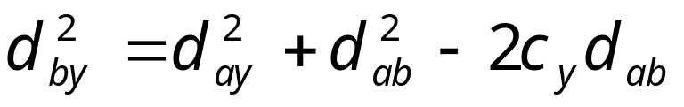
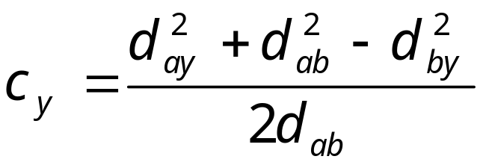
Pseudo-Projections
x_{b}
Given pivots (x_{a} , x_{b} ), for any third point y, we use the law of cosines to determine the relation of y along x_{a}x_{b}
The pseudo-projection for y is
This is first coordinate.
d_{b,y}
d_{a,b}
y
c_{y}
d_{a,y}
x_{a}

Slide 13
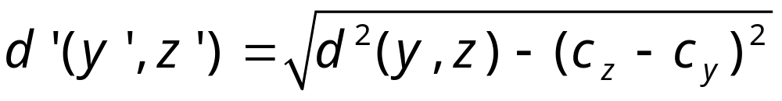
“Project to orthogonal plane”
c_{z}-c_{y}
x_{b}
Given distances along x_{a}x_{b} compute distances within the “orthogonal hyperplane”
Recurse using d ’(.,.), until k features chosen.
d_{y,z}
z
y
x_{a}
y’
d’_{y’,z’}
z’

Slide 14
The FastMap algorithm
D: distance function, Y: nxk data points
f=0 //global variable
FastMap(k,D)
  If k<=0 return
  (x_{a},x_{b})← chooseDistantObjects(D)
  If(D(x_{a},x_{b})==0), set Y[i,f]=0 for every i and return
  Y[i,f] = [D(a,i)²+D(a,b)²-D(b,i)²]/(2D(a,b))
  D’(i,j) // new distance function on the projection
  f++
  FastMap(k-1,D’)

Slide 15
FastMap algorithm
Running time
  Linear number of distance computations

Slide 16
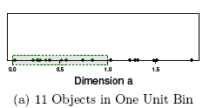
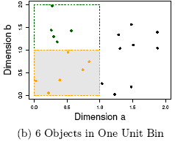
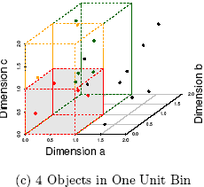
The Curse of Dimensionality
Data in only one dimension is relatively packed
Adding a dimension “stretches” the points across that dimension, making them further apart
Adding more dimensions will make the points further apart—high dimensional data is extremely sparse
Distance measure becomes meaningless
(graphs from Parsons et al. KDD Explorations 2004)

Slide 17
The curse of dimensionality
The efficiency of many algorithms depends on the number of dimensions d
  Distance/similarity computations are at least linear to the number of dimensions
  Index structures fail as the dimensionality of the data increases

Slide 18
Goals
Reduce dimensionality of the data
Maintain the meaningfulness of the data

Slide 19
Dimensionality reduction
Dataset X consisting of n points in a d-dimensional space
Data point x_{i}єR^{d} (d-dimensional real vector):
x_{i} = [x_{i1}, x_{i2},…, x_{id}]
Dimensionality reduction methods:
  Feature selection: choose a subset of the features
  Feature extraction: create new features by combining new ones

Slide 20
Dimensionality reduction
Dimensionality reduction methods:
  Feature selection: choose a subset of the features
  Feature extraction: create new features by combining new ones
Both methods map vector x_{i}єR^{d}, to vector y_{i} є R^{k}, (k<<d)
F : R^{d}→R^{k}

Slide 21
Linear dimensionality reduction
Function F is a linear projection
y_{i} = A x_{i}
Y = A X
Goal: Y is as close to X as possible

Slide 22
Closeness: Pairwise distances
Johnson-Lindenstrauss lemma: Given ε>0, and an integer n, let k be a positive integer such that k≥k₀=O(ε⁻² logn). For every set X of n points in R^{d} there exists F: R^{d}→R^{k} such that for all x_{i}, x_{j} єX
(1-ε)||x_{i} - x_{j}||²≤ ||F(x_{i} )- F(x_{j})||²≤ (1+ε)||x_{i} - x_{j}||²
What is the intuitive interpretation of this statement?

Slide 23
JL Lemma: Intuition
Vectors x_{i}єR^{d}, are projected onto a k-dimensional space (k<<d): y_{i} = R x_{i}
If ||x_{i}||=1 for all i, then,
||x_{i}-x_{j}||² is approximated by (d/k)||x_{i}-x_{j}||²
Intuition:
  The expected squared norm of a projection of a unit vector onto a random subspace through the origin is k/d
  The probability that it deviates from expectation is very small

Slide 24
JL Lemma: More intuition
x=(x₁,…,x_{d}), d independent Gaussian N(0,1) random variables; y = 1/|x|(x₁,…,x_{d})
z : projection of y into first k coordinates
  L = |z|², μ = E[L] = k/d
Pr(L ≥ (1+ε)μ)≤1/n² and Pr(L ≤ (1-ε)μ)≤1/n²
f(y) = sqrt(d/k)z
What is the probability that for pair (y,y’): |f(y)-f(y’)|²/(|y-y’|) does not lie in range [(1-ε),(1+ ε)]?
What is the probability that some pair suffers?

Slide 25
Finding random projections
Vectors x_{i}єR^{d}, are projected onto a k-dimensional space (k<<d)
Random projections can be represented by linear transformation matrix R
y_{i} = R x_{i}
What is the matrix R?

Slide 26
Finding random projections
Vectors x_{i}єR^{d}, are projected onto a k-dimensional space (k<<d)
Random projections can be represented by linear transformation matrix R
y_{i} = R x_{i}
What is the matrix R?

Slide 27
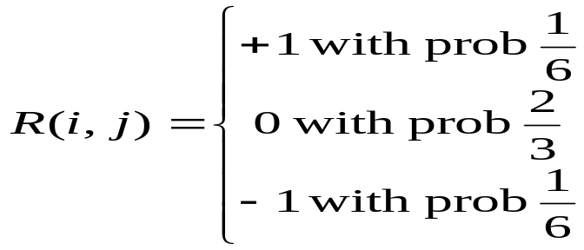
Finding matrix R
Elements R(i,j) can be Gaussian distributed
Achlioptas* has shown that the Gaussian distribution can be replaced by
All zero mean, unit variance distributions for R(i,j) would give a mapping that satisfies the JL lemma
Why is Achlioptas result useful?

