Slide 1
Data Processing and Storage Pipeline for E-Commerce Behavior Data
By:
Pradyoth SP (54)
Varun W R (64)
Bharath Anand (2)

Slide 2
Introduction
End-to-End Data Processing:
This project encompasses the entire spectrum of data processing, from ingestion to visualization.
Each stage contributes to the seamless flow of information, ensuring meaningful insights.
Technologies in Use:
Kafka: Powering real-time data streaming for efficient communication.
PySpark: Enabling scalable and distributed data processing.
Tableau: Transforming processed data into visually appealing insights.

Slide 3
Data
Source: Kaggle (eCommerce behavior data from multi category store)
Four events:
1. View
2. Add to cart
3. Remove from cart
4. Purchase
Size: 14.68 GB
Columns: 9

Slide 4
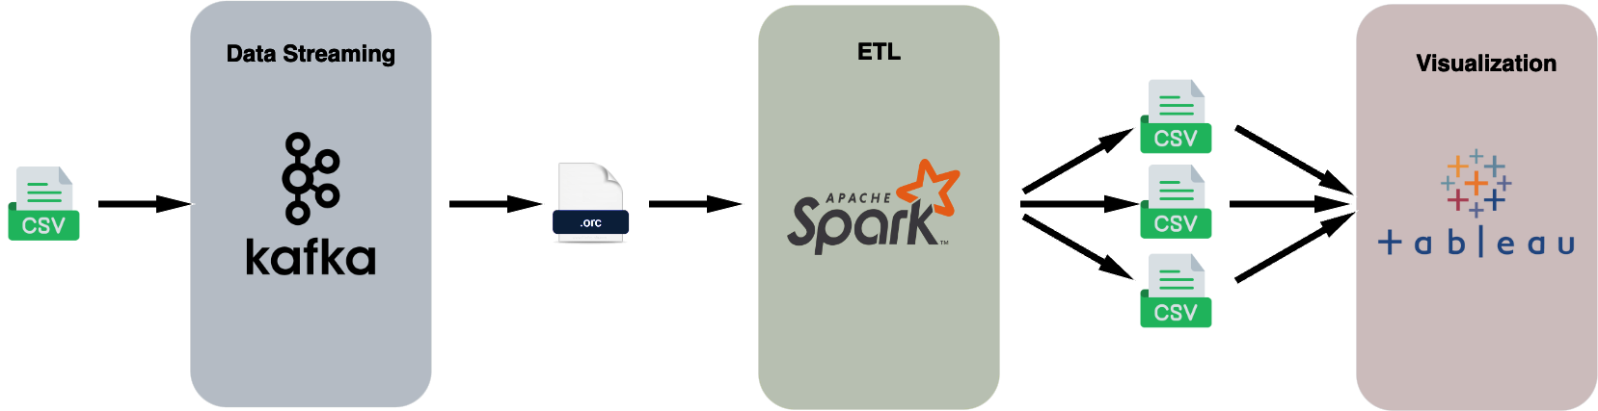
Project Workflow

Slide 5
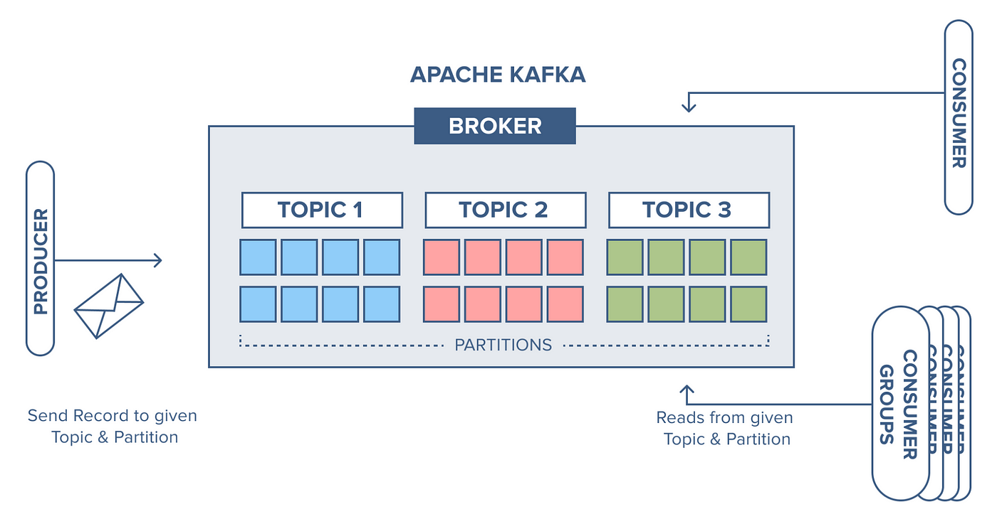
Kafka
Source: https://miro.medium.com/v2/resize:fit:1400/0*6FVLBloofcJp_RsF.png

Slide 6
Kafka Producer:
The producer script initiates the entire data pipeline process.
Its primary function is to read CSV data and seamlessly send it to the Kafka topic.
Batch size: 5000 rows

Slide 7
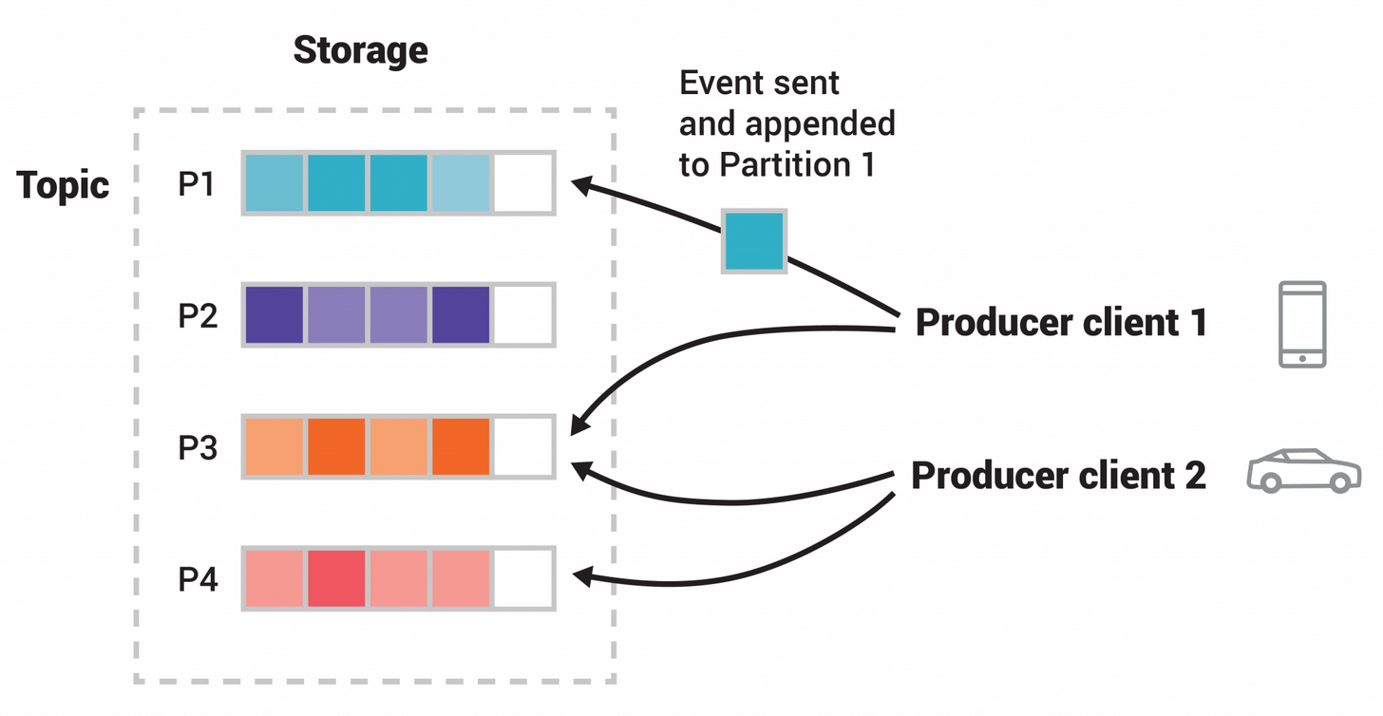
Kafka Topic:
A Kafka topic is a fundamental entity that categorizes and organizes messages sent by producers.
Key Kafka configurations, such as partitioning and replication, influence message distribution.

Slide 8
Kafka Consumer:
Kafka consumers subscribe to topics, establishing a connection to receive messages from producers.
Consumer scripts are designed to convert incoming messages, into the optimized ORC (Optimized Row Columnar) format.

Slide 9

PySpark Processing
The workflow involves reading ORC files, a columnar storage format, to efficiently handle large datasets.
Processed data is then saved, ensuring accessibility and seamless integration with downstream applications (Tableau).

Slide 10
PySpark Tasks:
Get top 10 categories.
Get top 10 interactions.
Get top 10 categories prices.

Slide 11
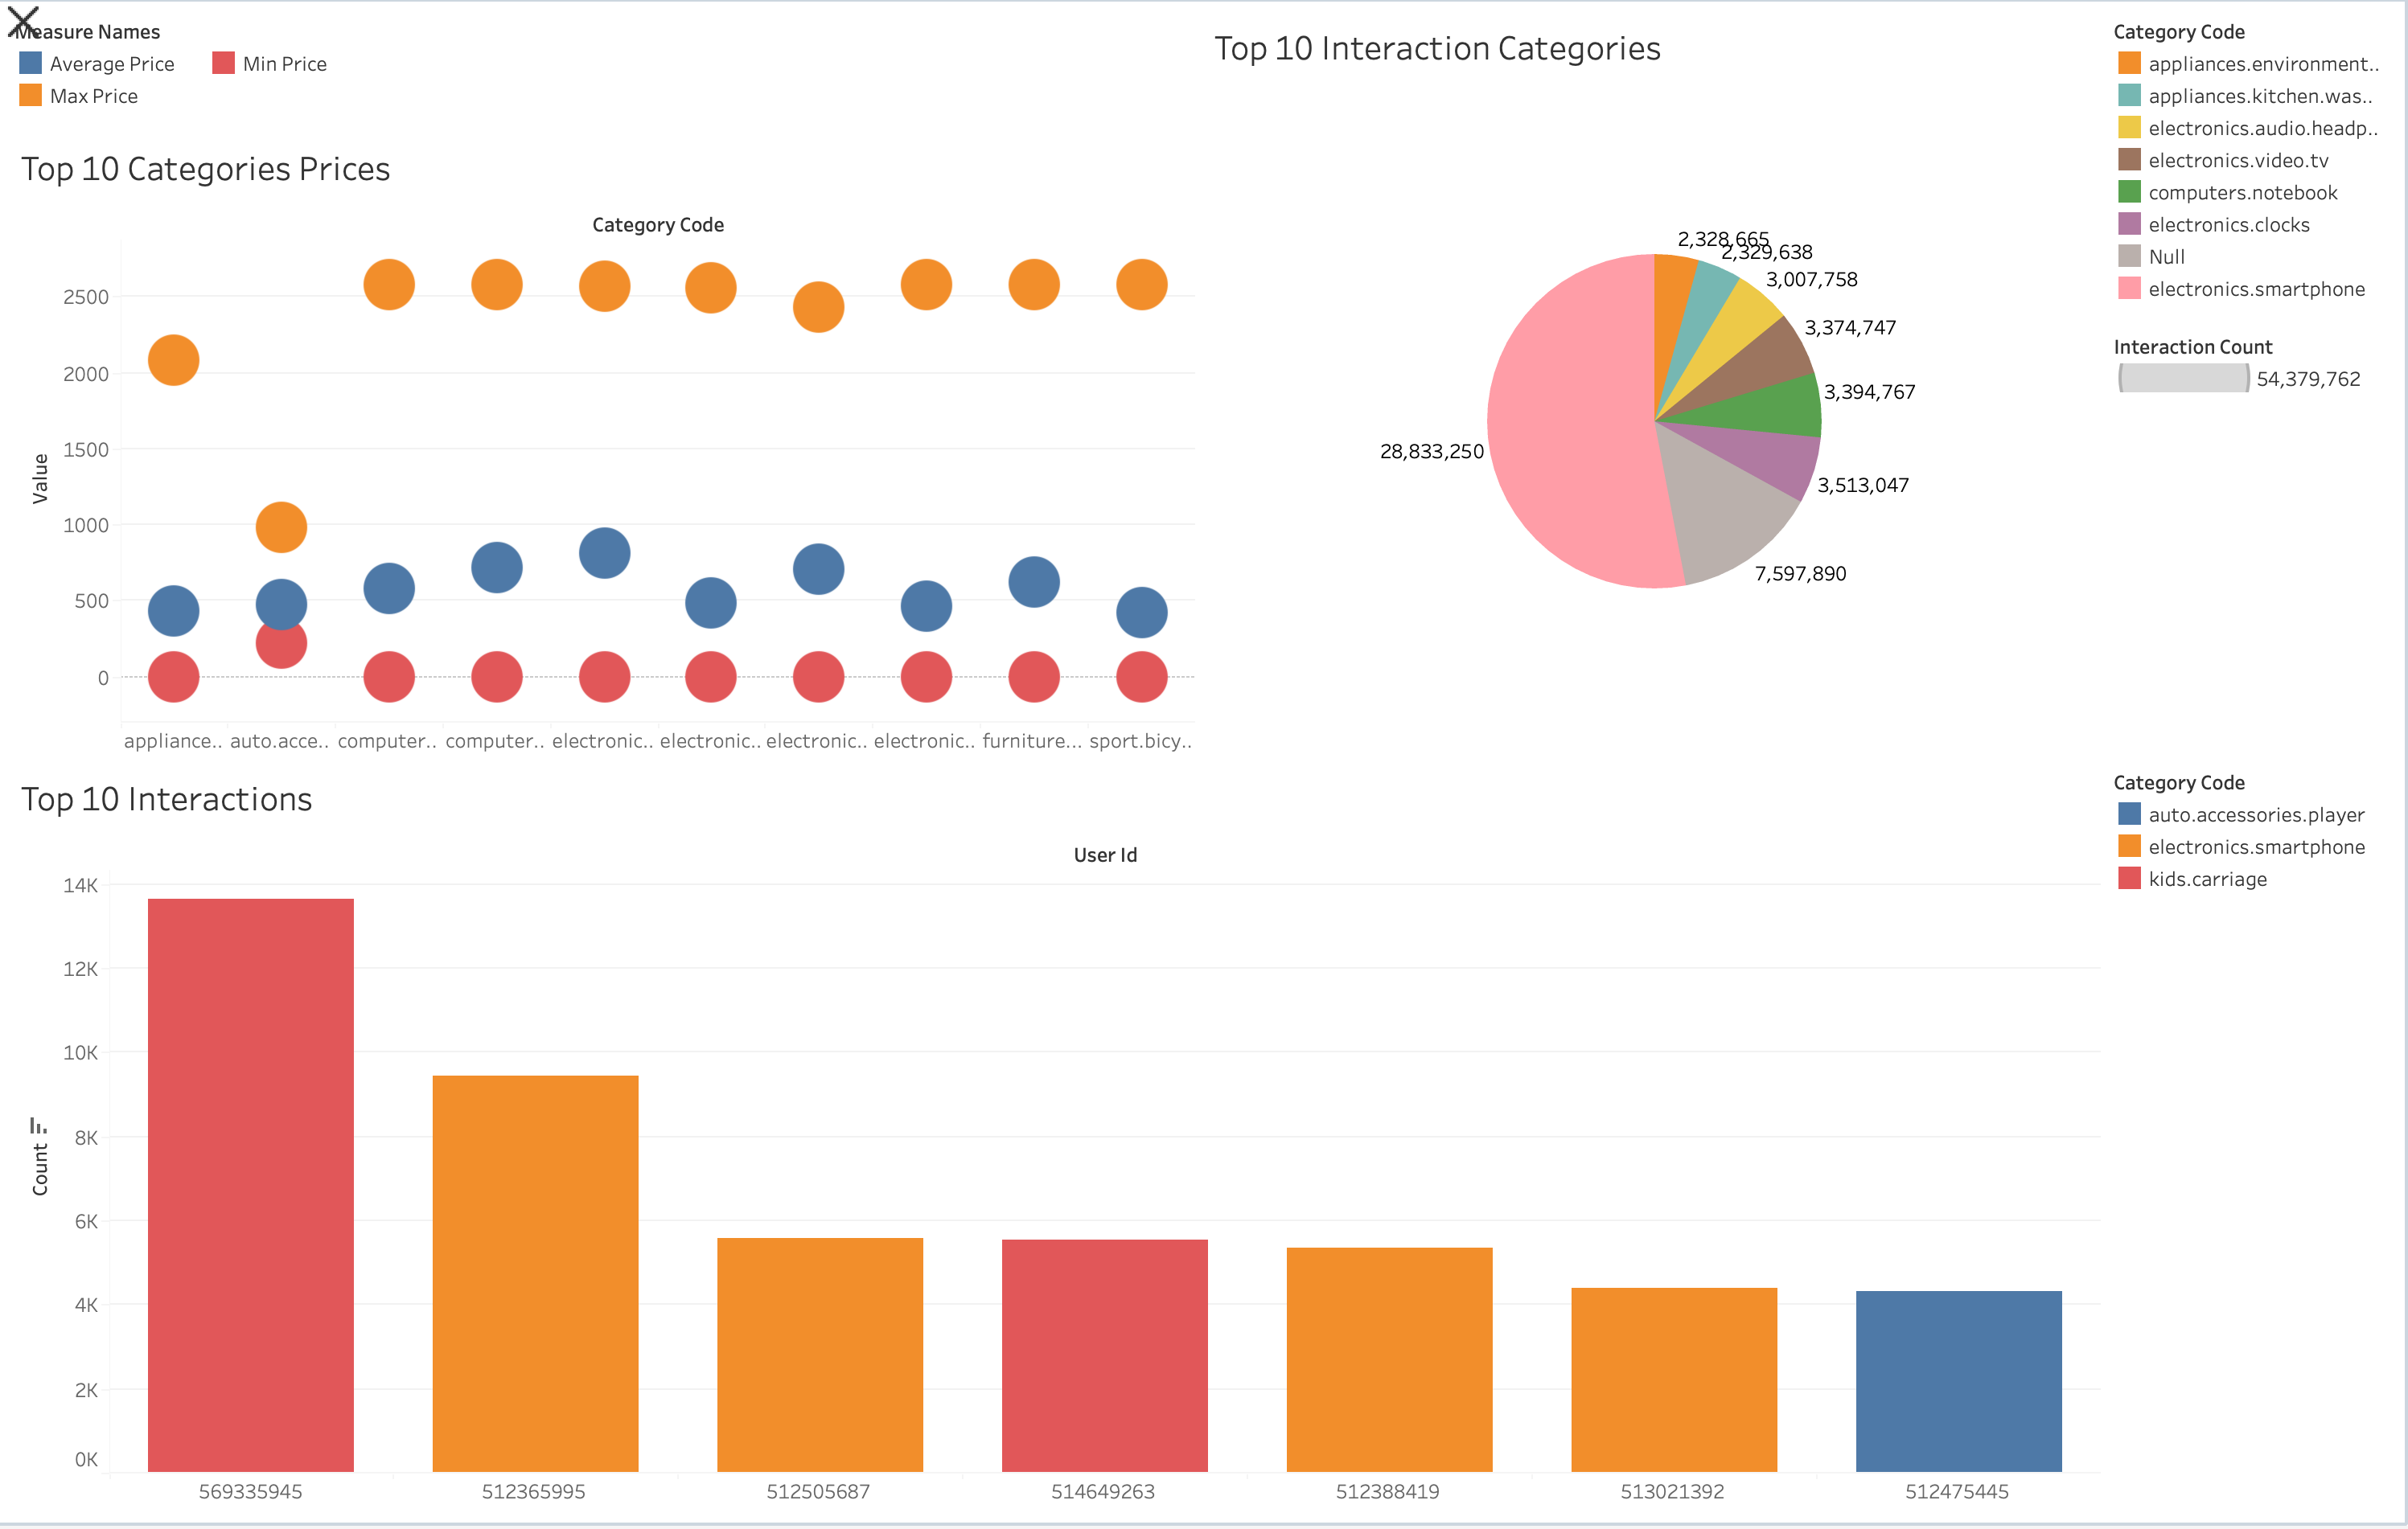
Tableau Visualization

Slide 12
Conclusion
Integration of Kafka, Apache Spark and Tableau in a big data project forms a robust end-to-end solution.
Kafka enables real-time data streaming.
Spark efficiently processes and analyses large volume of data.
Tableau provides powerful visualizations for deriving insights.

Slide 13
Future Enhancements
Scalability Considerations:
Assess the system's scalability to ensure it can handle a growing volume of data and increasing processing demands.
Exploration of Additional Data Sources:
Consider integrating diverse data sources to broaden the scope and depth of available data.
Real-time Processing:
Reducing latency in data availability could be a significant improvement for the system.

Slide 14

References
https://kafka.apache.org/
https://softwaremill.com/kafka-visualisation/
https://spark.apache.org/
https://www.tableau.com/

Slide 15

Q&A
Thank you for your attention! We would now like to invite any questions or comments from the audience.

Slide 16

Thank You

