Slide 1
DECISION TREE INDUCTION
ATTRIBUTE SELECTION MEASURES
31139 - Samit Kadam
31140 - Arjun Kankal
31180 - Pradyum Umale

Slide 2
CONTENT
Introduction
Information Gain
Gain Ratio
Gini Index
Examples and Applications
References

Slide 3
INTRODUCTION : DECISION TREE
A decision tree is a flowchart-like tree structure, where each internal node denotes a test on an attribute, each branch represents an outcome of the test, and each leaf node holds a class label.
Given a record/data, X, for which the associated class label is unknown, the attribute values of the tuple are tested against the decision tree. A path is traced from the root to a leaf node, which holds the class prediction for that tuple.
The construction of decision tree classifiers does not require any domain knowledge or parameter setting, and therefore is appropriate for exploratory knowledge discovery.
Decision trees can handle multidimensional data easily and pretty fast.
Application areas are such as medicine, financial analysis (eligibility for loans), molecular biology, etc.

Slide 4
INTRODUCTION : ATTRIBUTE SELECTION MEASURES
It is a metric for selecting the “splitting criterion” that “best” separates a given labelled data, containing of class-labelled training tuples, into individual classes.
Ideally each partition would be pure, realistically it approaches the ideal situation, but never meets it.
If the splitting attribute is continuous-valued, then a split point must also be determined as part of the splitting criterion.

Slide 5
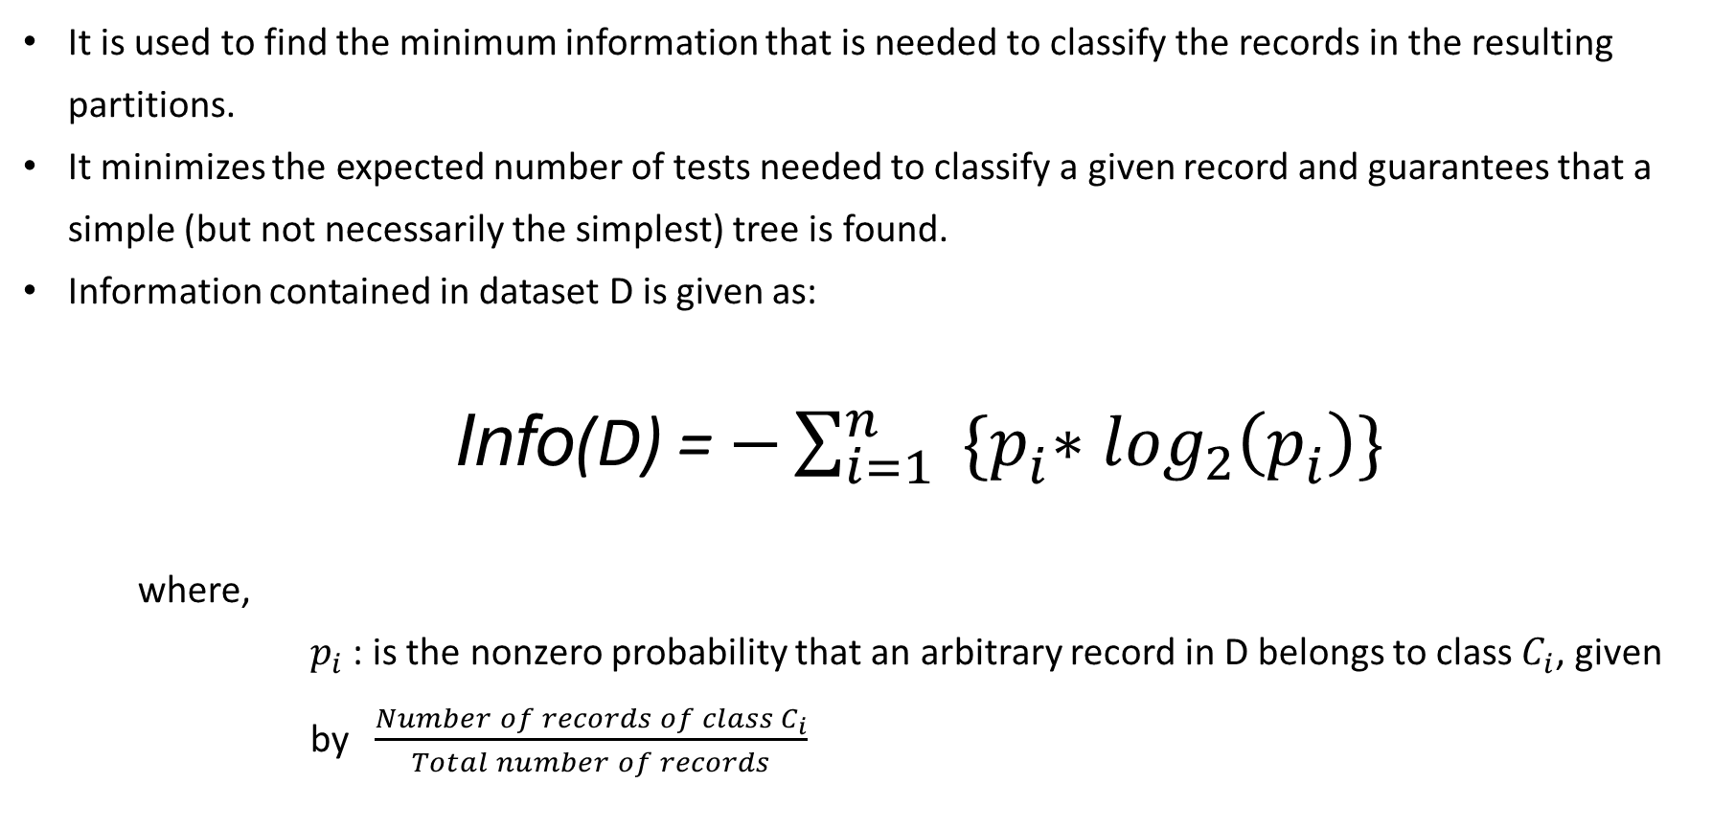
INFORMATION GAIN
It is used to find the minimum information that is needed to classify the records in the resulting partitions.
It minimizes the expected number of tests needed to classify a given record and guarantees that a simple (but not necessarily the simplest) tree is found.
Information contained in dataset D is given as:
    Info(D) = $−\sum_{i=1}^{n}{{ \{p}_{i}^{ }∗\log_{2}\left(p_{i}^{ }\right)\}}$
    where,
    $p_{i}$ : is the nonzero probability that an arbitrary record in D belongs to class $C_{i}$, given by $\frac{Number of records of class{ C}_{i}}{Total number of records}$

Slide 6
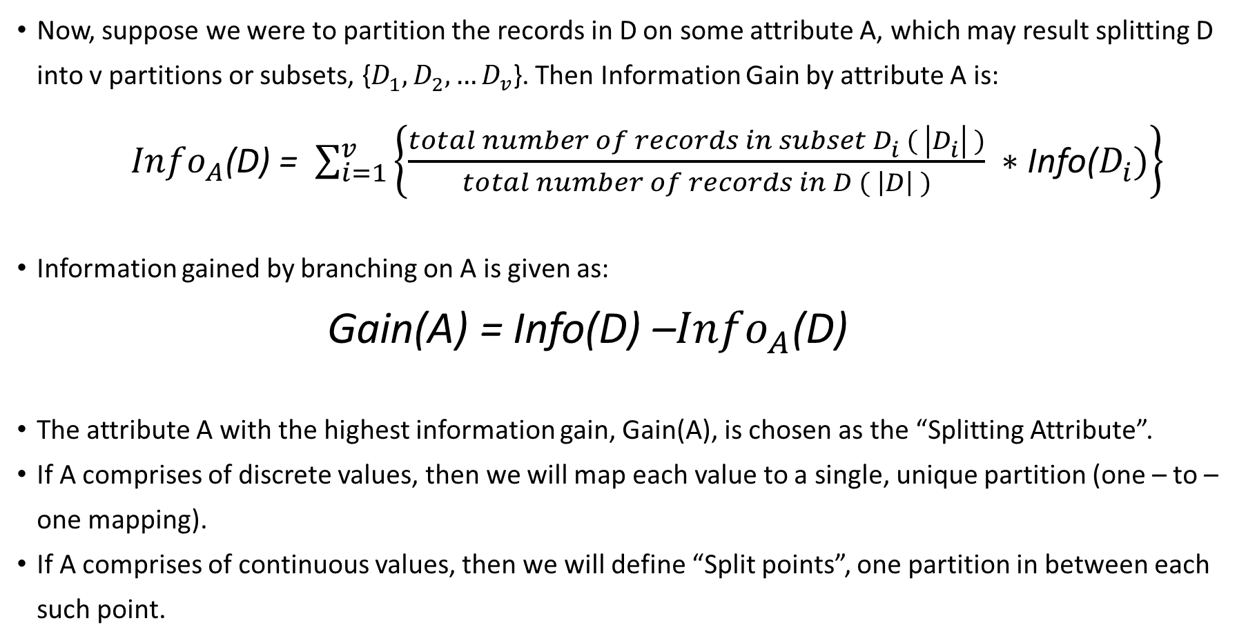
INFORMATION GAIN
Now, suppose we were to partition the records in D on some attribute A, which may result splitting D into v partitions or subsets, {$D_{1}^{ },D_{2}^{ }, …D_{v}^{ }$}. Then Information Gain by attribute A is:
      ${Info}_{A}^{ }$(D) = $\sum_{i=1}^{v}{\left\{\frac{total number of records in subset{ D}_{i}^{ } ( \left|D_{i}^{ }\right| )}{total number of records in D ( \left|D\right| )} ∗\text{Info(}D_{i}^{ })\right\}}$
      Information gained by branching on A is given as:
        Gain(A) = Info(D) –${Info}_{A}^{ }$(D)
        The attribute A with the highest information gain, Gain(A), is chosen as the “Splitting Attribute”.
        If A comprises of discrete values, then we will map each value to a single, unique partition (one – to – one mapping).
        If A comprises of continuous values, then we will define “Split points”, one partition in between each such point.

Slide 7
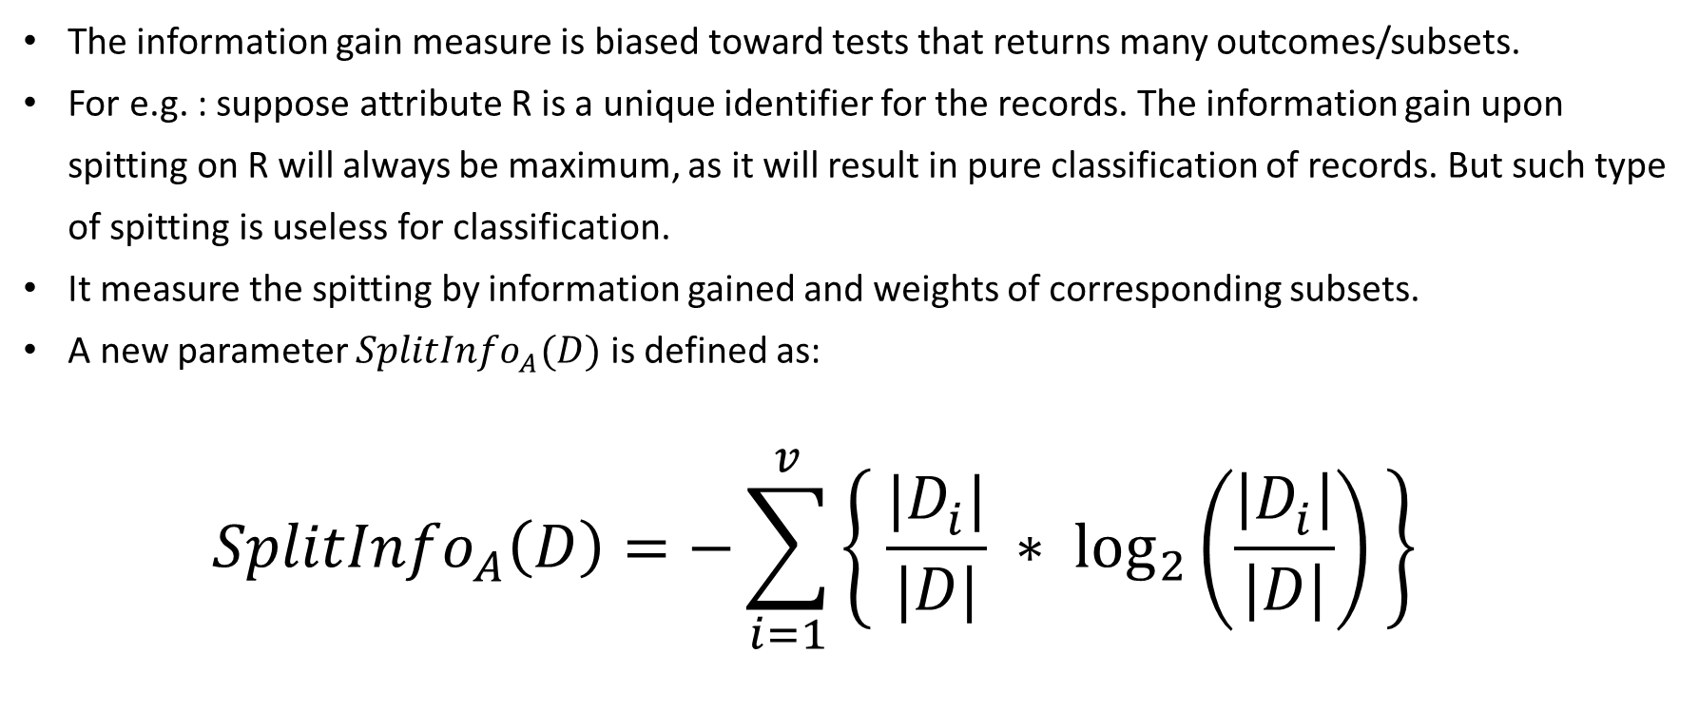
GAIN RATIO
The information gain measure is biased toward tests that returns many outcomes/subsets.
For e.g. : suppose attribute R is a unique identifier for the records. The information gain upon spitting on R will always be maximum, as it will result in pure classification of records. But such type of spitting is useless for classification.
It measure the spitting by information gained and weights of corresponding subsets.
A new parameter ${SplitInfo}_{A}^{ }(D)$ is defined as:
  $${SplitInfo}_{A}^{ }\left(D\right)=−\sum_{i=1}^{v}{\left\{ \frac{|D_{i}^{ }|}{|D|} ∗ \log_{2}\left(\frac{\left|D_{i}^{ }\right|}{\left|D\right|}\right) \right\}}$$

Slide 8
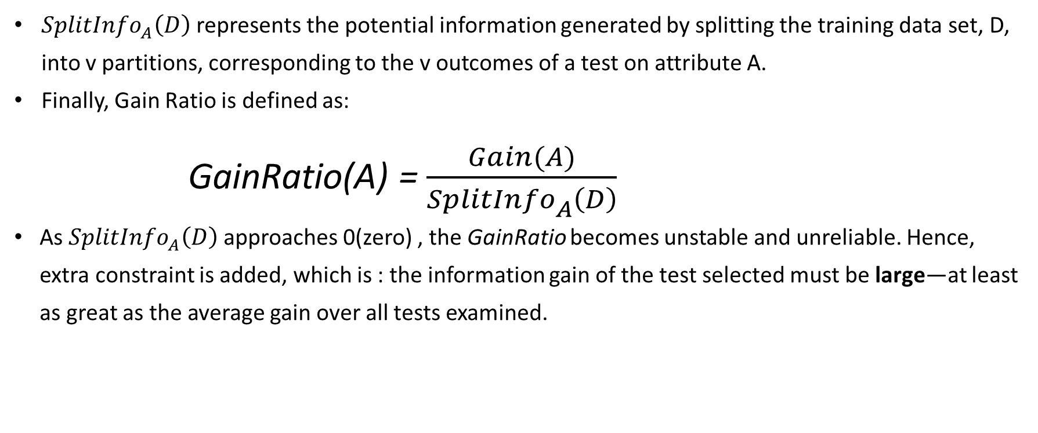
GAIN RATIO
${SplitInfo}_{A}^{ }\left(D\right)$represents the potential information generated by splitting the training data set, D, into v partitions, corresponding to the v outcomes of a test on attribute A.
Finally, Gain Ratio is defined as:
  GainRatio(A) = $\frac{Gain(A)}{{SplitInfo}_{A}^{ }\left(D\right)}$
  As ${SplitInfo}_{A}^{ }\left(D\right)$ approaches 0(zero) , the GainRatio becomes unstable and unreliable. Hence, extra constraint is added, which is : the information gain of the test selected must be large—at least as great as the average gain over all tests examined.

Slide 9
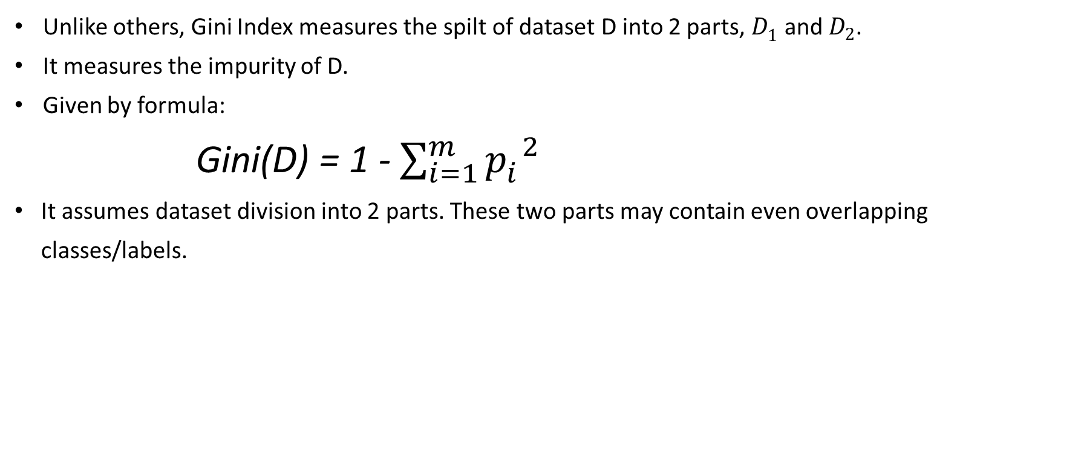
GINI INDEX
Unlike others, Gini Index measures the spilt of dataset D into 2 parts, $D_{1}^{ }$ and $D_{2}$.
It measures the impurity of D.
Given by formula:
  Gini(D) = 1 - $\sum_{i=1}^{m}{p_{i}^{ 2}}$
  It assumes dataset division into 2 parts. These two parts may contain even overlapping classes/labels.

Slide 10
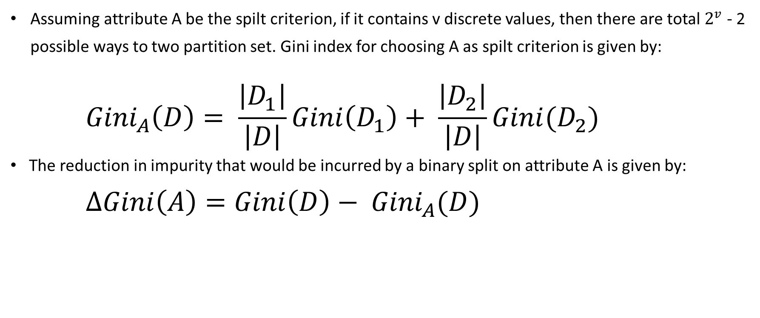
GINI INDEX
Assuming attribute A be the spilt criterion, if it contains v discrete values, then there are total $2^{v}$ - 2 possible ways to two partition set. Gini index for choosing A as spilt criterion is given by:
  $${Gini}_{A}\left(D\right)= \frac{\left|D_{1}\right|}{\left|D\right|}Gini\left(D_{1}\right)+ \frac{\left|D_{2}\right|}{\left|D\right|}Gini(D_{2})$$
  The reduction in impurity that would be incurred by a binary split on attribute A is given by:
    $$∆Gini\left(A\right)=Gini\left(D\right)− {Gini}_{A}(D)$$

Slide 11
EXAMPLE AND APPLICATION : ABOUT DATASETS
Iris dataset:
  Number of attributes: 4
  About attributes: length and width of both sepal and petal; all continuous attributes
  Dimensions: 150 records x 5 attributes (including class)
  Class: Setosa, Versicolor, Virginica
Lung cancer dataset:
  Number of attributes: 15
  About attributes: gender, age and other health factors; all binary, except age(continuous)
  Dimensions: 309 records x 16 attributes (including class)
  Class: YES, NO
Credit Approval dataset:
  Number of attributes: 15
  About attributes: mixture of 6 continuous and 9 categorical data (total 42 categories)
  Dimensions: 653 records x 16 attributes (including class)
  Class: +, -

Slide 12
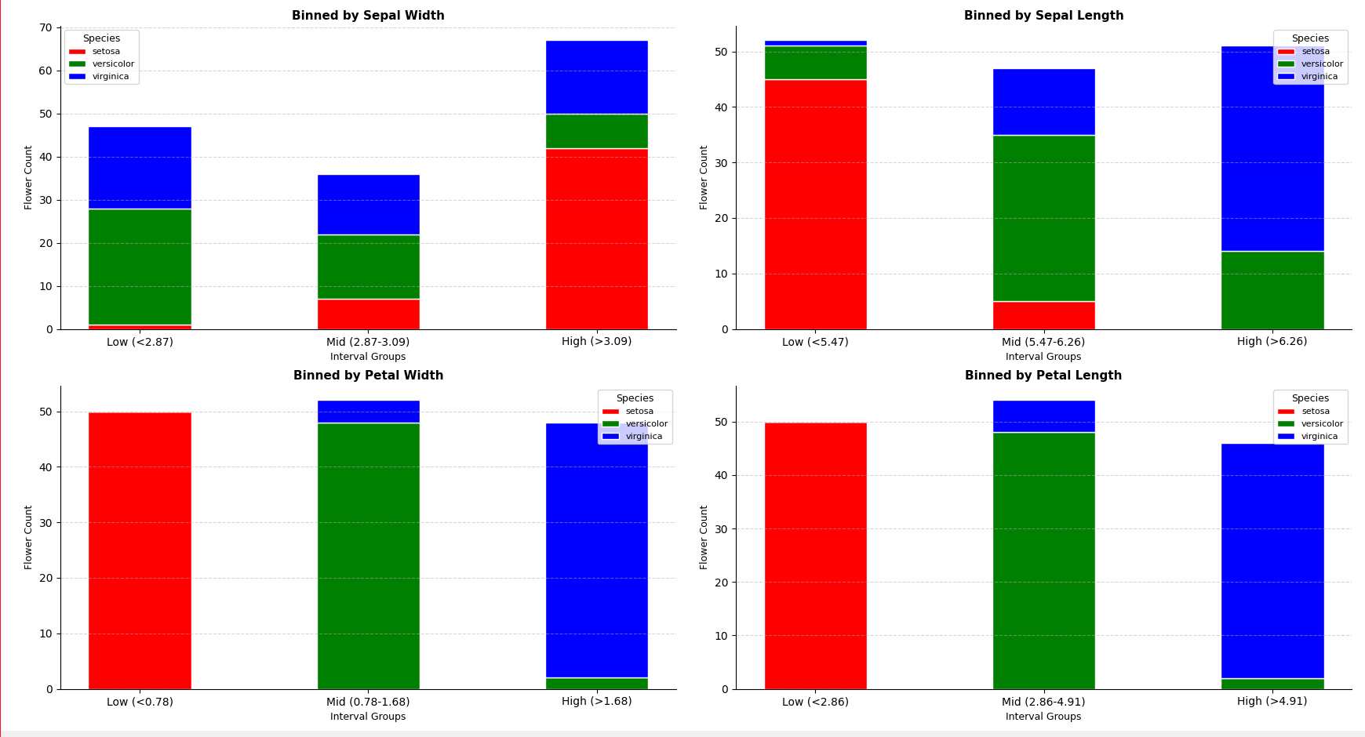
EXAMPLE AND APPLICATION : IRIS DATASET GRAPHS

Slide 13
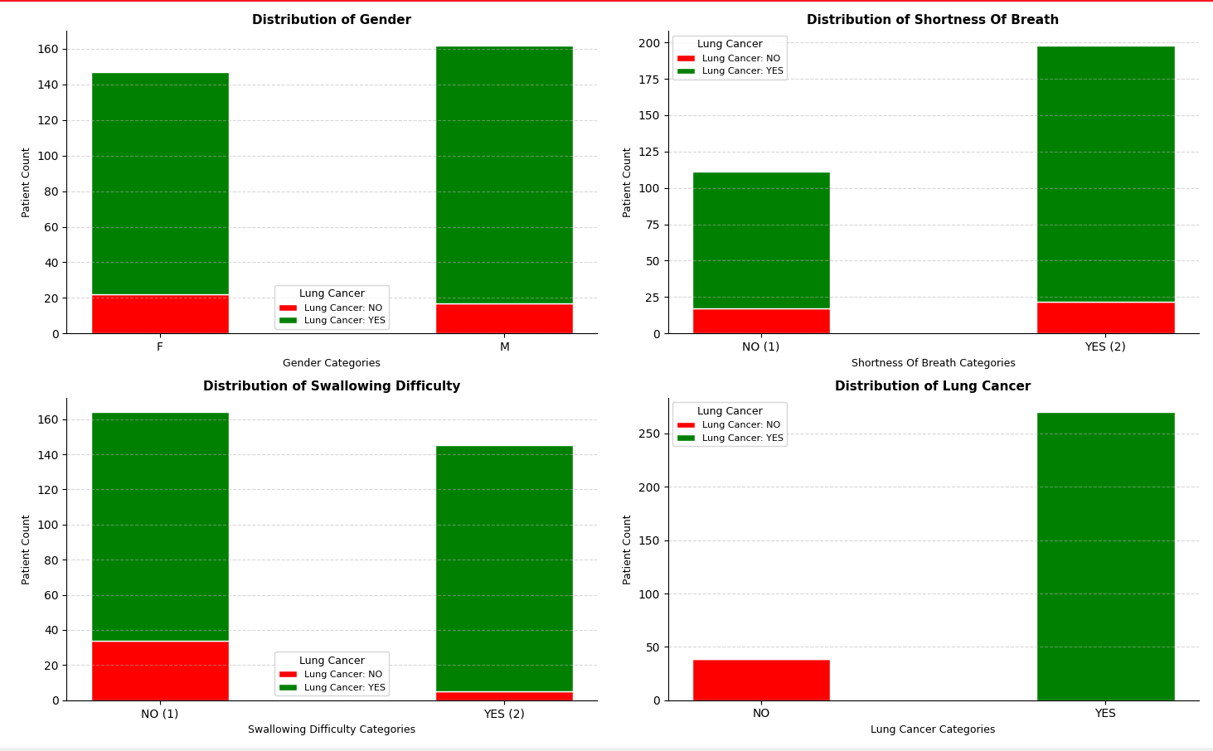
EXAMPLE AND APPLICATION : CANCER DATASET GRAPHS

Slide 14
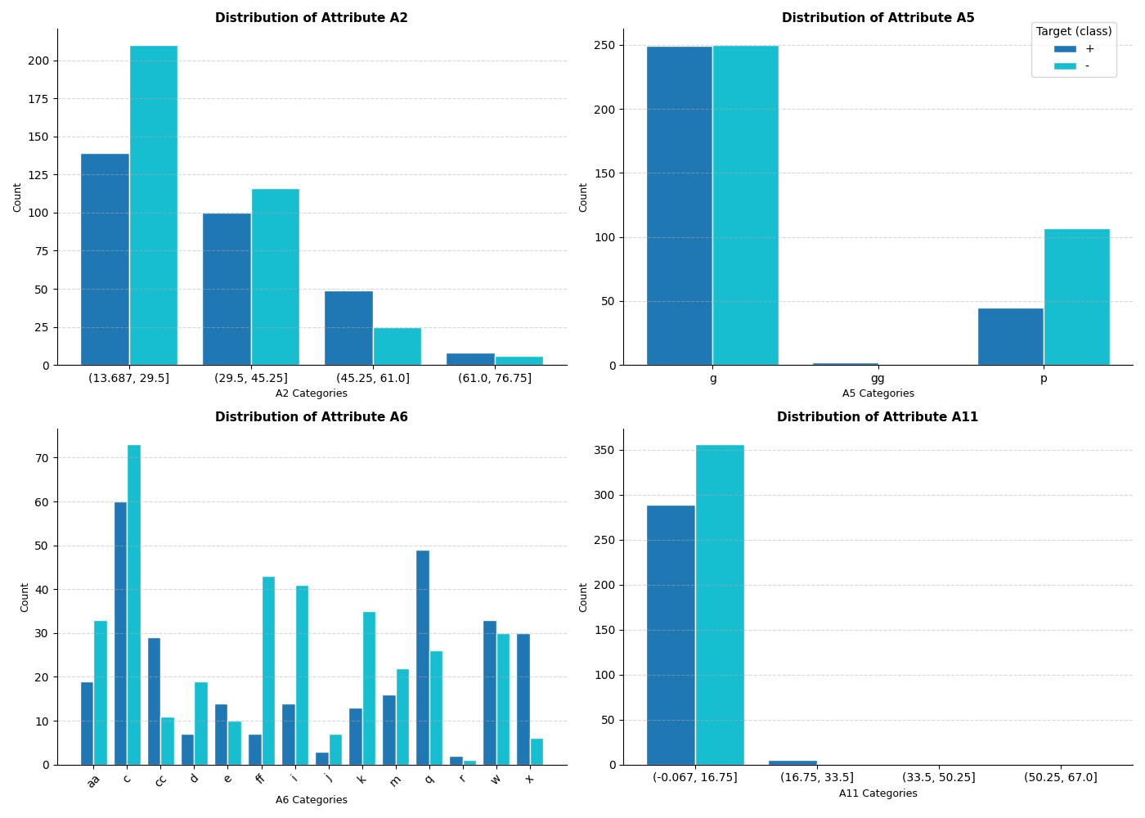
EXAMPLE AND APPLICATION : CREDIT DATASET GRAPHS

Slide 15
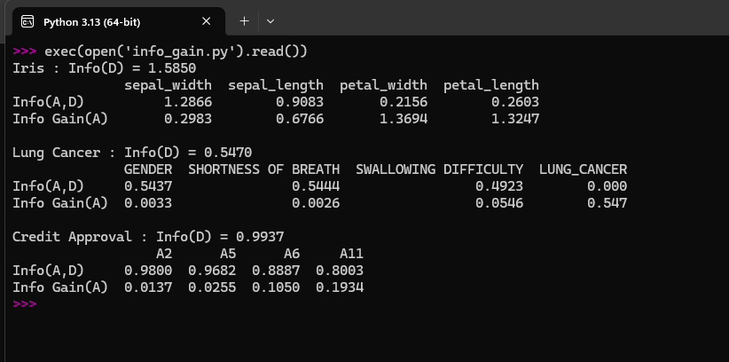
EXAMPLE AND APPLICATION : INFORMATION GAIN

Slide 16
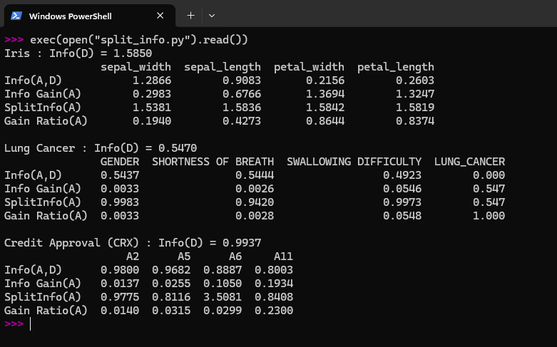
EXAMPLE AND APPLICATION : GAIN RATIO

Slide 17
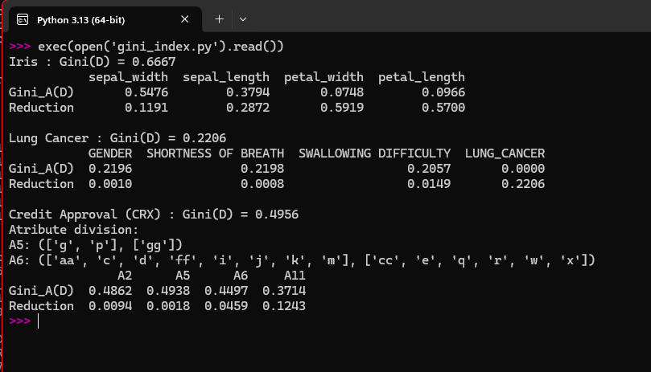
EXAMPLE AND APPLICATION : GINI INDEX

Slide 18
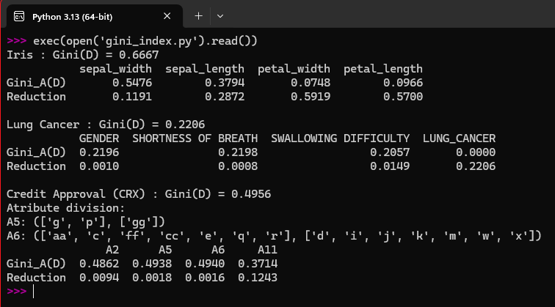
EXAMPLE AND APPLICATION : GINI INDEX

Slide 19
REFERENCES
Book: Data Mining: Concepts and Techniques 3rd Edition Morgan Kaufmann 2011
Iris dataset: https://www.kaggle.com/datasets/himanshunakrani/iris-dataset
Lung cancer dataset: https://www.kaggle.com/datasets/mysarahmadbhat/lung-cancer
Credit Approval dataset: https://www.kaggle.com/datasets/echo9k/uci-credit-approval/data
Sample code: https://github.com/PradyumUmale/dwm_presentation_grp4

Slide 20
THANK YOU

