Slide 1
Regression Analysis
Avinash Navlani

Slide 2
Regression Analysis
Regression analysis is a statistical process for estimating the relationships among variables.
Regression analysis is a form of predictive modelling technique which investigates the relationship between a dependent (target) and independent variable (s) (predictor).
Value of one variable is a function of other.

Slide 3
Regression Model and Equation
Regression Model
is the y-intercept of the regression line,
is the slope,
(the Greek letter epsilon) is random variable referred to as the error term. The error term accounts for the variability in y that cannot be explained by the linear relationship between x and y.
Regression Equation
E(y) is the mean or expected value of y for a given value of x

Slide 4
Where can you use regression?
This technique is used for forecasting, time series modelling and finding the causal effect relationship between the variables.

Slide 5
Dependent Variable
Explained Variable
Regeresand Variable
Predictand
Response
Endogenous
Independent Variable
Explanatory Variable
Regressor
Predictor
Stimulus or Control variable
Exogenous

Slide 6
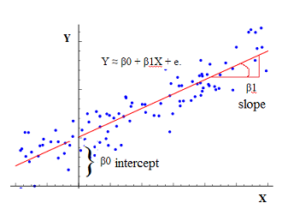

Slide 7
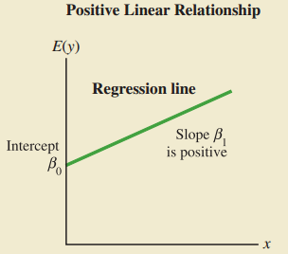
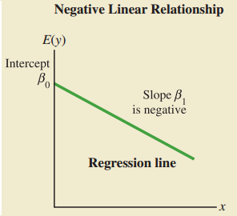
REGRESSION LINES

Slide 8
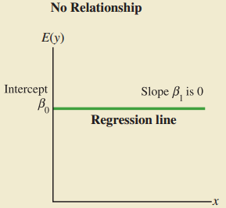
REGRESSION LINES (Conti)

Slide 9
Simple Regression
Simple Regression is compare two variables.
If there is one variable than the best prediction for other values is the mean of the dependent variable.
Difference between the best fit line and observed value is called the residual (or error).
Main objective is to find the best fitting line through the data that minimize the SSE(some of squared error).

Slide 10

Estimated Regression Equation
Sample statistics (denoted b₀ and b₁) are computed as estimates of the population parameters and . Substituting the values of the sample statistics b₀ and b₁ for and 1 in the regression equation.
is the point estimator of E(y), the mean value of y for a given value of x.

Slide 11
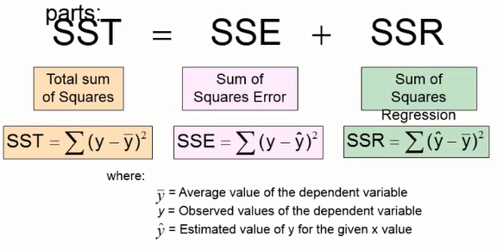

Slide 12
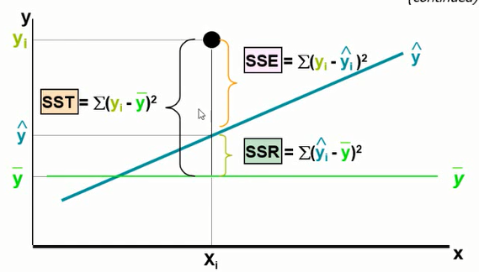

Slide 13
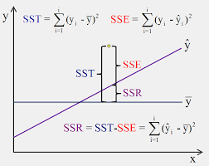

Slide 14
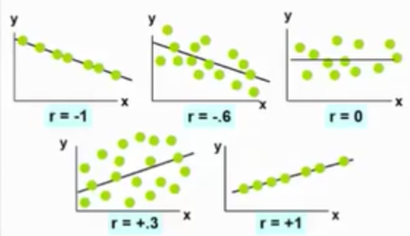
Examples

Slide 15
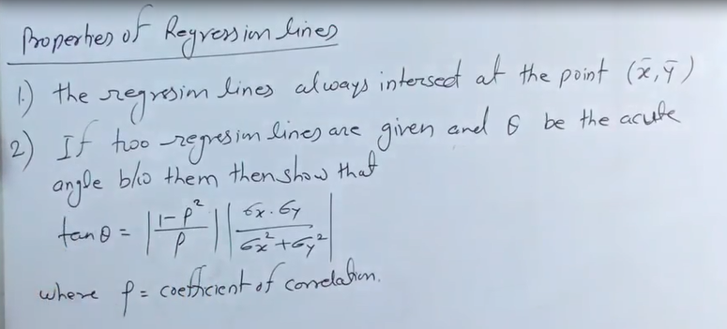

Slide 16
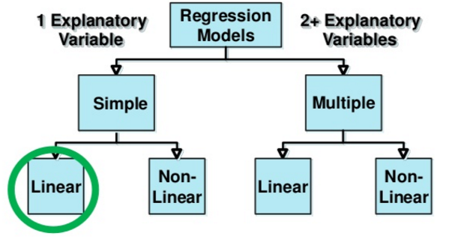
Types of Regression

Slide 17
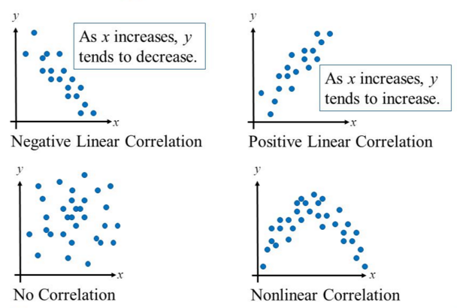
Types of Correlation

Slide 18
Develop a model that will allow you to make a prediction about what amount of tip to expect for a given bill amount.

Slide 19
Heteroscedasticity
heteroscedasticity (also spelled hetero-skedasticity) refers to the circumstance in which the variability of a variable is unequal across the range of values of a second variable that predicts it.

Slide 20
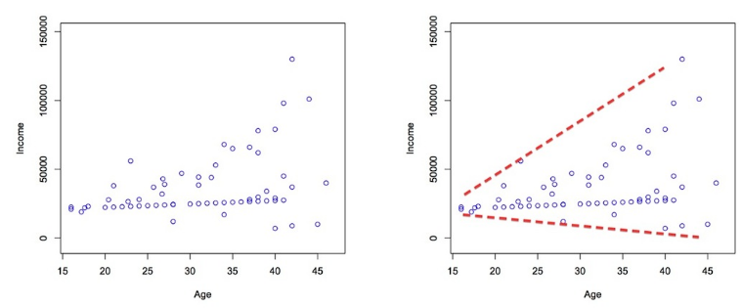
Detecting Heteroscedasticity
There are two ways to test for hetero-sedasticity:
Graphically
Through statistical tests

Slide 21
Through Statistical Test
Breush-Pagan test
NCV test

Slide 22
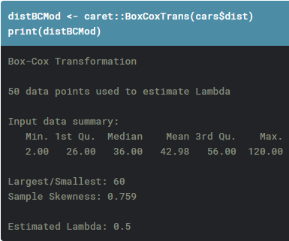
Box-Cox transformation
Box-cox transformation is a mathematical transformation of the variable to make it approximate to a normal distribution.
Often, doing a box-cox transformation of the Y variable solves the issue.

Slide 23
Multiple Regression
Regression Model
is the y-intercept of the regression line,
are the parameters,
p independent variables
(the Greek letter epsilon) is random variable referred to as the error term. The error term accounts for the variability in y that cannot be explained by the linear relationship between x and y.
Regression Equation
E(y) is the mean or expected value of y for a given value of x

Slide 24
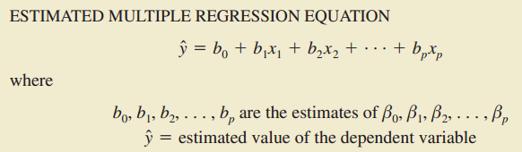
Estimated Regression Equation

Slide 25
Multicollinearity
Multicollinearity (also collinearity) is a phenomenon in which two or more predictor variables in a multiple regression model are highly correlated, meaning that one can be linearly predicted from the others with a substantial degree of accuracy.
Multicollinearity is a state of very high intercorrelations or inter-associations among the independent variables.

Slide 26
Why multicollinearity occurs?
It is caused by an inaccurate use of dummy variables.
It is caused by the inclusion of a variable which is computed from other variables in the data set.
Multicollinearity can also result from the repetition of the same kind of variable.
Generally occurs when the variables are highly correlated to each other.

Slide 27
Problems causes by Multicollinearity
The partial regression coefficient due to multicollinearity may not be estimated precisely. The standard errors are likely to be high.
Multicollinearity results in a change in the signs as well as in the magnitudes of the partial regression coefficients from one sample to another sample.
Multicollinearity makes it tedious to assess the relative importance of the independent variables in explaining the variation caused by the dependent variable.

Slide 28
How to detect multicollinearity?
Correlation coefficient between Independent Variable
Variance inflation factor (VIF)
Eigen values

Slide 29

Variance Inflation Factors
Variance inflation factors (VIF) measure how much the variance of the estimated regression coefficients are inflated as compared to when the predictor variables are not linearly related. Use to describe how much multicollinearity (correlation between predictors) exists in a regression analysis.
It provides an index that measures how much the variance (the square of the estimate's standard deviation) of an estimated regression coefficient is increased because of collinearity.

Slide 30

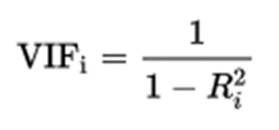
How to calculate VIF?
First we run an ordinary least square regression that has X_{i} as a function of all the other explanatory variables in the first equation.
calculate the VIF factor using Formula

Slide 31
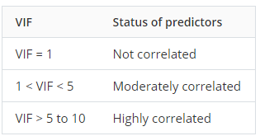

Slide 32
Eigen Values
detect by inspecting the eigen values of correlation matrix.
A very low eigen value shows that the data are collinear, and the corresponding eigen vector shows which variables are collinear.

Slide 33
Removing Multicollinearity
We can choose to remove either predictor from the model which are showing high correlation or high VIF value.
The decision of which one to remove is often a scientific or practical one
For Example:
blood pressure (y = BP, in mm Hg)
age (x₁ = Age, in years)
weight (x₂ = Weight, in kg)
body surface area (x₃ = BSA, in sq m)
duration of hypertension (x₄ = Dur, in years)
basal pulse (x₅ = Pulse, in beats per minute)
stress index (x₆ = Stress)
body surface area or weight have high correlation—
Which variable need to remove to overcome multicollinearity.
In this case weight is an easier measurement to obtain than body surface area, then the researchers would be well-advised to remove BSA.

Slide 34
Dummy Variable
It is categorical independent variable.
In Regression analysis such variable known as dummy variable.
Dummy variable also known as an indicator variable, design variable, Boolean indicator, categorical variable, binary variable, or qualitative variable.
Dummy Variable is one that takes the value 0 or 1 to indicate the absence or presence of some categorical effect that may be expected to shift the outcome.
N categories always has N-1 dummy variables.

Slide 35
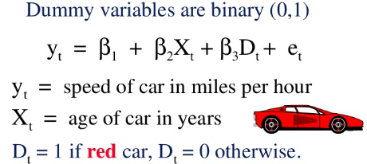

Slide 36
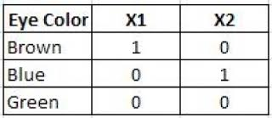
Another Example

Slide 37
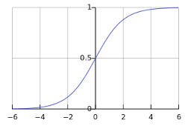
Logistic Regression
Model the probability of an event occurring depending on the values of the independent variables, which can be categorical or numerical.
Classify observation by estimating probability that an observation in particular categories.
Y Axis=Probability of happening event
X Axis=Value of Independent Variable

Slide 38
Logistic Regression(Conti…)
Dependent variable in logistic regression follow Bernoulli Distribution.
Estimation is done through maximum likelihood.
No R Square, Model fitness is calculated through Concordance, KS-Statistics.
Chi Square Statistics in place of t-statistics.

Slide 39

Logit Function
Logistics Regression Mode estimate an unknown p for any given linear combination of the independent variable.
Uses dichotomous or binary dependent variable.

Slide 40
Residual Vs Error
A residual is the difference between the observed value and the predicted value (by the model).
An error is the difference between the observed value and the true value.
Errors pertain to the true data generating process (DGP), whereas residuals are what is left over after having estimated your model.

Slide 41


