Slide 1
GUESSING THE NUMBER- A JAVA JOURNEY

Slide 2
TABLE OF CONTENT
Introduction
Gameplay Mechanics
Code Structure
Implementation Details
Challenges Faced
Conclusion

Slide 3
INTRODUCTION
The Java project on guessing the number is a fun and interactive game that allows users to guess a randomly generated number within a certain range. The game is designed to test the user's logical thinking and problem-solving skills, while also providing an entertaining experience.
The game begins with the COMPUTER being prompted to enter a range of numbers within which the randomly generated number will be chosen. Once the range is set, the user can begin guessing the number by inputting their data into the program.

Slide 4
Gameplay Mechanics
The Java project on guessing the number utilizes various gameplay mechanics to provide an engaging experience for the user. One such mechanic is the use of hints, which are provided to the user when they guess incorrectly. These hints may include whether the guessed number is too high or too low.

Slide 5
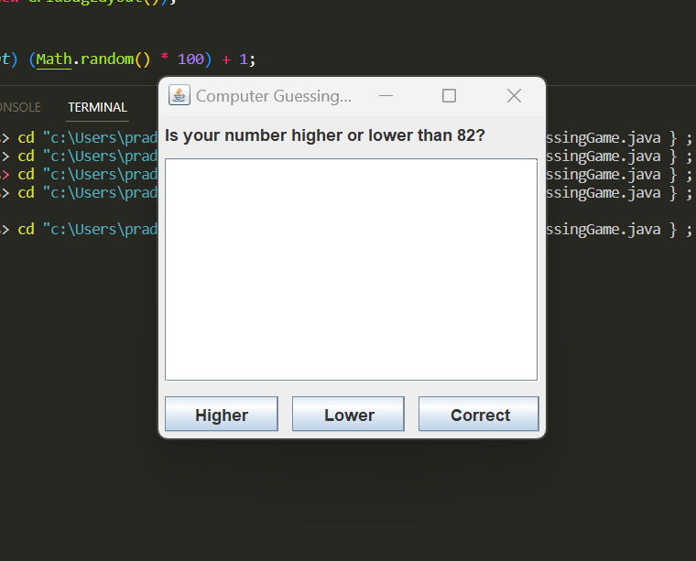

Slide 6
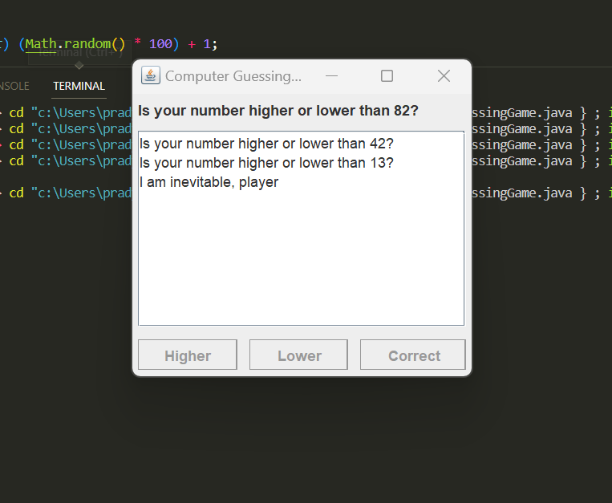

Slide 7
Code Structure
The Java project on guessing the number is built using object-oriented programming principles. The code is structured in a way that allows for easy maintenance and scalability. The main class of the program is the StartGame class, which contains methods for generating a random number, accepting user input.
GUI has been used to provide this game a simple and good looking interface using jframes.

Slide 8
Implementation Details
The Java project on guessing the number was implemented using the Eclipse Integrated Development Environment (IDE). The project was built using the Java Development Kit (JDK) version 8 and was tested on Windows and Mac operating systems.
The project utilizes various Java libraries, including the java.util.Random library for generating random numbers and the jframes library for GUI representation. The project also uses exception handling to ensure that the program runs smoothly and without errors.

Slide 9
Challenges Faced
During the development of the Java project on guessing the number, several challenges were faced. One of the major challenges was implementing the scrolling system in the GUI in a way that accurately reflected the user’s guesses. Another challenge was ensuring that the program could handle unexpected user input without crashing.
To overcome these challenges, testing and debugging were conducted. The program was also reviewed by teammates colleagues to identify any potential issues or areas for improvement in this game.

Slide 10
Conclusion
In conclusion, the Java project on guessing the number is a fun and challenging game that utilizes various gameplay mechanics and object-oriented programming principles. The project was developed using basic java operations and tested on multiple operating systems. testing and debugging were conducted to ensure a smooth and error-free experience for the user.
Overall, the Java project on guessing the number serves as a testament to the versatility and power of the Java programming language, and demonstrates the importance of good coding practices and attention to detail in software development.

