Slide 1
TeacherEase
Automated Question Paper Generation System with Cycle-Aware Non-Repetition
Project Guide
Prof. Mayur S. Bhurange
Academic Year 2026-27
Department of Computer Science & Engineering
P. R. Pote Patil College of Engineering & Management

Slide 2
1. The Problem We Solved
Manual paper setting is slow, repetitive, and risky.
Why the current process fails
Teachers rely on personal notes, printed lists, and scattered drafts.
Repeated questions often appear between regular and backlog papers in the same cycle.
Syllabus coverage becomes uneven and difficult to audit.
Confidential papers circulate through email and removable media.
Late detection of insufficient bank questions creates exam stress.
Impact on departments and examinations
Wasted faculty time in formatting, duplication, and correction.
Higher risk of unfair examination due to repeated questions.
Loss of institutional knowledge when faculty or records change.
No tamper-evident record of who generated or changed what.
Difficulty in maintaining a consistent, standard paper format.
2

Slide 3
2. Cost of Manual Question Paper Preparation
The real cost is not only time—it is quality, fairness, and confidentiality.
Hours
per paper
0%
cycle-safe repetition
High
manual error risk
Risk
confidentiality exposure
Manual drafting requires repeated selection, review, formatting, and final proofing before every exam.
Without a central question bank, departmental memory is fragmented across faculty and files.
Repeated questions in the same cycle undermine exam fairness for normal, backlog, and repeat candidates.
Paper setters must spend significant effort re-creating a standard header, instructions, and marks table each time.
3

Slide 4
3. TeacherEase Solution Overview
A secure, role-based platform for standardised and fair paper generation.
Central Question Bank
Unit-wise storage
Marks, BTL, CO tags
Active/inactive status
Reusable Blueprints
JSON-based pattern
Mark-wise and unit-wise rules
Reusable across subjects
Secure Generation
Cycle-aware exclusion
Transaction safety
Audit logging
Teachers add and maintain questions in a controlled bank.
The system applies a fixed blueprint and validates the bank before generation.
The database enforces selection rules, so the browser never receives the full candidate pool.
4

Slide 5
4. How the System Works
From question entry to final export in a single controlled process.
1. Teacher logs in
2. Maintain question bank
3. Select format, cycle, variant
4. Generate paper securely
5. Validate sufficiency
6. Export as Word / PDF / Image
5

Slide 6
5. Cycle-Aware Non-Repetition
The strongest guarantee is enforced at the database layer.
Core rule
Every generated question is recorded against an exam cycle.
The next paper in the same cycle excludes those question IDs before selection.
This prevents overlap between regular and backlog papers instead of depending on human memory.
The safeguard is part of the query itself and holds even if the client is misused.
This preserves fairness while keeping the selection process deterministic and auditable.
Regular paper
Q1, Q7, Q18
Backlog paper
Excludes these IDs automatically
6

Slide 7
6. Selection Algorithm Filter Chain
The database filters candidates before any randomization occurs.
Subject filter
Restrict to the target subject and active questions.
Unit filter
Limit to the required unit or blueprint slot.
Mark filter
Match the required mark value and question type.
Cycle exclusion
Remove questions already issued in the same exam cycle.
Sufficiency check
Abort if required candidates are below the minimum threshold.
Random top-N
Order by random() and select exactly N questions for the slot.
This chain ensures that the selection is valid, fair, and safe before inserting the paper.
7

Slide 8
7. Validation and Quality Checks
The system validates before and after generation to prevent weak or invalid papers.
Validation rules
Question bank sufficiency is checked before writing the paper.
Unit-wise and mark-wise counts are verified against the blueprint.
Randomization is tested repeatedly to confirm even distribution across eligible questions.
Regular and backlog papers are generated in the same cycle to confirm zero overlap.
The system aborts and rolls back if any requirement fails, leaving no partial paper.
Governance and control
Teacher access is restricted to allotted subjects using role-scoped rules.
Admins can review all papers, all subjects, and audit entries.
Export files are compared for content consistency across Word, PDF, and image outputs.
The app keeps question text out of the visible screen during generation.
Audit logs ensure the generation record is append-only and traceable.
8

Slide 9
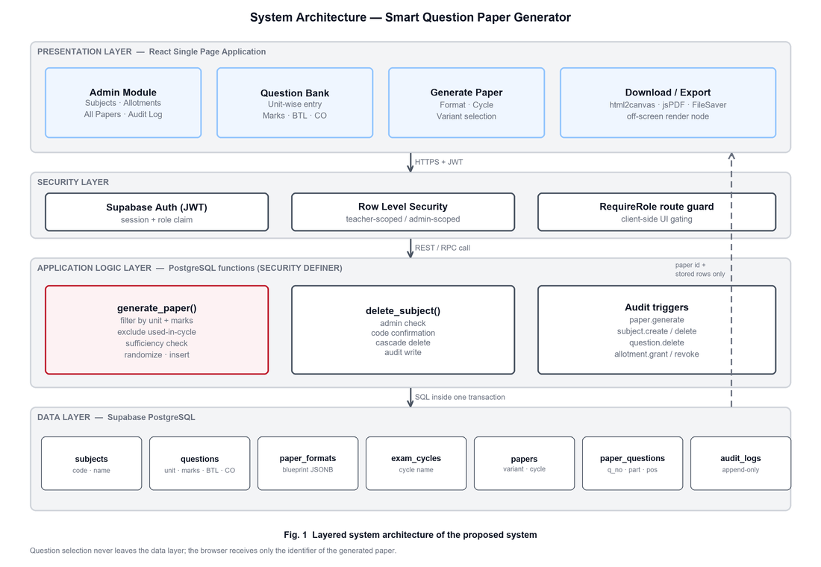
8. System Architecture
Layered architecture with secure database enforcement at the core.
9

Slide 10
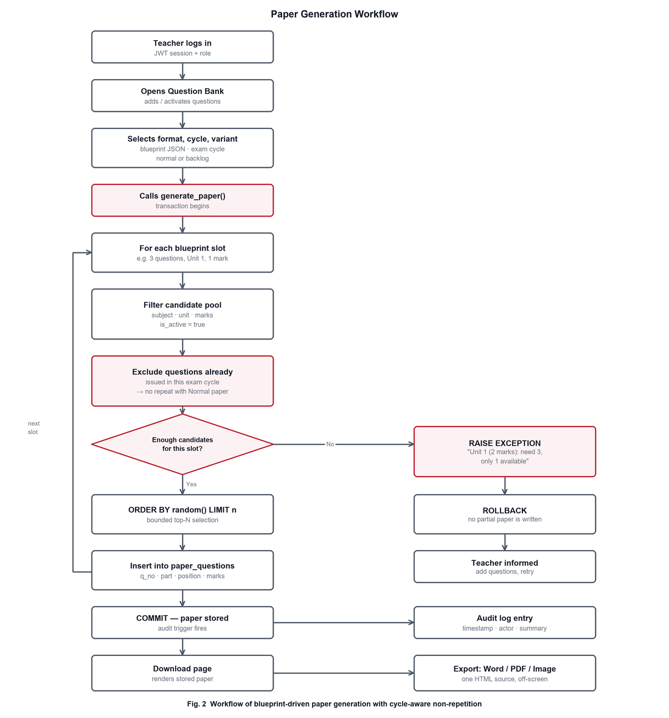
9. Paper Generation Workflow
The process is linear, validated, and protected by transaction-level checks.
10

Slide 11
10. Technology Stack
A light, dependable stack built for academic workflow and role control.
Frontend
React + React Router + single-page role-based UI
Authentication
Supabase Auth + JWT + profile-based role resolution
Database
Supabase PostgreSQL + Row Level Security + JSONB blueprints
Business Logic
PL/pgSQL SECURITY DEFINER functions and triggers
Export
html2canvas + jsPDF + FileSaver for Word/PDF/image outputs
DevOps
GitHub, collaboration, version control, reproducible deployment
11

Slide 12
11. Security and Access Control
Trust is built into the data layer, not only the UI.
Access control
Supabase Auth validates identity and issues JWT-based sessions.
Role resolution separates admin and teacher responsibilities.
Row Level Security restricts teachers to their allotted subjects.
Each paper generation runs inside one database transaction.
Audit entries are append-only and survive deletion of related records.
Security guarantees
The browser never receives the question pool used for generation.
Question text remains in the export file, not in the visible interface.
The server sovereignly decides what is valid and what should fail.
This reduces attack surface and helps maintain integrity under misuse.
The result is a stronger governance model for examination workflows.
12

Slide 13
12. Institutional Impact & Traction
The platform is designed to scale from a single department to a wider academic workflow.
1
department workflow
2+
roles
100%
audit trail
3
export formats
Reduces clerical effort for every paper generation cycle.
Improves fairness by eliminating question repetition within an exam cycle.
Strengthens confidentiality by keeping generated questions out of the visible interface.
Creates institutional memory through preserved question banks and auditable actions.
13

Slide 14
13. Competitor Comparison
TeacherEase is designed for department-level practicality, not just isolated paper generation.
Capability | Manual workflow | Generic random generators | TeacherEase
Capability | Manual workflow | Generic random generators | TeacherEase
Cycle-aware repetition control | No | No | Yes
Role-based access control | Weak | Limited | Strong
Syllabus rule enforcement | Manual | Partial | Database enforced
Audit log | Absent | Limited | Append-only
Export fidelity | Manual | Variable | Single source / identity
14

Slide 15
14. Limitations and Future Scope
The current version is practical and secure; the roadmap extends it further.
Current limitations
The question bank is currently seeded for one subject rather than a full institute-wide repository.
Bulk import of questions and data cleaning remains a next-step improvement.
Math and diagrammatic question support needs stronger formatting and rendering rules.
The process can extend to faculty dashboards, analytics, and institutional reporting.
Roadmap
Expand to multiple departments and semesters with shared taxonomy standards.
Introduce bulk question uploads and CSV/Excel import features.
Add analytics on difficulty, Bloom coverage, and question-bank utilization.
Upgrade to deeper AI-assisted quality checks while preserving governance and auditability.
15

Slide 16
15. Team
Student authors and guide for TeacherEase
Project Guide
Prof. Mayur S. Bhurange
1. Pradyumna G. Kulkarni
2. Satchit Anil Dhawale
3. Yashwant Vijayrao Kirakte
4. Aarya Sanjay Kukade
5. Vishesh Sandeeprao Pachghare
6. Ayush Rupesh Dongre
7. Nishant Sudhir Thakare
8. Janhavi Gopal Hire
9. Vaishnavi Ramesh Band
Thank You
16

