Slide 1
Analysis on Budget trends of Indian government from FY(2020-2023)

Slide 2
Overview of the Analysis
This analysis examines key government data trends,exploring various aspects through visualization and statistical insights. The findings highlight significant patterns and potential implications.
Columns:
SI. No. – Serial number (some missing values).
Parameters – Describes the type of financial data (e.g., revenue receipts, tax revenue).
2020-2021 – Financial values for the year 2020-21.
2021-2022 – Financial values for the year 2021-22.
2021-2022.1 – Possibly revised estimates for 2021-22.
2022-2023 – Financial values for the year 2022-23.

Slide 3
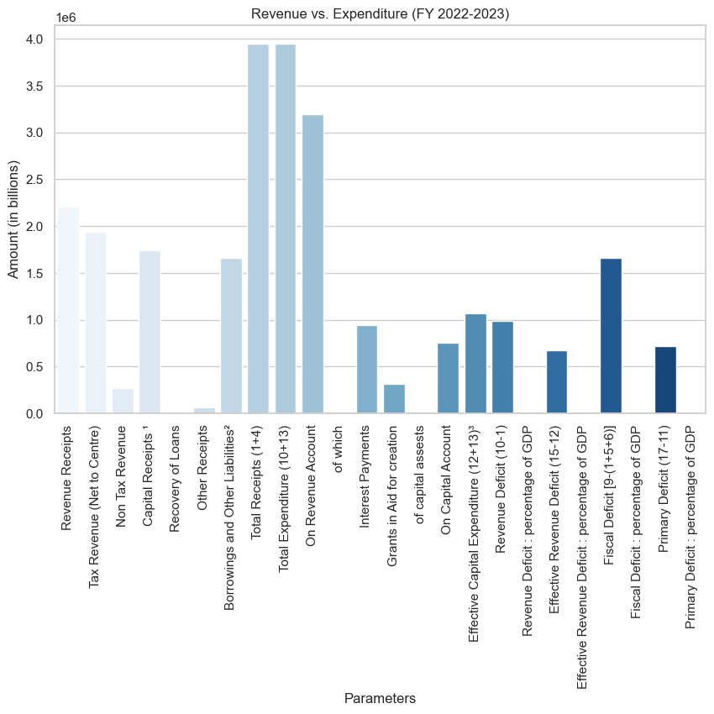
Description of Figure : Revenue vs Expenditure for FY(2022-2023).

Slide 4
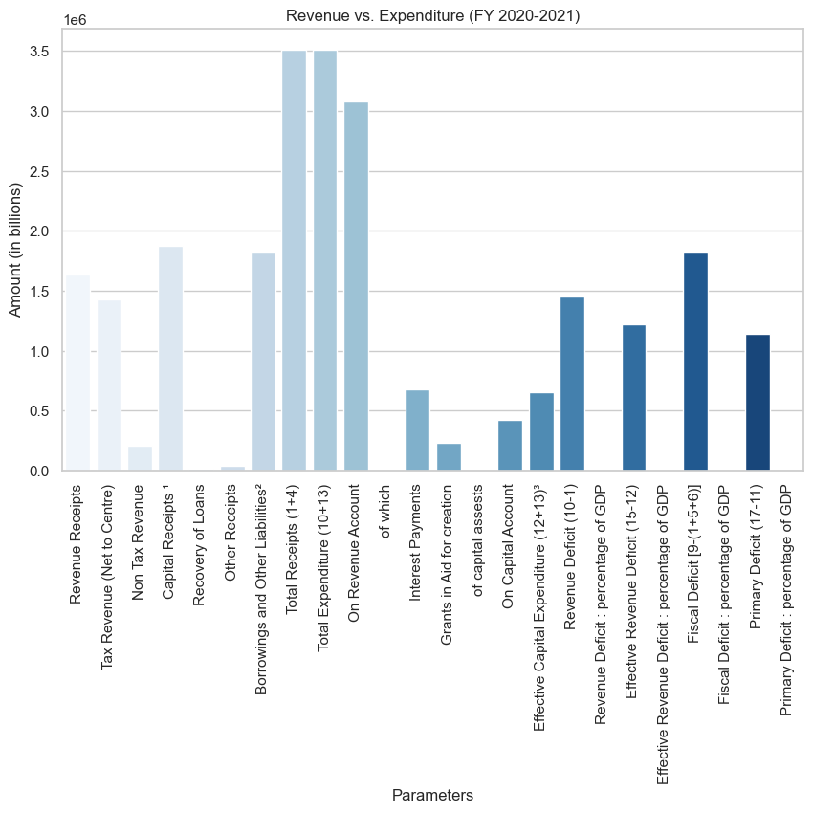
Description of Figure : Revenue vs Expenditure for FY(2020-2021)

Slide 5
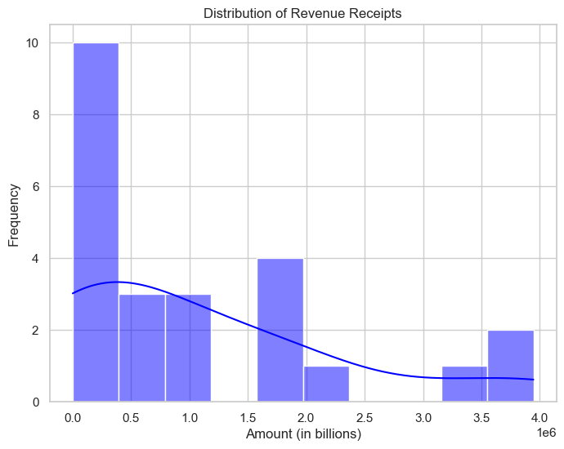
Description of Figure : This plot shows the distribution of revenue receipts over the years.

Slide 6
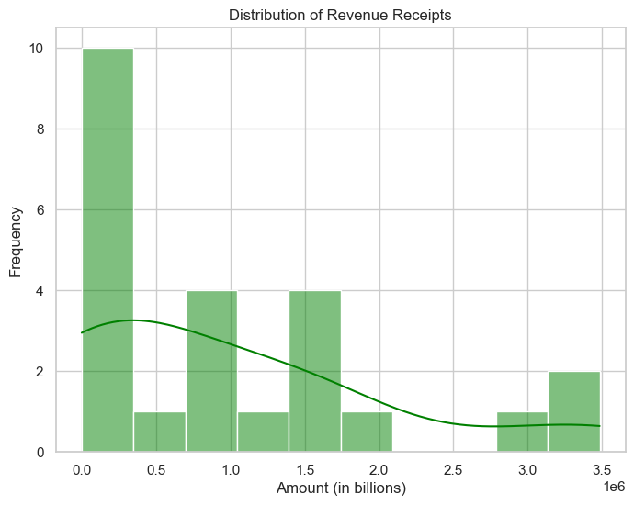
Description of Figure : This is the distribution for year 2021-2022 .

Slide 7
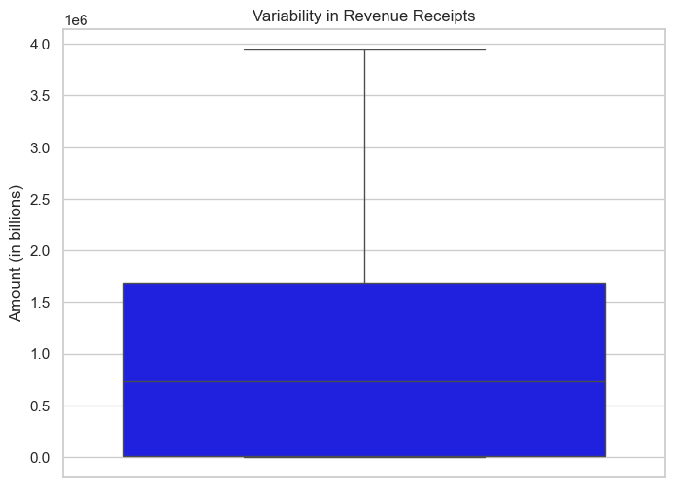
Description of Figure : Box plot showing variability in revenue receipts .

Slide 8
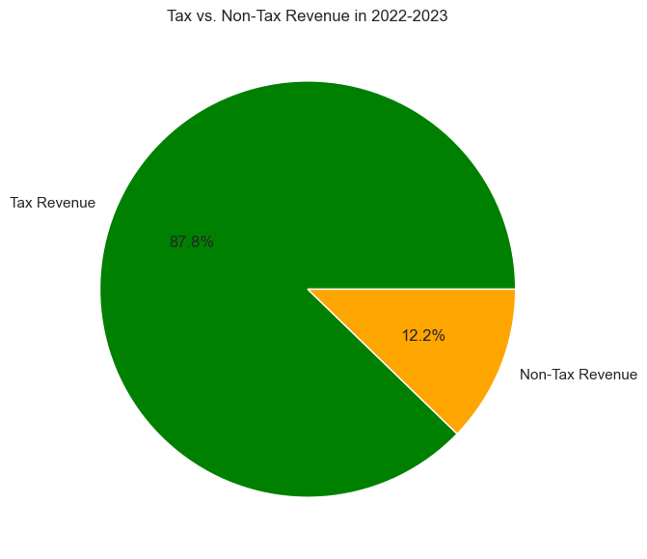
Description of Figure : Pie chart depicting Tax vs Non-Tax revenue in FY(2022-2023).

Slide 9
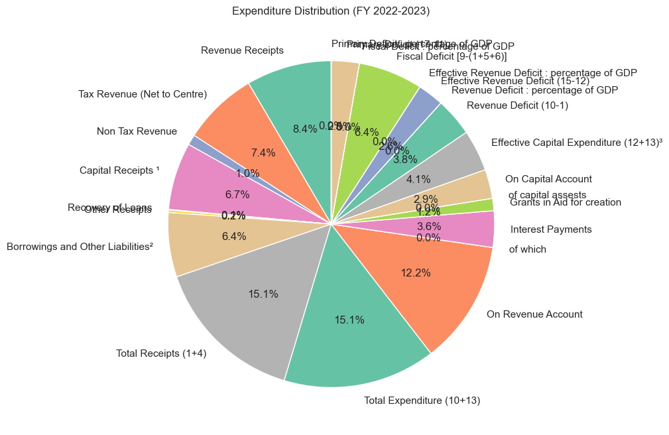
Description of Figure : Pie chart which shows the Expenditure Distribution for FY(2022-2023.

Slide 10
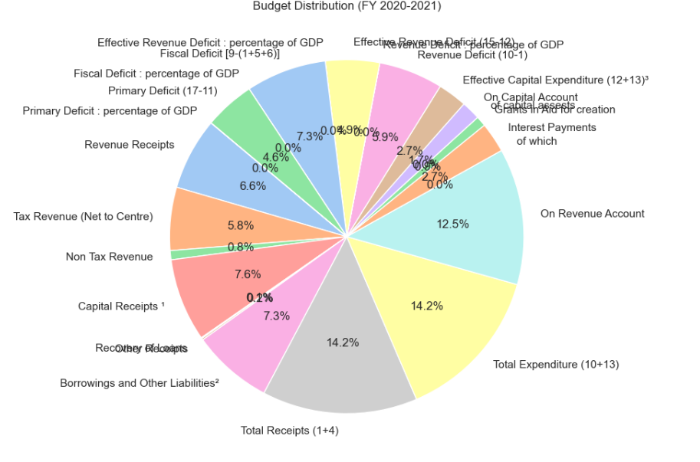
Description of Figure : Pie chart depicting the budget distribution for FY(2022-2023).

Slide 11
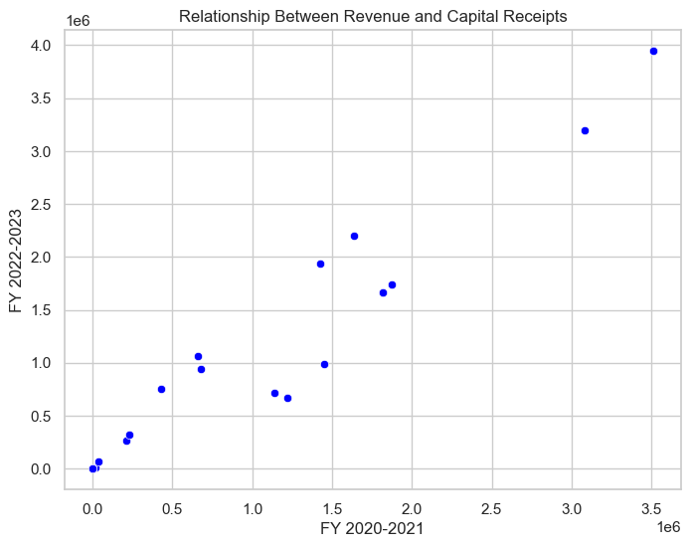
Description of Figure : Scatter plot showing the relationship between revenue and capital receipts.

Slide 12
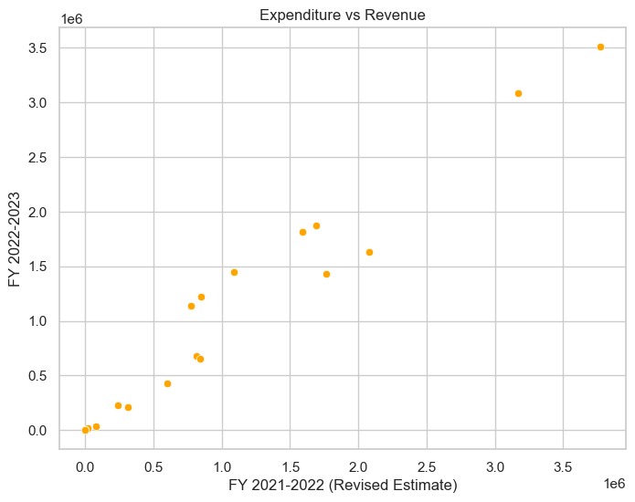
Description of Figure : This plot depicting the expenditure vs revenue for the FY(2021-2022) .

Slide 13
Final Observations
The analysis reveals critical insights into government data trends, highlighting
areas of concern and potential improvements. By leveraging these insights,
policymakers and stakeholders can make informed decisions for better
governance and resource allocation.

